Slide 1
Application for DB/GCCM Recertification
Capital Projects Advisory Review Board | Project Review Committee
January 2022

Slide 2
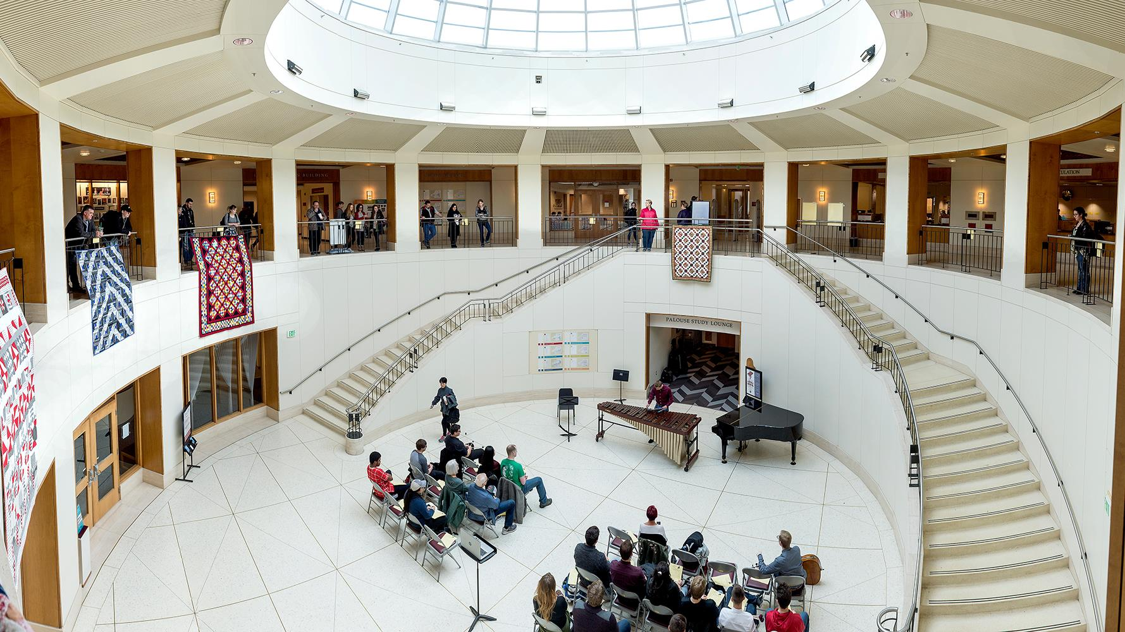
Olivia Yang
Associate Vice President Facilities Services
Joe Kline
Assistant Vice President Capital and Operations
Louise Sweeney
Lead Project Manager
Jason Harper
Lead Construction Manager
Maja Huff
Capital Contracts Manager
Introductions

Slide 3
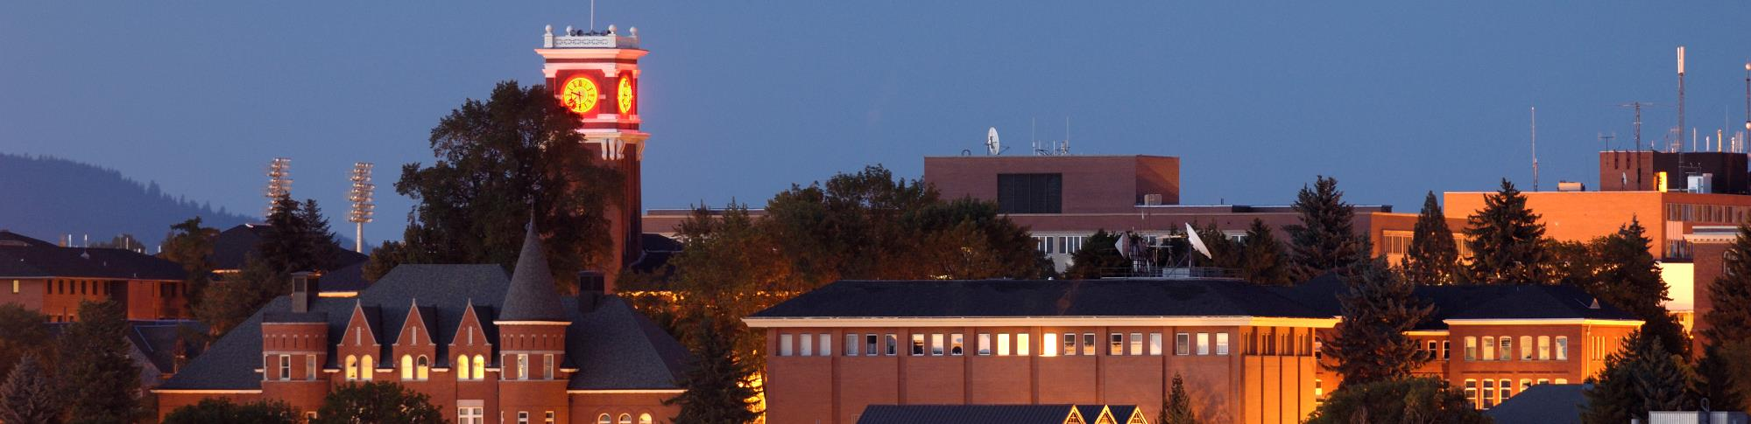
Washington State University
Land Grant, Research University
FIVE CAMPUSES
RESEARCH & EXTENSION CENTERS
CAPITAL PORTFOLIO
Pullman 1,742 acres, >12m SF
Spokane 40 acres
Tri-Cities 202 acres
Vancouver 351 acres
Everett 5 acres
Prosser
Puyallup
Wenatchee
Mt. Vernon
$150 M –
$300 M

Slide 4
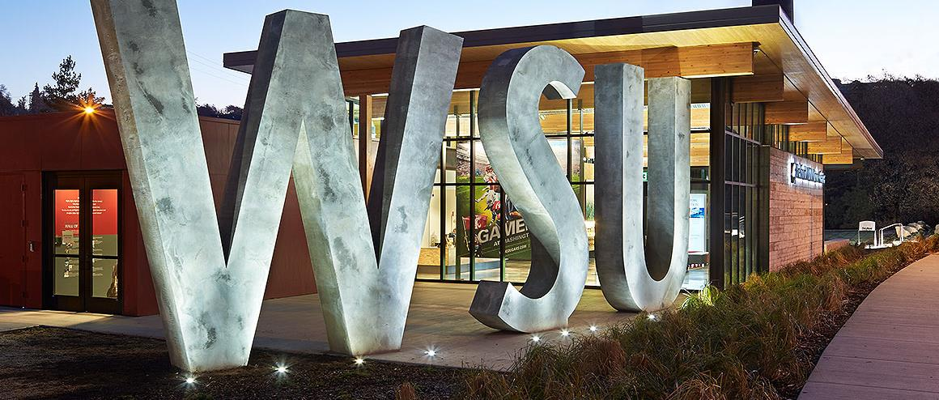
5
23
341
17
14
FIRM
Finance & Administration
Operations
Capital
Supply Management Services
Washington State University
Facilities Services

Slide 5
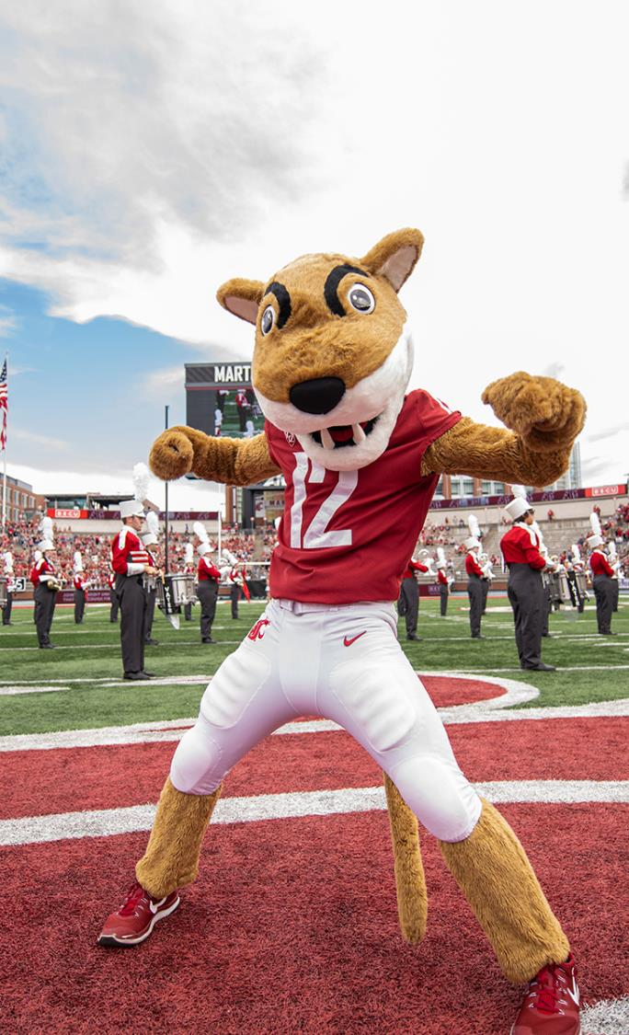
Why WSU is ready to be Recertified
WSU’s proven track record of delivering 30 GC/CM and 32 Design Build projects over our History.
Commitment to process improvement
  WSU PM/CM’s attend and have taught as part of AGC’s training programs.
  WSU staff participation on CPARB and subcommittees.
Contract Review (Perkins Coie)
  Review and reworking of contract documents occurring on almost every new contract based on lessons learned.
Ongoing PM/CM Staff Development
  Active in DBIA, CMAA, AIA, other trade organizations

Slide 6
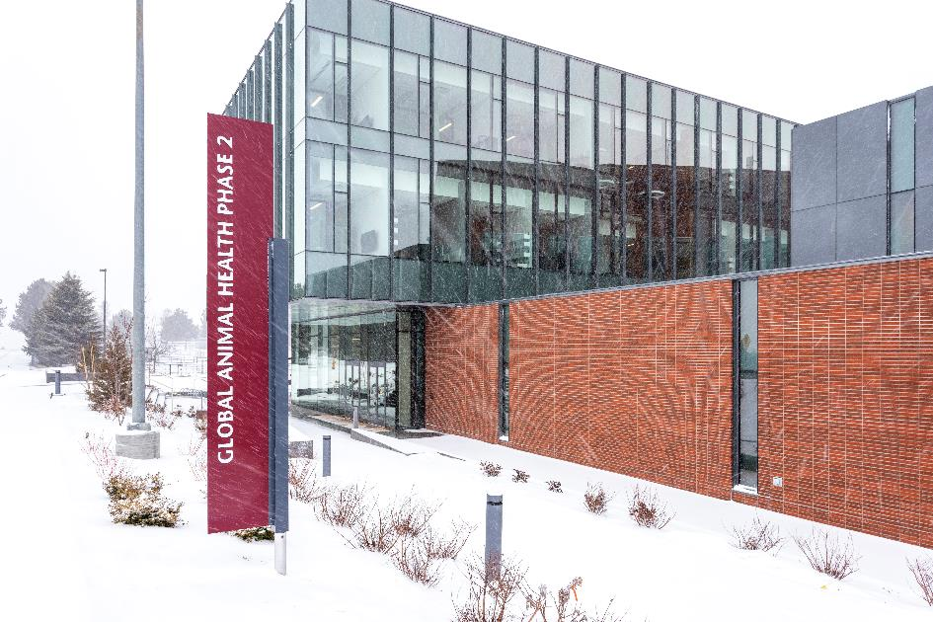
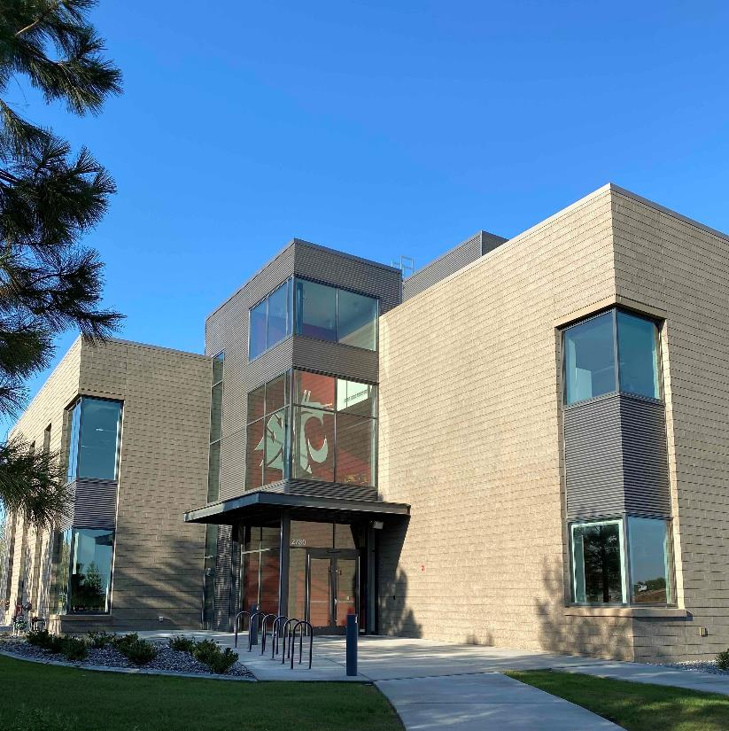
Global Animal Health 2
Project Budget $61.3M
DB Contract $48.6M
Completion Feb 2021
Observation
Laboratory Building
Funding over two biennia
DB Team: Bouten | Perkins & Will
Tri-Cities Academic Building
Project Budget $30.3M
DB Contract $24.6M
Completion Jun 2021
Observation
STEM Lab Classroom Bldg
Programming Challenges
DB Team: Hoffman | ZGF

Slide 7
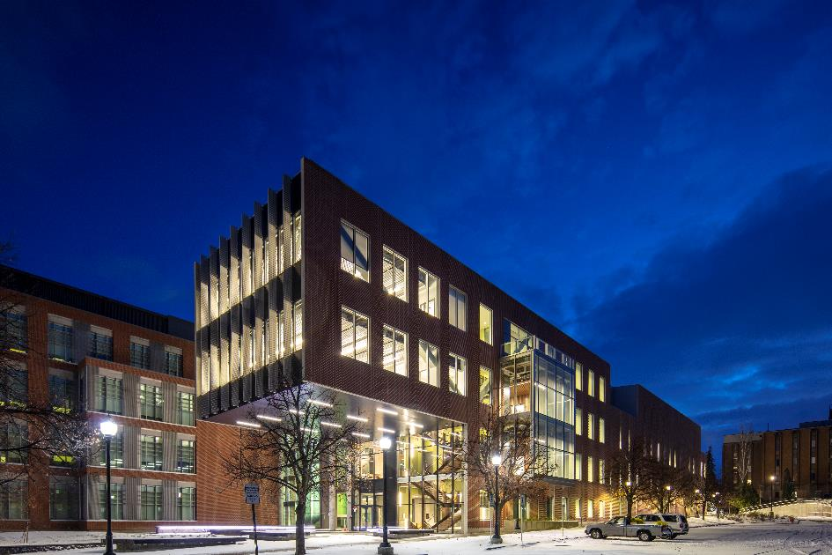
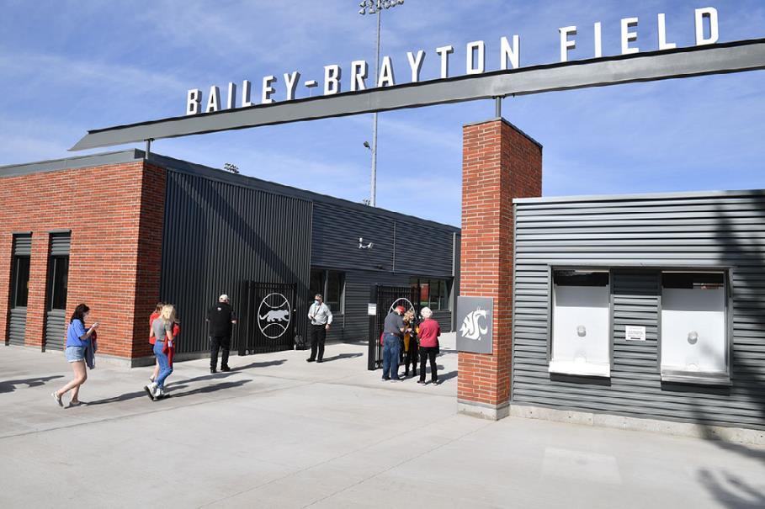
Plant Sciences REC5
Project Budget $63.6M
DB Contract $59.3M
Completion Oct 2020
Observation
Plant Biosciences
Modular Construction
Techniques
DB Team: Skanska | LMN
Cougar Baseball Clubhouse
Project Budget $10M
DB Contract $8.1M
Completion Nov 2020
Observation
Team Training Facility
Difficult Site
DB Team: Hoffman | SRG

Slide 8
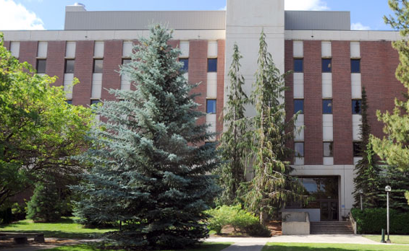
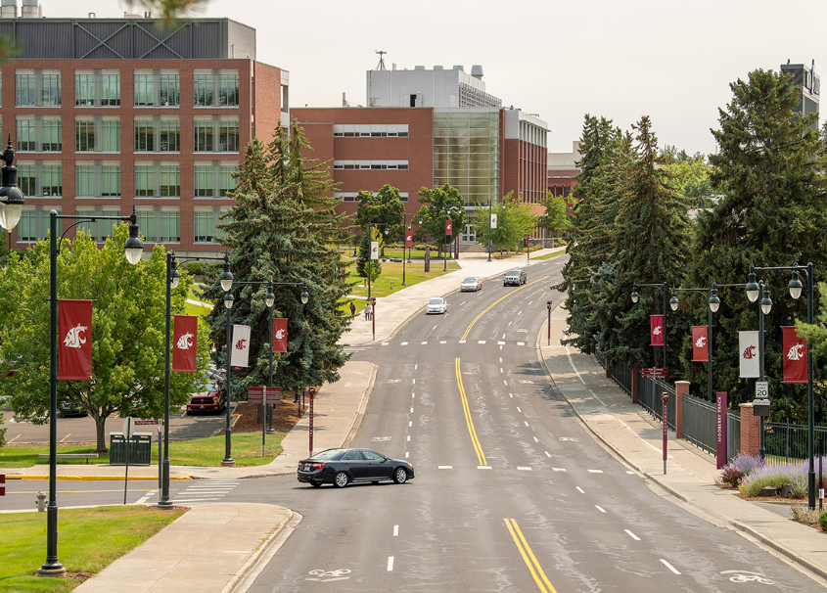
Bustad Vivarium Renovation and Building Controls Replacement
Project Budget $2.5M
DB Contract $1.9M
Completion Feb 2021
Observation
Non-Typical Scope
Addresses Deferered Maintanace Issues
DB Team: Quality Contractors | Design West Architects
Under 2M Design-Build Projects
Bustad HVAC Service Equipment Elements and Controls Upgrade
Building Automation System Network and Panel Upgrade

Slide 9
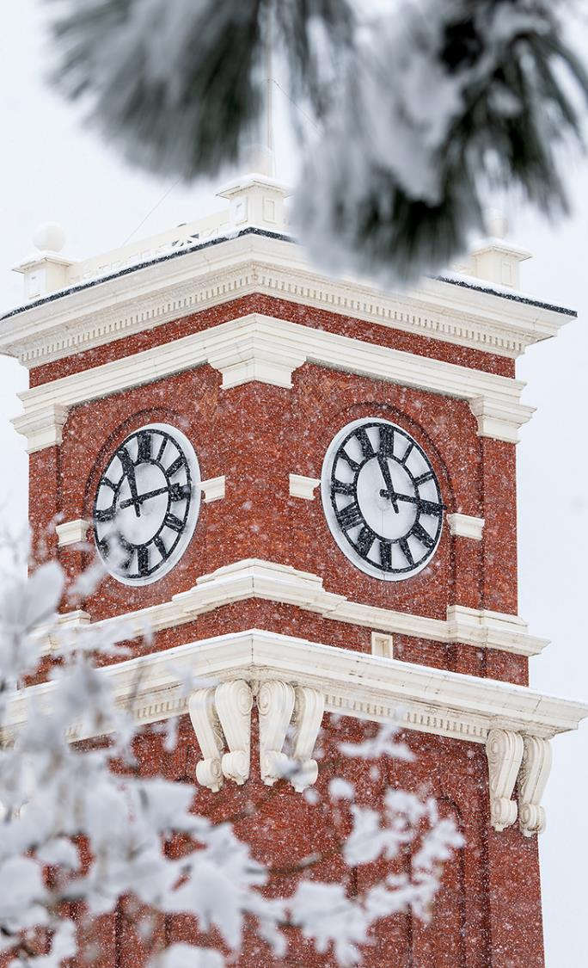
What we are learning
WSU is developing a program with small design build contracts with an eye towards addressing our deferred maintenance backlog which has been identified as a top 5 risk to the university.
Refining the deliverables for the RFQ, RFP.
Refining bonding and insurance requirements.
Goal of expanding opportunities for small and minority owned businesses.
Complete overhaul of our contract documents to right-size to smaller projects.
After a one year hiatus, WSU hosted its annual Design Build Forum in 2021 with over 250 participants.
Refining the process and deliverables for design phase.
Simplifying the RFQ/P process to avoid duplication with more concise submittals.
Partnering with OMWBE to develop new tactics to raise the participation of small and minority businesses.
Leveraging our DB partners to increase advertising and outreach.
Partnering with OMWBE and our DB teams to identify available firms.
DB teams are finding ways to remove barriers (bonding, insurance, retainage, paid-when-paid passdowns, etc) to increase participation.

Slide 10

Facilities Services
Capital Staff
Credentials Include:
Registered Architects
PE’s – Civil, Structural, Mechanical
Interior Design Certified – NCIDQ
Subject Matter Experts - MEP
10 | 3 | 6
Project Managers | Construction Managers | Engineering Group

Slide 11

4 DBIA Professionals | 3 DBIA Associates | 2 LEED Aps | 2 CCM
Certifications
Continuing Education Opportunities
Internal Training
DBIA Conferences and AGC Ed Foundation
Lunch & Learns
SCUP, Tradeline, AIA, AUID, Peers and Trade Partners
Presentations / Panel Discussions
SCUP, Tradeline, DBIA, AIA, CMAA, AGC
Collaborate w/ WSU Voiland College of Engineering & Architecture
State of Washington Public Owners Group

Slide 12
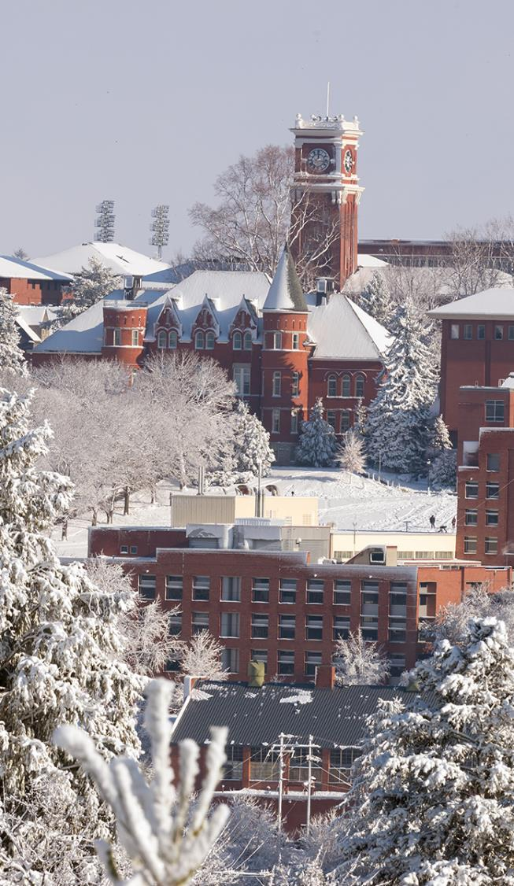
Project Awards
Troy Hall - AIA 2018 Seattle Honor Award
AIA 2018 National Merit Award
AIA WA Council 2017 Civic Design Award
The Spark - DBIA 2018 National Award for Merit
DBIA 2018 Award for Excellence in Teaming
DBIA 2018 Award for Excellence in Process
Cultural Center - DBIA 2018 National Award for Merit
DBIA 2018 Chairman’s Award and Excellence in Design - Architecture
Everett - BD+C Building Team Awards, Silver Award 2018
Champion of Sustainability, McKinstry 2017
VISION 2040 Award, Puget Sound Regional Council, 2017
Washington Building - AGC 2016 Under $10M Public Award

Slide 13
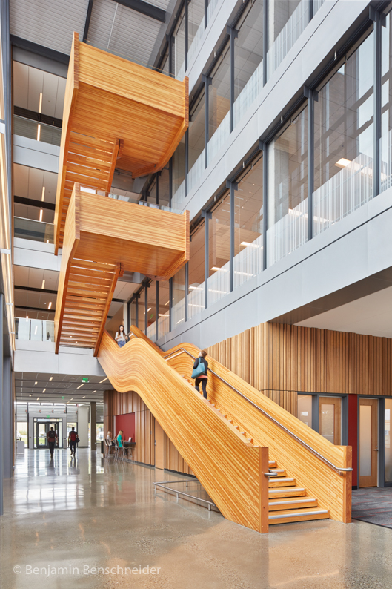
Facilities Services
Contracting
Legal Counsel
Sean Bowen, Assistant Attorney General
Andrew Greene, Perkins Coie LLP
Contract Documents
Express goal to be fair, reasonable and consistent across all forms of Public Works
Continual contract review
During this certification period
Revised and simplified ‘Cost of Work’ and ‘Fee’ allocations based on feedback from our external auditor and feedback from the industry.
Updated the Transition to Sustainable Occupancy scope and process .
Implemented inclusive professional insurance requirements into our Design-Build Contracts.
Under 2M Design-Build Agreement

Slide 14
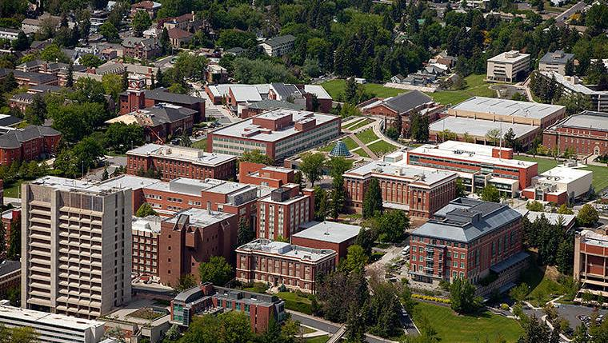
History of Alternative Procurement Success
Demonstrated Success on a Wide Variety of Project Types
Well Qualified and Experienced Team of Project Managers and Construction Managers
In Summary:
WSU is ready to be recertified

Slide 15
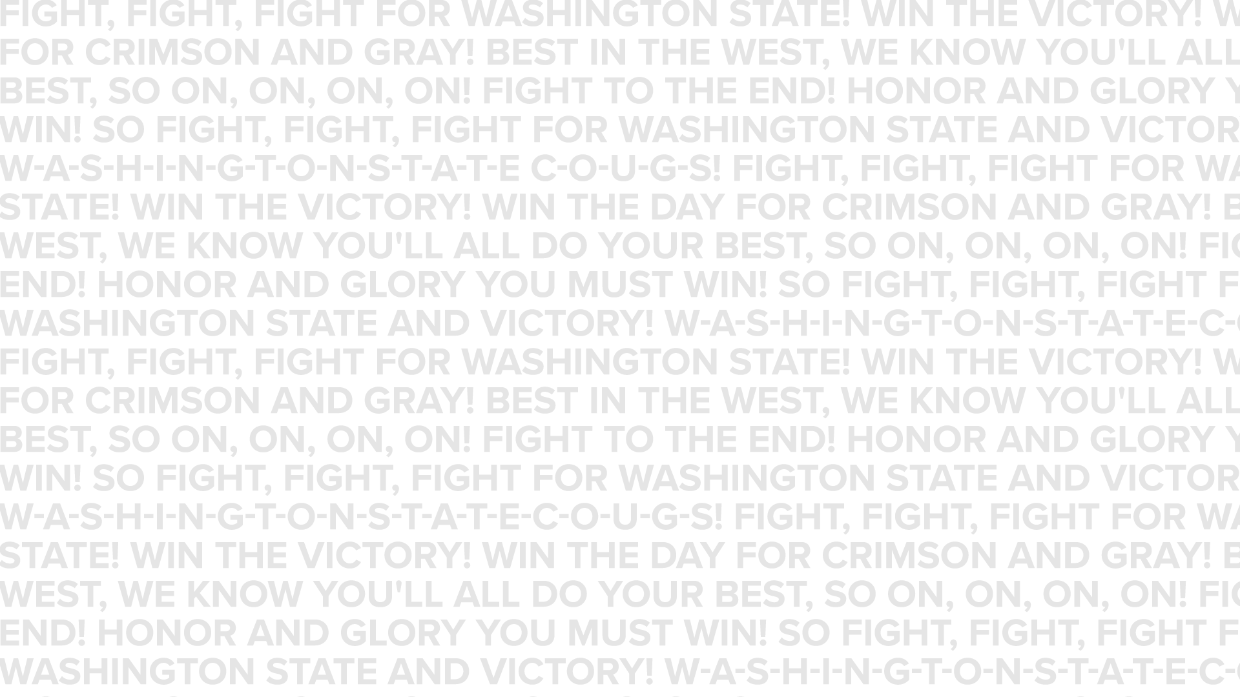
Questions

