Slide 1


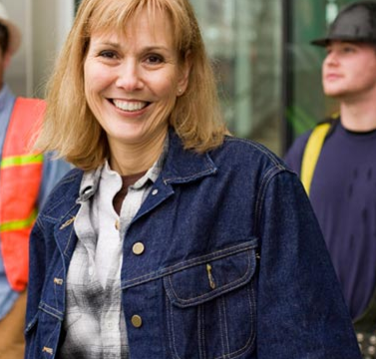

State of Washington
2019 Disparity Study
Presented by the
Office of Minority and Women's Business Enterprises
Presenters:
Lisa van der Lugt (OMWBE)
Rex Brown (OMWBE)

Slide 2
Contact Information:
Lisa van der Lugt, Director Washington State Office of Minority & Women’s Business Enterprises
Office: 360-664-9757
Cell: 360-528-0514 Lisav@OMWBE.WA.GOV
Rex Brown, Assistant Director-
Governor’s Subcabinet on Business Diversity
Washington State Office of Minority & Women’s Business Enterprises
Office: 360-664-9769
Cell: 360-561-7261
RexB@OMWBE.WA.GOV

Slide 3
Why does OMWBE exist?
  Our charge: Identify and eliminate barriers to equal participation by minority- and women-owned businesses in contracts with state agencies and educational institutions.
History of OMWBE
OMWBE was created in 1983 by the state legislature. OMWBE is governed by RCW 39.19, which states:
  “…The purpose and intent of this chapter are to provide the maximum practicable opportunity for increased participation by minority and women-owned and controlled businesses in participating in public works and the process by which goods and services are procured by state agencies and educational institutions from the private sector.”

Slide 4
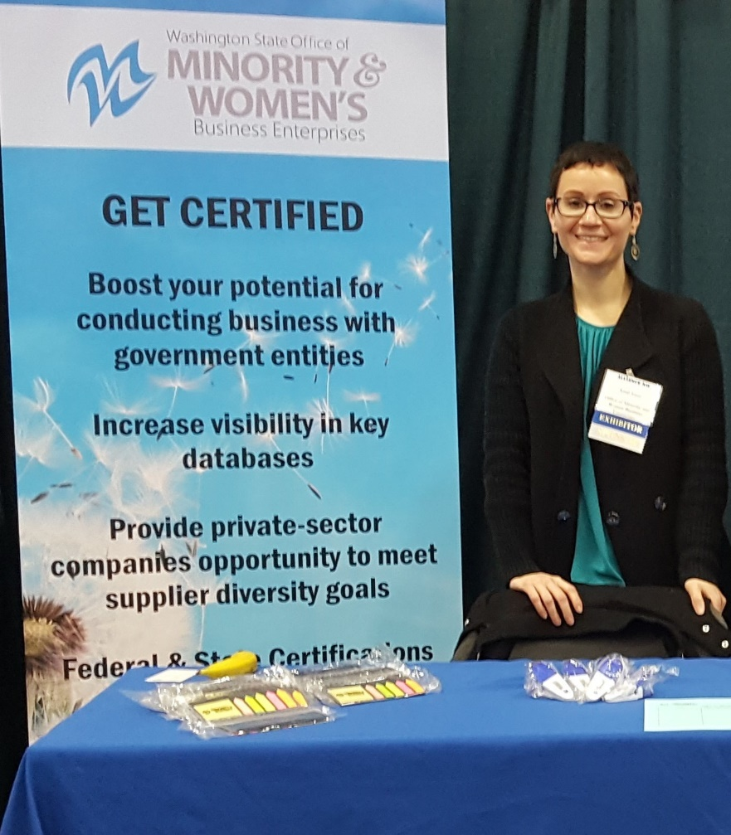
What does OMWBE do?
Leads Governor’s Subcabinet on Business Diversity.
Certification: State’s sole certifying agency for small businesses owned and controlled by minority, women, and socially and economically disadvantaged persons.
Supplier Diversity: Works with state and local agencies to improve supplier diversity in state contracting.

Slide 5
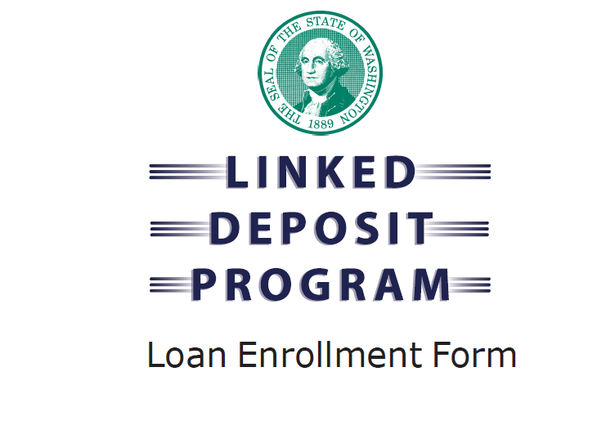
What else OMWBE does . . .
Linked Deposit:
  We coordinate the Linked Deposit Loan Program with Washington State Department of Veterans Affairs and Office of State Treasurer.
Tracking and Reporting:
  We track and report diverse spending by state agencies.
Partnerships:
  We partner with other agencies and organizations to educate businesses on the certification and public procurement process.

Slide 6
Statutory Authority
OMWBE is “to provide the maximum practicable opportunity for increased participation by minority and women-owned and controlled businesses in participating in public works and the process by which goods and services are procured by state agencies and educational institutions from the private sector.”- RCW 39.19.010
The State of Washington intends to “develop procurement policies, procedures, and materials that encourage and facilitate state agency purchase of goods and services from Washington small businesses.”- RCW 39.26.005

Slide 7

What is a Disparity Study?
A disparity study is an analysis that examines the number of specified individuals or groups who are available to obtain contracts, and those who are actually selected (utilized).
The 2019 WA study looked at goods and services, client services and public works contracting and purchasing.

Slide 8
Utilization and Availability
Determine utilization as a percent of total dollars in the agencies geographic and product marketplaces
  75% sample
Determine the availability as a percent of all firms.
Calculate disparity indices for contracts:
  All race & sex groups & all industry groups combined & disaggregated.
  Examine various impacts by industry & North American Industry Classification System (NAICS) codes.

Slide 9

Disparity Ratios
Disparity ratio = M/WBE utilization ÷ availability

Slide 10
Washington State
Utilization Analysis
Washington State Availability Analysis
Study collected data and analyzed state utilization of MWBEs (all funded contracts for FFY sectors & all agencies from 2012 to 2016)
Final Data Contract file
=$3,484,653,357
613 prime contracts (74.5%) =$2,596,300,922
2,690 subcontractor contracts (25.5%)
=$888,352,435
MWBE aggregated weighted availability
(all sectors and agencies combined)
Race/Gender Populations | Percent of Population | Dollars Distributed to Population
MWBEs | 15.2% | ≈$444,050,244.54
Blacks | 1.7% | ≈$35,084,771.45
Hispanic | 0.7% | ≈$16,473,011.36
Asians | 2.6% | ≈$21,385,445.52
Native Americans | 0.6% | ≈$49,726,396.15
White Females | 9.6% | ≈$321,380,620.06
Non MWBEs | 84.8% | ≈2,413,069,446.62
÷

Slide 11
What does the Disparity Study say?
Race/Gender | Disparity Ratios (all sectors & agencies combined) | Disparity Ratios (without Client Services) | Disparity Ratios (without Client Services & NAICS 238210)
MWBEs: | 102.4% | 71.3%^{* + +} | 54.43%^{*** + +}
Blacks: | 70.4% ⁺ ⁺ | 2.5% ⁺ ⁺ | 2.52% ⁺ ⁺
Hispanics: | 86.8% | 110.1% | 85.87%
Asians: | 29.3% ⁺ ⁺ | 29.9% ⁺ ⁺ | 30.37% ⁺ ⁺
Native Americans: | 294.5% | 310.3% | 322.35%
White females: | 116.8% | 79.8% ⁺ ⁺ | 53.05% ⁺ ⁺
Non-MWBEs: | 99.6% | 105.3%*** | 109.02%***
Below 80%?
*** Indicates statistical significance at the 0.001 level
* Indicates statistical significance at the 0.05 level
+ + Indicates substantive significance(under 80%)

Slide 12

Statewide Disparity Analysis
Survey of Business Owners:
  Very large disparities in firms’ sales receipts between M/WBEs & Non-M/WBEs
American Community Survey:
  In most cases, M/WBEs were underutilized relative to White men.
  Wages & business earnings were lower for these groups compared to White men.

Slide 13
Key Anecdotal Data Reported
Most M/WBEs reported that it is extremely difficult to obtain work on State projects.
M/WBE certification conferred few benefits.
Long established firms recounted the negative impact of Initiative 200.
Small firms found it difficult to access contracting information.
Contracts were often too large for small firms.
Insurance, bonding, experience requirements, etc., are barriers.
Antiquated & decentralized state systems are challenges.

Slide 14
Disparity Study Recommendations
Implement an electronic data collection & monitoring system.
Examine current policies & provide best practices.
Conduct pre-bid conferences.
Post winning bidders/proposers to WEBS.
Conduct additional outreach efforts:
  Conduct special outreach to M/WBEs in industries where they have received few opportunities.
  Focus outreach on agencies with low M/WBE utilization.
Increase technical assistance to M/WBEs & small firms.
Lengthen solicitation times.
  (cont’d)

Slide 15
Disparity Study Recommendations
Review contract sizes & scopes.
Raise the Direct Buy limits.
Adopt “quick pay” policies.
Review insurance, surety bonding & experiences requirements.
Train state staff on how to increase diversity in contracting.
Develop race- & gender-neutral programs like:
  Bonding & financing support
  Target Market program
  Mentor-protégé program, etc.
Develop performance measures for success.

Slide 16
Path forward: The Governor’s Subcabinet on Business Diversity
What is it?
Governor Jay Inslee chose 12 of his executive cabinet agencies for the Subcabinet. These agencies make up 2/3 of the total state spend with key partner agencies (see roadmap).
While the problem is too broad and complex for a quick fix, the subcabinet has identified a clear and strategic path to achieve durable and sustainable changes.

Slide 17


Roadmap to Contracting Equity
Governing Body — Governor’s Subcabinet on Business Diversity
Attorney General’s Legal Opinion (No. 2017-02) Disparity Study
Standardize Race and Gender Neutral Measures* Evaluate Race and Gender Neutral Measures
YES, IT’S
WORKING
NO, IT’S NOT
OR
Continue Race and Gender Neutral Measures
Confirm Race and Gender Neutral Measures not sufficient
Consider Race and Gender Conscious Measures
* Among agencies - policy, procedures, measures, training, adjustments.
Subcabinet agencies and partners: Department of Enterprise Services • Department of Social and Health Services • Department of Transportation • Health Care Authority • Department of Corrections • Department of Labor and Industries (Represent 2/3 of state spending)
Office of Minority and Women’s Business Enterprises * Department of Veteran Affairs • Commission on African American Affairs • Commission on Asian Pacific American Affairs • Commission on Hispanic Affairs • Governor’s Office for Regulatory Innovation and Assistance • Attorney General’s Office
19-02-0081

Slide 18











The path to standardizing race and
gender neutral measures among agencies
Community of Practice
The Community of Practice (CoP) provides support for agencies including resources such as model polices, tools and best practices as well as training support
Piloting: Six agencies representing 2/3 of state spending*
Existing CoP Toolbox
Current Voluntary Measures
Improved agency guidance and support voluntary goals
Established model contract language
Created guidance on targeted community engagement and outreach
Merged statewide small business information for easier access
Updated and merged resources for technical assistance
Improved certification process
Utilized inclusion plans in public works contracting
In Progress
Establish nine model policies
Provide guidance on supplier diversity training options and best practices
Establish internal agency culture action team
Utilize state’s data sources to help inform supplier diversity efforts
Improve methodology for tracking and monitoring good faith efforts
Include diverse spending data from purchase cards
Conduct proof of concept; measuring participation in client services and provider contracts
Check, adjust and expand CoP toolbox
Additional agencies join the CoP
Check, adjust and expand toolbox
Subcabinet agencies and partners
Washington State
DEPARTMENT OF SOCIAL HEALTH SERVICES
*Represent 2/3 of state spending

Slide 19






Areas of Focus
Measurement Framework
Community of Practice (CoP)
Improved Certification
Technical Assistance
Legal Framework provides the foundation
AGO Opinion Disparity Study

Slide 20




Detailed Action Plan:
Task | Task Lead | Partners | Expected Outcome | Status | Due Date
Measurement Framework | OMWBE, LNI | DSHS, DOC | Create suite of measures to provide the best dashboard for accountability and improving results. Increase use and reliability of data. | Ongoing | Completed January 2018
Improved OMWBE Certification | OMWBE |  | Conduct rulemaking to reduce unnecessary barriers and improve certification timeframes. | Ongoing | Completed January 2018
Community of Practice (CoP) | DSHS, WSDOT, DES, OMWBE | HCA | Embed a broad understanding of equity, diversity and inclusion throughout community of procurement professionals. | Ongoing | Launched February 2018
Technical Assistance | OMWBE, DES | ORIA, Commerce | Create a system for small business to customize their needs to available resources. Central web site with “triage” services. Feedback loop for quality control. | Ongoing | Launched October 2018
Disparity Study | DES | 31 State Agencies and 2 Educational Institutions | Provide necessary data needed to understand whether minority-, women- and veteran-owned businesses have equal access to contracting opportunities. | Ongoing | Completed 6/19/2019

Slide 21
Questions and Answers
Thank You!

