Slide 1
Public-Private Partnerships for the Delivery of Public Facilities and Infrastructure
Dr. Aziz
(Ahmed M. Abdel Aziz; amaziz@uw.edu))
University of Washington
Presented to the CPARB May 2016 Meeting
This presentation includes copyrighted material, no part would be extracted, copied, or printed in any way without permission.

Slide 2
Outline
P3 Projects, Worldwide Presence, USA Market
P3 Definition, Benefits, and Systems
P3 Project Options Analysis
P3 Procurement Process & Transaction Design
P3 Project Finance
P3 Payment Mechanisms
P3 Oppositions and Implementation
P3 Case Study - Sea-to-Sky Highway, BC

Slide 3
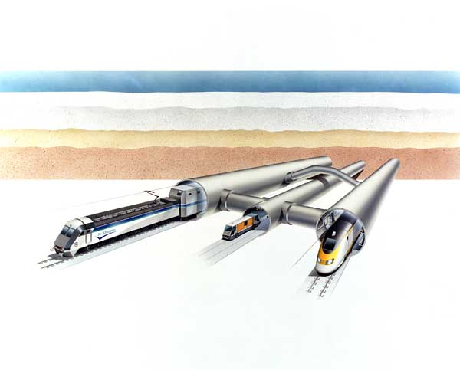
P3 Projects - Tunnels
Channel Tunnel: (1985), $16B, 50km, 99 years
BOT; commercial freedom (usage payment)

Slide 4
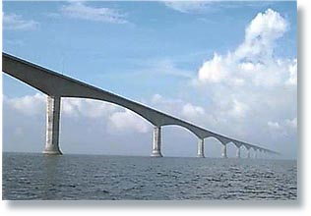
P3 Projects - Bridges
Confederation Bridge: (1987), C$1.2B, 13km, 35 years
BOT, pre-established tolls (usage payment)

Slide 5
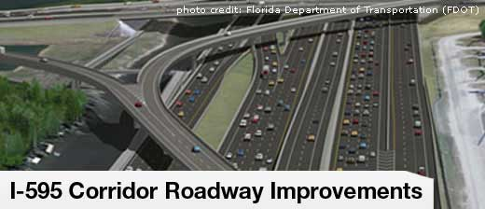
P3 Projects - Highways
I-595 Florida (2008), $1.83b, 10.5mi, 35 yr, DBFOM, equity $207m, debt $781m, TIFIA $781m, AV pay [1st in USA], Private Partner (Dragados, AECOM, HNTB, Roy J Assoc.)

Slide 6

P3 Projects - Hospitals
BC North Cancer Center: (2008), C$70m, 5,000 m2, 30 yr DBFM, 20% equity; performance-based service payment

Slide 7
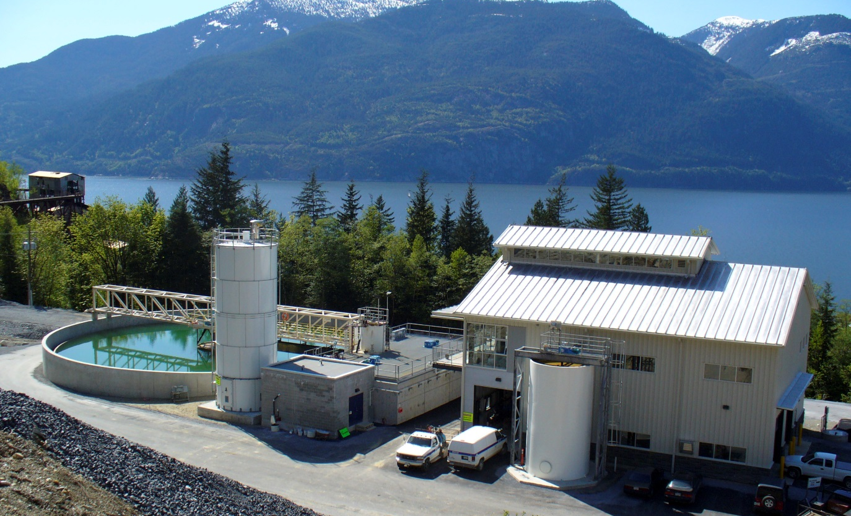
P3 Projects – Treatment Facility
BC Britannia Mine Water Treatment Plant: (2004), C$27m, 500,000 m3/yr, 20 years, DBFO, payments linked to treated water volume and meeting environmental regulations.

Slide 8
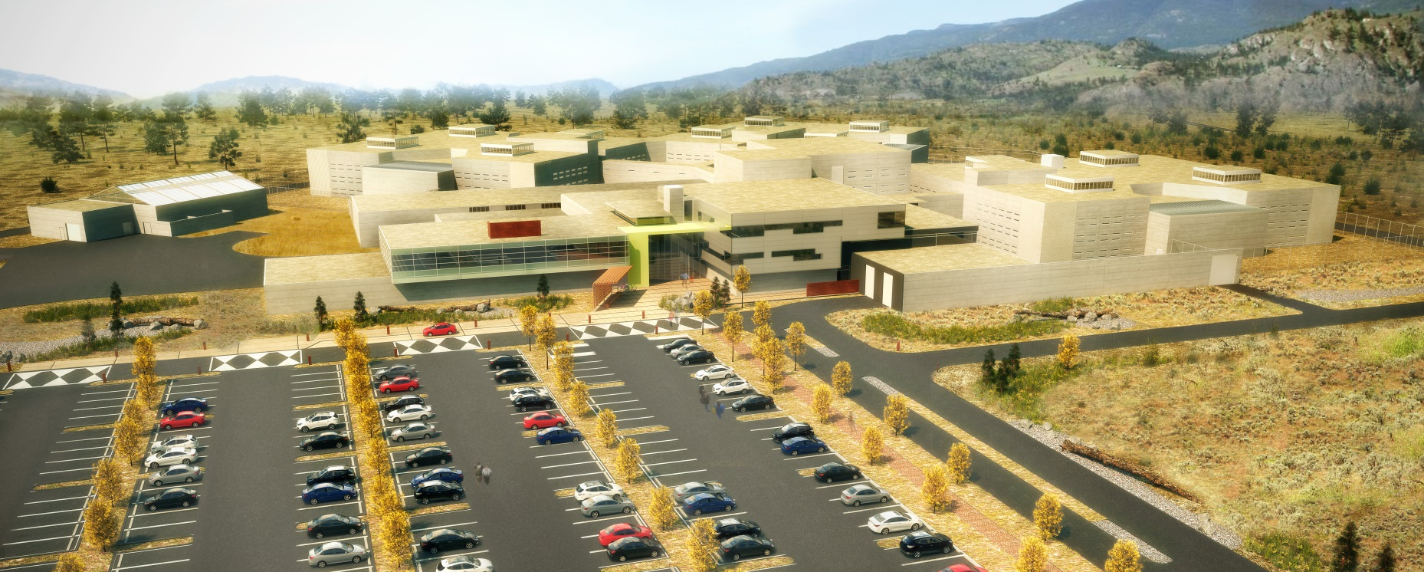
P3 Projects – Correctional Facilities
Okanagan Correctional Centre, (2012), C$193m, 387 cells, 30 yr, DBFM (design, construction, facility mgmt, and life cycle services), performance-based availability/service payment

Slide 9
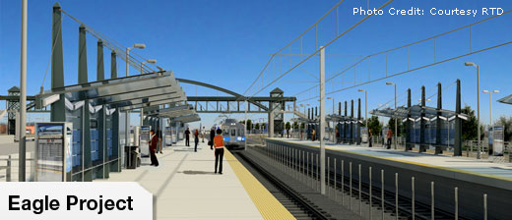
P3 Projects – Light Rail Transit
Denver Transit Eagle: (2011), $2.1b, 34 mile rail line, equity $54.3 m, PAB $396M, 34 yr, DBFOM, TIFIA $280m, availability payments (P. Based)

Slide 10

P3 Projects – Schools
Bristol Schools (UK): (2004), £119m, 4 schools, equity £4.7 m, 27 yr, DBFO, availability payments

Slide 11
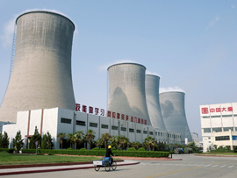
P3 Projects – Power Plant
Laibin B Power Plant (China): (1997), $616m, 2 x 360mw, equity 154m (25%), 18 yr, BOT, French EDFI & ALSTOM

Slide 12

P3 Projects - Water
Bayonne Water Facilities, NJ. (2012), 8.5-17.6 mgd, $175 m financing, Private (United Water, K. K. Roberts KKR) run the city W&S operations in a 40-yr concession for $150m. BMUAuthority continue at $.5m/yr to administer the concession.

Slide 13
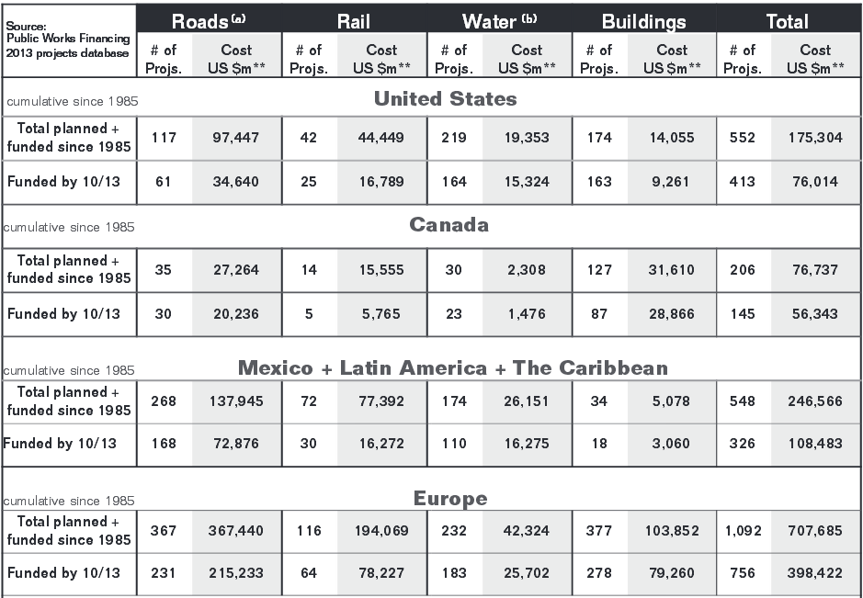
P3 Worldwide Presence
PPPs inventory as of 2013; PW Finance, v. 298, November 2014

Slide 14
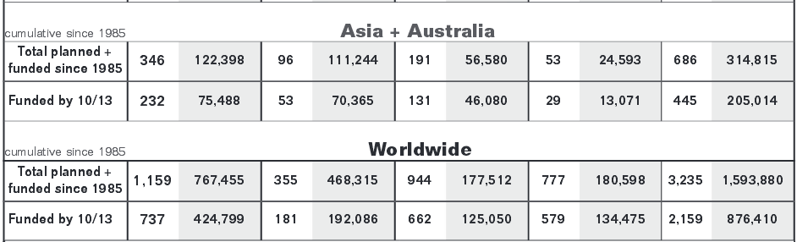
P3 Worldwide Presence
PPPs inventory as of 2013; PW Finance, v. 298, November 2014

Slide 15
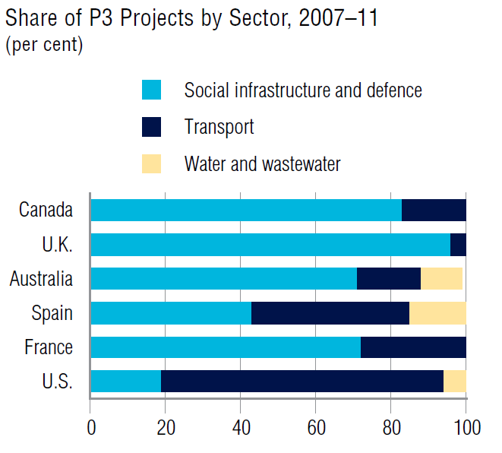
P3 Worldwide Presence
Infrastructure Journal Database

Slide 16
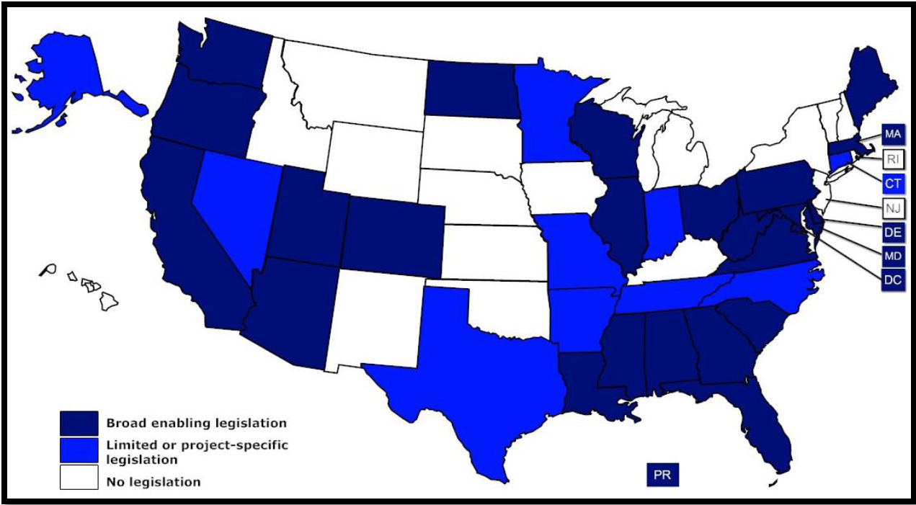
P3 Market in the USA
States with PPP Enabling Transportation Legislation
(33 states, District of Columbia, and Puerto Rico)
National Conference of State Legislatures (NCSL 2016)

Slide 17
P3 Market in the USA
Transportation:
1991 ISTEA
Intermodal Surface Transportation Efficiency Act
1998 TEA-21
Transportation Equity Act for the 21st Century
2005 SAFETEA-LU
Safe, Accountable, Flexible, Efficient Transportation Equity Act: A Legacy for Users
2012 MAP-21
Moving Ahead for Progress in the 21st Century Act
2015 STRR
Surface Transportation Reauthorization & Reform Act
Water
2014 WRRDA Water Resources Reform and Development Act

Slide 18
P3 Market in the USA
It is gaining momentum; the common reasons for a slow growing market were:
Robust $3.7 trillion municipal bond market (tax-exempt)
Public stakeholders opposition and/or involvement in P3 decision making
Significant cost incurred in proposal preparation
Possibility of changing law and not adequate legislation
Negative publicity and public not informed about the benefits of P3

Slide 19
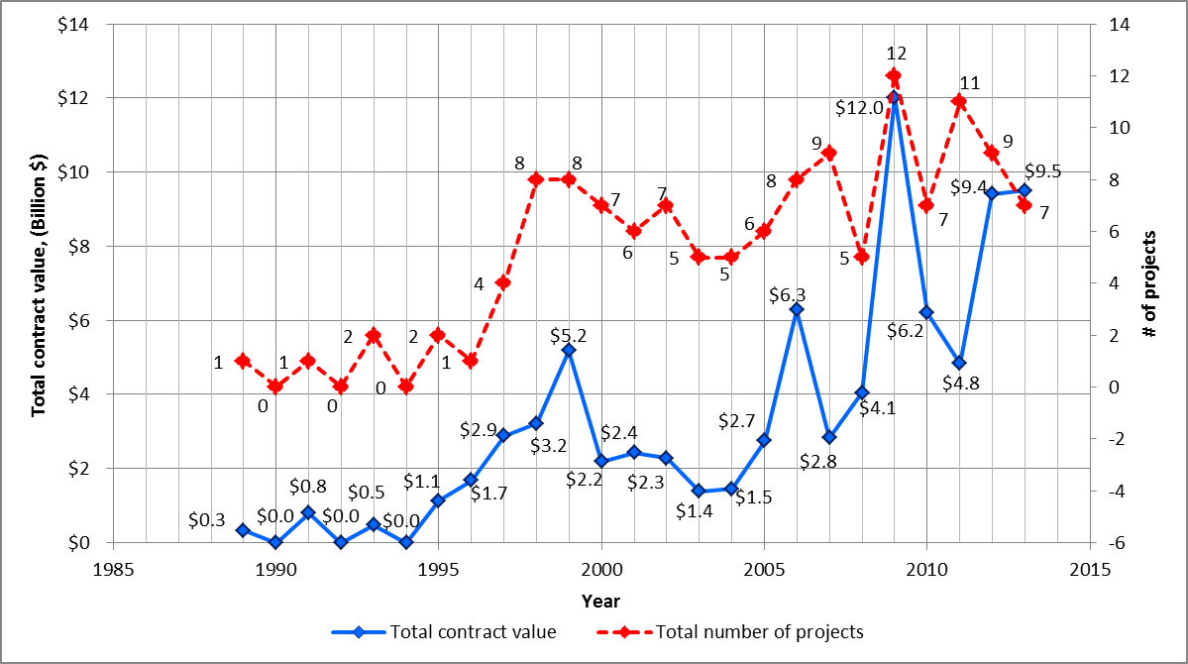
P3 Market in the USA
Transportation PPP projects and total contract values for given years
(PWF 2013, 2014) and (FHWA 2014)

Slide 20
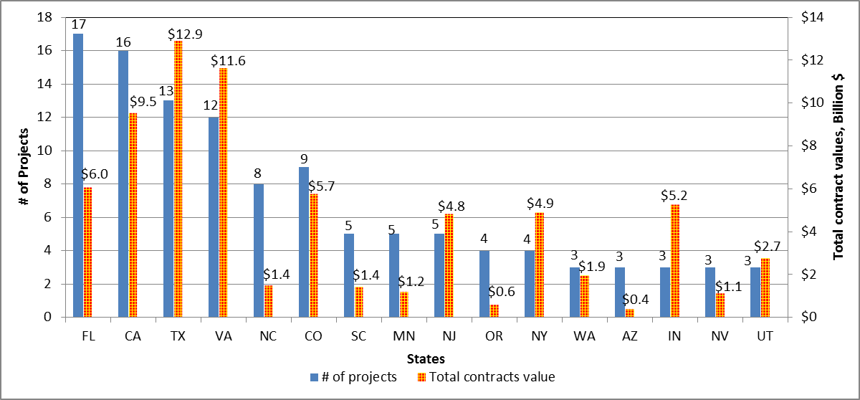
P3 Market in the USA
States and their projects and project value (rounded $) (PWF 2013, 2014; FHWA 2014)

Slide 21
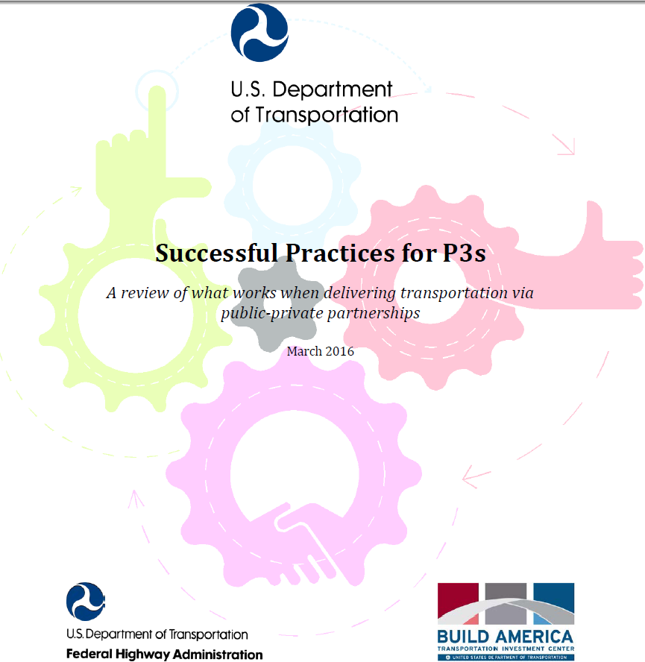
P3 Market in the USA

Slide 22

P3 Market in the USA
Texas Expanding Beyond Transportation

Slide 23
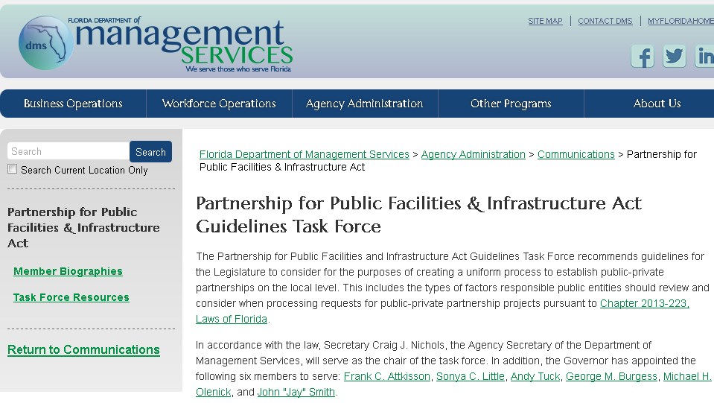
P3 Market in the USA
Florida Expanding Beyond Transportation

Slide 24

P3 Market in the USA
Puerto Rico Expanding beyond transportation

Slide 25
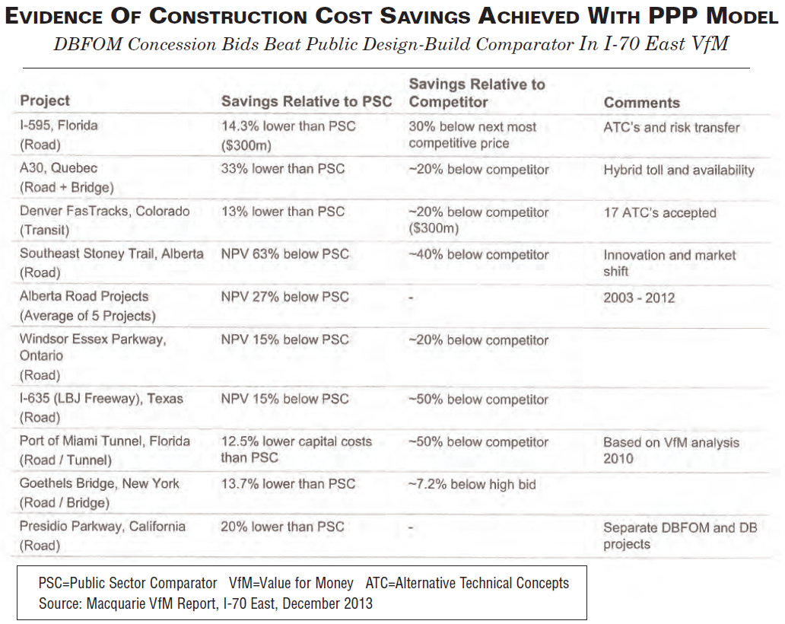
P3 Market in the USA
Does it PPP Work?
PW Finance, v. 298, November 2014

Slide 26
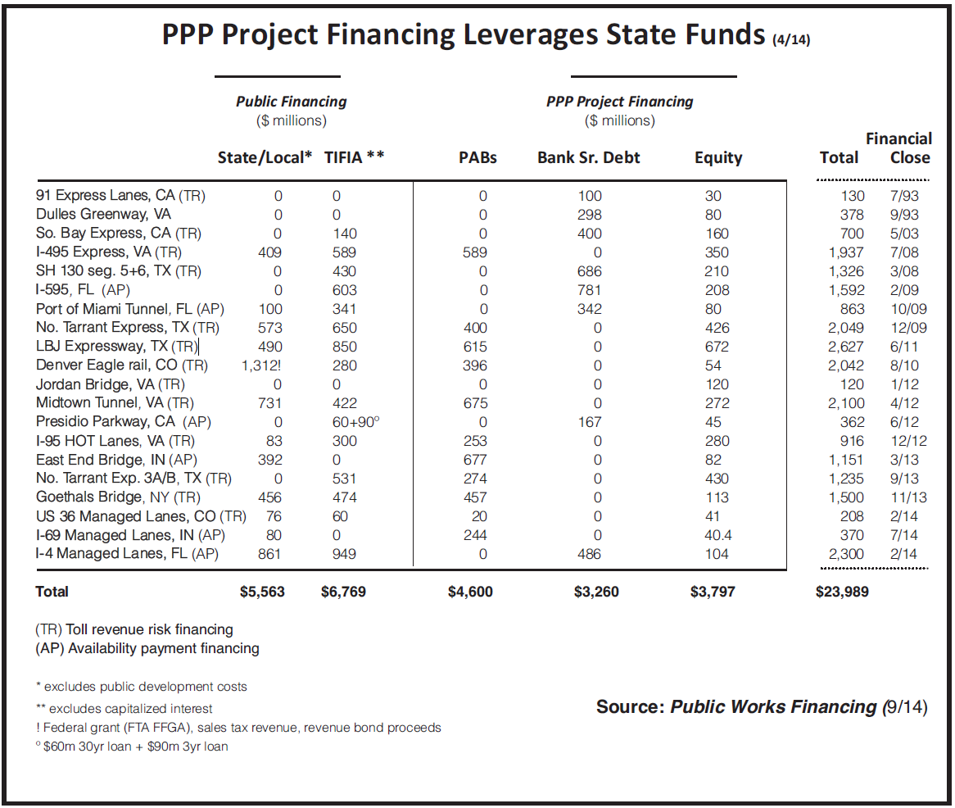
P3 Market in the USA
Does it PPP Work?
PW Finance, v. 296, September 2014

Slide 27
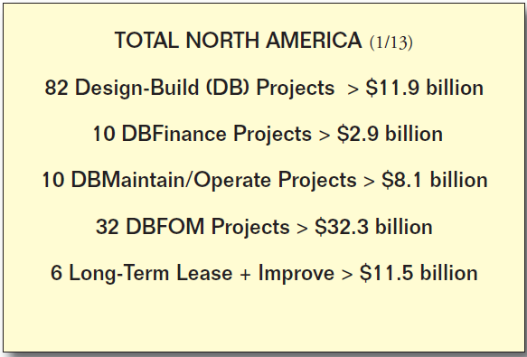
P3 Market in the USA
Does it PPP Work?
PW Finance, 2013

Slide 28
P3 WA State Law
2005:
Transportation Innovative Partnerships Act allowed P3 for all modes of transportation. No private finance. Requires citizen advisory committee for projects of $300 million.
2012:
The WA Joint Transportation Committee endorsed a study to evaluate P3. The study made a P3 screening tool, developed financial model, and assessed 5 projects. Recommended a new P3 legislation, screening projects, use of VfM, de-politicize the approach to P3, create P3 office in the DOT, use of 2-step procurement, and enable private debt financing and return. The study addressed many of the cavities in the 2005 Act.
2016:
Capital Projects Advisory Review Board working on draft for all sectors

Slide 29
P3 Definition
A long-term contractual arrangement between a public agency and a private entity through which:
The skills and assets of each sector are shared in delivering an asset or provision of service.
The private sector takes additional risks in design, finance, operation, maintenance, or revenue.
Used for monetizing existing assets, developing new facilities, or expanding facilities/services.
Remuneration is linked to performance, and made over the life of the long-term agreement.
Means to raise additional funds
Adapted from USDOT

Slide 30
P3 Definition
An alternative procurement mechanism for government to provide infrastructure and services using the private sector resources and expertise with full or partial transfer of risks to the private sector.
Government get to focus on policy, planning, and regulation while delegating day-to-day operations to the private sector.
PPP can foster new solutions for governments facing ageing/lack of facilities/infrastructure (lack of funds) or requiring more efficient services or seeking efficiency gains.
Adapted from World Bank

Slide 31
P3 Definition
PPP is more than finance. PPP is a long term relationship between public and private sector to deliver an output (performance). There are many methods, each with pros and cons. It is based on:
Payment upon delivery (no delivery no pay).
Risks allocation (who does what best)
VFM whole life costings
Competition to get best value
Adapted from IMF

Slide 32
P3 Benefits
Useful in complex projects susceptible to cost increase. Provides efficiencies in integrating D/B/O/M, and reduction in life cycle cost.
More risk transfer to the private party: cost of design, construction and OM, market demand, facility service.
Provides better operating efficiencies, better services, and compliance with regulations (e.g. environmental)
Accelerate the delivery (fast track) of public projects
Expand the financial capacity of public agencies (private equity), increase total debt capacity (legal limits on issuing more debt), close financial gap.

Slide 33
P3 Systems
DBOM: Woodland-Davis W system (CA);
Combined-Sewer Overflow Abatement Facility (MA)
LT Lease/Monetization: Bayonne W facility (JN); W&W facility (Penn), others
Design Build
DBFOM
Minimum Private Sector Roles, Skills, and Risks High

Slide 34
DB
Single point of responsibility for DB; better collaboration for D&B
Design liability transfer to the DB firm; less change orders
Transfer disputes (design subs & construction subs) to the DB firm
If project fails, owner uncertainty is reduced (responsible party!)
Competition on price and non-price factors provides for innovative proposals to solve particular design challenges
Competition as to proposals meeting performance requirements
Owner’s Transaction costs ~ 1% to 3% of construction cost (8-12% in DBB) (in part, due to design completion 20% -30% against 100%)
Rapid delivery due to DB overlap (efficiencies in the DB schedule)
DB significantly outperform DBB for expected performance
Lack of interest or control of long-term risks of facility operation

Slide 35
DBOM
All the advantages of DB
Single point of responsibility for D, B, and operation
Integrates all three areas of expertise into every phase
Operator-driven design w/ significant attention to operability
Cost savings due to reduction of price contingencies typically included in the individual work under DBB
Transfer operation risk to DBOM firm including OM cost
Should have clear service responsibilities and enforcement mechanism for the owner (e.g. performance deduction)
Better to have ability to terminate for convenience (using fee)
Seattle: Tolt water treatment plant (2008) and Cedar Water Treatment Facility (2006); 30% savings were reported.

Slide 36
DBFOM
All the advantages of DB & DBOM
Equity holders caries risk with designer/builder/operator making it better for effective project execution
  investment and loan jeopardized if service is not properly provided
  Absorb risk of collecting damages from DB & O sub if they fail to perform
Savings are in the life cycle cost, but better to use tax-exempt debt or state loans (e.g. revolving funds).
Convenience termination fee (equity, equity return, outstanding debt), it is a payment for purchase of the asset.

Slide 37
P3 Options Analysis & VfM
Establish project objectives asset, service, usage, availability, quality, safety, etc.
Establish what is available and/or must be kept funding, guarantees, operation, maintenance, supply, etc.
Create output specifications/requirements
Create Public Sector Comparator (PSC) scope (CE), demand/pricing, O&M, discount rate, inflation
Create & Assess P3 Options (DBOM, DBFOM) financing, risk transfer, payment types, MAP, ROI, LCCM
Choose system(s) with best Value-for-Money
Selection Process (RFQ, RFP) & Evaluation of Proposals

Slide 38
P3 Options Analysis & VfM
Life Cycle Cost Models/ VfM – PSC vs. P3
Debt/Equity Ratio
Rate of Return
Drawdown & Repayments
Service Charges & Adjustment
Interest rates & fees
Revenues & Demand Risk
Exchange rates
Finance
Revenues
O&M
Construction
Length of Concession/Agreement
Investment Cost & Cost Overrun
Operation Costs
Construction Time & Completion Risk
Maintenance Costs
Inflation Effects
Financial/economic models to assess if P3 system is the right one to use.
Notes:
The Life Cycle of a Project Starts with Construction, …..
There are Several Indicators and Criteria Needed in Evaluation of Investment Projects Particularly the P3 Projects

Slide 39
P3 Procurement Process
Selection Process
  Multi-Stage
  RFQ, RFP, Negotiation, award, and financial close
  Unsolicited Proposals
Proposals Evaluation (Best-Value Method)
  Criteria (Price, Design, Schedule, Qualification, Quality, ...)
    Prequalification is important in w&w that involves sophisticated technology, owner need to make sure that the contractor has the technical expertise and financial strength to sustain a long-term effort
  Rating System (pass/fail, scoring system) and Award algorithms

Slide 40
P3 Transaction Design
Need to clearly define:
Allocation of responsibilities
Allocation of Risk, inc. FM and unforeseen risks
Financing and developer’s returns (cap, Tbill)
Revenues, Price settings and adj. mechanism
Payment mechanism (payment types, performance measures, penalties and bonuses)
Security package and public parties security
Project duration and termination
Dispute resolution and settlements

Slide 41


























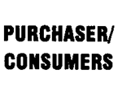
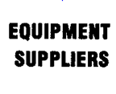





P3 Security Package
(UNIDO 1996 BOT Guidelines)

Slide 42
P3 Project Finance
Funding Sources:
- Tax Revenues
- User Fees
Financing Sources
Equity Financing
Private/Public
Debt Financing
Private
Debt Financing
Public
Municipal Bonds
TIFIA/WIFIA
GARVEES
PAB
SIB
Public Offering
Private Debt
Bonds & Notes
PAB
Project Financing
Conventional Financing
Syndicated Credit Facility
Private Placements
Term Loans
Bank Loans

Slide 43
P3 Project Finance
Federal/State Finance Facilities
TIFIA: Transportation Inf. Finance and Innovation Act
WIFIA: Water Inf. Finance and Innovation Act
PABs: Private Activity Bonds
GARVEES: Grant Anticipation Revenue Vehicle
BAB: Build America Bonds
SIBs: State Infrastructure Banks (revolving funds capitalized with fed-aid funds and matched state funds)

Slide 44
P3 Project Finance
Municipal Bonds v.s. other Financing
It is all about pricing the risk over the project life cycle. Evaluate potential projects under PPP (reasonable finance + risk allocated to private + cost efficiencies + speed delivery) v.s. PSC (low finance + risk allocated to public + O&M uncertainties)
PPP can work w/o private finance
Other tax-exempt finance, e.g. PABs, could be used
Federal finance (TIFIA, etc) offers lower rates and can assume default risks much better than muni investors.
“When the private sector takes on risks that it can manage more cost-effectively, a PPP may be able to save money for taxpayers and deliver higher quality or more reliable service over a shorter timeframe………it creates value for taxpayers by lowering long-term project costs, improving the quality of service, or both ” (US Treasury Report 2014)

Slide 45
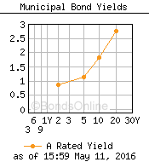
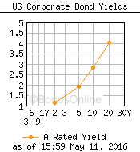
P3 Project Finance
Municipal Bonds v.s. other Financing
Although private financing is typically 1-3% higher than public finance, the gap has been narrowing. (WB/IFC 2013)

Slide 46
P3 Payment Mechanisms
P3 links compensation to the achievement of government objectives and to meeting performance criteria.
User Satisfaction
Payment
Usage
Payment
Safety Payment
Availability
Payment
Deduction Structure
Capital
Payment
Payment Mechanism
Hybrid PB DBFO Payment Mechanism

Slide 47
P3 Oppositions & Concerns
“Supporters say P3s bring needed financing, technology, management, and risk sharing to infrastructure development.
Detractors say government agencies are better positioned to finance and own infrastructure and protect the public interest.”
(Papajohn et al. ASCE 2011, v 27, no 3).

Slide 48
P3 Oppositions & Concerns
Labor union opposes P3 over employment & pension
Professional Engineers union in CA opposed P3 “A bad deal for taxpayers”. Objected P3 for the Presidio Parkway arguing that it lacked public agency involvement and inspection. The California Supreme Court, in 2011, rejected an appeal from the union and allowed the state to contract with a PPP company.
Trucking industry opposes P3 for tolling highways
Public opposition for tolls. Minnesota vetoed TH212 down for tolls.
Loss of gov. control, e.g. non-compete clause.
Excess private profits.

Slide 49
P3 Successful Implementation
Need to have:
Comprehensive P3 legal framework, State P3 Act
Centralized P3 Unit under Treasurer (serving all departments) or for each state department
Develop proper education, understanding and tools
  Staged procurements and best-value evaluations
  Understanding for the use of private finance
  Risk allocation strategies
  Payment mechanisms
  Detailed business plan and Value-for-Money assessments (PSC)
  Standardized contracts (to be tailored for projects)
  Public education and stakeholders management

Slide 50
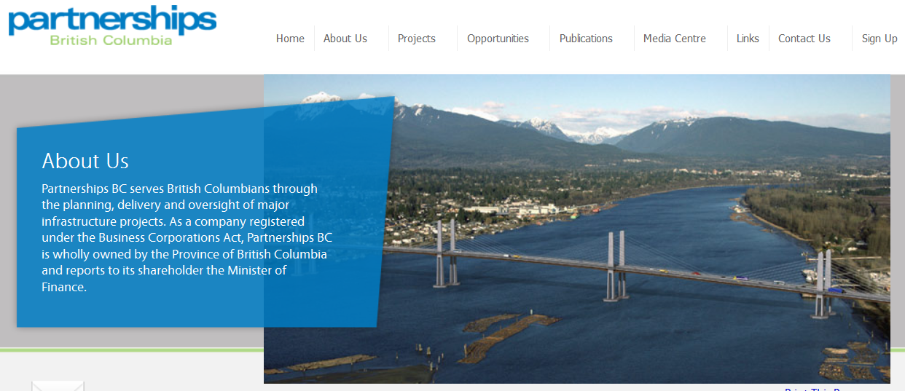
Sea-to-Sky Highway
P3 Unit: Partnerships BC

Slide 51
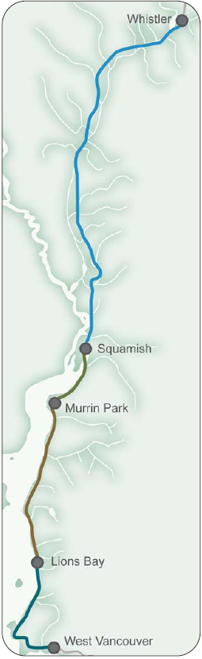

Sea-to-Sky Highway
100km improvement project between Vancouver and Whistler
Capital Cost: $600m; PB DBFO: 25 Years (Option Analysis)

Slide 52
Sea-to-Sky – Selection & Evaluation
Objective
Bidding RFP
Improve safety
Improve reliability (travel time)
Improve capacity (comm. growth)
Manage traffic flows during construction to minimize disruption and maximize predictability, and
Remain on schedule and on budget
Annual Affordability Ceiling is established (AAC)
A Maximum Performance Payments (MPP) defined
Proposals evaluated based on meeting baseline requirements, and for the additional improvements that could be achieved within the AAC
Performance payments linked to predefined service standards

Slide 53
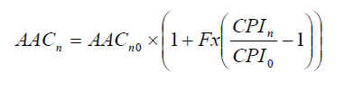
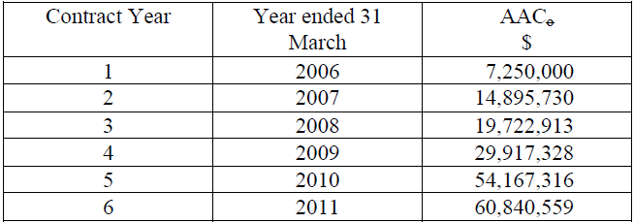
Sea-to-Sky – Selection & Evaluation
Annual Affordability Ceiling
Adjusted annually for inflation at 35%

Slide 54
Sea-to-Sky – Selection & Evaluation
Project Company
Project Financing
S2S Transportation Group
Finance: Macquarie NA
Design/Build: Kiewit
Construction: JJM Constr.
Design: Hatch Mott MacDonald
O&M&R: Miller Paving
O&M: Capilano Highway Ser.
C$498 Private Placement at floating rate over CDOR by 110bp to 120bp during construction and thereafter (CDOR Canadian Deposit Offering Rate)

Slide 55
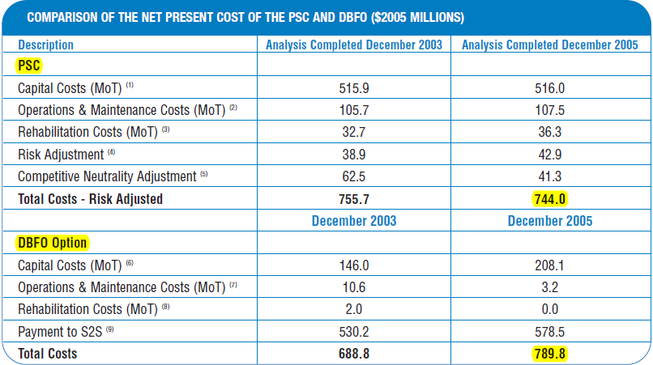
Sea-to-Sky – Selection & Evaluation

Slide 56
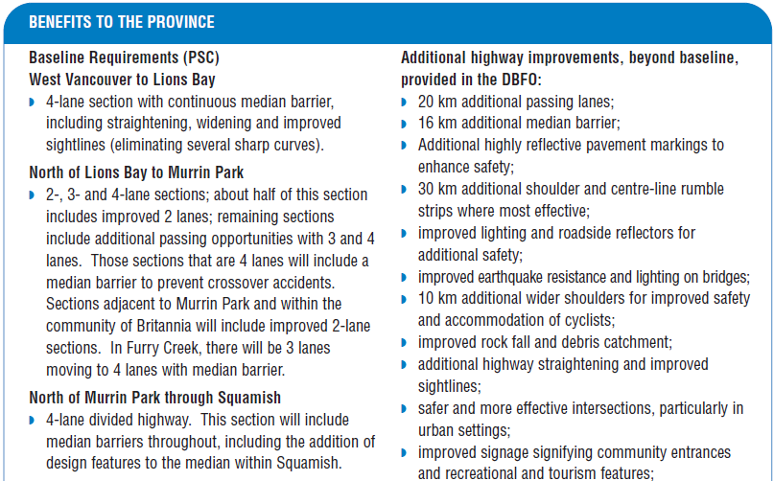
Sea-to-Sky – Selection & Evaluation
$131m estimated benefits

Slide 57
Sea-to-Sky – Payment Mechanism

Slide 58
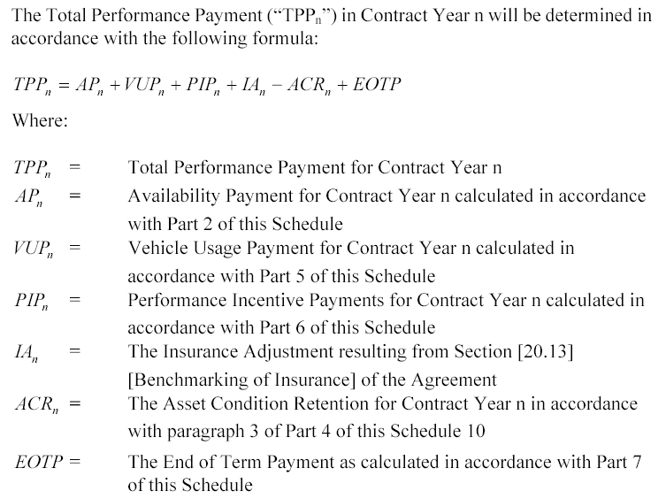
Sea-to-Sky – Payment Mechanism

Slide 59
Sea-to-Sky – Payment Mechanism
Performance measures for [pavement patching and crack sealing]
maximum response time to repair defects (h hour, d day)

Slide 60
Sea-to-Sky – Payment Mechanism
Non-Conformance Event Point Rate Deduction (NCE/NCEP)

Slide 61
Sea-to-Sky – Payment Mechanism
Non Conformance Event Point Rate Deduction (NCEP)

Slide 62
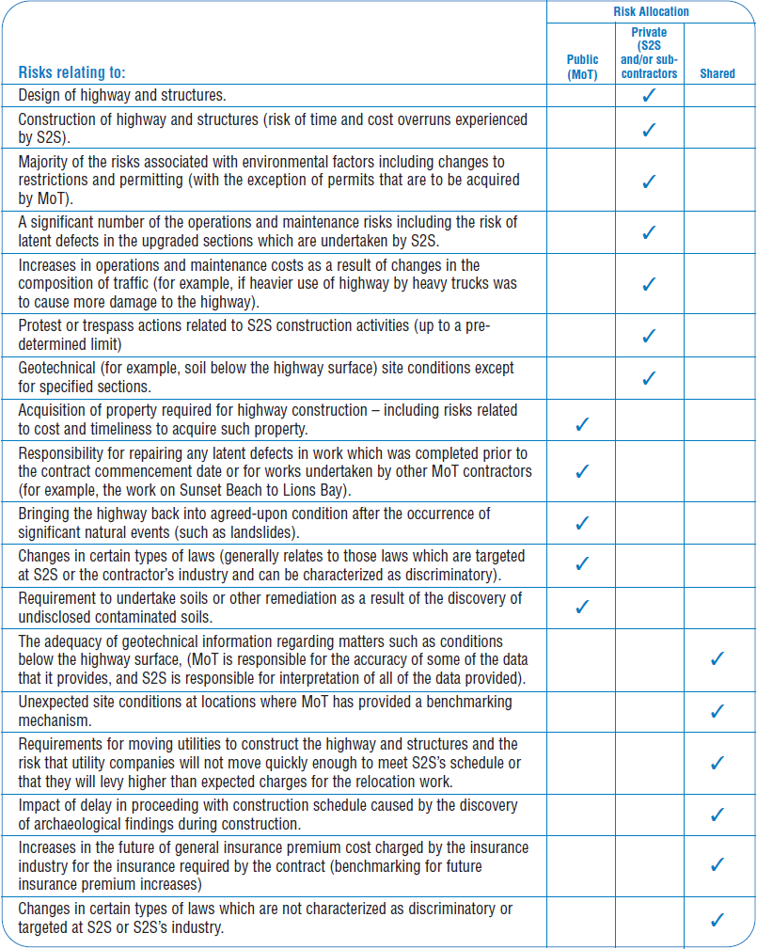
Sea-to-Sky – Risk Allocation

Slide 63
Sea-to-Sky – Risk Allocation

Slide 64
Sea-to-Sky – Risk Allocation

