Slide 1


Local Government Public Works Contracting Study– CPARB Update
September 10, 2020

Slide 2
Participation Ask
Need: Committee to discuss important themes from the survey
Time commitment: Five two-hour meetings over the period from May 2020 to September 2020
Raising Thresholds
Creating Uniformity for Thresholds
Small Business Inclusion
Minority and Women Owned Inclusion
Wrap Up
May 28th
June 25th
July 23rd
August 6th
August 27th

Slide 3

Approval Timeline
August 27th: Final committee meeting
September 10th: Presentation to CPARB Board
September 24th: Interview Feedback webinar
October CPARB Board Meeting: Approval of recommendations
December CPARB Board Meeting: Final report approval

Slide 4

Voting Members
Andrew Thompson – Granite Construction (General Contractors)
Chris Herman – Washington Public Ports Association
Jane Wall – Washington State Association of Counties
Jolene Skinner – L&I
Karen Mooseker – Mukilteo School District
Keith Michael – Forma Construction (General Contractors)
Kristin Hall – Snohomish PUD
Michael Transue – Mechanical Contractors Association

Slide 5
Public Works Committee Purpose
To review the public works contracting processes for local governments, including the small works roster and limited public works processes, and create recommendations for efficiency to be presented to the CPARB Board.
This review will include the following:
  Most common contracting procedures
  Current public works contracting thresholds
  Analysis of applying an inflation-based indicator and other potential threshold adjustments
  Recommendations to increase uniformity and efficiency for local government public works contracting
  Rates of participation for small and minority-and-women owned businesses and barriers to improving the participation rate

Slide 6
Supporting information

Slide 7
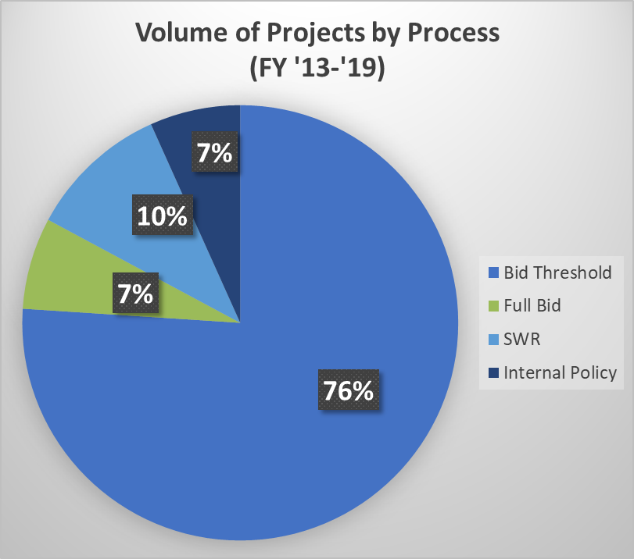
Current Expedited Process Structure

Slide 8
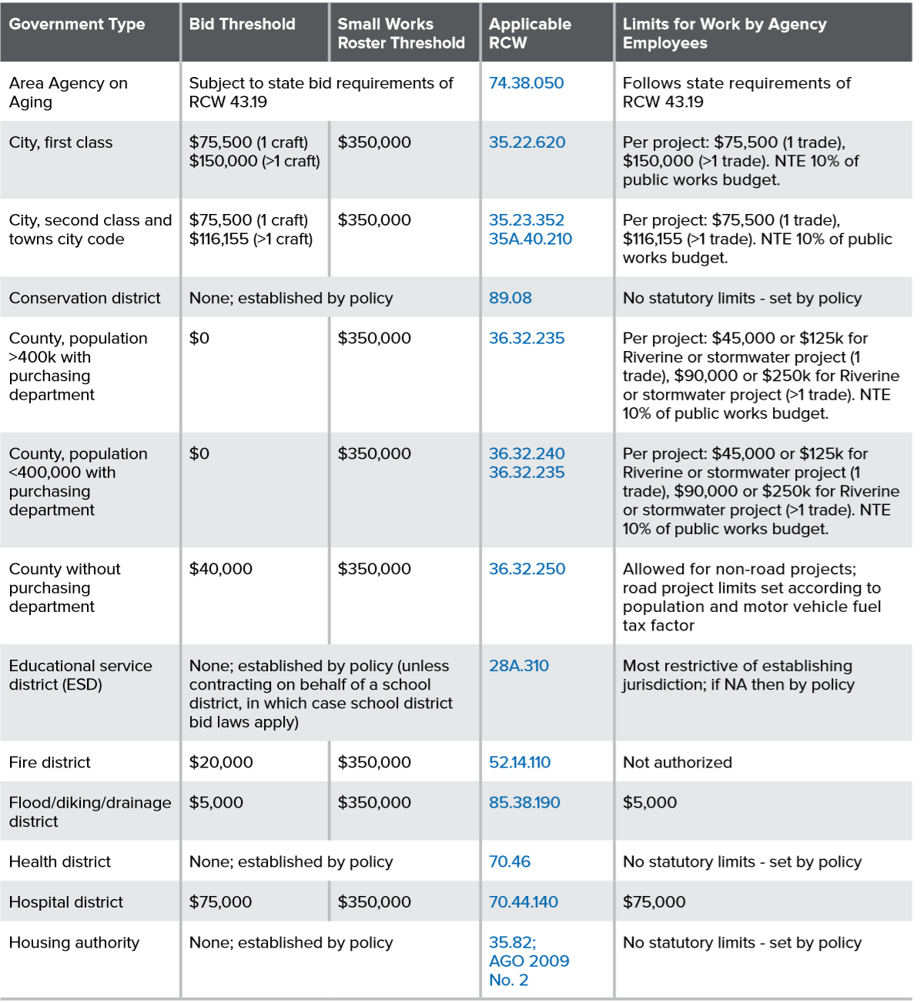
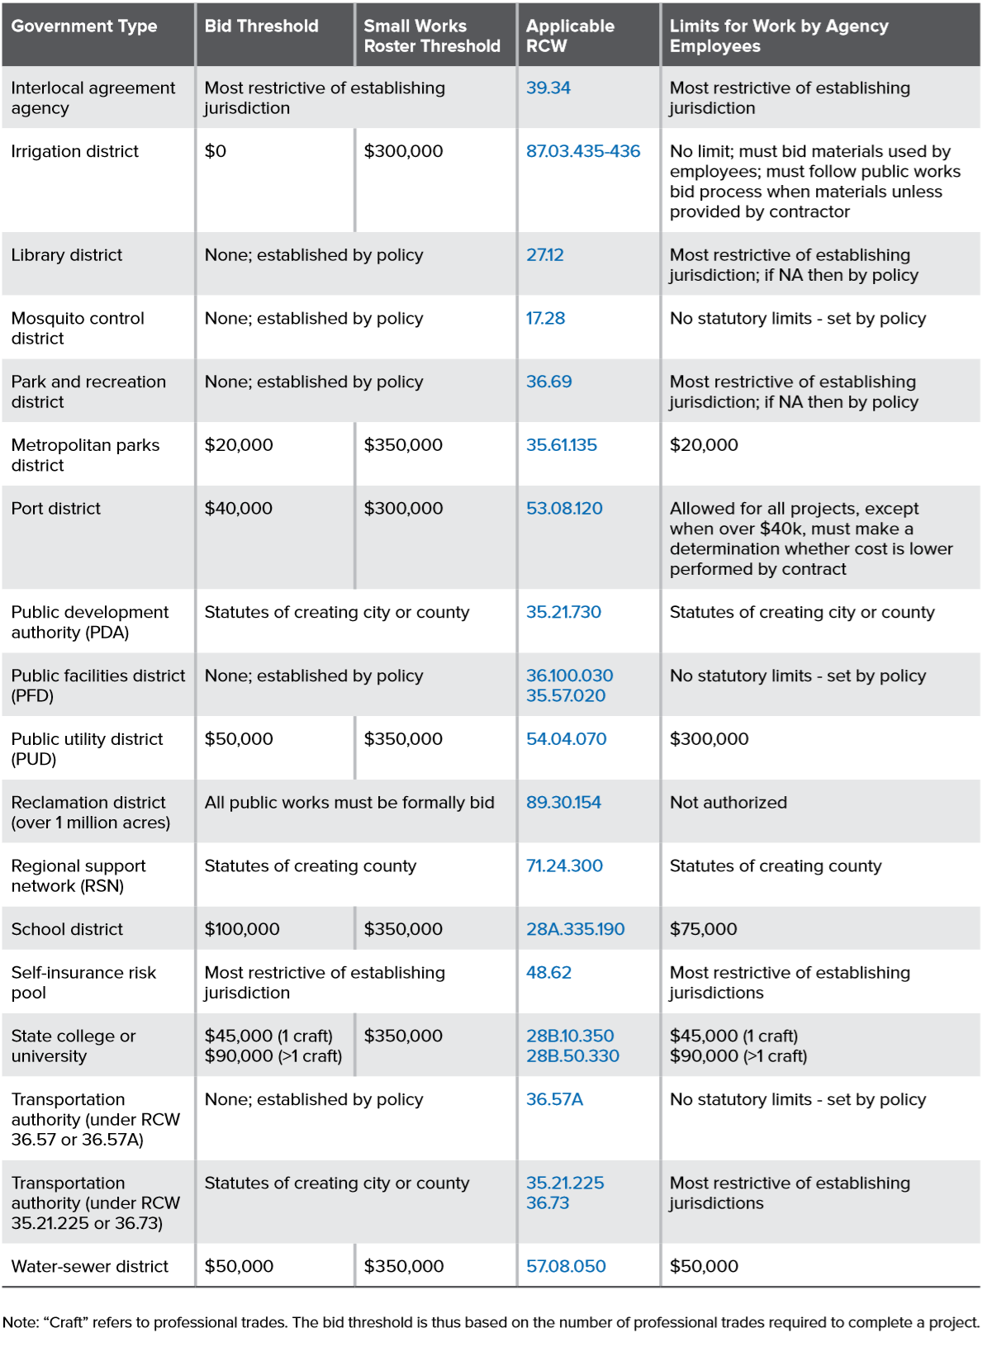
Defining Thresholds
Two primary public works thresholds
  Bid Threshold
  SWR
Take a variety of forms across agency types

Slide 9
CCI Inflation Adjustment

Slide 10
Resources for ensuring bidding requirements

Slide 11
Public Works Project Notification Source

