Slide 1


Local Government Public Works Contracting Study– Update
October 8, 2020

Slide 2
Recommendations – Unanimous / Policy
# | Recommendation | Vote Status | Ongoing maintenance | Considerations
1 | Adjust Port District and Irrigation District Small Works Roster Statutes to refer to RCW 39.04.155 | Unanimously in favor | No | Someone appointed to review statute language for Port and Irrigation districts
5 | Remove retainage and bond requirements for projects under $5,000 | Unanimously in favor | No | Someone appointed to review which statute to update.
8 | Define small business in the public works contracting statute | Unanimously in favor | No | Identify which statute to update and develop language definition

Slide 3
Recommendations – Unanimous / Maint.
# | Recommendation | Vote Status | Ongoing maintenance | Considerations
6 | Create a centralized list of rosters | Unanimously in favor | Yes | How will this be implemented? Who will maintain this? Commitment from agencies to keep updated Determine if set in statute or other mechanism
7 | Create list of certification/registration programs for disadvantaged businesses | Unanimously in favor | Yes | How will this be implemented? Who will maintain this? Commitment from issuing agencies to keep updated
10 | Coordinated schedule for significant outreach events between public agencies and other stakeholders | Unanimously in favor | Yes | How will this be implemented? Who will maintain this? Commitment from agencies to keep updated

Slide 4
Recommendations – Not Unanimous / Policy
# | Recommendation | Vote Status | Ongoing maintenance | Considerations
5 | Expand the ‘no-bid response’ process to all agencies | Yes: 6 No: 1 | No | Define process to avoid misuse Revisit current authorization to align with this implementation
6 | Give unit price contracting authority to all public agencies | Yes: 5 Abstain: 1 No: 1 | No | Define process to avoid misuse Revisit current authorization to align with this implementation

Slide 5
Recommendations – Not Unanimous / Maint.
# | Recommendation | Vote Status | Ongoing maintenance | Considerations
2 | Tie Small Works Roster threshold increases to state-wide inflation factor based on CCI | Yes: 4 Abstain: 1 No: 2 | Yes | Expansion of SWR a concern for some business entities Define process for five-year inflation increase
7 | CPARB update to supplemental bidder responsibility guidelines | Yes: 3 No: 4 | Yes | Is funding required for this effort? Define scope of update
10 | Provide professional assistance to local government for contracting guidance and marketing and outreach to contractors | Yes: 3 No: 4 | Yes | Define scope of support Two lines of support (agency and business) Concern about creating new resources to implement this Identify current available resources

Slide 6
Supporting information

Slide 7
Potential Future Studies
Review thresholds below statutory designation
Review structure of current types of local government
Impact of a master statute
Review consolidation of county thresholds
Increase base SWR threshold amount
Evaluate advertisement requirements for formal competitive bids (i.e. Newspapers vs. other forms)
Review impact of centralized state-wide roster
Determine potential program for sub-contractors to express interest in projects
Evaluate possibilities for electronic solicitations for all competitive bidding (only available for SWR)
Expand data collection efforts by L&I (contract types) and OMWBE (participation rates) through a sustained funding model
Identify how State and OMWBE studies relate to local government

Slide 8
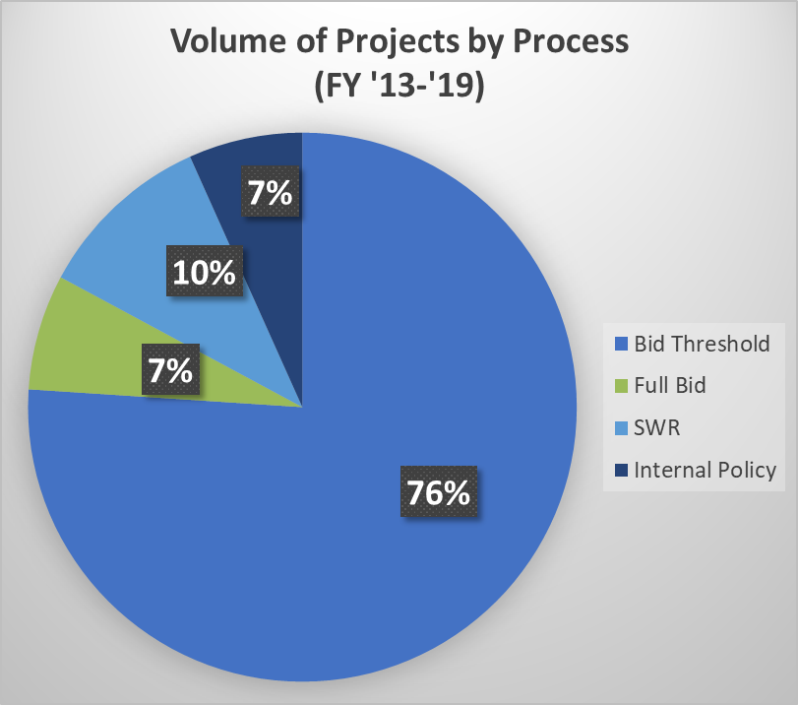
Current Expedited Process Structure

Slide 9
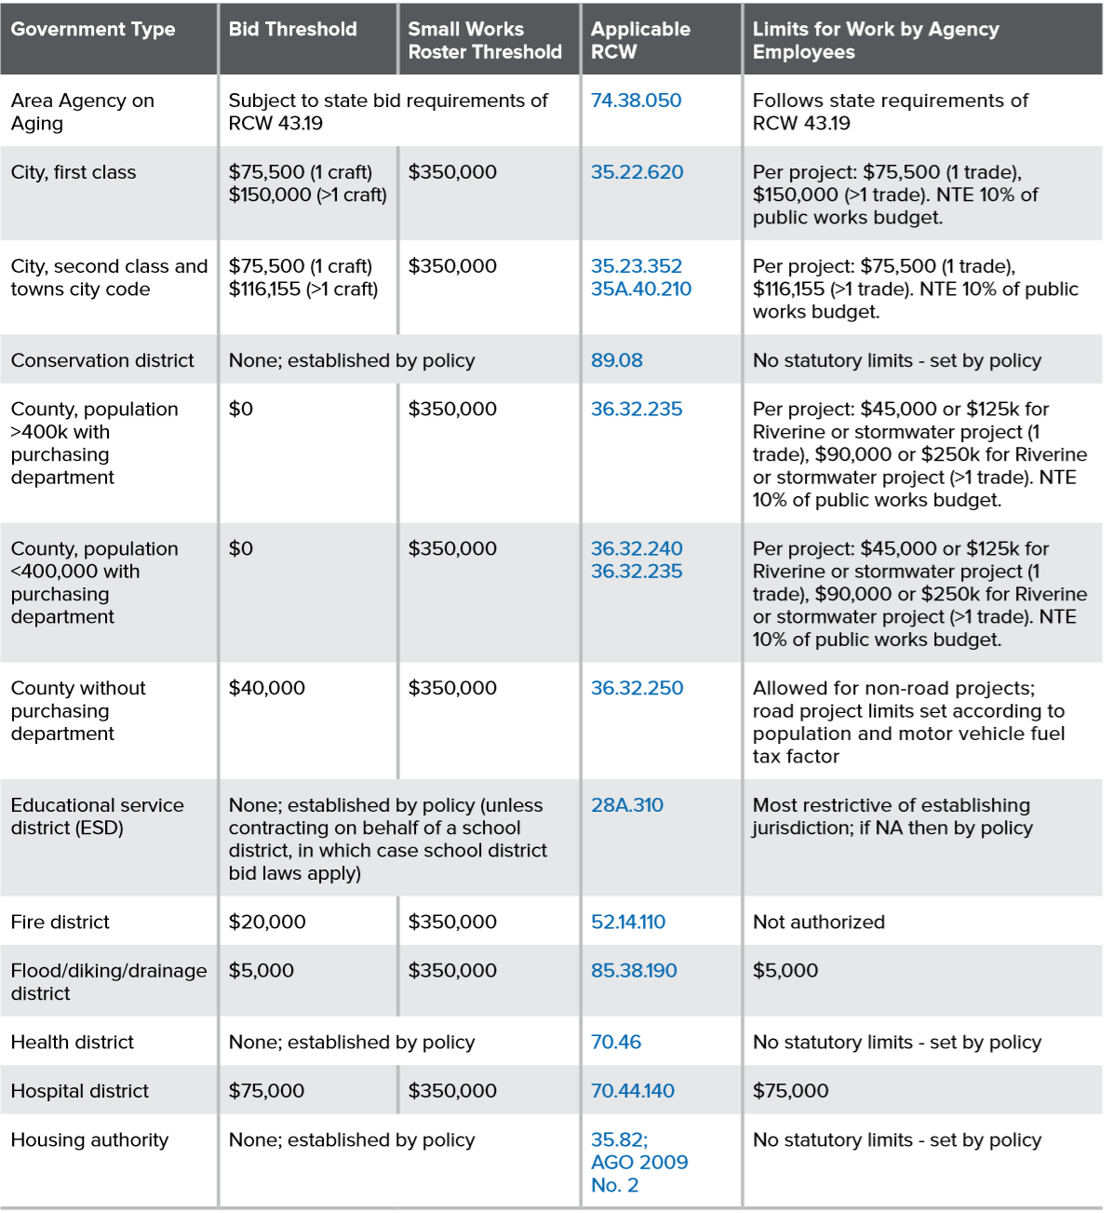
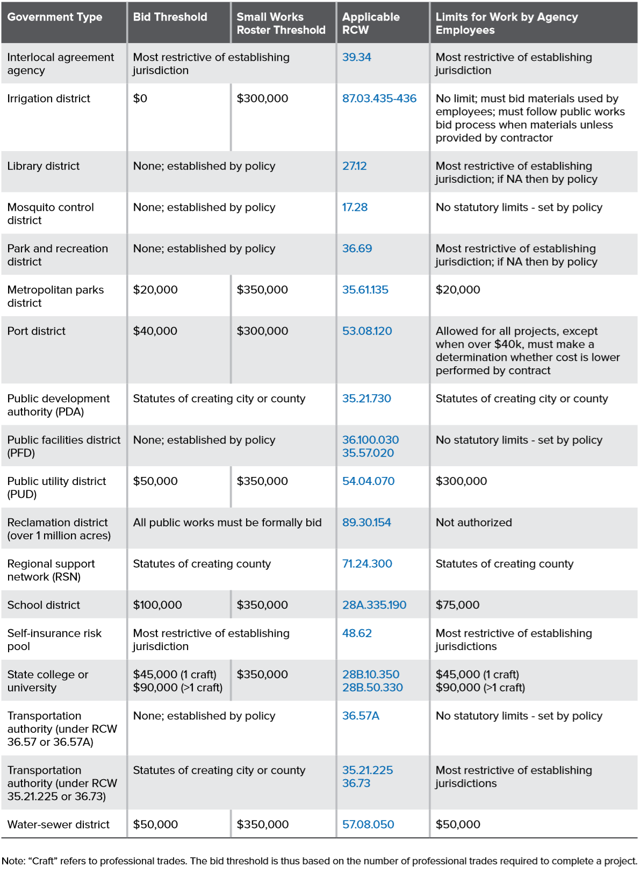
Defining Thresholds
Two primary public works thresholds
  Bid Threshold
  SWR
Take a variety of forms across agency types

Slide 10
CCI Inflation Adjustment

Slide 11
Resources for ensuring bidding requirements

Slide 12
Public Works Project Notification Source

