Slide 1

Roadmap for Improving
Small & Minority-, Women- and Veteran- Owned Business Participation in State Contracting
December 13, 2018
Chris Liu, Director
Department of Enterprise Services
Presenter:
Rex Brown, Administrative Director
Business Diversity Subcabinet
Department of Enterprise Services

Slide 2
Contact Info:
Chris Liu, Director
Department of Enterprise Services
Desk: 360.407.9201
Cell: 360.628.0058
Chris.Liu@des.wa.gov
Rex Brown, Administrative Director
Business Diversity Subcabinet
Department of Enterprise Services
Desk: 360.407.7926
Cell: 360.763.2744
Rex.Brown@des.wa.gov

Slide 3






Our Technical Teams
Measurement
Framework
Improved
Certification
Technical Assistance
Diversity Culture &
Framework
Community of
Practice (CoP)
Engagement and
Assistance CoP
AGO Opinion Disparity Study
Legal Framework on a Parallel Path

Slide 4

Legal Clarification
The Subcabinet requested and received a formal opinion from the state Attorney General Office (AGO) regarding RCW 49.60.400 (state initiative I-200)
The subcabinet is working with the AGO on an inventory of race and gender-neutral measures state agencies can use today.

Slide 5

Disparity Study
Washington’s disparity study will give us valuable information about how well state agencies are doing when it comes to including minority- and women-owned businesses in state government contracts and purchasing.
This pioneering statewide disparity study will look at goods and services and public works contracting and purchasing throughout state agencies
Most studies focus on one type of purchasing at one agency, city department or district

Slide 6


4.1.a: Increase state agency and educational institution utilization of state-certified small businesses
Detailed Action Plan:
Task | Task Lead | Partners | Expected Outcome | Status | Due Date
Measurement Framework | OMWBE, LNI | DSHS, DOC | Create suite of measures to provide the best dashboard for accountability and improving results. Increase use and reliability of data. | Ongoing | Completed January 2018
Improved OMWBE Certification | OMWBE |  | Eliminate any unnecessary barriers and improve certification timeframes. | Ongoing | Completed January 2018
Community of Practice (CoP) | DSHS, WSDOT, DES, OMWBE | HCA | Embed a broad understanding of equity, diversity and inclusion throughout community of procurement professionals. | Ongoing | Launched February 2018
Technical Assistance | OMWBE, DES | ORIA, Commerce | Create a system for small business to customize their needs to available resources. Central web site with “triage” services. Feedback loop for quality control. | Ongoing | Launched October 2018
Disparity Study | DES | 33 State Agencies | Provide necessary data needed to understand whether minority-, women- and veteran-owned businesses have equal access to contracting opportunities. | Ongoing | Initial Draft before 1/31/19

Slide 7

Small Business Assistance
Technical Team
Small businesses have been asking for easier to find and use technical assistance
In October, the Subcabinet launched an effort to consolidate information into one place

Slide 8

Technical Team to Building a Diversity Culture and Framework
A “community of practice” is essential for durable and sustainable results.
It ensures business diversity is:
  1) Part of our culture
  2) A recognized priority
  3) Fully supported with planning, practice, policy, resourcing, training, etc.
Executive Sponsors: OMWBE

Slide 9
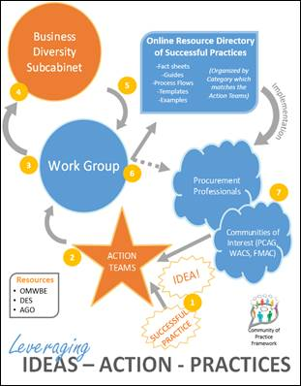
Creating a Community of Practice

Slide 10

What 10 Community of Practice Action Teams are Working On
Outreach
Business assistance
Internal agency culture
Internal processes (to remove barriers for small businesses)
Planning/forecasting (to allow lead time for best practices)
Statewide master contracts (for goods and services - to identify diverse business opportunities)
Provider networks and client services (to increase use of certified firms)
Using data (to increase supplier diversity)
Purchase cards (to include diverse spending data)
Public works best practices

Slide 11


Community of Practice
As a state, we are using a strategic and coordinated approach.
We will continue to work transparently and inclusively.

Slide 12
Questions and Answers
Thank You!

