Slide 1
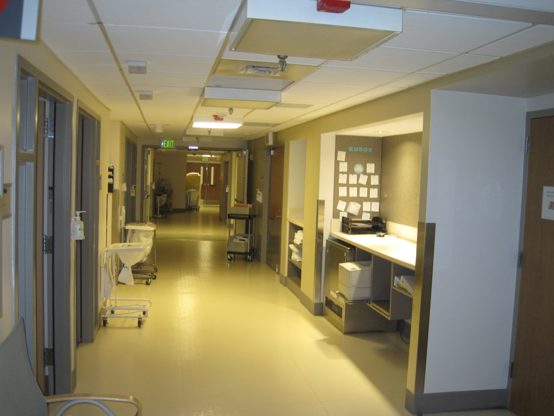
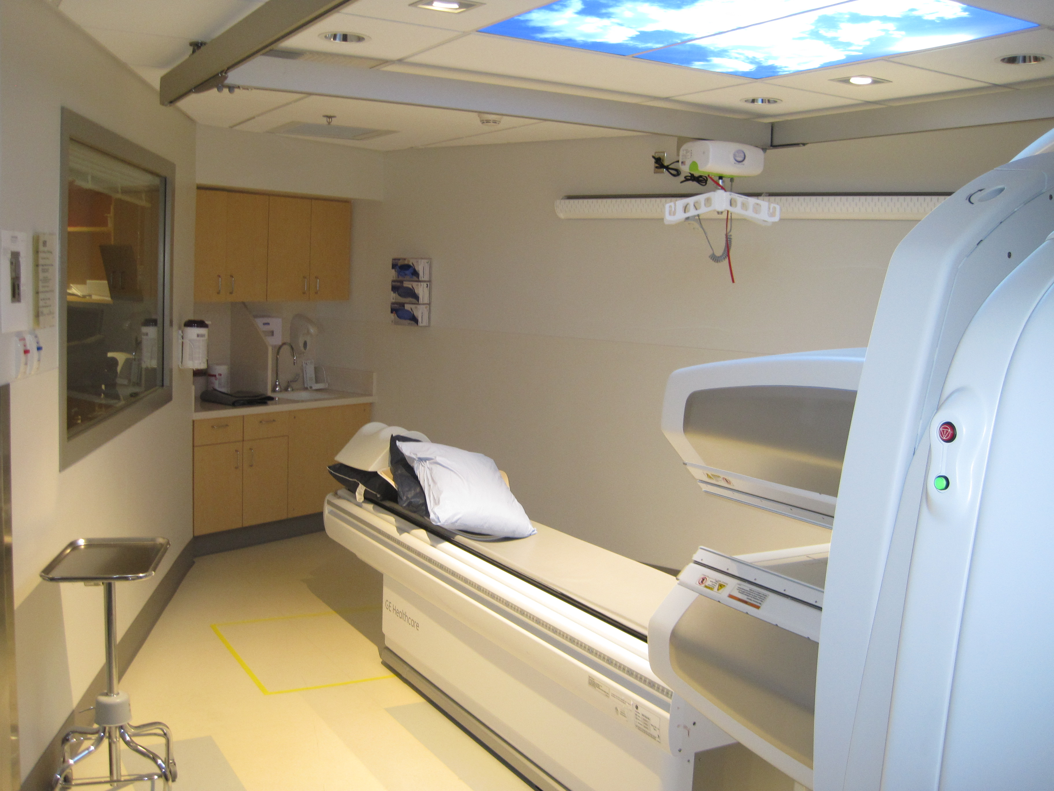
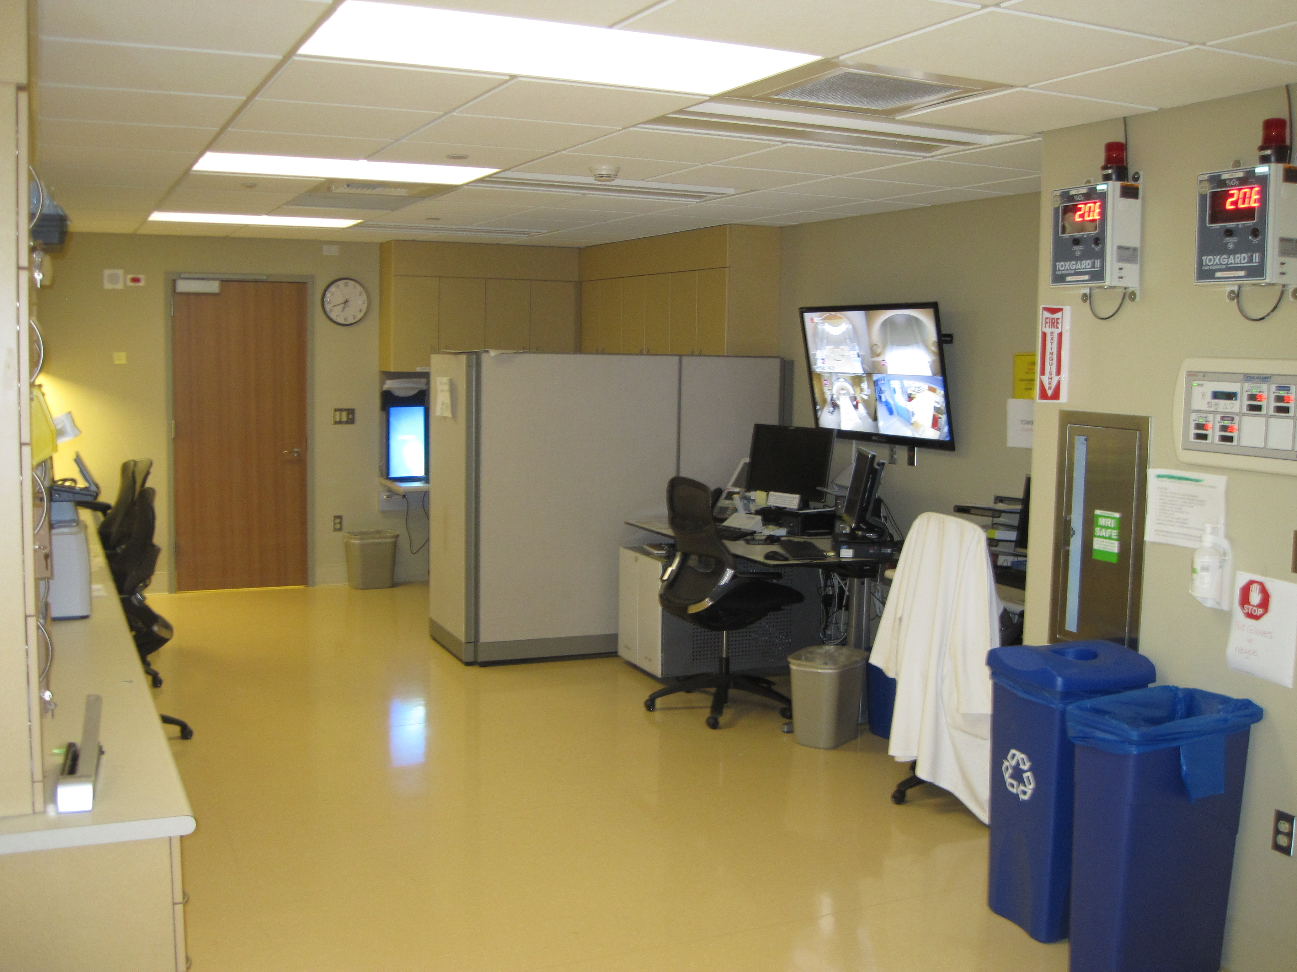
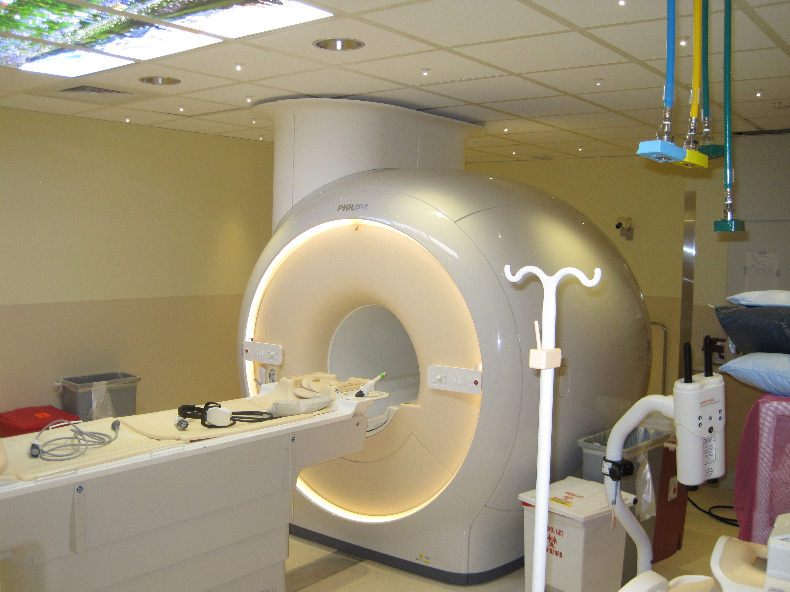
Capital Planning & Development
Critical Patient Care Facilities Roster
May 12, 2016

Slide 2
Overview
Used at both UWMC and HMC, and specialized medical research facilities
Created due to patient safety, infection control requirements, and coordination of utility shutdowns to prevent life threatening situations
Improves schedules
Qualified GCs to foresee and plan their projects

Slide 3
Guidelines
RFQs published yearly with no due date
Qualifications accepted once per year
Scoring Committee established from CPD, UWMC and HMC
Rosters are populated for two years
Criteria is based on RCW 28B.20.744
Projects are placed on the roster as a joint decision between CPD and hospital staff
Project specific bidder responsibility for sub-trades cannot be used

Slide 4
Accomplishments
Improved Schedule Duration:
35% percent decrease in median bid duration from bid date to NTP

Slide 5
Accomplishments, Cont.
Improved Performances:
Based on 51 projects prior to the roster
4 current projects using the roster

Slide 6
Roster Usage 2014 thru December 2015
3 each “B” roster projects
7 each “A” roster projects
Average contract award = $684,510

Slide 7
Contractors
A:
Andersen Construction Co
Bayley Construction
Centennial Contractors Ent.
Howard S. Wright
Lease Crutcher Lewis
M.A. Mortenson Company
Skanska USA Building, Inc.
Swinerton Builders
B:
Forma Construction
Graham Contracting, Ltd.
Kirtley-Cole Associates LLC
Lydig Construction, Inc.

Slide 8
Business Equity Outreach Efforts
Yearly Outreach Event – GC Roster meet & greet with Subcontractors.
Review of Outreach Plans by the Business Equity Evaluation Panel
Distribute RFP for Roster to the following: Tabor 100, National Assoc of Minority Construction Contractors, OMWBE, Minority Business Enterprise Center, PTAC, Northwest MMSDC

Slide 9
Business Equity Outreach 2017-18
Targeted outreach during solicitation to state certified firms.
One on One meetings with Roster GC’s to review outreach plans.
Requesting submission of GC outreach effort post bid.
Track & Report OMWBE certified and non-certified M/ W participation.

Slide 10
Q&A
Thank You!

