Slide 1


^{City of Airway Heights}
^{Recreation Complex}
January 26, 2017 | PRESENTATION

Slide 2
Recreation Complex Overview
35,000 SF facility with softball/soccer fields
Includes gym, lap pool, therapy and children’s recreation pool, Jacuzzi, etc.
Phased expansion
Site challenges - basalt bedrock, paleochannel, cultural resources.
Early DB involvement - assist with determining best location of site improvements

Slide 3
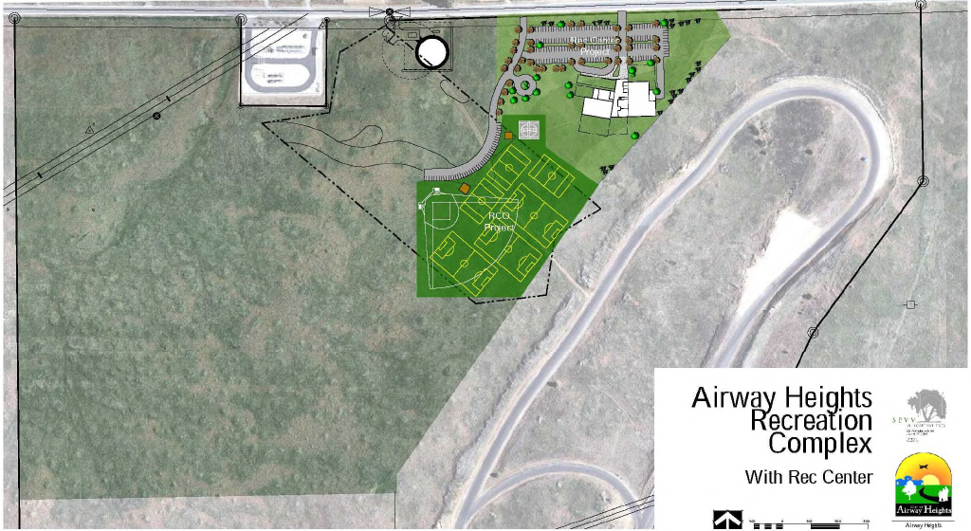
Overall Site Plan

Slide 4
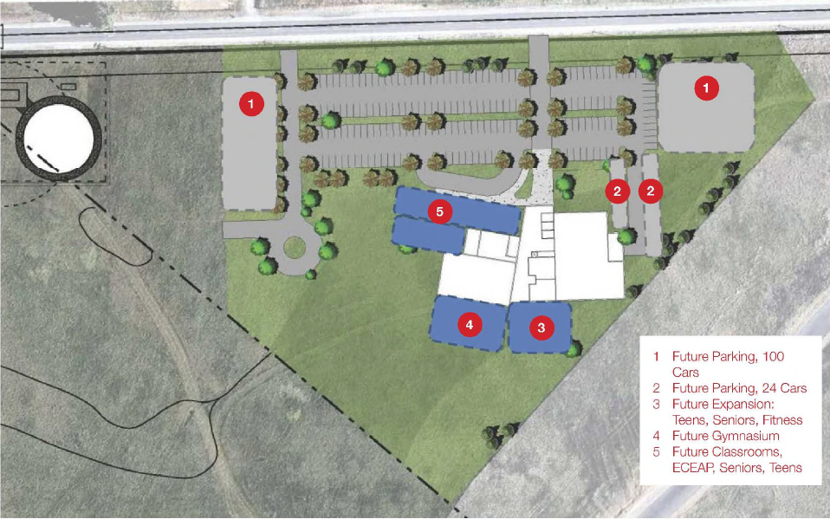
Phasing Plan

Slide 5
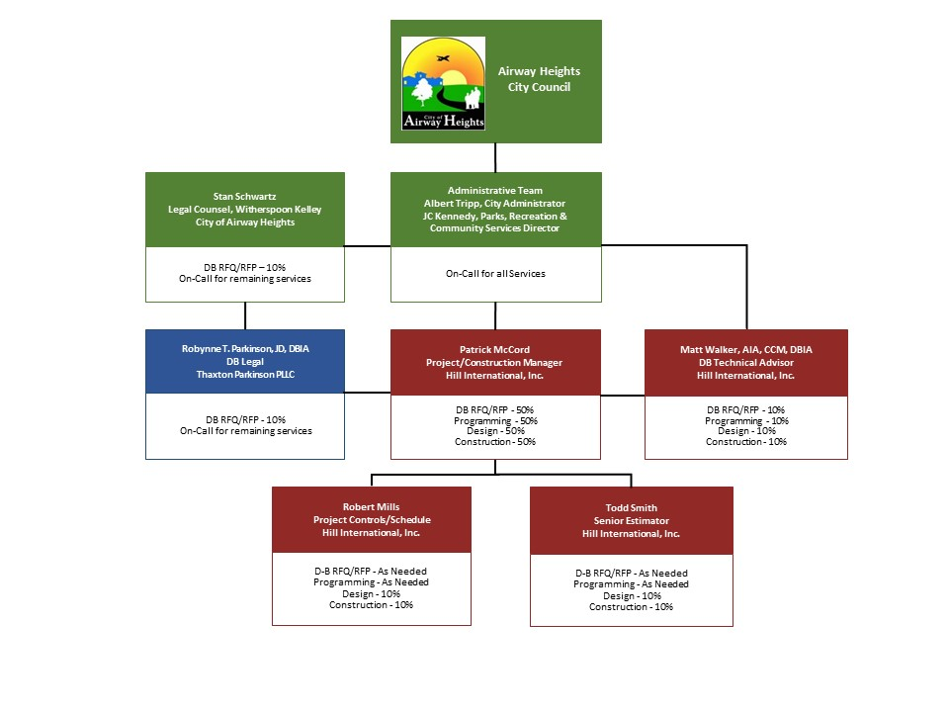
Organizational Chart

Slide 6
Recreation Complex Budget
Costs for Professional Services $ 1,150,000
Estimated construction costs $ 9,750,000
Equipment and furnishing $ 850,000
Contract administration costs $ 200,000
Contingencies $ 600,000
Other project costs $ 485,240
Sales Tax $ 964,760
Total $ 14,000,000

Slide 7
Schedule
Activity Projected Date
RFQ Issued 2-Feb-17
SOQs Due 2-Mar-17
Short-List 13-Mar-17
RFP Issued 16-Mar-17
Proprietary Mtg. One, Two 30-Mar-17 / 13-Apr-17
Proposals Due 4-May-17
Selection of Design-Builder 15-May-17
Anticipate NTP 23-May-17
Design Phase 5/23/2017 - 3/30/2018
Construction Phase 9/18/2017 - 9/13/2018

Slide 8
Procurement Approach
  Request for Qualifications
    Successful Experience with Projects of Similar Scope and Complexity
    Team Organization
    Experience developing GMP collaboratively with Owner
    Shortlist no more than five finalists
  Request for Proposal
    Management approach specific to the project
    Innovation and Problem Solving
    Interactive Proprietary Meetings
    Price related factor: Fee
    $25,000 honorarium
      Limited required proposal submittals
      Concept floor plans/renderings

Slide 9
Design-Build Agreement
  Validation and GMP Development Period
  Validate information from the Owner.
  Examines options to identify innovation
  Commercially reasonable examination of site
  Develop Basis of Design Documents, Project Schedule, GMP
  Contract Amendment
  GMP Execution Period
Complete Design
Construction
Close out

Slide 10
Benefits of Design-Build Delivery
RCW 39.10.300(1)(b) “Greater Innovation or efficiencies between the designer and the builder”
  Maximum coordination of design/construction phasing provide greatest project value and cost efficiency
RCW 39.10.300 (1)(c) “significant savings in project delivery time”
  Progressive Design-Build is the fastest delivery method. Starting site work early beneficial to the schedule
RCW 39.10.280(2)(a) “Substantial Fiscal Benefit”
  The City’s project budget is limited. The Design-Builder required to design within budget.
  The Design-Builder’s involvement in the development of the scope shifts more risk of the performance of the project to the DB

Slide 11
Questions and Answers
Confirm 5% budget contingency
  Owner’s contingency = 5% of DB Contract
JC Kennedy design/constr experience
  Sent under separate cover
Management Responsibility?
  City will manage Hill’s contract
City Administrators’ involvement?
  JC deeply involved – all phases
  Will consult with Albert Tripp
  Hill will manage DB Contract
Patrick McCord’s PM experience
  Sent under separate cover

Slide 12


^{Thank You!}

