Slide 1

OLYMPIC MIDDLE SCHOOL
RECONSTRUCTION
Application to use the GC/CM Project Delivery Method
January 26, 2017
Our Mission: In a safe environment, all students will achieve high standards of learning in order to become ethically responsible decision makers and lifelong learners.

Slide 2
Introductions

Slide 3
The Project Team
Here Today
Jeffrey Grose, Executive Director of Capital Projects, Auburn School District
Cindi Blansfield, Assistant Superintendent, Business & Operations, Auburn School District
Ron Harpel, Principal in Charge, BLRB Architects
Jim Dugan, GC/CM Advisor, Parametrix
Dan Cody, GC/CM Procurement Consultant, Parametrix
Also on the team
Bob Lindstrom, Project Manager, BLRB Architects
Graehm Wallace, Perkins Coie, External GC/CM Legal Advisor

Slide 4
Agenda
The District
The Project
Project Budget
Project Schedule
Why GC/CM
Public Body Qualifications
Project Organization
GC/CM Experience
Summary

Slide 5
The District

Slide 6
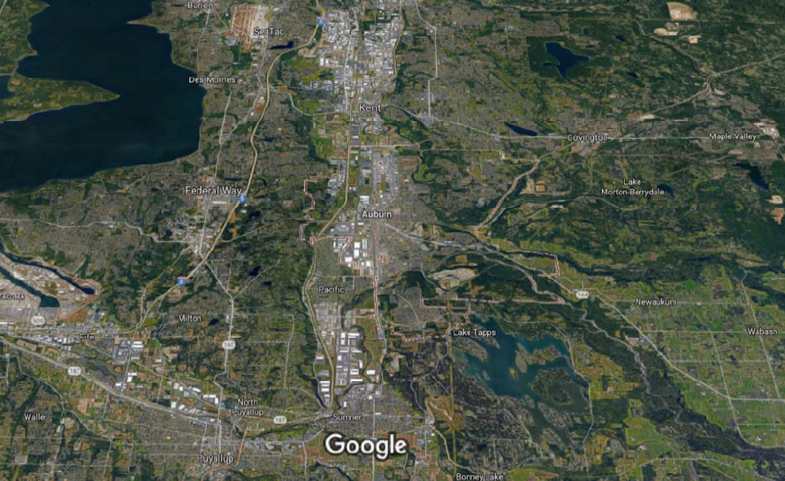
Auburn School District
Auburn

Slide 7
District Statistics
62 square mile area bridging King and Pierce counties
Serves residents in Auburn, Algona, Pacific, Lake Tapps and unincorporated areas of King County
Began serving students in 1896
Current enrollment: 15,919 students
Twenty-two schools comprised of:
  14 Elementary Schools
  4 Middle School
  4 High Schools
Over 1,000 certified staff members and over 900 classified staff members

Slide 8
District – 2016 Bond Program
Capital bond passed in 2016 - $456 M
Most recent prior capital bond: 2008 ($110 M)
Bond program includes:
  2 new elementary schools
  Replacement and modernization of 1 middle school
  Replacement of 5 elementary schools
Olympic Middle School is the first project of the 2016 bond program.
After new Olympic MS is constructed, existing buildings on campus will have limited modernizations and be used as interim school for upcoming elementary school replacement projects.

Slide 9
The Project

Slide 10
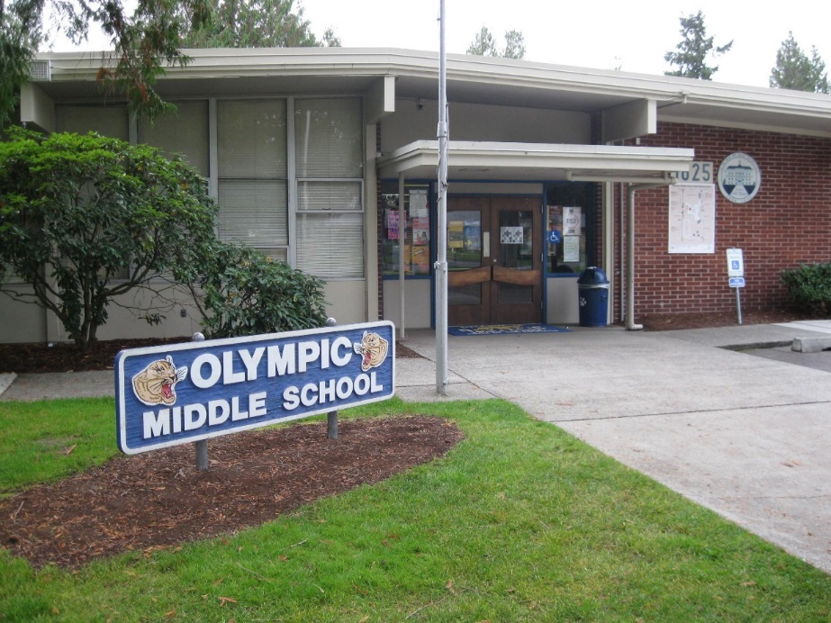
Existing Olympic Middle School
Built 1957
Additions or modernizations in 1960, 1974, 1982, 1988 and 2002
Grades 6-8
17.4 acre site
Adjacent to single & multi-family residential neighborhood
Campus plan school with multiple buildings and covered walkways
Buildings total 99,467 SF in area
Constructed primarily of single-story masonry and wood-framing

Slide 11
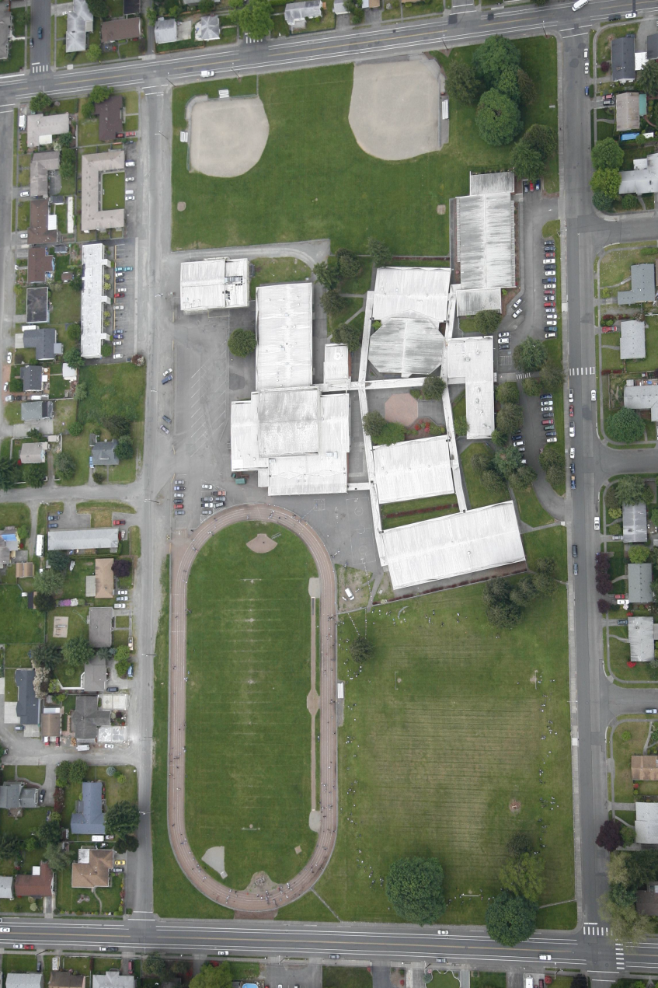
Olympic Middle School- Phase 1
March 2018 – June 2019
Construct New Middle School on South End of Site
Existing School Remains Open
Demo Existing 14,000 SF Building
Portable Classrooms Added to Existing School Site

Slide 12
Olympic Middle School- Phase 2
July – August 2019
Minor Modernization of Existing School
Use as Interim Elementary School for 4-5 Year Period

Slide 13
Olympic Middle School- Phase 3
July – November 2024
Demo Existing Buildings
Construct Small Field House
Construct Athletic Fields, Parking & Landscaping

Slide 14
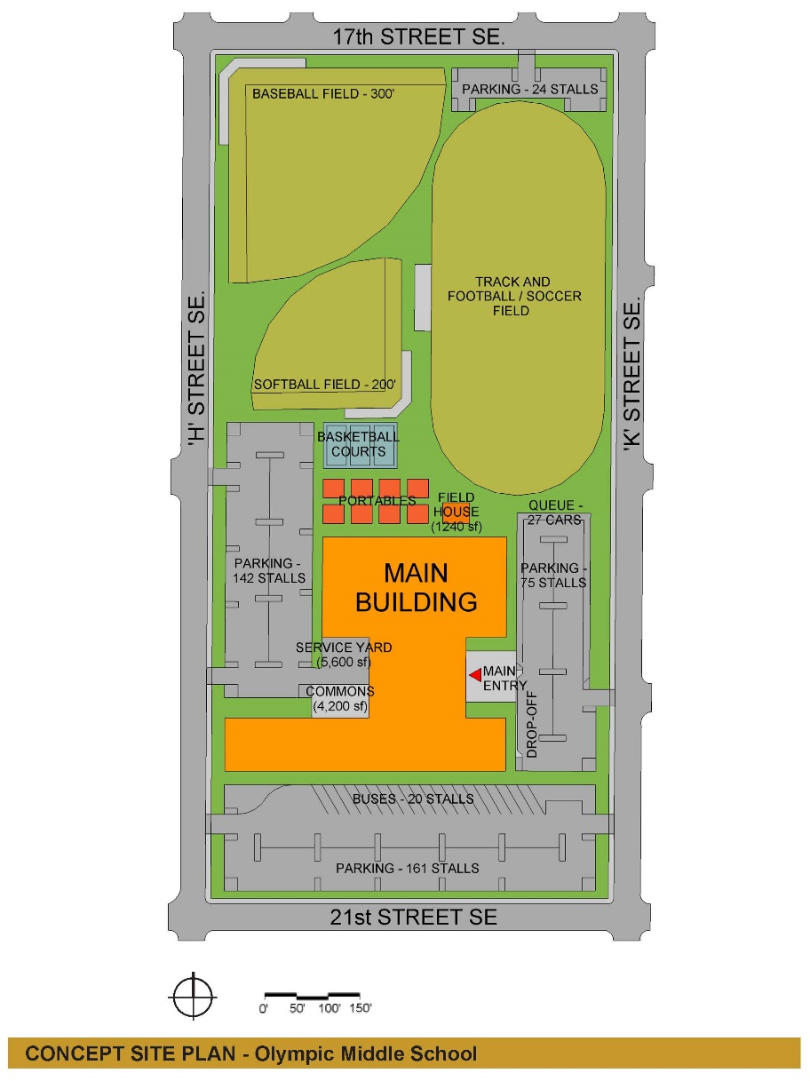
Conceptual Olympic Middle School
98,000 SF
Grades 6-8
800 Student Capacity
Single or Multi-Story Components
Owner’s MACC for Phase 1 & 2:
$45,000,000
Begin Schematic Design: February 2017
Start Phase 1 Construction: March 2018
Start Phase 2 Construction: June 2019
Occupy Phase 1 & 2: August 2019

Slide 15
Olympic MS Project Budget
Category | Budget
GC/CM MACC (Includes GC/CM Risk Contingency @ 3% of MACC) | $41,400,000
GC/CM Fees, SGC’s, Pre-Con Serv. & NSS Allowances (8% of MACC) | $3,600,000
Subtotal (Owner’s MACC) | $45,000,000
Contingencies – Owner’s Construction (5% of MACC) | $2,250,000
Contingencies – Owner’s Project (5% of MACC) | $2,250,000
Fixtures, Furniture, Equipment & Technology (6% of MACC) | $2,700,000
Professional Services Allowance (Architects & Engineers) (10% of MACC) | $4,500,000
Owner’s Consultants (Survey, Geo-Tech, Hazmat, Insp., etc) (1% of MACC) | $450,000
Contract Administration Cost (PM/CM, etc) (5% of MACC) | $2,250,000
Other Related Project Costs (Permits, Fees, etc) | $1,800,000
Sales Tax (10% of MACC) | $4,500,000
TOTAL: | $65,700,000

Slide 16
Olympic MS GC/CM Schedule
Presentation to the PRC | January 26, 2017
Release GC/CM RFP | January 27, 2017
RFP Submittals Due | February 10, 2017
Shortlist SOPs and Send Invitation to Interview | February 15, 2017
Interviews | February 22, 2017
Shortlist Interviews and Release GC/CM RFFP | February 23, 2017
RFFP Opening and Selection of GC/CM | March 2, 2017
Pre-Con Work Plan Due | March 17, 2017
School Board Approval of Selected GC/CM | March 27, 2017
Pre-Con Agreement Executed | March 29, 2017
Pre-Con Services | March 2017 to January 2018
Construction Phase | March 2018 thru Summer 2019

Slide 17
Why GC/CM Delivery Method

Slide 18
GC/CM Statutory Criteria
(1) Implementation of the project involves complex scheduling, phasing, or coordination.
(2) The project involves construction at an occupied facility which must continue to operate during construction.
(3) The involvement of the General Contractor/Construction Manager during the design stage is critical to the success of the project.
(4) The project encompasses a complex or technical work environment.
(5) The project requires specialized work on a building that has historic significance.
(6) The project is, and the public body elects to procure the project, as a heavy civil construction project.

Slide 19
Olympic Middle School
GC/CM Project Criteria
(1) Implementation of the project involves complex scheduling, phasing, or coordination.
(2) The project involves construction at an occupied facility which must continue to operate during construction.

Slide 20
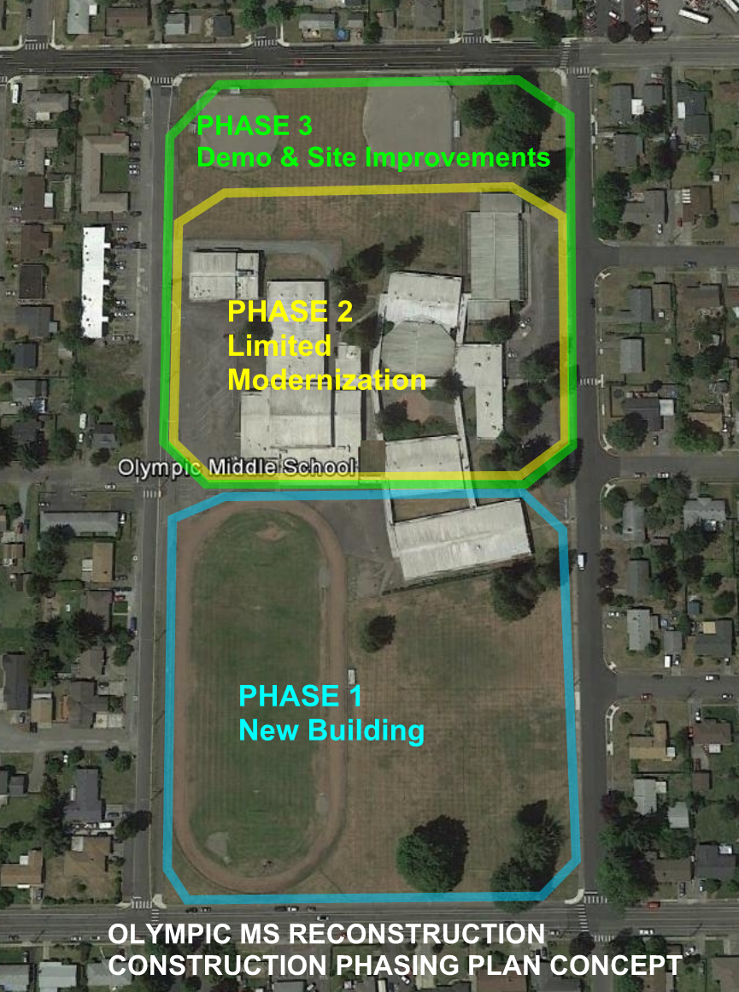
Project involves construction on an occupied school site that must continue to operate during construction

Slide 21

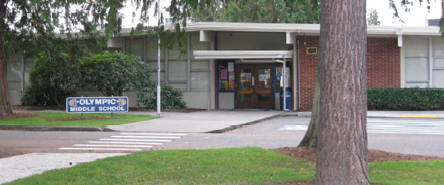
Other Critical GC/CM Factors
Safety: Small site with close proximity of students and construction activities
Risk Management: Competing with continuous increases in market costs and decreased resource availability
Partnership: Strong desire to have collaborative relationships with a project team that develops from start of project

Slide 22
ASD
Auburn School District Qualifications

Slide 23
Leadership Team
ASD has extensive K-12 capital projects experience including projects of similar scope and complexity.
  All of which have been delivered using Design-Bid-Build.
  Long track record of building projects on-time and within budget.
ASD is new to the GC/CM method of project delivery.
Assigned ASD PM: Executive Director of Capital Projects, Jeffrey Grose
  36 years heading the Capital Projects program at ASD.
  Degrees in architecture and building construction.
  Work experience with architectural firms, contractor and Owner.
  Certified Value Engineer.
  Arbitrator for AAA and member of Dispute Resolution Board Foundation.
  Completed AGC GC/CM Training Workshop in January 2017.
ASD hired Parametrix for GC/CM Procurement and Advisory services.
ASD retained Graehm Wallace and BLRB with depth of GC/CM experience.
ASD satisfies the public body qualifications by staff augmentation with consultants.

Slide 24
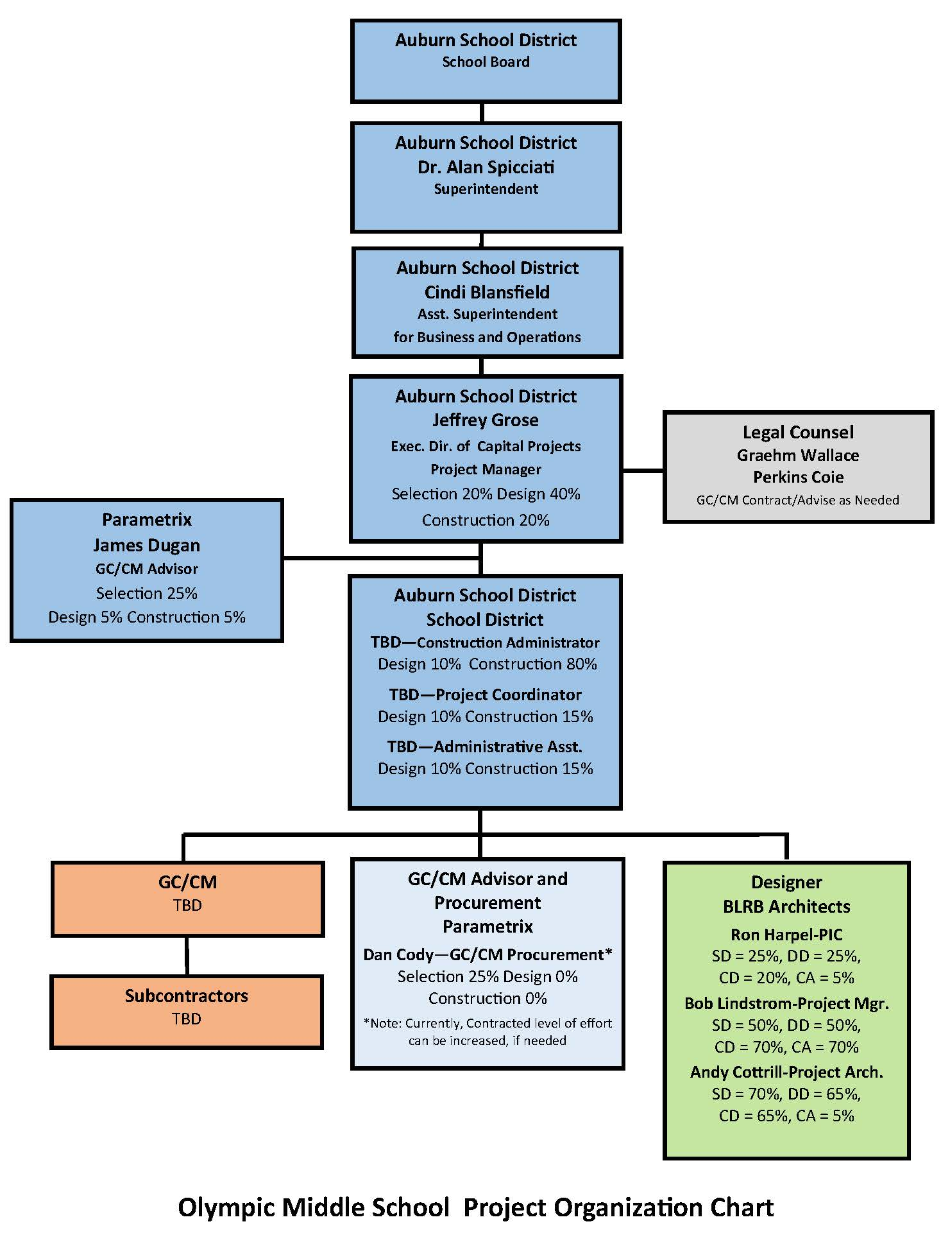
Olympic MS Project Organizational Chart

Slide 25
Project Team
GC/CM Experience

Slide 26
Name | Experience
Jeffrey Grose Executive Director of Capital Projects Auburn School District | 41 Years Design / Construction / Project Management 36 years with Auburn School District. Over 100 projects completed varying from small modernization projects to $120M, highly-complex, multi-phase high school modernization and reconstruction project. 1st GC/CM Project
Jim Dugan GC/CM Advisor Parametrix | 39 Years Program / Project Management 12 GC/CM Projects: TPS: Stadium HS, McCarver ES, Stewart MS, Browns Point ES COT: Tacoma Convention and Trade Center, MPT Eastside Community Center CKSD: Central Kitsap HS/MS and Olympic HS MVSD: East Division ES, Madison ES, and Old Main HS BISD: Blakely ES TPS Board of Director: 2005 – 2011 Appointed to the Project Review Committee July 1, 2016 – 3 Year Term
Dan Cody GC/CM Procurement and PM/CM Support Parametrix | 30 Years Program / Project Management 8 GC/CM Projects: TPS: Browns Point ES MPT Eastside Community Center CKSD: Central Kitsap HS/MS and Olympic HS MVSD: East Division ES, Madison ES, and Old Main HS BISD: Blakely ES Registered Architect in the State of Washington
Ron Harpel, AIA Architect Principal-in-Charge BLRB Architects | 30 Years Specializing in Education Facility Design Services 3 GC/CM Projects: Northshore SD: Skyview MS & Canyon Creek ES Lake Washington SD: North Redmond ES & Margaret Mead ES

Slide 27
Summary
Project is funded with the appropriate budget.
Project meets qualifying RCW 39.10 criteria.
Project Management Plan is developed and has clear and logical lines of authority.
Project team has the experience and continuity.
Project team has the capacity.
Project team is prepared and ready to move forward.

Slide 28
Thank you

