Slide 1
THREE ELEMENTARY SCHOOL GC/CM PROGRAM Elementary No. 15, Elementary No. 16 and Lea Hill Elementary
Application to use the GC/CM Project Delivery Method
May 24, 2018
Our Mission: In a safe environment, all students will achieve high standards of learning in order to become ethically responsible decision makers and lifelong learners.
Notes:
Jeff Grose with ASD Capital Projects Department.
Thank you for opportunity to present our application for approval GC/CM delivery for our 4 Elementary School Replacement Program.

Slide 2
Introductions
Notes:
1. We will begin by introducing our team.

Slide 3
Project Team
Here today:
Jeffrey Grose, Executive Director of Capital Projects, Auburn School District
Bob Lindstrom, AIA, Project Manager, BLRB Architects
Jim Dugan, GC/CM Advisor, Parametrix
Dan Cody, GC/CM Procurement Consultant, Parametrix
Also on the team:
Matt Nolan, Construction Administrator, Auburn School District
Ron Harpel, AIA, Principal-in-Charge, BLRB Architects
Graehm Wallace, GC/CM Legal Advisor, Perkins Coie
Notes:
Team members with me today are:
Jeffrey Grose, Executive Director of Capital Projects, Auburn School District
Steven M. Shiver, Principal-in-Charge, NAC Architecture
Guy Overman, AIA, Lead Planner and Designer, NAC Architecture
Jim Dugan, GC/CM Advisor, Parametrix
Dan Cody, GC/CM Procurement Consultant, Parametrix
Other important team members are:
Karee Loghry, Project Manager, NAC Architecture
Heidi Deaver, Project Architect, NAC Architecture
Graehm Wallace, Perkins Coie, GC/CM Legal Advisor
All of these individuals are highly skilled, have many years of experience and pleasure to work with.

Slide 4
Agenda
Auburn School District
School District Qualifications
3 Elementary School GC/CM Program
Why GC/CM Delivery Method?
Summary
Notes:
Agenda is similar to the agendas presented to you for other GCCM applications.
Our purpose today is to:
Provide information about ASD and our project team.
Tell you about our 4 elementary school replacement program.
Show you we have the resources and skills needed to successfully execute GCCM for this program.
Demonstrate why this program is eligible for and worthy of being approved for use of GCCM.

Slide 5
Auburn School District
Notes:
1. Next I would like to tell you a little bid about ASD.

Slide 6
School District Statistics
62 square mile area within King and Pierce counties
Serves residents in Auburn, Algona, Pacific, Lake Tapps and unincorporated areas of King and Pierce Counties
Began serving students in 1896
Current enrollment: 16,400 students
Twenty-two schools:
14 Elementary Schools
4 Middle School
4 High Schools
Over 1,900 staff members
Notes:
ASD is located in south King County.
We are a middle size school district with 22 schools, 16,000 students and 1,900 staff members.
We have been around a long time. Our first school house was a log cabin built in 1869 by the families living in the area. It had a mud fire place and a floor of split cedar logs lying on the dirt.

Slide 7
School District Capital Projects Bond Program
Capital Projects Bond:
Passed in November 2016.
$456,000,000
Scope:
Replace Olympic Middle School.
Replace 5 elementary schools: Chinook, Dick Scobee, Lea Hill, Pioneer and Terminal Park.
Build 2 new elementary schools: Elementary School No. 15 and 16.
Phase 1:
Replace Olympic MS.
GC/CM project under construction.
Construction Completion date – August 2019.
Phase 2:
Replace Dick Scobee, Pioneer, Chinook and Terminal Park Elementary Schools.
4 school GC/CM program.
Projects completed sequentially, one per year, with occupancy from 2020 to 2023.
First project, Dick Scobee Elementary, under design.
Phase 3:
Build 2 new elementary schools and replace Lea Hill Elementary.
Projects completed sequentially, one per year, with occupancy from 2020 to 2022.
Elementary No. 15 starting schematic design.
Notes:
This 4 elementary school replacement program is part of a $456M bond issue approved by the voters in 2016.
This GCCM program will be the second phase of the bond program.

Slide 8
School District Qualifications
Notes:
1. Next I would like to tell you the leadership team for this project and our GCCM experience.

Slide 9
Leadership Team
Auburn School District
Extensive K-12 capital projects experience.
Long record of building projects on-time and within budget.
This program will be District’s third opportunity to use GC/CM.
Jeffrey Grose, Executive Director of Capital Projects, serving as Project Manager.
Degrees in architecture and building construction.
Work experience with architectural firms, contractor and Owner.
Certified Value Engineer.
Former Arbitrator for AAA and member of Dispute Resolution Board Foundation.
Matt Nolan, Project Coordinator, serving as Construction Administrator.
Degree in architecture and LEED Accredited.
Registered Architect, State of Washington.
Work experience with architectural firms and contractor.
Construction administration experience in competitively bid, design/build and negotiated fee projects.
Notes:
ASD has extensive construction experience including projects of larger scope and greater complexity.
We are proud of a long track record of completing our projects on-time and within budget.
I will manage the project for the school district during the pre-construction phase and will have in house staff supporting me. I will then utilize other staff members to administer the construction phase.
This slide shows my background..
One item to note is that I have completed AGC GC/CM Training Workshop.
ASD hired Parametrix as GCCM consultant and advisor.
ASD retained Graehm Wallace as GCCM legal counsel.
ASD hired NAC Architecture as the project architect. While our NAC team does not have extensive GC/CM experience:
The firm has completed a number of GC/CM projects.
NAC team has a reputation and history of working collaboratively with Owners and contractors on their design/bid/build projects. This approach is a natural fit for a GCCM program.
This team satisfies the public body qualification for staff augmentation with consultants.

Slide 10
Leadership Team
Parametrix
Selected for GC/CM procurement and advisory services.
Extensive GC/CM procurement and advisory experience.
Recent experience assisting 9 Washington school districts on 18 GC/CM projects.
Jim Dugan, GC/CM Advisor.
Dan Cody, GC/CM Procurement and Support.
BLRB Architects
Selected as the program Architect.
Extensive K-12 experience assisting over 80 school districts in Washington and Oregon.
Firm has worked on over 300 elementary school projects.
Recent GC/CM experience with Auburn, Lake Washington and Northshore School Districts.
Ron Harpel, Principal-in-Charge.
Bob Lindstrom, Project Manager.
Perkins Coie
Retained as legal counsel and GC/CM Advisor.
Firm has provided legal counsel for over 50 GC/CM projects in Washington State.
Experts in GC/CM contracts and procedures.
Graehm Wallace, attorney and GC/CM advisor.
Leadership Team satisfies RCW requirement that Auburn School District has staff or consultants with expertise and prior experience managing GC/CM projects.
Notes:
ASD has extensive construction experience including projects of larger scope and greater complexity.
We are proud of a long track record of completing our projects on-time and within budget.
I will manage the project for the school district during the pre-construction phase and will have in house staff supporting me. I will then utilize other staff members to administer the construction phase.
This slide shows my background..
One item to note is that I have completed AGC GC/CM Training Workshop.
ASD hired Parametrix as GCCM consultant and advisor.
ASD retained Graehm Wallace as GCCM legal counsel.
ASD hired NAC Architecture as the project architect. While our NAC team does not have extensive GC/CM experience:
The firm has completed a number of GC/CM projects.
NAC team has a reputation and history of working collaboratively with Owners and contractors on their design/bid/build projects. This approach is a natural fit for a GCCM program.
This team satisfies the public body qualification for staff augmentation with consultants.

Slide 11
Project Team
GC/CM Experience
Name | Experience
Jeffrey Grose Executive Director of Capital Projects Auburn School District | 43 Years Design / Construction / Project Management. 38 years with Auburn School District. Over 100 projects completed varying from small modernization projects to $120M, highly-complex, multi-phase high school modernization and reconstruction project. 3rd GC/CM program. Completed AGC GC/CM Training Workshop in January 2017.
Jim Dugan GC/CM Advisor Parametrix | 40 Years Program / Project Management. 14 GC/CM Projects. Appointed to the Project Review Committee July 1, 2016 – 3 Year Term.
Dan Cody GC/CM Procurement and CM Support Parametrix | 31 Years Program / Project Management. 10 GC/CM Projects. Registered Architect, State of Washington.
Ron Harpel, AIA Architect, Principal-in-Charge BLRB Architects | 31 Years Specializing in Education Facility Design. 3 GC/CM Projects: Northshore SD: Skyview MS & Canyon Creek ES Lake Washington SD: North Redmond ES & Margaret Mead ES Auburn SD: Olympic MS Replacement
Notes:
This chart shows the level of project management and GCCM experience for key team members.
Every individual has extensive design, construction or project management experience.
A quick look shows each key team members has at least 3 decades of experience.
This is a seasoned group.

Slide 12
Management Organization Chart
Notes:
Because ASD has initial experience on a GCCM project, we have been able to evaluate the amount of time needed by school district staff to manage the preconstruction phase of a GCCM project and used this wisdom in allocating time for this program.
However, I will add that ASD has the funds, resources, flexibility and administrative support to adjust or supplement staffing during the project if found to be necessary to ensure success of the program.
Bottom line – is that we will make sure we do whatever is necessary to successfully complete these projects.

Slide 13
Three Elementary School GC/CM Program
Notes:
We have combined 4 replacement school projects into a single program to capitalize on the benefits of a having one design firm and one GCCM contractor to design and build 4 elementary schools in sequence, one per year.

Slide 14
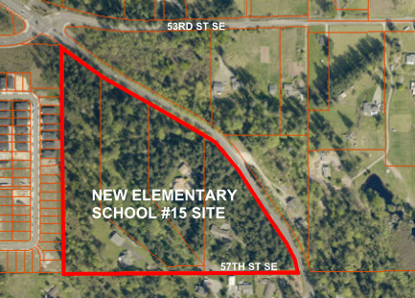
New Elementary School No. 15
Size and Capacity
74,000 SF
650 students
Pre-K to 5th grade
Site
22 acres
Wooded with
3 residences
Sloping terrain
Design
Single-story
Owner’s GMP Budget
$38,000,000
Schedule
Began design May 2018
Begin construction May 2019
Occupy August 2020
Notes:
Dick Scobee Elementary School will be the first school replaced under this program.
The school is named after Auburn resident and astronaut Dick Scobee, who died while commanding the space shuttle Challenger in 1986.
Dick Scobee being replaced first because it has the highest enrollment of the 4 replacement schools. School enrollment is the methodology used in determining the sequence of the replacement schools.
A feature unique to Dick Scobee is that is located on a busy arterial street with minimal area for on-site parking, bus loading and parent pick up. This busy street will create a construction access and traffic challenges for the contractor.

Slide 15
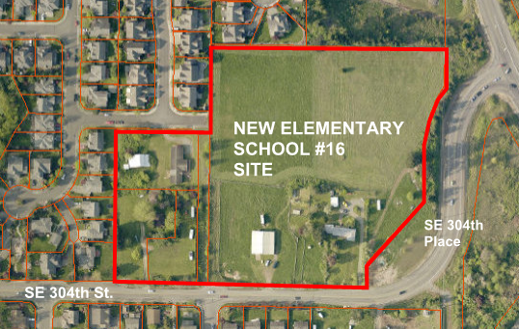
New Elementary School No. 16
Size and Capacity
74,000 SF
650 students
Pre-K to 5th grade
Site
10.5 acres
Pasture land with
3 residences
Minor sloping
terrain.
Design
Two-story
Owner’s GMP Budget
$35,000,000
Schedule
Begin design January 2019
Begin construction April 2020
Occupy August 2021
Notes:
Dick Scobee Elementary School will be the first school replaced under this program.
The school is named after Auburn resident and astronaut Dick Scobee, who died while commanding the space shuttle Challenger in 1986.
Dick Scobee being replaced first because it has the highest enrollment of the 4 replacement schools. School enrollment is the methodology used in determining the sequence of the replacement schools.
A feature unique to Dick Scobee is that is located on a busy arterial street with minimal area for on-site parking, bus loading and parent pick up. This busy street will create a construction access and traffic challenges for the contractor.

Slide 16
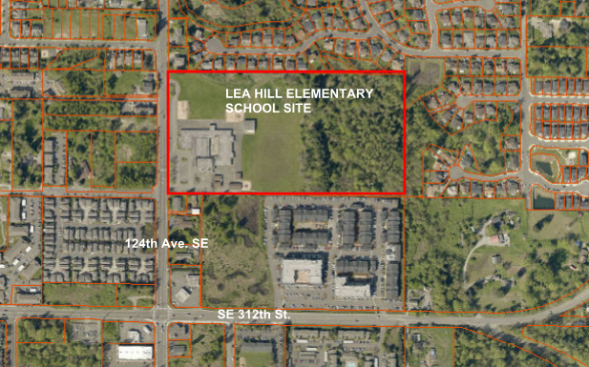
Lea Hill Elementary School Replacement
Size and Capacity
74,000 SF
650 students
Pre-K to 5th grade
Site
20 acres – approx.
11 acres buildable
Existing school site
Design
One or two-story
Owner’s GMP Budget
$35,000,000
Schedule
Begin design January 2020
Begin construction July 2021
Occupy August 2022
Notes:
Dick Scobee Elementary School will be the first school replaced under this program.
The school is named after Auburn resident and astronaut Dick Scobee, who died while commanding the space shuttle Challenger in 1986.
Dick Scobee being replaced first because it has the highest enrollment of the 4 replacement schools. School enrollment is the methodology used in determining the sequence of the replacement schools.
A feature unique to Dick Scobee is that is located on a busy arterial street with minimal area for on-site parking, bus loading and parent pick up. This busy street will create a construction access and traffic challenges for the contractor.

Slide 17
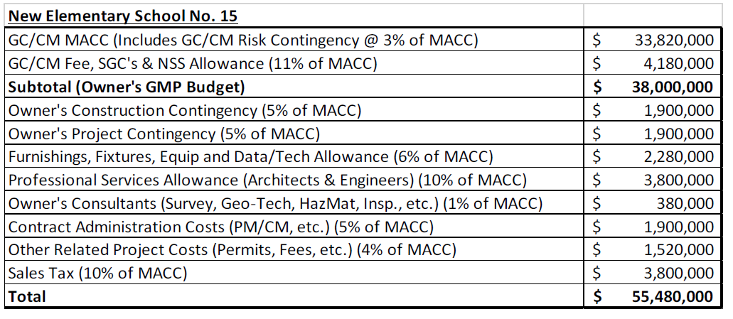
Elementary School No. 15 Project Budget
Notes:
Highlights for the Dick Scobee budget are:
Budgeted $42.3M for the project.
Established an Owner’s MACC of $29M.

Slide 18
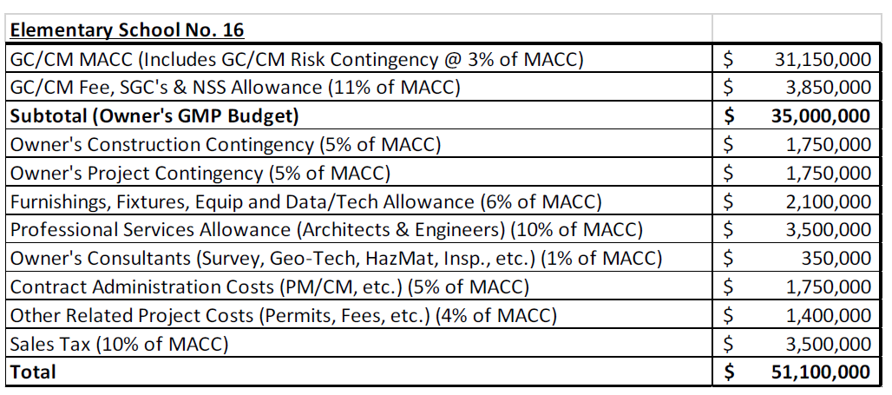
Elementary School No. 16 Project Budget
Notes:
Pioneer Elementary Budget:
Budgeted $43.8M for the project.
Established an Owner’s MACC of $30M.
Primary reason for increase over Dick Scobee is inflation costs.

Slide 19
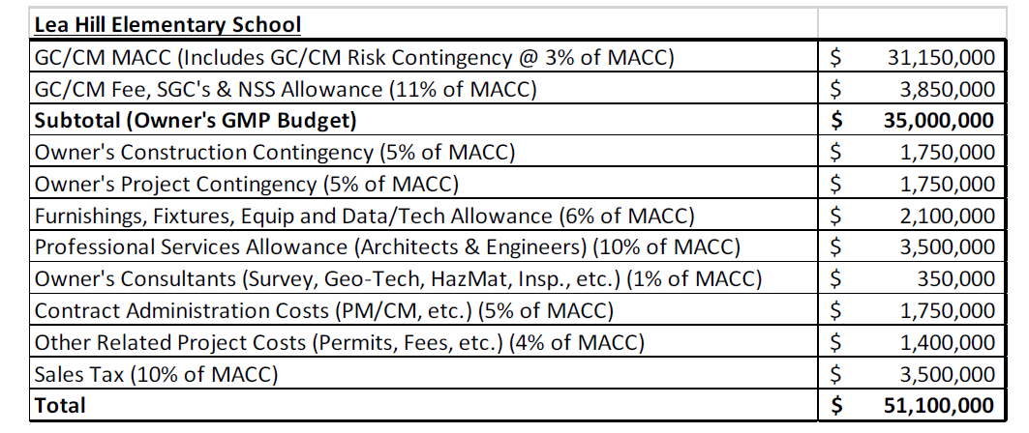
Lea Hill Elementary School Project Budget
Notes:
Chinook Elementary Budget:
Budgeted $45.2M for the project.
Established an Owner’s MACC of $31M.
Inflation has increased cost over prior project.

Slide 20
GC/CM PROCUREMENT SCHEDULE
Task | Date
Presentation to the PRC | May 24, 2018
Release GC/CM RFP | May 29, 2018
RFP Submittals Due | June 14, 2018
Shortlist Candidates and Send Interview Invitation | June 16, 2018
Interviews | July 2, 2018
Identify Most-Qualified Candidates and Release GC/CM RFFP | July 3, 2018
RFFP Opening and Selection of GC/CM | July 12, 2018
Early Services Contract | July 16, 2018 – Aug. 15, 2018
Pre-Con Work Plan Due | August 3, 2018
School Board Approval of Selected GC/CM | August 13, 2018
Pre-Con Agreement Executed | August 15, 2018
Pre-Con Services – Elementary School No. 15 | July 2018 – Mar. 2019
Pre-Con Services – Elementary School No. 16 | Jan. 2019 – Mar. 2020
Pre-Con Services – Lea Hill Elementary School | Jan. 2020 – May 2021
Notes:
Our GCCM procurement schedule is set up to move expeditiously through the GCCM selection process so that the GCCM will be on board prior to the start the design phase for the first project.
Schedule shown here includes minor revision to the Pre-Con. Services dates from that shown in the PRC application.
The revision increases the duration of the pre-con. phases from 9 to 12 months.
Under this schedule, the GCCM’s Pre-con. manager will provide pre-con. services for a project from January to December, then start work pre-con. work on the next project the following January.
This will provide continuity and a smooth work flow without overlapping pre-con services from project to project.

Slide 21
Program Schedule
ELEMENTARY SCHOOL NO. 15 | Start | Finish
Schematic Design | May. 2018 | July 2018
Design Development | Aug. 2018 | Sept. 2018
Construction Documents | Oct. 2018 | Mar. 2019
Permitting | Dec. 2018 | Apr. 2019
Subcontract Bidding | Mar. 2019 | Apr. 2019
Construction | May 2019 | June 2020
Owner Move-in | July. 2020 | July. 2020
Final Completion | Aug. 2020 | Aug. 2020
First Day of School | Sept. 2020 | Sept. 2020
New Building Warranty Period | July 2020 | July 2021
ELEMENTARY SCHOOL NO. 16 | Start | Finish
Schematic Design | Jan. 2019 | Mar. 2019
Design Development | Apr. 2019 | June 2019
Construction Document | July 2019 | Jan. 2020
Permitting | Oct. 2019 | Mar. 2019
Subcontract Bidding | Jan. 2020 | Feb. 2020
Construction | Apr. 2020 | June 2021
Owner Move-in | July. 2021 | July 2021
Final Completion | Aug. 2021 | Aug. 2021
First Day of School | Sept. 2021 | Sept. 2021
New Building Warranty Period | July 2021 | June 2022
Notes:
The next two slides show the schedule for each project.
These schedules have updated the construction duration from the PRC application to show when the work will start on-site and be substantially complete.
This time period is from July to July.
Each of the 4 projects follows the same construction schedule.
School gets out for summer break the 3rd week in June.
ASD spends the last week of June moving out furniture, equipment and supplies.
GCCM begins abatement of hazardous material from existing buildings July 1.
Demolition of building can start when abatement done.
Construction of entire facility must be done by end of July the following year.
There will be one month of on-site construction overlap in the month of July between projects for 3 summers.
On one project, the GCCM will be wrapping work for building occupancy on one project while doing abatement work and site prep on another project.
We have reviewed this situation with GCCM contractors and confirmed they can effectively handle this overlap.

Slide 22
Program Schedule
LEA HILL ELEMENTARY SCHOOL REPLACEMENT | Start | Finish
Schematic Design | Jan. 2020 | Mar. 2020
Design Development | Apr. 2020 | June 2020
Construction Documents | July 2020 | Jan. 2021
Permitting | Oct. 2020 | Mar. 2021
Subcontract Bidding | Jan. 2021 | Feb. 2021
Construction | July 2021 | July 2022
Owner Move-in | Aug. 2022 | Aug. 2022
Final Completion | Aug. 2022 | Aug. 2022
First Day of School | Sept. 2022 | Sept. 2022
New Building Warranty Period | Aug. 2022 | June 2023
Notes:
This shows the project schedules for the 3rd and 4th projects: Chinook and Terminal Park.

Slide 23
Why GC/CM Delivery Method?
Notes:
We propose do use the GCCM delivery method for this 4 school program because:
It meets the intent of the legislature as identified in RCW 39.10.200.
It meets the criteria established in RCW 39.10.340 for use of GCCM procedures.
It will improve the potential for success of 4 projects.

Slide 24
GC/CM Project Criteria
Each project included in the three school program meets the following RCW criteria (in bold print):
Implementation of the project involves complex scheduling, phasing, or coordination.
The project involves construction at an occupied facility which must continue to operate during construction.
The involvement of the General Contractor/Construction Manager during the design stage is critical to the success of the project.
The project encompasses a complex or technical work environment.
The project requires specialized work on a building that has historic significance.
The project is, and the public body elects to procure the project as a heavy civil construction project.
Notes:
This show the criteria that our 4 school replacement projects meets for approval of the GCCM process.
In short, we meet the criteria of:
Complex scheduling and phasing.
Involvement of the GCCM during design for success of the project.

Slide 25
New Elementary School No. 15
Project requires an aggressive 14 month construction schedule.
Project includes extensive roadway improvements and utility line extensions at a busy 2-lane arterial, Kersey Way, while the road remains in operation.
Improvements include traffic signal, additional traffic lanes, curbs and gutters, sidewalks, landscaping, street lights, pavement restoration, retaining walls and storm drainage.
1/3 mile extension of new water and sewer lines within Kersey Way.
Traffic signal and road construction design and permitting must be approved by both City of Auburn and Pierce County.
Road improvements and utility extensions must be completed during a short two month summer construction period.
Failure to complete work on time will have a significant negative impact on traffic traveling to and from Auburn.
Completion of Elementary School No. 15 by the summer of 2020 is essential to relieve significant overcrowding at other elementary schools in the area.
By 2020, approximately 550 students in the area of the new school will attend classes in temporary portable classrooms.
A new school is needed for these students.
Short building construction time period combined with extensive roadway and off-site utility work creates complex and technical scheduling, coordination and work environment challenges.
Notes:
This show the criteria that our 4 school replacement projects meets for approval of the GCCM process.
In short, we meet the criteria of:
Complex scheduling and phasing.
Involvement of the GCCM during design for success of the project.

Slide 26
New Elementary School No. 16
Project requires an aggressive 14 month construction schedule.
Project includes roadway construction of curbs and gutters, sidewalks, landscaping, street lights, and pavement restoration at an arterial road, SE 304th St., while the road remains in operation.
It is essential the new school is completed and ready for students and staff by August 2021.
Timely completion is essential so the new building will be available for use as the interim elementary school for students and staff from the third project, Lea Hill Elementary School.
Failure to complete Elementary School No. 16 on time will delay the start of construction of Lea Hill Elementary School project.
Short building construction time period combined with roadway work and the absolute need to complete project on time creates critical scheduling, coordination and work environment challenges.
Notes:
This show the criteria that our 4 school replacement projects meets for approval of the GCCM process.
In short, we meet the criteria of:
Complex scheduling and phasing.
Involvement of the GCCM during design for success of the project.

Slide 27
Lea Hill Elementary School Replacement
Project requires an aggressive 13 month construction schedule.
Project includes abatement of hazardous materials and demolition of existing school buildings before construction on the new school building can begin.
This work reduces the time available for construction of the new facility.
Project includes roadway construction of curbs and gutters, sidewalks, landscaping, street lights, and pavement restoration at an arterial road, 124th Ave. SE, while the road remains in operation.
Completion of Lea Hill Elementary School by summer of 2022 is essential to allow Elementary School No. 16 to open for new students and relieve significant overcrowding at other elementary schools in the area.
By 2021, approximately 475 students in the area of the new school will attend classes in temporary portable classrooms.
Elementary School No. 16 must be available in 2021 for these students.
Short building construction time period combined with roadway work and the absolute need to complete project on time creates critical scheduling, coordination and work environment challenges.
Notes:
This show the criteria that our 4 school replacement projects meets for approval of the GCCM process.
In short, we meet the criteria of:
Complex scheduling and phasing.
Involvement of the GCCM during design for success of the project.

Slide 28
Other GC/CM Factors for Success
Involvement of a GC/CM during the design phase.
Selection of a contractor based upon skill, experience, team members and price.
Collaborative approach to the project.
Improved cost control.
Improved scheduling and phasing opportunities.
Improved market access to subcontractors and suppliers.
Potential for early bid packages.
Potential for early procurement of long-lead items.
Notes:
Utilization of the GC/CM process provides other opportunities for success of this 4 school replacement program. These are:
Potential for early bid packages.
Potential for early procurement of long-lead items.
Improved management of neighborhood access, egress and traffic during construction.
Improved management of complex off-site work in the public roadways.
Again, these are benefits that are not available or often missing on design/bid/build projects.

Slide 29
3 Projects – One GC/CM
Utilization of the GC/CM process for this 3 school program provides unique opportunities and benefits:
Ability to execute 3 similar and sequential projects with a common team of highly qualified individuals.
Continuity of project leadership for all 3 projects.
Planning and design efficiencies.
Potential for cost savings by GC/CM overhead reduction with 3 projects and one GC/CM.
Reduced learning curve.
On-going lessons learned.
Opportunity to establish a long-range plan for 3 sequential projects with input from and involvement with the same design team and GC/CM.
Notes:
It is important for you to know why are requesting your authorization to use the GCCM delivery method for a 4 project program.
The GC/CM process provides a unique opportunity to execute 4 similar and sequential projects with a common team of highly qualified individuals that includes one architect and one GCCM. This provides the opportunity for:
Common and consistent leadership for all 4 projects.
Cost savings by having same design team on all 4 projects.
Potential for cost savings in GC/CM overhead with one GCCM for 4 projects.
Planning and design efficiencies.
Construction management efficiencies.
Reduced learning curve.
On-going lessons learned.
Opportunity to establish and manage a long-range plan for 4 sequential projects with input from and involvement of the same design team and GC/CM.
Auburn School District, NAC and Parametrix are very excited about these opportunities and benefits of using GCCM for 4 sequential projects.

Slide 30
Summary
Program is funded with the appropriate budget.
Program meets criteria of RCW 39.10.
Team has the necessary experience and will provide leadership continuity for the 3 projects.
Team has the capacity for the 3 project program.
Team is prepared and ready to proceed.
Utilization of the GC/CM delivery method will provide multiple benefits for the school district and its citizens and contribute to the success of this 3 school program.
Notes:
In summary:
Program is funded and has an appropriate budget.
Program meets criteria of RCW 39.10.
Team has the necessary experience and will provide continuity for the 4 projects.
Team has the capacity for the 4 project program.
Team is prepared and ready to proceed.
Utilization of the GC/CM delivery method will provide multiple benefits for the school district and its citizens, and help ensure the success of this 4 school replacement program.
In closing:
ASD is proud of our history of successfully completing projects.
We measure this success by building our projects as promised to the community, finishing on time and within budget, and completing projects in a manner that is safe and minimizes disruptions of education and school district operations.
We believe the GCCM delivery method will held ensure success of this program. We also want this to be a model to show how use of GCCM can have added benefits when used on a multi-project program.

Slide 31
Thank you!
Notes:
Thank you for your time.
We look forward to your questions and deliberations.

