Slide 1

FOUR ELEMENTARY SCHOOL REPLACEMENT PROGRAM
Dick Scobee, Pioneer, Chinook and Terminal Park
Application to use the GC/CM Project Delivery Method
July 27, 2017
Our Mission: In a safe environment, all students will achieve high standards of learning in order to become ethically responsible decision makers and lifelong learners.
Notes:
Jeff Grose with ASD Capital Projects Department.
Thank you for opportunity to present our application for approval GC/CM delivery for our 4 Elementary School Replacement Program.

Slide 2
Introductions
Notes:
1. We will begin by introducing our team.

Slide 3
Project Team
Here today:
Jeffrey Grose, Executive Director of Capital Projects, Auburn School District
Steven M. Shiver, FAIA, LEED AP, Architect, Principal-in-Charge, NAC Architecture
Guy Overman, AIA, LEED AP, Architect, Lead Planner and Designer, NAC Architecture
James Dugan, GC/CM Advisor, Parametrix
Dan Cody, GC/CM Procurement Consultant, Parametrix
Also on the team:
Karee Loghry, AIA, LEED AP, Architect, Project Manager, NAC Architecture
Heidi Deaver, RA, LEED, AP, Architect, Project Architect, NAC Architecture
Graehm Wallace, Perkins Coie, GC/CM Legal Advisor
Notes:
Team members with me today are:
Jeffrey Grose, Executive Director of Capital Projects, Auburn School District
Steven M. Shiver, Principal-in-Charge, NAC Architecture
Guy Overman, AIA, Lead Planner and Designer, NAC Architecture
Jim Dugan, GC/CM Advisor, Parametrix
Dan Cody, GC/CM Procurement Consultant, Parametrix
Other important team members are:
Karee Loghry, Project Manager, NAC Architecture
Heidi Deaver, Project Architect, NAC Architecture
Graehm Wallace, Perkins Coie, GC/CM Legal Advisor
All of these individuals are highly skilled, have many years of experience and pleasure to work with.

Slide 4
Agenda
The District
The Program
Auburn School District Qualifications
Organization
Project Budgets
Project Schedules
Why GC/CM
Summary
Notes:
Agenda is similar to the agendas presented to you for other GCCM applications.
Our purpose today is to:
Provide information about ASD and our project team.
Tell you about our 4 elementary school replacement program.
Show you we have the resources and skills needed to successfully execute GCCM for this program.
Demonstrate why this program is eligible for and worthy of being approved for use of GCCM.

Slide 5
The District
Notes:
1. Next I would like to tell you a little bid about ASD.

Slide 6
District Statistics
62 square mile area bridging King and Pierce counties
Serves residents in Auburn, Algona, Pacific, Lake Tapps and unincorporated areas of King County
Began serving students in 1896
Current enrollment: 16,000 students
Twenty-two schools comprised of:
  14 Elementary Schools
  4 Middle School
  4 High Schools
Over 1,000 certified staff members and over 900 classified staff members
Notes:
ASD is located in south King County.
We are a middle size school district with 22 schools, 16,000 students and 1,900 staff members.
We have been around a long time. Our first school house was a log cabin built in 1869 by the families living in the area. It had a mud fire place and a floor of split cedar logs lying on the dirt.

Slide 7
District – 2016 Bond Program
Capital bond passed in 2016 - $456 M
2016 bond program includes:
  Replace Olympic Middle School (current GC/CM project)
  Replace 5 elementary schools (Chinook, Dick Scobee, Lea Hill, Pioneer and Terminal Park)
  Build 2 new elementary schools (Elementary School No. 15 and 16)
Bond Program - Phase 1: Replace Olympic MS. Currently in Design Development Phase. After the new Olympic MS is constructed, the existing building will be used as an interim school for the replacement school projects.
Bond Program – Phase 2: Replace 4 elementary schools (Dick Scobee, Pioneer, Chinook, Terminal Park).
Bond Program – Phase 3: Build 2 new elementary schools and replace one elementary school ( Lea Hill Elementary).
Notes:
This 4 elementary school replacement program is part of a $456M bond issue approved by the voters in 2016.
This GCCM program will be the second phase of the bond program.

Slide 8
Auburn School District Qualifications
Notes:
1. Next I would like to tell you the leadership team for this project and our GCCM experience.

Slide 9
Leadership Team
ASD has extensive, successful, K-12 capital projects experience including projects of similar scope and complexity.
  All of which have been delivered using Design-Bid-Build.
  Long track record of building projects on-time and within budget.
This program will ASD’s second opportunity to use GC/CM method of project delivery.
Assigned ASD PM: Executive Director of Capital Projects, Jeffrey Grose
  37 years heading the Capital Projects program at ASD.
  Degrees in architecture and building construction.
  Work experience with architectural firms, contractor and Owner.
  Certified Value Engineer.
  Arbitrator for AAA and member of Dispute Resolution Board Foundation.
  Completed AGC GC/CM Training Workshop in January 2017.
  Currently Owner’s PM for Olympic Middle School GC/CM project.
ASD hired Parametrix for GC/CM Procurement and Advisory services.
ASD retained Graehm Wallace as legal counsel with depth of GC/CM experience.
ASD hired NAC Architecture as the Architect. While NAC team does not have extensive GC/CM experience, the firm has considerable GC/CM extensive and the team for this program has proven, successful experience in design and construction of K-12 capital projects of this size and larger.
ASD satisfies the public body qualifications by staff augmentation with consultants.
Notes:
ASD has extensive construction experience including projects of larger scope and greater complexity.
We are proud of a long track record of completing our projects on-time and within budget.
I will manage the project for the school district during the pre-construction phase and will have in house staff supporting me. I will then utilize other staff members to administer the construction phase.
This slide shows my background..
One item to note is that I have completed AGC GC/CM Training Workshop.
ASD hired Parametrix as GCCM consultant and advisor.
ASD retained Graehm Wallace as GCCM legal counsel.
ASD hired NAC Architecture as the project architect. While our NAC team does not have extensive GC/CM experience:
The firm has completed a number of GC/CM projects.
NAC team has a reputation and history of working collaboratively with Owners and contractors on their design/bid/build projects. This approach is a natural fit for a GCCM program.
This team satisfies the public body qualification for staff augmentation with consultants.

Slide 10
Project Team
GC/CM Experience
Name | Experience
Jeffrey Grose Executive Director of Capital Projects Auburn School District | 42 Years Design / Construction / Project Management 36 years with Auburn School District. Over 100 projects completed varying from small modernization projects to $120M, highly-complex, multi-phase high school modernization and reconstruction project. 2nd GC/CM Project Completed AGC GC/CM Training Workshop in January 2017.
Jim Dugan GC/CM Advisor Parametrix | 39 Years Program / Project Management 14 GC/CM Projects: Appointed to the Project Review Committee July 1, 2016 – 3 Year Term
Dan Cody GC/CM Procurement and PM/CM Support Parametrix | 30 Years Program / Project Management 10 GC/CM Projects: Registered Architect in the State of Washington
Guy Overman, AIA, LEED AP Architect, Lead Planner/Designer NAC Architecture | 40 Years Specializing in Education Facility Design Services 1 GC/CM Project Extensive construction administration experience.
Notes:
This chart shows the level of project management and GCCM experience for key team members.
Every individual has extensive design, construction or project management experience.
A quick look shows each key team members has at least 3 decades of experience.
This is a seasoned group.

Slide 11
Organization
Notes:
The following organization chart identifies the roles and time commitment of the school district staff assigned to the project as well as the roles and commitment of our consultants.

Slide 12
Project Organization Chart
Notes:
Because ASD has initial experience on a GCCM project, we have been able to evaluate the amount of time needed by school district staff to manage the preconstruction phase of a GCCM project and used this wisdom in allocating time for this program.
However, I will add that ASD has the funds, resources, flexibility and administrative support to adjust or supplement staffing during the project if found to be necessary to ensure success of the program.
Bottom line – is that we will make sure we do whatever is necessary to successfully complete these projects.

Slide 13
The Program
Replacement of 4 Elementary Schools
Notes:
We have combined 4 replacement school projects into a single program to capitalize on the benefits of a having one design firm and one GCCM contractor to design and build 4 elementary schools in sequence, one per year.

Slide 14
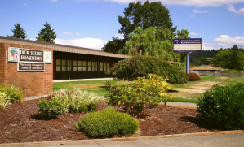
Dick Scobee Elementary School
REPLACEMENT SCHOOL
Existing School:
  Built in 1954
  62,700 SF
  517 students
New School:
  74,000 SF
  650 students
Site: 8.9 acres
Proposed Design: Single and 2-story building
Owner’s MACC: $29 M
Construction: July 2019 – July 2020
Occupancy: August 2020
Notes:
Dick Scobee Elementary School will be the first school replaced under this program.
The school is named after Auburn resident and astronaut Dick Scobee, who died while commanding the space shuttle Challenger in 1986.
Dick Scobee being replaced first because it has the highest enrollment of the 4 replacement schools. School enrollment is the methodology used in determining the sequence of the replacement schools.
A feature unique to Dick Scobee is that is located on a busy arterial street with minimal area for on-site parking, bus loading and parent pick up. This busy street will create a construction access and traffic challenges for the contractor.

Slide 15
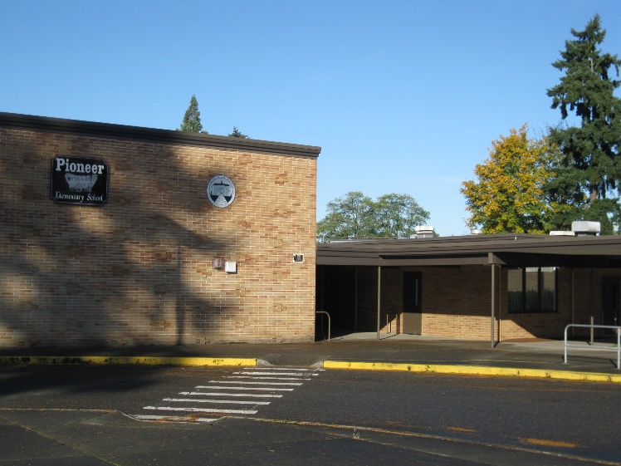
Pioneer Elementary School
REPLACEMENT SCHOOL
Existing School:
  Built 1959
  41,200 SF
  497 students
New School:
  74,000 SF
  650 students
Site: 11.1 acres
Proposed Design: Single and 2-story building
Owner’s MACC: $30 M
Construction: July 2020 – July 2021
Occupancy: August 2021
Notes:
Pioneer Elementary School will be the second school replaced.
The school is named in honor of the pioneer settlers of the Auburn valley where the school is located. These are the same settlers who built our first school house in 1869.
A feature unique to Pioneer is that the school district has been able to acquire an additional surrounding property to expand the site from 8 to 11 acres. That is the good new. On the challenging side, this will require the school district to rezone additional property. This requires a year and a half process – of which we have accommodated in our project schedule.

Slide 16
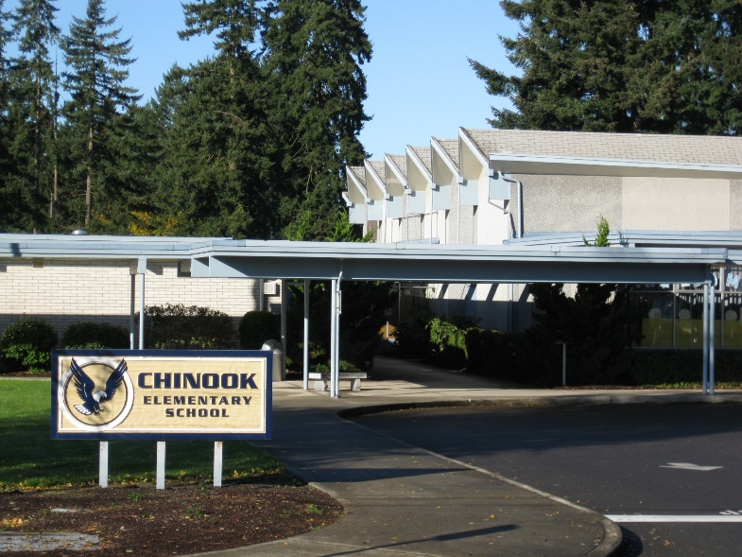
Chinook Elementary School
REPLACEMENT SCHOOL
Existing School:
  Built 1963
  43,200 SF
  488 students
New School:
  74,000 SF
  650 students
Site: 10.99 acres
Proposed Design: Single and 2-story building
Owner’s MACC: $31 M
Construction: July 2021 – July 2022
Occupancy: August 2022
Notes:
Chinook Elementary School will be the third school replaced.
The school is located on the Muckleshoot Indian Reservation and has proudly served native students and other Auburn School District students since 1963.
A feature unique to Chinook is that it is located on a busy state highway that will require upgrades as part of the project. This includes a traffic light, and half street improvements. The work must be done while the highway remains in operation and will be worthy challenge for the contractor.

Slide 17
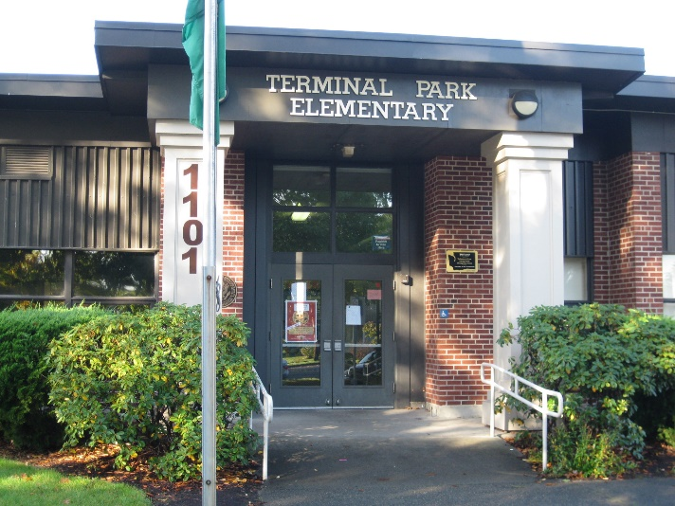
Terminal Park Elementary School
REPLACEMENT SCHOOL
Existing School:
  Built 1945
  38,700 SF
  466 students
New School:
  74,000 SF
  650 students
Site: 6.09 acres
Proposed Design: Single and 2-story building
Owner’s MACC: $30 M
Construction: July 2022 – July 2023
Occupancy: August 2023
Notes:
Terminal Park Elementary School will be the last school replaced as part of this program.
Auburn is a long-time railroad town with two major railroad lines passing through it.
Terminal Park was named for the terminal end of the railroad lines and the neighborhood where the rail workers lived.
A feature unique to Terminal Park is that is the smallest school site in the district at 6 acres. This will require well-thought out site coordination and phasing by the contractor.

Slide 18
Project Budgets
Notes:
I will briefly touch on the budgets established for these projects.
ASD has also sold a portion of the $456M bonds so we have funds in the bank to design and build Dick Scobee Elementary.
ASD will sell more bonds as needed for maintaining our cash flow.

Slide 19
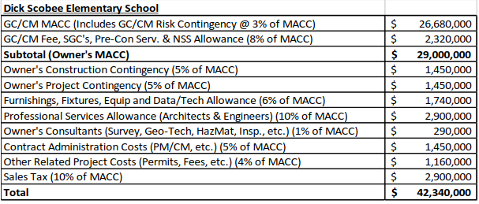
Dick Scobee Elementary School
Project Budget
Notes:
Highlights for the Dick Scobee budget are:
Budgeted $42.3M for the project.
Established an Owner’s MACC of $29M.

Slide 20
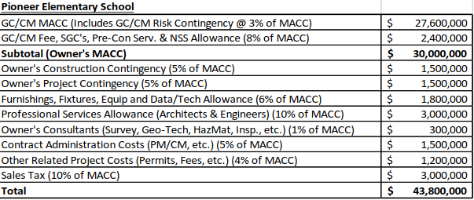
Pioneer Elementary School
Project Budget
Notes:
Pioneer Elementary Budget:
Budgeted $43.8M for the project.
Established an Owner’s MACC of $30M.
Primary reason for increase over Dick Scobee is inflation costs.

Slide 21
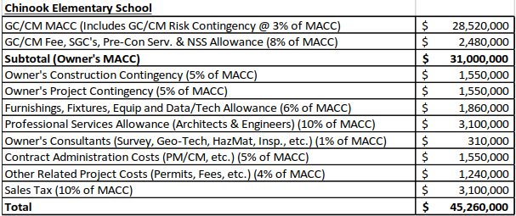
Chinook Elementary School
Project Budget
Notes:
Chinook Elementary Budget:
Budgeted $45.2M for the project.
Established an Owner’s MACC of $31M.
Inflation has increased cost over prior project.

Slide 22
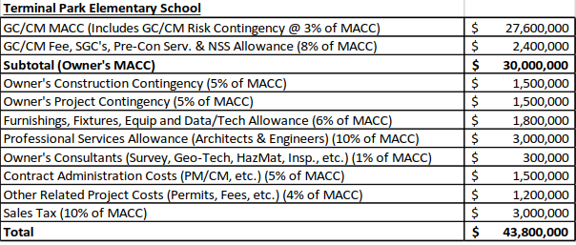
Terminal Park Elementary School
Project Budget
Notes:
Terminal Park Elementary Budget:
Budgeted $43.8M for the project.
Established an Owner’s MACC of $30M.
Project cost has decreased from prior project because Terminal Park requires less site and right-of-way improvements.

Slide 23
Project Schedules
Notes:
1. I will briefly review the GCCM Procurement Schedule and project schedule for each replacement school.

Slide 24
GC/CM PROCUREMENT SCHEDULE
Task | Date
Presentation to the PRC | July 27, 2017
Release GC/CM RFP | August 2, 2017
RFP Submittals Due | August 21, 2017
Shortlist Candidates and Send Interview Invitation | August 24, 2017
Interviews | Sept. 6, 2017
Identify Most-Qualified Candidates and Release GC/CM RFFP | Sept. 8, 2017
RFFP Opening and Selection of GC/CM | Sept. 25, 2017
Pre-Con Work Plan Due | Oct. 9, 2017
School Board Approval of Selected GC/CM | Oct. 23, 2017
Pre-Con Agreement Executed | Oct. 27, 2017
Pre-Con Services – Dick Scobee Elementary | Jan. – Dec. 2018
Pre-Con Services – Pioneer Elementary | Jan. – Dec. 2019
Pre-Con Services – Chinook Elementary | Jan. – Dec. 2020
Pre-Con Services – Terminal Park Elementary | Jan. – Dec. 2021
Notes:
Our GCCM procurement schedule is set up to move expeditiously through the GCCM selection process so that the GCCM will be on board prior to the start the design phase for the first project.
Schedule shown here includes minor revision to the Pre-Con. Services dates from that shown in the PRC application.
The revision increases the duration of the pre-con. phases from 9 to 12 months.
Under this schedule, the GCCM’s Pre-con. manager will provide pre-con. services for a project from January to December, then start work pre-con. work on the next project the following January.
This will provide continuity and a smooth work flow without overlapping pre-con services from project to project.

Slide 25
Project Schedule
Dick Scobee Elementary School | Start | Finish
Design | Nov. 2017 | Oct. 2018
Permitting | Sept. 2018 | Dec. 2018
Subcontract Bidding | Dec. 2018 | Jan. 2019
Owner Move-out | June 2019 | June 2019
Construction | July 2019 | July 2020
Owner Move-in | Aug. 2020 | Aug. 2020
Final Completion/Closeout | July 2020 | Aug. 2020
First Day of School | Sept. 2020 | Sept. 2020
New Building Warranty Period | July 2020 | July 2021
Pioneer Elementary School | Start | Finish
Design | Nov. 2018 | Oct. 2019
Permitting | Sept. 2019 | Dec. 2019
Subcontract Bidding | Dec. 2019 | Jan. 2020
Owner Move-out | June 2020 | June 2020
Construction | July 2020 | July 2021
Owner Move-in | Aug. 2021 | Aug. 2021
Final Completion/Closeout | July 2021 | Aug. 2021
First Day of School | Sept. 2021 | Sept. 2021
New Building Warranty Period | July 2021 | June 2022
Notes:
The next two slides show the schedule for each project.
These schedules have updated the construction duration from the PRC application to show when the work will start on-site and be substantially complete.
This time period is from July to July.
Each of the 4 projects follows the same construction schedule.
School gets out for summer break the 3rd week in June.
ASD spends the last week of June moving out furniture, equipment and supplies.
GCCM begins abatement of hazardous material from existing buildings July 1.
Demolition of building can start when abatement done.
Construction of entire facility must be done by end of July the following year.
There will be one month of on-site construction overlap in the month of July between projects for 3 summers.
On one project, the GCCM will be wrapping work for building occupancy on one project while doing abatement work and site prep on another project.
We have reviewed this situation with GCCM contractors and confirmed they can effectively handle this overlap.

Slide 26
Project Schedule (cont’d.)
Chinook Elementary School | Start | Finish
Design | Nov. 2019 | Oct. 2020
Permitting | Sept. 2020 | Dec. 2020
Subcontract Bidding | Dec. 2020 | Jan. 2021
Owner Move-out | June 2021 | June 2021
Construction | July 2021 | July 2022
Owner Move-in | Aug. 2022 | Aug. 2022
Final Completion/Closeout | July 2022 | Aug. 2022
First Day of School | Sept. 2022 | Sept. 2022
New Building Warranty Period | July 2022 | June 2023
Terminal Park Elementary School | Start | Finish
Design | Nov. 2020 | Oct. 2021
Permitting | Sept. 2021 | Dec. 2021
Subcontract Bidding | Dec. 2021 | Jan. 2022
Owner Move-out | June 2022 | June 2022
Construction | July 2022 | July 2023
Owner Move-in | Aug. 2023 | Aug. 2023
Final Completion/Closeout | July 2023 | Aug. 2023
First Day of School | Sept. 2023 | Sept. 2023
New Building Warranty Period | July 2023 | June 2024
Notes:
This shows the project schedules for the 3rd and 4th projects: Chinook and Terminal Park.

Slide 27
Why GC/CM Delivery Method?
Notes:
We propose do use the GCCM delivery method for this 4 school program because:
It meets the intent of the legislature as identified in RCW 39.10.200.
It meets the criteria established in RCW 39.10.340 for use of GCCM procedures.
It will improve the potential for success of 4 projects.

Slide 28
GC/CM Statutory Criteria
Implementation of the project involves complex scheduling, phasing, or coordination.
The project involves construction at an occupied facility which must continue to operate during construction.
The involvement of the General Contractor/Construction Manager during the design stage is critical to the success of the project.
The project encompasses a complex or technical work environment.
The project requires specialized work on a building that has historic significance.
The project is, and the public body elects to procure the project as a heavy civil construction project.
Notes:
1. The information shown here reiterates what everyone of you already knows – that is RCW criteria for execution of a GCCM project by a public agency.

Slide 29
GC/CM Project Criteria
Four Elementary School Replacement Program
Implementation of the project involves complex scheduling, phasing, or coordination.
The project involves construction at an occupied facility which must continue to operate during construction.
The involvement of the General Contractor/Construction Manager during the design stage is critical to the success of the project.
The project encompasses a complex or technical work environment.
The project requires specialized work on a building that has historic significance.
The project is, and the public body elects to procure the project as a heavy civil construction project.
Notes:
This show the criteria that our 4 school replacement projects meets for approval of the GCCM process.
In short, we meet the criteria of:
Complex scheduling and phasing.
Involvement of the GCCM during design for success of the project.

Slide 30
Critical Phasing
Critical phasing occurs because of the dependency among all four projects included in this GC/CM program.
  The replacement schools will be built sequentially, one per year.
  The students and staff from each school will be housed at the old Olympic MS as an interim school during construction of the replacement school.
  The old Olympic MS will only accommodate one interim school at a time.
  Failure to complete a project on time will delay occupancy and interfere with the start and completion of the following replacement schools.
Notes:
Critical phasing occurs because to the dependency among all four projects included in this GC/CM program.
The replacement schools will be built sequentially, one per year.
The students and staff from each school will be housed at the old Olympic MS at an interim school during construction of the replacement school.
The old Olympic MS will only accommodate one interim school at a time.
Failure to complete a project on time will delay occupancy and interfere with the start and completion of the following replacement schools.
A GCCM contractor can assist the school district during both the design and construction stage to successfully phase the project.

Slide 31
Complex Scheduling
Complex scheduling occurs because of the short duration in which each project must be built and made ready for occupancy.
  The 4 replacement schools will be built on the site of each existing school.
  The existing sites will not accommodate the start of building demolition and site preparation prior to the end of the school year.
  Each project requires an aggressive construction schedule.
  Each school must be built within 13 months – from July to July. This includes:
    Abatement of hazardous materials from the existing school buildings.
    Demolition of existing buildings and parking lots.
    Construction of new 74,000 square foot facility and extensive site improvements.
    Construction of utility line relocations, utility line extensions and street improvements.
Notes:
Complex scheduling occurs because of the short duration in which each project must be built and made ready for occupancy.
The 4 replacement schools will be built on the site of each existing school.
The existing sites will not accommodate the start of building demolition and site preparation prior to the end of the school year.
Each school must be built within 13 months – from July to July.
As with critical phasing, a GCCM contractor can assist the school district during both the design and construction stage to successfully address complex scheduling.

Slide 32
Involvement of GC/CM during Design Phase
Involvement of a GC/CM during the design phase will provide benefits that are critical to the success of this 4 project program.
    Selection of a contractor based upon skill, experience, team members and price.
    Collaborative approach to the project.
    Improved cost control.
    Improved scheduling and phasing opportunities.
    Improved market access to subcontractors and suppliers.
    Risk reduction.
Notes:
Involvement of a GC/CM during the design phase will provide benefits that are critical to the success of this 4 project program. These are GCCM benefits you are well aware of and are benefits that are often missing in design/bid/build projects.
Selection of a contractor based upon skill, experience, team members and price.
Collaborative approach to the project.
Improved cost control.
Improved scheduling and phasing opportunities.
Improved market access to subcontractors and suppliers.
Risk reduction.

Slide 33
Other GC/CM Factors for Success
Utilization of the GC/CM process provides other opportunities for success of this 4 school replacement program.
  Potential for early bid packages.
  Potential for early procurement of long-lead items.
  Improved management of neighborhood access, egress and traffic during construction.
  Improved management of complex off-site work in the public roadways.
Notes:
Utilization of the GC/CM process provides other opportunities for success of this 4 school replacement program. These are:
Potential for early bid packages.
Potential for early procurement of long-lead items.
Improved management of neighborhood access, egress and traffic during construction.
Improved management of complex off-site work in the public roadways.
Again, these are benefits that are not available or often missing on design/bid/build projects.

Slide 34
4 Projects – One GC/CM
Utilization of the GC/CM process for this 4 school replacement program provides a unique opportunity to execute 4 similar and sequential projects with a common team of highly qualified individuals. This provides the opportunity for:
  Continuity of project leadership for all 4 projects.
  Cost savings by having same design team on all 4 projects.
  Potential for cost savings by GC/CM overhead reduction with 4 projects and one GC/CM.
  Planning and design efficiencies.
  Reduced learning curve.
  On-going lessons learned.
  Opportunity to establish a long-range plan for sequential 4 projects with input from and involvement with the same design team and GC/CM.
Notes:
It is important for you to know why are requesting your authorization to use the GCCM delivery method for a 4 project program.
The GC/CM process provides a unique opportunity to execute 4 similar and sequential projects with a common team of highly qualified individuals that includes one architect and one GCCM. This provides the opportunity for:
Common and consistent leadership for all 4 projects.
Cost savings by having same design team on all 4 projects.
Potential for cost savings in GC/CM overhead with one GCCM for 4 projects.
Planning and design efficiencies.
Construction management efficiencies.
Reduced learning curve.
On-going lessons learned.
Opportunity to establish and manage a long-range plan for 4 sequential projects with input from and involvement of the same design team and GC/CM.
Auburn School District, NAC and Parametrix are very excited about these opportunities and benefits of using GCCM for 4 sequential projects.

Slide 35
Summary
Program is funded with the appropriate budget.
Program meets criteria of RCW 39.10.
Team has the necessary experience and will provide continuity for the 4 projects.
Team has the capacity for the 4 project program.
Team is prepared and ready to proceed.
Utilization of the GC/CM delivery method will provide multiple benefits for the school district and its citizen, and help ensure the success of this 4 school replacement program.
Notes:
In summary:
Program is funded and has an appropriate budget.
Program meets criteria of RCW 39.10.
Team has the necessary experience and will provide continuity for the 4 projects.
Team has the capacity for the 4 project program.
Team is prepared and ready to proceed.
Utilization of the GC/CM delivery method will provide multiple benefits for the school district and its citizens, and help ensure the success of this 4 school replacement program.
In closing:
ASD is proud of our history of successfully completing projects.
We measure this success by building our projects as promised to the community, finishing on time and within budget, and completing projects in a manner that is safe and minimizes disruptions of education and school district operations.
We believe the GCCM delivery method will held ensure success of this program. We also want this to be a model to show how use of GCCM can have added benefits when used on a multi-project program.

Slide 36
Thank you!
Notes:
Thank you for your time.
We look forward to your questions and deliberations.

