Slide 1
Bainbridge High School: Building 100 Replacement & Modernizations
Application to use the GC/CM Project Delivery Method
July 26, 2018
Our Mission: “strong MINDS, strong HEARTS, strong COMMUNITY”
Ensure every student is future ready!
Notes:
Good day: I’m Jim Dugan, Master of the Universe and today’s facilitator for Bainbridge Island’s School District’s Capital Projects Department
Thank you for opportunity to present our application for approval GC/CM delivery for our Bainbridge High School Bldg. 100 Replacement Project.

Slide 2
Agenda:
Introductions
District Statistics
The Project
Project Budget
Project Schedule
Why GC/CM
Qualifications-Public Body
Organization- Project Team
Summary
Notes:
Today’s agenda is to:
Provide information about Bainbridge Island SD and our project team.
Tell you about our planned High School replacement program.
Demonstrate why this program is eligible for and worthy of being approved for use of GCCM.
Show you we have the, personnel, resources, and skills needed to successfully execute GCCM for this program.

Slide 3
Team Introductions
Notes:
1. We will begin by introducing our team...

Slide 4
Project Team: Here today
Bainbridge Island School District:
Tamela VanWinkle – Executive Director, Capital Projects & Facilities
Christy Barrie – Manager, Capital Projects; Project Manager
Parametrix:
Jim Dugan – Program Manager, GC/CM Advisor
Mahlum Architects:
Corrie Rosen – Principal
Ilva Wilson – AIA, LEED AP BD+C: Project Manager
Notes:
Team members with me today are:
Myself; Tamela VanWinkle, Executive Director of Capital Projects, Bainbridge Island School District
Christy Barrie, Project Manager and Manager of Capital Projects, BISD
JoAnn Wilcox, AIA, LEED AP; Design Principal with Mahlum Architects
Other important team members are our Design Team and Consultants;
Jim Dugan, Parametrix; providing GC/CM Advisory services and Program Management
Ilva Wilson, Mahlum Architects; Project Architect
c. Chester Weir, Mahlum Architects, Project Manager on the architect side, who will manage the project with Christy.

Slide 5
Additional Team Members (Not Presenting): Parametrix:
Jesse Noga – Project Manager: GC/CM Procurement
Maggie Anderson– Project Controls and Support: GC/CM Procurement
Mahlum Architects:
David Mount – AIA, LEED AP: Principal in Charge
Dwayne Epp – Project Specifications / Quality Review & Controls
JoAnn Wilcox– AIA, LEED AP: Design Principal, Project Architect
Perkins Coie Law:
Graehm Wallace – External D/B Legal Counsel
Notes:
Team members not presenting with us today are:
Dwayne Epp, Project Coordinator/ Quality control with Mahlum Architects
Chester Weir, Project Manager with Mahlum Architects.
Jesse Noga, Parametrix, Project Manager; GC/CM Procurement
Maggie Anderson, Parametrix, Project Controls
Graehm Wallace, Legal counsel, Perkins Coie
Our Consultants and sub consultants share our vision about the project; all of these individuals are highly skilled, have many years of experience with GC/CM and other delivery methods, and are a pleasure to work with.

Slide 6
Bainbridge Island School District
Notes:
1. Next I would like to tell you a little bit about Bainbridge Island School District.

Slide 7
School District Statistics
Located in Kitsap County
Services the City & island townships of Bainbridge Island
Began serving Students in 1861
510 Teachers, Administrators & Support Staff members
Current Student Enrollment: 3785 students as of May 2017
Seven (7) Schools, comprised of:
Three Elementary Schools
One Intermediate School
One Middle School
One High School
One ‘Options’ School (serves K-12)
Capital Bond passed in 2016: $81.2M; covers Blakely ES Replacement, Bainbridge HS Bldg. 100 Replacement, Essential Renovations
Notes:
Bainbridge Island School District is located in Kitsap County.
We are a small-sized school district with 7 schools, less than 4000 students and just over 500 staff members.
We have been around a long time. Our first school house was built in 1861 by the families living in the area. We have a storied history of community support and involvement around education.
Bainbridge Island HS is one of the top ranked schools in the nation, as rated by both Newsweek and US News & World Report
BISD had a capital bond passed in 2016 for $81.2 Million, which covered Blakely Elementary School (GC/CM currently under construction), Bainbridge high School, and Misc. Capital Projects. This project will use funding from that Bond.

Slide 8
Bainbridge High School GC/CM Delivery Program
Notes:
For our High School Project, we have elected to use the GC/CM Delivery Method

Slide 9
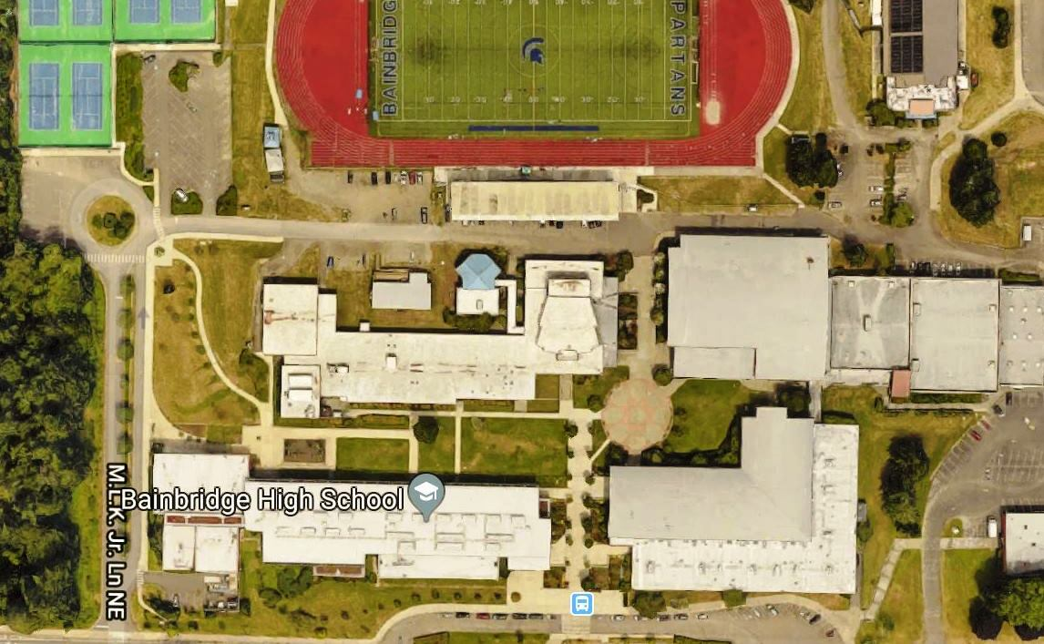
Overall Site Plan: Existing Campus
Notes:
This is our campus as it exists today. As you can see, there are tight areas with minimal space to use as laydown area, as well as areas which will need to remain accessible to the public while construction is underway.
Multiple areas on the site are meant to remain occupied wherever practical to do so, until completion.
We have combined these multiple project pieces within a design strategy and plan to enter into a phased program to capitalize on the benefits of a having one design firm and one GCCM contractor to design and build the necessary spaces in sequence without negative impact to the community.

Slide 10
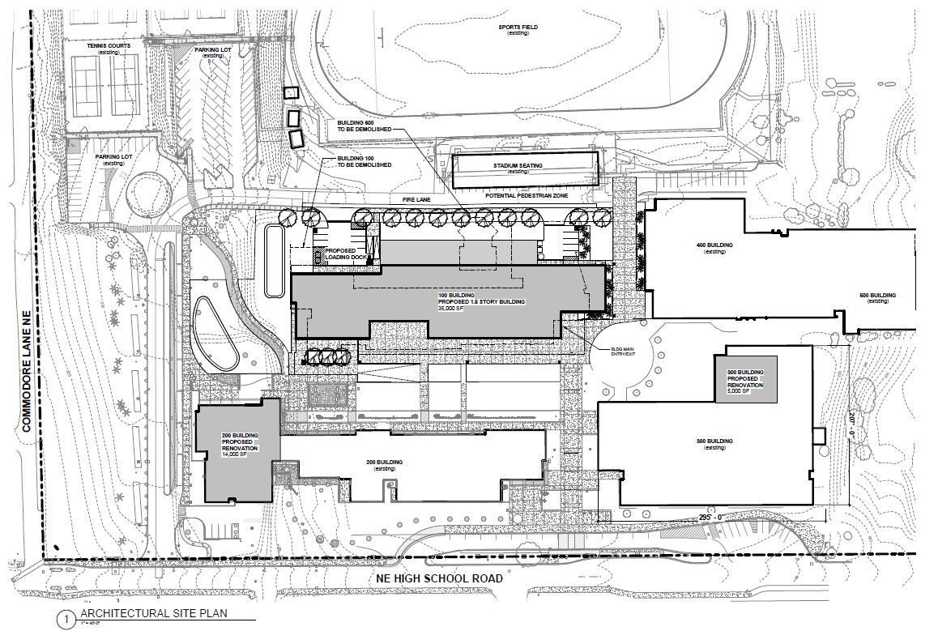
Overall Site Plan: Architectural Plans
Bldg. 100
Bldg. 200
Bldg. 300
Notes:
This drawing shows construction areas as identified by the design team, and associated square footage with each portion of the project.
As you can tell, the footprint of Bldg. 100 is to be reduced; with the current building being abated/ demolished- including the existing theater seen in the satellite image of Bldg. 100.
The yet-to-be-constructed School’s theater is set to be constructed in existing commons space as a phased-in tenant improvement at the end of this project.

Slide 11
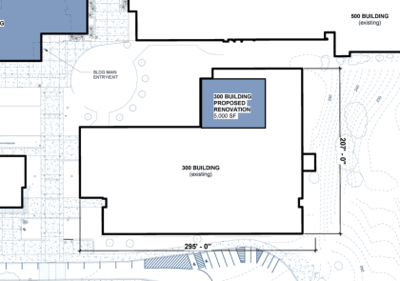
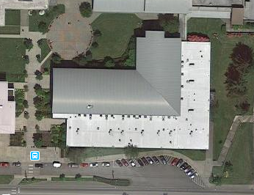
Phase 1: Building 300 SPED Renovations
Scope:
Existing Building Interior Modifications to accommodate new Special Education Space
Schedule
Began Construction Design January 2018
Begin Construction June 2019
Construction Completion September 2019
Notes:
To begin with, we will need to have the selected GC/CM immediately start renovating Special Education spaces in the existing Bldg. 300 at the area shown by the arrows on your slide.
These spaces MUST be completed prior to demolition of Bldg. 100, as the staff and students using it are currently housed in Bldg. 100 and need to move in prior to demolition.
Current (tentative) construction schedule dates are listed; subject to adjustment by GC/CM once design is complete.

Slide 12
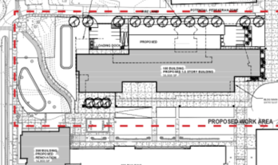
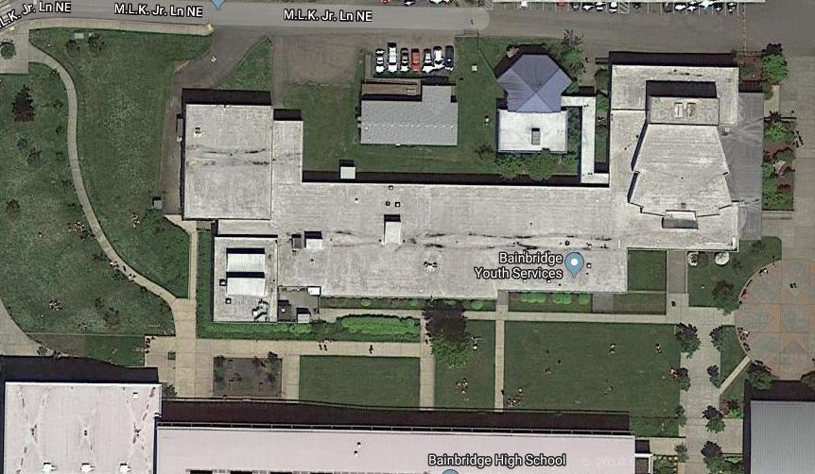
Phase 2: Building 100 Demo & Replacement
Size and Capacity
35,000 SF
3900 students
Serves 9th-12th Grade
Site
Bldg. 100 site is approx. 2.5 acre
Lightly wooded with adjacent residences
Developed terrain with light civil work
Schedule
Began Design January 2018
Begin Construction September 2019
Construction Completion/Occupy January 2021
Notes:
Our primary goal is to demolish our existing Building 100, and construct a new building in its place to be ready for the second half of the 2021 school year

Slide 13
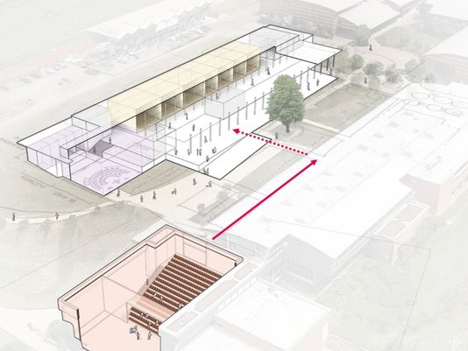
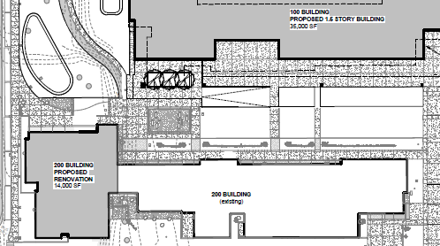
Phase 3: Bldg. 200 Renovations
Scope
Misc. Renovations to area formerly occupied by Kitchen. Kitchen being moved to new Bldg. 100
Future Theater Renovation
Schedule
Begin Design January 2018
Begin Construction January 2021
Complete Construction June 2021
Occupy June 2021
Note: Total funding still being procured for Bldg. 200 Theater Renovation, although design phase is funded and underway; new Levy planned for Feb 2019 to cover any additional costs over current
Notes:
Included in our design plans is the renovation of current commons space in Building 200 on campus, to construct a new theater in the commons space due to the demolition of the existing School Theater at Building 100.
Funding is still being procured to be sure the theater can move from Design to Construction by primary construction start of Bldg. 100, or before it’s completed. Design of the theater space was approved by our Board using funding from the previous bond measure.
Multiple methods of fund raising are being considered for use on thr theater portion of this project; from allowances of savings on other phase work via Value Engineering on Bldg. 100, naming rights, to donations, future bond measures, etc.

Slide 14
Project Budget
GC/CM Budget | $23,136,059
GC/CM Risk Contingency (3% of MACC) | $694,081
GC/CM MACC (Including GC/CM Risk Contingency @ 3% of MACC) | $23,830,140
GC/CM Fee, SGC's & NSS Allowance (11% of MACC) | $2,544,966
Subtotal | $27,069,187
Owner's Construction Contingency (5% of MACC) | $1,156,803
Furniture, Fixtures, Equip. & Data Allowance (6% of MACC) | $1,388,164
Professional Services Allowance (Architects & Engineers) (10% of MACC) | $2,313,606
Owner's Consultants (Survey, Geo-Tech, HazMat, Test & Inspect) (1% of MACC) | $231,361
Contract Administration Costs (PM/CM, etc.) (5% of MACC) | $1,156,803
Other Related Project Costs (Permits, Fees, etc.) (4% of MACC) | $925,442
WA State Sales Tax (Calculated @ 10% of MACC- Current WSST @9%; however, project extends to 2021 and could see tax increases) | $2,313,606
Total Project Budget | $36,554,972
Notes:
Here’s a snapshot of our project budget, including significant contingency to allow for market escalation, etc.

Slide 15
GC/CM PROCUREMENT SCHEDULE
PRC Application | 6/20/2018
PRC Presentation | 7/26/2018
First publication of RFP for GC/CM Services | 7/30/2018
Second publication of RFP for GC/CM Services | 8/6/2018
Project Information Meeting (Date subject to change.) | 8/9/2018
Last Day for questions to be submitted | 8/10/2018
Addendum to RFP issued | 8/13/2018
RFP Submittal Deadline | 8/15/2018
Review & Score Submittals Received | 8/16/2018
Notify Submitters of Most Highly Qualified Submitters Invite to Interview | 8/16/2018
Interviews with Short‐Listed Firms | 8/23/2018
Notify Submitters of Most Highly Qualified Firms & Invited to Submit RFFP | 8/24/2018
Last day for questions to be submitted | 8/29/2018
Addendum to RFFP issued | 8/31/2018
RFFP Submittal Deadline & Opening | 9/7/2018
Notify Submitters of Scoring and Most Qualified GC/CM | 9/7/2018
Early Services Contract with GC/CM | 9/10/2018
Pre‐Con Work Plan Due | 9/21/2018
School Board Approval of GC/CM Selection | 9/13/2018
GC/CM Agreement w/ Pre‐Con Services Executed | 9/21/2018
Notes:
Our GCCM procurement schedule is set up to move expeditiously through the GCCM selection process so that the GCCM will be on board prior to the start the design phase for the project.
Bid schedules are tight due to rapid-paced market conditions and the need to match Board approval schedules, begin construction with enough time for substantial completion prior to the new School Year.
The Schedule shown here includes phasing placeholders for expected starts/completion of phase work; to be validated and adjusted through design completion and contract awarding.
Under this schedule, the GCCM’s Preconstruction Manager (if applicable) will provide pre-con services including Bldg. 300 renovation, Bldg. 100 Abatement, and possibly pre-con work at Bldg. 200.

Slide 16
Phase 1 Project Schedule: Bldg. 300 Renovations
Schedule Item | Start | Finish
Programming (Ed Specs) | January 2018 | June 2018
Schematic Design | June 2018 | September 2018
Design Development | October 2018 | January 2019
Construction Documents | February 2019 | August 2019
Site Development Review | May 2019 | August 2019
Building Department Review/Permitting | May 2019 | August 2019
Negotiate GMP (90% CDs) | June 2019 | June 2019
Early Bid Packages | June 2019 | June 2019
Subcontract Bidding | July 2019 | August 2019
Building 300 Construction | June 2019 | September 2019
Owner Building 300 Move‐in | September 2019 | October 2019
Warranty | September 2019 | August 2020
Notes:
The next few slides show the schedule for each phase
Each component of our project follows the same construction schedule with regard to Design/Development.
These schedules updated construction durations to show approximately when the work will start on-site, and be substantially complete.
For the first portion of our work this time period is from Jun to Sept 2019.
Our project begins with a renovation at Bldg. 300, to renovate space for SPED classrooms which will allow students and staff to relocate from Bldg. 100 prior to its demolition.
School gets out for summer break in mid-June.
GCCM begins abatement of hazardous material (if any) from existing buildings starting upon the end of the school year.
Renovation of building can start following any abatement and/or demo being done.
Construction of entire facility must be substantially complete before demolition of Bldg. 100 to allow for Owner move-in to new spaces.
There will be on-site construction overlap in the month of June-September between phases. The GCCM will be wrapping work for building occupancy on one project while doing abatement work and site prep on another project.
We have plans to review this situation with GCCM contractors and confirm through the procurement process which can most effectively handle the overlapping activity.

Slide 17
Why GC/CM Delivery Method
Notes:
We propose do use the GCCM delivery method for this program because:

Slide 18
GC/CM Project RCW Criteria:
* This Project meets 3 items of 6 criteria for GC/CM Delivery per RCW 39.10.340:
Implementation of the project involves complex scheduling, phasing, or coordination.
The project involves construction at an occupied facility which must continue to operate during construction.
The involvement of the General Contractor/Construction Manager during the design stage is critical to the success of the project.
The project encompasses a complex or technical work environment
The project requires specialized work on a building that has historic significance.
The project is, and the public body elects to procure the project as a heavy civil construction project.
Notes:
This shows the criteria that our school replacement project meets RCW 39.10.340 for use of GCCM procedures:
In short, we meet the criteria of:
Complex Scheduling and Phasing.
b. Construction at an Occupied Facility
Involvement of the GCCM during design for success of the project.
Complex Work Environment with multiple businesses, owners, and public agency
We believe GCCM best provides the potential for success of the project work and will bring the best value to the Bainbridge Island School District and Public Community.

Slide 19
Phase 1: Special Education Classroom Remodel: Bldg. 300
Project requires an aggressive 3 month construction schedule.
Project includes work in an existing building with active summer programming; mobilization could occur while the school is still occupied for start of project/demolition as permitted; possibly while the school remains in operation.
Failure to complete work on time will have a significant negative impact on Building 100 work; Tenant Improvements need to be complete, with occupancy given for students to be relocated to Bldg 300 from 100 prior to its demolition.
Completion of Bainbridge High School Bldg. 100 by the end of 2020 is essential.
A short building construction time period, combined with extensive on-site work creates complex and technical scheduling, coordination and work environment challenges. The GC/CM will be responsible.
Notes:
The next few slides show more phase specific information about why we believe GC/CM is most appropriate for this project.

Slide 20
Bainbridge High School Bldg. 100 Replacement
Project includes Stormwater treatment, Utility connections, Service lanes, Accessibility, Lighting, and Landscaping within confines of existing campus.
Project to include abatement period of hazardous materials, and demolition of existing school buildings before major construction on the new school building can begin.
Building construction time periods, combined with roadway, outdoor space construction and associated landscaping work; combined with the absolute need to complete project on time creates critical scheduling, coordination and work environment challenges that a GC/CM can anticipate and plan for.

Slide 21
Tenant Improvements: Bldg. 200
Areas are expected to possibly be occupied during construction windows
Kitchen to be relocated to new Bldg. 100, and existing space being remodeled into Drama/Theatre support spaces
Miscellaneous building interior improvements
Construction / Renovation of Existing Bldg. 200 Commons area, to be converted into Theater (Existing Theater at Bldg. 100 to be included in demolition). Area to be converted is already a high-volume space.
Notes:
Renovation of Commons into Theater space, and renovation of existing Kitchen into Drama Classrooms, other support spaces for Theater.

Slide 22
GC/CM Factors for Success
Involvement of a GC/CM during the design phase gives collaborative approach to project; allows for better planning and design efficiencies; Value Engineering; reduces learning curve for team on a long range phased plan; ongoing lessons learned add value
Execution of planned sequential projects with a continuous, common team from design through construction; improved scheduling and phasing opportunities
Improved cost controls, market access to subcontractors, suppliers, and more streamlined administrative controls
Improved Potential for early bid packages for early work and long-lead items in an escalating Labor and Materials marketplace
Notes:
We believe GC/CM ultimately gives Bainbridge Island School District the best opportunity for success on their project using GC/CM by way of (but not limited to) these other qualifying factors:
Potential for early bid packages.
Potential for early procurement of long-lead items.
Improved management of neighborhood access, egress and traffic during construction.
Improved management of complex off-site work in the public roadways.
Again, these are benefits that are not available or often missing on design/bid/build projects.

Slide 23
Project Team Qualifications
Notes:
1. Next I would like to tell you about the leadership team for this project, and a bit about our GCCM experience.

Slide 24
Project Team Qualifications:
Bainbridge Island School District:
Extensive K-12 Capital Projects experience with a long record of on-time & on-budget projects
No WA State Audit findings since 1995
This program will be District’s second opportunity to use GC/CM
Tamela VanWinkle, Executive Director of Capital Projects; serving as Project Executive.
Christy Barrie, Capital Projects Manager; serving as Project Manager
Parametrix:
Extensive experience assisting 10 Washington school districts on 19 GC/CM projects
Jim Dugan; Program Director, GC/CM Advisor (14 GC/CM Projects)
Jesse Noga; Project Manager, GC/CM Procurement and Support (Completed GC/CM Workshop)
Maggie Anderson; GC/CM Support & Project Controls (Completed GC/CM Workshop)
Notes:
BISD has extensive construction experience including projects of larger scope and greater complexity.
We are proud of a long track record of completing our projects on-time and within budget.
__________ will manage the project for the school district during the pre-construction phase and will have _________ supporting ___.
One item to note is that I have completed AGC GC/CM Training Workshop.
BISD has hired Parametrix as GCCM consultant and advisor.
BISD has retained Graehm Wallace as GCCM legal counsel.
BISD has hired Mahlum Architecture as the project architect.
The firm has completed a number of GC/CM projects.
Mahlum’s team has a reputation and history of working collaboratively with Owners and contractors on their GC/CM & design/bid/build projects. We believe this team’s approach is a natural fit for a GCCM program.
This team satisfies the public body qualification under RCW 39.10 for staff augmentation with consultants.

Slide 25
Project Team Qualifications:
Mahlum Architects:
Extensive K-12 experience assisting over 80 school districts in WA and OR
Firm has worked on over 300 High School projects; over 35 of those were GC/CM Delivery
Recent GC/CM experience with Edmonds, Shoreline, Issaquah, & Seattle School District
David Mount; Principal-in-Charge (9+ GCCM)
JoAnn Wilson; AIA, LEED AP, Project Manager (6+ GCCM)
Perkins Coie:
Retained as legal counsel and GC/CM Advisor
Firm has provided legal counsel for over 50 GC/CM projects in Washington State
Experts in GC/CM contracts and procedures
Graehm Wallace; Project Attorney, GC/CM advisor
**BISD’s assembled Project Team meets Statutory Requirements of the RCW (Sec. 39.10.350) for GC/CM Delivery; by way of having experienced, qualified staff, augmented with hired consultants and designers with vast expertise and prior experience managing GC/CM projects.
Notes:
More info regarding our Project Team:

Slide 26
Project Team GC/CM Experience
Name | Experience
Tamela VanWinkle Executive Director of Capital Projects Bainbridge Island School District | 31 Years: Project Planning/Design/ Construction/Project Management 24 years working in K-12; 16 years at Bainbridge Island School District Over $169M in projects at BISD; all completed- varying from small modernization projects to $120M, highly-complex, multi-phase high school modernization and reconstruction project 2nd GC/CM program Extensive work experience with Architectural firms, Contractors, and Owner
Christy Barrie Capital Projects Manager Bainbridge Island School District | 21 Years Project & K-12 Construction Management 4 GC/CM Projects Master’s Degree in Architecture Registered Architect, State of Washington 21 year work experience with Architectural firms, Contractor & Project Management Vast Construction administration experience in competitively bid, design/build and negotiated fee projects (22 in total; 4 in GC/CM).
Jim Dugan Program Director, GC/CM Advisor Parametrix | 40 Years Program / Project Management 14 GC/CM Projects Appointed to the Project Review Committee July 1, 2016 – 3 Year Term
David Mount AIA, LEED AP Architect, Principal-in-Charge Mahlum Architects | 23+ Years Specializing in Education Facility Design 9 K-12/Higher Education GC/CM Projects; 2 projects in the past 14 years with this Owner. Recent GC/CM Project portfolio includes: Early Learning Center, Kellogg MS - Shoreline SD Eaglestaff MS, Cascadia ES - Seattle Public Schools Lynndale ES, Madrona K-8 School – Edmonds SD
Notes:
This chart shows the level of project management and GCCM experience for key team members.
Every individual has extensive design, construction, and/or project management experience, including multiple GC/CM deliveries.
A quick look shows each key team members has at least 2 decades of experience.
Conclusion: This is a seasoned group.

Slide 27
Project Management Organization Chart
Notes:
Because BISD has initial experience on a GCCM project, we have been able to evaluate the amount of time needed by school district staff to manage the preconstruction phase of a GCCM project and have used this wisdom in allocating time for this program.
However, I will add that BISD has the funds, resources, flexibility and administrative support to adjust or supplement staffing during the project if found to be necessary to ensure success of the program.
Bottom line – is that we will make sure we do whatever is necessary to successfully complete these projects.

Slide 28
Summary
Project is funded with the appropriate budget and time allowances
Project meets several criteria of RCW 39.10.340 for GC/CM Delivery
Utilization of the GC/CM delivery method will provide multiple benefits for the school district; its citizens and visitors will benefit greatly from the value of this program
Team has the necessary experience and will provide leadership continuity for the Project’s various pieces
Team has the capacity and availability for the Project’s program
Team is prepared and ready to proceed
Notes:
In summary:
Program is funded and has an appropriate budget.
Program meets criteria of RCW 39.10.
Team has the necessary experience and will provide continuity for the projects.
Team has the capacity for the entire program.
Team is prepared and ready to proceed.
Utilization of the GC/CM delivery method will provide multiple benefits for the school district and its citizens, and help ensure the success of this 4 school replacement program.
In closing:
BISD is proud of our history of successfully completing projects and expect to continue that tradition with this project.
We measure this success by building our projects as promised to the community, finishing on time and within budget, and completing projects in a manner that is safe and minimizes disruptions of education and school district operations.
We believe the GCCM delivery method will held ensure success of this program. We also want this to be a model to show how use of GCCM can have added benefits when used on a multi-phase program at an occupied and very busy site

Slide 29
Thank you!
Notes:
Thank you for your time.
We look forward to your questions and deliberations.

