Slide 1

Capt. Johnston Blakely
Elementary School Replacement
Application to use the GC/CM
Project Delivery Method
September 22, 2016
“strong MINDS, strong HEARTS, strong COMMUNITY”
Ensure every student is future ready!

Slide 2
Agenda
Introductions
The District
The Project
Project Budget
Project Schedule
Why GC/CM
Public Body Qualifications
Project Organization
GC/CM Experience
Summary

Slide 3
Introductions

Slide 4
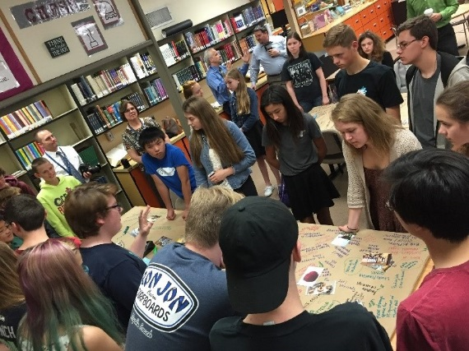
The Project Team
Here Today
Tamela Van Winkle, Executive Director, BISD
Charlie Demming, Project Manager, BISD
Bill LaPatra, GC/CM Advisor, Mithun
Susan Olmsted, Project Manager, Mithun
Jim Dugan, GC/CM Advisor, Parametrix
Dan Cody, GC/CM Consultant, Parametrix

Slide 5
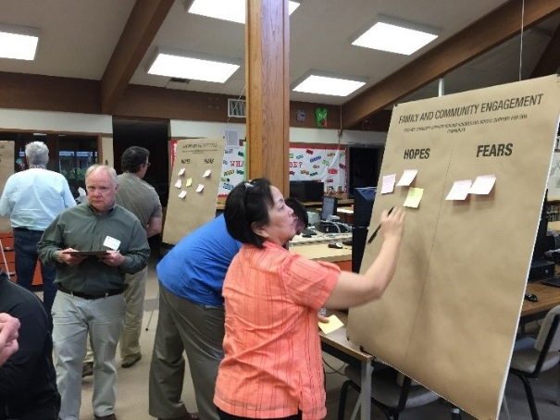
The Project Team
Not Here Today
Dr. Peter Bang-Knudsen, Superintendent, BISD
Doug Holen, External GC/CM Advisor
Graehm Wallace, Perkins Coie, External GC/CM Legal Advisor

Slide 6
The District

Slide 7

Bainbridge Island School District

Slide 8
The District
Located in Kitsap County
Serves the City and island of Bainbridge Island
Began serving students in 1861
Current enrollment: 3,785
Seven (7) schools comprised of:
  Three (3) Elementary Schools
  One (1) Intermediate School
  One (1) Middle School
  One (1) High School
  One (1) Options School K-12
510 teachers, administrators and support staff
Six (6) year Capital Facilities Plan 2014 – 2020
BISD 15 year Master Plan 2015
Capital bond passed in 2016 - $81.2 M
Prior capital bonds: 2006 ($45 M) and 2009 ($42M)

Slide 9
Mission, Vision & Guiding Principles:
Community & Partnerships Matter

Slide 10
The Project

Slide 11
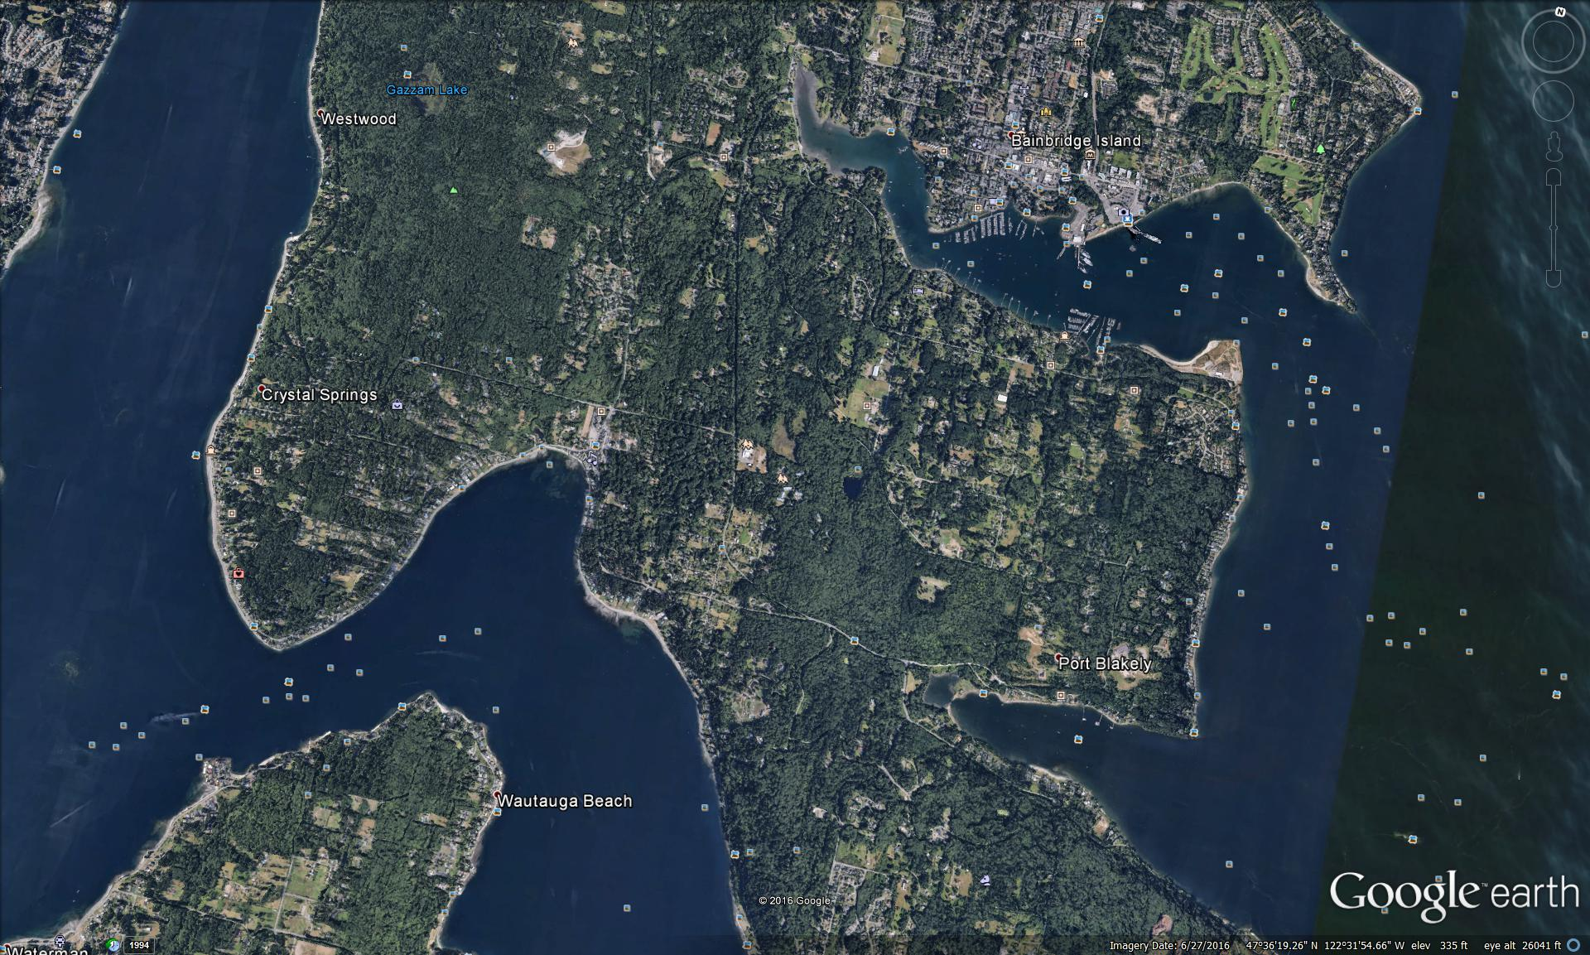
Location on Bainbridge Island

Slide 12
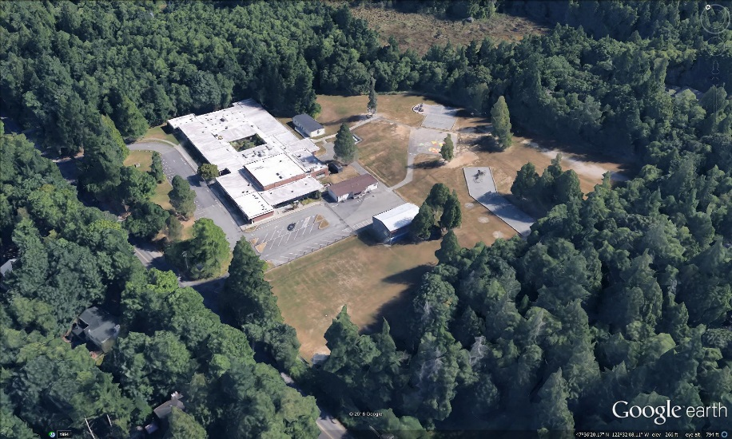
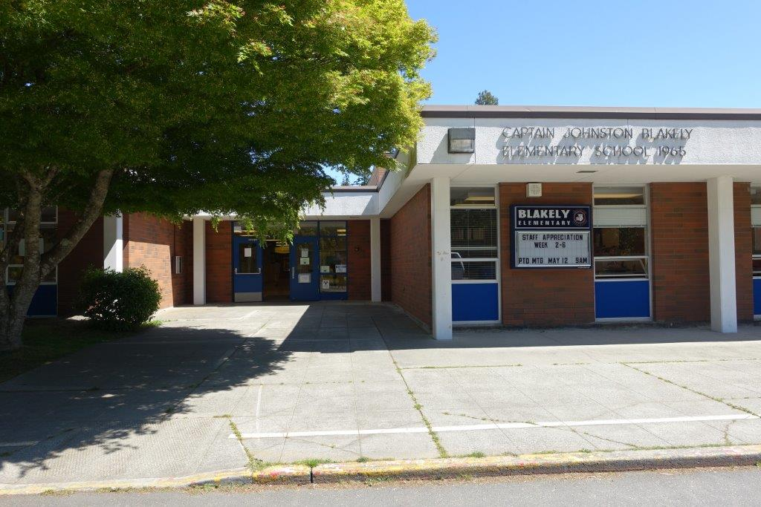
Existing Blakely Elementary School
Built 1965
1989 and 1993 Additions
Grades K-4
12 Acre Site
Adjacent to sensitive ecosystem
Adjacent to Rural Residential
43,503 SF Building
Single Story
Concrete Block and Brick
350 Students

Slide 13
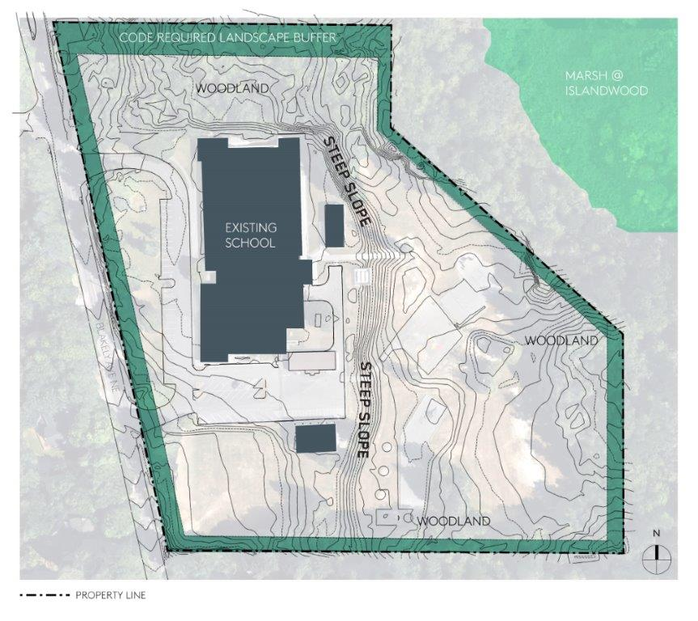
Existing Blakely Elementary School

Slide 14
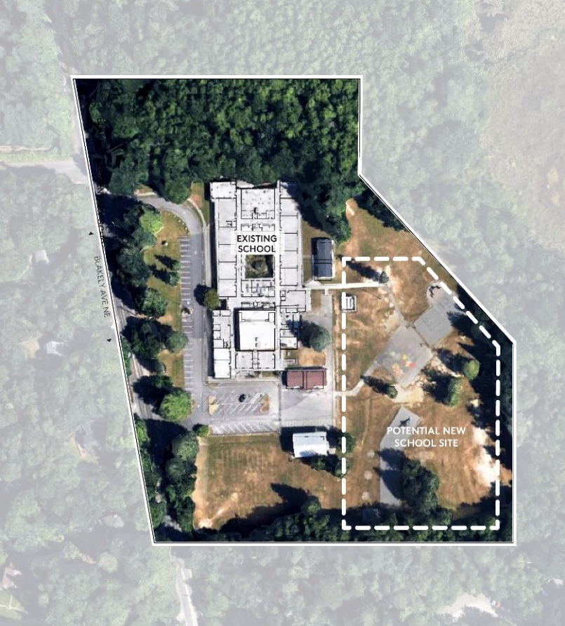
New Blakely Elementary School
65,150 SF
Single & Multi-Story Components
Pre-K thru Grade 4
Total Project Cost:
$38,964,667
Owner’s MACC:
$26,291,948
In Schematic Design
Build New; Demo Existing
Start Construction: Jan 2018
Occupy: Sept 2019

Slide 15
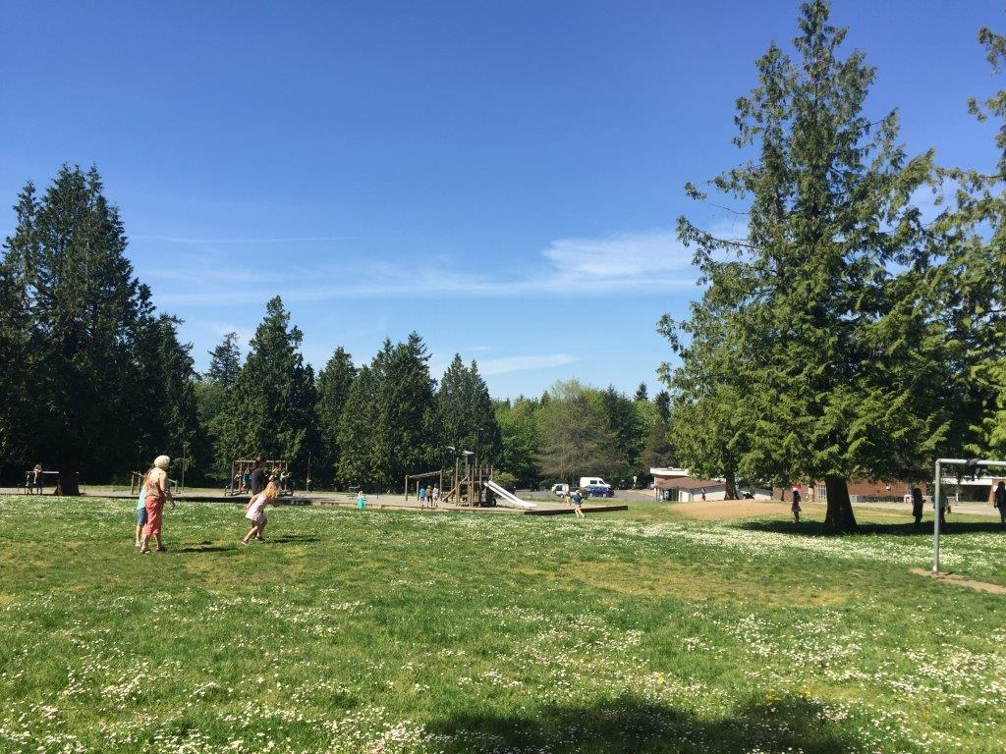
Proposed New Blakely ES Location

Slide 16

Occupied Elementary School

Slide 17
Current Parent and Bus Drop Off

Slide 18
Current Staff Parking Lot

Slide 19
Temporary Playfield

Slide 20
New School Site

Slide 21
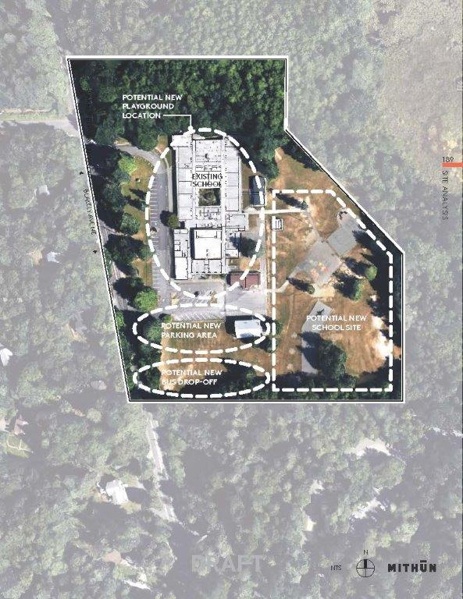
Future Configuration
New Playground Location
New Parking Area
New School Site
New Bus Drop off

Slide 22
Blakely ES Project Budget
Category | Budget
Professional Services (A/E, etc.) | $2,892,114
Project MACC (includes GC/CM risk contingency @ 3% of MACC) | $24,451,512
Contingencies – Design, Construction and Owner | $2,497,736
Fixtures, Furniture, Equipment & Technology @ 7.5% | $1,840,436
GC/CM Fee, NSS Allowance and Pre-Con Services Fee | $1,840,436
Contract Administration (PM, CM, etc) | $788,758
Owner Consultants | $657,299
Other Costs (utilities, permits, special inspections, etc.) | $1,708,977
Sales Tax | $2,287,399
TOTAL: | $38,964,667

Slide 23
Blakely ES GC/CM Schedule
Presentation to the PRC | September 22, 2016
Release GC/CM RFP | September 26, 2016
RFP Submittals Due | October 10, 2016
Shortlist SOPs and Send Invitation to Interview | October 14,2016
Interviews | October 31, 2016
Shortlist Interviews and Release GC/CM RFFP | November 1, 2016
RFFP Opening and Selection of GC/CM | November 14, 2016
Pre-Con Work Plan Due | December 1, 2016
BISD School Board Approval of Selected GC/CM | December 8, 2016
Pre-Con Agreement Executed | December 12, 2016
Pre-Con Services | December 2016 to January 2018
Construction Phase | January 2018 thru Summer 2019

Slide 24
Blakely ES Development Schedule
Schematic Design Complete
December 2016
New School Construction Phase
January 2017 thru Spring 2019
Existing School Demolition and New Fields Construction
Summer 2019
Occupied Site and Critical Phasing: Risk Management

Slide 25
Why GC/CM Delivery Method

Slide 26
GC/CM Statutory Criteria
(1) Implementation of the project involves complex scheduling, phasing, or coordination.
(2) The project involves construction at an occupied facility which must continue to operate during construction.
(3) The involvement of the General Contractor/Construction Manager during the design stage is critical to the success of the project.
(4) The project encompasses a complex or technical work environment.
(5) The project requires specialized work on a building that has historic significance.

Slide 27
GC/CM Statutory Criteria
(1) Implementation of the project involves complex scheduling, phasing, or coordination.
(2) The project involves construction at an occupied facility which must continue to operate during construction.
(3) The involvement of the General Contractor/Construction Manager during the design stage is critical to the success of the project.
(4) The project encompasses a complex or technical work environment.
(5) The project requires specialized work on a building that has historic significance.

Slide 28

Project involves construction on an occupied site that must continue to operate during construction

Slide 29
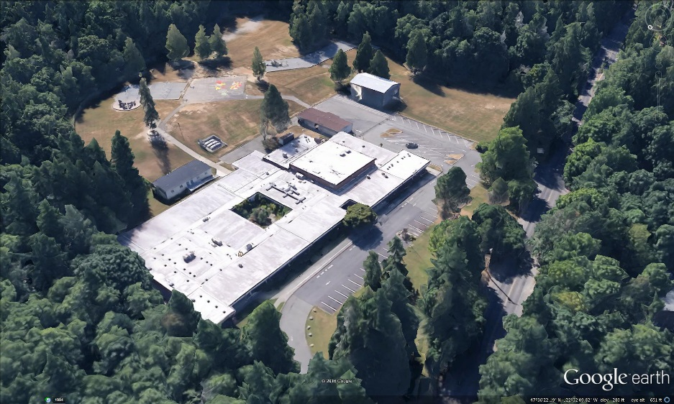
Other Critical Factors
Safety
Extremely small site requiring close adjacency of elementary age students and construction activities
Risk Management
Competing with continuous increases in market costs and decreased resource availability
Partnership
Strong desire to have “collaborative” relationships with a project team that develops from conceptual design

Slide 30
Safety
School in Operation
Construction Zone
Parent and Bus and Staff Activity
Children Playing

Slide 31
Public Benefit
  Public and District Safety
  Cost Risk Management
  Community Relationships
  Fiscal Accountability

Slide 32
Public Body Qualifications

Slide 33
BISD Leadership Team
Prior experience with capital projects of similar size and complexity
Most recent was Wilkes ES @ $21.4 M Construction cost completed in August of 2014
All of which have been delivered using Design-Bid-Build
The District is new to the GC/CM method of project delivery
BISD Executive Director/Tamela VanWinkle: Extensive capital development experience - $169 M and three bond programs in BISD alone
BISD Project Manager/Charlie Demming: Senior level PM with depth of GC/CM experience
BISD hired Parametrix for GC/CM Procurement and Advisory services
Parametrix retained Doug Holen as external GC/CM counsel
BISD retained Graehm Wallace and Mithun – depth of GC/CM experience
BISD satisfies the public body qualifications by staff augmentation with consultants

Slide 34
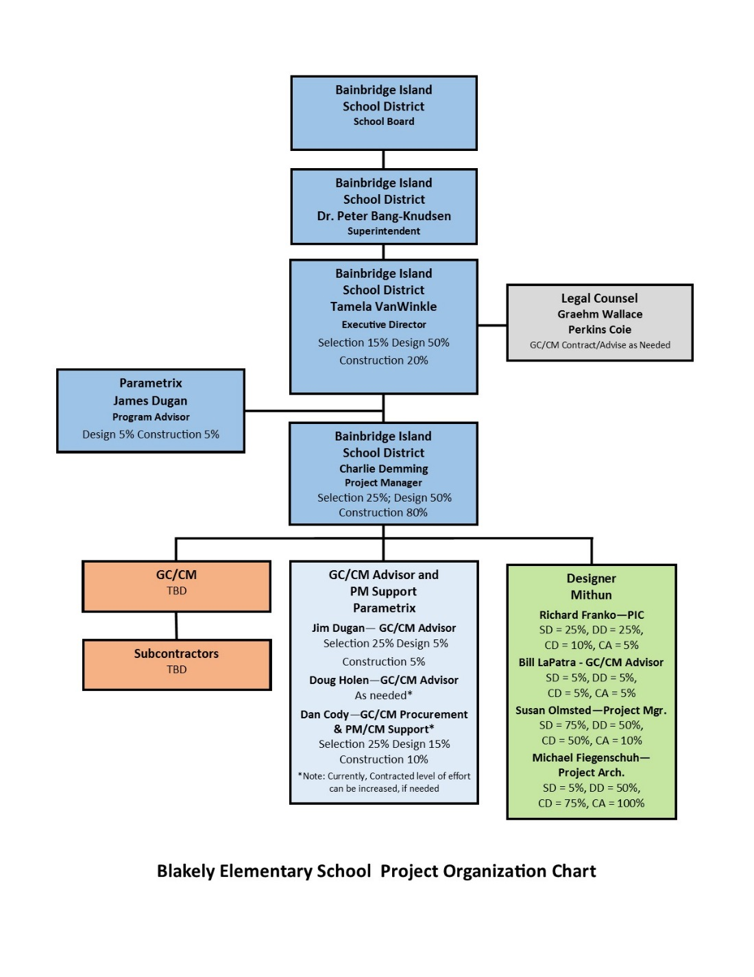
Blakely ES Project Organizational Chart

Slide 35
Jim Dugan – Project Commitments and Capacity
GC/CM Program Advisor – Jim Dugan
Completed GC/CM Procurement Contracts
TPS McCarver ES
Stewart MS
TPS Browns Point ES
MPT Eastside Community Center
GC/CM Procurement Contracts – Complete by October 1, 2016
CKSD Central Kitsap HS and MS Projects
GC/CM Procurement Contracts in Progress
MVSD EDES GC/CM Procurement – Interview Stage
Ample capacity for the BISD GC/CM Procurement and Advisor Role

Slide 36
Project Team GC/CM Experience

Slide 37
Name | Experience
Tamela VanWinkle Executive Director Bainbridge Island School District | 29 Years Program/Project Management 15 years with BISD 22 Years in K-12
Charlie Demming, CCM, REFP, LEED AP Blakely ES Project Manager Bainbridge Island School District | 41 Years Program/Project Management 8 GC/CM Projects: Vashon HS; Roosevelt HS; Portland Public School Renovation Program; Oregon State Public Utilities Building; Oregon State Human resources Building; Atlantic Richfield Corporate headquarters; 5th & I Office Building; New Songdo Project Member of CMAA, PMI, A4LE, CSI, AGC and AACE
Jim Dugan GC/CM Advisor Parametrix | 38 Years Program/Project Management 10 GC/CM Projects: TPS Stadium High School, COT Tacoma Convention and Trade Center, TPS McCarver Elementary School; TPS Stewart Middle School; MPT Eastside Community Center, TPS Browns Point Elementary School; CKSD HS/MS and OHS Projects; MVSD East Edison ES and Madison ES TPS Board of Director: 2005 – 2011 Appointed to the Project Review Committee July 1, 2016 – 3 Year Term
Dan Cody GC/CM Procurement and PM/CM Support Parametrix | 30 Years Program/Project Management 8 GC/CM Projects: TPS McCarver ES and Stewart MS; MVSD East Division ES and Madison ES; CKSD CKHS and MS; CKSD Olympic HS; TPS Browns Point ES; MPT Eastside Community Center Registered Architect in the State of Washington
Doug Holen External GC/CM Advisor Parametrix | 33 GC/CM Projects GC/CM External Delivery Method Advisor
Bill LaPatra, AIA, LEED AP and Susan Olmsted, AIA, ASLA, LEED AP BD+C Design Team PIC and PM Mithun | 37 Years Specializing in Education Facility Design Services Supporting 12 plus K-12 and Higher Education Clients 2 GC/CM Projects: UW Lander Residence Hall; UW Terry Maple Residence

Slide 38
Summary
Project is funded with the appropriate budget
Project meets qualifying RCW criteria
Project Management Plan is developed and has clear and logical lines of authority
Project team has the experience and continuity
Project team has the capacity
Project team is prepared and ready to move forward

Slide 39
Thank you

