Slide 1
Olympic High School Modernization Phase 2
November 29, 2018

Slide 2
Agenda
Introductions
Site Overview
Project
Description
Budget
Funding
Schedule
Qualifying Criteria for GC/CM Contracting Procedure
Public Benefit
Public Body Qualifications
Project Organization
Project Team Experience
Lessons Learned
Summary

Slide 3
Introductions

Slide 4
Project Team
Central Kitsap School District (CKSD)
* David McVicker, Superintendent, CKSD
Doug Newell, Assistant Superintendent of Finance and Support
Robin Shoemaker, Director of Capital Projects
Dennis Burch, Senior Project Manager
Joel Hansen, Project Manager
* Sydney Thiel, Project Manager
SKL Architects
Gladys Ly-Au Young, Principal in Charge/PM
* Wing Yee Leung, Project Architect I
* Jeremy Imhoff, Project Architect II
Perkins Coie LLP
* Graehm Wallace, External GC/CM Legal Advisor
* Not Here Today

Slide 5
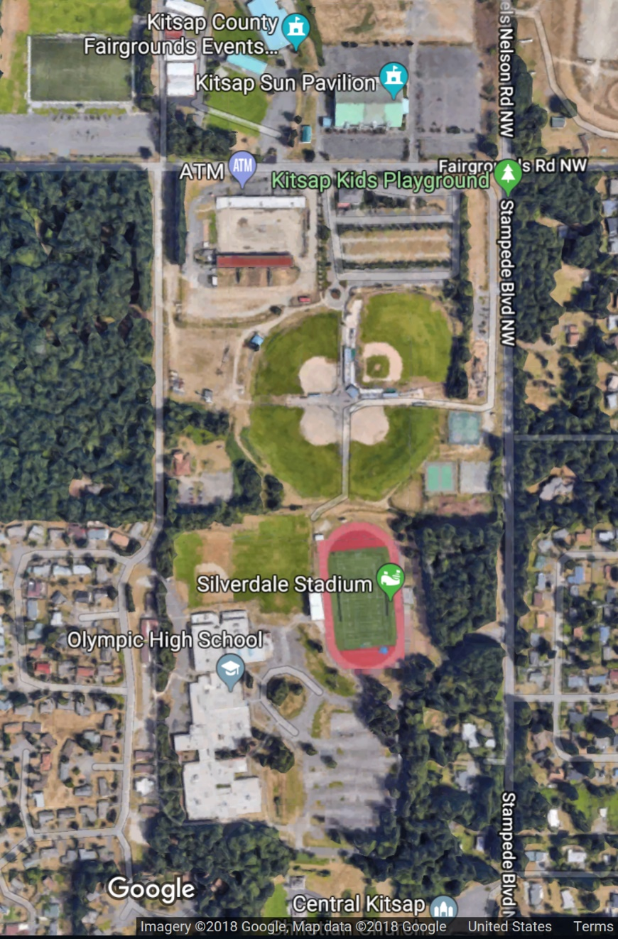
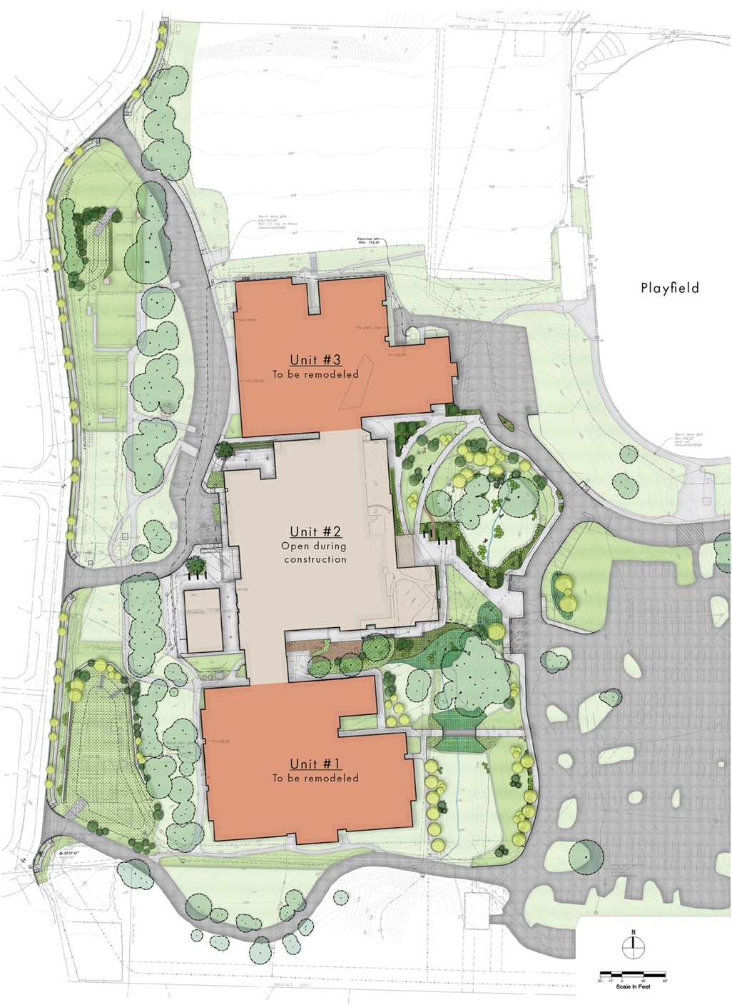
Site Overview
Unit 3 – Phase 2
Unit 2 – Phase 1
Unit 1 – Phase 2

Slide 6
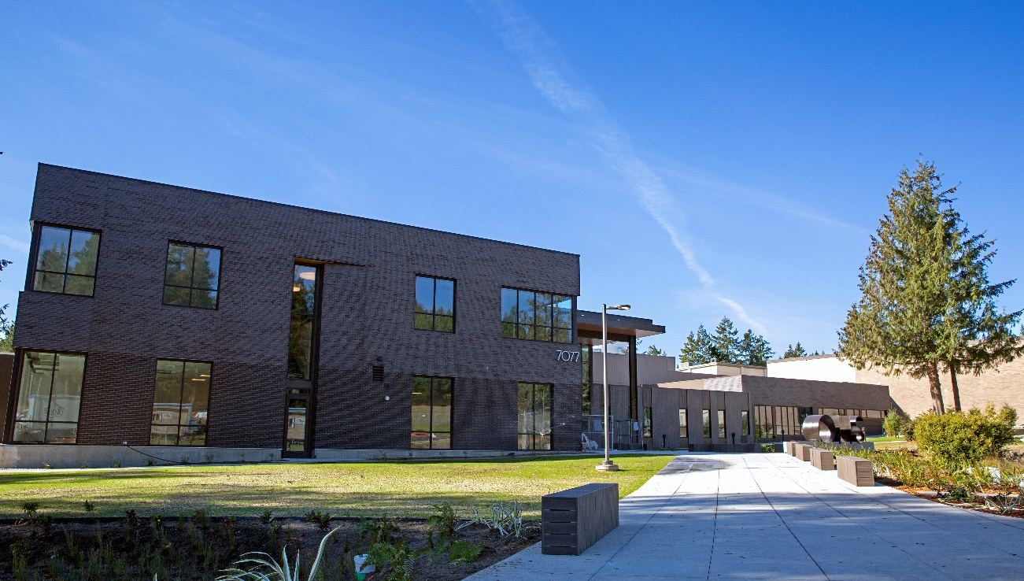
OHS Modernization and Addition Phase 1 (Unit 2)
Unit 2 - Originally
constructed
in 1979
Unit 2 – Modernized
in 2018

Slide 7
OHS Modernization Phase 2 Project Description
37 acre site
Existing Facility – 3 Units totaling 196,000 SF
1979: Original Construction
1989 and 1991: Minor Expansions
2018: Modernization and Addition Phase 1 Project (Unit 2)
Portables
Phase 2 Project Objectives
Incorporate flexibility for future addition
Unit 1
Update classrooms
Eliminate interior classrooms and convert to flexible spaces
Renovate restrooms
Incorporate a staff room
Unit 3
Reconfigure locker rooms (school and natatorium)
Construct a team classroom
Modernize remaining spaces
Exterior updated
Potential natatorium relocation

Slide 8
Project Budget
Category
Cost for Professional Services | $3,235,000
Estimated project construction costs (including construction contingencies) | $20,202,000
Equipment and furnishing costs | $960,000
Off Site Costs | Included in Construction
Contract administration costs (Owner, Construction Manager, etc.) | $500,000
Contingencies (design and owner) | $1,963,000
Other related project costs (permits, Insurance, Principal/Staff Salaries) | $660,000
Sales Tax | $1,955,000
Total | $29,475,000
Notes:
Funding Status
The project is funded through local and state construction assistance funding. In July 2018, the Office of Superintendent of Public Instruction (OSPI) committed $18,852,000 to the Phase 2 Modernization project. Local funding of $10,623,000 is provided from a combination of 2018 and projected 2019 Federal Heavy Impact Aid funding, and funding from the 2016 voter approved Capital Bond for athletic facilities at Olympic High School.

Slide 9
Project Funding
Project funding provided from state and local
construction assistance
State $18,852,000 - Office of Superintendent of Public Instruction
Local $10,623,000 - 2018 and projected 2019 Federal Heavy Impact Aid funding and 2016 voter approved Capital Bond for athletic facilities at Olympic High School
Total $29,475,000
Notes:
Funding Status
The project is funded through local and state construction assistance funding. In July 2018, the Office of Superintendent of Public Instruction (OSPI) committed $18,852,000 to the Phase 2 Modernization project. Local funding of $10,623,000 is provided from a combination of 2018 and projected 2019 Federal Heavy Impact Aid funding, and funding from the 2016 voter approved Capital Bond for athletic facilities at Olympic High School.

Slide 10
Project Schedule
Category | Start | Finish
Programming (Ed Specs) | 10/15/2018 | 2/15/2019
Schematic Design | 11/15/2018 | 3/15/2019
Design Development | 3/16/2019 | 7/16/2019
Construction Documents | 7/17/2019 | 11/17/2019
Agency Review/Permitting | 7/18/2019 | 11/3/2019
Subcontractor Bidding | 9/15/2019 | 11/30/2019
Construction | 12/1/2019 | 7/30/2021
Substantial Completion |  | 7/31/2021
Punchlist/Final Completion/Closeout | 7/15/2021 | 8/31/2021
Owner Move-In (Overall Project phased as determined with GC/CM) | 7/31/2021 | 9/1/2021
Warranty | 7/31/2021 | 7/31/2022

Slide 11
GC/CM Schedule
Category | Start | Finish
PRC Presentation | 11/29/2018 | 11/29/2018
Advertise for GC/CM Services | 12/14/2018 | 12/14/2018
RFP Submittal Deadline | 1/17/2019 | 1/17/2019
Notify Submitters of Most Highly Qualified Submitters and Invite to Interview | 1/22/2019 | 1/22/2019
Interviews with Short-Listed Firms | 2/5/2019 | 2/5/2019
Notify Submitters of Most Highly Qualified Submitters and Invite to Submit RFFP | 2/6/2019 | 2/6/2019
RFFP Submittal Deadline & Opening | 2/15/2019 | 2/15/2019
Notify Submitters of Scoring and Most Qualified GC/CM | 2/18/2019 | 2/18/2019
School Board Approval – Use of GC/CM Procedure | 2/27/2019 | 2/27/2019
Pre-Con Preparatory Activities and Services | 2/28/2019 | 10/30/2019
MACC Estimate/Negotiation (90% CD’s) | 10/1/2019 | 10/30/2019
School Board Approval of MACC/GMP | 11/6/2019 | 11/6/2019
GMP Amendment Executed | 11/7/2019 | 11/7/2019

Slide 12
Qualifying Criteria for GC/CM Contracting Procedure
Complies with 4 of 6 Statutory Criteria (RCW 39.10.340)
Implementation of project involves complex scheduling, phasing, or coordination
The project involves construction at an occupied facility which must continue to operate during construction
The involvement of the GC/CM during the design stage is critical to the success of the project
The project encompasses a complex or technical work environment
The project requires specialized work on a building that has historic significance
The project is, and the public body elects to procure the project as, a heavy civil construction project. However, no provision of this chapter pertaining to a heavy civil construction project applies unless the public body expressly elects to procure the project as a heavy civil construction project.

Slide 13
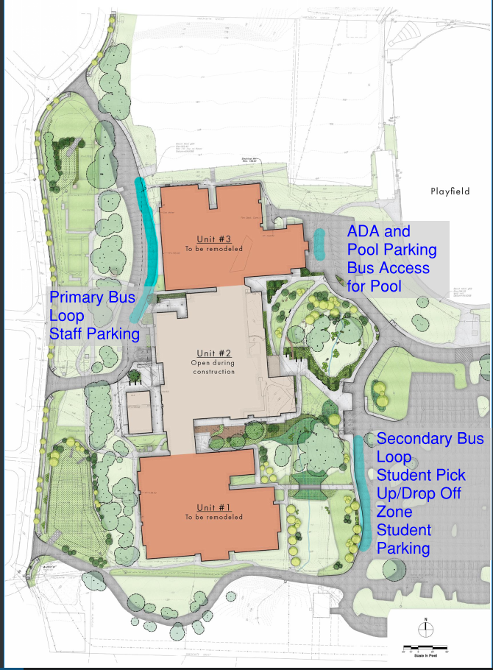
GC/CM Contracting Procedure
Implementation of project involves complex scheduling, phasing, or coordination
Occupied site
School
Community
Critical Phasing
Maintain sufficient classrooms
School and community sports and activities
Safety
Student Access
All Units, portables, playfields, Natatorium
Student pick-up/drop-off

Slide 14
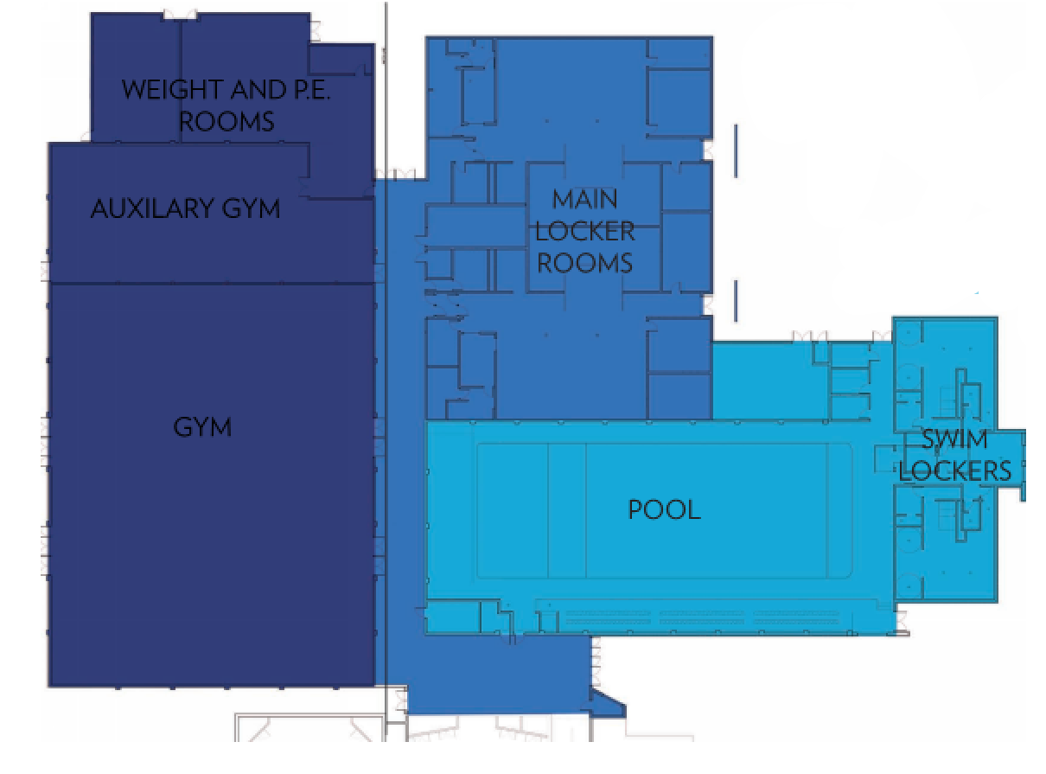
GC/CM Contracting Procedure
The project involves construction at an occupied facility which must continue to operate during construction
Occupied site
Critical Phasing
Safety
Neighborhood traffic
and access
Contractor staging
Unit 3

Slide 15
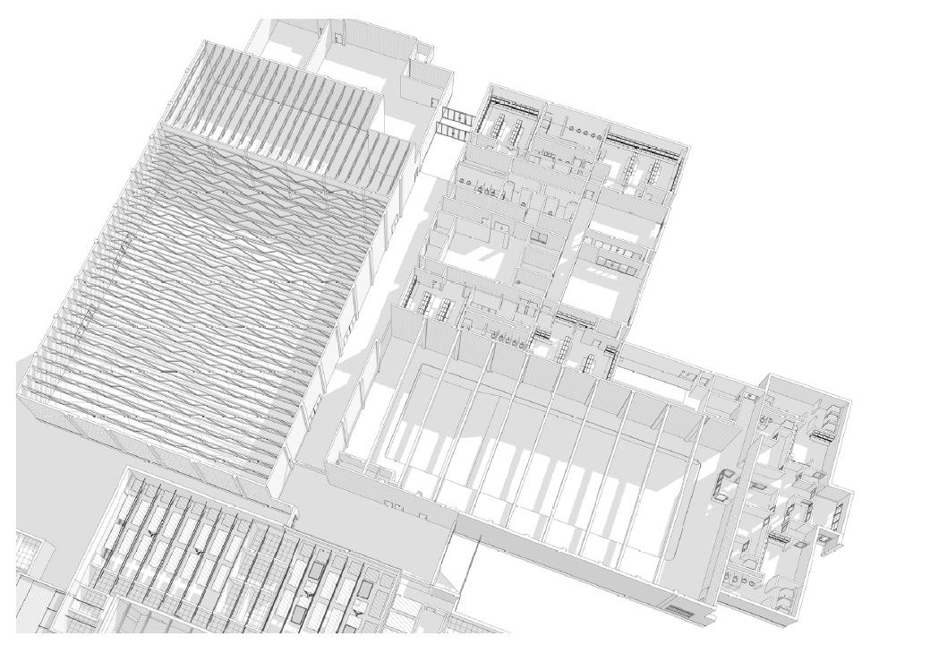
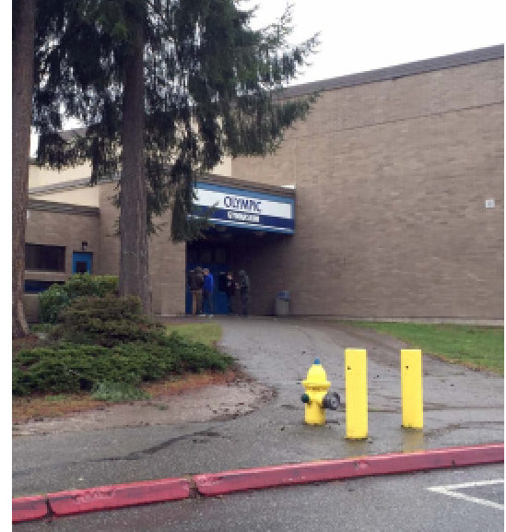
GC/CM Contracting Procedure
3. The involvement of the GC/CM during the design stage is critical to the success of the project
Input will influence design and bid document development
Determine best approach for construction sequencing
Input from GC/CM Contractor is critical to:
Staying in budget
Minimizing impact to education
Maintaining safe environment for student, staff and community
Unit 3

Slide 16
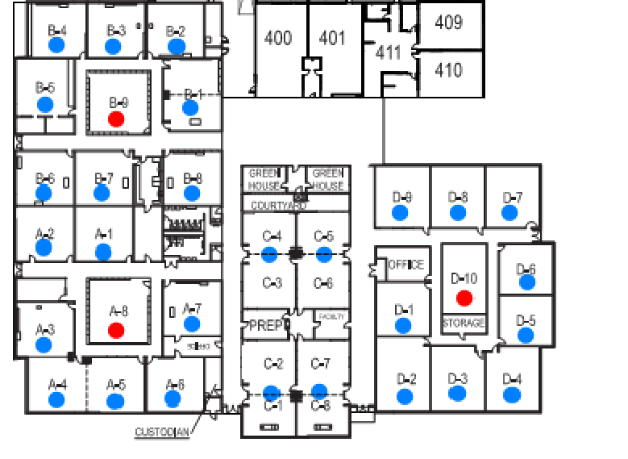
GC/CM Contracting Procedure
The project encompasses a complex or technical work environment
Staging, phasing and scheduling
Maintaining access for emergency response
Maintaining a safe environment
Site access plan to minimize impact on neighborhood
Unit 1

Slide 17
Public Benefit
Substantial Fiscal Benefit
Cost management: Explore solutions that are cost effective
Reduce likelihood of construction delay claims and litigation
Substantial Public Benefit over Traditional Design-Bid-Build
Real time cost estimation
Development of a more efficient and accurate phasing plan and overall project schedule
More responsive and responsible bids by subcontractors
Ability to accommodate and coordinate site activities
Ongoing value analysis and constructability review during design

Slide 18
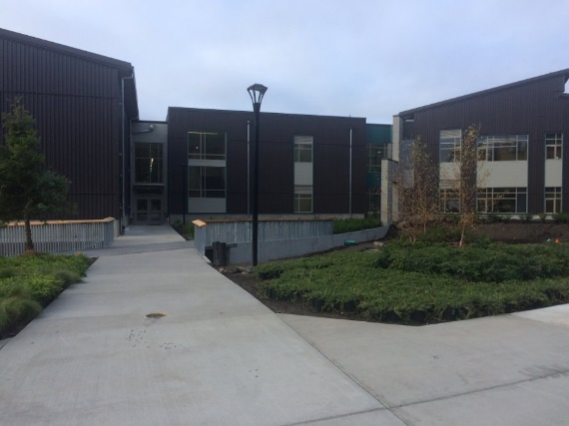
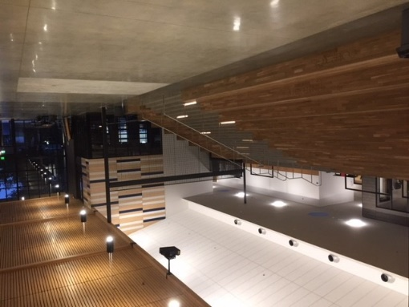
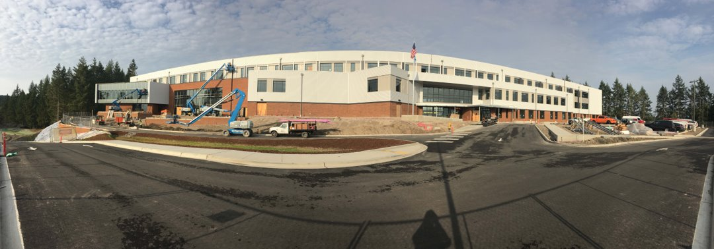
Public Body Qualifications
Total of $236M in projects completed or
in-progress since 2013
Primarily Design Bid Build
Klahowya Secondary School Addition ($15.9M), 41,000 SF
Two projects ($171.2M) utilizing GC/CM
delivery method
Olympic High School Modernization and Addition Phase 1 ($38.9M), 88,000 SF
Central Kitsap High School and Middle School Replacement ($132.3M), 335,000 SF
CKSD
Secondary Schools Project Summary
$187.1M
3.5 year design and construction period (2/2016 to 8/2019)
Klahowya Secondary School
Central Kitsap HS and MS
Olympic HS
Student Commons

Slide 19
Project Organization
CKSD will utilize full time staff as the project management team
All have attended or are scheduled to attend AGC GC/CM training

Slide 20
Project Team Experience
Name | Experience
Robin Shoemaker Director, Capital Projects Central Kitsap School District | 39 Years Program/Project Management 3 GC/CM Projects: UW Law School Building, OHS Modernization and Addition Phase 1, and Central Kitsap High School and Middle School Replacement
Dennis Burch Senior Project Manager Central Kitsap School District | 40+ Years Program/Project Management 1 GC/CM Project: OHS Modernization and Addition Phase 1
Joel Hansen Project Manager Central Kitsap School District | 12 Years Program/Project Management 1 GC/CM Project: OHS Modernization and Addition Phase 1
Sydney Thiel Project Manager Central Kitsap School District | 20 Years Program/Project Management 2 GC/CM Projects: Central Kitsap High School and Middle School Replacement, Community Rowing Boathouse
Gladys Ly-Au Young Principal in Charge/PM SKL Architects | 24 Years Architect 1 GC/CM Project: OHS Modernization and Addition Phase 1
Wing Yee Leung Project Architect I SKL Architects | 20+ Years Architect 1 GC/CM Project: OHS Modernization and Addition Phase 1
Jeremy Imhoff Project Architect II SKL Architects | 10+ Years Architect 1 GC/CM Project: OHS Modernization and Addition Phase 1

Slide 21
Lessons Learned
Optimize Pre-Construction Period
Identify critical questions that need joint resolution and/or mutual understanding
More developed schedule
GC/CM Contractor project staffing
Utilize GC/CM outreach efforts
Adequate design document review time and interdisciplinary coordination
GC/CM Delivery Methodology
Engaged project delivery team to include Owner
Risk contingency utilization
Use of allowances in bids

Slide 22
Summary
Project is funded with the appropriate budget
Project meets qualifying criteria under RCW 39.10.340
Project management plan is developed and has clear and logical lines of authority
Project team has:
Necessary experience with GC/CM delivery methodology to include experience at project site
Continuity
Sufficient contract administration personnel with construction experience
Capacity
No previous audit findings on any projects
Project team is prepared and ready to move forward

Slide 23
Questions

