Slide 1
State of Washington
CPARB
Project Review Committee
Central Valley School District
Alternative Delivery
Public Body Approval for GC/CM
November 30, 2017

Slide 2
Agenda
Introductions
Project Team Qualifications
District Statistics
CVSD Internal Processes & Procedures
Candidate Projects
Summary
Questions and Answers

Slide 3
Introductions
Ben Small, Superintendent
Jay Rowell, Deputy Superintendent
Jerrol Olson, Planning Principal
Dan Chandler, OAC Services – GC/CM Advisor
Jeff Jurgensen, OAC Services – GC/CM Advisor & Program Manager

Slide 4
Project Team Qualifications
Ben Small - Superintendent
10 Years as a Superintendent of Central Valley School District
Actively involved in all aspects of all 13 projects associated with the 2015 Capital Bond.
Developed the Construction Handbook for the CVSD Board of Directors

Slide 5
Project Team Qualifications
Jay Rowell – Deputy Superintendent
Led all 13 projects associated with the 2015 Capital Bond
Construction administrator for 6 GC/CM projects totaling $144.5M
Responsible for coordination and management of all consultants
Over 31 years of school experience much of it also handling construction issues as well

Slide 6
Project Team Qualifications
Jerrol Olson – Planning Principal
Planning principal for 6 GC/CM projects totaling $144.5M
Responsible for coordination and management of design and construction focusing on meeting the specific needs of the end user
Over 30 years of school experience with 20 years of administration experience focused on shared decision making and team building

Slide 7
District Statistics
Educating Spokane Valley area students since 1890
Approximately 14,000 students
Award-winning schools, programs and departments
Recognized for effective financial management

Slide 8
District Statistics
1.7 million square feet of interior space
13 elementary schools
6 middle schools
2 high schools
2 special schools
Technical Skill Center cooperative
2 support facilities
337 acres of land

Slide 9
GC/CM Experience
History with alternative delivery projects since 2015
CVSD
Chester
Greenacres Elementary
Evergreen Middle
North Pines Middle
Opportunity Elementary
Sunrise Elementary
OAC – over 57 alternative delivery projects valued at over $2B
Perkins Coie – unchallenged legal expertise

Slide 10
CVSD Internal Processes
Project is identified in Bond Planning
Preliminary delivery method identified
District Project/Program Manager Prepares Delivery Method Recommendation
Deputy Superintendent Reviews & Approves Delivery Method Recommendation
Deputy Superintendent confirms use of GC/CM with Superintendent
Board of Directors Approves use of GC/CM delivery & Contract and Future Amendments
Project Manager proceeds with GC/CM procurement according to RCW & CVSD requirements & standards

Slide 11
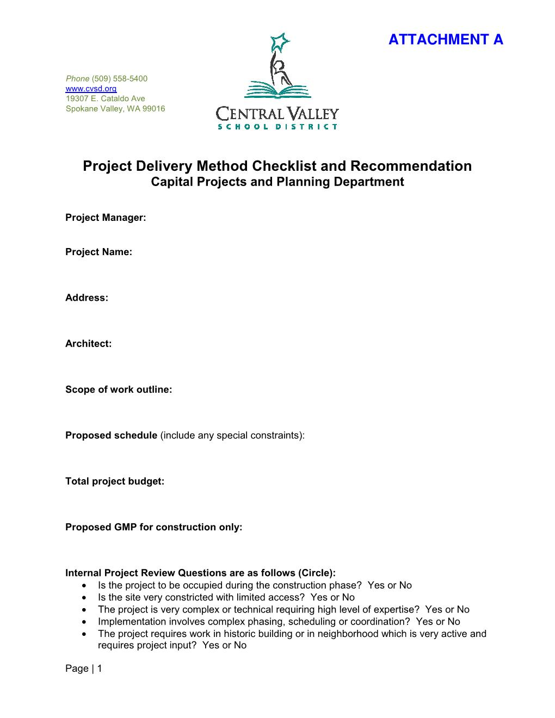
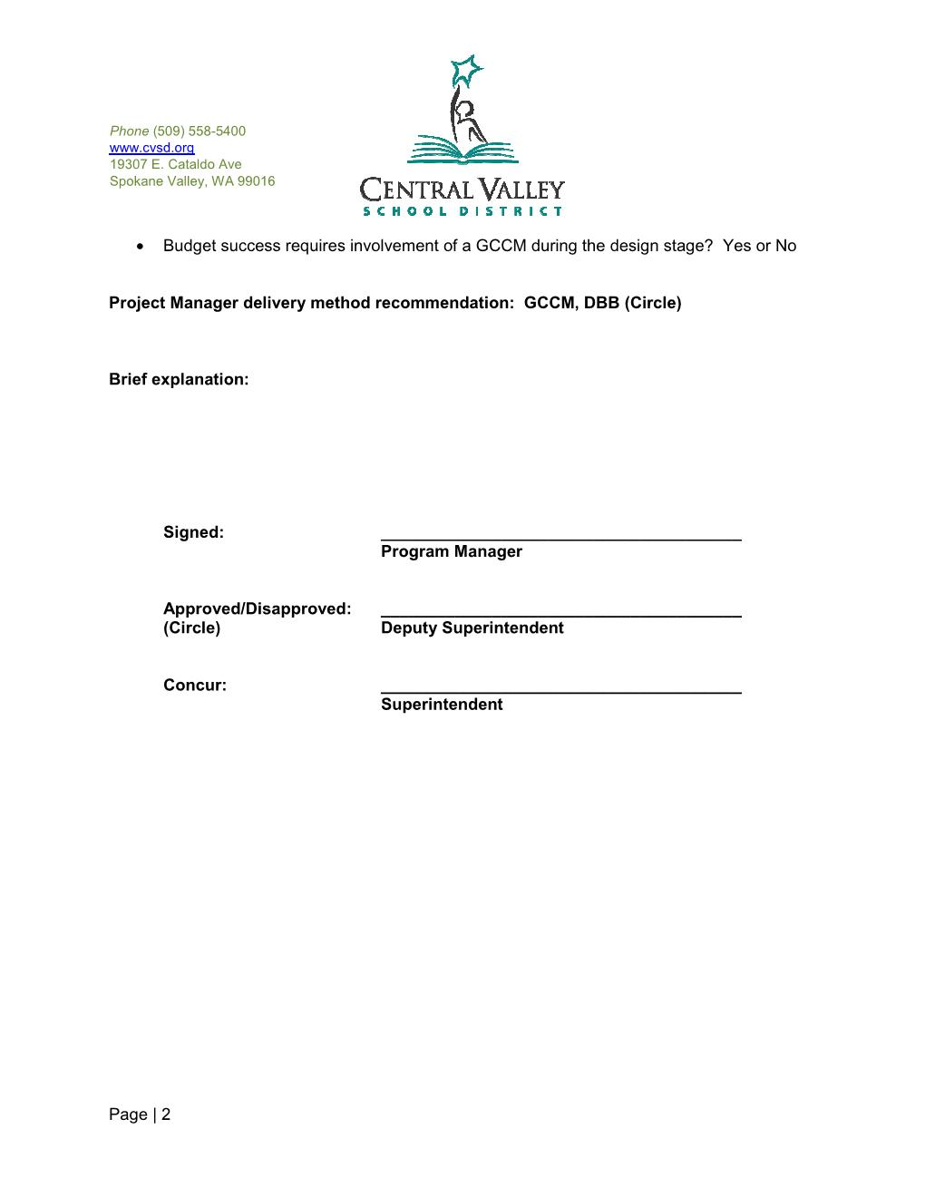
CVSD Internal Processes

Slide 12
Candidate Projects
Modernizing a significant number of school
buildings and technology in Central Valley School District requires a well thought out, long-range bond plan
Phase I 2015 to 2018 – In progress ($225M)
Phase II 2018 to 2021 - ($165M estimated)

Slide 13
Summary
4 successfully completed GC/CM projects (2 additional in early and mid 2018)
Qualified internal staff
Highly qualified advisory and legal support
Established internal processes
School Board is very supportive of Agency GC/CM as seen by the attached Resolution

Slide 14
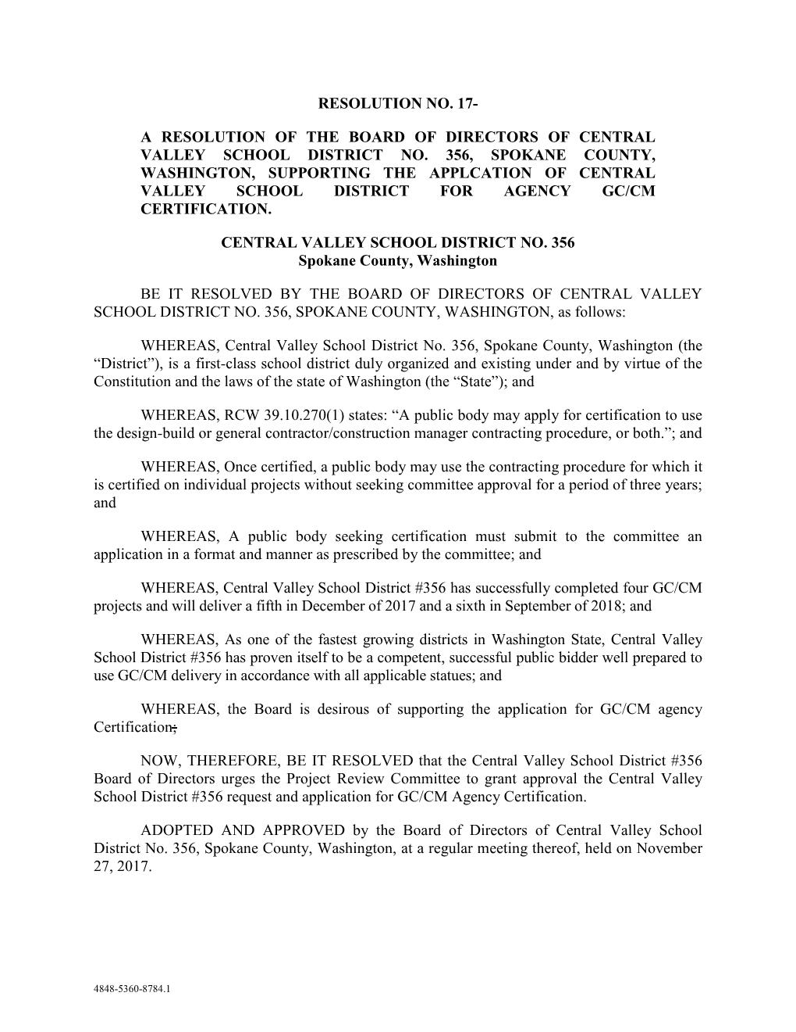
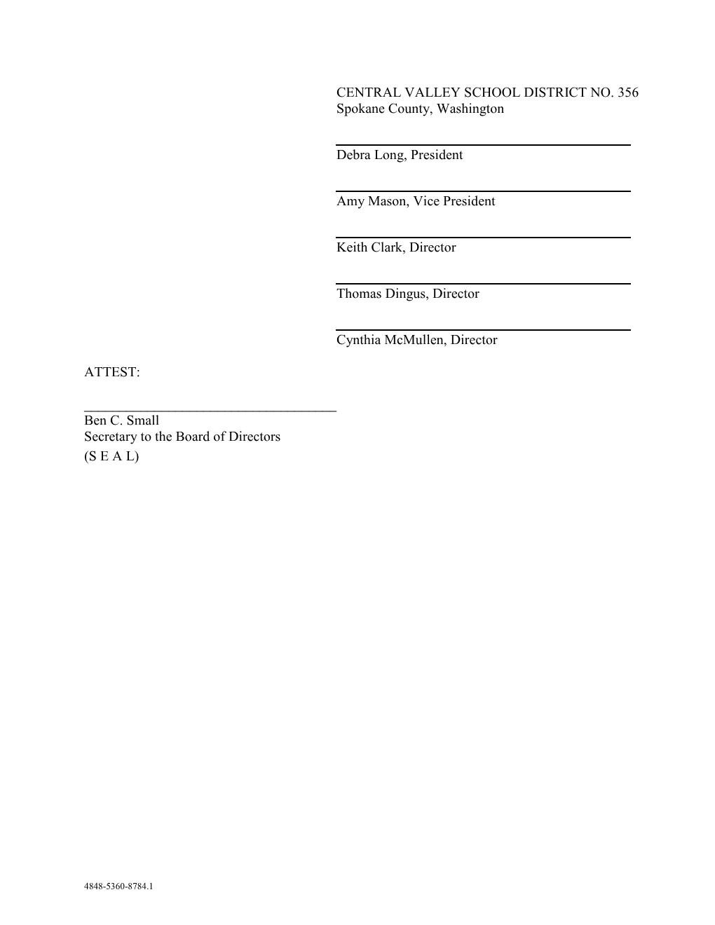
School Board Resolution

Slide 15
Questions & Answers

