Slide 1
State of Washington
CPARB
Project Review Committee
Central Valley School District #356
Alternative Delivery
Public Body Recertification for GC/CM
September 24, 2020

Slide 2
Agenda
Introductions
Project Team Qualifications
District Statistics
GC/CM Experience
CVSD Internal Processes & Procedures
Candidate Projects
Summary
Questions and Answers

Slide 3
Introductions
Ben Small, Superintendent
Jay Rowell, Associate Superintendent
Jerrol Olson, Director of Facilities
Jeff Jurgensen, OAC Services – GC/CM Advisor & Program Manager
Jonathan Miller, OAC Services – GC/CM Advisor & Senior Project Manager

Slide 4
Project Team Qualifications
  Ben Small – Superintendent
    13 years as Superintendent of Central Valley School District; 18 years total as a Superintendent
    30 years of experience in the K-12 realm
    Actively involved in all aspects of every Capital Facility Project
    Developed the Construction Handbook for the CVSD Board of Directors

Slide 5
Project Team Qualifications
Jay Rowell – Associate Superintendent
  Has led every Capital Facility Project from the 2015 and 2018 Bond Program
  Construction administrator for 10 GC/CM projects totaling $183M
  Responsible for coordination and management of all consultants
  Over 34 years of school experience combined with six years of construction experience
  Certified from the 2015 and 2017 AGC GC/CM Workshop

Slide 6
Project Team Qualifications
Jerrol Olson – Director of Facilities
  Planning principal for 5 GC/CM projects totaling $144.5M; transitioned to Facilities Director in 2018
  Responsible for coordination and management of design and construction focusing on meeting the specific needs of the end user
  34 years of school experience with 20 years of administration experience focused on shared decision making and team building
  Completed 2017 AGC GC/CM Workshop

Slide 7
District Statistics
Educating Spokane Valley area students since 1890
Nearly 15,000 students
Award-winning schools, programs and departments
Recognized for effective financial management
Passed 2018 Bond with over 70% voter approval

Slide 8
District Statistics
1.8 million square feet of interior space
  14 elementary schools
  6 middle schools
  2 high schools (3rd opens fall 2021)
  3 choice schools
  Technical Skill Center
  cooperative
  2 support facilities
Nearly 500 acres of land

Slide 9
GC/CM Experience
GC/CM Projects since 2015
CVSD
  Chester Renovation and Expansion
  Greenacres Elementary Renovation and Expansion
  Evergreen Middle Renovation and Expansion
  North Pines Middle New in Lieu
  Opportunity Elementary Renovation and Expansion
  Sunrise Elementary Renovation and Expansion
  Riverbend Addition
  Horizon Middle Renovation and Expansion
  HVAC Projects at Four Elementary Schools
  Synthetic Turf (Heavy Civil) at High Schools

Slide 10
GC/CM Experience
OAC Services, Inc. – over 65 alternative delivery projects valued at over $2B
Perkins Coie – unchallenged legal expertise, served as construction counsel since 2015

Slide 11
CVSD Internal Processes
CVSD identifies projects in pre-bond planning
Scope of each project is further defined, and budgets are drafted
Each project is evaluated against RCW 39.10.340
Projects that meet at least one of the RCW criteria are further evaluated with pros and cons
Scope of each project is finalized, and final budgets are created
Based on funds, scopes, pros, and cons, delivery method recommendation is made by Capital Facilities
Superintendent Small reviews recommendation and makes delivery method determination
Recommended delivery method is presented to School Board for Approval
Procurement Begins

Slide 12
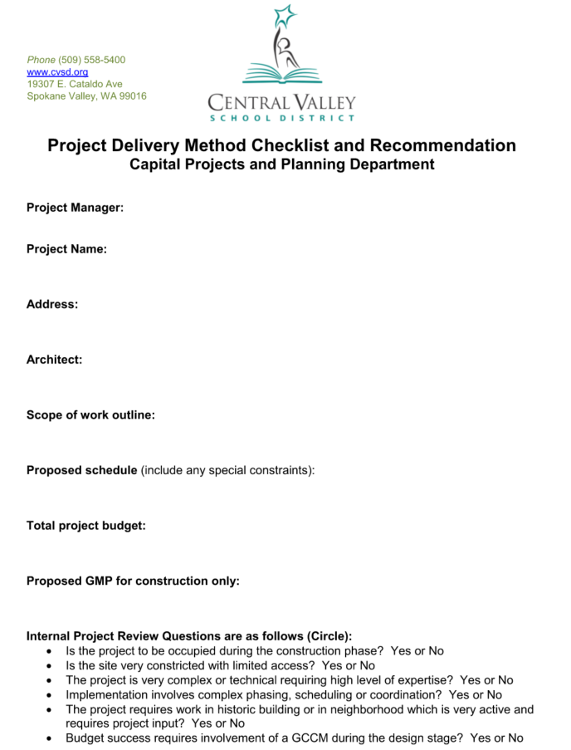
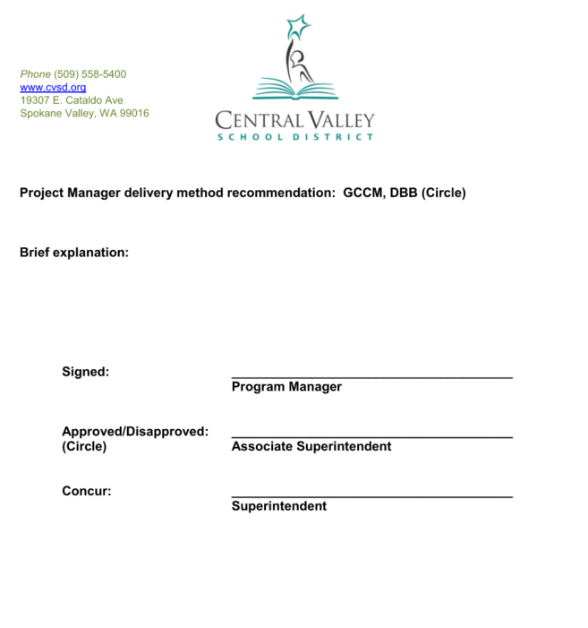
CVSD Internal Processes

Slide 13
Candidate Projects
CVSD must continue to update schools, and add additional schools to keep up with the growth in the area
  Phase I 2015 to 2018 – In progress ($225M)
☑ Phase II 2018 to 2021 – ($165M estimated)
Phase III 2021 to 2029 – ($153M estimated)
  Renovate and Expand Two Elementary Schools
  Transportation Facility
  New Elementary School
  New Middle School
  Upgraded Support Facilities

Slide 14
Summary
Ten successfully completed GC/CM projects
Qualified internal staff
Highly qualified advisory and legal support
Established internal processes
Agency GC/CM approval allows for greater flexibility in uncertain times

Slide 15
Questions & Answers

