Slide 1

Application for
Project Approval
Fords Prairie and Jefferson Lincoln Elementary Schools Replacement
Thursday, July 27, 2017

Slide 2
Agenda
  Introduction of Project Team
  Why this Project is Suited for GC/CM
  Scope
  Schedule
  Budget & Funding
  Questions
Notes:
Dan Chandler

Slide 3
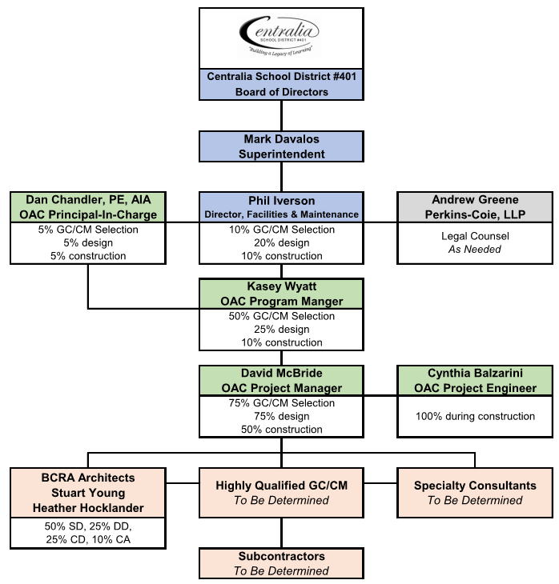
Project Team
Notes:
Kasey Wyatt

Slide 4
Project Leadership Expertise
Project Leadership
  Phil Iverson, Maintenance & Operations
    20 year industry veteran
    Extensive experience with complex projects
    Alternative Delivery experience
  Kasey Wyatt, Program Manager
    23 year industry veteran
    Extensive GC/CM experience
    Over $1 billion in K12 project Experience
  Stuart Young, Principal In Charge
    31 Years industry veteran
    Extensive K12 design experience
    Extensive GC/CM experience
Notes:
Kasey Wyatt

Slide 5
Project Leadership Expertise
Project Leadership
  David McBride, Project Manager
    12 Year industry experience
    GC/CM experience
  Heather Hocklander, Architect Project Manager
    16 year industry veteran
    K12 design expertise
    GC/CM experience
  Cynthia Balzarini, Project Engineer
    10 Years industry experience
    GC/CM experience
Notes:
Kasey Wyatt

Slide 6
Why Project is Suited for GC/CM
Fords Prairie & Jefferson Lincoln
Replacement Schools
Complex phasing and scheduling
Occupied
Involvement of GC/CM is critical
Notes:
David McBride

Slide 7
Scope
Fords Prairie Elementary School
Replace the existing 36,265 SF school with a new 58,500 SF building.
Jefferson Lincoln Elementary School
Replace the existing 34,651 SF school with a new 58,500 SF building.
Both elementary schools will move from a K-3 to a K-6 model, and house a capacity of 525 students.
New schools will include classrooms, art/music rooms, science rooms, library, cafeteria, gymnasium and covered outdoor space.
The replacement of elementary schools will be built on the existing sites.
Notes:
David McBride

Slide 8
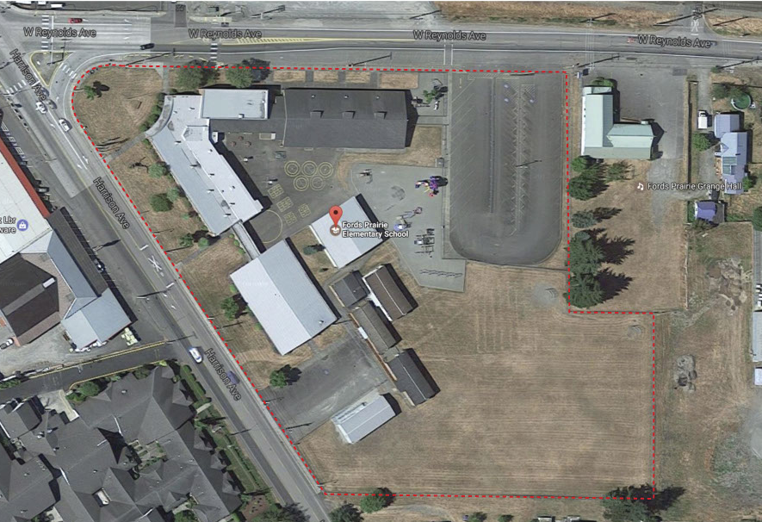
Scope
Fords Prairie Elementary
Notes:
Phil Iverson

Slide 9
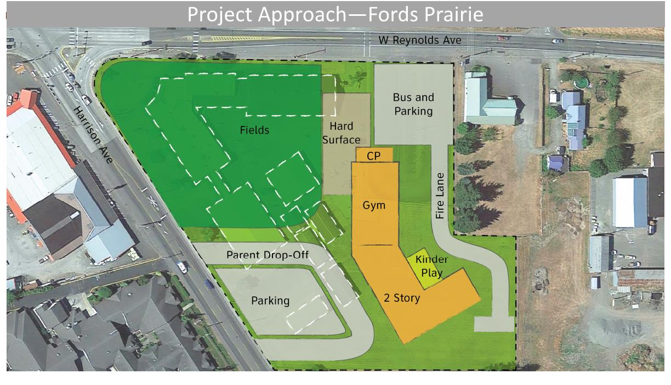
Conceptual Plan
Fords Prairie Elementary School
Conceptual Plan
Fords Prairie Elementary
Notes:
Stuart Young

Slide 10
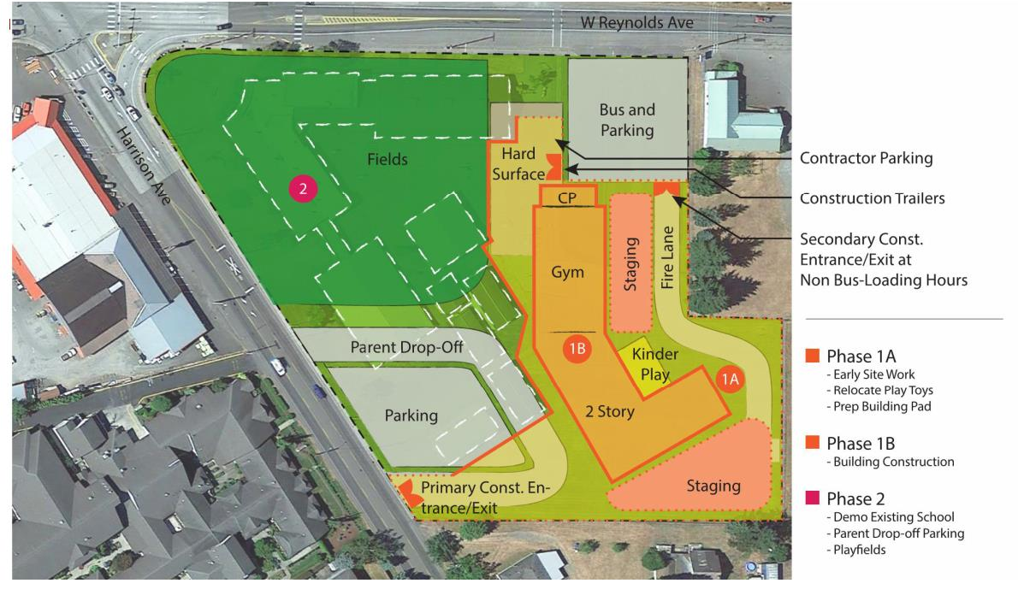
Phases
Fords Prairie Elementary
Notes:
Stuart Young

Slide 11
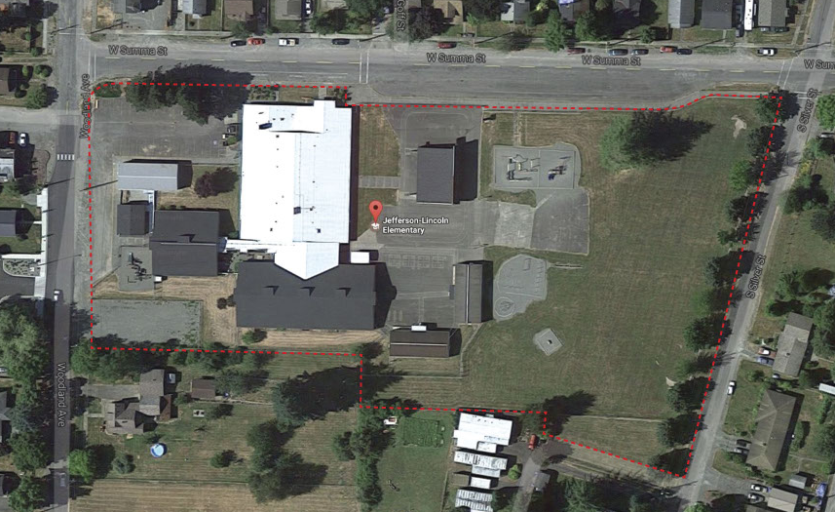
Scope
Jefferson Lincoln Elementary School
Scope
Jefferson Lincoln Elementary
Notes:
Phil Iverson

Slide 12
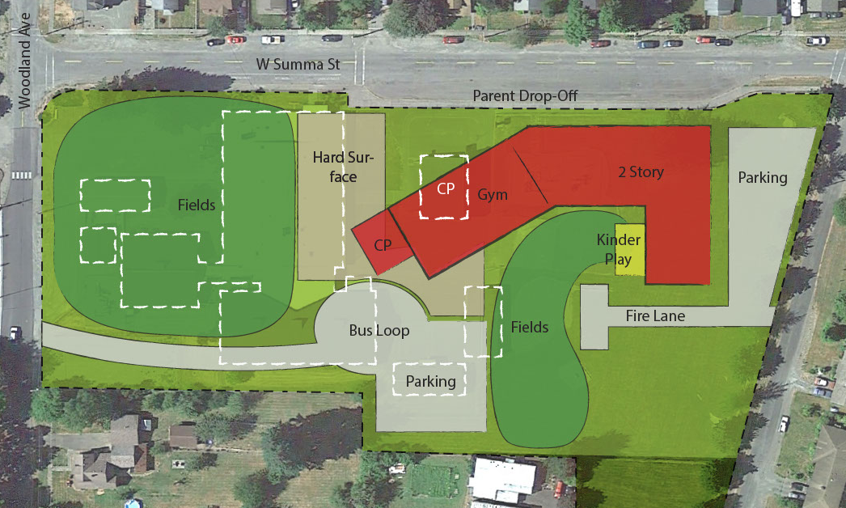
Conceptual Plan 2
Jefferson Lincoln Elementary School
Conceptual Plan
Jefferson Lincoln Elementary
Notes:
Stuart Young

Slide 13
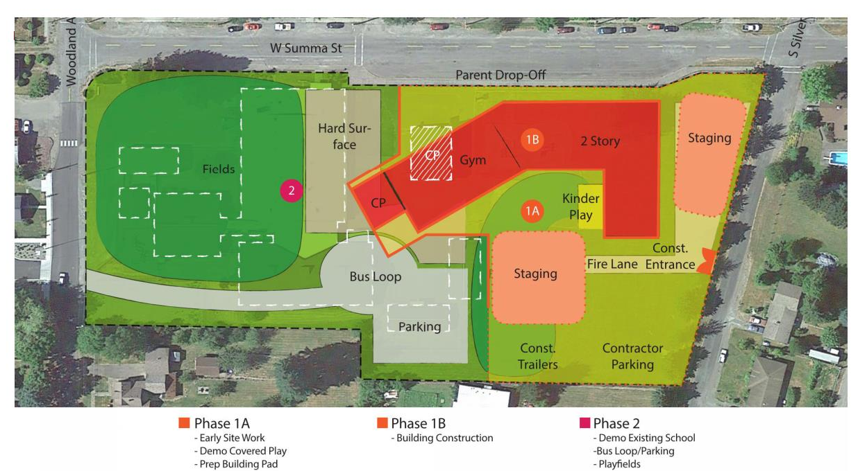
Phases
Jefferson Lincoln Elementary
Notes:
Stuart Young

Slide 14
Schedule
GC/CM Process July - September 2017
  1st Advertisement for GC/CM RFQ July 31, 2017
  2nd Advertisement for GC/CM RFQ August 7, 2017
  GC/CM Presubmittal Meeting August 10, 2017
  Statement of Qualifications Due August 21, 2017
  Short-list Most Qualified GC/CM’s August 25, 2017
  Interview GC/CM’s September 12, 2017
  Open GC/CM Fee Proposals September 14, 2017
Programming and Ed Specs August 2017 - October 2017
Schematic Design August 2017 - October 2017
Design Development November 2017 - February 2018
Construction Documents February 2018 - June 2018
Permitting April 2018 - June 2018
Construction May 2018 - July 2019
Occupancy August 2019
Notes:
David McBride

Slide 15
Budget
Fords Prairie Elementary School
Construction GMP (including GC/CM Contingency at 3.5%) $19,497,650
Cost of Professional Services (Design, Management & Staff) $ 3,229,360
Equipment & Furnishings $ 1,200,000
Project Contingencies (5% of GMP) $ 974,883
Other project costs (utilities, permits, consumables, moving) $ 1,238,000
Sales Tax $ 1,598,807
Total approved budget $27,738,700
Jefferson Lincoln Elementary School
Construction GMP (including GC/CM Contingency at 3.5%) $19,481,510
Cost of Professional Services (Design, Management & Staff) $ 3,228,874
Equipment & Furnishings $ 1,200,000
Project Contingencies (5% of GMP) $ 974,076
Other project costs (utilities, permits, consumables, moving) $ 1,238,000
Sales Tax $ 1,597,484
Total approved budget $27,719,944
Notes:
David McBride

Slide 16
Questions?

