Slide 1

Lake Chelan Community
Hospital & Clinics
Replacement Facility
Presentation for Project Approval GCCM Project Delivery
July 27, 2017

Slide 2
Agenda [KA]
Project Team
Purpose of GCCM Application
Project Description
Benefits of GCCM Project Delivery
Team Management
Schedule
Response to PRC Questions Issued 7/19/2017
Summary/Questions

Slide 3
Project Team [KA] [Each Team Member Short Intro]
Barry Leahy
Owner Rep/PM
SD- 50% DD-80% CD-80%
Construction 80%
Collins Woerman
AOR
[see % allocations below]
GC/CM
TBD
LCCHC
Kevin Abel
CEO
DD-25% CD-10%
Construction -10%
DBPM
Dick Bratton
GC/CM Consultant
GC/CM Select 50%
DD-10% CD-10%
Design Consultants
Subcontractors
Chelan County Public Hospital District #2
Owner Consultants
Perkins Coie
Counsel
Graehm Wallace

Slide 4
Purpose of GCCM Application [BL]
LCCHC Project Influences
  Project Meets GC/CM Criteria
    Critical Scheduling, Phasing, Transition
    Early GC/CM Interaction
  LCCHC Received PRC Approval February 2009
  Schedule
  Cost
  Project Duration Over Several Seasons
  Rural Location
  Industry Forces
  Early Team Interaction
  Public Interaction/Agency Interaction
  LCCHC Team Fully Prepared

Slide 5
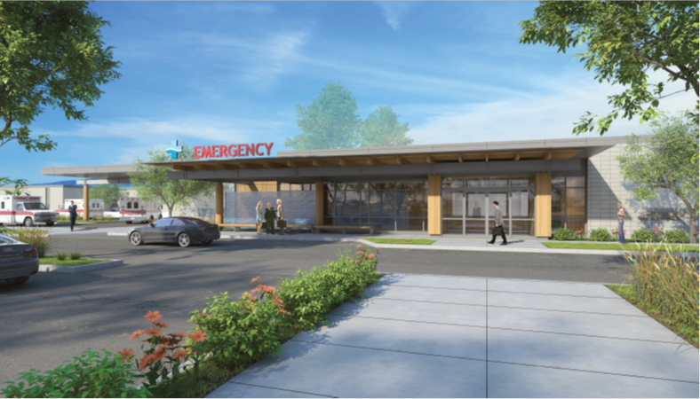
Project Description [PG]

Slide 6
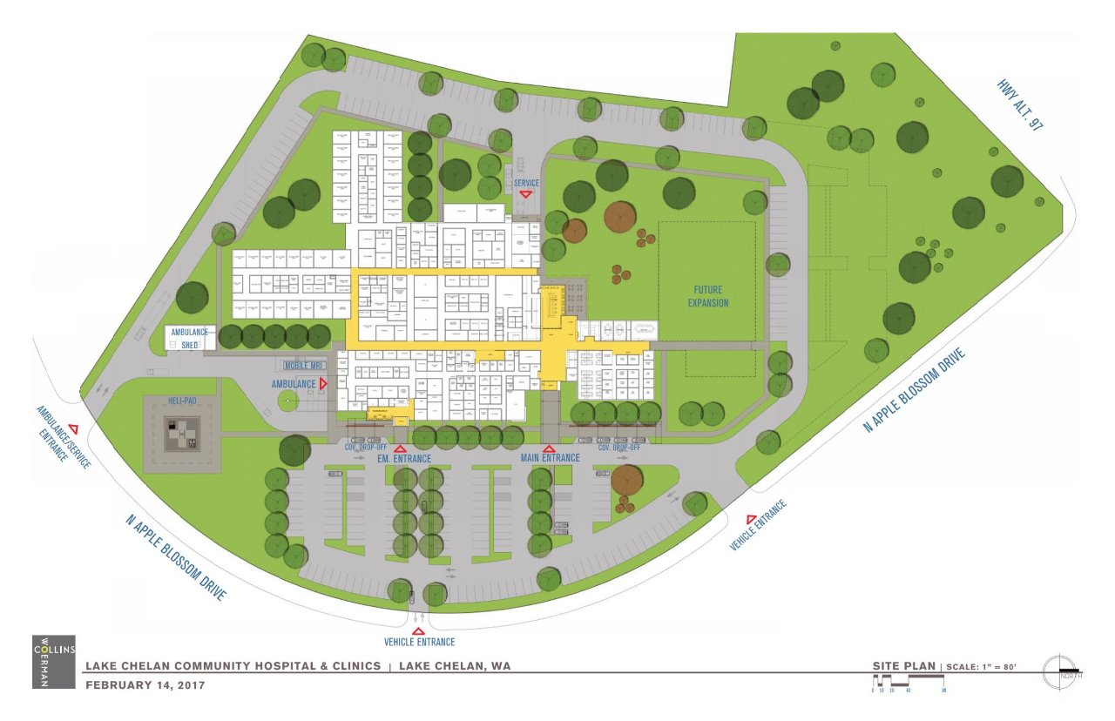

Slide 7
Benefits of GC/CM Project Delivery [BL]
Owner/Designer/Contractor Early Collaboration
  Utilize Team Expertise Early at SD
Compliant to RCW 39.10 P&P
Early Review of SD/Site Challenges
Establish Budget/Provide DD with Budget Advice
Identify and Coordinate Long Lead Items
Full CD Set Detailed with GC/CM Input
MACC at 90% CD, VE and Budget Reconciliation
Interactive Design/Contractor Team Group Effort for BIM Modeling and Clash Mitigation
GC/CM Influence and Coordination of Move Transition

Slide 8
Team Management- *Definite Decisions [KA]
Direct A/E
Program to Budget
Collins Woerman
Phil Giuntoli
Manage Design
Minimize RFIs
Review COs
MEPS Control
Conformed Coordinated Design
DBPM
Dick Bratton
Consult for GC/CM Selection
Consult for Contracting and USDA
GC/CM
Precon-MACC to Budget
Manage Subcontractors
Direct GC/CM
RFIs
COs
Daily Inspections
Control
Budget, Schedule, Quality, Safety
Construction Administration
Participate in Precon Phase as Advisory
Manage Project
-Contract
-Fiduciary
-Consultants
LCCHC*
Kevin Abel
Barry Leahy

Slide 9
Schedule [BL]
Item | Task | Schedule-Target dates
Project Predesign and Financial Feasibility Study/Market Analysis |  | Completed (Jan/Feb 2017)
1 | GC/CM PRC Application | July 3, 2017
2 | LCCHC PRC Presentation | July 27, 2017
3 | GC/CM Delivery Approval | July 28, 2017
4 | Official State Authority Notice | August 7, 2017
5 | GC/CM RFP | August 28, 2017
6 | GC/CM Selection | Oct 07, 2017
7 | Schematic Design Complete | Feb 26, 2018
8 | Baseline Estimate | Feb 26, 2018
9 | GC/CM Budget - 50% DD | Apr 16, 2018
10 | VE/Constructability | Apr/May 2018
11 | Design Development Complete | May 21, 2018
12 | Construction Docs Complete | Aug 6, 2018
13 | Mini MACC - 90% CDs | Sept/Oct 2018
14 | Permitting | Nov 5, 2018
15 | MACC | Jan 2, 2019
16 | Site Mobilization | Jan 3, 2019
17 | Construction | June 4, 2020

Slide 10
Response to PRC Questions Issued 7/19/2017[BL]
This is a terrific project. The construction cost of $392/SF (including escalation) seems low for a hospital/clinic. How confident are you in the budget for this size project? Response: Healthcare Collaborative Group developed the budget based on other similar Critical Access Hospitals. It is a one story design and will not include some of the more expensive areas found in PPS hospitals like MRI.
2. Will the USDA provide the additional $25M in funding? If not, are there other funding sources? Response: The USDA application is in process and we are confident it will be approved. If it is not funded we have a backup plan to issue revenue bonds. The financial plan for the project is conservative due to the voted component being paid by property tax.
3. The design phase seems short for such a specialized facility. If the design runs longer is there contingency to cover the additional cost? Is there a required completion date? Response: The architect agreement has adequate funds for project design completion and has specifically included liberal terms of 29 months for services.
4. Site mobilization is Sept. 2019. Is February 4, 2019 the anticipated completion date? Or, should it be February 2020? If so, that would be reasonable. Response: PRC did not receive the updated schedule after application submittal, the updated schedule is within this PPT which shows 1/3/2019 and 6/4/2020 for the two dates in question.
5. It appears that Dick Bratton is the only team member that has direct GC/CM experience or has taken the AGC GCCM training. Do other team members have GCCM RCW 39.10 experience or plan to take the AGC training? Response: Barry Leahy and a CW team member plan to take the two day AGC training.
6. Is the project going to have a Project labor Agreement (PLA)? If so, are you planning to have a dual benefit reimbursement program (for example: Sound Transit and City of Seattle both have these programs with their PLAs)? Response: Prevailing wages are required to be paid to workers, laborers and mechanics on all public works, according to RCW 39.12.020. A PLA is not mandatory or realistic in a remote location such as Chelan, and fair and competitive open bidding can be achieved without labor restrictions and through the prevailing wage requirement.

Slide 11
Summary [KA]
Applicant Final Comments
Questions

