Slide 1
Rock Island and Rocky Reach
Dam Modernizations
Application to use the GC/CM Delivery Method
March 22, 2018 Presentation
“To provide sustainable, reliable utility services that enhance the quality
of life in Chelan County.”

Slide 2
Agenda
Introductions
CCPUD Capital Improvement Plan
The Projects
Project Budgets
Project Schedule
Why GC/CM
Qualifications
Organization
Summary

Slide 3

Introductions

Slide 4
The Project Team – Here Today
Chelan County Public Utility District No. 1
Dan Frazier, Director of Shared Services
Sam Dilly, P.E. Project Manager III
Katie Yount, General Counsel
TCF Architecture
Randy Cook , AIA, Principal-in-Charge/ Project Manager
Mark Winsor, AAIA, Project Designer/Project Manager Support
Parametrix
Jim Dugan, GC/CM Program Advisor
Dan Cody, GC/CM Procurement & PM/CM
Michelle Langi, Project Controls Specialist
Perkins Coie
Graehm Wallace, GC/CM Legal Advisor

Slide 5
The Project Team:
Other Team Members
Chelan County Public Utilities District No. 1
Steve Wright, General Manager
Jeff Smith, Manager Director - District Services
Erik Wahlquist, General Counsel
Tim Detering, Project Manager II
Tyler Sellers, Construction Manager II

Slide 6

Chelan County PUD
Capital Improvement Program

Slide 7
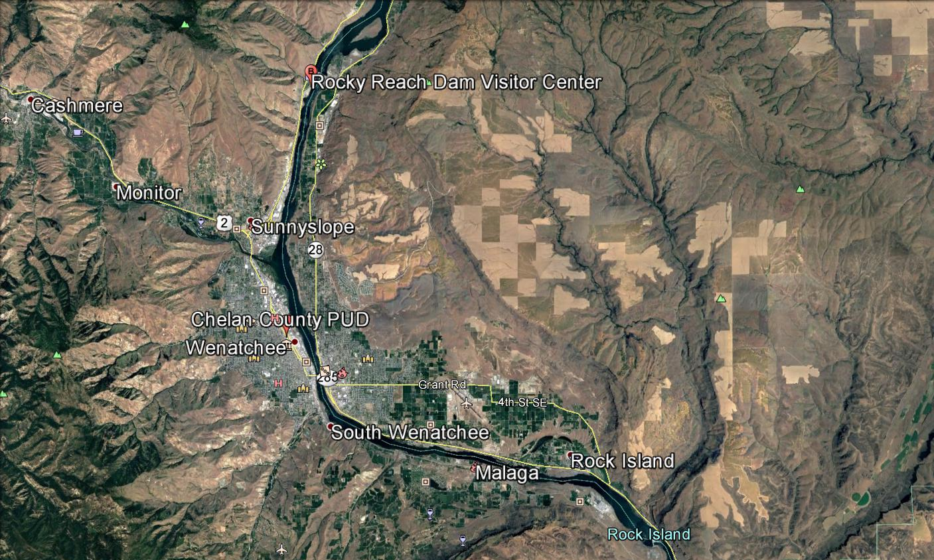
Chelan County PUD No. 1

Slide 8
The District
Chelan County PUD was established by a vote of people in 1936
Second largest, non-federal, publicly owned hydro generation capacity in the U.S.
800 Employees
50,000 Customers
3,000 sq. mile service territory
35% of hydropower generated serves county residents, the remainder is sold through contracts and into the energy market.
Three Hydroelectric projects
  Lake Chelan Dam –Built in 1927
  Rock Island Dam – Built in 1933
  Rocky Reach Dam – Built in 1961
Operate
  Water/wastewater – approx. 5,000 customers
  Fiber & telecom – 13,000 customers
  Parks & recreation – 14 parks along the Columbia River and Lake Chelan

Slide 9
2018 Capital Improvement Plan
Rock Island Dam
New Buildings & Modernizations
  Heated Storage Building
  New Blast/Paint/shop building
  ATKO Building Remodel For Machine Shops
  Stone & Webster Building
  Cobra building
  New Crew Building
  New PH2 Engineering Offices & Breakrooms
  New Warehouse & Tool Building
  Existing Clean Room & Storage Building
  Existing Media Blast Building (Rehab)
  Existing Crew Building (Demo)
  Existing offices (Remodel)
  Existing warehouse
  Existing Shop Building
  Existing Ph1 Storage
  Existing Storage (Rehab)
Rocky Reach Dam
New Buildings & Modernizations
  New Paint & Blast Building
  New Storage Building
  New Office Building
  New Haz-mat Building
  New Crew Building
  New Fuel Island
  Dive shop
  Tool Room
  Electrical Clean Room
  Machine Shop
  Fabrication Shop & CNC

Slide 10
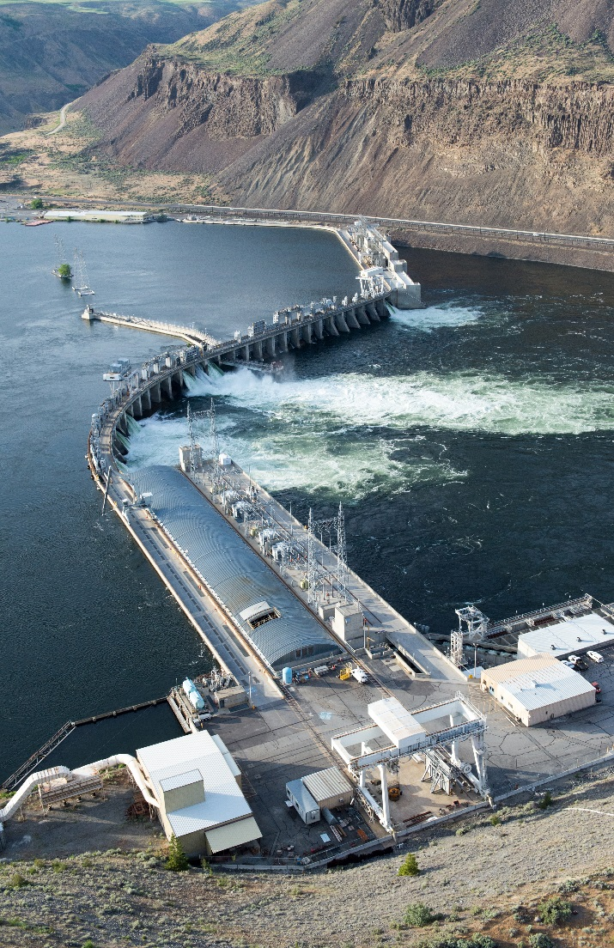
2018 Long Range Facilities Plan
  Initiated by Strategic Plan in 2014
  Developed a 50 year Facility Plan
  Comprehensive Public Engagement
  Three Locations:
    Rock island Dam Hydro Support Facilities
    Rocky Reach Dam Hydro Support Facilities
    Headquarters Facility in Wenatchee
  Approved Hydro Support Facilities
  5 year Funding Approved

Slide 11
Business Equity:
Community Inclusion Plan
Chelan County PUD is committed to Equity and Excellence. Developing strong business relationships and community partnerships are critically important to fulfilling the districts mission.
The District’s goals include:
Robust Stakeholder Engagement for All District Projects and Initiatives
Growing Diversity Programs for Future Workforce Development:
  2016 Creation of Community Outreach Position
  Community Needs Assessment - Find the Gaps in Knowledge, Skills & Abilities
  2017 Development of Multiple Diversity Outreach Programs (Discover Us, “Pizza, Pop & Power Tools”, STEM Academy, WorkSource Veterans Program)
  2018 New CAMP (College Assistance Migrant Program) development

Slide 12
The Projects

Slide 13
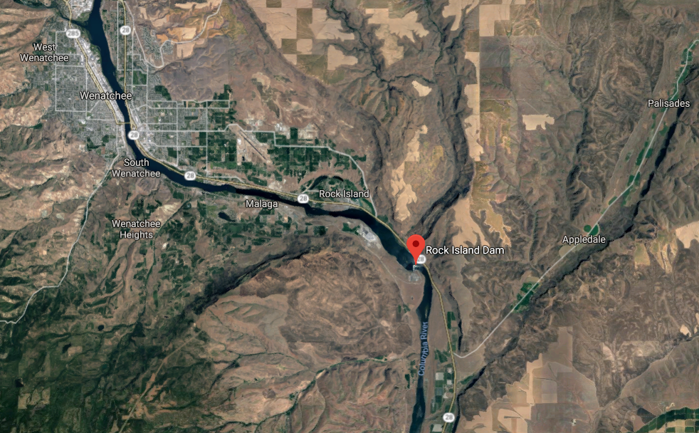
Rock Island Dam

Slide 14
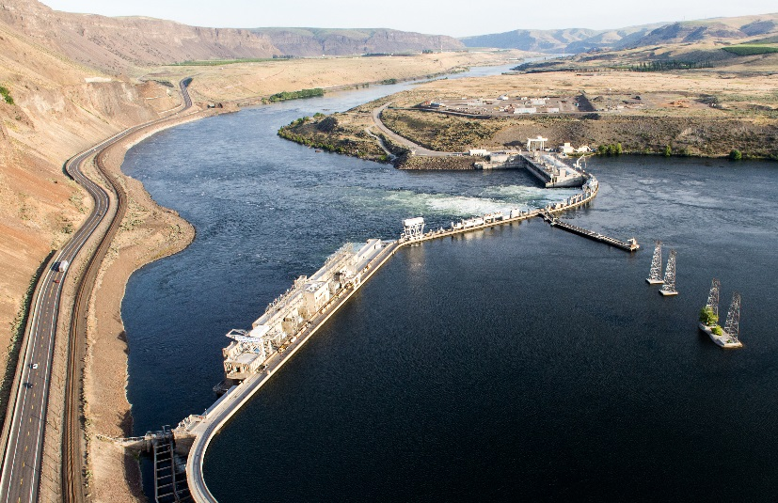
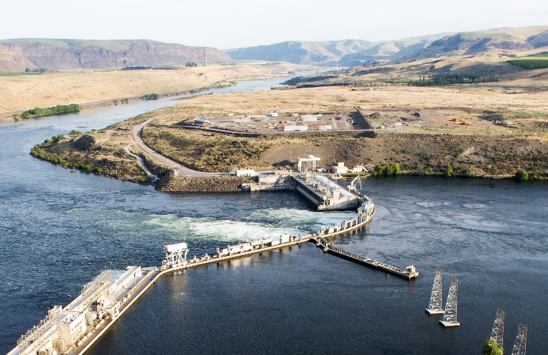
Rock Island Dam
Built Spillway and Powerhouse 1 from 1929 to 1932
First Hydropower project on the Columbia River
Built Powerhouse 2 1974 - 1979
629 MW production capacity
Connected by a single lane across the Columbia River
Confined work areas
Essential facility operation
Planned significant 10 year rehabilitation project starting 2020

Slide 15
Rocky Reach Dam

Slide 16
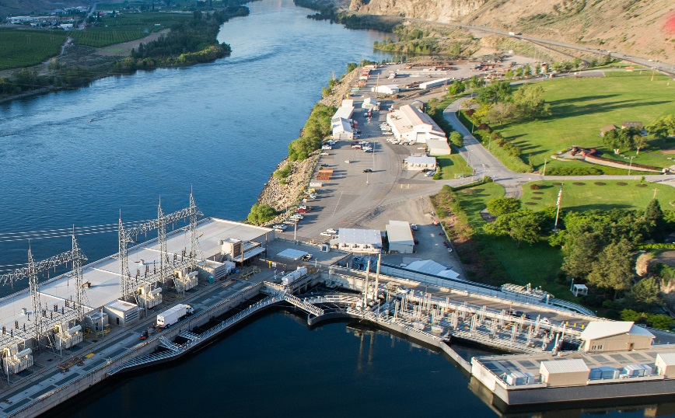
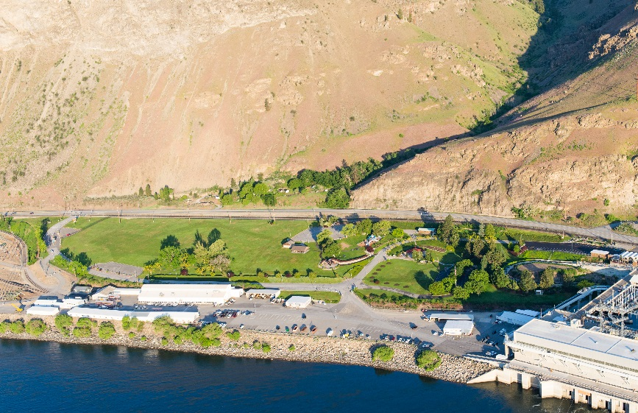
Rocky Reach Dam
Built in 1961
1300 MW Production Capacity
Public access Visitor’s Center, Park and Powerhouse Museum
Central Maintenance work force facilities for all three Dams
Continuous on-going Unit repairs and Overhauls use the Facilities
On-going large Turbine unit rehabilitation until at least 2020

Slide 17
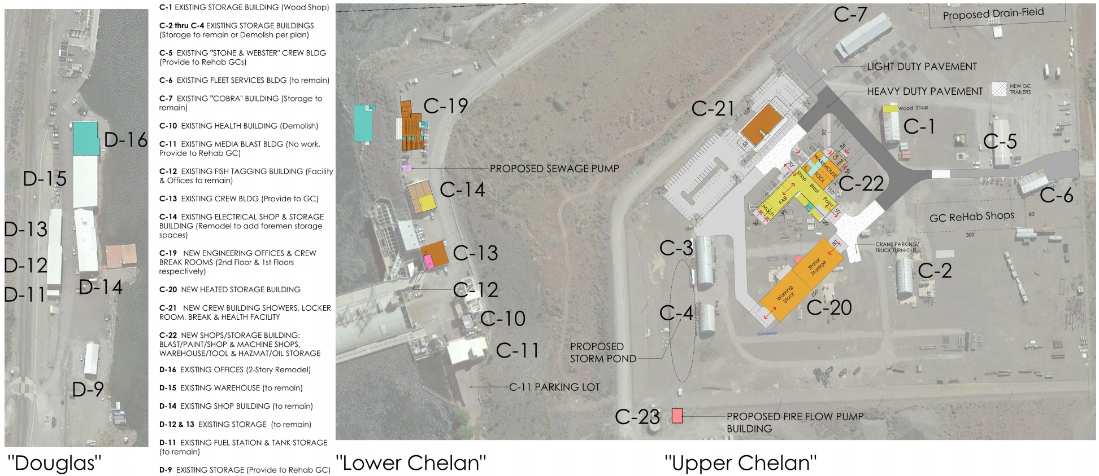
Rock Island Scope of Work

Slide 18
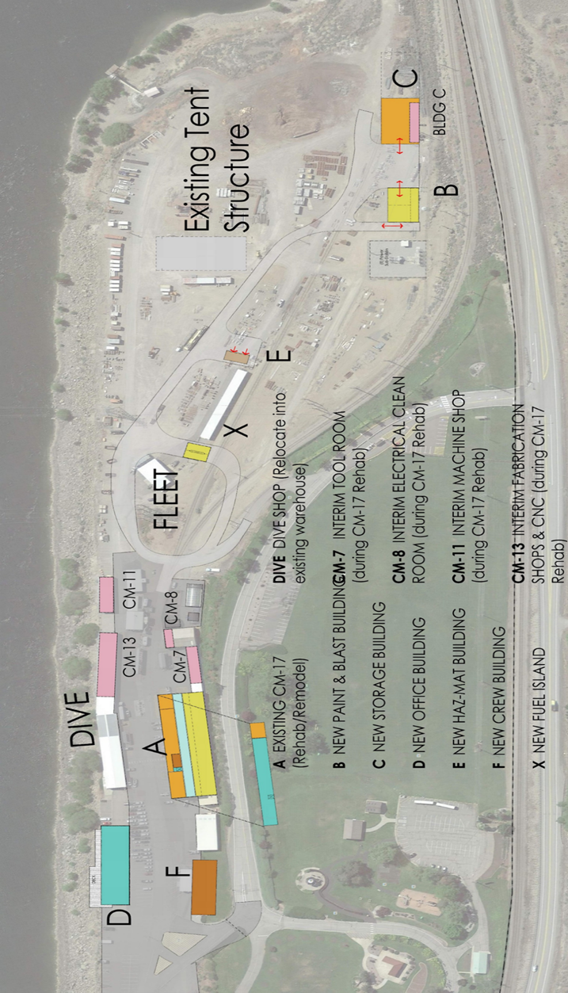
Rocky Reach Scope of Work

Slide 19
Rock Island Project Budget
Category | Budget
Project MACC (includes GC/CM Risk Contingency @ 3% of MACC) | $23,324,725
GC/CM Fee, SGC’s, Pre-Con Services and NSS Allowance (13.5% of MACC) | $3,640,275
Owner’s Construction and Project Contingency (6% of MACC) | $1,617,900
Furnishings, Fixtures, Equipment, Data & Technology (0.025% of MACC) | $67,413
Professional Services (A/E) (14.47% of MACC) | $3,901,836
Owner’s Consultants (2.5% of MACC) | $674,125
Contract Administration (PM, CM) (2.5% of MACC) | $674,125
Other Related Project Costs (Permits Fees, Etc.) | $1,670,572
Sales Tax (8.2% of MACC) | $2,211,130
Total | 39,400,000

Slide 20
Rocky Reach Project Budget
Category | Budget
Project MACC (includes GC/CM Risk Contingency @ 3% of MACC) | $24,553,025
GC/CM Fee, SGC’s, Pre-Con Services and NSS Allowance (13.5% of MACC) | $3,831,975
Owner’s Construction and Project Contingency (6% of MACC) | $1,703,100
Furnishings, Fixtures, Equipment, Data & Technology (0.25% of MACC) | $70,963
Professional Services (A/E) (14.47% of MACC) | $4,107,310
Owner’s Consultants (2.5% of MACC) | $709,625
Contract Administration (PM, CM) (2.5% of MACC) | $709,625
Other Related Project Costs (Permits Fees, Etc.) | $1,483,708
Sales Tax (8.2% of MACC) | $2,327,570
Total | 31,200,000

Slide 21
Rock Island & Rocky Reach GC/CM Schedule
Project Schedule | Start
PRC Presentation | March 22, 2018
Publication of Advertisement for GC/CM Services | April 6 & 13, 2018
Project Information Meeting (date subject to change) | April 13, 2018
RFP Submittal Deadline | April 20, 2018
Open & Score Submittal Received | April 23-27, 2018
Notify Submitters of Most Highly Qualified Submitters & Invite to Interview | April 30, 2018
Interviews with Short-Listed Firms | May 7-11, 2018
Notify Submitters of Most Highly Qualified Firms & Invite to Submit RFFP | May 14, 2018
RFFP Submittal Deadline & Opening | May 25, 2018
Notify Submitters of Scoring and Most Highly Qualified GC/CM | May 28, 2018
Early Assistance Services | May 30, 2018
Pre-Con Work Plan Due | June 18, 2018
Commission Board Approval of GC/CM Selection | July 2, 2018
GC/CM Agreement with Pre-Con Services Executed | July 16, 2018

Slide 22
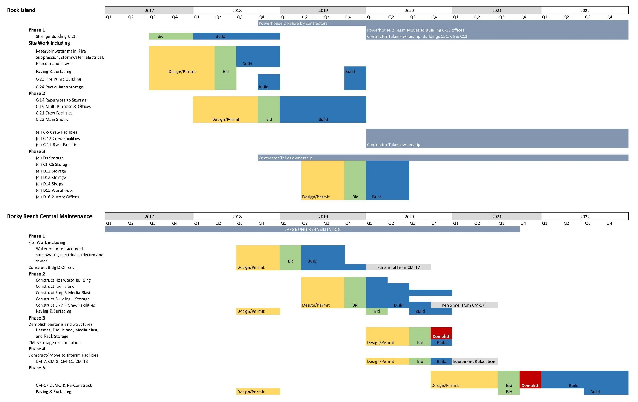
Rock Island & Rocky Reach Dam Development Schedules
Critical Phasing – Essential Facilities

Slide 23
Why GC/CM Delivery Method for Rock Island & Rocky Reach
Dam Support Facilities

Slide 24
Complies with 3 of the 5 Statutory Criteria
(1) Implementation of the project involves complex scheduling, phasing, or coordination.
(2) The project involves construction at an occupied facility which must continue to operate during construction.
(3) The involvement of the General Contractor/Construction Manager during the design stage is critical to the success of the project.
(4) The project encompasses a complex or technical work environment.
(5) The project requires specialized work on a building that has historic significance.

Slide 25
Projects involve complex scheduling, phasing, and coordination on an occupied Essential Facility site
Required continuous operation of both hydros at all times
Support facilities house the labor and equipment that maintains and operates the hydros
The support facilities will remain occupied and in use during the support facilities improvements
Need GC/CM feedback on planned phasing to ensure the most efficient and cost effective phasing plan
Need GC/CM feedback immediately regarding cost estimating

Slide 26
Other Critical Factors
Safety: Improved Safety Planning and Execution
Inflation: Manage Escalating Market Costs
Multiple Packages: Sites and Buildings
Procurement: Early Procurement of Long Lead Items and Larger Quantity Bundling for Value
Cost Savings: Mobilization and Overhead Reduction with Two Projects and One GC/CM

Slide 27
Two Projects – One GC/CM
Experienced cost savings at Clover Park SD combined projects
    Key factor to savings – same design team on both projects
Experienced cost savings at Tacoma Public Schools
    McCarver ES and Stewart MS Modernizations
    Projects maintain separate project teams
    Savings achieved in reduced overall company overhead, combined procurement, and careful sequencing of the Work
    Approximate savings in the $1 M range
GC/CM RFP includes demonstrating this kind of experience
Depth of experience by our leadership team and our design team and having the same design team for both projects – forms the basis for this two project GC/CM approval request

Slide 28
Public Benefits ……
Standardized Improvements
Enhanced Safety
Enhanced Cost and Schedule Control
Appropriate Risk Allocation
Fiscal Accountability

Slide 29
Public Body Qualifications

Slide 30
CCPUD Leadership Team
The District
New to the GC/CM method of project delivery
CCPUD GC/CM Team Experience
Parametrix: GC/CM Procurement and Advisory Services
Parametrix: GC/CM Program and Project Management Services
Perkin Coie: GC/CM External Legal Services
TCF Architects: GC/CM Design Services
CCPUD satisfies the public body qualifications by staff augmentation with consultants.

Slide 31
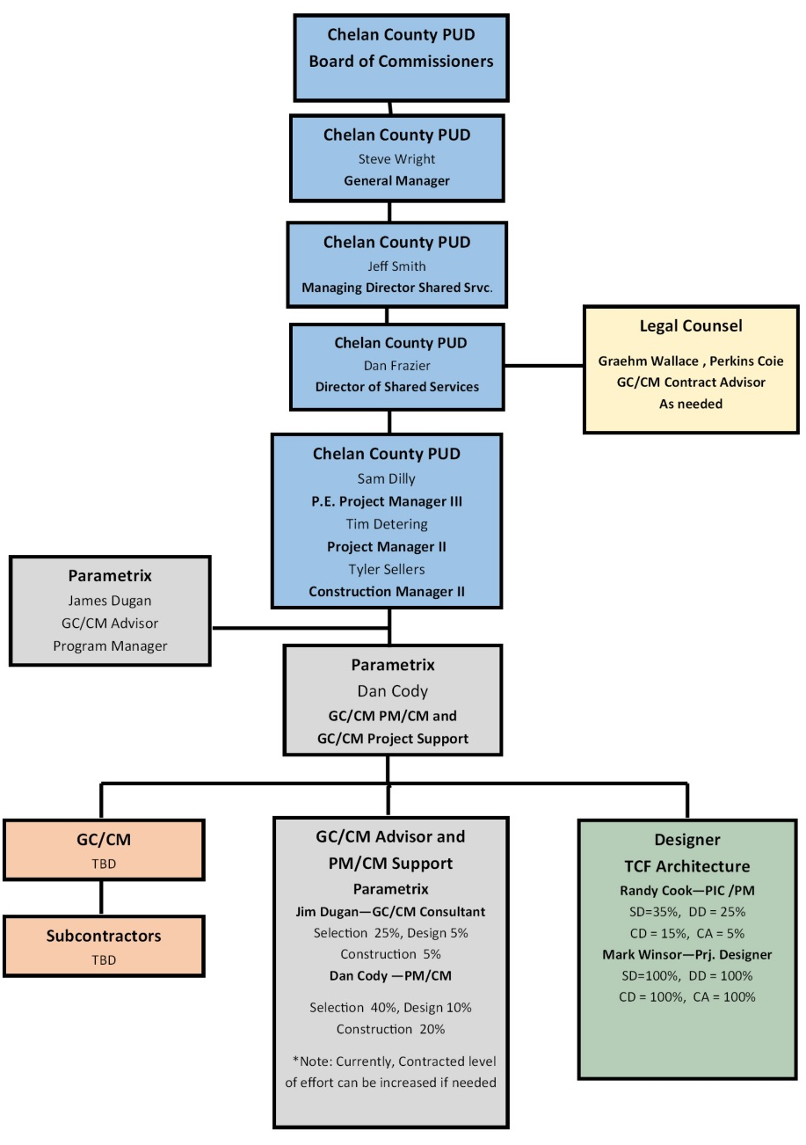
Rock Island & Rocky Reach Dam
Project Organizational Chart

Slide 32
Project Team GC/CM Experience

Slide 33
Name | Experience
Dan Frazier Director of Shared Services Chelan County PUD | 26 yrs. Program/Project Management 26 yrs. in Public Works/Public Utility
Sam Dilly, P.E. Project Manager III Chelan County PUD | 24 yrs. Civil Engineer/Project Management 12 yrs. Project Management
Tim Detering Project Manager II Chelan County PUD | 36 yrs. Project Management/Construction Management
Tyler Sellers Construction Manager II Chelan County PUD | 18 yrs. Construction Management
Jim Dugan GC/CM Program Advisor Parametrix | 40 yrs. Program/Project Management 18 GC/CM Projects: ASD Olympic Middle School, ASD Four Elementary School Program, MVSD Old Main Building, MVSD Madison Elementary, MVSD East Division Elementary, BISD Blakely Elementary School, TPS Stadium High School, COT Tacoma Convention and Trade Center, TPS McCarver Elementary School; TPS Stewart Middle School; MPT Eastside Community Center, TPS Browns Point Elementary School; CKSD HS/MS and OHS Projects Tacoma Public Schools Board of Director: 2005 – 2011 Project Review Committee Member: 3 Year Term Ends June 2019

Slide 34
Name | Experience
Dan Cody GC/CM Procurement & PM/CM Parametrix | 30 yrs. Of Design & PM/CM 10 GC/CM Projects: LSSD HS, ASD Olympic Middle School, MVSD MVHS Old Main Building Historic, MVSD Madison Elementary, MVSD East Division Elementary, CKSD CKSH and Middle School, CKSD Olympic HS, TPS Browns Point Elementary, Metro Parks Tacoma Eastside Community Center
Randy Cook , AIA Principal in Charge/Project Manager TCF Architecture | 30yrs. TCF Architecture- PIC/PM GC/CM Project: LWSD Wilderness Elementary School, TPS Browns Point Elementary School, Mt. Vernon School District East Division Elementary School and Madison Elementary School, WSD Washington Elementary School, Olympia School District ORLA
Mark Winsor, AAIA Project Manager Support/Project Designer TCF Architecture | 32 yrs. Project Manager Support/Project Designer

Slide 35
Summary
Projects are funded with the appropriate budgets
Projects meet qualifying RCW 39.10 criteria
Project Management Plan for both projects are developed and have clear and logical lines of authority
Project team has the necessary experience in addition to continuity both projects
Project team has the capacity for both projects
Project team is prepared and ready to proceed
GC/CM RFP is complete and ready to publish

Slide 36
Thank you

