Slide 1
Rock Island Dam Powerhouse #2
Turbine Generator Rehabilitation Project
Application to use the Progressive D/B Delivery Method
September 27, 2018 Presentation
“To provide sustainable, reliable utility services that enhance the quality
of life in Chelan County.”

Slide 2
Agenda
Introductions
Chelan County PUD
The Project
Project Budget
Project Schedule
Why Progressive Design-Build
Qualifications
Organization Chart
Summary

Slide 3

Introductions

Slide 4
The Project Team – Here Today
Chelan County Public Utility District No. 1
Brett Bickford, Director – Engineering and Project Management (EPM)
John Sagerser, Rock Island EPM Manager
Katie Yount, Internal Legal Counsel
Perkins Coie
Andrew Greene, D/B Legal Advisor
Parametrix
Jim Dugan, D/B Program Advisor
Dan Cody, D/B Procurement & D/B PM/CM Support
Maggie Anderson, Project Controls Specialist

Slide 5
The Project Team:
Other Team Members
Chelan County Public Utilities District No. 1
Steve Wright, General Manager
Justin Erickson, Managing Director - District Services
Chuck Boss, Construction Manager
Perkins Coie
Graehm Wallace, D/B Legal Advisor
Outside Design Build Advisor
John Palewicz
Hydro Design Consultant
Ron Israelson, Stantec Consulting

Slide 6
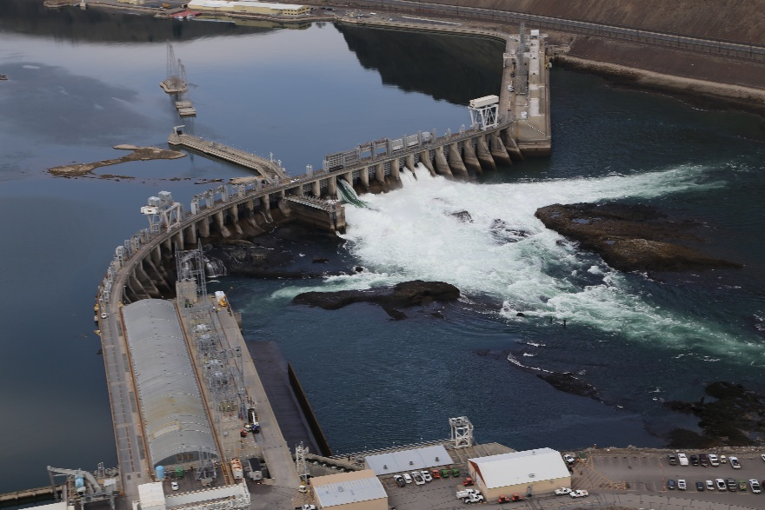
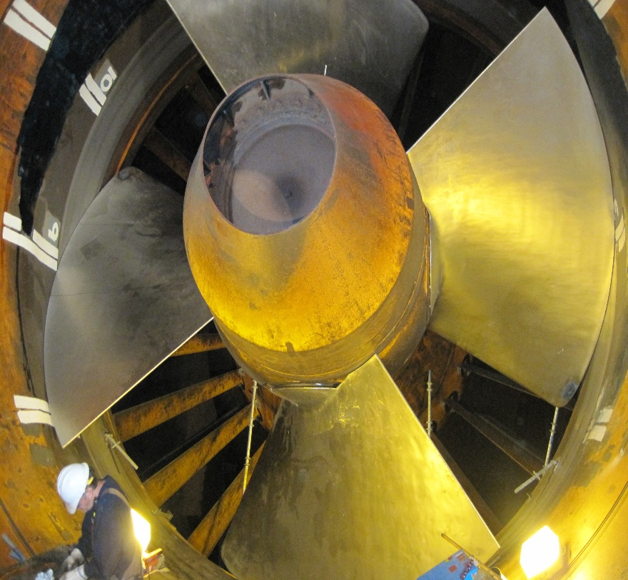
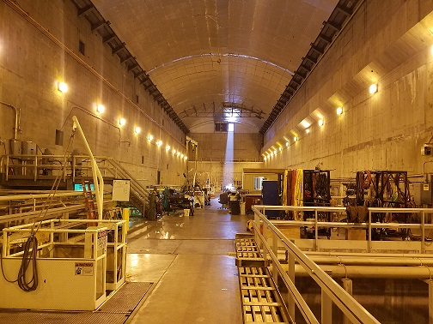
Chelan County PUD

Slide 7
The District
Chelan County PUD was established in 1936
Second largest, non-federal, publicly owned hydro generation capacity in the U.S.
800 Employees
50,000 Customers
3,000 sq. mile service territory
Approximately 2,000 megawatts of generating capacity
35% of hydropower generated serves county residents, the remainder is sold through contracts and into the energy market.
Three Hydroelectric projects
  Lake Chelan Dam –Built in 1927
  Rock Island Dam – First Powerhouse built in 1933,
                Second Powerhouse built in 1979
  Rocky Reach Dam – Built in 1961
Operate
  Water/wastewater – approx. 5,000 customers
  Fiber & telecom – 13,000 customers
  Parks & recreation – 14 parks along the Columbia River and Lake Chelan

Slide 8

The Project

Slide 9
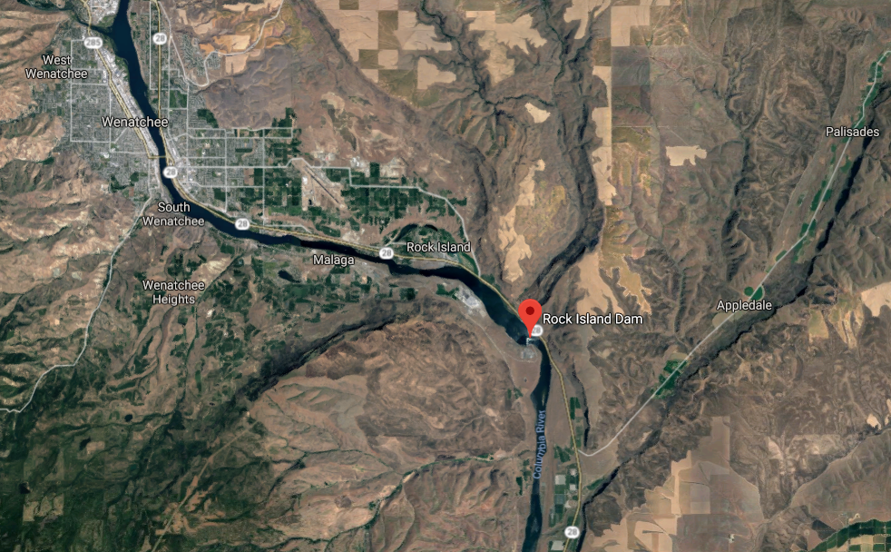
Rock Island Dam

Slide 10
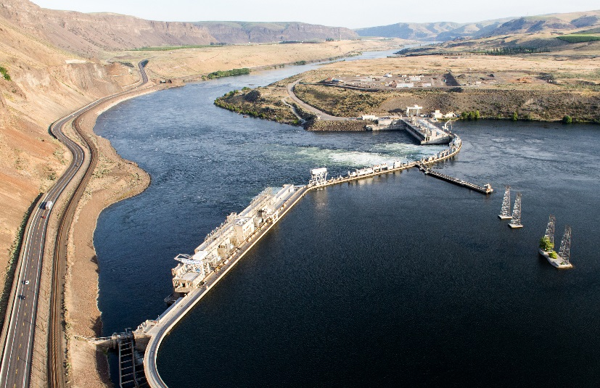
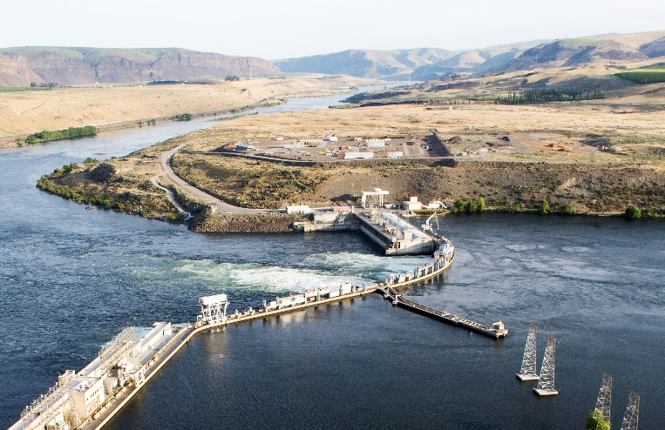
Rock Island Dam
First Powerhouse built in 1933
First Hydropower project on the Columbia River
Second Powerhouse built in 1979
Last Hydropower project on the Columbia River
Eight (8) original turbine-generator units installed in Powerhouse #2
“Bulb” type turbines are rare in the United States
Turbine-generators have exceeded their 40-year useful life
Rehabilitation will ensure another 40 years of reliable/efficient operation
Rehabilitation will be phased to minimize disruption to power generation capability

Slide 11
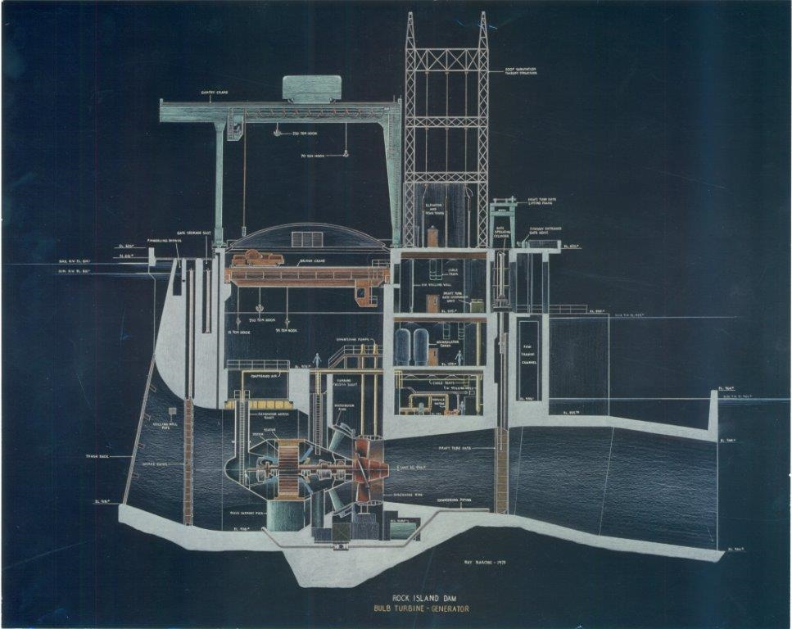

Slide 12
Rock Island Dam
Powerhouse #2 Rehabilitation
  Assess turbine generator components; disassemble, clean, inspect/assess for re-use.
  Refurbish most turbine generator major components.
    Sandblast, inspect for re-use and remaining life, repair and re-machine to original dimensions and tolerances as necessary.
  Turbine work - weld/machine worn and corroded parts that have 40 years remaining life. Replace bearing, bushings and seals. Manufacture and install new parts that do not have 40 years remaining life.
Generator work - inspect stator frame and rotor spider, rewind or replace stator, refurbish or replace poles, replace spider and rim if necessary.
  Re-assemble components into a functioning turbine generator.
  Refurbish or replace bridge crane and gantry crane trolleys in preparation for installation.
  Assess and upgrade (as necessary) all associated balance of plant systems.

Slide 13
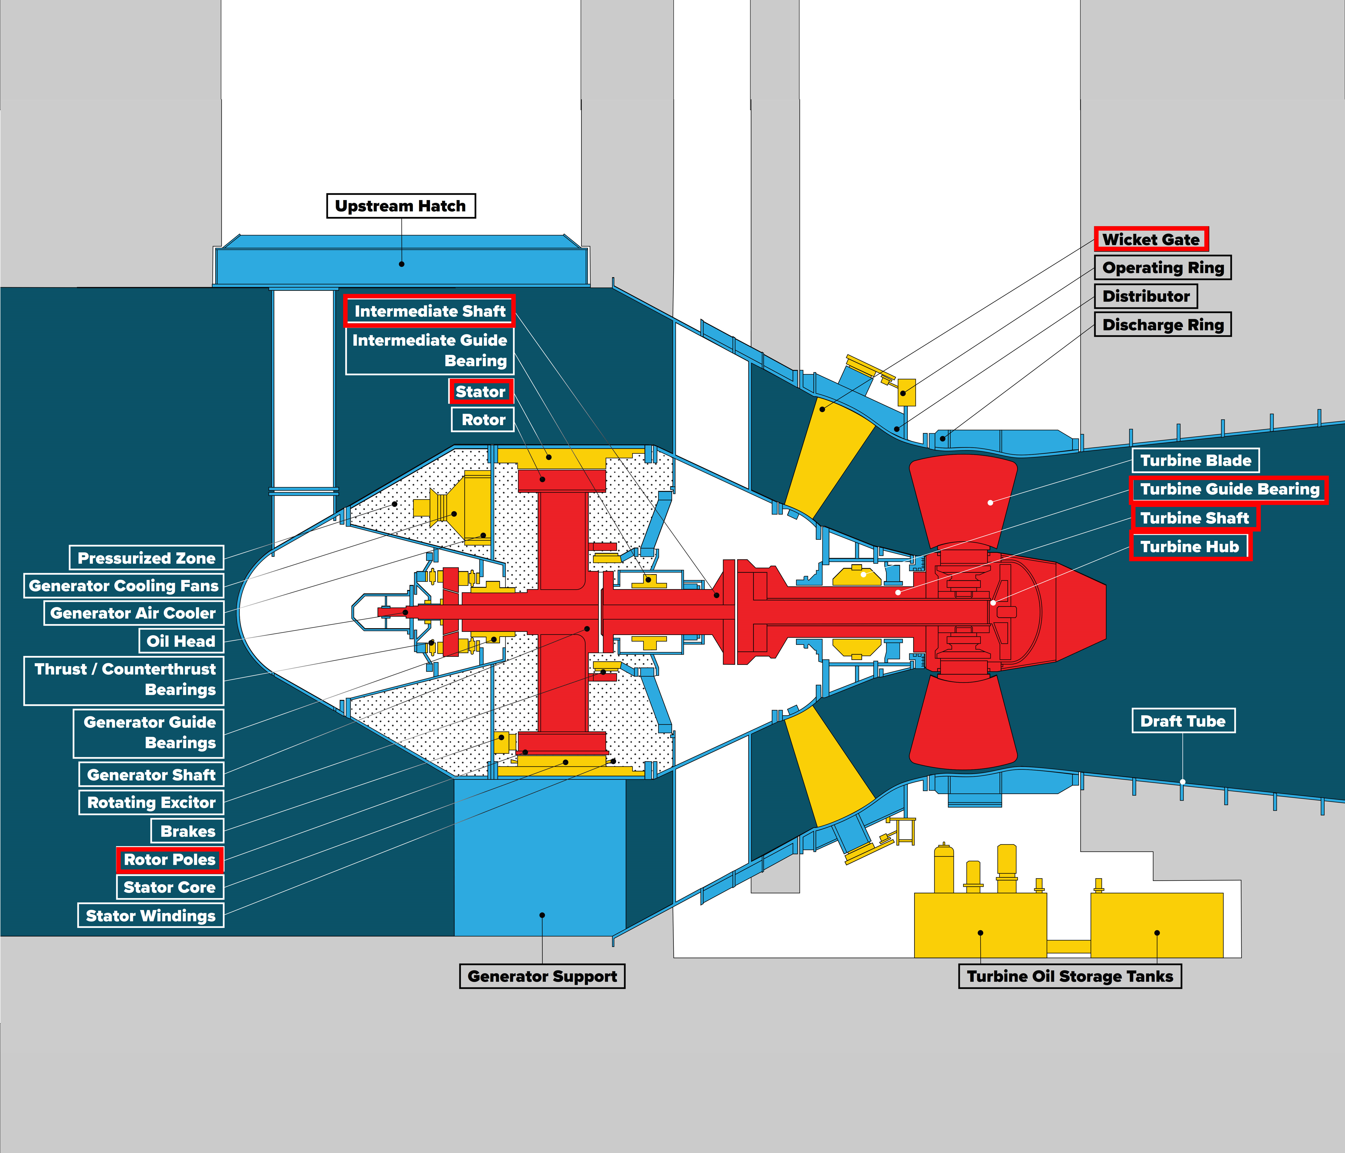

Slide 14
Rock Island Dam Powerhouse #2 Turbine Generator Rehabilitation Project Budget
Category | Budget
Costs for Professional Services (A/E, Legal, etc.) | $ 6,000,000
Contractor Design | $ 10,000,000
Contractor Manufacturing and Mobilization | $ 26,000,000
Develop Site Machining and Fabrication Capabilities | $ 12,000,000
Unit Installation | $240,000,000
District Administration and Project Management | $ 19,000,000
Total | $313,000,000
Note: All design and construction costs identified above include 8.2% sales tax and a combined 25% contingency for design, construction, escalation and inflation

Slide 15
Project Funding
  Overall project scope, schedule, budget presented to District Board of Commissioners in November 2017
  Approved 2018 capital funds associated with the project
  District currently plans to fund project with cash reserves until 2022
  District has not issued bonds for capital projects since 2009
  Average capital expenditure of $44M between 2010 and 2017 using cash reserves
  District’s current bond rating is AA+/Stable, one of the top five public utilities
  Ability to fund project after 2022 using external debt is high

Slide 16
Rock Island Dam Powerhouse #2 Turbine Generator Rehabilitation Project D/B Schedule
Project Schedule | Estimated Date
PRC Presentation | September 27, 2018
Publication of RFQ for Design/Build Services | October 12, 2018
Project Information Meeting (Date subject to change.) | October 29, 2018
RFQ Submittal Deadline | November 14, 2018
Open & Review/Score Submittals Received | November 14-19, 2018
Identify Finalists & Issue RFP & Proprietary Meeting Notifications | November 21, 2018
Proprietary Meeting #1 | December 3, 2018
Proprietary Meeting #2 | January 28, 2019
Proprietary Meeting #3 | March 11, 2019
RFP Submittal Deadline (Proposals & Cost Factors) | April 17, 2019 3:00pm
Open & Review Proposals (Cost Factors not reviewed) | April 18-24, 2019
Design/Builder Interviews | April 25, 2019
Open Cost Factors & Score Proposals | April 29, 2019
Notify Design/Builders of Scoring and Most-Qualified Design/Builder | May 1, 2019

Slide 17
Rock Island Dam Powerhouse #2 Turbine Generator Rehabilitation Project D/B Schedule
Project Schedule | Estimated Date
Design/Build Contract Negotiation | May 6-31, 2019
Execute Design/Build Agreement with Preconstruction Services | July 1, 2019
Preconstruction Phase Services | July - December 2019
GMP Negotiation | November 2019
GMP Amendment Executed | December 2019
Design Phase – First Unit | July 2019 – February 2020
Manufacturing – First Unit and Unit Common | March 2020 – July 2021
Site Set-up and Mobilization | July 2020 – September 2021
Bidding & Construction Phase | September 2021 – January 2029

Slide 18
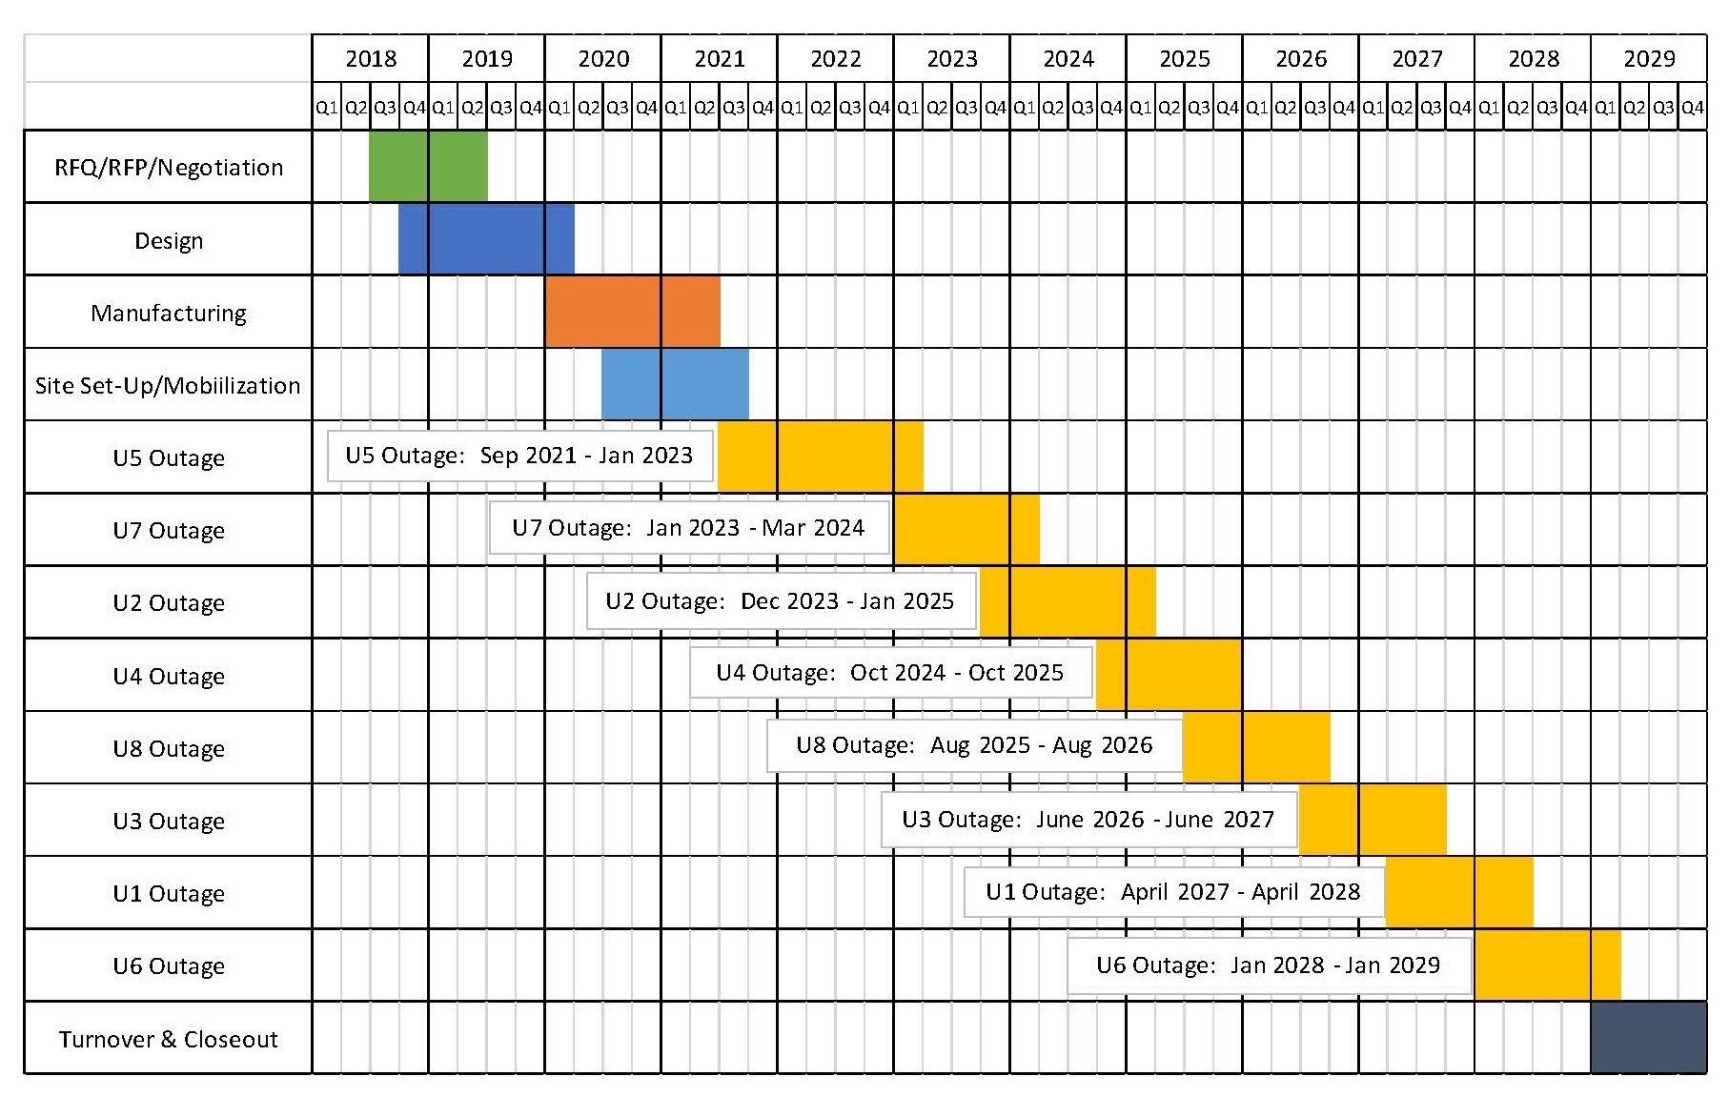
Rock Island Dam Powerhouse #2 Turbine Rehabilitation Project Development Schedules
Critical Phasing

Slide 19
Why D/B Delivery Method for Rock Island Dam Powerhouse #2 Turbine Generator Rehabilitation Project

Slide 20
RCW 39.10 D/B Statutory Compliance
(5.1) If the construction activities are highly specialized and a D/B approach is critical in developing the construction methodology
  Limited access for removal and reinstallation
  Massive scale/size of components
  Very specialized machining/fabrication will be required
  Very tight clearances/tolerances required between operational and stationary components
  Phased construction required to minimize operational impacts on power generation
(5.2) If the project provides opportunity for greater innovation and efficiencies between the designer and builder
  “Bulb” turbine-generator rare in the U.S.
  Limited contractors qualified/experienced to do this type of work
  Will require evaluation of each turbine-generator as they are removed/disassembled
  Design may vary based on condition and needs of each unit
  Owner does not have expertise to specify options for improvement to existing systems
(5.3) If significant savings in project delivery time would be realized

Slide 21
Public Body Qualifications

Slide 22
CCPUD Leadership Team
CCPUD has extensive construction experience including projects of similar scope and complexity
  All of which have been delivered using Design-Bid-Build or Negotiated Contract.
  Long track record of building projects on-time and within budget.
CCPUD is new to the Design Build method of project delivery
CCPUD team members are registered to attend the upcoming AGC Design-Build Workshop
Parametrix: Dan Cody D/B PM Support and Jim Dugan Internal D/B Advisor
John Palewicz: External D/B Advisor
Graehm Wallace, (Perkins Coie): External D/B Legal Counsel
CCPUD satisfies the public body qualifications by staff augmentation with consultants.

Slide 23
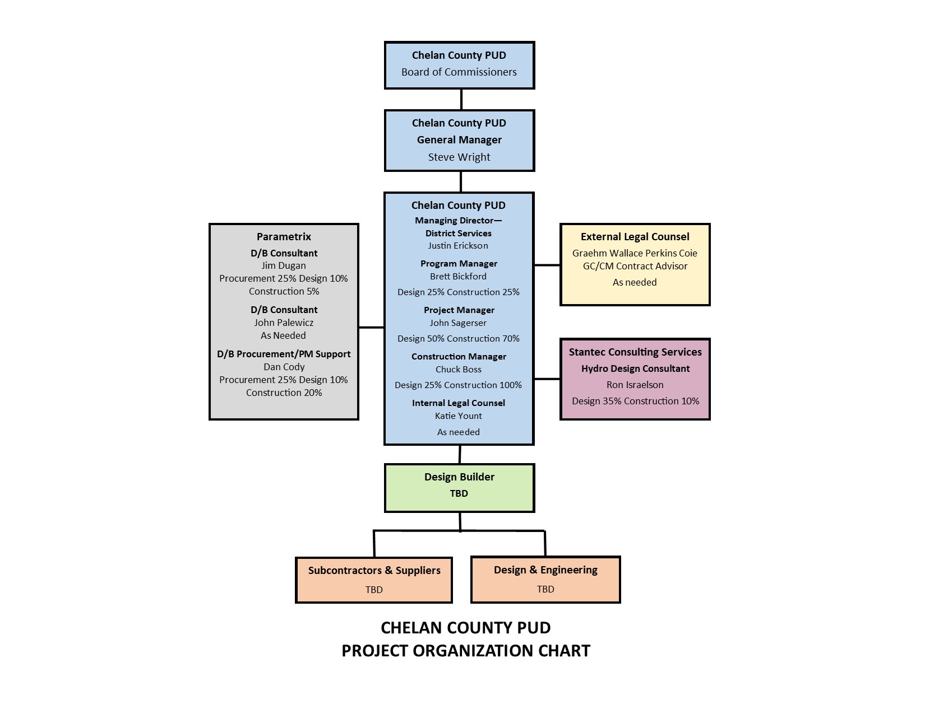
Rock Island Dam Powerhouse #2 - Turbine Generator Rehabilitation Project
Project Organizational Chart

Slide 24
Project Team D/B Experience

Slide 25
Name | Experience
Brett Bickford Director – Engineering and Project Management (EPM) Chelan County PUD | 30 yrs. Civil Engineering/Project Management Experience 25 yrs. Hydro Engineering/Project Management Experience Project Manager for Rocky Reach Fish Bypass System ($110M 2001 to 2003) Project Manager for Rock Island Powerhouse 1 Rehabilitation ($150M 2003 to 2017)
John Sagerser Rock Island EPM Manager Chelan County PUD | 28 yrs. Electrical Engineering/Project Management Experience 17 yrs. Hydro Engineering/Project Management Experience Project Manager for Lake Chelan Hydro Modernization ($35M 2006 to 2010) Project Manager for Rock Island Powerhouse 1 Rehabilitation (2015 to 2018)
Chuck Boss Construction Manager Chelan County PUD | 20 yrs. Industrial Engineering/Construction Management Experience 12 yrs. Hydro Construction Management/Quality Control Experience Construction Manager Rock Island Powerhouse 1 Rehabilitation QA/QC Representative Rock Island Powerhouse 1 Rehabilitation Construction Manager Rock Island Denil Installation/Removal
Jim Dugan D/B Program Advisor Parametrix | 40 yrs. Program/Project Management Projects: TPS – Boze Elementary School; TPS Hunt Middle School; Willapa Elementary School Gym; Multiple large D/B projects worldwide with The Austin Company Project Review Committee Member: 3 Year Term Ends June 2019

Slide 26
Name | Experience
Dan Cody D/B Procurement and PM Support Parametrix | 30 yrs. Of Design & PM/CM 4 D/B Projects: South Puget Sound Community College – Lacey Campus; Building #1; Tacoma Public Schools – Boze Elementary School; Tacoma Public Schools – Hunt Middle School; Willapa Elementary School Gym
John Palewicz D/B Consultant/Advisor | 38 yrs. Of Design & Owners Rep 8 D/B Projects: UW - Husky Football Stadium, UW - Husky Baseball Park, UW – West Campus Utility Plant, UW – Global Innovation Exchange, WWU – Administration & Support Services Building, WWU – Residence Hall, Tacoma Public Schools – Boze Elementary School, Tacoma Public Schools – Hunt Middle School
Graehm Wallace Outside Legal Counsel Perkins Coie | Graehm has prepared Design-Build contract documents under RCW 39.10 for the Washington State School Directors Association, the Tacoma School District, and the Willapa Valley School District as well as Design-Build contract documents for dozens of private projects. Graehm has over twenty-two years legal counsel experience working in all areas of construction and has provided legal assistance to over 100 Washington public entities. His work has covered all aspects of contract drafting and negotiating. This includes preconstruction, architectural, engineering, construction-management, GC/CM, Design-Build and bidding. Graehm has also provided legal advice during construction, claim prosecution and defense work.

Slide 27
Summary
Project is funded with the appropriate budgets
Projects meet qualifying RCW criteria
Project Management Plan is developed and has clear and logical lines of authority
Project team has the necessary experience
Project team has the capacity
Project team is prepared and ready to proceed

Slide 28
Thank you

