Slide 1
Panel Procedures
20 minute applicant presentation (with a 5 minute reminder provided)
15 minute panel question and answer session
10 minutes for public comments only, no questions allowed (limited to 2 minutes per person)
15 minutes for panel deliberations and determination.
Total time: 60 minutes
Remind application team to sign-in before they leave.

Slide 2

Fire Stations 42 & 45
Rebuild Two New Stations On Existing Sites
Maintain Critical Life-safety Operations
Application to Use Progressive Design-Build
Project Review Committee Meeting: June 27th, 2019
Notes:
Erin: COB intro ,embrace innovation, agenda overview 1 Minute

Slide 3


Agenda
    Introductions and Org Chart
    Project Description
    Budget and Funding
    Schedule
    Why Progressive Design Build
    Project Management and Qualifications
    Questions
Notes:
Erin

Slide 4
Introduction – Organizaton Chart
Notes:
Erin to address Robynne and point out DBIA quals on team, Jeff, Butch, Dave, Krista 3 Minute

Slide 5
Project Description - Public Benefit
  Maintain critical life-safety operations during construction of two fire stations and temporary facilities.
  Substantial fiscal benefit to the City and tax payers by speeding up overall delivery.
  Significantly reduced liability and risk exposure to the City and tax payers.
Notes:
Dave 1 Minute

Slide 6
Project Description - Scope
    New rebuild of Fire Stations 42 & 45 on existing sites.
    Temporary facilities and/or phased construction for both stations.
    Maintain critical life-safety operations during construction.
    LEED Silver, 1% for the Arts
    Station 45 - Canyon Park/Police Department Office:
      Approx. 17,000 SF facility with 4 bays.
    Station 42 - Downtown HQ/Training/Administration:
      Approx. 26,000 SF facility with 5 bay drive through.
      Approx. 3,000 SF detached reserve & support apparatus room structure; constructed as a separate non-essential building; 3 bays.
      Training tower/facility if budget allows.
Notes:
Jeff 1 Minute

Slide 7
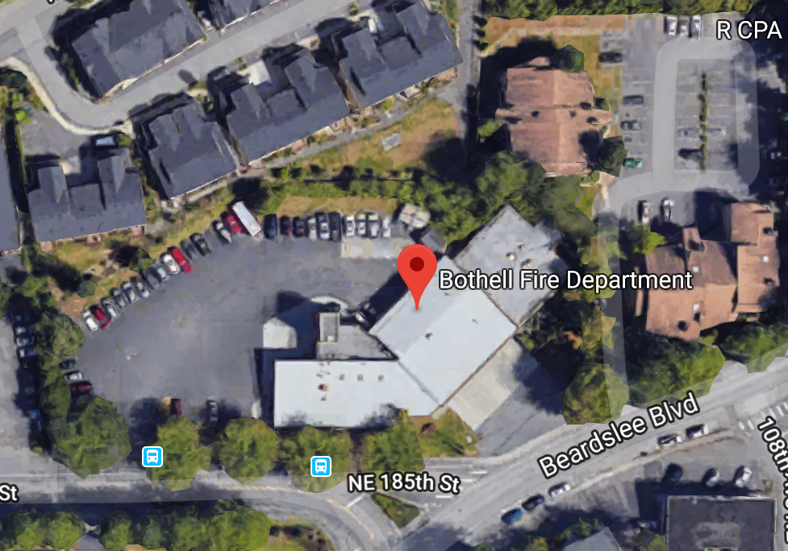
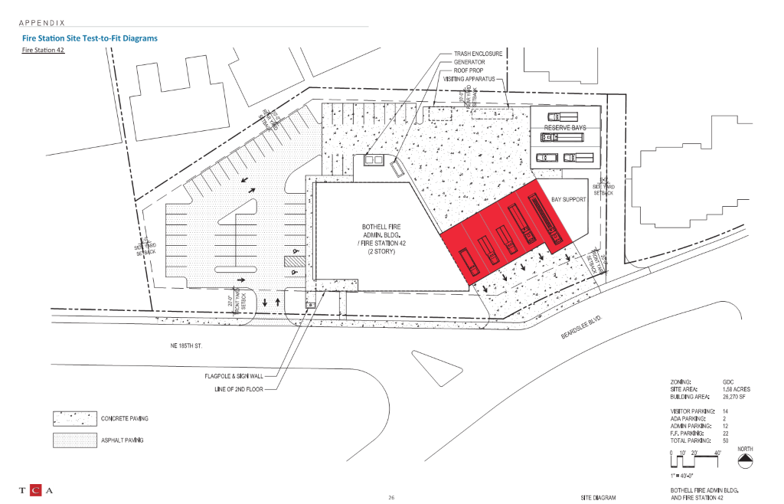
Project Description – Station 42
Notes:
Butch 1 Minute

Slide 8
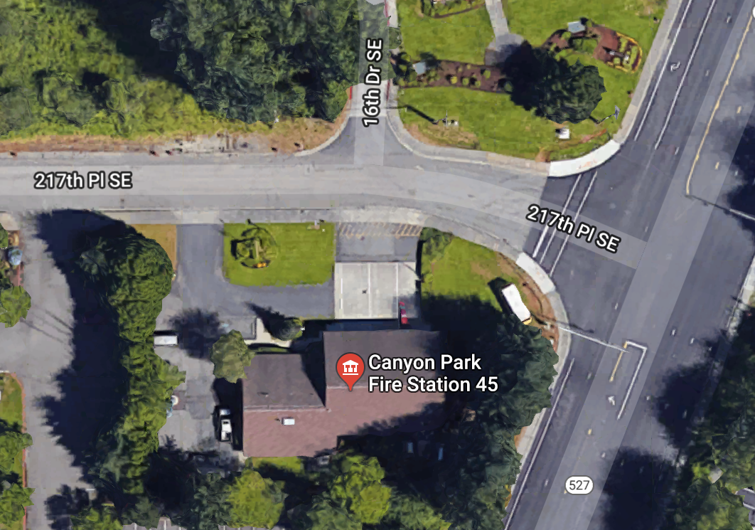
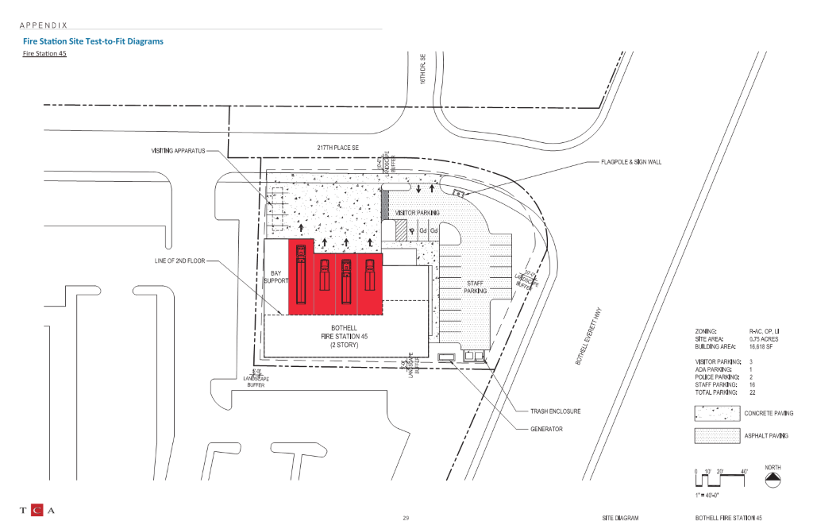
Project Description – Station 45
Notes:
Butch 1 Minute

Slide 9
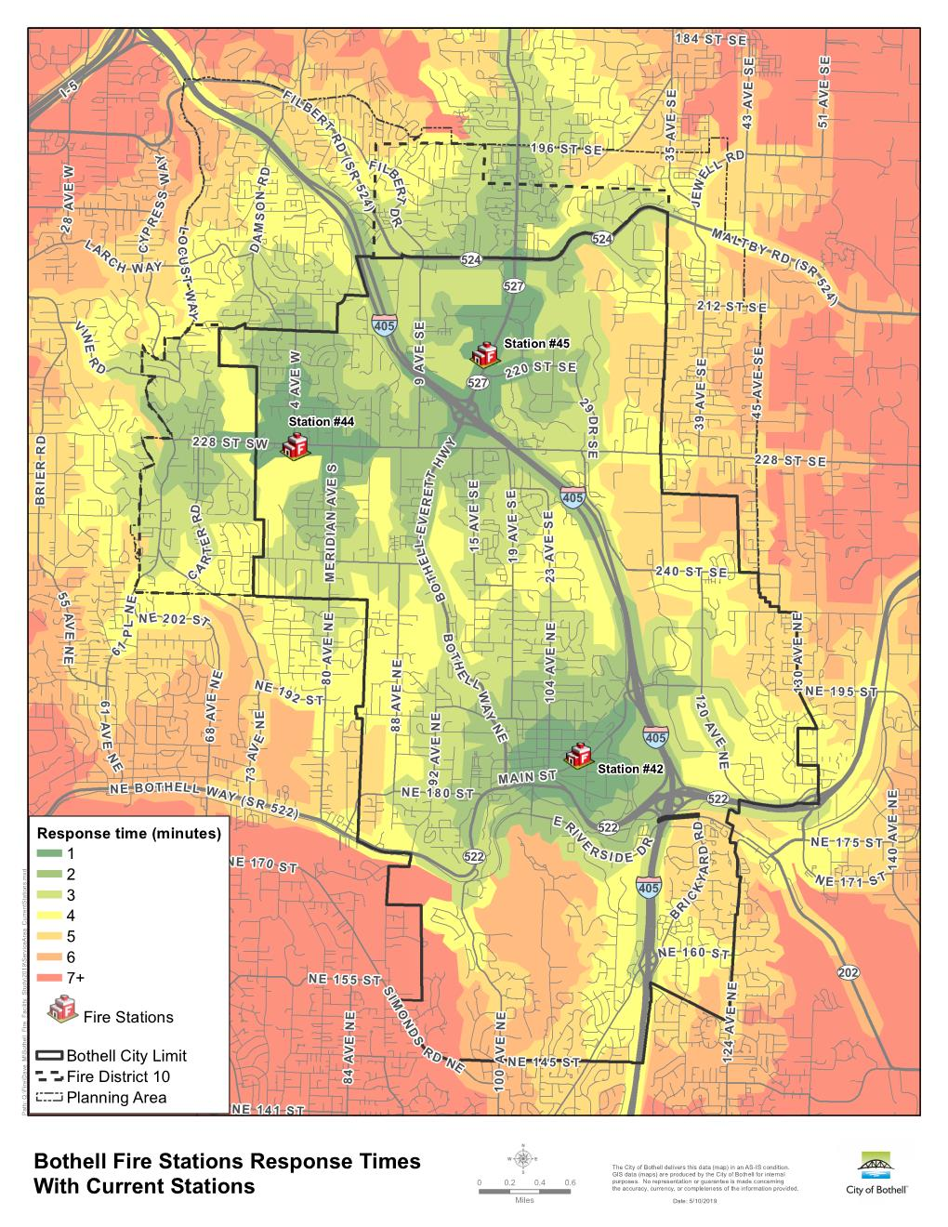
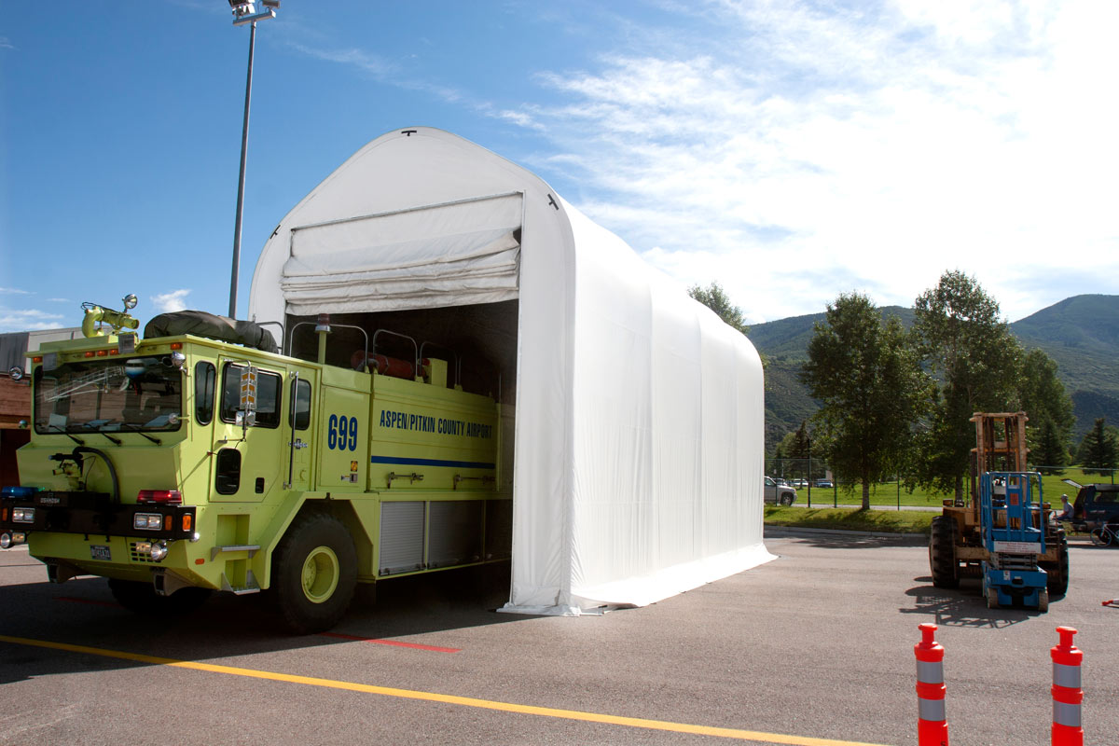
Project Description – Temp. Facilities
Notes:
Butch 1 Minute

Slide 10
Funding - Budget
Project Funding fully secured $35.5 million capital bond approved by voters in November 2018.
Budget
Costs for Professional Services (owner-direct only, not including design) | $500,000
Estimated project design/construction costs (including contingencies): | $24,000,000
Equipment and furnishing costs | $1,500,000
Off-site costs (Temp. facilities, utilities.) | $1,500,000
Contract administration costs (owner CM etc.) | $1,500,000
Contingencies (owner) | $3,000,000
Other related project costs (permitting, art) | $500,000
Sales Tax | $3,000,000
Total | $35,500,000
Notes:
Krista 1 Minute

Slide 11
Procurement Schedule
Description | Fire Station | Duration | Start | Finish
Ad/Outreach/Q&A | 42/45 | 1 months | 5/24/2019 | 6/27/2019
PDB RFQ Process (pending PRC approval) | 42/45 | 1 month | 6/28/19 | 7/24/19
SOQ due |  |  |  | 7/19/19
SOQ Review, Shortlist |  |  | 7/22/19 | 7/24/19
PDB RFP Process | 42/45 | 1.5 month | 7/29/19 | 9/12/19
Issue RFP |  |  |  | 7/29/19
Proprietary Interactive Meetings |  |  | 8/19/19 | 8/20/19
Proposals due |  |  |  | 8/30/19
Management Plan Review, Fee Opening, Scoring |  |  | 8/31/19 | 9/5/19
Notice of Intent to Award |  |  |  | 9/12/19
Notes:
Krista 1 Minute

Slide 12
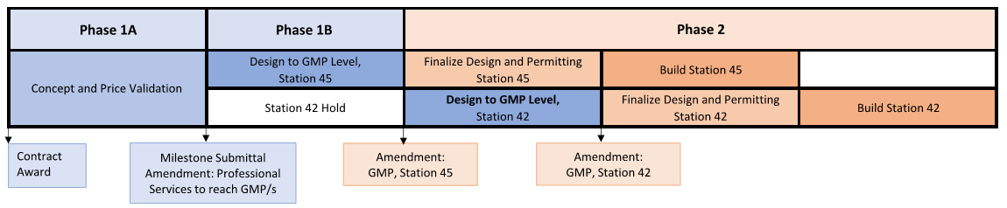
DB Schedule
Description | Fire Station | Duration | Start | Finish
Contracting Period/Council Approval | 42/45 | 2 months | 9/11/19 | 11/5/19
Phase 1a:
>30% Design/Estimating/Validation/Temp. Facilities | 42/45 | 5 months | 11/5/19 | Spring 2020
Phase 1b:
>60% design, development of GMP (Pending DB input) | 45 | 3 months | Spring 2020 | Summer 2020
>30% design, development of preliminary GMP (Pending DB input) | 42 | ON HOLD |  | Summer 2020
Phase 2:
GMP/Final Design/Permitting/Construction (Pending DB input) | 45 | 21 months | Summer 2020 | Spring 2022
GMP/Final Design/Permitting/Construction (Pending DB input) | 42 | 24 months | Spring 2021 | Spring 2023
Notes:
Krista 1 Minute

Slide 13
Why PDB? Meets RCW 39.10.300 Criteria
Opportunity for Greater Innovation and Efficiencies
  Small constrained sites require complex phasing, permitting, and/or temporary facilities offsite.
  Coordination of two stations allows for lessons learned and design/construction standards development.
Savings in Project Delivery Time
  Efficient sequencing of design and construction with one team for both stations and temporary facilities.
  Flexible subcontractor procurement: best value selection, design-assist, phased procurement, SWMBE.
Activities are Specialized
  Specialized design and equipment: decontamination, emergency communications, vehicle maintenance, operations and fire fighter health and safety.
  Temporary facilities are integral to project success to ensure Fire response times and service.
Notes:
Krista 2 Minute

Slide 14
Project Management
Roles & Responsibilities Matrix
 |  | City / OAC / Legal Team
 | DB Procurement: | 20% | 10% | 5% | 5% | 5% | 20% | 5% | 1% | 1% | 40% | 1% | 10% | 1% | 10% | 1% | 1% | 1% | 10%
 | Design: | 20% | 10% | 5% | 5% | 5% | 20% | 5% | 1% | 1% | 40% | 25% | 1% | 1% | 1% | 1% | 5% | 1% | 1%
 | Construction / Closeout: | 20% | 10% | 5% | 5% | 5% | 20% | 5% | 1% | 1% | 40% | 25% | 1% | 1% | 1% | 1% | 1% | 1% | 1%
ID | Item Description | Jeff Sperry | Erin Leonhart | Steve Morikawa | Bruce Kroon | Chris Bothwell | Virginia Samuelson | Gretchen Zundel | Jason Torrie | Paul Byrne | Krista Lutz | Adam Johnson | Dave Jobs | Judy Sawin | Stacy Shewell | Dave Petersen | Glen Lyons | Matt Wigging (Roen, Est) | Robynne Thaxton (Legal, DB)
P1 | Delivery Method selection | x | x | x | x | x | x |  |  |  | x |  | x |  | x
P2-100 | Design-Build Procurement/Contracting | x | x | x | x | x | x |  |  | x | x |  | x |  | x |  |  |  | x
P2-200 | Project Management | x | x | x |  |  | x |  | x |  | x | x | x
P2-300 | PMP / Project Controls / Workflow Processes | x | x | x |  |  | x |  |  |  | x | x |  | x |  |  | x
P2-400 | Schedule Review and Analysis |  |  |  |  |  |  |  |  |  | x | x |  |  |  | x
P2-500 | Cost Review and Analysis |  |  |  |  |  |  | x |  |  | x | x |  |  |  |  |  | x
P3 | FF&E Coordination | x |  |  | x |  | x |  |  |  | x | x
P3 | Warranty Period | x |  |  |  |  | x |  |  |  | x | x
Notes:
Krista 1 Minute

Slide 15




Thank You / Questions
PRC Panel
Jim Dugan
Panel
Parametrix
Quinn Dolan
Panel
Centennial Contractors
Tim Buckley
Panel
Meng Analysis
Janice Zahn
Panel Chair
Port of Seattle
Brian Eppler
Panel
University Mechanical
Mark Ottele
Panel
Granite Construction
David Talcott
Panel
Exeltech Consulting
Kyle Twohig
Panel
City of Spokane
Fire Station Team
Butch Noble,
City of Bothell, Deputy Fire Chief
Erin Leonhart,
City of Bothell, Director Public Works,
Project Sponsor
Jeff Sperry,
City of Bothell, Manager Fleet and Facilities,
Project Lead
Krista Lutz,
OAC,
Project Manager
Dave Jobs,
OAC,
Principal in Charge
Notes:
Krista to field questions with support by all

