Slide 1
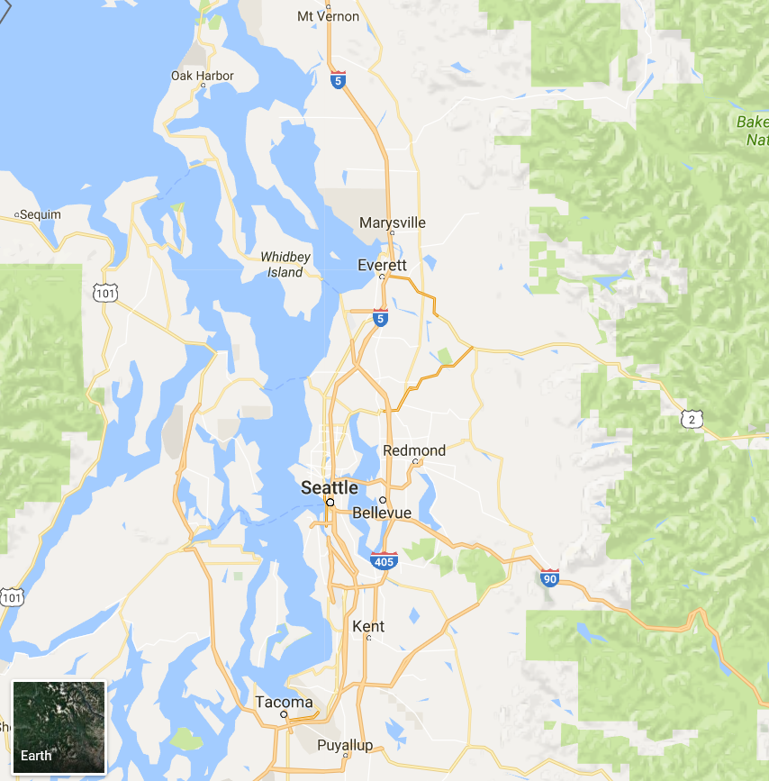
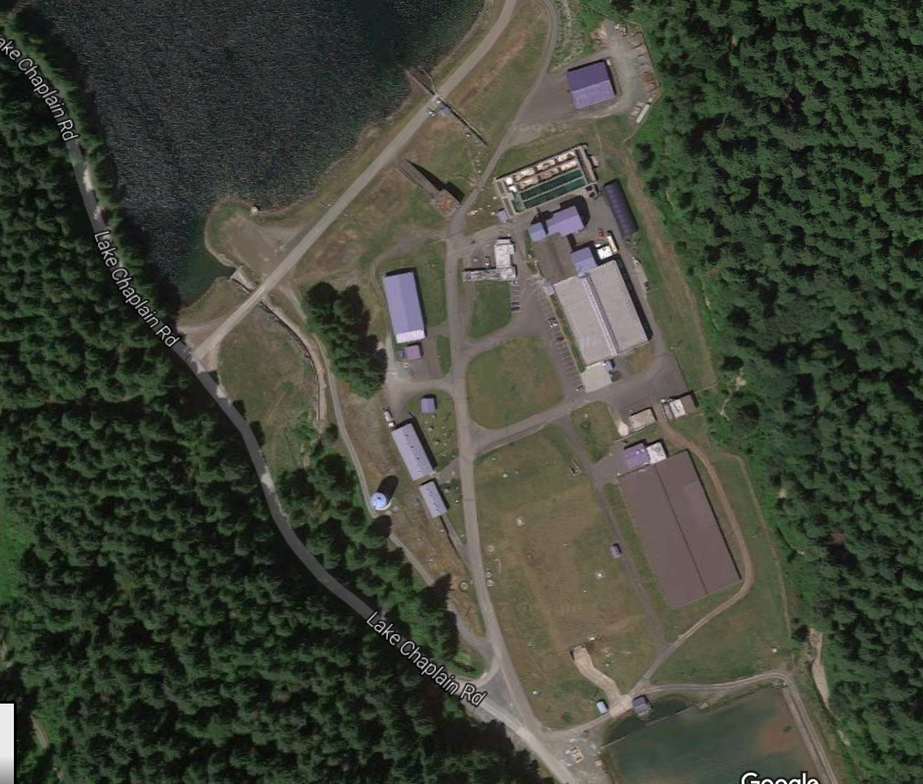
Water Filtration Plant Clearwell Roof Replacement Using Design-Build Project Review Committee Presentation
City of Everett
January 26, 2017

Slide 2
Presentation Overview
City of Everett Introduction | Richard Hefti
Project Description / Schedule | Richard Hefti
City Reasons for DB Delivery | Richard Hefti
D-B Team Qualifications and Experience | Richard Hefti
RCW 39.10 Requirements | Pat Tangora

Slide 3
Regional Water Provider
4.5 billion gallons
50 billion gallons

Slide 4
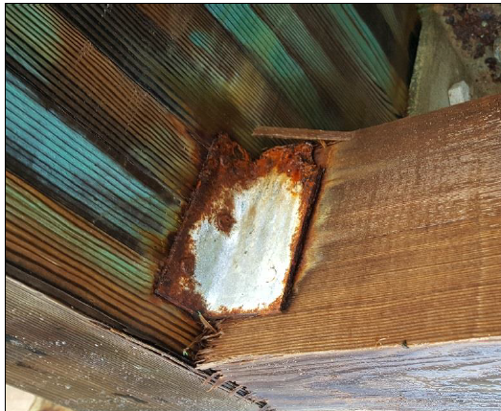
East Clearwell Project
140 ft x 268 ft
34 year old roof
Structural integrity concerns (corrosion, delamination)
East Clearwell
West Clearwell (buried)

Slide 5
Schedule
Allowable Period with One Clearwell Offline
 | J | F | M | A | M | J | J | A | S | O | N | D | J | F | M | A | M | J
RFQ Issued
SOQs Submitted
Shortlist
RFP Issued
Proposals Submitted
DB Selection
DB NTP
Design/Construct
Cleanup/ De-mob

Slide 6
Why the City chose D-B
East clearwell is critical component of City’s water infrastructure and construction around operating water facilities is high risk – must be exceptionally well coordinated.
Much of the design is vendor provided. High degree of coordination is required by vendor and installer. DB allows vendor with preferred installer since they are on same team
DB provides greater opportunities for innovation and collaboration between vendor and installer.
DB is better able to manage unforeseen conditions.
Qualifications considered in the procurement – high quality long-term installation
Ability to accelerate schedule
Success with similar Reservoir 6 roof system replacement project

Slide 7
D-B Team Experience

Slide 8
D-B Team Introduction
LEGAL
CITY OF EVERETT
Public Works Department
JIM MILLER, P.E.
City Engineering Supervisor
RICHARD HEFTI, P.E.
City Project Manager
PAT TANGORA, P.E.
BC Project Manager
DESIGN-BUILDER
TBD
TADD GIESBRECHT, P.E.
Technical Manager
SPECIALTY CONSULTANTS
SCOTT HARPER, P.E.
Structural Engineer
Patrick Weber, P.E.
Project Engineer
Materials | Corrosion Probe
Geotech | Shannon & Wilson
Notes:
Highlight team involvement from procurement through construction

Slide 9
D-B Team Experience
 |  | CITY OF EVERETT |  | BROWN AND CALDWELL
PROJECT | TYPE | James Miller, PE | Richard Hefti, PE | Pat Tangora, PE | Tadd Giesbrecht, PE
Everett Reservoir 6 Roof Replacement | D-B | ✓ | ✓ | ✓ | ✓
Everett WPCF Phases A and C Expansion | GC/CM | ✓ |  | ✓ | ✓
Everett Pipeline #5 River Crossing | D-B | ✓ | ✓
Tacoma Central TP Expansion | D-B |  |  | ✓ | ✓
Spinal Cord Injury Treatment Center, Minneapolis, MN VA Hospital Extended Care Facility Expansion, Des Moines, IA VA Hospital | D-B D-B |  | ✓ ✓
Santa Fe Buckman Direct Diversion | D-B |  |  | ✓
Joint Base Lewis McChord, WWTP Upgrade | D-B |  |  | ✓
SPU Cedar and Tolt WTPs | DBO |  |  | ✓
Walla Walla WTP Upgrade | GC/CM |  |  | ✓
King County Brightwater WWTP | GC/CM & DBB |  |  | ✓
King County Brightwater Marine Outfall | D-B |  |  | ✓
Wilsonville, Oregon WWTP | DBO |  |  | ✓
Boise, Idaho Dixie Drain Phosphorus Treatment Plant | GC/CM |  |  |  | ✓
Notes:
Emphasize common projects between team members

Slide 10
Project Meets RCW 39.10
✓

Slide 11
Satisfies RCW 39.10.300
✓
1a) Highly specialized construction activities
1b) Project provides for greater innovation and efficiency between designer and builder
1c) Significant savings in project delivery time would be realized
✓
✓

Slide 12
1a) Highly specialized construction activities
Roof vendors – installer coordination and contractual relationship vital
Integration of new roof system with existing infrastructure

Slide 13
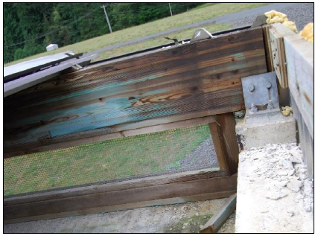
1b) Greater innovation and efficiency between designer and builder
Materials selection relatively open
Incorporate existing structural components

Slide 14
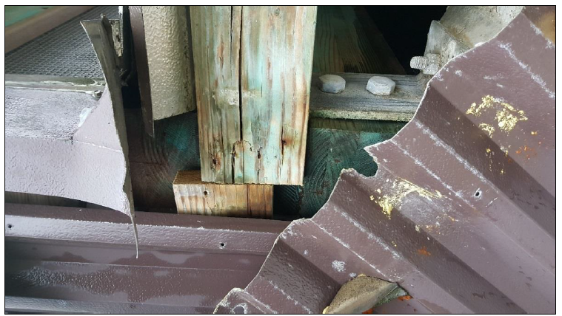
1c) Significant savings in project delivery time would be realized
Elimination of two separate procurement processes for design and construction (~ 1-2 months)
Fabrication concurrent with early construction activities (~ 2-3 months)

Slide 15
Satisfies RCW 39.10.280
✓
RCW 39.10.280:
Substantial fiscal benefit: less risk, greater opportunities for cost and schedule savings
DBB not practical for quality or schedule
Qualified public body and consultant team
Resolved audit findings – Everett has had no audit findings

Slide 16
Questions?

