Slide 1
Reclaimed Water Disinfection Facility
Application to use the Progressive D/B Delivery Method
November 29, 2018 Presentation
We are stewards of our natural and built environment, striving to preserve and create an extraordinary community for our residents, businesses, neighbors and visitors

Slide 2
Agenda
Introductions
City of Snoqualmie
The Project
Project Budget
Project Schedule
Why Progressive Design-Build
Public Body Qualifications
Organization Chart
Project Team Experience
Summary

Slide 3
Introductions

Slide 4
The Project Team: Here Today
City of Snoqualmie
Dan Marcinko, Director of Public Works
Jeff Hamlin, Project Manager
Parametrix
Dan Cody, D/B Procurement & D/B PM/CM Support
Jim Dugan, D/B Program Advisor
Maggie Anderson, Project Controls Specialist

Slide 5
The Project Team: Other Team Members
City of Snoqualmie
Bob Larson, City Administrator
Todd Saxberg, Utilities Operations Manager
Brian Coleman, PM/CM Support
External Legal Counsel
Pacific Law Group, Ogden Murphy Wallace

Slide 6
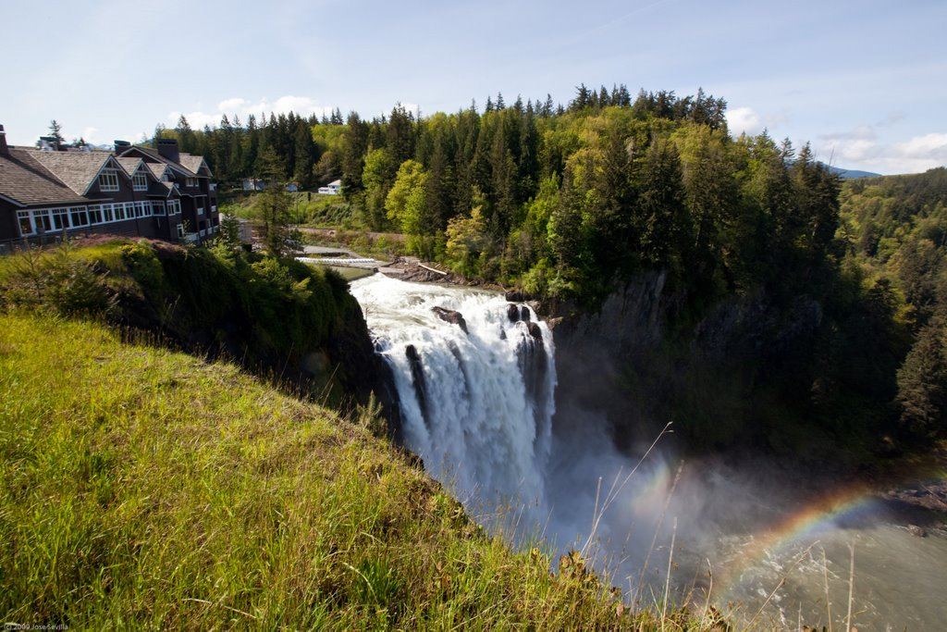
City of Snoqualmie
Located approximately 30 miles east of Seattle
Voted for incorporation in 1903.
Original economy based on lumber and hydroelectric
Current economy includes business parks, tech companies and tourism
In 2016, population was 13,190
Population is growing rapidly

Slide 7
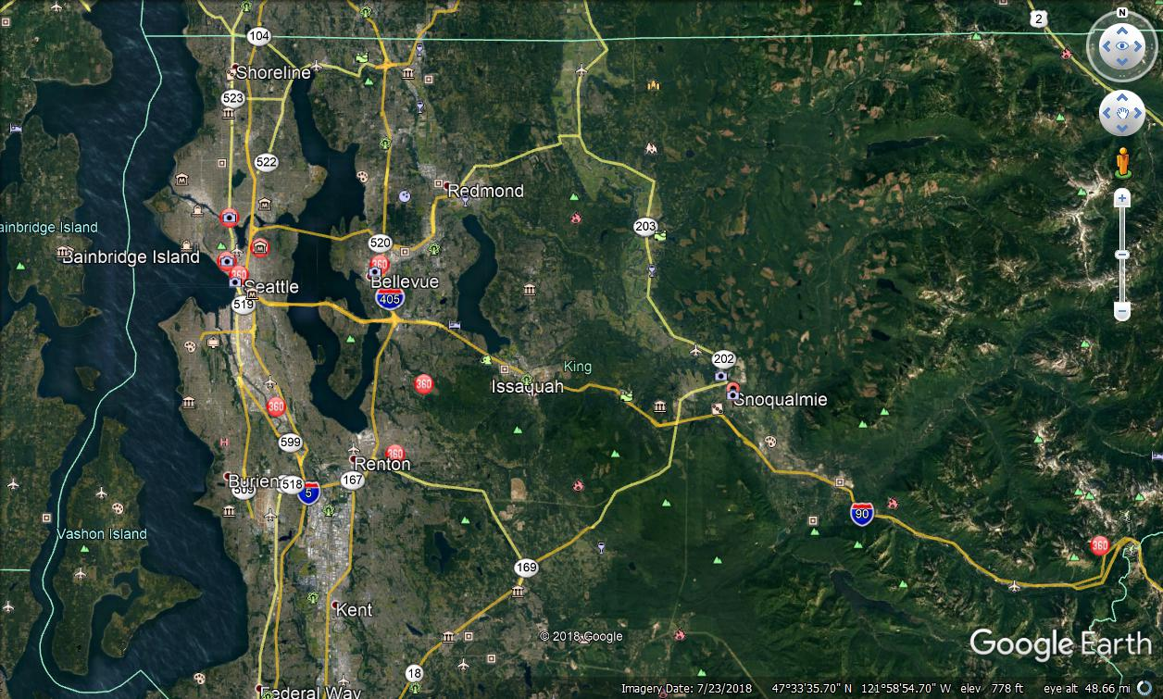
Location
Project Location

Slide 8
The Project

Slide 9
City of Snoqualmie Reclaimed Water Disinfection Facility
Proposed Water Disinfection Facility will expand COS reclaimed water infrastructure to include:
New irrigation intake structure at the lake with a spray system for remediation of algae and pond weed.
A dedicated, deep transmission pipeline from the lake screen separate from the existing overflow directed to a new below-grade cast-in-place concrete clearwell with baffles
A clearwell inlet structure with motorized gate for flow and level control and monitoring flash mix basin
Bulk sodium hypochlorite chemical storage and feed facility
Chlorine residual analyzers for both the golf course and parks irrigation systems
Electrical and controls improvements

Slide 10
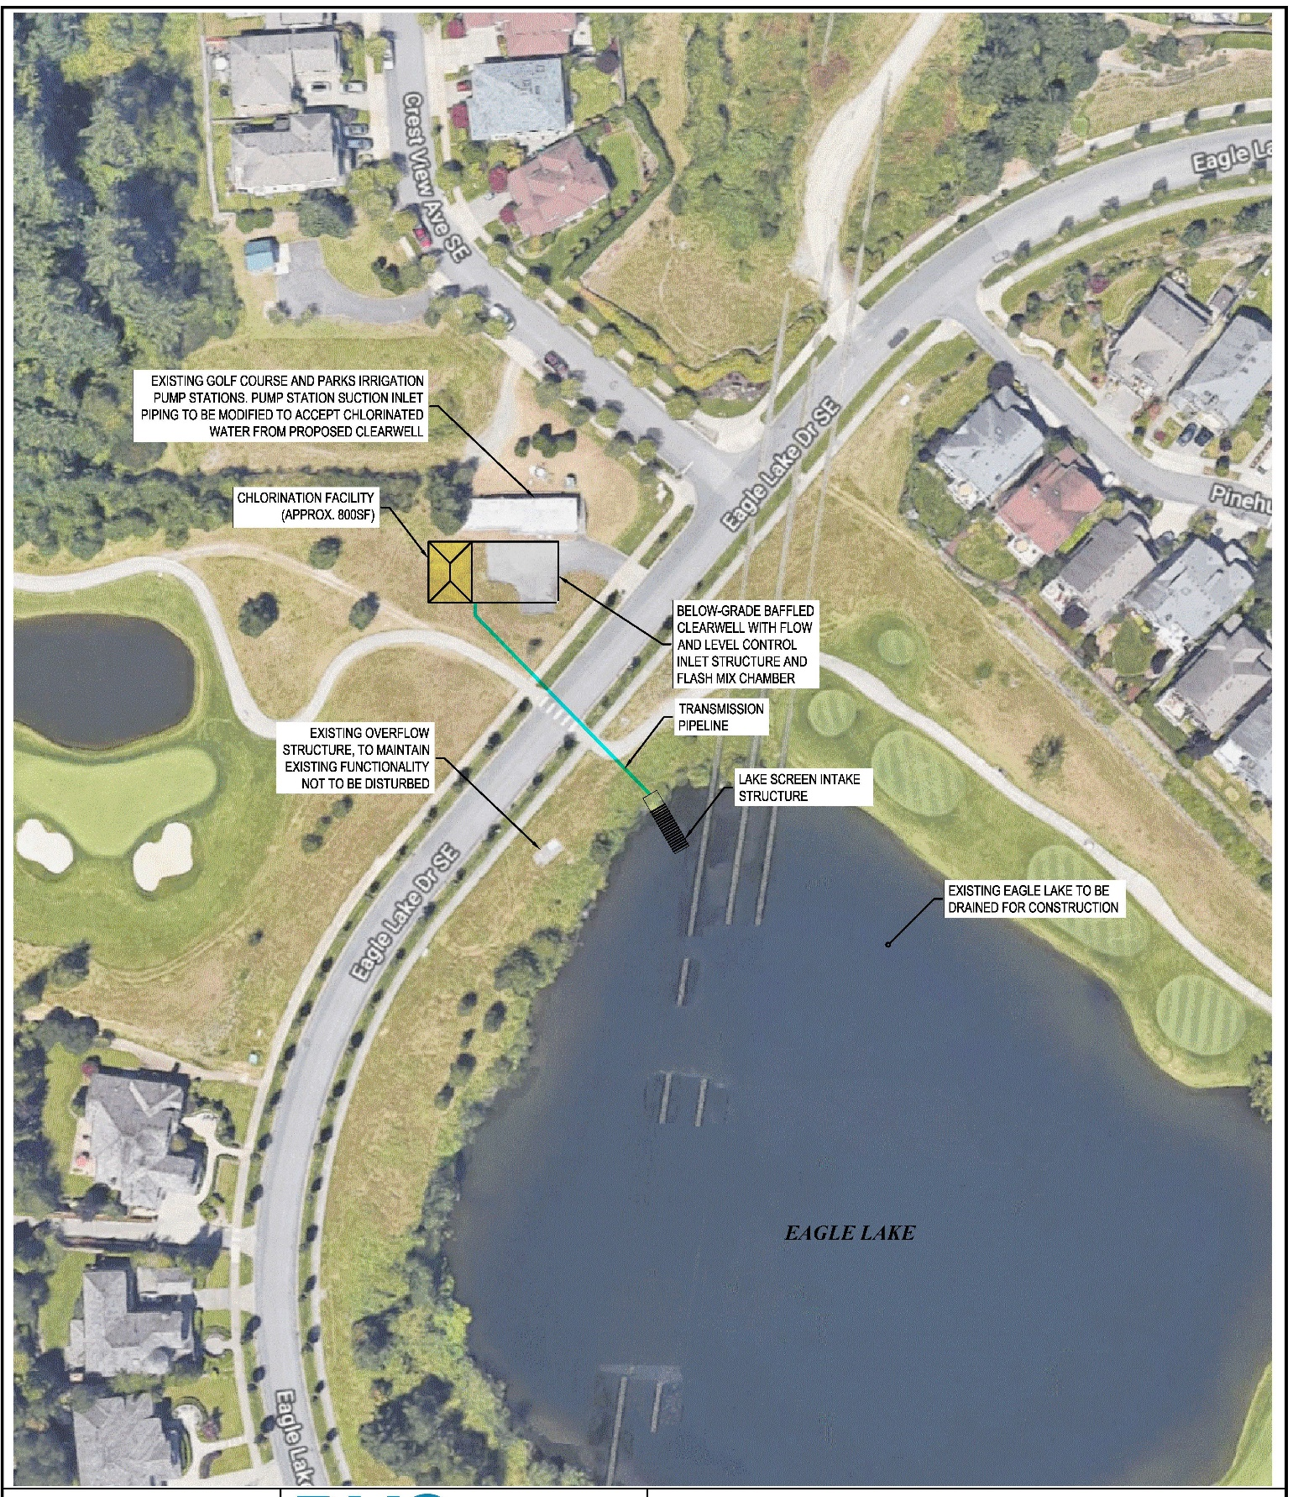
Reclaimed Water Disinfection Facility

Slide 11
City of Snoqualmie Reclaimed Water Disinfection Facility Project Budget
Category | Budget
Costs for Professional Services (A/E, Legal, etc.) 20% | $ 560,000
Estimated Project Construction Costs (including construction contingencies) | $ 2,800,000
Contract Administration Costs (owner, cm, etc.) | $ 756,000
Contingencies (escalation, design & owner) (25%) | $ 700,000
Sales Tax | $ 288,960
Total | $ 5,104,960

Slide 12
Project Funding
Funding for the project feasibility/scoping study and preconstruction/design services to arrive at a GMP agreement for the work is available from funds in the current 2017/18 capital budget.
Funding to construct the facility is included in the 2019/2020 capital budget and the City will utilize external debt (the sale of bonds) to fund this portion of the project.
City currently has a bond rating of AA
Ability to fund project utilizing external debt is high

Slide 13
City of Snoqualmie Reclaimed Water Disinfection Facility Schedule
Project Schedule | Estimated Date
PRC Presentation | November 29, 2018
Publication of RFQ for Design/Build Services | December 17, 2018
Project Information Meeting (Date subject to change.) | January 7, 2019
RFQ Submittal Deadline | January 14, 2019
Open & Review/Score Submittals Received | January 15-18, 2019
Identify D/B Finalists & Issue RFP & Proprietary Meeting Notifications | January 18, 2019
Proprietary Meeting | February 4, 2019
RFP Submittal Deadline (Proposals & Cost Factors) | February 11, 2019
Open & Review Proposals (Cost Factors not reviewed) | February 12-15, 2019
Notify Design/Builders of Scoring and Most-Qualified Design/Builder | February 19, 2019
Negotiate D/B Preconstruction Services Contract | March 6, 2019
Execute D/B Contract | March 15, 2019

Slide 14
City of Snoqualmie Reclaimed Water Disinfection Facility Schedule
Project Schedule | Estimated Date
30% Design Complete | May 30, 2019
60% Design Complete | September 27, 2019
Negotiate GMP Amendment | October 4, 2019
Execute GMP Amendment | October 14, 2019
Building Permit Available | April 2020
100% Design Complete | April 2020
Construction Begins | May 2020
Substantial Completion | April 2021

Slide 15
Why Progressive D/B Delivery Method for Reclaimed Water Disinfection Facility Project

Slide 16
RCW 39.10.300 D/B Statutory Compliance
Construction activities are highly specialized and a D/B approach is critical in developing the construction methodology
Project provides opportunity for greater innovation and efficiencies between the designer and builder
Significant savings in project delivery time would be realized

Slide 17
Advantages to Progressive Design/Build Delivery
Single contract for the City to manage
Encourages collaboration and innovation between City and Design/Builder
Potential for shorter design period, quicker construction start and earlier completion
Contractor hires the design team and therefore warrants the quality of construction documents, reducing the owner’s risk of claims
Ability to get to cost certainty (GMP) quicker than other delivery methods

Slide 18
Public Body Qualifications

Slide 19
City of Snoqualmie Leadership Team
The City of Snoqualmie has a successful history of planning and executing capital projects, including previous infrastructure projects similar to this project, through our Public Work Division.
The City of Snoqualmie is new to the Progressive Design Build method of project delivery, but has augmented their staff with APD Consultants - Parametrix.
City of Snoqualmie Project Manager, Jeff Hamlin, attended last month’s AGC D/B Workshop and has prior D/B experience.
Parametrix Staff: Jim Dugan External D/B Advisor; Dan Cody D/B Procurement & PM/CM Support & Maggie Anderson, Project Controls Specialist
The City of Snoqualmie satisfies the public body qualifications by staff augmentation with consultants.

Slide 20
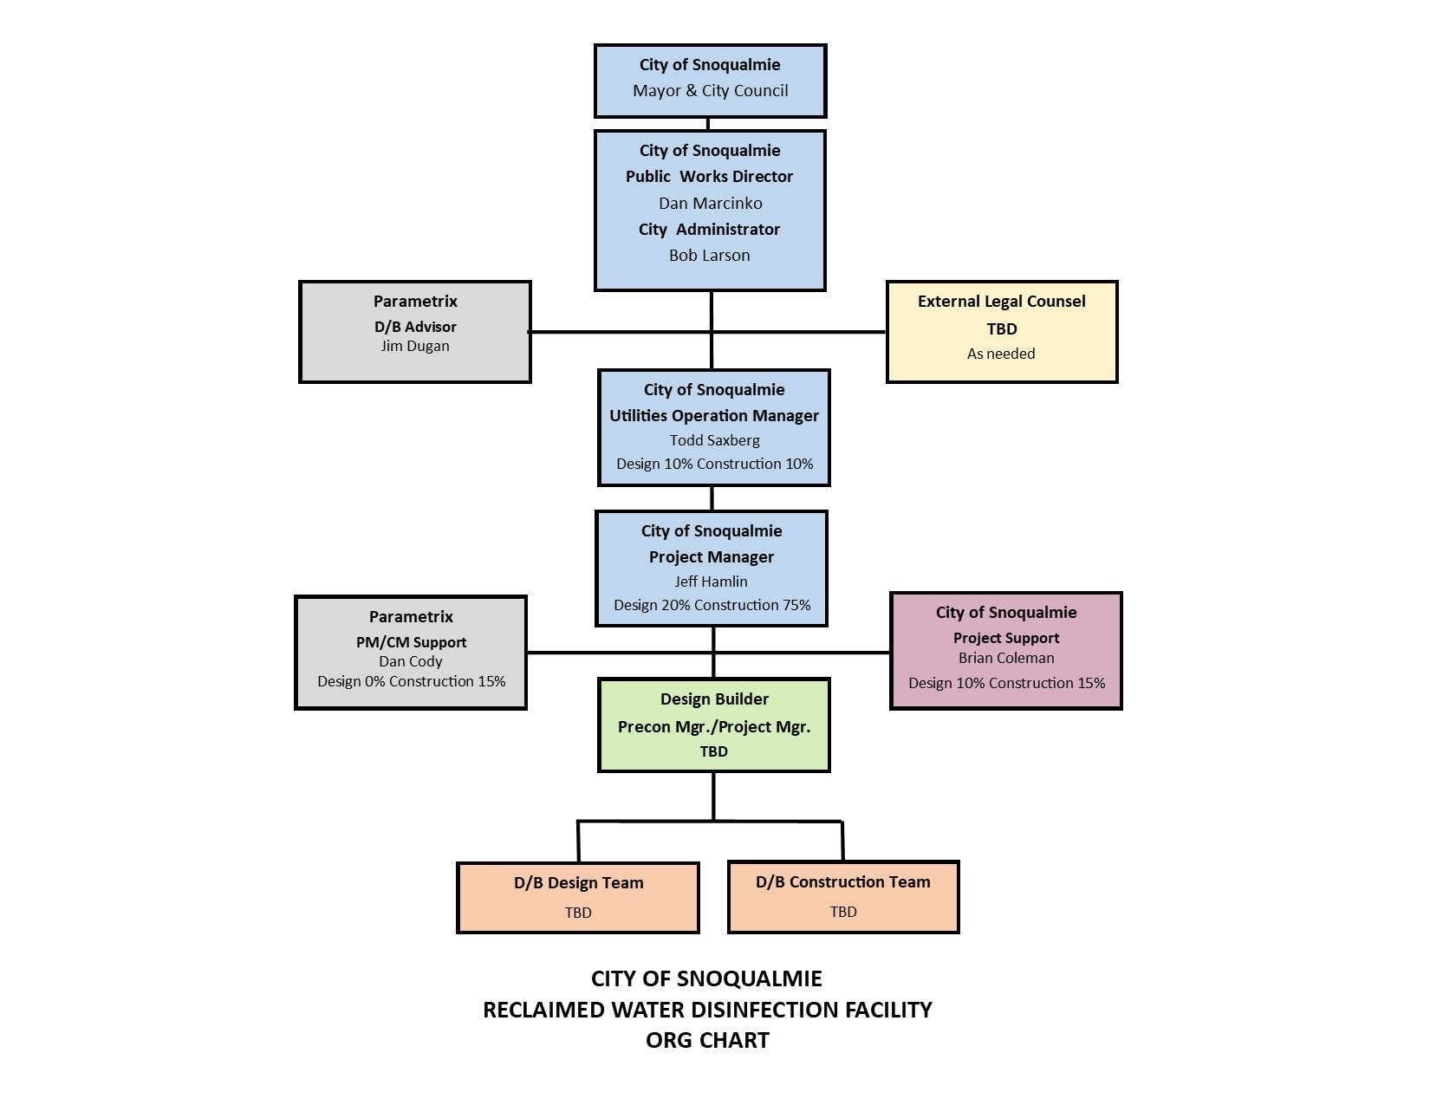
City of Snoqualmie: Reclaimed Water Disinfection Facility Project Organizational Chart

Slide 21
Project Team D/B Experience

Slide 22
Name | Experience
Jeff Hamlin Project Manager/Construction Manager City of Snoqualmie | 26 yrs. Design and Project Management Emphasis on design and management of public and private civil engineering projects. D/B Projects: I-405 Congestion Relief, Nespelem Indian Health Center, Klamath Co. Transfer and Recycling Center, Thurston County Transfer Station
Dan Cody D/B Procurement and PM Support Parametrix | 32 yrs. Design & PM/CM D/B Projects: South Puget Sound Community College – Lacey Campus; Building #1; Tacoma Public Schools – Boze Elementary School; Tacoma Public Schools – Hunt Middle School; Willapa Elementary School Gym, Chelan County PUD Generator Unit Rehabilitation
Jim Dugan D/B Program Advisor Parametrix | 40 yrs. Program/Project Management D/B Projects: TPS – Boze Elementary School; TPS Hunt Middle School; Willapa Elementary School Gym; Chelan County PUD Generator Unit Rehabilitation, Multiple large D/B projects worldwide with The Austin Company Project Review Committee Member: Term Ends December 2020

Slide 23
Summary
Traditional D/B/B is not the preferred delivery method
Project meets qualifying RCW 39.10 criteria
Project team has D/B delivery knowledge and experience
Project team is sufficiently staffed with experienced personnel
Project Management Plan is developed and has clear and logical lines of authority
There is appropriate time to execute the project
Project team has experience with project type & scope
PM/CM personnel is knowledgeable in D/B process
City has no unresolved audit findings
Project team is prepared and ready to proceed

Slide 24
Thank you

