Slide 1
City of Spokane, Public Works and Utilities
Post Street Pedestrian and Utility Bridge
May 25, 2017

Slide 2
Post Street Bridge Overview
Why replace the Post Street Bridge?
Built 1917, super structure severely deteriorated
Significant Load Limits in place
Bridge serves as major link to downtown
Bridge provides vital peak hour relief
Need to upsize non-redundant sanitary sewer main
Need to upsize power, communications & water transmission links

Slide 3
Post Street Bridge Map

Slide 4
Organizational Chart

Slide 5
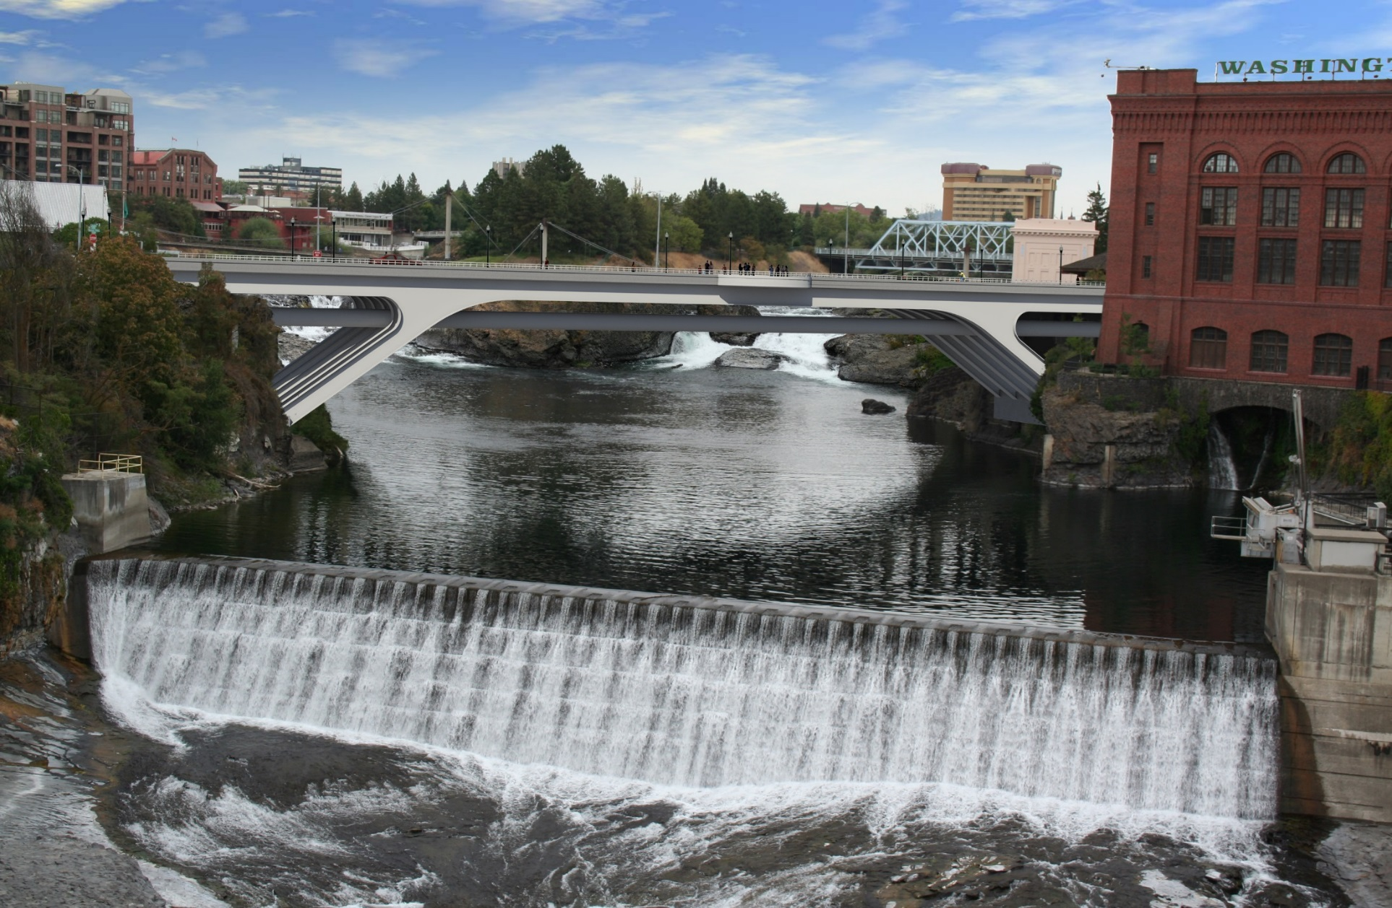
Post Street Bridge Artist Rendering

Slide 6
Post Street Bridge Project Budget
Professional Services $ 1,245,000
Construction Cost $ 8,300,000
Contract Admin/Other $ 100,000
Contingencies $ 477,250
Other Related Project Expenses $ 377,790
Sales Tax $ 839,960
Total Project Cost $ 11,300,000

Slide 7
Updated Schedule
Issue DB RFQ June 1, 2017
Statement of Qualification Due June 28, 2017
Short-List Announced July 12, 2017
RFP Issued July 17, 2017
Proprietary Meeting July 26, 2017
Proposal Due Aug 29, 2017
Selection of Design-Builder Sep 12, 2017
City Council Meeting/Contract Approval Nov 6, 2017
Anticipate NTP Nov 20, 2017
Design Phase Nov 2017 – Jan 2019
Construction Phase Oct 2018 – Dec 2020

Slide 8
Procurement Approach
Request for Qualifications
Successful Experience with Bridge Projects of Similar Scope and Complexity
Team Organization
Experience developing GMP collaboratively with Owner
Shortlist no more than five finalists
Request for Proposal
Management approach specific to the project
Innovation and Problem Solving
Interactive Proprietary Meetings
Price related factor: Fee
$5,000 - $10,000 honorarium
Limited required proposal submittals
Consistent with other projects

Slide 9
Design-Build Agreement
Validation and GMP Development Period
Validate information from the Owner.
Examines options to identify innovation
Commercially reasonable examination of site
Develop Basis of Design Documents, Project Schedule, GMP
Contract Amendment
GMP Execution Period
Complete Design
Construction
Close out

Slide 10
Benefits of Design-Build Delivery
RCW 39.10.300(1)(b) “Greater Innovation or efficiencies between the designer and the builder”
Maximum possibility for coordination of design, demolition and construction phasing to provide greatest project value and cost efficiency
RCW 39.10.300 (1)(c) “significant savings in project delivery time”
Progressive Design-Build is the fastest delivery method. Starting demolition work prior to completion of design is beneficial to the schedule
RCW 39.10.280(2)(a) “Substantial Fiscal Benefit”
The budget is limited to fit within the City’s project budget. The Design-Builder will be required to design within that budget.
The Design-Builder’s involvement in the development of the scope shifts more risk of the performance of the project to the design-build team
With one team managing the coordination of the various aspects of the project the City’s risk of claims by various contractors performing adjacent projects are reduced.

Slide 11
Questions/Answers
In section 6.2, what is meant by “Enhanced Warranty”?
Answer: Enhanced warranty refers to the benefit of the Owner having a single contract for both design and construction that transfers the majority of responsibility for achieving the reasonable performance requirements for the project as well as the completeness, accuracy and integration of the design and construction processes to the design-build entity.
For example, in the case of the need to maintain service through the sewer interceptor, the construction must occur on only one half of the bridge at a time. Having a single point of responsibility for the design as well as the sequencing and scheduling of the construction of both of these halves will reduce the risk to the City of claims based on issues with the design. In addition, the integration of the designer and the constructor at the design phase through progressive design-build will assist in resolving conflicts between the design and the constructions means and methods that are inherent in a bridge that must be constructed with special circumstances such as the requirement to constantly maintain the service of the sewer interceptor.

Slide 12
Questions/Answers
The schedule provides less than 1 month from issue of RFP to due date for proposals. In Section 7.8 DB Procurement, it appears that the deliverable will include submittal of proposed design solutions, and scoring may be based on cost or other price-related factors. Please explain why more time is not given for the preparation of proposals.
Answer: Agree that RFP phase is too optimistic. The City is consulting with WSDOT and will also consult with the industry before establishing a final timeline for Proposal submittals. The City recognizes the unique nature of heavy civil construction and will base its final timeline on recommendations from both WSDOT and the industry. The City’s intent is to increase the duration of the RFP phase in response to these recommendations. Further, the City intends to use the Progressive Design-Build model as much as it can and will significantly reduce the number of required design solutions with the RFP submittal to the bare minimum to reduce the burden on the Proposer and to maximize the early integration between the City and the Design-Builder.

Slide 13
Questions/Answers
3. Attachment E illustrates that the City has only complete one D/B project, the Nelson Service Center, which appears to have gone 13% over budget and delivered 3 months late. The vast majority of the other projects were DBB delivery, on budget but typically delivered late. Please explain what the City and Consultants will be doing differently to ensure on-time, on-budget delivery of this project.
Answer: The project budget was increased due to owner approved scope additions. The DB team identified opportunities to increase the number of Fleet maintenance bays and expand the facility size for a nominal increase in cost. The City felt the project was achievable per the original budget but was happy to receive a better product for a small increase in budget. The Nelson Service Center was the 2016 DBIA Excellence in Process award recipient.
Other schedule increases to DBB projects are primarily attributed to unforeseen underground conditions and owner directed increases to scope.

Slide 14
Questions/Answers
4. Please verify that an appropriate honorarium will be issued to the teams that are not awarded the project. (RCW 39.10.330 Item 8)
Answer: It is the city’s intent to provide an honorarium to shortlisted firms that are not selected for the project. The honorarium amount has not been established yet but will likely be between $5,000 and $15,000 and the amount will be based on the considerations set forth in the statute.

Slide 15
Thank you!

