Slide 1


City of West Richland Police Facility
Project Review Committee | Project Approval Process
January 23, 2020

Slide 2
Organizational Chart
Construction Manager
Brent Gerry
City of West Richland Mayor
Robynne Thaxton (Parkinson)
JD, FDBIA DB Legal Counsel
Thaxton Parkinson, PLLC
Roscoe Slade, P.E. III
Project Director
Public Works Director
Project Committee
Ben Majetich, Chief of Police, Design Advisor
Ilka Gilliam, Contract and Procurement Advisor
Danielle, Mullins, P.E., Utilities, Site & Infrastructure Advisor
Nicole Stickney, Regulatory & Approval Advisor
Construction Manager
Construction Manager
D-B RFQ/RFP - 10%
Design - On-call
Construction - On-call
D-B RFQ/RFP - 10%
Design - 10%
Construction - 10%
On-call for all Services
Matt Walker, AIA, CCM, DBIA
Principal-in-Charge/Advisor
Hill International, Inc.
Becky Blankenship, Assoc. AIA, DBIA
Project Manager
Hill International, Inc.
Drew Woodruff, P.E.
City Representative
City of West Richland
Construction Manager
D-B RFQ/RFP - 10%
Design - 5%
Construction - 5%
D-B RFQ/RFP - 100%
Design - 100%
Construction - 50%
D-B RFQ/RFP - 50%
Design - 50%
Construction - 75%
Anna Valdez
Project Controls Engineer Lead
Hill International, Inc.
Patrick McCord, Assoc. DBIA
Senior Estimator
Hill International, Inc.
Debbie Selzer
Document Controls Specialist
Hill International, Inc.
D-B RFQ/RFP - 10%
Design - 10%
Construction - 15%
D-B RFQ/RFP - 10%
Design - 10%
Construction - 15%
D-B RFQ/RFP - 10%
Design - 10%
Construction - 15%

Slide 3
Police Facility Overview
Replace existing facility that no longer meets our needs
  New facility - approximately 22,500 SF
  Includes space for:
    police administration operations;
    staff and administrative support;
    animal control;
    storage of collected evidence; and
    Department of Corrections

Slide 4
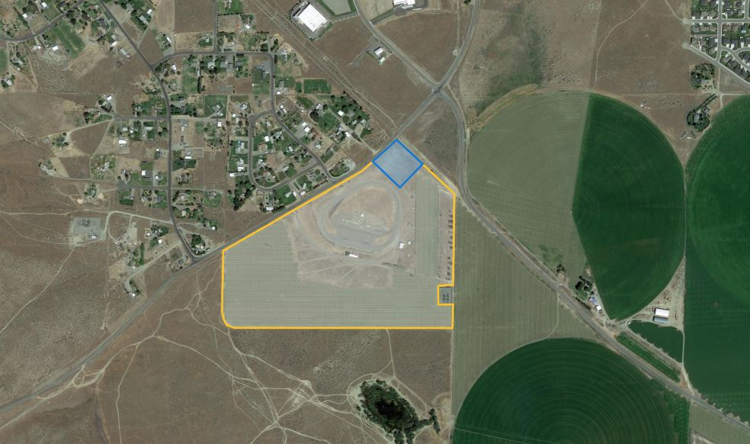
Proposed Police Facility Site

Slide 5
Police Facility Project Budget
  Professional Services $ 1,081,850
  Construction Cost $ 8,430,000
  Equip. & Furnishings $ 904,328
  Contract Admin/Other $ 335,137
  City Contingency $ 700,000
  Other Related Project Expenses $ 103,495
  WSST $ 858,690
  Total Project Cost $ 12,413,500

Slide 6
Schedule
  D-B RFQ Advertisement Feb 3, 2020
  D-B SOQ Due Feb 19, 2020
  Shortlist Finalists Feb 26, 2020
  Issue RFP Mar 4, 2020
  DB Team/Owner Interactive Mtg Mar 18, 2020
  Proposal Due Apr 2, 2020
  DB Team Interviews Apr 8, 2020
  Selection of DB Team Apr 20, 2020
  NTP/Design Phase May 2020 thru Mar 2021
  Construction Phase Oct 2020 thru Nov 2021

Slide 7
Procurement Approach
  Request for Qualifications
    Successful Experience with Projects of Similar Scope and Complexity – Police Stations or Correctional Facilities
    Team Organization
    Experience developing GMP collaboratively with Owner
    Shortlist no more than three finalists
  Request for Proposal
    Management approach specific to the project
    Innovation and Problem Solving
    Interactive Proprietary Meetings
    Statutorily required evaluation factors
    Price related factor: Fee
    $5,000 honorarium
      Limited required proposal submittals
      Consistent with other projects

Slide 8
Design-Build Agreement
  Phase 1 - Validation and GMP Development Period
  Validate information from the Owner
  Examine options to identify innovation
  Commercially reasonable examination of site
  Develop Basis of Design Documents, Project Schedule, GMP
  Contract Amendment
  2. Phase 2 - GMP Execution Period
Complete Design
Construction
Close out

Slide 9
Benefits of Design-Build Delivery
RCW 39.10.300(1)(b) “Greater Innovation or efficiencies between the designer and the builder”
  Maximum possibility for coordination of design and construction phasing to provide greatest project value, cost efficiency and design for specialized equipment and processes.
RCW 39.10.300 (1)(c) “significant savings in project delivery time”
  Progressive Design-Build is the fastest delivery method. Starting construction work prior to completion of design results in a significantly reduced schedule.
  An earlier completion date for the City of West Richland Police Facility will allow greater efficiency in emergency response services at an earlier date. This is critical for serving a broader portion of the community as soon as possible.
RCW 39.10.280(2)(a) “Substantial Fiscal Benefit”
  The budget is limited to fit within the City’s project budget. The Design-Builder will be required to design within that budget.
  The Design-Builder’s involvement in the development of the scope shifts more risk of the performance of the project to the design-build team.
  With one team managing the coordination of the various aspects of the project the City’s risk of claims by various contractors performing adjacent projects are reduced.

Slide 10
Additional Questions
QUESTION
Provide validation schedule and include timing of GMP negotiations
RESPONSE
Phase 1 of the Contract (validation) – approx. September 25 (150 days)
Subject to change based on the project requirements.
This date is consistent with other projects of similar scope and complexity.
It is currently unknown whether there will be construction activities prior to signing the GMP.
Limited scope construction activities prior to signing the GMP, benefit the project

Slide 11
Cont’d Additional Questions
QUESTION
Why not do outreach or outreach events to increase MWBE participation?
RESPONSE
The City of West Richland sends our Advertisement for RFQ, RFP, Invitations to Bid to OMWBE to be posted on their website
Encourages small, woman and minority-owned businesses to participate in our projects

Slide 12

Thank you!

