Slide 1
City of Seattle
Design-Build and GC/CM
Public Body Certification
Presented to the CPARB Project Review Committee
September 26, 2019
Notes:
LIZ:
Thank you for your time today.
My name is Liz Alzeer, I am the Division Director for City Purchasing and Contracting Services for the City of Seattle.
We are here to present our applications for design-build and general contractor/construction manager public body certification.
To be direct, as you know, in 2017 we applied for recertification and were denied.
We took the comments of the CPARB PRC Board very seriously.
We have revised and updated our process to ensure a stronger determination process, closer monitoring and the engagement of our knowledgeable and experienced personnel.
These revisions and updates have led to your committee approving three alternative public works projects since 2017, and we believe it has also led to a strong process that leverages qualifications and experience to carry out alternative public contracting.
In this presentation, we will cover our certification qualifications and highlight what we’ve changed since 2017.

Slide 2
Our Team
Presenters:
Liz Alzeer – Division Director, City Purchasing and Contracting Services
Jessica Murphy – Construction Program Manager, Office of the Waterfront
Alan Lord – Program Manager, Seattle Public Utilities
Lloyd Dixon – Project Manager, Seattle City Light
Mark Nakagawara – Construction Contracts Manager, City Purchasing and Contracting Services
Certification Team Members
Mark Miller – Major Maintenance Program Manager, Capital Development and Construction Management
Corey Lew – Project Controls Manager, Seattle City Light
Chris Woelfel – Program Manager, Seattle City Light
Brian Sperry – Program Manager, Seattle Department of Transportation
Hui Yang – Supervising Civil Engineer, Seattle Public Utilities
Jesse Gilliam – Senior Policy Advisor, City Purchasing and Contracting Services
Ian Hernandez – Senior Construction Contracts Specialist, City Purchasing and Contracting Services
Russell King – Attorney, City Attorney’s Office
Additional Support
Rebecca Keith– Attorney, City Attorney’s Office
Notes:
LIZ
First, I would like to introduce our team. For the sake of time we won’t personally introduce ourselves, but everyone’s name is on the slide.
This team, most all of whom are here today, has been working as a Citywide workgroup for the past five months to develop our application and our updated determination and monitoring process.
You will hear from some of my colleagues a bit later on.

Slide 3
Personnel with Knowledge and Experience
A, B.2, B.1, S12
49 staff members with DB and GC/CM project delivery experience including:
  Project Managers, Engineers and Construction Managers
  Financial Analysts
  Contract Analysts
Active industry participation:
  Rebecca Keith, CPARB Member (City Attorney’s Office)
  Jessica Murphy, PRC Member (Office of the Waterfront)
Notes:
The team we have here is a key subsection of our overall City staff who are personnel with project delivery knowledge and experience and appropriate construction experience.
Specifically, we have 49 City staff members with project delivery knowledge and experience in design build and GCCM.
Attachment C of both applications lists each team members qualifications, certifications and experience with alternative DB and GCCM projects.
Among our staff are project managers, construction managers and engineers, architects, lawyers, contracting experts, and DBIA trained and certified professionals.
Each capital department has its own construction management group.
The City also has active industry participation, including Jessica Murphy, a PRC member, and Rebecca Keith, a CPARB member. The City works with these members to stay up to date on CPARB best practices, including the reauthorization effort.
I do want to note the letters in the corner of the screen. When a slide addresses a criteria on your evaluation sheet, we have noted the criteria in the corner. This is also true with the supplemental questions you offered.

Slide 4
Internal Approval Process Chart
A, B.3, B.5, B.7, S3, S4, S5, S6
Step 1 |  | Step 2 |  | Step 3
Capital department develops project scope, budget, schedule, programmatic details and construction risk assessment; conducts project methodology review; and submits a Contracting Type Assessment, including a section of supplemental questions specific to DB or GC/CM delivery, to CPCS. |  | CPCS forwards projects requesting DB or GC/CM delivery to an interdepartmental Internal Review Committee (IRC), comprised of trained and experienced staff who evaluate the ability of projects to meet the criteria of RCW 39.10. |  | The Internal Review Committee, which meets as needed to review projects requesting DB or GC/CM delivery in a timely manner, reviews the project and requests follow up information from capital departments as needed, prior to making a final determination.
Step 4 |  | Step 5 |  | Step 6
The Internal Review Committee makes a final determination whether the project may proceed as DB or GC/CM. The committee prepares and disseminates a written statement of its reasons for approving or disapproving the project for DB or GC/CM delivery. |  | If approved, the capital department proceeds with DB or GC/CM project procurement, in accordance with the approach defined in the approved Contracting Type Assessment. |  | The Internal Review Committee conducts quarterly oversight reviews of the project. Project is monitored for statutory compliance, best practices and progress consistent with originally approved project approach.
Red text denotes process steps added since the City of Seattle’s previous application in 2017.
Notes:
Liz:
I’d now like to go through what may be the most significant change in process since our 2017 application: our internal approval process chart.
I want to flag that everything highlighted in red on this slide are steps that have changed since 2017.
To walk you through the process:
Step 1: First, the capital department develops project scope and other parameters and submits a contracting type assessment that now includes a specific list of DB and GCCM questions to my division, City Purchasing and Contracting Services. The questions mirror the PRC process as much as possible and, to respond to your supplemental question, includes information about internal and contracted staff capacity.
Step 2: If the application meets the basic criteria of 39.10, we forward the application to the newly created interdepartmental internal review committee, which is basically a City level project review committee. The Internal Review Committee includes trained and experienced staff from the capital departments and CPCS who will evaluate these projects against the criteria of 39.10.
Step 3 and 4: The Internal Review Committee reviews the written application and a verbal presentation if the applicant requests, asks questions, makes a determination and prepares a written statement.
Step 5: If the Internal Review Committee approves the project, the capital department moves forward with the procurement. If the Internal Review Committee rejects the project, they make recommendations on how to meet criteria.
Step 6: The Internal Review Committee conducts quarterly oversight reviews to ensure statutory compliance, adoption of best practices and project progress, including review of project impacts such as high dollar value change orders. This will address some of the issues from our last certification where projects landed over budget and over timeline – when something like this is happening we’ll be able to raise concerns early in the process.
Overall these changes mean we will be better able to leverage our experience in order to determine which projects meet alternative public works criteria.

Slide 5
DB & GC/CM Determination Process: Internal Review Committee
A, B.3, B.5, B.7, S1, S2, S10
Selected by Capital Department heads
Experienced experts in DB and GC/CM contracting
Reviews all proposed DB and GC/CM projects
Quarterly monitoring for statutory compliance
May make recommendations for statutory compliance
Identifies global lessons learned and process improvement opportunities across projects
Members serve three years
Notes:
Liz
I will now drill down into the Internal Review committee, our City-level PRC, and who is on it. As I mentioned, this committee is new since 2017.
Membership is selected by the heads of our capital departments including Seattle Public Utilities, Seattle City Light, Finance and Administrative Services and Seattle Department of Transportation.
The membership will be experts in DB GC/CM contracting, selected from among our 49 staff members who have experience in the field.
The committee will convene both on an as needed basis when a project is submitted to review if it is appropriate for DB or GC/CM contracting, and on a quarterly basis to monitor for statutory compliance. The IRC may make recommendations for statutory compliance that the departments must comply with.
The committee will also look globally for lessons learned and process opportunities across projects.
Members will serve for the duration of the public body certification period (3 years).
AA, B3, B5, B7

Slide 6
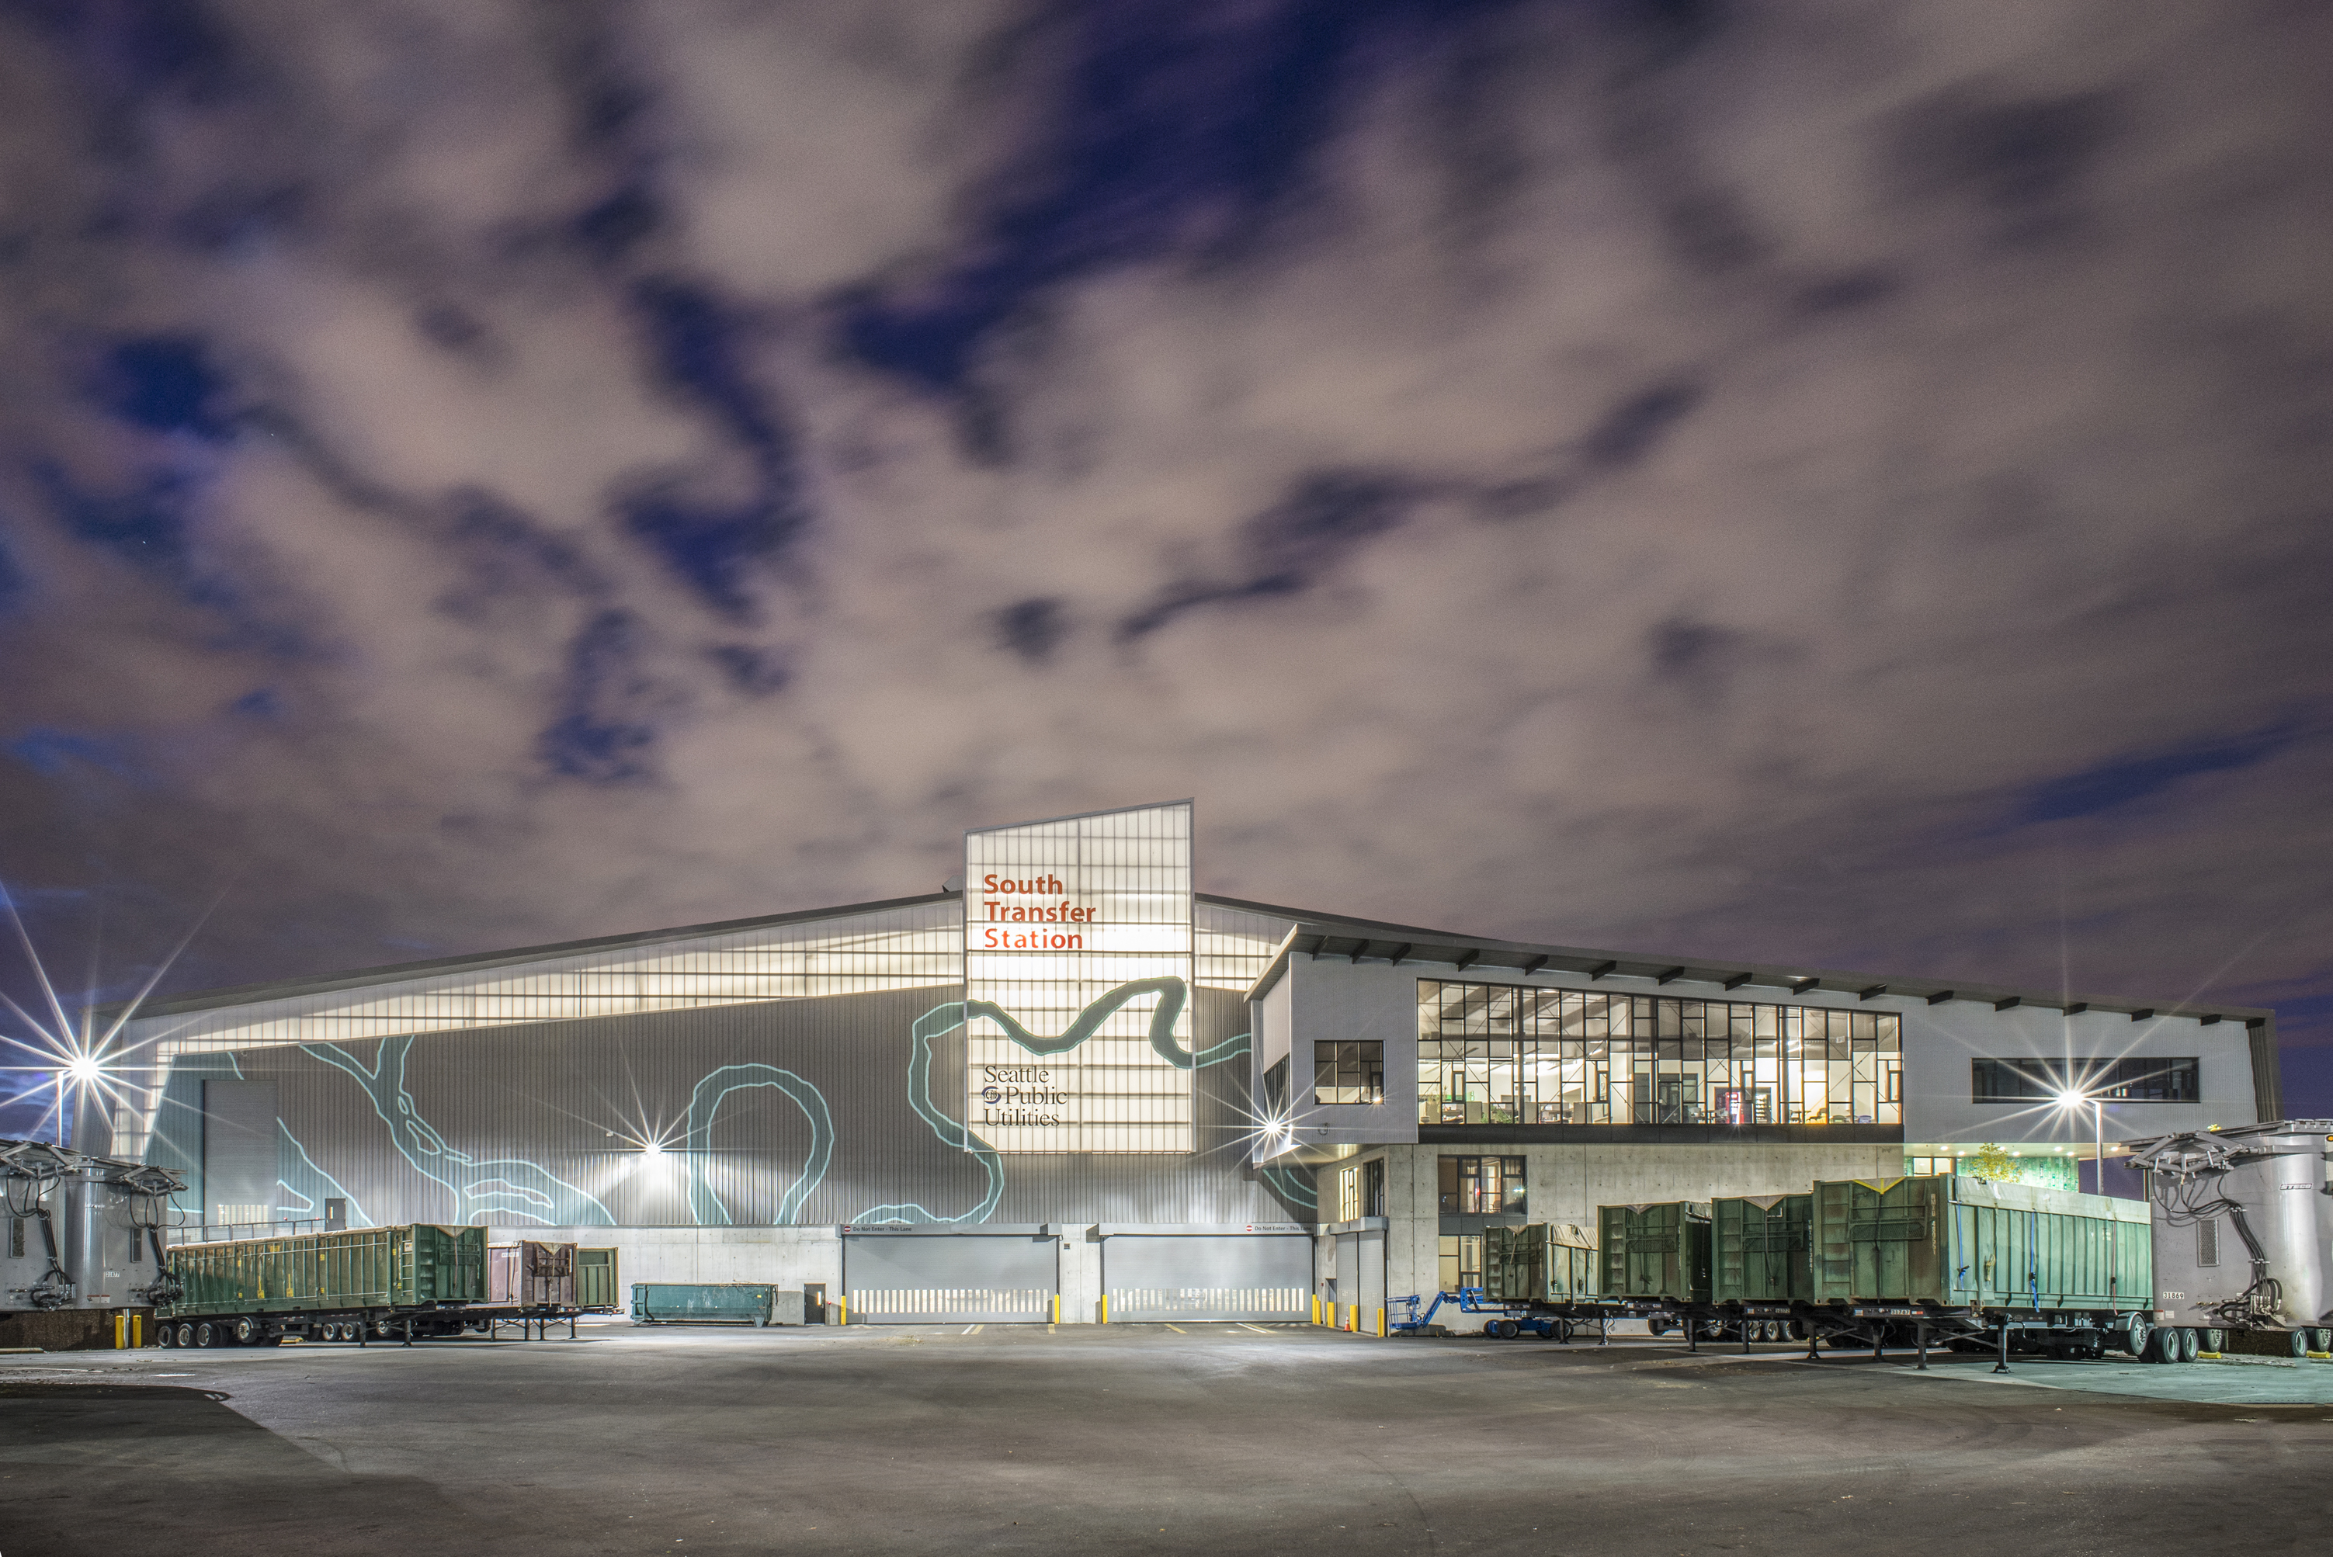
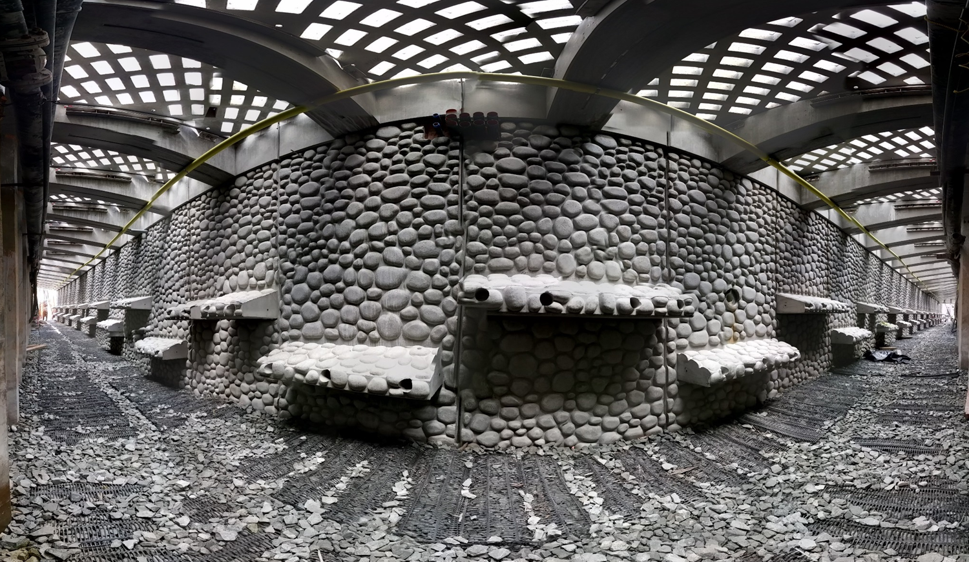
Public Works Management Experience
B.1, B.4
45 projects valued at $5M or above delivered in the past 10 years, including five Design-Build and eight GC/CM projects (Attachment B)
Capital project categories: transportation; water, wastewater, drainage and solid waste; electric utility; and general government and public facilities
331 Public Works projects awarded to-date since the City’s previous certification application in January 2017
Well-developed and enthusiastic bidding pool
Notes:
Jessica:
I now want to turn to our project management experience – our demonstrated success in managing public works projects.
Attachment B highlights 25 of the 45 projects valued at $5M or above in the past ten years – two of them are pictured here – the South Transfer Station and the Seawall.
Our capital project categories are diverse and include transportation, water, wastewater, drainage, and solid waste and electric projects.
The projects include five design build and eight GCCM projects. Three of these projects have been approved since 2017.
These 25 projects are part of 331 public works projects that have been awarded to date since the City’s previous certification in January 2017, demonstrating our ability to successfully execute public works projects.
We are fortunate to have a well-developed and enthusiastic bidding pool of contractors we work with on these projects.

Slide 7
Management Plan for Alternative Public Works
A, B.3, S9
Mayor and City Council
Capital Budget Approval
Capital Departments
Capital Project Approval
Internal Review Committee
Procedure Approval
FAS/CPCS
Contract Compliance
Project Managers
Contract Development
Law Department
Legal Support
Construction Managers
Construction Project Management
Internal Review Committee
Procedure Monitoring
GC/CM Firm / Design Builder
Project Execution
Notes:
JESSICA :
I now want to share the management plan for public works. This flow chart is in the template of the typical management plan outlined on the CPARB PRC website.
First, the Mayor and City Council work with City capital departments to identify capital projects approve the capital budget. I’ll talk about that more in the next slide.
From there, capital departments identify the projects they are going to work on. They go to the Internal Review Committee to obtain procedure approval.
Once approval is obtained, the procurement and project delivery plan begin. CPCS works with the capital departments on the procurement and contract development, with legal support as needed.
After the project is procured, construction managers work with GC/CM firm or the design builder on project execution. CPCS and Law are available for support and consultation.
And, as previously stated, the project checks in with the Internal Review Committee quarterly to ensure continued compliance.

Slide 8
Capital Facilities Plan Management
B.5
CAPITAL DEPTS.
Propose Capital Projects
CAPITAL CABINET
Approve Capital Projects
End Result:
Six-year Capital Improvement Plan
2018-2023 plan totals $6.8B over six years
CAPITAL CABINET
Recommendation to City Budget Office
CITY BUDGET OFFICE
Develop Capital Budget
CITY BUDGET OFFICE
Submit Budget to Mayor’s Office
MAYOR’S OFFICE
Approve Capital Budget
CITY COUNCIL
Review and Adopt Capital Budget
Notes:
Jessica
I also want to speak to the capital facilities plan budgeting planning and budgeting process
As I mentioned in the last slide, first the capital departments propose projects.
They send their proposals to the committee of heads of capital departments who coordinate and approve capital projects.
The capital cabinet sends their recommendation to the City Budget Office.
The City Budget Office develops the Capital Budget and submits to the Mayor’s office.
The Mayor’s office approves the budget and sends to Council who reviews and adopts the capital budget.
What results is a six year capital improvement plan.
This year the plan totals $6.8B over six years.

Slide 9
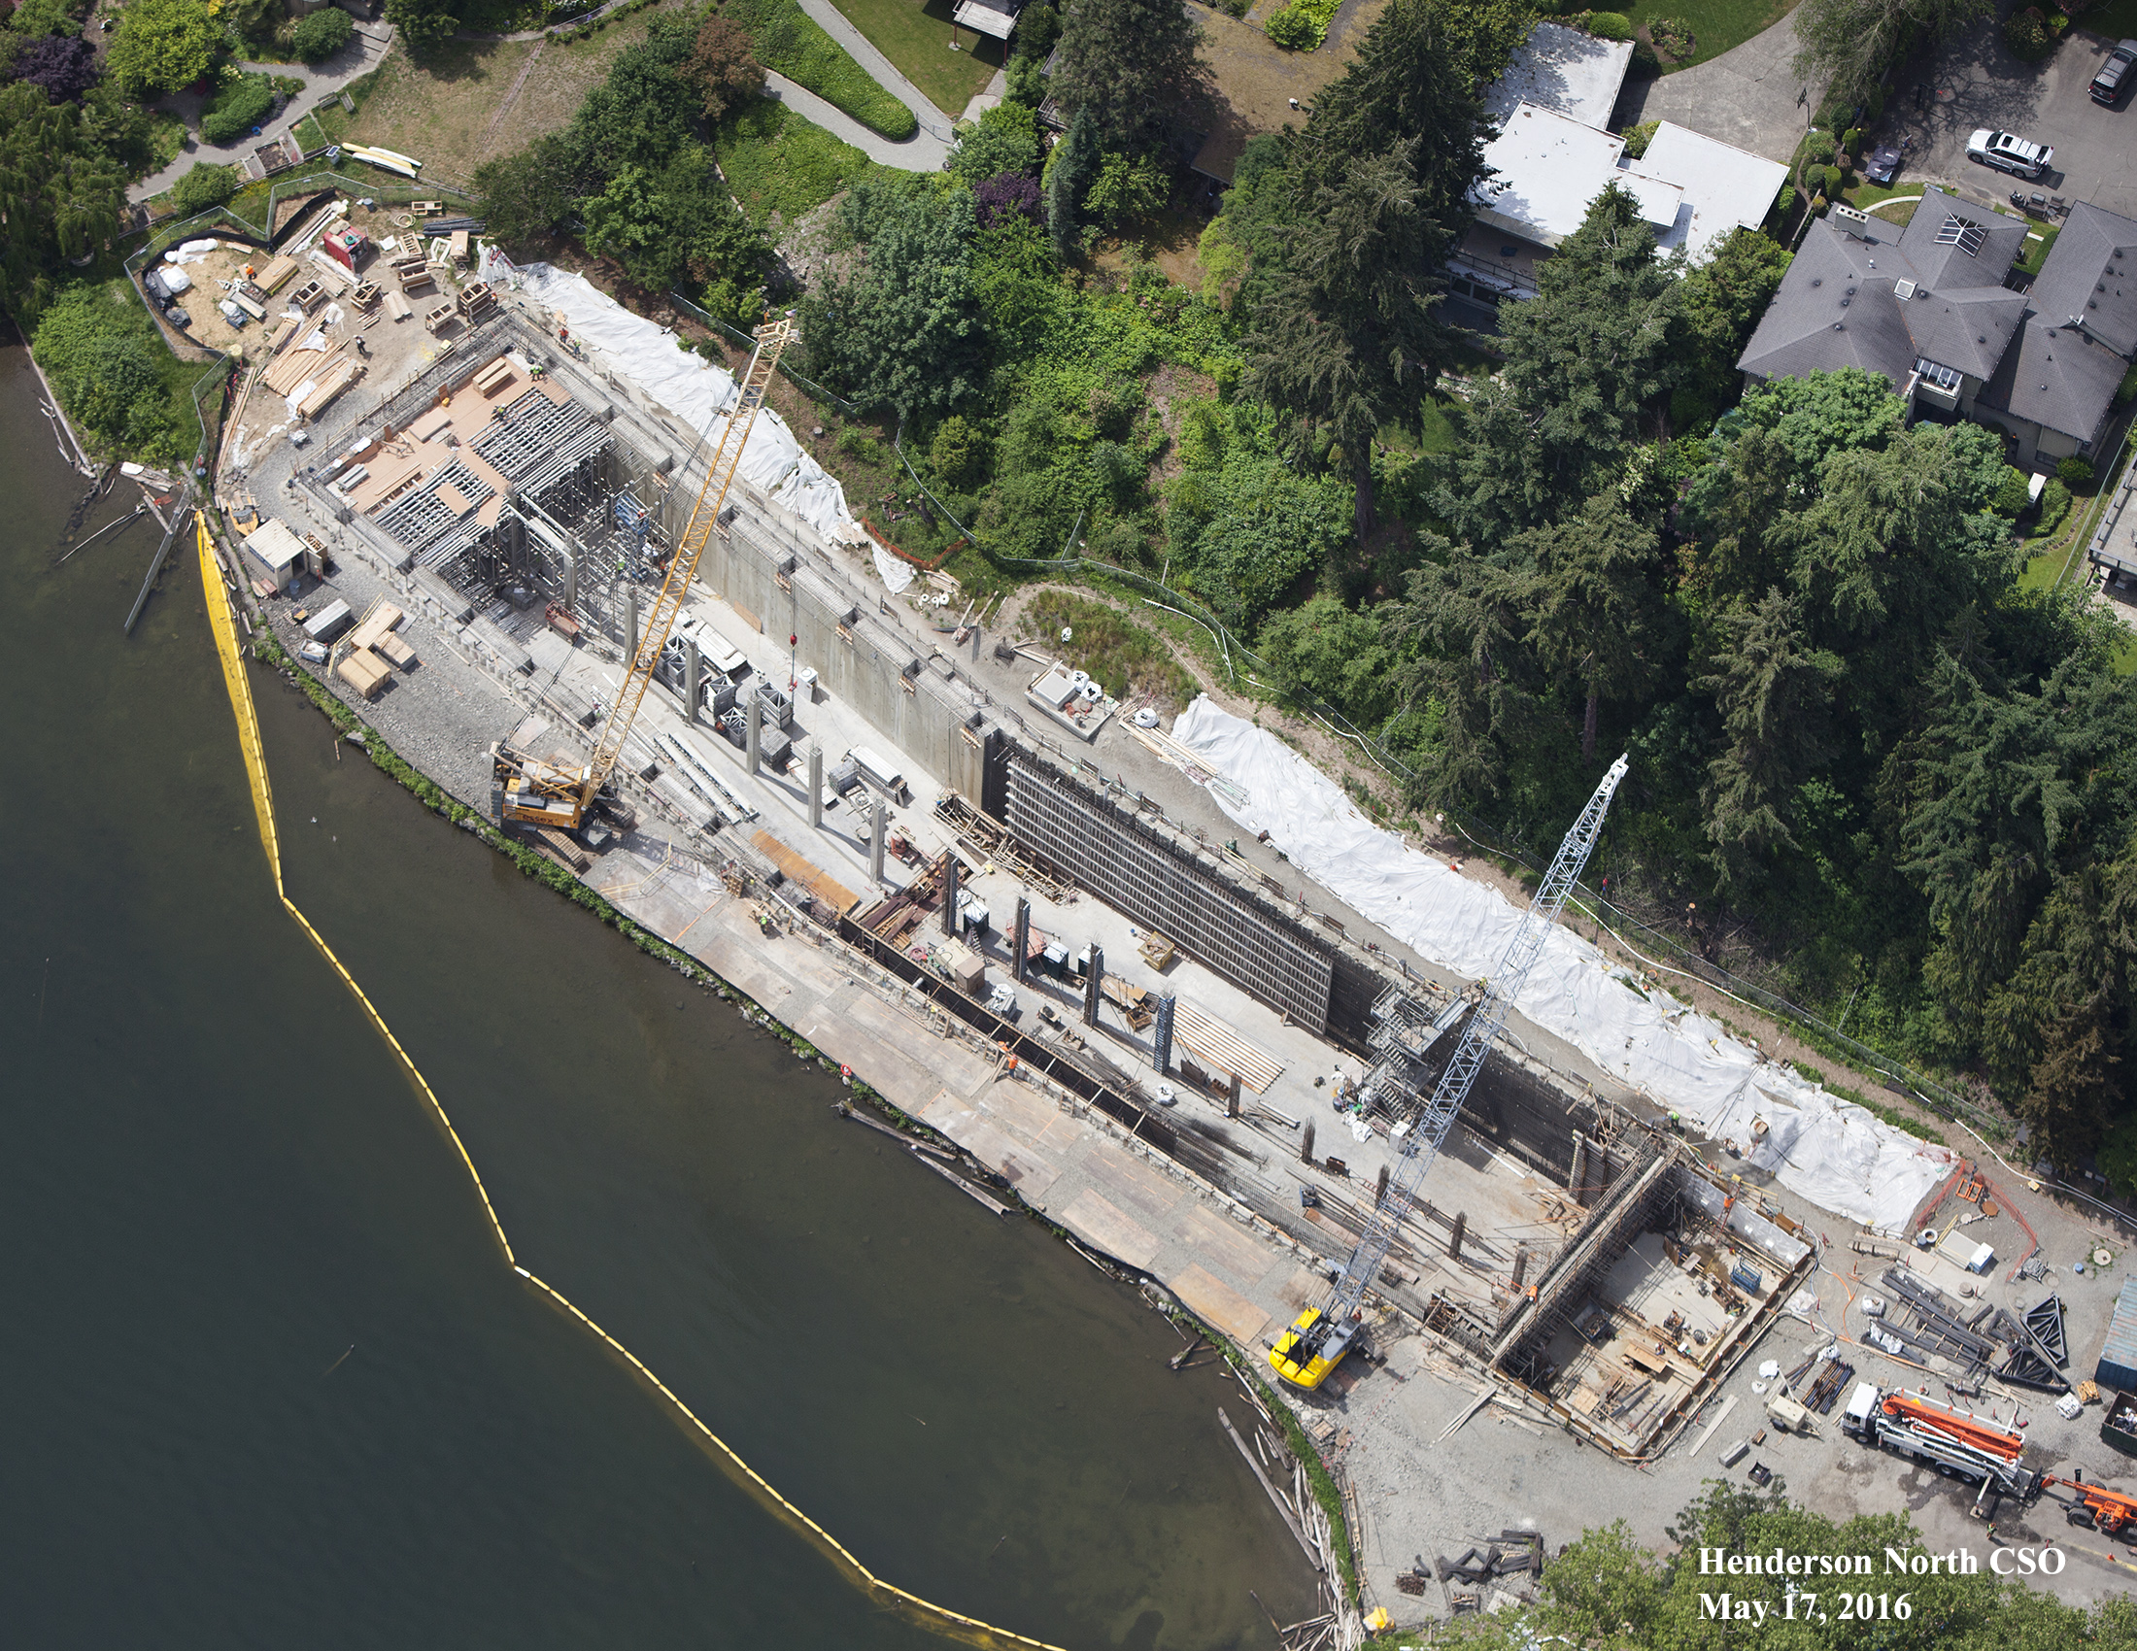
Demonstrated Success in GC/CM Delivery
A, B.6
Henderson North CSO Reduction
Why selected: Contractor input was critical for constructability, sequencing, and risk management.
Benefits:
    Reduced impact to public & Park revenue.
    Risk management of unknown groundwater conditions.
Lessons learned: Value of pre-con risk management and stakeholder outreach to project cost and execution.
Notes:
ALAN:
Henderson North CSO Reduction
Why selected: Contractor input was critical for constructability, sequencing, and risk management.
Benefits:
Reduced impact to public & Park revenue.
Risk management of unknown groundwater conditions.
Lessons learned: Value of pre-con risk management and stakeholder outreach to project cost and execution.

Slide 10
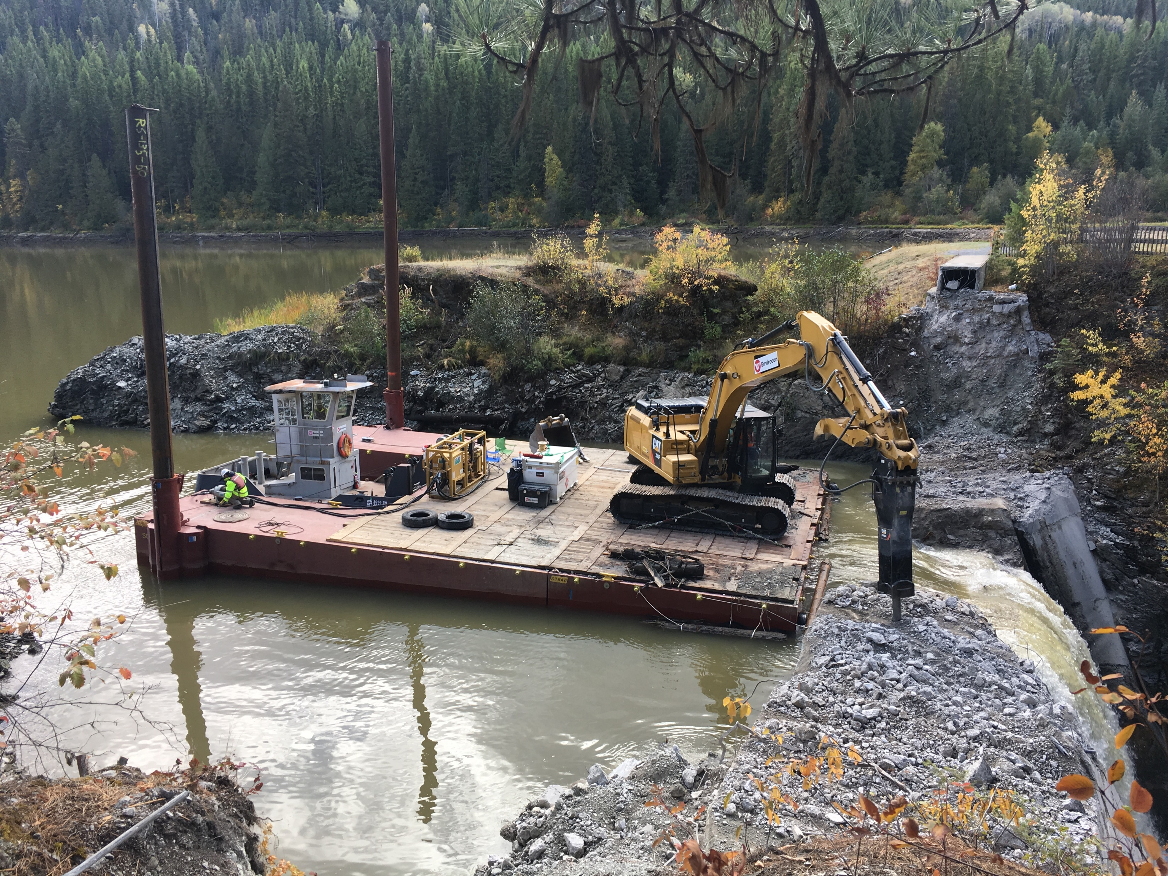
Demonstrated Success in DB Delivery
A, B.6
Mill Pond Dam Removal and Habitat Restoration (DB)
  Why Selected: Limited info about pre-dam site conditions and regulatory concerns.
  Benefits: No-cost redesign of channel and structure configuration after 2018 flood.
  Lessons learned: Best value selection allowed City to evaluate based on long term goals, sustainability and future maintenance concerns.
Notes:
B4, B6
LLOYD:
Mill Pond was a strong DB candidate due to the limited quality of data on pre-dam site conditions, various dam removal strategies available and significant regulatory concerns.
A significant benefit of the DB process for this process was a no cost redesign of the channel and structure configuration following the flood of 2018.
The best value selection of the DB team allowed the City to evaluate the proposals with respect to long term goals, sustainablity and future maintenance concerns.

Slide 11
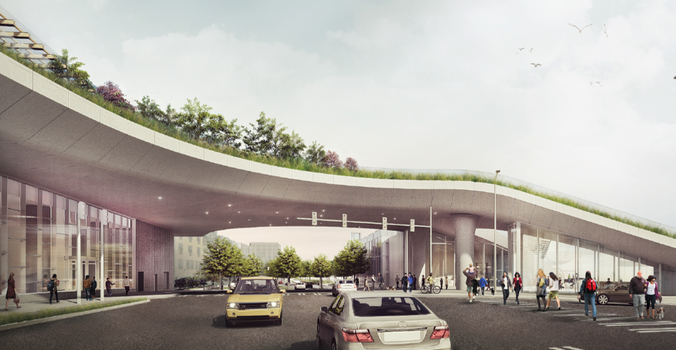
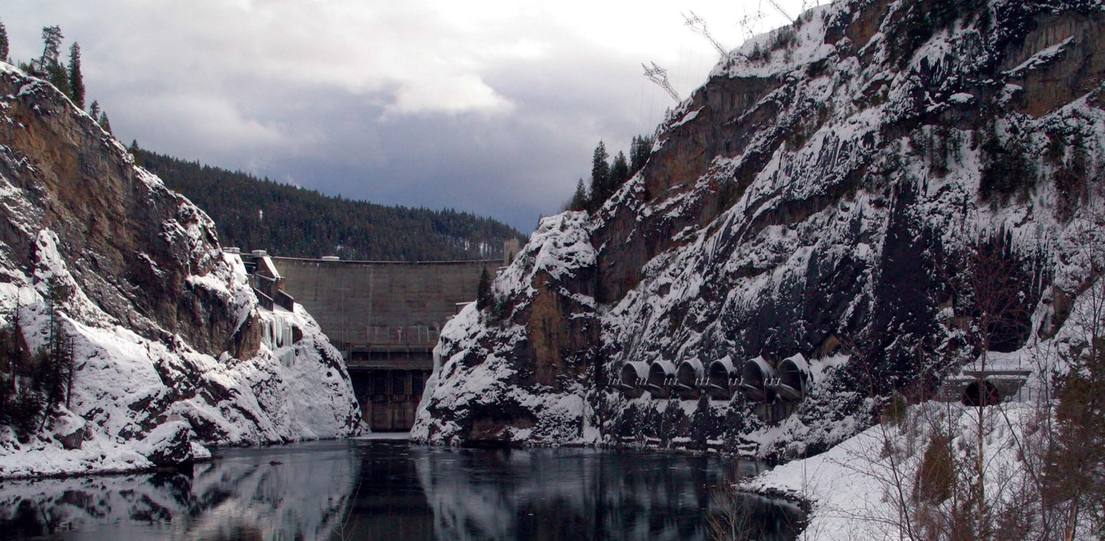
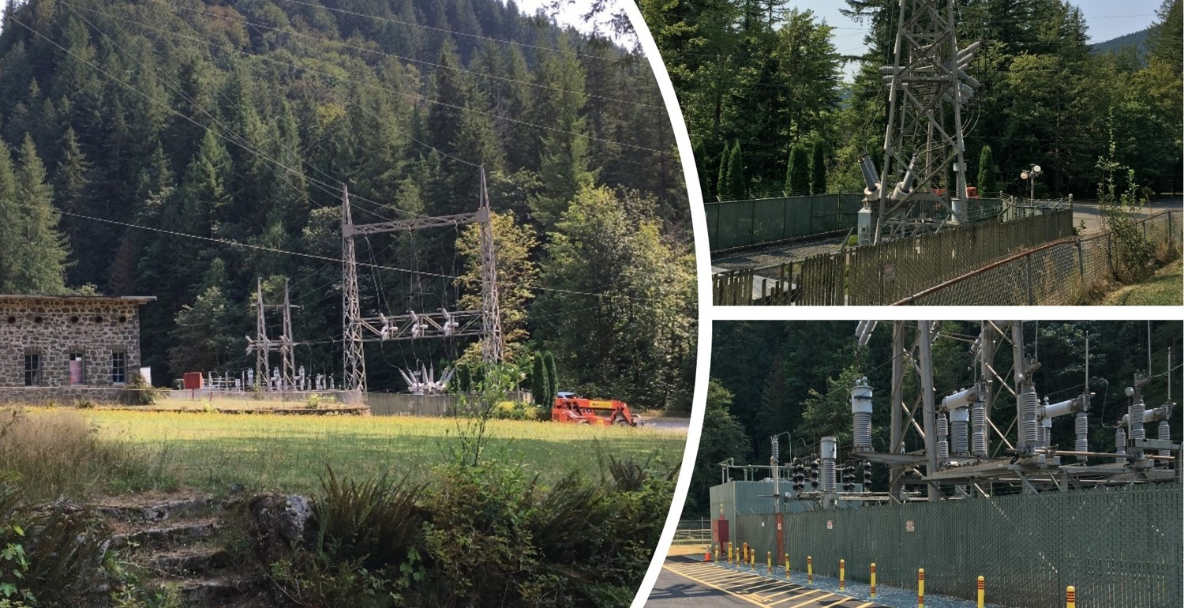
Ability to meet requirements of RCW 39.10: recently-approved projects
B.7
Overlook Walk (GC/CM)
  PRC approved May 2018.
  Overlook Walk is in the fifth month of a 22-month preconstruction services contract. They are currently estimating the 30% documents.
Boundary Dam Units 51, 52 & 54 Generators Rehabilitation (DB)
  PRC approved October 2017.
  Started construction August 19.
  Design builder manufacturing and delivering new components. Old generator being disassembled.
  Contract completion remains on schedule.
Cedar Falls 115-26kV Substation (DB)
  PRC approved September 2018.
  In contract execution phase after a successful RFP process.
  SCL and DB will start material procurement and break ground next summer.
Notes:
MARK
Thank you, Lloyd.
We also want to touch on our three recently approved projects, demonstrating our ability to meet the requirements of RCW 39.10. All projects so far are progressing smoothly.
You can read the full details on each slide.
Overlook Walk was approved by your committee May 2018. Overlook Walk is currently in preconstruction services.
Boundary Dam was approved in October 2017 and started construction last month. Contract completion is on schedule.
Cedar Falls was approved September 2018 and is in the contract execution phase.
All of these projects will give quarterly updates to the Internal Review Committee as part of our new structure, so we will be able to continue to assess the progress of these projects and their compliance with 39.10.

Slide 12
Audit Findings
C
There have been no audit findings since the expiration of our previous public body certification in December 2016.
Notes:
Mark
We also want to note that there have been no audit findings since the expiration of our previous public body certification in December 2016.

Slide 13
Women & Minority-Owned Business Utilization
FY2018 Construction Spend: $210,790,364
  WMBE contract payments (self and state-certified): $40,380,850 (19.1%)
  State-certified contract payments: $26,667,411 (12.7%)
  Number of state certified firms utilized: 121
Notes:
MARK:
We also want to speak to our women- and minority-owned business use.
We have a strong commitment to equity in contracting – the Seattle Mayor signed an Executive Order this week supporting contracting equity, especially for women- and minority-owned businesses.
This experience is demonstrated through our WMBE spend. In 2018, we had a overall construction spend of almost $210.8M.
$40M of that – or 19.1% was with either self or state certified WMBE firms.
Specifically, $26.7M, or 12.7% was with state-certified firms.

Slide 14
Supplemental Questions
Will other departments or semi-autonomous organizations be able to use DB or GC/CM with this process?
Other departments: Yes, provided IRC determines appropriate experience and engagement through the application. Semi-autonomous organizations: no.
Does the City receive and include industry feedback on DB or GC/CM processes?
Yes. We solicit and then incorporate both project-specific and industry-wide feedback.
Notes:
Mark
You should have received a paper with our answers to your questions, but we did want to highlight a few not covered in this presentation.
First – someone asked if other departments or semi-autonomous organizations will be able to use DB or GC/CM with this process.
Our answer is that other departments will be able to use the process only if the IRC determines appropriate experience and engagement with the application.
With semi-autonomous organizations – the City does not extend RCW 39.10 to capital projects of private parties, but with our public/private projects, we do require compliance with prevailing wage, WMBE, and labor protections.
Second, you asked if the City includes industry feedback on DB and GCCM processes.
The answer is yes – we receive feedback through a variety of channels from 360 reviews to monthly industry meetings. This feedback has informed adjustments to the advertising process, project operations, and updates to our specs.

Slide 15
Supplemental Questions
Has a summary of lessons learned been prepared or is one planned? How are lessons learned captured and applied?
We gather and share lessons learned through formal debriefings, ongoing monthly meetings and project reviews.
The IRC will record and share lessons learned on a Citywide basis.
Projects will report to the IRC on application of lessons learned.
How are staff new to the delivery method trained and made aware of lessons learned?
A combination of training and mentorship.
Notes:
Next up – you asked about lessons learned.
We have a variety of ways to capture and apply lessons learned at the City – through formal debriefings, ongoing monthly meetings and project reviews.
While we don’t have an overall summary of lessons learned at this time, the IRC will function as a place to record and share lessons learned, and check in with projects on a quarterly basis to see how they are applying their lessons learned.
Finally, you asked how staff new to the delivery method are trained and made aware of lessons learned?
The answer is a combination of training and mentorship – we encourage our staff to receive continued education and certification, and we also partner them with experienced staff members to share their learnings.
Now I’ll hand it back to Liz.

Slide 16
Summary
Updated determination and monitoring processes, including an Internal Review committee
Experienced alternative public works professionals
Citywide commitment to management and capital oversight
Demonstrated success with alternative public works
Notes:
LIZ: Thank you again for your time. We hope you see through this presentation how we made our process stronger based on your feedback and how we are qualified for certification.
To summarize:
We overhauled our determination processes by adding an internal review committee.
We have experienced alternative public works professionals on staff.
There is a Citywide commitment and cross-departmental dialogue to project management and to capital oversight.
Our recent projects show demonstrated success.
Thank you and now we’ll take questions.

Slide 17
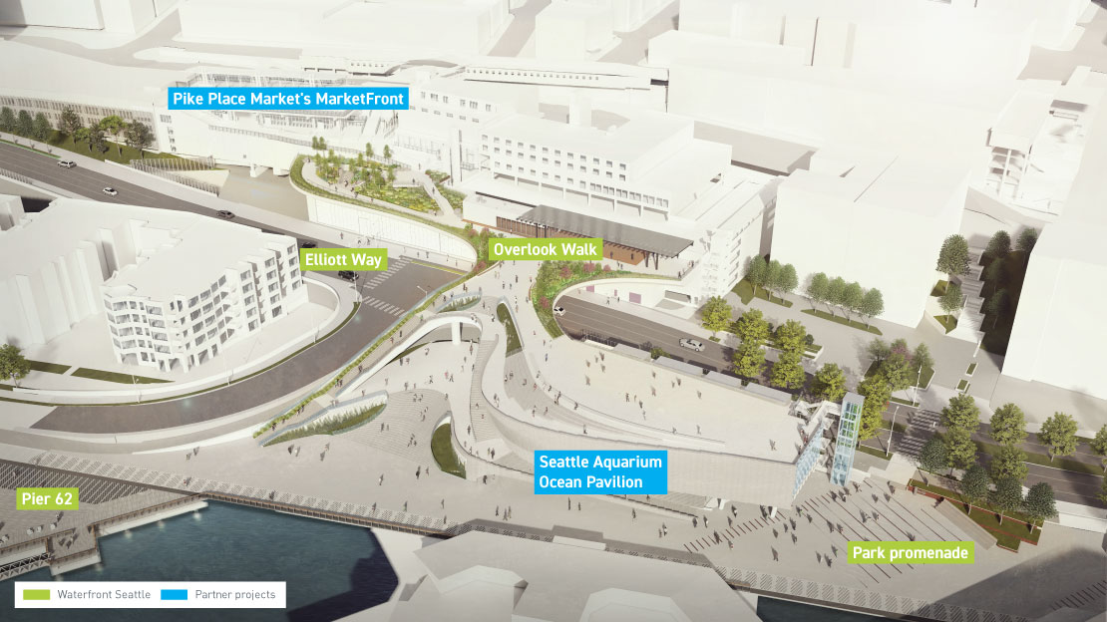
Questions?
Overlook Walk - GC/CM

Slide 18
Planned Alternative Public Works Projects
Large-Scale Utility Pole Replacement
Powerhouse Crane Rehabilitation
Generator Re-winds at Seattle City Light Dams
Seattle Municipal Tower Vertical Conveyance Replacement (Elevators and Escalators)
Notes:
SLIDE IN CASE OF QUESTION
Upcoming projects

Slide 19
Management Plan for Alternative Public Works
CPCS
Conduct 360 Reviews; Monitor WMBEs
CITY BUDGET OFFICE
Develop Capital Budget
MAYOR & CITY COUNCIL
Approve Capital Budget
CONSULTANT
Design Assistance
RISK MANAGEMENT DEPT.
Review Insurance
RESIDENT ENGINEER
Manage Project
CAPITAL CABINET
Approve Capital Projects
CAPITAL DEPT.
Develop Programmatic Project Plan
IRC
Approve usage of DB or GC/CM Project Delivery
CPCS
Assign Public Works Number; Begin Tracking
CAPITAL DEPT.
Develop Contract Package
CPCS
Bid and Execute Contract
CPCS
Project Closeout
CONTRACTED DB or GC/CM TEAM
Manage Project
SUBJECT MATTER EXPERT
Design & Permit Assistance
LAW DEPT.
Review Bonding
IRC
Monitors Project
Notes:
SLIDE IN CASE OF QUESTION
I’d now like to show our management plan for alternative public works.
First our capital budget is established by City Budget Office and approved by City Council. From that, our Capital Cabinet, our capital department directors, approve projects.
Capital departments then develop a programmatic project plan and go through the Internal Review Committee to approve usage of DB or GC/CM.
CPCS works to begin tracking the process, the capital department develops a contract package, and after a review from risk management and law, we bid and execute the contract
Then construction begins, with the resident engineer managing with the DB and GCCM team and IRC and CPCS monitoring the project, through to close out.
B3, B5
Add Capital Cabinet, CBO, Mayor, Council

