Slide 1
GC/CM APPROVAL REQUEST CLARK COUNTY FIRE PROTECTION DISTRICT 6 – FIRE STATION 62 AND 63 PROJECT

Slide 2
PROJECT TEAM
JERRY GREEN
FIRE CHIEF, CLARK COUNTY FIRE DISTRICT 6
KRISTAN MAURER
PROJECT MANAGER, ASSISTANT CHIEF – LOGISTICS & PLANNING, CLARK COUNTY FIRE DISTRICT 6
DAVID TAYLOR
ASSISTANT CHIEF - FINANCE & SUPPORT SERVICES, CLARK COUNTY FIRE DISTRICT 6
SHAWN NEWBERRY
ASSISTANT CHIEF - OPERATIONS, CLARK COUNTY FIRE DISTRICT 6
JEFF HUMPHREYS, AIA
PROJECT PRINCIPAL, ARCHITECT, MACKENZIE
CATHY BOWMAN, AIA
PROJECT MANAGER, ARCHITECT, MACKENZIE
ANDREW MCALLISTER, AIA
PROJECT ARCHITECT, ARCHITECT, MACKENZIE

Slide 3
PROJECT ORGANIZATION
CLARK COUNTY FIRE DISTRICT 6 (CCFD6)
KRISTAN MAURER PROJECT MANAGER CCFD6
GCCM
CONTRACTOR – TBD
PROJECT MANAGER
PROJECT SUPERINTENDENT
MACKENZIE
JEFF HUMPHREYS – PROJECT PRINCIPAL
CATHY BOWMAN – PROJECT MANAGER
ANDREW MCALLISTER – PROJECT ARCHITECT
STRUCTURAL ENGINEER
CIVIL ENGINEER
LANDSCAPE ARCHITECT
PLANNING
MACKENIZE CONSULTANTS
INTERFACE ENGINEERING

Slide 4
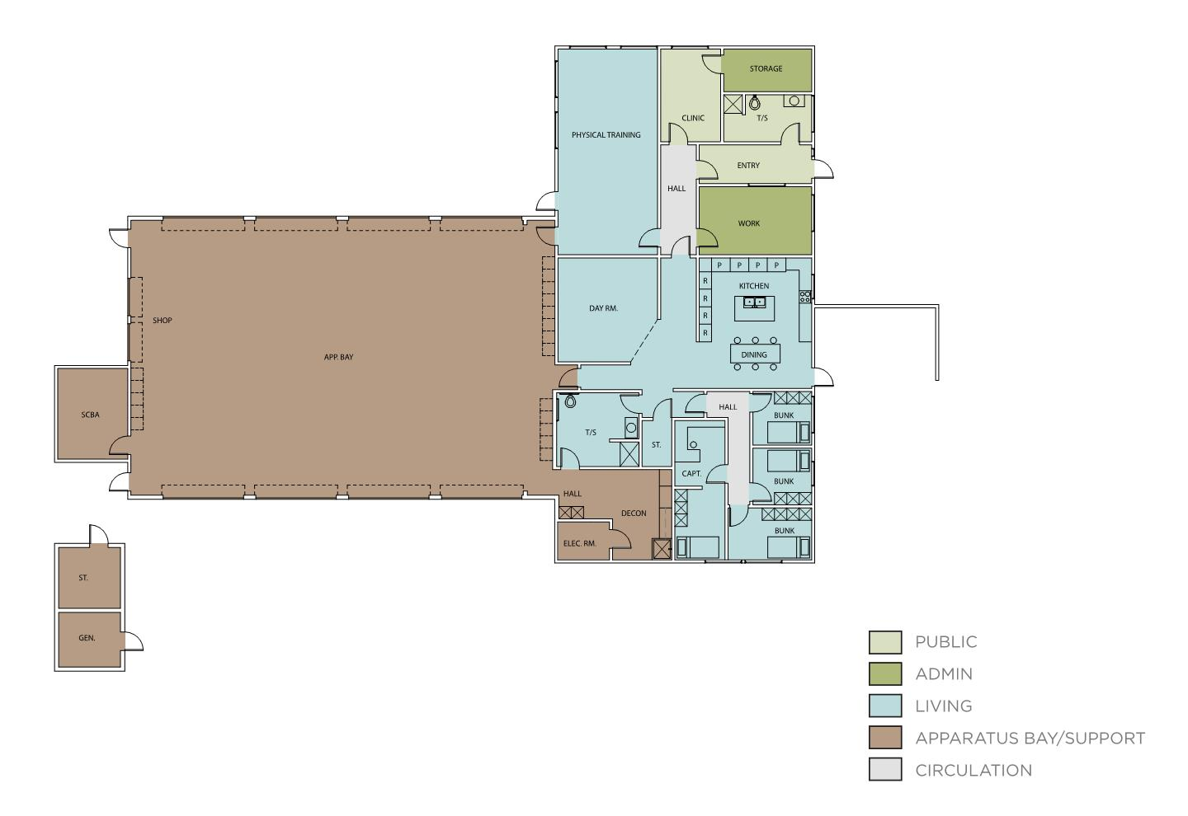
PROJECT DESCRIPTION – STATION 62

Slide 5
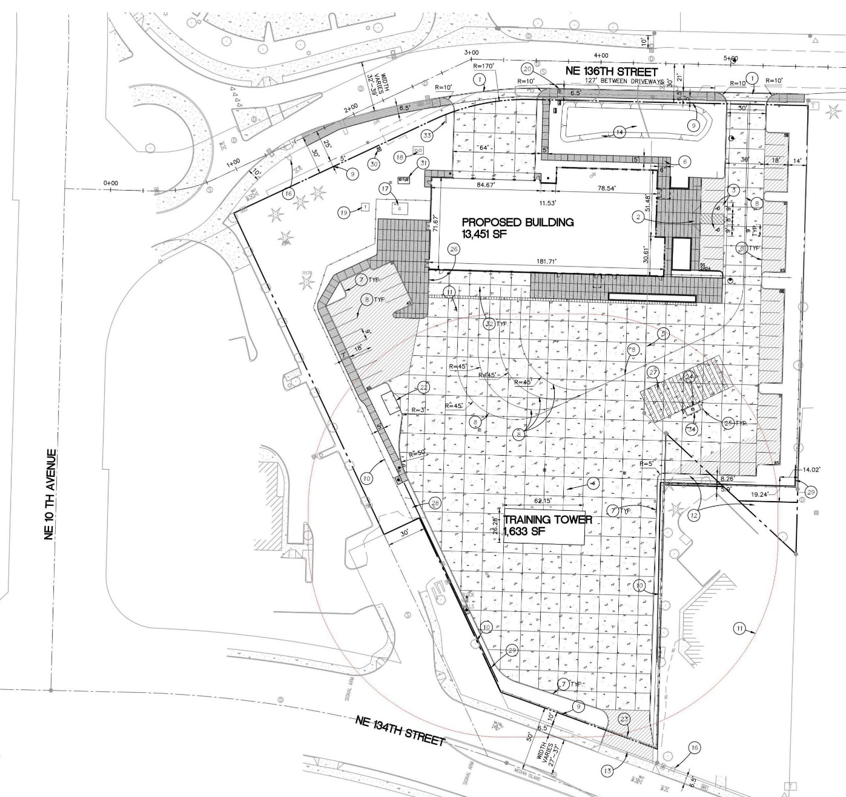
PROJECT DESCRIPTION – STATION 63

Slide 6
PROJECT BUDGET
Costs for Professional Services (A/E, Legal etc.) $1,091,232.70
Estimated project construction costs (including construction contingencies): $9,431,957.19
Equipment and furnishing costs $478,490.50
Off-site costs $132,873.13
Contract administration costs (owner, cm etc.) $0.00
Contingencies (design & owner) $108,297.47
Other related project costs $0.00
Sales Tax $847,490.55
Total $12,090,341.5

Slide 7
SCHEDULE
Fire Station 62 Seismic Upgrade/Remodel | Start | Completion
Design Procurement (A/E) | December 2015 | March 2016
Programming / Pre-Design (Master Plan for District) | April 2016 | December 2016
Design Development | January 2017 | March 2017
Construction Documents | April 2017 | June 2017
Permitting | June 2017 | Ongoing
GCCM Procurement | January 2018 | February 2018
GCCM Pre-Construction | March 2018 | April 2018
Primary Construction Phase I | April 2018 | June 2018
Primary Construction Phase II | July 2018 | August 2018
FF & E / Owner Move In | August 2018 | September 2018

Slide 8
SCHEDULE
Fire Station 63 – Replacement Station | Start | Completion
Design Procurement (A/E) | December 2015 | March 2016
Programming / Pre-Design (Master Plan for District) | April 2016 | December 2016
Design Development | January 2017 | June 2017
Construction Documents | September 2017 | June 2017
GCCM Procurement | January 2018 | February 2018
GCCM Pre-Construction | March 2018 | May 2018
Permitting | May 2018 | July 2018
Construction | July 2018 | July 2019
FF & E / Owner Move In | August 2019 | September 2019

Slide 9
WHY GC/CM
COMPLEX SCHEDULE / PHASING
OCCUPIED FACILITY
SITE ELEMENTS
VOLATILE MARKET CONDITIONS

Slide 10
WHY GC/CM
TWO STATIONS WITH OVERLAPPING SCHEDULES AND COMPLEX PHASING
THE PROJECTS NEED TO BE COMPLETED PRIOR TO THE EXPIRATION OF THE GENERAL OBLIGATION BOND WINDOW.
COST ESCALATION AND CURRENT REGIONAL MARKET CONDITIONS: IMPORTANT TO CHECK REAL-TIME COST OF CONSTRUCTION AND RESPOND ACCORDINGLY.
VETTING DESIGN TEAM’S ASSUMPTIONS TO MINIMIZE CONSTRUCTIBILITY ISSUES, ELIMINATE COSTLY SOLUTIONS, AND CALIBRATE THE QUALITY OF ALL STATION DESIGNS.

Slide 11
WHY GC/CM
RESPONDING TO THE ESCALATING MARKET, A GC/CM CAN PROCURE CERTAIN EARLY BUY OUT PACKAGES TO MINIMIZE THE COST AND SCHEDULE IMPACT TO THE PROJECT.
ONE DESIGN AND CONSTRUCTION TEAM FOR ALL FIRE STATIONS TO STREAMLINE END USER PARTICIPATION, PROJECT DELIVERY PROSSES, AND MINIMIZE CHANGE ORDER EXPOSURE DURING CONSTRUCTION.
THROUGH PRE-CONSTRUCTION THE GC/CM WILL UNDERSTAND THE WORK LONG BEFORE THE BIDS ARE TAKEN, PARTICIPATING IN SCHEDULE DEVELOPMENT AND PACKAGING TRADE SCOPES TO FIR THE MARKETPLACE AND REALISTICALLY SET EXPECTATIONS BEFORE WORK IS BOUGHT OUT.

Slide 12
EXPERIENCE
CCFD6
UNDERSTANDING OF THE DISTRICT AND RESPONSE NEEDS
63 OF YEARS OF EXPERTISE IN THE FIRE RESPONSE INDUSTRY
MACKENZIE
COMPLETED 12+ GC/CM PROJECTS WITH TOTAL VALUE OVER $153 MILLION
DEVELOPED GC/CM RFP, SELECTION PROCESS, CONTRACT NEGOTIATION, AND CONSTRUCTION ADMINISTRATION ON PAST PROJECTS

Slide 13
CCFD6 EXPERIENCE
JERRY GREEN – FIRE CHIEF
SERVING THE DISTRICT SINCE APRIL OF 2004
FIRE CHIEF OF CLARK COUNTY FIRE DISTRICT 6 SINCE 2009

Slide 14
CCFD6 EXPERIENCE
KRISTAN MAURER
ASSISTANT CHIEF – LOGISTICS AND PLANNING
PROJECT ROLE: OWNER PROJECT MANAGER
SERVING THE DISTRICT SINCE JUNE 1999
MASTER’S DEGREE IN PUBLIC ADMINISTRATION
BACHELOR’S DEGREE IN PARAMEDICINE
ASSOCIATE’S DEGREE IN FIRE SCIENCE
GRADUATE OF THE EXECUTIVE OFFICER PROGRAM AT THE NATIONAL FIRE ACADEMY

Slide 15
CCFD6 – EXPERIENCE
DAVID TAYLOR
ASSISTANT CHIEF – FINANCE AND SUPPORT SERVICES
BEGAN HIS CAREER IN THE FIRE SERVICE IN 1976 AS A FIREFIGHTER WITH THE US AIR FORCE.
SERVING THE DISTRICT SINCE 1982
SHAWN NEWBERRY
ASSISTANT CHIEF – OPERATIONS
BEGAN FIRE SERVICE IN 1996
SERVING THE DISTRICT SINCE 1999

Slide 16
MACKENZIE – EXPERIENCE
JEFF HUMPHREYS, AIA
PROJECT PRINCIPAL
LICENSED ARCHITECT IN WA
OVER 25 YEARS OF EXPERIENCE IN THE INDUSTRY
PROJECT RESPONSIBILITIES:
PROVIDE EXECUTIVE LEADERSHIP FOR THE PROJECTS, SERVING AS A RESOURCE FOR CCFD6 AND THE DESIGN TEAM.
PROVIDE QAQC REVIEW FOR THE PROJECT
PROVIDE GUIDANCE FOR DESIGN, DETAILING AND EXECUTION THROUGHOUT THE PROJECT.
Project | Value | Role/Tasks | Completed
Lake Oswego Police and City Hall | $30 M | Project Principal | Current
Pendleton Fire Department - Replacement Station 1 | $8 M | Project Principal | Current
Depoe Bay Rural Fire District - Station 2300 Remodel & Seismic Upgrade | $2.5 M | Project Principal | 2017
Philomath Fire District - Remodel & Seismic Upgrade | $2 M | Project Principal | 2017
Rockwood Police Department | $3.5 M | Project Principal | 2014
Canby Police Department | $ 7 M | Project Principal | 2012

Slide 17
MACKENZIE - EXPERIENCE
CATHY BOWMAN, AIA
PROJECT MANAGER
LICENSED ARCHITECT IN OREGON; CURRENTLY IN THE PROCESS OF RECIPROCITY FOR LICENSE IN WASHINGTON
OVER 10 YEARS OF EXPERIENCE IN THE INDUSTRY
PROJECT RESPONSIBILITIES:
MANAGE DEVELOPMENT, PLANNING, PROGRAMMING, PROCUREMENT, DESIGN, BIDDING, CONSTRUCTION, CODE COMPLIANCE, CONTRACT DEVELOPMENT AND DISPUTE RESOLUTION
Project | Value | Role/Tasks | Completed
Pendleton Fire Department - Replacement Station 1 | $8 M | Project Manager | Current
Depoe Bay Rural Fire District - Station 2300 Remodel & Seismic Upgrade | $2.5 M | Project Manager | 2017
Philomath Fire District - Remodel & Seismic Upgrade | $2 M | Project Designer | 2017
University of Kentucky - Student Housing Phase I | $28.6 M | Project Architect | 2013
Central Bank - Central Server Room and Facilities | $2.2 M | Project Architect | 2013
Mountain Telephone Headquarters | $6 M | Project Architect | 2012
Central Laboratory Facility / KY State Police | $8.2 M | Project Designer | 2011

Slide 18
MACKENZIE - EXPERIENCE
ANDREW MCALLISTER, AIA
PROJECT ARCHITECT
LICENSED ARCHITECT IN OREGON; CURRENTLY IN THE PROCESS OF RECIPROCITY FOR LICENSE IN WASHINGTON
OVER 10 YEARS OF EXPERIENCE IN THE INDUSTRY
PROJECT RESPONSIBILITIES:
WORKING WITH THE DESIGN TEAM TO DEVELOP DESIGN AND CONSTRUCTION DOCUMENTS.
Project | Value | Role/Tasks | Completed
Lake Oswego Police and City Hall | $30 M | Project Designer | Current
University of Michigan Undergraduate Science Building | $46.5 M | Project Manager | 2005
Episcopal Academy Chapel | $8.5 M | Project Manager | 2008

Slide 19
DEPOE BAY RURAL FIRE STATION 2300 SEIMIC UPGRADE AND REMODEL
SIZE: 10,000 SF
COMPLETED: 2017
GC/CM: P&C CONSTRUCTION
FINAL CONSTRUCTION COST: $2,500,000

Slide 20
PHILOMATH FIRE DISTRICT – REMODEL & SEISMIC UPGRADE
SIZE: 15,372 SF
COMPLETED: 2017
GC/CM: GERDING BUILDERS
FINAL CONSTRUCTION COST: $2,000,000

Slide 21
ROCKWOOD POLICE STATION
SIZE: 12,656 SF
COMPLETED: 2014
GC/CM: P&C CONSTRUCTION
FINAL CONSTRUCTION COST: $3,500,000

Slide 22
CANBY POLICE DEPARTMENT
SIZE: 40,135 SF
COMPLETED: 2012
GC/CM: P&C CONSTRUCTION
FINAL CONSTRUCTION COST: $7,000,000

Slide 23
SUMMARY
CLARK COUNTY FIRE DISTRICT 6 – FIRE STATIONS 62 & 63
SIGNIFICANT PROJECT FOR CLARK COUNTY
MEETS CPARB CRITERIA FOR GC/CM
MACKENZIE HAS A LONG HISTORY OF BUILDING SUCCESSFUL PULIC PROJECTS
THE TEAM HAS A VERY STRONG GC/CM EXPERIENCE AND RECORD

