Slide 1

Application for Certification of a Public Body
RCW 39.10 Alternative Public Works Contracting – GC/CM
July 27, 2017
The mission of Clover Park School District is to ensure each child learns what he or she
needs to know to succeed and contribute to the community.

Slide 2
Agenda
Presenting Team
Clover Park School District
Agency Organization Chart
Capital Planning & Construction Org Chart
GC/CM Experience
GC/CM Team Experience
GC/CM Lessons Learned
Delivery Method Determination
GC/CM Candidate Projects
Business Equity
Summary

Slide 3
Presenting Team
Rick Ring – Administrator Business Services & Capital Projects
Bill Coon – Director of Capital Projects
Jim Dugan – Program Manager
Dan Cody – GC/CM Procurement & PM/CM
Michelle Langi- Project Controls Specialist

Slide 4
Other Team Members
Latanya Figueroa – Purchasing Manager
Paul Popovich – Capital Project Supervisor
Joe Missel – Project Manager
Greg Stidham – Sr. Construction Manager
Dale Stafford – Small Capital Project Manager
Graehm Wallace – GC/CM Attorney

Slide 5
Clover Park School District
Founded in 1928
Comprised of 24 Schools:
    16 Elementary Schools
    5 Middle Schools
    3 High Schools
    Numerous Special Programs
Approximately 12,685 students
Over 1,500 employees
Serving Pre-K thru 12th grade
One of the largest districts in Pierce County

Slide 6
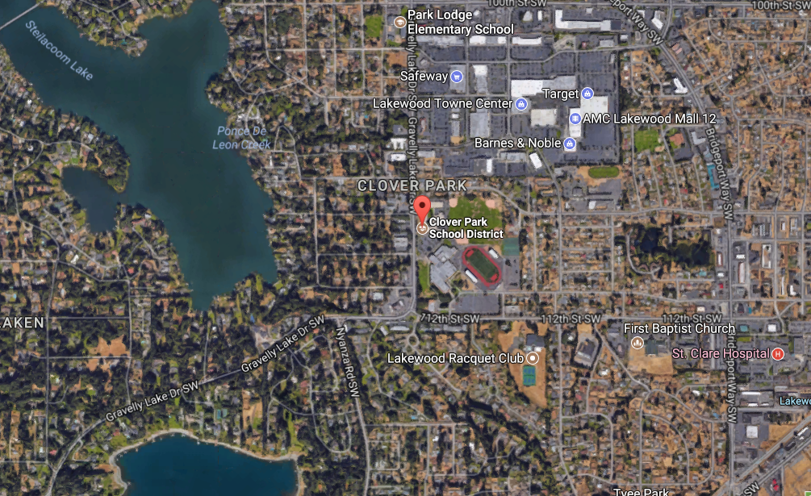
Clover Park School District

Slide 7
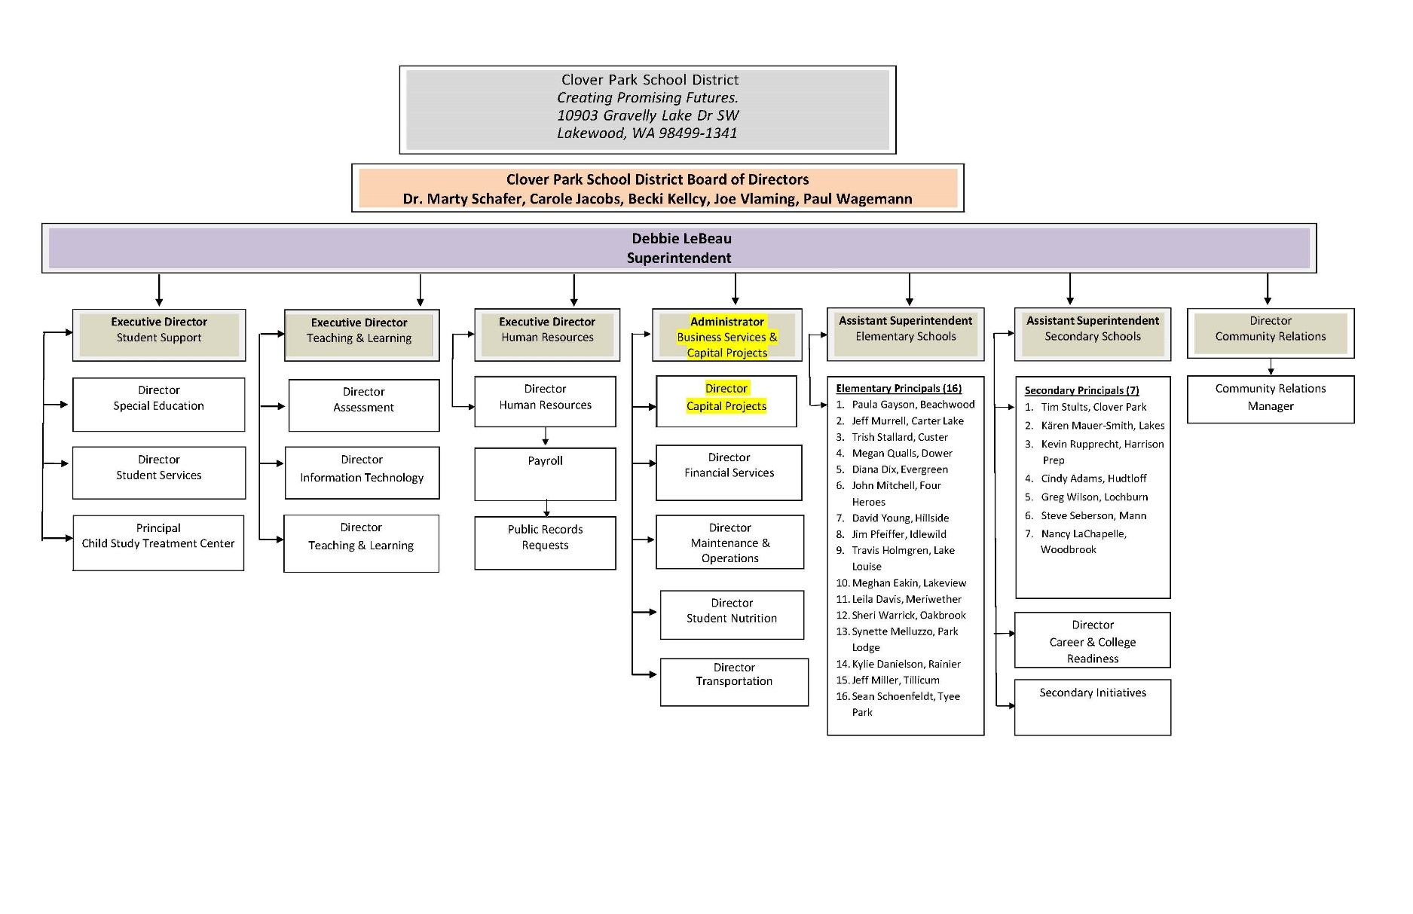
Agency Organization Chart

Slide 8
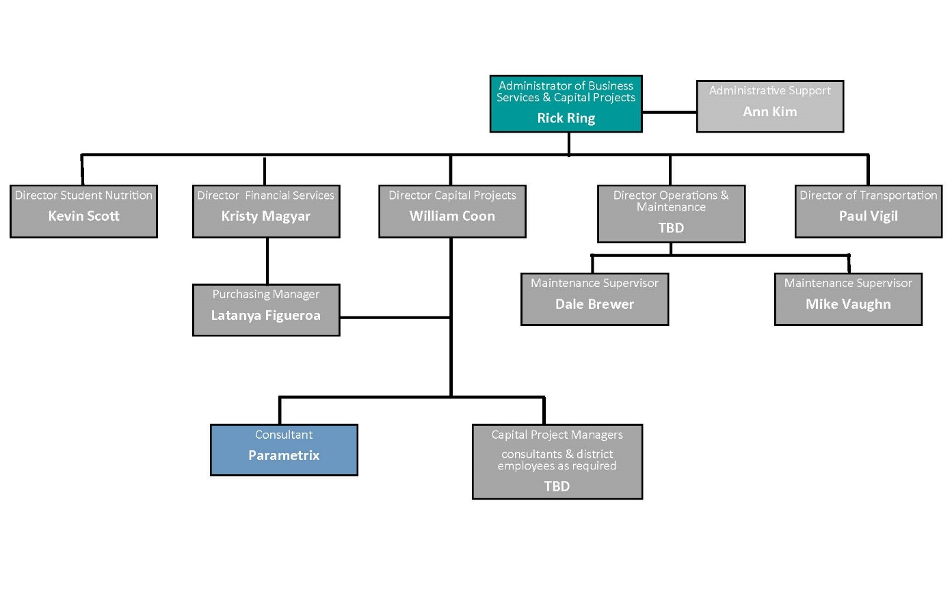
Capital Planning & Construction Organization Chart

Slide 9
Capital Project History

Slide 10
Clover Park School District Planning
Facility Advisory Committee
  Created in 2001
  Comprised of 20 various types of community members including local citizens, school representatives, and military & industry experts to include architects & engineers
  Augmenting and Enhancing the internal team – Since 2006 teaming with external consulting teams.
  CPSD has developed a comprehensive controls system to plan and execute the work, select the most appropriate delivery methods and apply GC/CM successfully.
Notes:
Beginning work on the next 30 year Master Plan

Slide 11
Clover Park School District: 2006
CPSD passed a $65 M capital bond issue comprised of two major capital projects
  Lakeview Hope Academy
  Lakes High School (GC/CM)
In partnership with JBLM the Public School on Military Installations Program (PSMI) was implemented to raise awareness of failing school infrastructures on military bases across the U.S.
In addition a national program to fix educational facilities on military installations was created as a result of the (PSMI)

Slide 12
Clover Park School District: 2010
CPSD passed a $92 M capital bond issue comprised of 3 major capital projects.
    Hudtloff Middle School Replacement and site improvements
    Four Heroes Elementary School new combined K-5 elementary school consolidated by Oakwood and Southgate elementary schools
    Harrison Preparatory School new combined 6-12 prep school in partnership with Clover Park Technical College

Slide 13
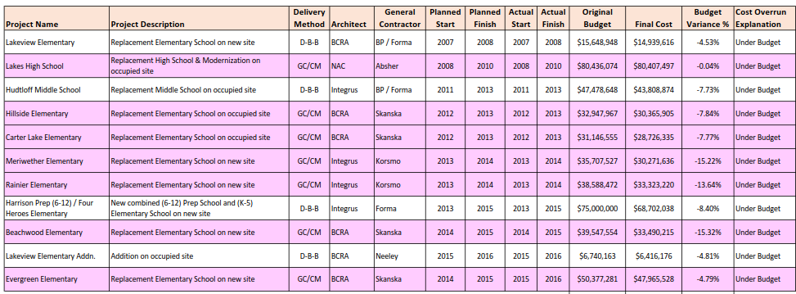
CPSD Public Body Experience: 2001 - 2016
Notes:
As a public body depth of public works experience
TPS is a major capital project builder

Slide 14
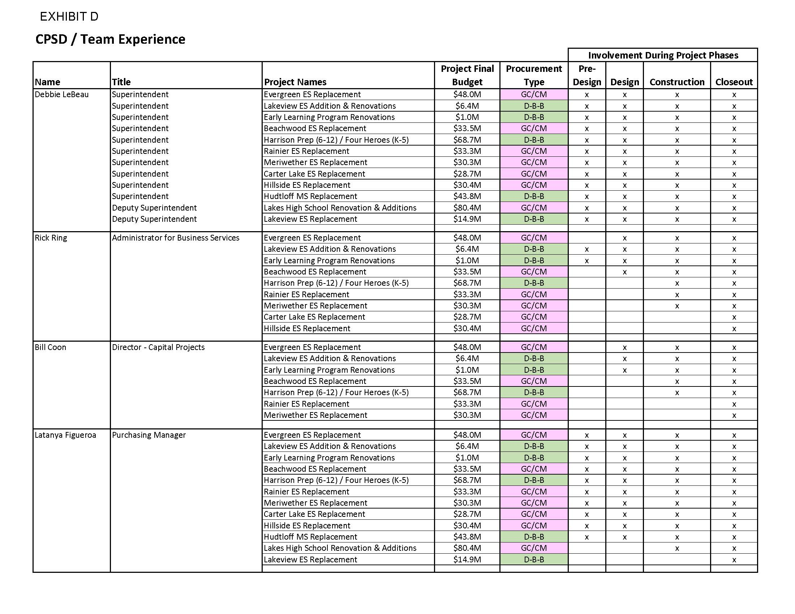
CPSD Team Experience
Notes:
Yellow Highlighted GCCM Projects
Green Highlighted- Just beginning or starting in the next couple of years
May or may not be occupied

Slide 15
CPSD Project Delivery Experience & Qualifications
Successfully passed $450 M in Capital Improvement Funding since 2006
  $65 M in 2006
  $92M in 2010
  Nearly $300M was granted by the U.S. Department of Defense Office of Economic Adjustment, state assistance and local funding to fix educational facilities on military installations
Between 2006 and 2016 alone, funds were used for modernizations, replacements, and/or build additions to 11 public schools
  11 projects complete to date

Slide 16
CPSD Project Delivery Experience & Qualifications
7 successful GC/CM projects to include 6 in the last 5 years
Since 2006, CPSD has successfully delivered 11 large capital projects valued at approximately $418 million.
All projects completed on time
All project completed under budget
Notes:
Controls
-Weekly Staff Meetings
-Weekly progress meetings
-One on one PM daily and weekly meetings
-Standing daily and weekly meetings with COO
-Multi Vista- Photographic Interactive As-Built
-Digitized As Builts and OEM Manuals in the Cloud (Skisite)
-Chalk Schools- Soup to nuts process for Project approvals

Slide 17
GC/CM Experience
GC/CM Project History, 6 projects:
(1) Carter Lake Elementary School
(2) Hillside Elementary School
(3) Rainier Elementary School
(4) Meriwether Elementary School
(5) Beachwood Elementary School
(6) Evergreen Elementary School
GC/CM Project Organization Chart
GC/CM Roles and Responsibilities
Notes:
Summary of out GCCM Projects in the past

Slide 18
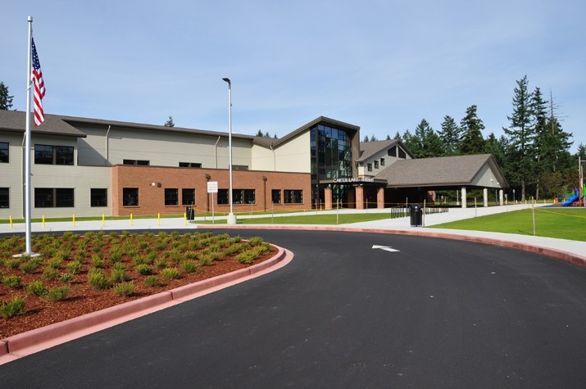
Carter Lake Elementary School
Replacement
Planned Start: 2012
Actual Start: 2012
Planned Finish: 2013
Actual Finish: 2013
Planned Budget: $31,146,555
Actual Budget: $28,726,3354
Budget Variance: -7.77%
Notes:
2nd GCCM Project
Finished slightly over budget but 1 year early

Slide 19
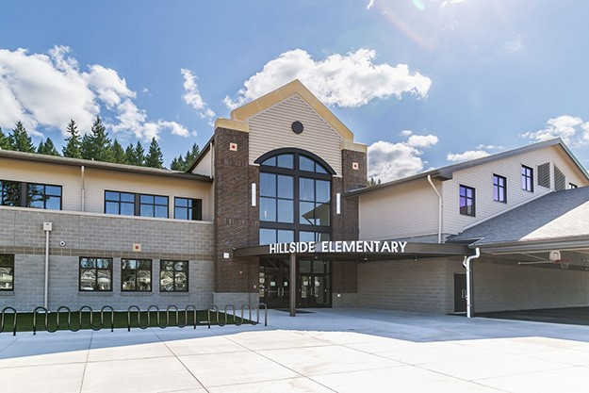
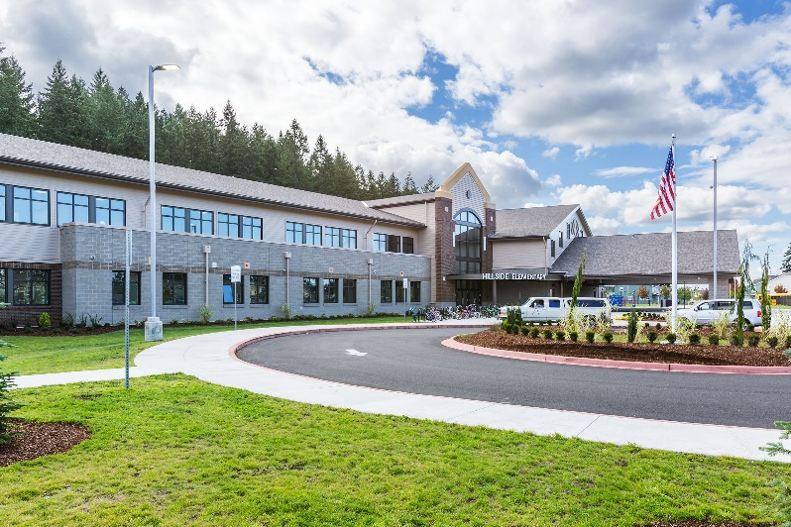
Hillside Elementary School
Replacement
Planned Start: 2012
Actual Start: 2012
Planned Finish: 2013
Actual Finish: 2013
Planned Budget: $32,947,967
Actual Budget: $30,365,905
Budget Variance: -7.84%
Notes:
3rd Project
On Time and slightly under budget
King 5 twice , Komo 4, TNT Coverage

Slide 20
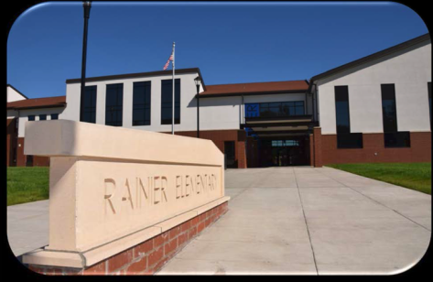
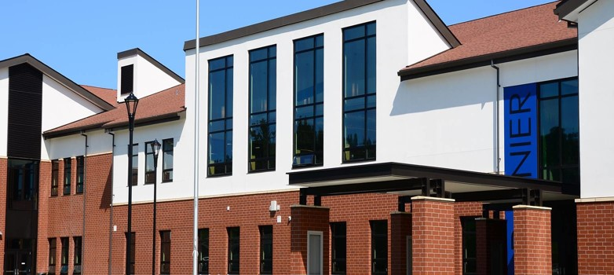
Rainier Elementary School
Replacement
Planned Start: 2013
Actual Start: 2013
Planned Finish: 2014
Actual Finish: 2014
Planned Budget: $38,588,472
Actual Budget: $33,323,220
Budget Variance: -13.64%
Notes:
4th project
7 months ahead of schedule

Slide 21
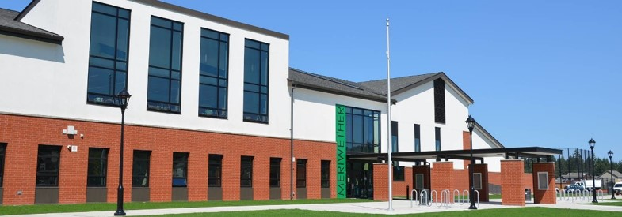
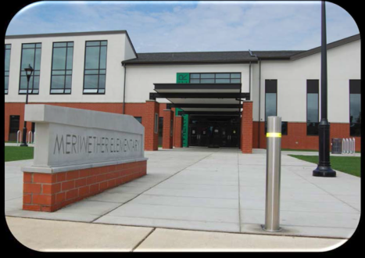
Meriwether Elementary School
Replacement
Planned Start: 2013
Actual Start: 2013
Planned Finish: 2014
Actual Finish: 2014
Planned Budget: $35,707,527
Actual Budget: $30,271,636
Budget Variance: -15.22%

Slide 22
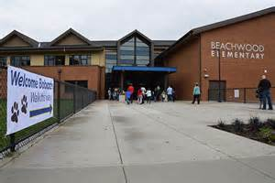
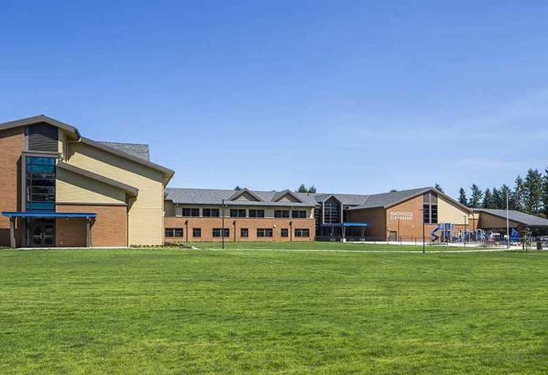
Beachwood Elementary School
Replacement
Planned Start: 2014
Actual Start: 2014
Planned Finish: 2015
Actual Finish: 2015
Planned Budget: $39,547,554
Actual Budget: $33,490,215
Budget Variance: -15.32%

Slide 23
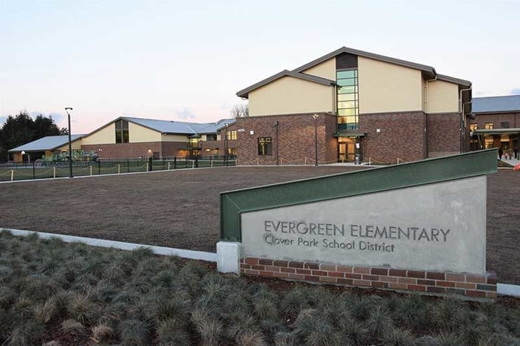
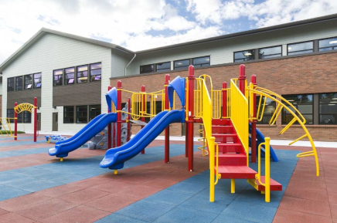
Evergreen Elementary School
Replacement
Planned Start: 2014
Actual Start: 2015
Planned Finish: 2015
Actual Finish: 2016
Planned Budget: $50,377,281
Actual Budget: $47,965,528
Budget Variance: -4.79%

Slide 24
GC/CM Lessons Learned
Communication must be improved between stakeholders during design and the construction management team during construction (Carter Lake ES)
Consult Risk Management and maintenance staff early in design to identify potential safety issues in the building and site components (Hillside ES)
Coordinate final FF&E layouts with power and data outlet locations to avoid conflicts (Rainier ES)
The use of BIM software reduces system conflicts and errors (Meriwether ES)
Schedule commissioning of the elevator early for easier move-in to the 2nd floor (Beachwood ES)
Review final site layout with transportation to avoid conflicts (Evergreen ES)
Notes:
The unknowns in McCarver and Stewart
Managing the Risk effectively
BPES- 3rd party estimator and GCCM estimator with numbers less $1000 off on a $30 M Project.

Slide 25
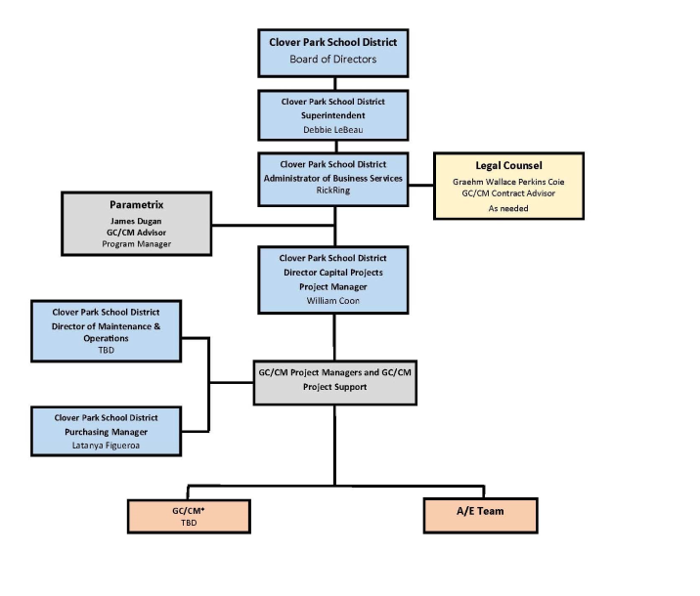
GC/CM Project Organizational Chart
Blue: CPSD District Staff
Grey: Consultant Staff
Yellow: Legal Support
Orange: External Contracts
Notes:
TPS majority of experience is not dependent on consultant staff
TPS augments with consultant staff.
Internal Legal Counsel – Felipe Mendez
External Legal Counsel (Construction)- Graehm Wallace
External Legal Counsel (Real Estate)- Mark Hood

Slide 26
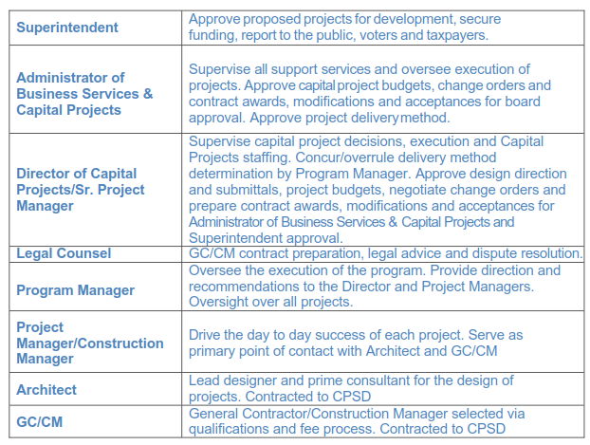
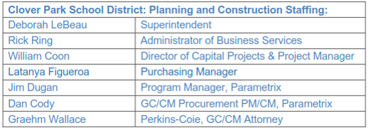
GC/CM Roles and Responsibilities
Notes:
Clearly defined roles and responsibilities

Slide 27
GC/CM Delivery Method Determination
Project is identified in Bond planning
Preliminary delivery method identified
Project Manager Prepares Delivery Method
Purchasing Manager Reviews and Approves Delivery Method Recommendation
Director of Capital Projects. Proceeds with GC/CM procurement according to CPSD standards
Director of Capital Projects confirms use of GC/CM with the Administrator of Business Services
Board of Directors Approves GC/CM Contract and Future Amendments
Notes:
TPS Process of Determination about whether a project is suitable for GCCM or not

Slide 28
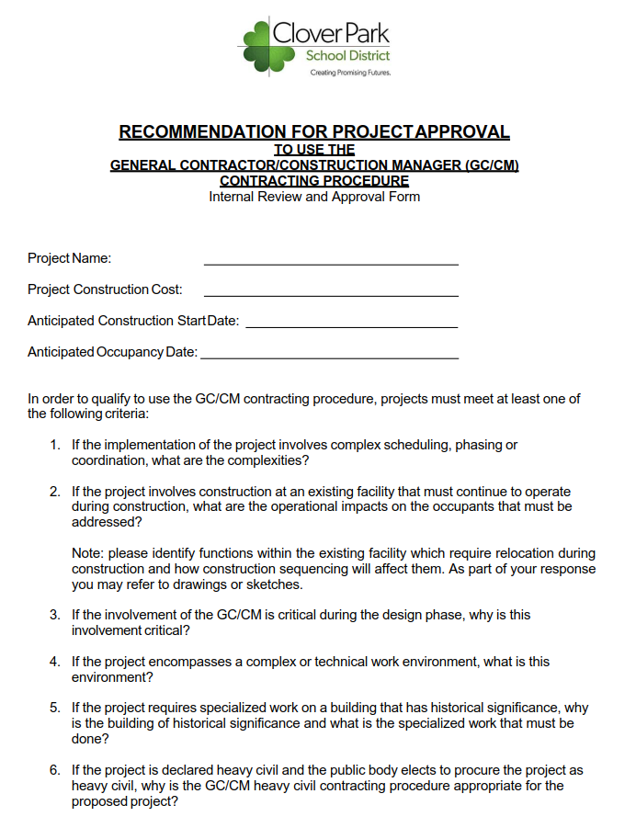
Delivery Method Recommendation

Slide 29
Future GC/CM Candidate Projects
Combine Woodbrook MS and Mann MS
Combine Dower ES and Custer ES
Combine Lake Louise ES and Idlewild ES
Lochburn MS Renovation
Tyee Park ES Replacement
Notes:
Next Few slides to demonstrate:
-Funded projects in Que
-Potential Occupied sites
-Potential Complex Phasing

Slide 30
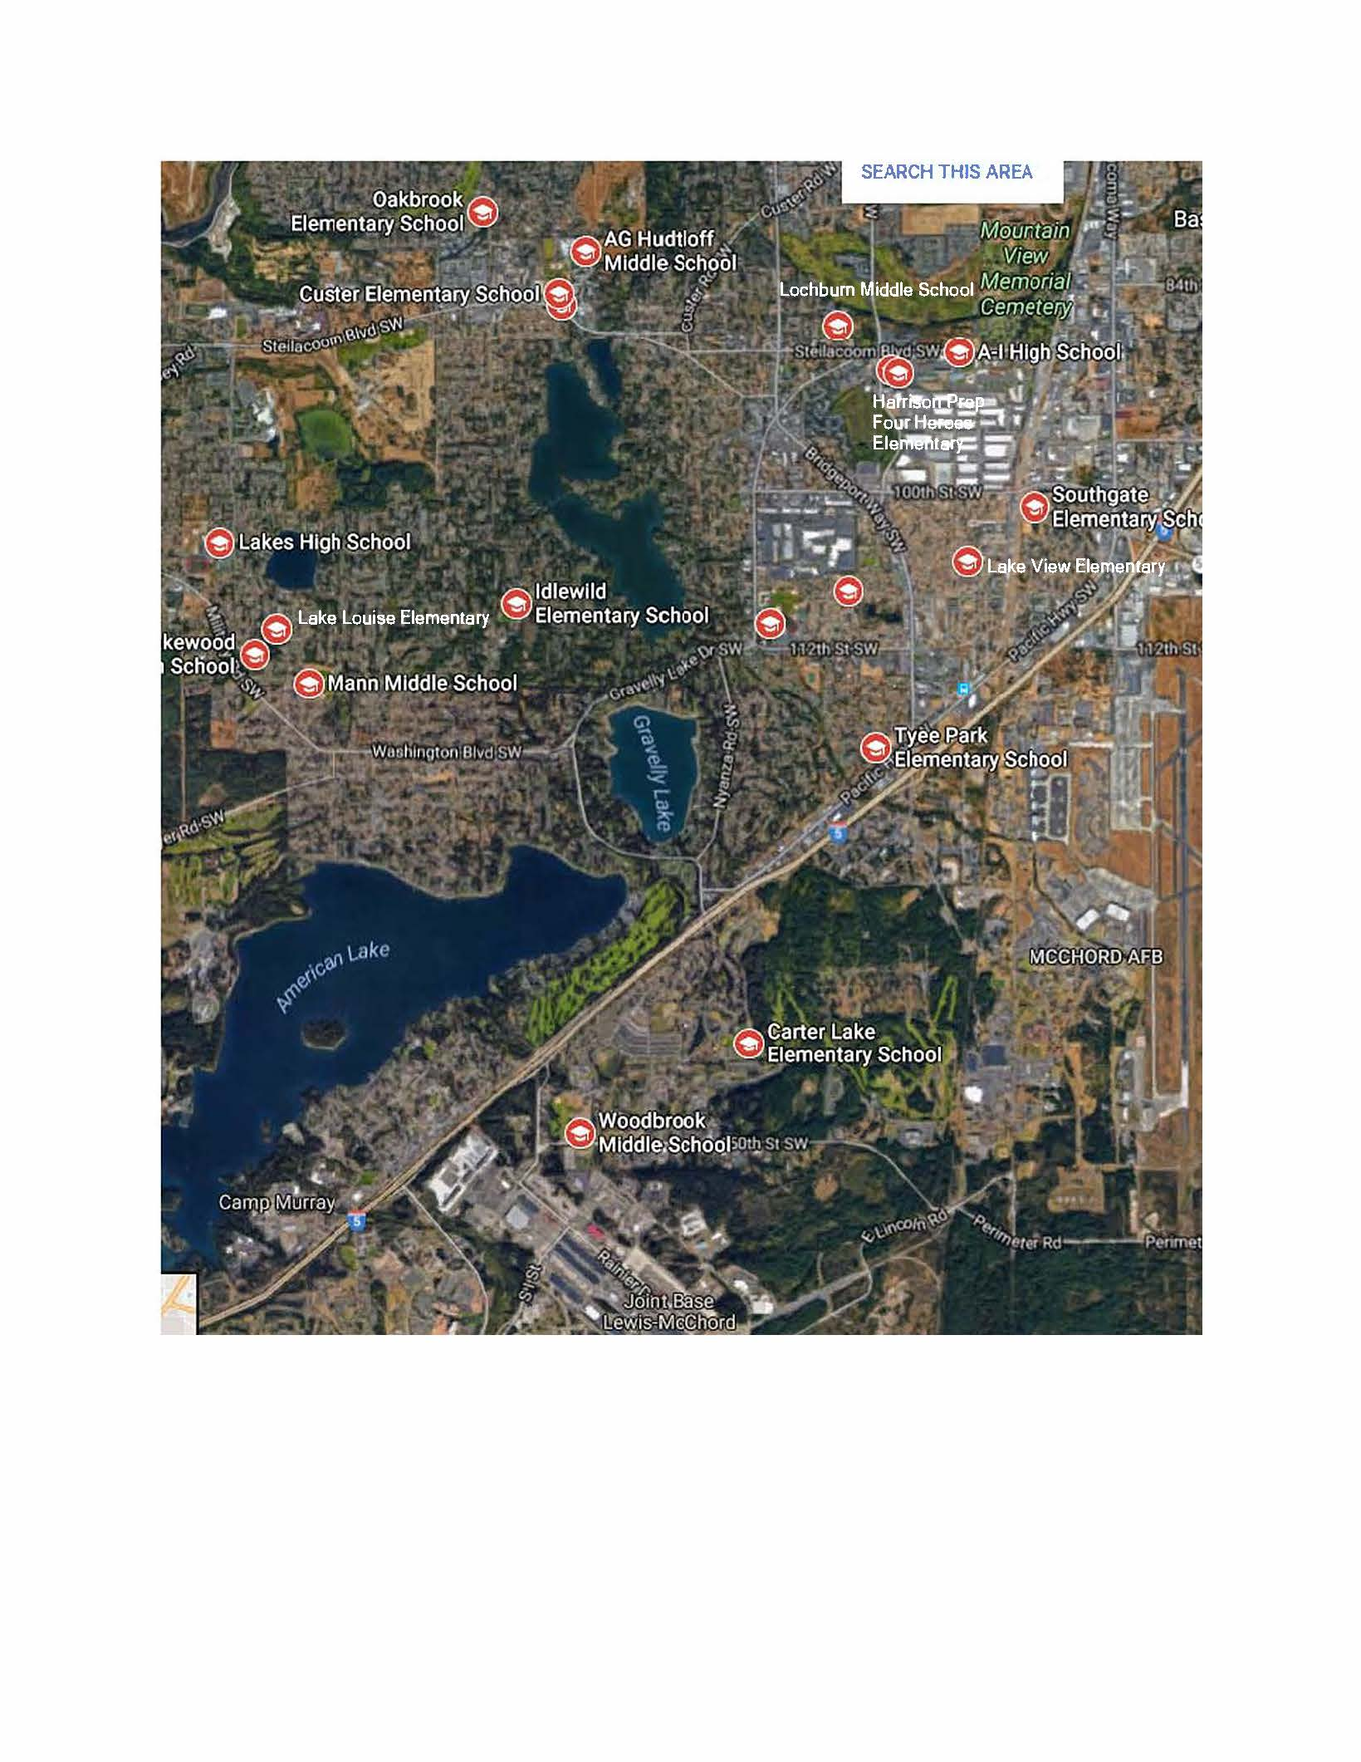
GC/CM Candidate Project Location

Slide 31
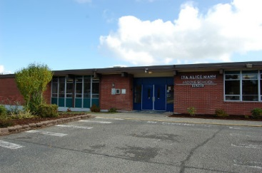
Mann Middle School

Slide 32
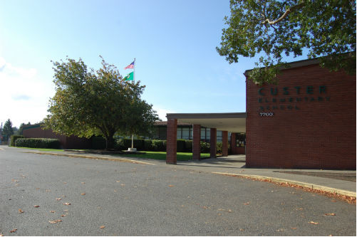
Custer Elementary School

Slide 33
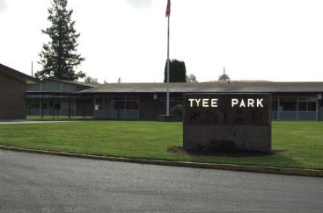
Tyee Park Elementary School

Slide 34
Business Equity
Clover Park School District is committed to Community Inclusion, as partnerships are critical to student education and community health and sustainability.
Clover Park School District will endeavor to:
  Maintain and increase contracts with local businesses by:
    Increasing local share of total construction
    Adopt Governor’s diverse business goals, including:
    10% Minority-Owned Business Enterprises,
    6% Woman-Owner Business Enterprises, and
    5% Small Business Enterprises (SBE)

Slide 35
Summary
History
Competency
Experience
No Audit Findings On Projects
All Remaining CPSD Projects Will Be Occupied Sites
Notes:
Competency
As the third largest and one of the fastest growing school districts in Washington, Tacoma Public Schools has proven itself to be a competent, successful public builder well prepared to use GC/CM delivery in accordance with all applicable statutes.
History
With a five (5) GC/CM project history, 4 complete and one in design, TPS has the experience required to utilize the GC/CM delivery method when applicable. The referenced GC/CM projects were primarily historic modernizations of size and significance and difficulty. All were completed on time and on or under budget.
Experience
Currently contracted with Parametrix, one of Washington’s experienced GC/CM project leadership teams, the District is ideally positioned to select GC/CM delivery when appropriate and execute future GC/CM projects successfully on time, on budget, and compliant with the requirements of RCW 39.10. Staff experience is comprised of primarily internal employees (5) and augmented with consultant staff members (2), all co-located at the District Planning and Construction offices.
Audit
The District has received no audit findings on any projects previously identified.

Slide 36
Thank you

