Slide 1

Application for Recertification of a Public Body
RCW 39.10 Alternative Public Works Contracting – GC/CM
May 28,2020
The mission of Clover Park School District is to ensure each child learns what he or she
needs to know to succeed and contribute to the community.

Slide 2
Agenda
Presenting Team
Clover Park School District
Capital Project Experience
Team Roles & Responsibilities
Self-Certification Project Data
Delivery Method Determination
Business Equity
Facilities Advisory Committee and
Capital Bond Planning
Capital Projects in Progress
Future GC/CM Candidate Projects
Lessons Learned / Best Practices
Why Agency Certification?
Summary

Slide 3
Presenting Team
Rick Ring – Asst. Superintendent of Business Services/Capital Projects
Bill Coon – Sr. Project Manager
Jim Dugan – Program Manager
Jesse Noga – GC/CM Procurement & PM/CM Support
Latanya Figueroa – Purchasing Manager
John Boatman – Maintenance & Operations Director

Slide 4
Clover Park School District
Founded in 1928
Comprised of 22 Schools:
16 Elementary Schools
3 Middle Schools
3 High Schools
Numerous Special Programs
Approximately 13,000 students
Over 1,500 employees
Serving Pre-K thru 12th grade
One of the largest districts in Pierce County

Slide 5
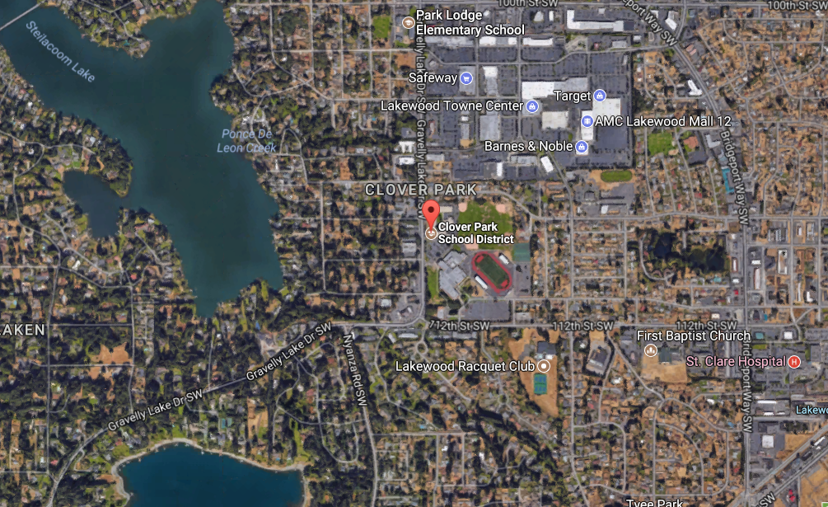
Clover Park School District

Slide 6
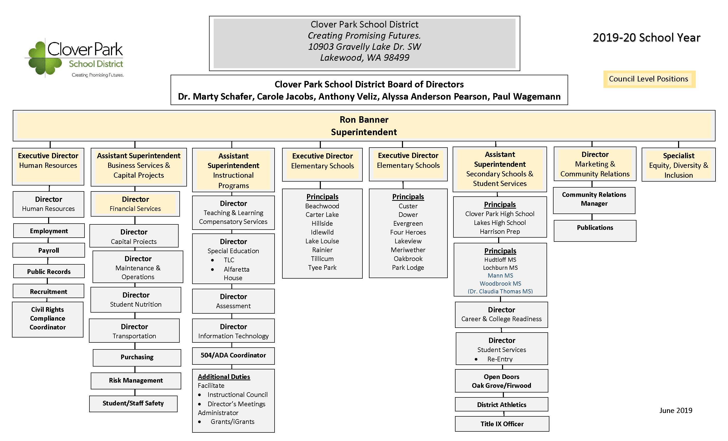
Agency Organizational Chart

Slide 7
Capital Projects
Agency Self-Certification History

Slide 8
Clover Park School District Planning & Construction
Potential Projects are identified by our Facility Advisory Committee; created in 2001; comprised of 20 various types of community members including local citizens, school representatives, and military & industry experts to include architects & engineers
  Our FAC augments and enhances the District’s internal team for project selection; and since 2006, we have also augmented our District staff with external consulting teams
In partnership with JBLM, the Public School on Military Installations Program (PSMI) was implemented to raise awareness of failing school infrastructures on military bases across the U.S.; resulting in creation of a national program to fix educational facilities on military installations
Notes:
Beginning work on the next 30 year Master Plan

Slide 9
CPSD Project Delivery Experience & Qualifications
Successfully funded approximately $460 M in Capital Improvement projects since 2006
These funds were used for modernization, replacement,
and additions to 11 public schools including 7 successful GC/CM projects including 6 in the last 5 years
All projects were completed on time or ahead of schedule
All projects have been completed under budget
Self- Certification Period GC/CM Project History:
2017-2020: Two projects: Evergreen Elementary &
Thomas Middle School
Notes:
The CPSD capital improvements program included 1 modernization and replacement, 8 replacements on occupied/new sites, 1 new combined (6-12) Prep School and (K-5) Elementary school and 1 addition using the DBB and GC/CM delivery method.
We are the fourth largest school district in Pierce County and the 28th largest (public) school district in the state of Washington.
We have successfully passed over $450 million in capital improvement funding since 2006 to modernize, replace and/or build additions to 11 public schools.
All projects were successfully completed on time and under budget.

Slide 10
CPSD Team Experience
Project | Year | GMP Orig. Contract Amount | Construction Actual | Cost Diff. | Budget % Savings | Delivery Method
Lakeview ES | 2006 | $15,648,948 | $14,939,616 | $709,332 | 4.53% | D/B/B
Lakeview ES Addition | 2016 | $6,740,163 | $6,416,176 | $323,987 | 4.81% | D/B/B
Lakes HS Renovation | 2006 | $80,436,074 | $80,407,497 | $28,577 | 0.03% | GC/CM
Hudtloff MS | 2010 | $47,478,648 | $43,808,874 | $3,669,774 | 7.73% | D/B/B
Harrison Prep/Four Heroes ES | 2010 | $75,000,000 | $68,702,038 | $6,297,962 | 8.40% | D/B/B
Hillside ES | 2013 | $32,947,967 | $30,365,905 | $2,582,062 | 7.84% | GC/CM
Carter Lake ES | 2012 | $31,146,555 | $28,726,335 | $2,420,220 | 7.77% | GC/CM
Meriwether ES | 2014 | $35,707,527 | $30,271,636 | $5,435,891 | 15.22% | GC/CM
Rainier ES | 2014 | $38,588,472 | $33,323,220 | $5,265,252 | 13.64% | GC/CM
Beachwood ES | 2015 | $39,547,554 | $33,490,215 | $6,057,339 | 15.32% | GC/CM
Evergreen ES | 2016 | $50,377,281 | $47,965,528 | $2,411,753 | 4.79% | GC/CM
Thomas MS | 2018 | $72,000,000 | Underway | TBD | TBD | GC/CM
Notes:
Lakeview Elementary ($15.6 million), Lakeview Elementary addition ($ 6.7 million), Hudtloff Middle School ($47.4 million) and Harrison Prep/Four Heroes Elementary ($75 million) were completed using the DBB delivery method. Lakes High School ($80.4 million), Hillside Elementary ($32.9 million), Carter Lake ($31.1 million), Meriwether Elementary (35.7 million), Rainier Elementary ($38.5 million), Beachwood Elementary ($39.5 million) and Evergreen Elementary ($50.3 million) were successfully completed on time and under budget using the GC/CM delivery method.

Slide 11
GC/CM Delivery
Self-Performance Subcontracting Results
Project | GC/CM | Final MACC / GMP | Self-Performed Work Type | Cost Total | Self-Performed % to GMP @ Closeout
Evergreen Elementary School | Skanska | $36,428,491 | Concrete & Flatwork | $2,135,044 | 5.86%
 |  |  | Structural Package | $5,902,920 | 16.20%
 |  |  | TOTALS: | $8,037,964 | 22.07%
Project | GC/CM | Final MACC / GMP | Self-Performed Work Type | Cost Total | Self-Performed % to GMP @ Closeout
Dr. Claudia Thomas Middle School | Korsmo | $54,311,772 | Architectural Misc. | $2,736,964 | 5.04%
 |  |  | Concrete & Structural Steel | $9,898,054 | 18.22%
 |  |  | Waterline | $671,546 | 1.24%
 |  |  | TOTALS: | $13,306,564 | 24.50%
Notes:
As you can see, our GC/CM management has included assuring self performed work is maintained under the statutory maximum of 30%

Slide 12
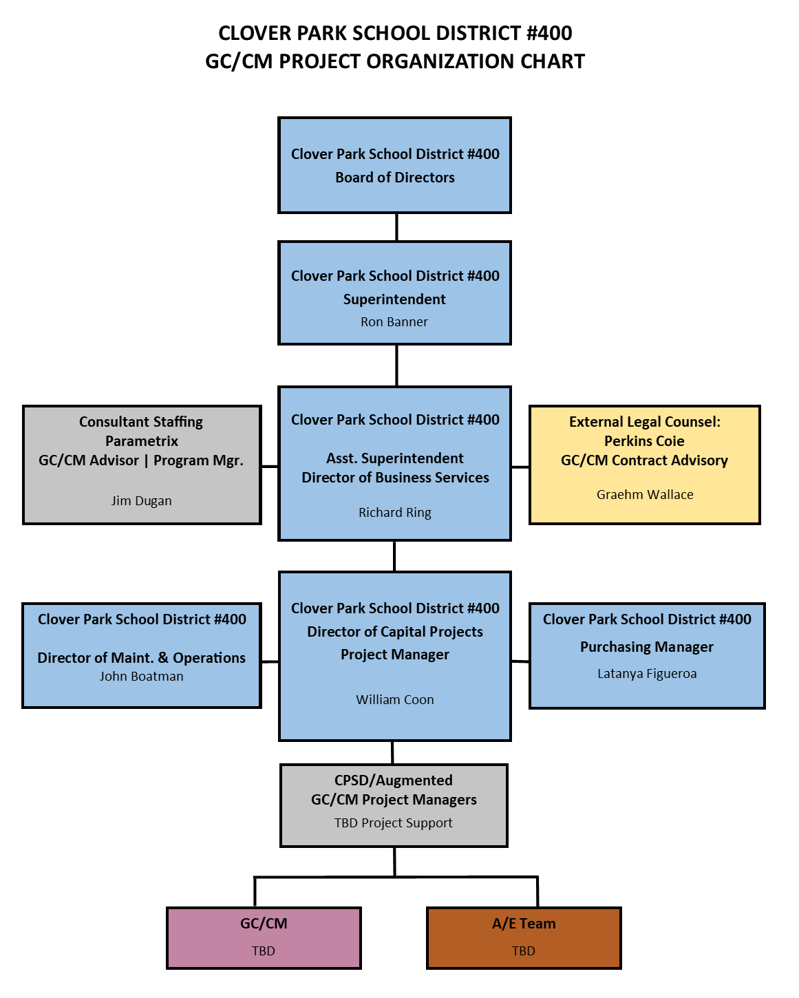
Capital Planning & Construction
Organizational Chart
Notes:
The team we put together has a long-standing history of successfully completing GC/CM projects, and the current CPSD staff have extensive experience delivering GC/CM projects.
Addltlonally,CPSD has retained Perkins Coie for legal support and GC/CM Contracts/Advisory services, and Parametrix for Capital Program support, Bond planning, Advisory Committee assistance, GC/CM procurement, and PM/CM and advisory services and as needed for assurance that the best value for public dollars can be delivered.

Slide 13
GC/CM Project Team
Roles and Responsibilities
Name | Role | Responsibilities
Ron Banner | Superintendent | Approves proposed projects for development, secure funding, report to the public, voters, and taxpayers
Rick Ring | Assistant Superintendent of Business Services & Capital Projects | Supervises all support services and oversees execution of projects. Approves Capital Projects budgets, Change Orders, and Contract Awards, Modifications, and Acceptances for Board approvals. Approves Project Delivery method
William Coon | Director of Capital Projects / Senior Project Manager | Approves design direction and submittals, manages project budgets, change orders and prepares contract awards, modifications and acceptances for review and approval by the Asst. Superintendent of Business Services & Capital Projects
Graehm Wallace | Legal Counsel | GC/CM Contract Preparation, legal advice, and dispute resolution. Contracted to CPSD
Jim Dugan | Program Manager | Serves as a technical consultant/advisor to the Assistant Superintendent of Business Services & Capital Projects related to capital facilities planning and recommendations to the Director and Project Managers on a as needed basis.
William Coon | Project Manager / Construction Manager | Drives the day to day success of each project. Serves as primary Point of Contact with Architect and GC/CM
TBD | Architect | Lead designer and prime consultant for the design of projects. Contracted to CPSD
TBD | GC/CM | General Contractor / Construction Manager selected via public qualifications and fee selection process. Contracted to CPSD
Notes:
Clearly defined roles and responsibilities

Slide 14
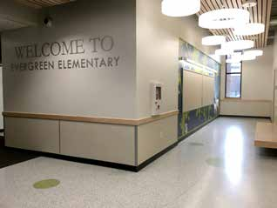
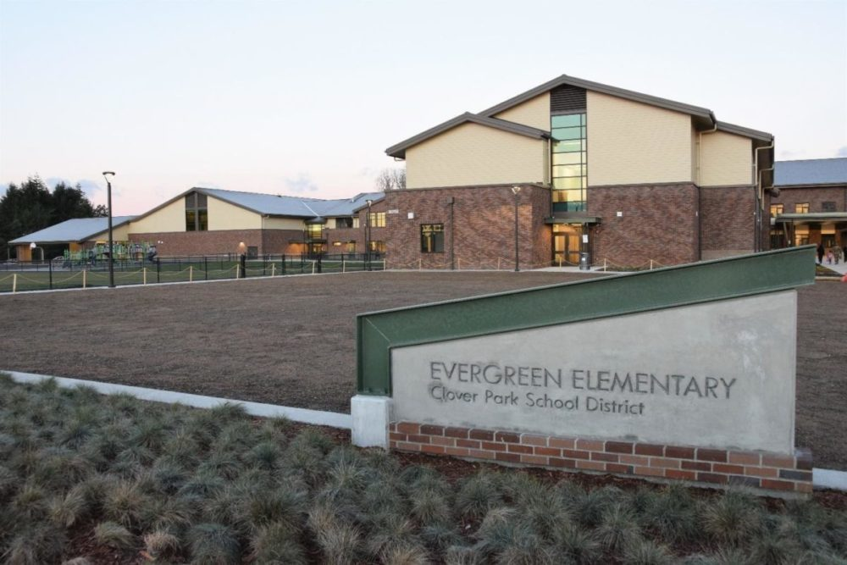
Evergreen Elementary School
Replacement
Planned Start: 2014
Actual Start: 2015
Planned Finish: 2015
Actual Finish: 2016
Planned Budget: $50,377,281
Actual Budget: $47,965,528
Budget Variance: -4.79 %

Slide 15
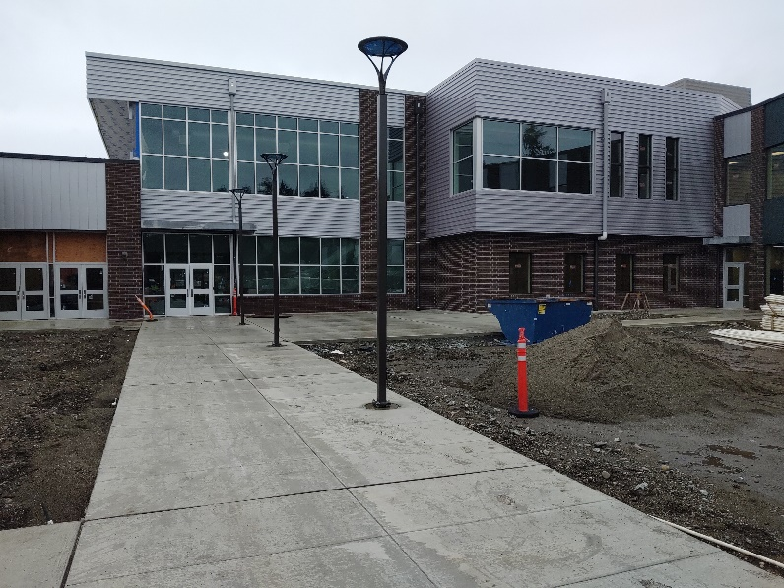
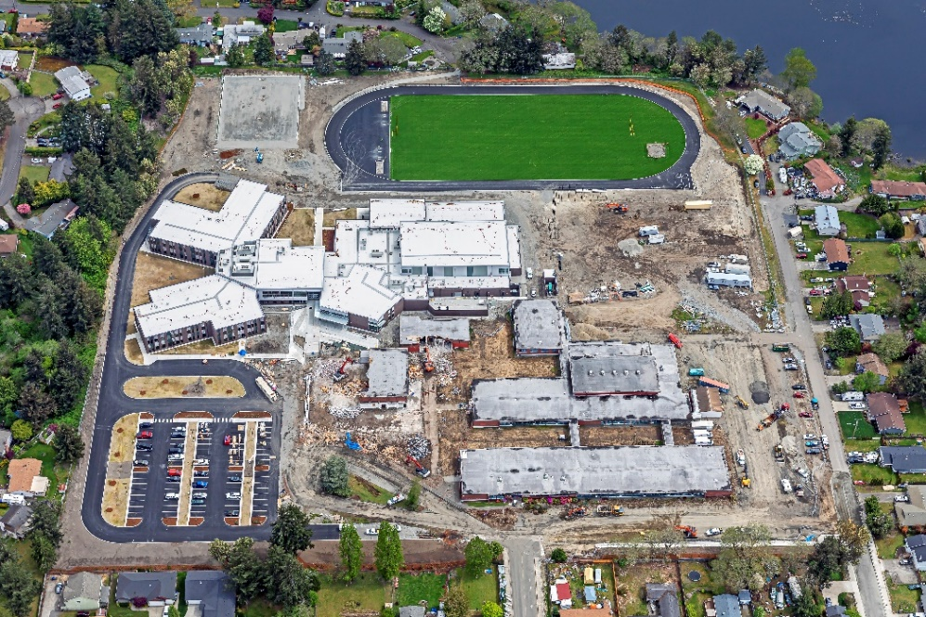
Dr. Claudia Thomas Middle School
Replacement school combining
Alice Mann & Woodbrook MS
Planned Start: July 2018
Actual Start: July 2018
Planned Finish: June 2020
Actual Finish: TBD (Covid-19)
Planned Budget: $72,000,000
Actual Budget: TBD
Budget Variance: TBD
Notes:
In 2016, a Facility Advisory Committee was convened again and one of the recommendations of the committee was to close Woodbrook Middle School and construct a new middle school to be combined with Mann Middle School on the Mann site.
In December 2016, the CPSD Board of Directors authorized the selection of an architectural firm to design a new middle school in the anticipated closure of Woodbrook Middle School between June and December 2019 when the new school is scheduled to be complete.
Construction is nearly complete for this new middle school, with substantial completion on horizon. Final completion has been delayed due to the Coronavirus Pandemic. This project was and remains an excellent candidate for GC/CM delivery.

Slide 16
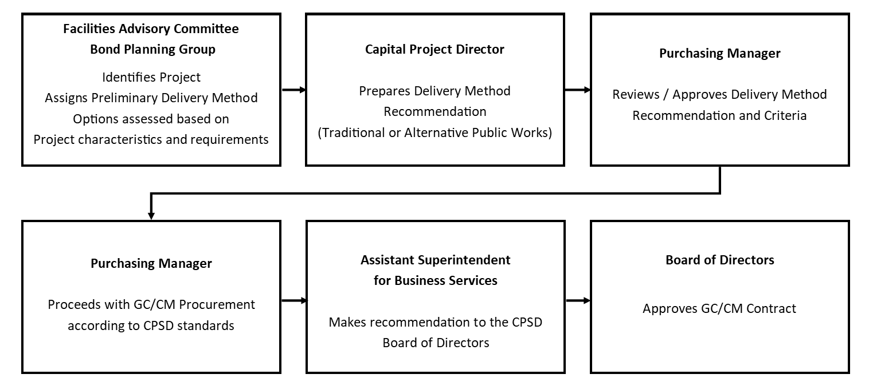
Internal GC/CM Delivery Method Determination
Notes:
TPS Process of Determination about whether a project is suitable for GCCM or not

Slide 17
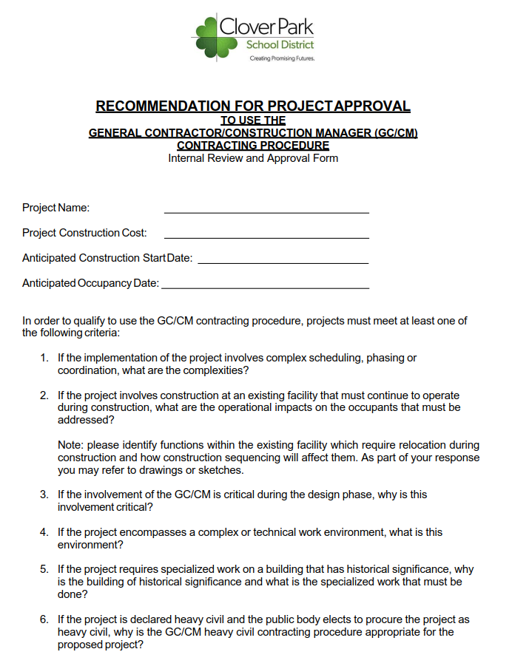
Delivery Method
Recommendation
Process
Internal Process;
Clover Park District Staff analyzes/scrutinizes project criteria similarly to the PRC.
If a project is qualified, the team makes recommendations for GC/CM delivery method based on criteria provided in RCW 39.10.340
If approved, the Assistant Superintendent routes to Board of Directors for final and financial approvals.
Notes:
Our internal process analyzes project criteria directly from the statutory criteria in 39.10.340

Slide 18
Business Equity
Clover Park School District is on an Equity Journey.
Our aim is to move the district forward in becoming more equitable and inclusive for staff, students, families, and community members. We have launched several initiatives to cultivate conversations around equity and inclusion at the district level; amongst school staff, student groups, and families throughout our community. Equity is the core of everything we do in Clover Park School District.
We are carefully and thoughtfully shifting in our mindsets, practices, and polices to ensure each student learns what he or she needs to succeed and contribute to the community. The District also employs an Equity, Diversity, and Inclusion Specialist to assist in realizing these goals.
Regarding procurement efforts on Projects, the District will endeavor to maintain or increase the number of contracts with local businesses by increasing the local share of total construction to these firms, leveraging the Governor’s diverse business goals, including:
    10% Minority-Owned Business Enterprises
    6% Woman-Owner Business Enterprises
    5% Small/Mini/Micro Business Enterprises (SBE)
    5% Veteran Owned Businesses
Notes:
Acceptable Inclusion Plans are those that state an attainable inclusion goal, list out specific scopes of work that are available on a project, discuss those opportunities that match available MWBE enterprises, discuss a bidding and packaging strategy that reflects availability, and demonstrates the use of helpful business strategies that welcome and support diverse subcontractors.

Slide 19
Facilities Advisory Committee &
Capital Bond
Planning
FAC – will reconvene in June and will be making recommendations related to a
Capital Projects Bond in late Fall 2020
The facility advisory committee recommendations will include project priorities related to replacement; modernization and possible consolidation scenarios for the following facilities:
(7) Elementary Schools: Custer, Dower, Lake Louise, Idlewild, Tyee Park, and one new Elementary School
Modernization and addition to Clover Park High School
Phased in replacement or modernizations of Lochburn Middle School
Funding
Notes:
What we accomplish over the next 1-3 years will be limited to available funding. With the pass of a successful bond we hope to start renovation at CPHS and begin the replacement process of at least 2 elementary schools

Slide 20
Capital Projects in Progress
Thomas Middle School – Scheduled to open in September
Tillicum Elementary – Electrical/Mechanical Replacement – 2 yr phased project – final phase scheduled to be complete August 2020
Clover Park High School – Major Renovation Occupied – Design work approved – construction dependent on passing bond

Slide 21
Future GC/CM Candidate Projects
Clover Park High School Modernization and Addition
  Schedule
  Occupied Site
  Project Complexity
Lochburn Middle School Modernization/Replacement
  Schedule
  Occupied Site
  Project Complexity
Elementary Schools - TBD
Notes:
Next Few slides to demonstrate:
-Funded projects in Queue
-Potential Occupied sites
-Potential Complex Phasing

Slide 22
GC/CM Lessons Learned
Agency Certification enhances project planning and expedites the process.
Early collaboration with the GC/CM maximizes savings
GC/CM process enhances the accuracy and ability to coordinate schedules.
Availability of sub contractor has been enhanced
Transitions in the GC/CM pre-design/estimating team members and construction team requires significant coordination with the Architect/Engineer and Owner.
Owners need to commit the time to be actively involved in the process, meetings and site visits.
The team needs to develop norms and processes early on
and reaffirm them often with the team.
Designs change and stakeholders not on the team need
to be kept informed.

Slide 23
GC/CM Best Practices
Monthly Executive Leadership Meetings for the purpose of discussing and proactively solving issues, interests, and conflicts.
Stakeholder involvement throughout the process.
Early Involvement of the GC/CM in the process.
Involvement of local permitting Jurisdictions' into the process early.
Enhanced collaboration opportunities.
Team Building Opportunities

Slide 24
Why
Agency Re-Certification?
Programmatic need is better solved by being able to develop multiple plans concurrently, and leveraging phased work using GC/CM method
Allows for more Integrated Project Delivery, optimizing project results, and maximizing efficiency throughout all phases of design and construction.
Provides greater flexibility with timing of projects
Reduces overall cost to Agency for project development
Collaboration
Sustainability

Slide 25
Summary
History
Competency
Experience
No Audit Findings On Projects
Notes:
Competency
As one of the largest and fastest growing school districts in Washington, Clover Park School District has proven itself to be a competent, successful public builder well prepared to use GC/CM delivery in accordance with all applicable statutes.
History
With our robust GC/CM project history, including one in construction and others in design, Clover Park has no apprehension to utilize the GC/CM delivery method when applicable. All were completed on time and on or under budget.
Experience
Currently contracted with Parametrix, one of Washington’s experienced GC/CM project leadership teams, alongside similarly credible legal team at Perkins Coie, the District is ideally positioned to select GC/CM delivery when appropriate and execute future GC/CM projects successfully on time, on budget, and compliant with the requirements of RCW 39.10.
Our project staff is comprised of primarily internal employees and augmented with consultant staff members as needed.
Audit
The District has received no audit findings on any projects previously identified.

Slide 26
Thank You

