Slide 1

Capital Projects Advisory Review Board
Project Review Committee
Recertification Presentation
September 22, 2016
Notes:
Pick a logo for the main page of your presentation. Delete the other logo.

Slide 2

Presenters:
Engineering & Architectural Services
Facility Professional Services
Department of Enterprise Services
Janet Knoblach AIA, Program Manager
Nancy Deakins PE, Assistant Program Manager

Slide 3
Our Clients:
Community & Technical Colleges - 34 campuses
Capitol Campus
Department of Corrections
Department of Ecology
Department of Social and Health Services
Department of Veterans Affairs
Washington State Patrol
Military Department
Department of Enterprise Services
Approximately 20 additional small agencies
K-12 & Local Agencies

Slide 4
Engineering & Architectural Services

Slide 5
Professional Committees
Capital Projects Advisory Review Board (CPARB)
CPARB Sub Committees
Project Review Committee (PRC)
Architects, Engineers, & Agencies Committee (AEA)
Assoc. General Contractors Facilities Group

Slide 6
Alternate Public Works Projects
Current and Recent Projects
1063 Block - Design-Build
Student Housing, Bellevue College - GCCM
Pacific Tower Improvements, Department of Commerce - GCCM
Main Building South Wing Renovation,
Community Colleges of Spokane - Design-Build
Pierce County Readiness Center, Military Department - Design-Build
Clover Park Technical College
Center for Advance Manufacturing Technologies - Design-Build
K/3 Modular Classroom CLT Proviso Projects - Progressive Design-Build
SPSCC, Lacey Campus - Design-Build
Natural Resources Building Capital Campus
Garage Fire Suppression & Critical Repairs - Progressive Design-Build

Slide 7
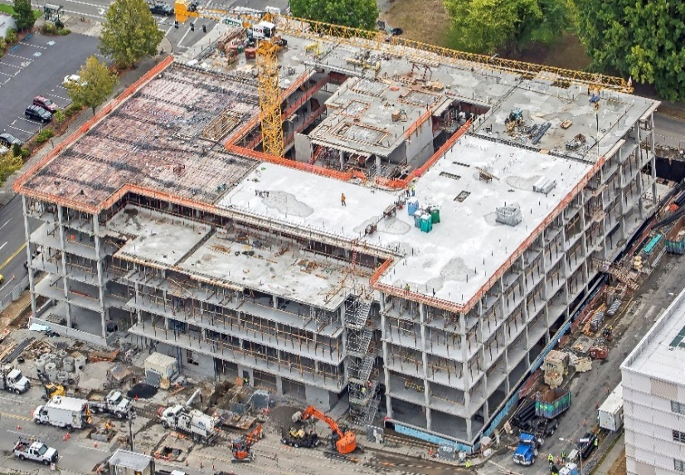
1063 Block 2014-009
DB Contractor: Sellen Construction
DB Designer: ZGF
Contracting Method: Design Build
Construction Cost: $65,500,000
Date of Contract: July 2, 2015 for demolition and construction
Date of Completion: September 2017
This State agency office building at the north side of the West Legislative Campus of the State Capitol in Olympia is five stories and 215,000 square feet. Tenant mix includes administrative offices for agencies from the Washington State Patrol, some Legislative groups, groups of the Office of Financial Management and the Office of State Treasurer. The scale, materials and orientation of the project was designed to complement the Olmstead green to the south and be a compatible form with the current master planning goals and the established West campus plan. The building was designed to be in the top tier of all public buildings in the US for minimal energy use with features like photovoltaics on the roof and entry canopy and geothermal wells below grade.

Slide 8
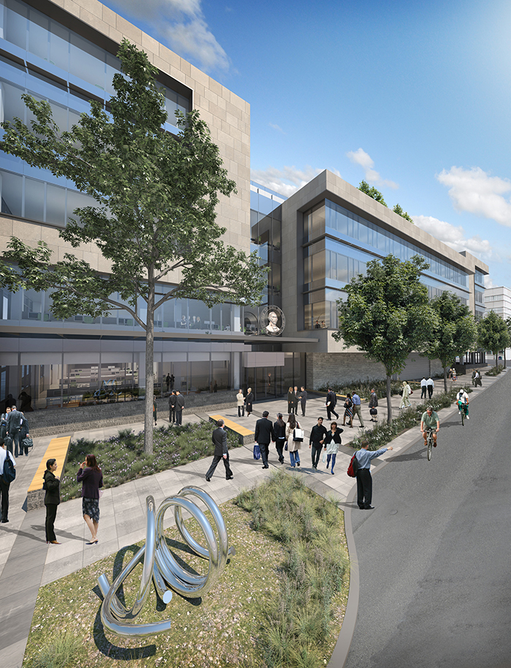
1063 Block 2014-009 (Continued)

Slide 9
Student House,
Bellevue College 2015-185
DB Contractor: Walsh Construction Co.
DB Designer: NAC Architecture, Inc.
Contracting Method: GCCM
Construction Cost: $28,500,000.00 (projected – end of DD phase
Date of Contract: March 8, 2016 (preconstruction services)
Date of Completion: July 1, 2018 (substantial comp.) / Sept. 1, 2018 (project comp)
Bellevue College, as a part of their initiative to provide a quality educational experience to the students of their community and those beyond the immediate community are building their first student housing facility. The Bellevue College Campus is an extremely busy and densely occupied campus. Staging and phasing the construction of the new student housing facility had the potential to seriously impact campus operations so the decision was made to use the GCCM process to team with designers and contractor to minimize the potential of those impacts. As is common with these types of projects, budget is not unlimited, and physical constraints impact the overall design and cost of the project. The project is currently reaching the end of the Design Development Stage. The design team and contractor team are actively collaborating and working through the issues of design and budget. The project is on track for budget and schedule.

Slide 10
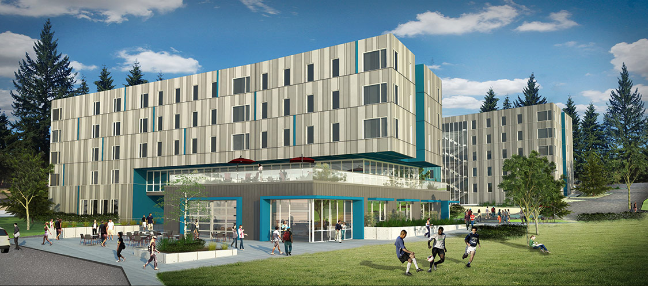
Student House,
Bellevue College 2015-185 (Continued)
Early Site Package Underway, Packages Bid Jan 2017
NAC & Walsh Construction Complete September 2018

Slide 11
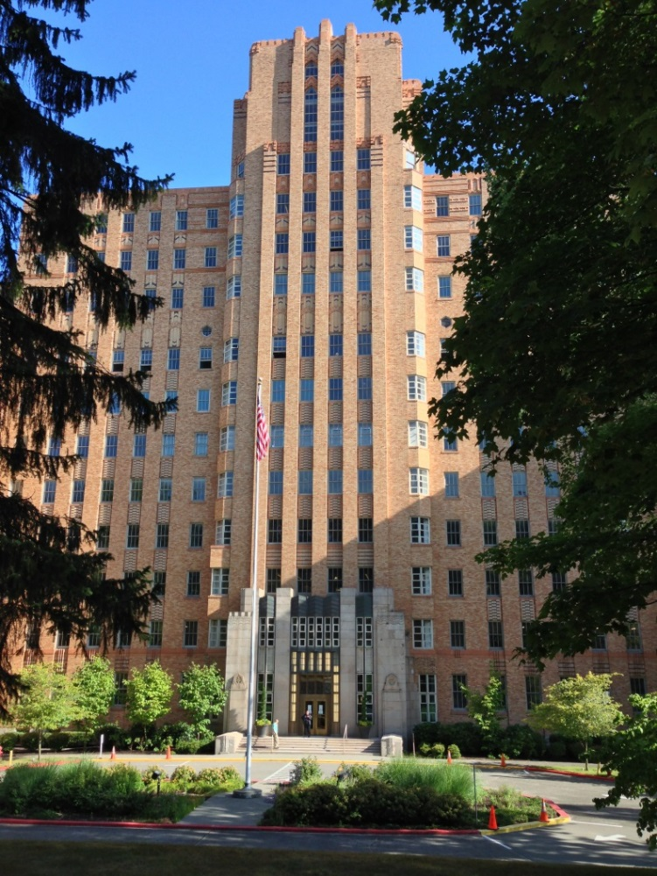
Pacific Tower Improvements,
Department of Commerce 2014-195
Contractor: M. A. Mortenson Co.
Architect: Schreiber Starling & Lane Architects
Contracting Method: GCCM
Construction Cost: $10,377,263.73
Date of Contract: June 23, 2014
Date of Completion: June, 2016
The Pacific Tower Improvements project utilized the GCCM alternative contracting procedure. This historic building is approximately 258,000 square feet. The Department of Commerce has a lease agreement for approximately 205,000 square feet, including the main tower. Construction consisted of seismic upgrades to the structure, demolition of previous tenant improvements and constitution of new tenant spaces throughout the building.

Slide 12
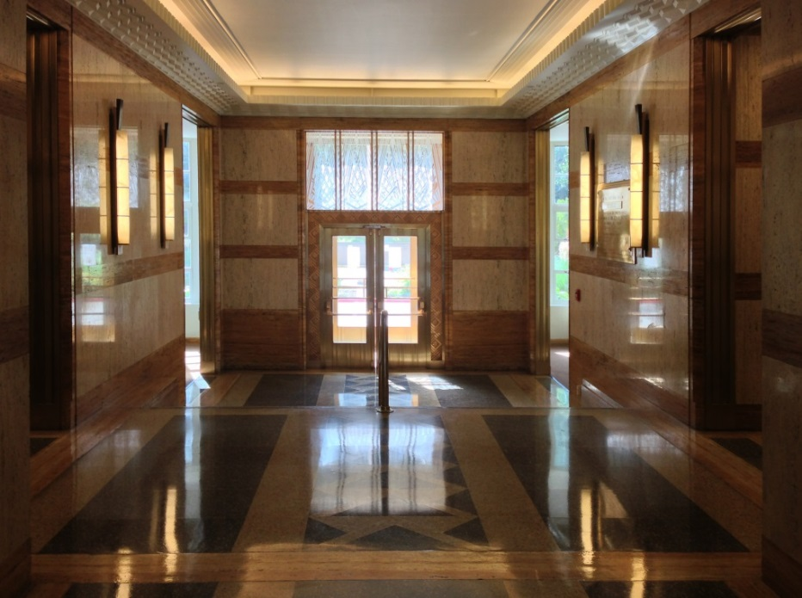
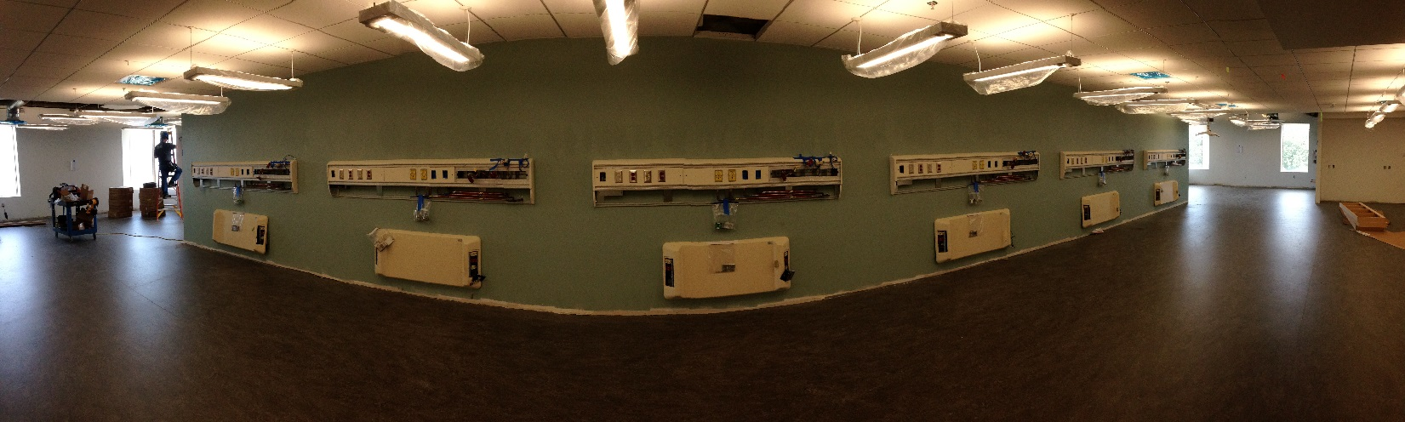
Pacific Tower Improvements,
Department of Commerce 2014-195 (Cont.)
The most substantial tenant space was developed as a medical training facility for the Seattle Central College. The project schedule involved building out tenant suites on various schedules as driven by lease agreements.
The GCCM contracting method
was utilized to accommodate multiple construction phases in a highly compressed schedule.

Slide 13
Main Building South Wing Renovation,
Community Colleges of Spokane
Contractor: Not Selected
Architect: Not Selected
Contracting Method: Design Build
Construction Cost: $18,000,000
Date of Contract: N/A
Date of Completion: N/A
The project is on the Spokane Community College campus. The renovation is approximately 50,849 SF, located in the South Wing of Building. The addition of classrooms and offices is approximately 6,969 SF and will be located at the west end of the south wing. The project was originally identified to be design-bid-build, but changed as it went through the legislative process. The A/E team to develop the Pre-Design and the RFQ/RFP has been selected and is headed by ALSC Architects. Currently, the agreement is being negotiated.

Slide 14
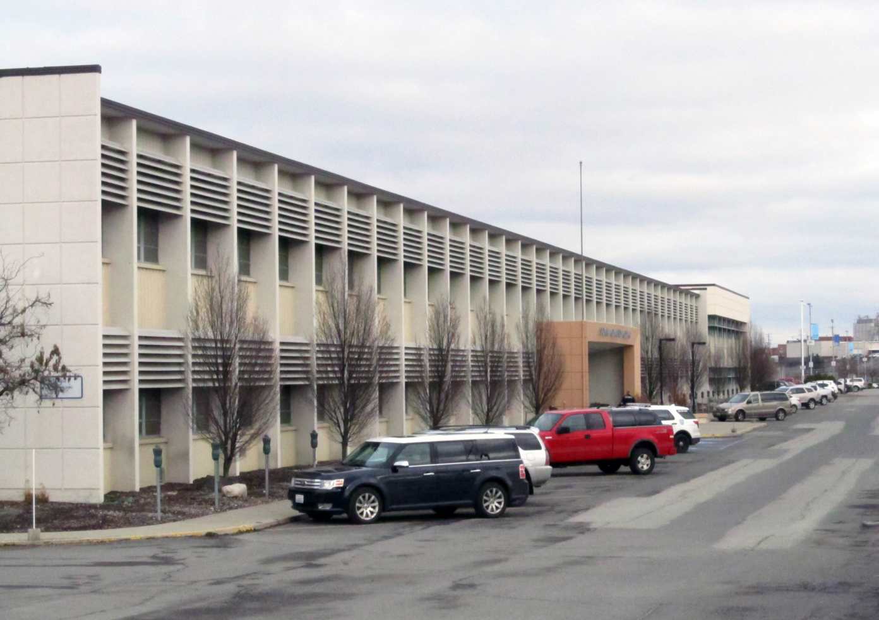
Main Building South Wing Renovation,
Community Colleges of Spokane (Cont.)
RFQ: September 22, 2016
SOQs: October 12, 2016
RFP: October 31, 2016
Proposals: December 9, 2016
NTP: January 5, 2017
Complete: 2019

Slide 15
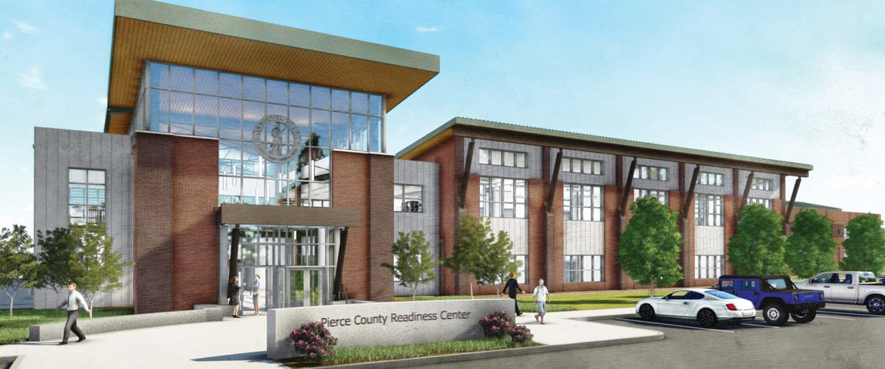
Pierce County Readiness Center 2013-295
DB Contractor: Absher Construction Co.
DB Architect: Tetra Tech
Contracting Method: Design Build
Construction Cost: $26,651,781.45
Date of Contract: September 12, 2014
Date of Completion: August 28, 2016
Status: Underway

Slide 16
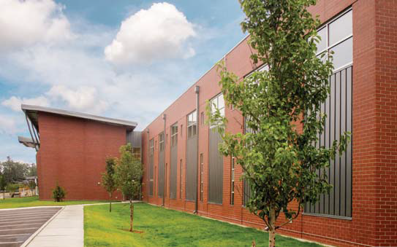
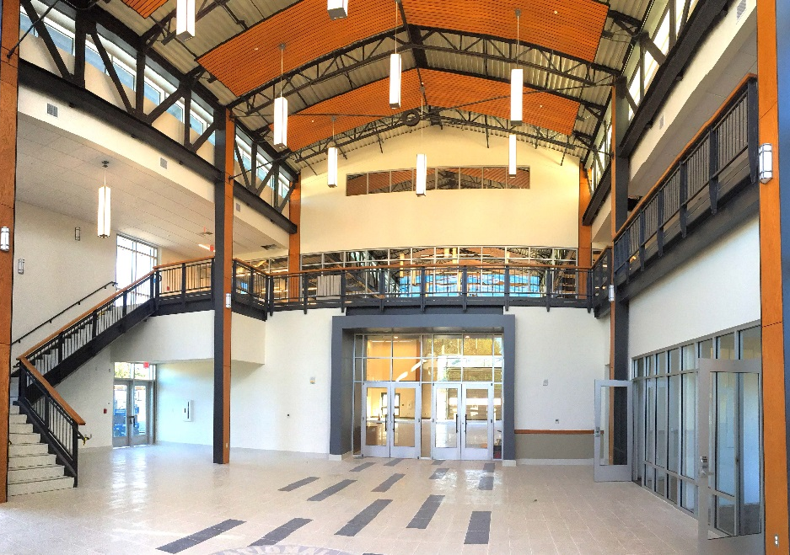
Pierce County Readiness Center,
Military Department 13-295 (Continued)
This project is replacing a military readiness center in downtown Tacoma with
a new 80,701 gsf readiness center and 16,812 gsf unheated pre-engineered vehicle storage building. Traditional DB selection was used and there are no significant cost, schedule, or quality problems.

Slide 17

Center for Advance Manufacturing Technologies, Clover Park Tech 2016-173
Contractor: DB Team not selected yet
Contracting Method: Design Build
MADCC: $35,000,000
Date of Contract: Nov. 2016
Date of Completion: Aug. 2019
Status: Finalizing Project Requirements for DB Selection
This project is a new 62,500 sf Center for Advanced Manufacturing Technologies Building in Lakewood, Washington.
Traditional DB selection will be used.
Finalists:
Absher-GGLO
Korsmo-SRG
Mortenson-Schacht Aslani
RFP: September 15, 2016
Proposals: December 2, 2016
NTP: January 5, 2017
Complete: 2019

Slide 18
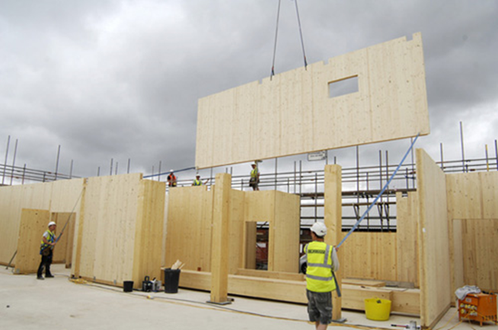
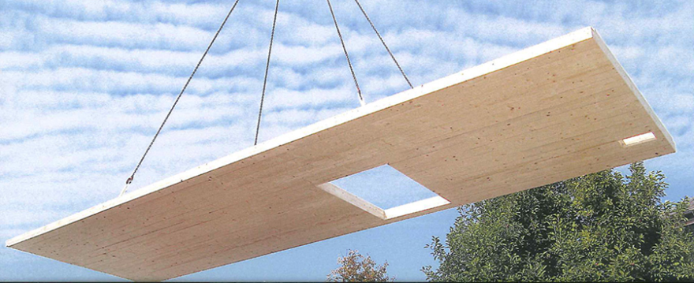

K\3 Modular Classroom
CLT Proviso Projects 2016-743 & 2016-173
Contractor: Not Selected
Architect: Not Selected
Contracting Method: Progressive Design Build
Construction Cost: $5,000,000
Date of Contract: Est July 2016
Date of Completion: Est January 2017
Western WA, $3M Walsh/Mahlum
Eastern WA, $2M Graham/NAC
The project is to select two different Design Build teams to construct for classrooms at five school district locations. The classrooms are to be built from Cross Laminated Timber, CLT. Three schools districts are on the west side of the state and two school districts on the east side
of the state. Toppenish, Wapato, Sequim,
Mt. Vernon and Seattle.

Slide 19
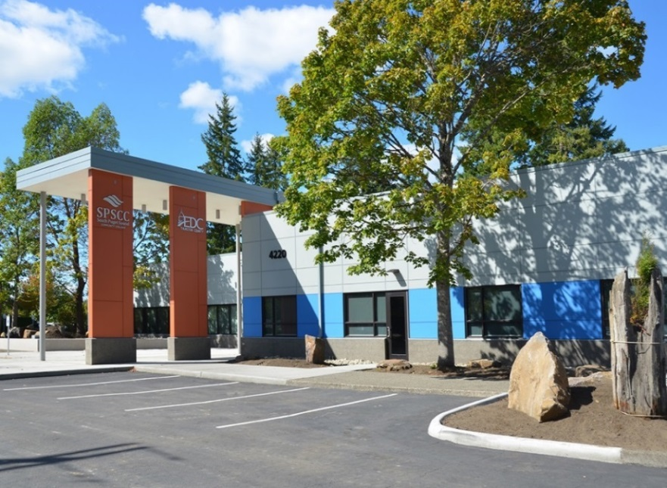
South Puget Sound Community College, Lacey Building
Contractor: Korsmo Construction
Architect: KMB Design Group
Contracting Method: Design Build
Construction Cost: $9,168,357
Date of Contract: June 30, 2014
Date of Completion: July 2015
Gross Sq Ft: 51,892
DESIGN-BUILD PROJECT TEAM
Department of Enterprise Services, State of Washington
PROJECT MANAGER YELENA N. SEMENOVA
STRUCTURAL ENGINEER AHBL
MECHANICAL CONTRACTOR MACDONALD-MILLER INC
ELECTRICAL ENGINEER AULT ELECTRIC CO INC
ELECTRICAL CONTRACTOR CROSS ENGINEERS, INC
TELECOMMUNICATIONS HARGIS ENGINEERS INC
INTERIOR DESIGN GS INTERIORS INC
SUSTAINABILITY SPECIALIST INVENTRIX ENGINEERING INC

Slide 20
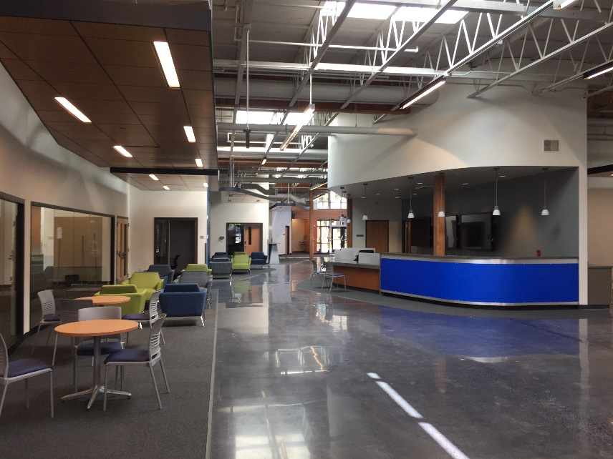
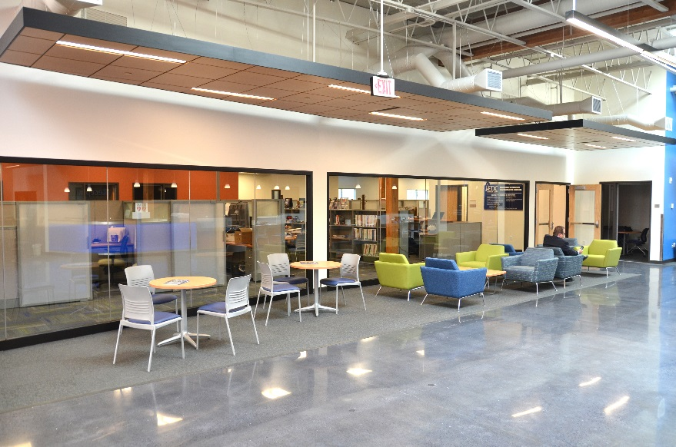
South Puget Sound Community College, Lacey Building (Continued)

Slide 21
Future DBB Projects
Green River Student Affairs Tenant Impr. $ 3 M Sep 2016
Lower Columbia Main Bldg. Renov $ 3 M Dec 2016
WSP Replace Weigh Station $ 2 M Feb 2017
GHS Birch: Acute MHealth Remd $ 3 M Jan 2017
DSHS WSH E. Campus Bldg. Renov. $ 6 M Feb 2017
DSHS WSH New Kitch/Commissary $18M Mar 2017
Dependent on Construction Funding 2017-19
College/Client MACC Bids
Highline Health & Life Sci (B26) $15M May 2017
Whatcom Learning Commons $22M July 2017
Big Bend Prof-Tech Educ Center $25M Jan 2018
/Mil Tumwater Readiness Ctr $31M Feb 2018
/DSHS WSH 2 Forensic Wards $17M

Slide 22
Future DBB Projects
Dependent on Design Funding 2017-19
College | Design | MACC
Wenatchee - Wells Hall Replacement | $3M | $27M
Olympic - Shop Bldg. Renovation | $1M
Pierce Cascade Bldg. Reno Ph.3 | $3M
So. Seattle - Automotive Technology | $2M
Bates - Medical Mile Health Sci | $3M

Slide 23
Panel Question 1: Lessons Learned
All projects need good communication and planning
Projects benefit from having existing site & building as-builts, design standards, & committed leadership
Need realistic contingencies for type of construction
Eligibility to submit RFQ based on prior work for client
Honorariums
Design Build
  is not for every client/project
  Owner should not mistake DB as magical solution for basic financial issues or hidden conditions
  Limitations on # of boards, slides, pages & fly threw to limit team efforts, expense and design scope limits
Progressive Design Build
  Verify budget with proposed design fees
  Limitations on Presentation group size

Slide 24
Panel Question 2 :
Project Experiences applied to Decision Process
DES’s experience with Traditional Design Build helped approaching Progressive Design Build
Best to decide delivery method upfront
Analyzing issues on large DBB projects makes us want to press more for using DB or GC/CM on large complex projects

Slide 25
Panel Question 3 :
Lessons, but No Process Change?
Lessons may not change why we would use DB or GC/CM as each project has particular needs
Need to increase communication and training for clients on alternative public works opportunities

Slide 26
Panel Question 4 :
Client Understanding Methods
PMs coordinate and plan projects with Client Agencies
Provided DB Overview at SBCTC Budget Development Workshops
Client Workshop included UW GC/CM Presentation
Met/conferenced with clients considering methods
Invited clients to E&AS Hosted DBIA Training in Oct.
Challenges
  Some request project funding w/o PM input
  Varying experience with construction projects & methods

Slide 27
Panel Question 5: Staff Changes
Replaced those retired
Added PMs
Back to 4 Team Managers
Added Program Manager
Increased Contract Staff

Slide 28
Panel Question 6:
Continuous Training for Staff
40% have attended GC/CM training
30% will have DBIA training (w/ hosting in Oct.)
100% RS Means Cost Estimating Training
Lean Huddles – Lessons Learned are shared
Annual PM Workshop
Creating Project Management Manual for project consistency and customer service

Slide 29
Thank you
Questions?

