Slide 1
Seattle Multimodal Terminal at Colman Dock Project
Project Review Committee
December 4, 2014

Slide 2
Agenda overview
Project background
GC/CM as appropriate delivery method
Public benefit
Public body qualifications
Questions

Slide 3
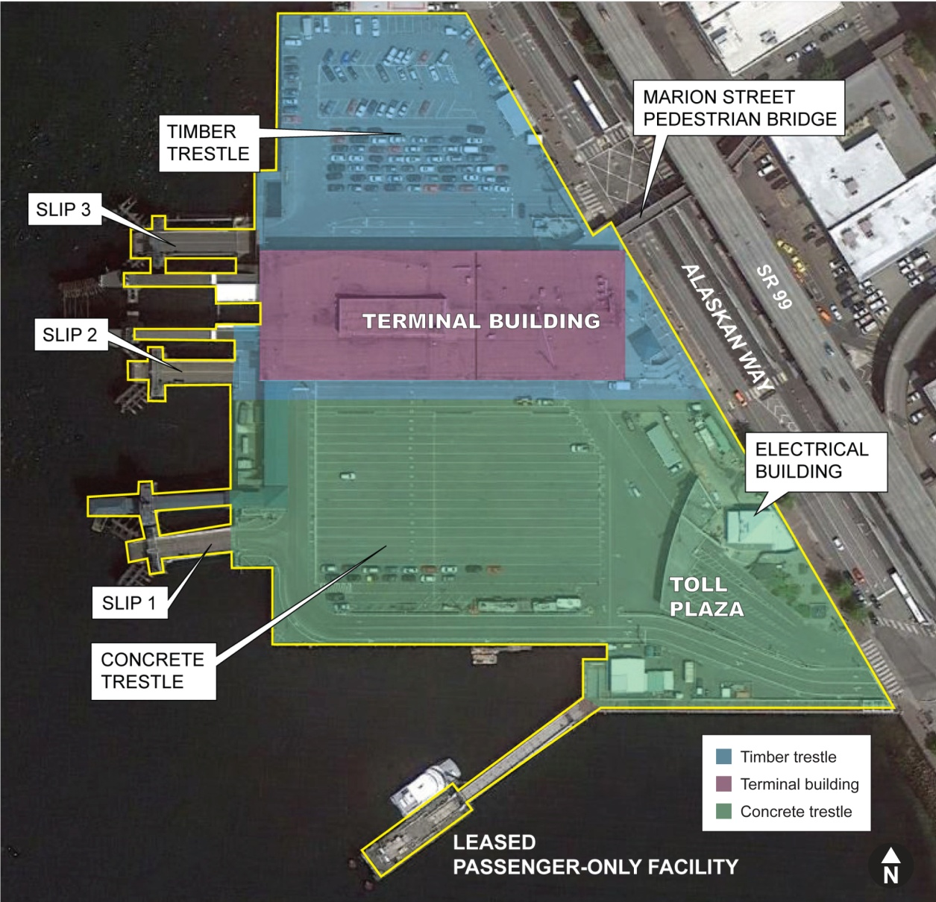
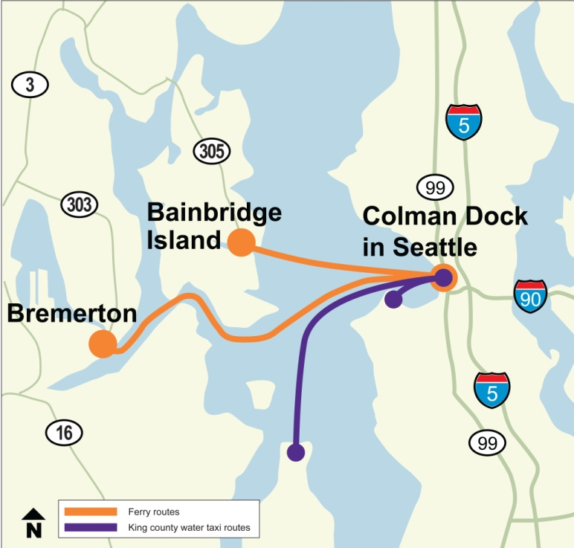
Colman Dock today
Regional transportation hub
In 2013, 9 million people used Colman Dock including 4.9 million pedestrians

Slide 4
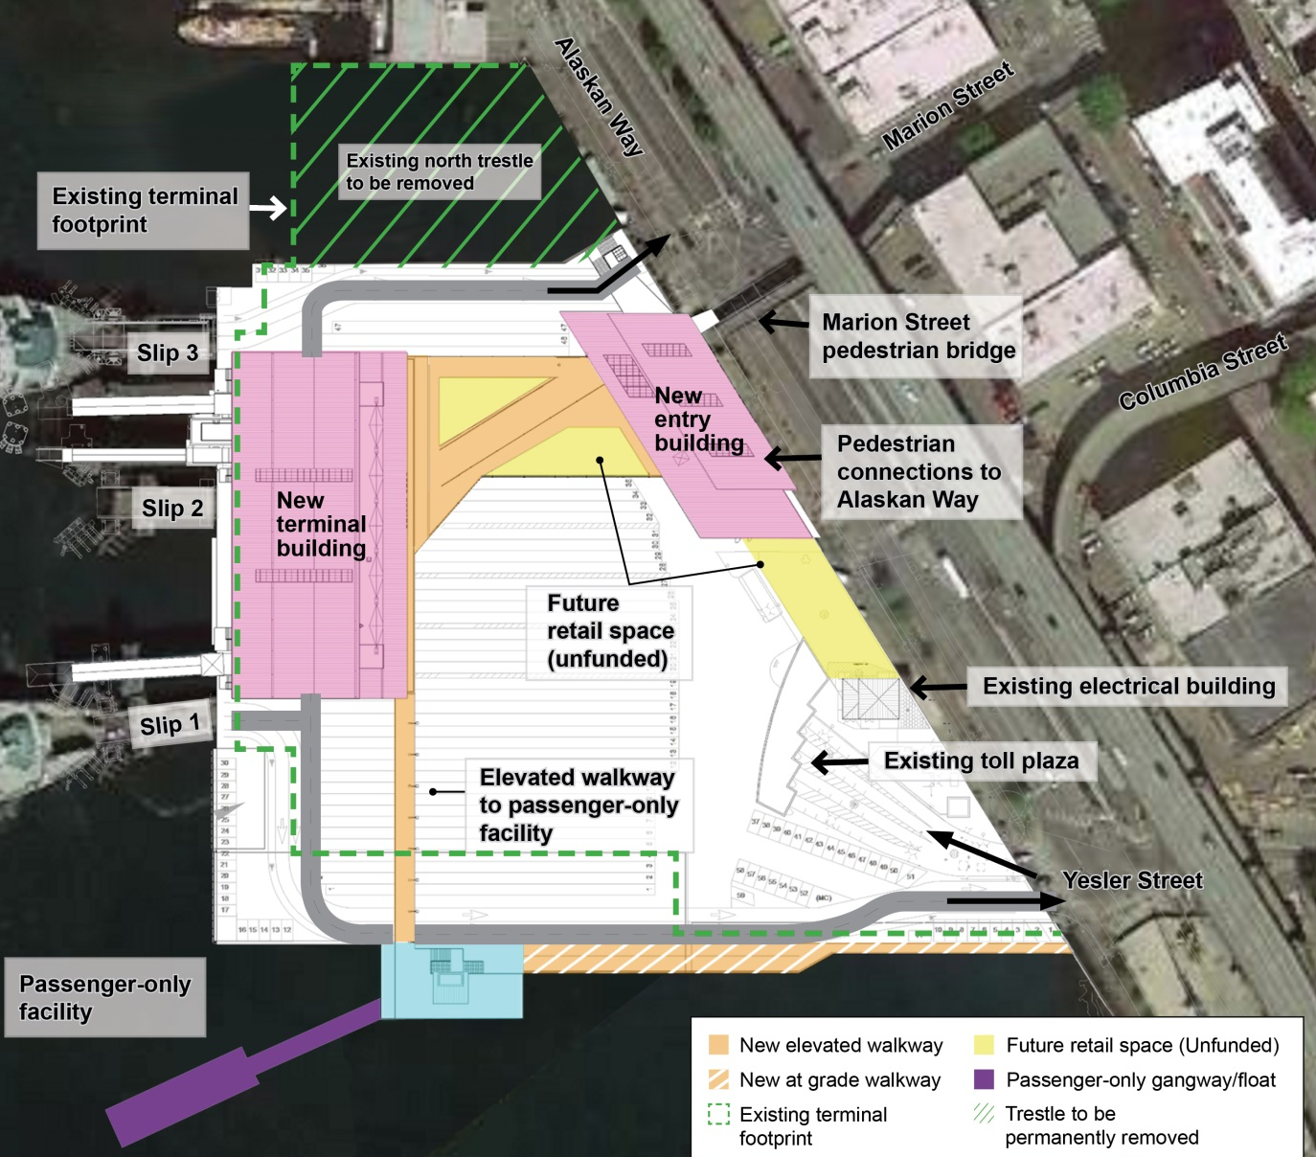
Project elements
Replacing the timber portion of the dock with a new and reconfigured dock.
Replacing the main terminal building.
Replacing the vehicle transfer span and overhead loading structures (Slip 3).
Replacing the passenger-only facility with funding provided by King County.
Improving accessibility and pedestrian connections to transit.
Mitigating for ~5,000 sq ft of new over-water coverage using Pier 48.

Slide 5
Schedule and budget
Schedule
2011 – early 2015: Environmental process/preliminary design
2015 – 2017: Pre-construction and permitting
Early to mid-2015: GC/CM procurement
August 2017 – early 2023: Construction
Cost
Overall project expected to cost approximately $268 million, including a risk reserve
Estimated project construction costs (incl. contingency): $177 million
Funding
Design funds have been appropriated for the 2013-2015 biennium to cover preconstruction phase activities
Remaining design funds are expected to be appropriated in the 2015 legislative session
Construction funding will require future legislative appropriation; WSDOT will also pursue federal grants

Slide 6
GC/CM as appropriate delivery method
Complex scheduling, phasing and coordination
Facility operational during construction
Early involvement of GC/CM is critical
Complex and technical work environment

Slide 7
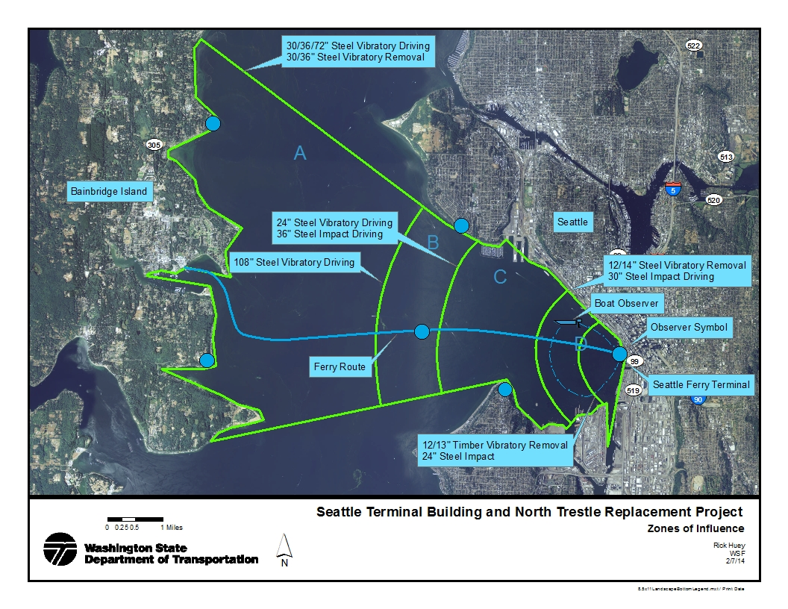
Complex scheduling, phasing and coordination
Environmental and tribal commitments
Permits and environmental compliance restrict in-water work and require intensive monitoring
Example zone of influence for marine mammal monitoring

Slide 8
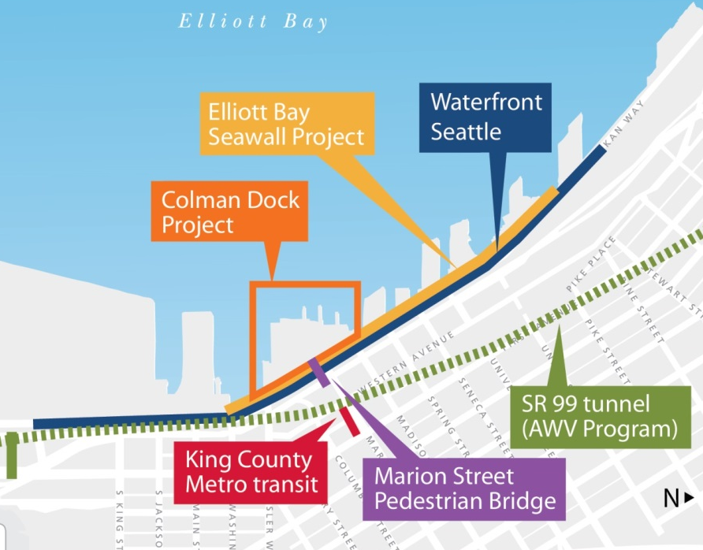
Complex scheduling, phasing and coordination

Slide 9
Facility operational during construction
Continuous operation of two WSF routes and two King County routes
Maintain level of service for all modes
Commercial and general purpose vehicles
Pedestrians (compliant with Americans with Disabilities Act)
Bicyclists
Systems and utilities operational at all times

Slide 10
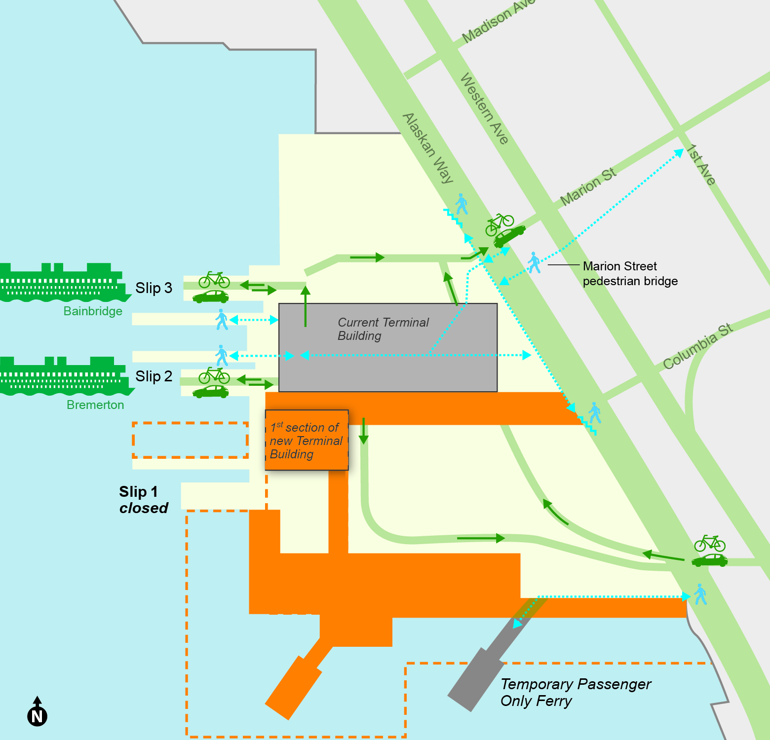
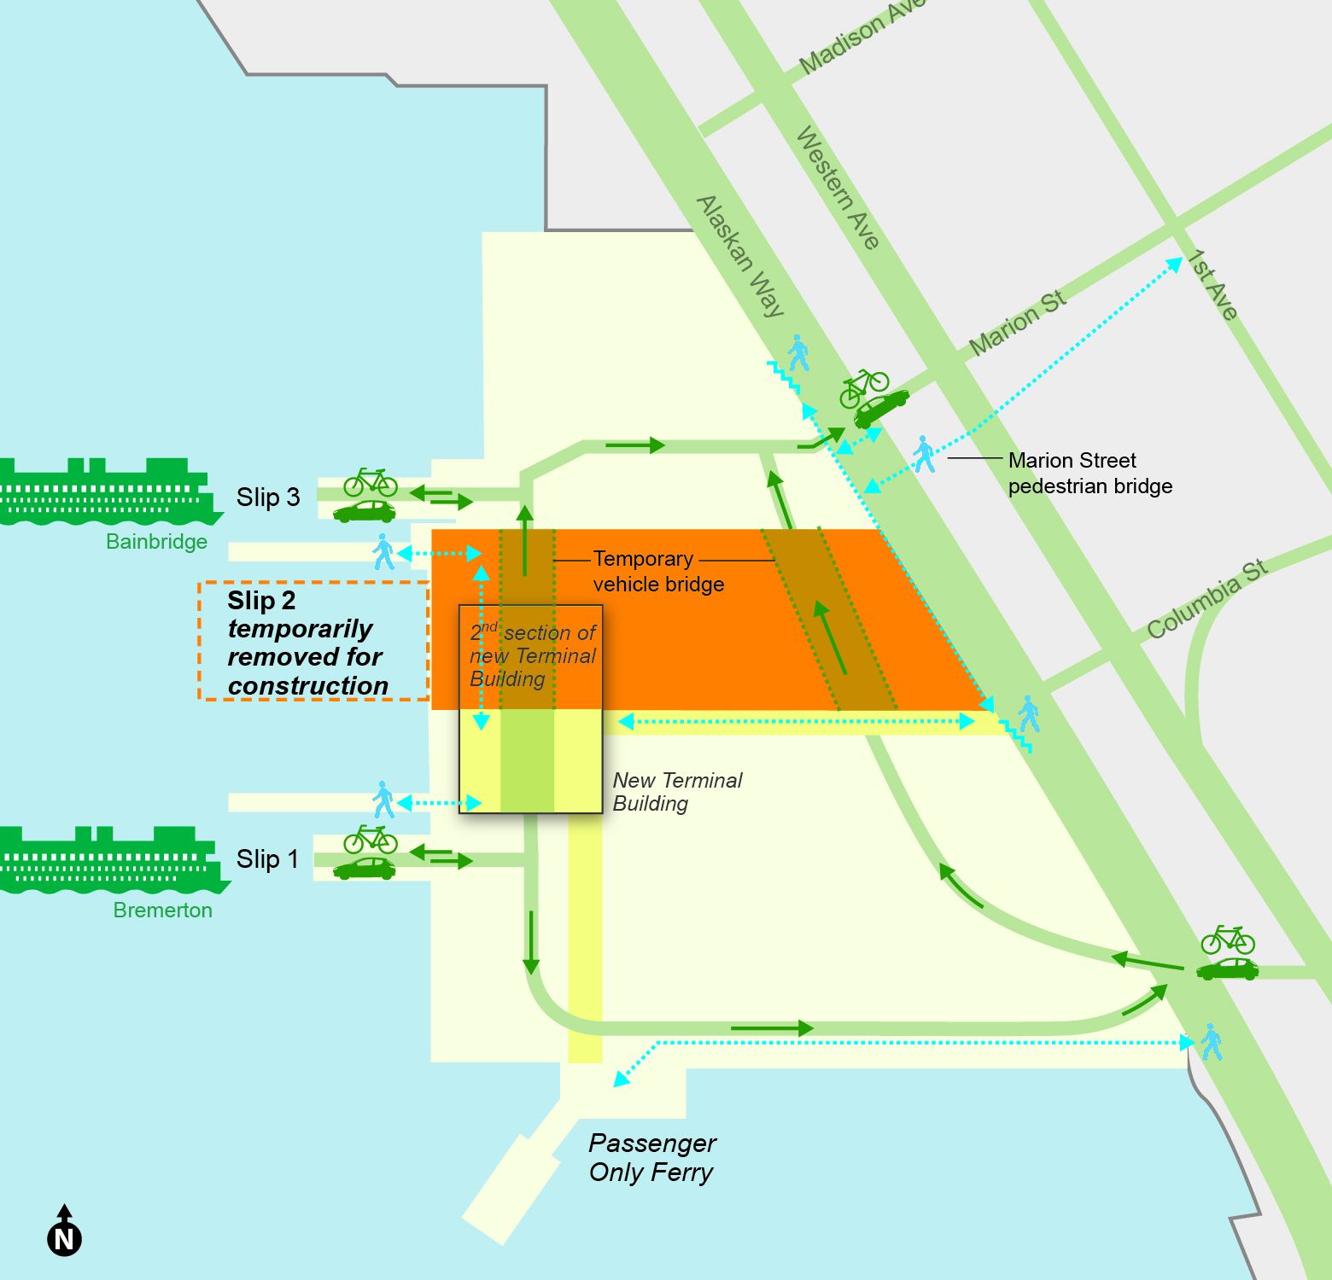
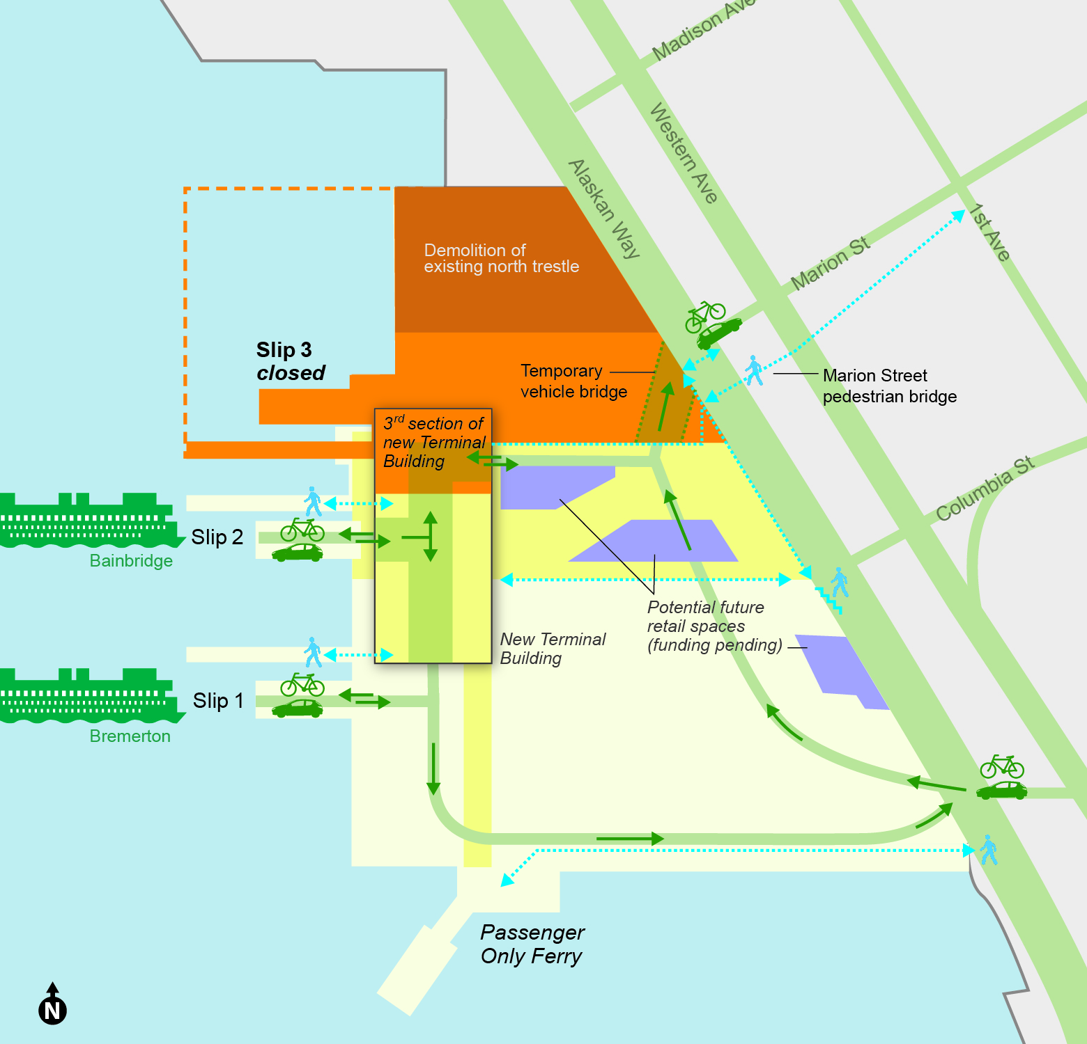
Facility operational during construction
Complex construction phasing to support operational requirements
Phase 1
Phase 2
Phase 3

Slide 11
Early involvement of GC/CM is critical
Design will not proceed beyond 30 percent without GC/CM input
Development of permit applications requires detailed description of construction methods and phasing
Several aspects of design require early coordination with GC/CM
Foundation design
Barging plan
Maintenance of traffic
Procurement of long-time lead items

Slide 12
Complex and technical work environment
Complex regulatory environment
Challenging geotechnical conditions
Contaminated sediments
High degree of stakeholder involvement

Slide 13
Public benefit
Earlier project cost information to inform agency budget decisions
Ability to prequalify and select general and sub contractors
Ability to maintain operations while ensuring a safe environment
Ability to adhere to permit requirements and tribal commitments

Slide 14
Public body qualifications
Project team brings core competencies required for success
Project delivery experience
GC/CM experience and training
Project management experience and continuity
Construction contract administration experience

Slide 15
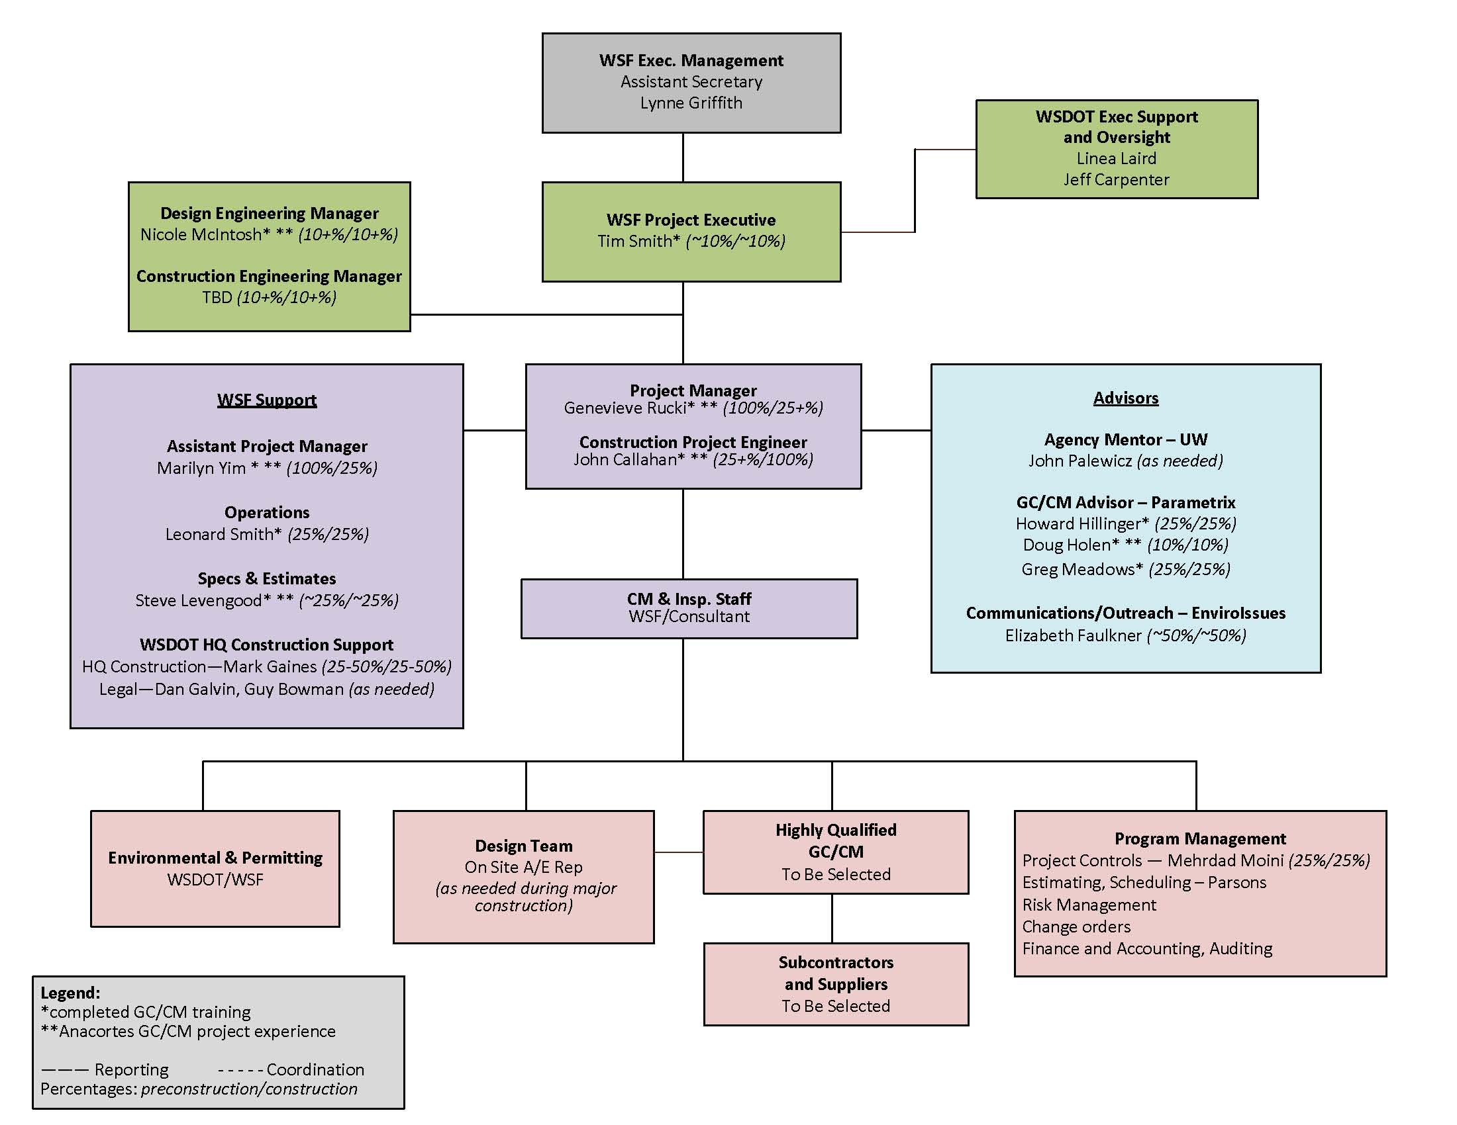
Public body qualifications

Slide 16
Summary
Alternate delivery provides substantial fiscal benefit
Project meets criteria to use GC/CM delivery
Project team has necessary qualifications

Slide 17
Questions

