Slide 1
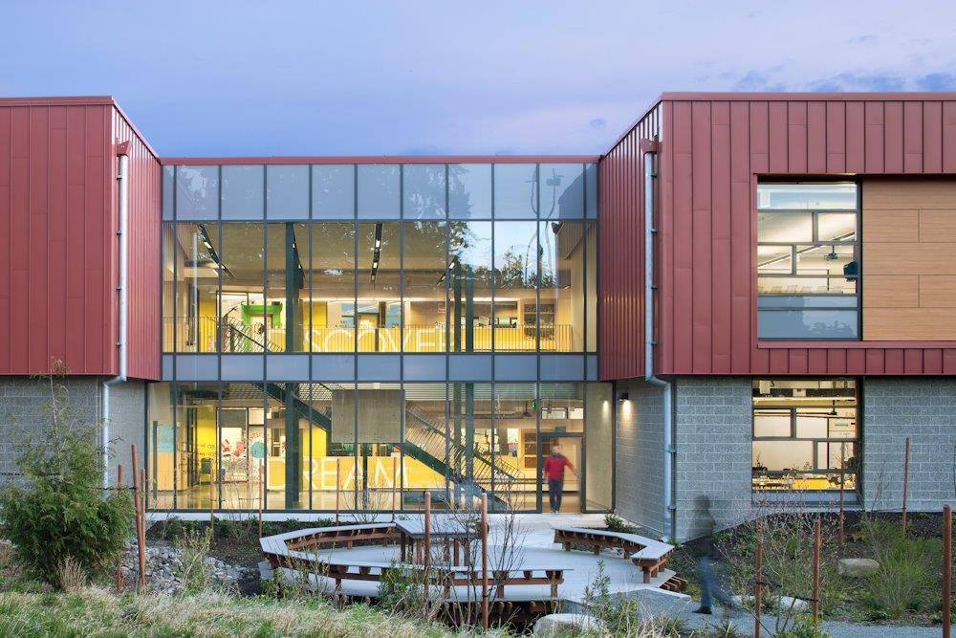
EDMONDS SCHOOL DISTRICT No. 15
GC/CM Public Body Presentation to Project Review Committee | July 24, 2014
GC/CM Recertification Presentation to Project Review Committee | May 25, 2017
Put presentation on flash drive

Slide 2
EDMONDS SCHOOL DISTRICT No. 15
Recertification Agenda
Agenda
Introductions
GC/CM Experience since Certification and Overall Lessons Learned
Project Specific Lesson Learned – Lynnwood, Mountlake Terrace and Spruce
Project Specific Lesson Learned – Madrona, Alderwood and Lynndale
Responses to Written Committee Questions
Discussion

Slide 3
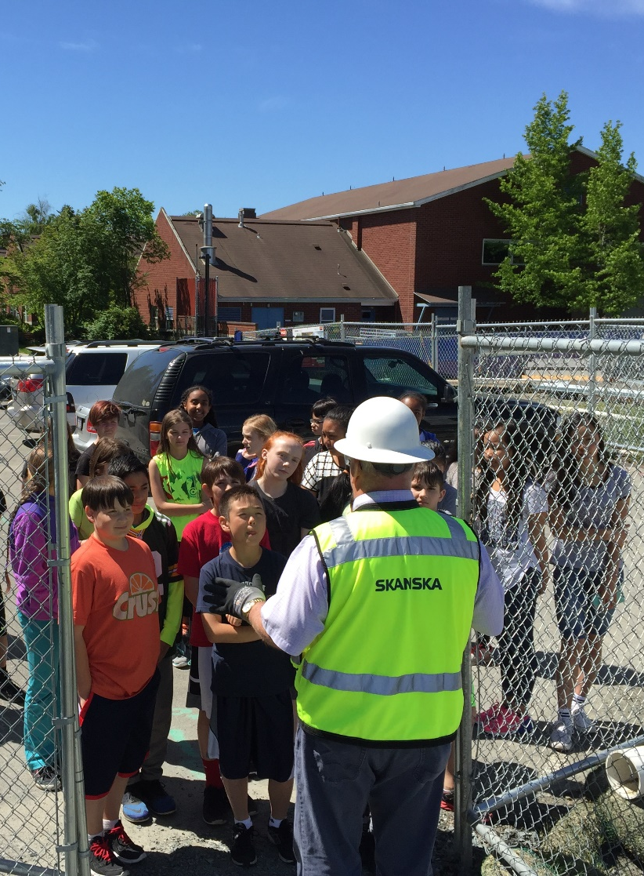
EDMONDS SCHOOL DISTRICT No. 15
Recertification Presenters
Stewart Mhyre
Executive Director Business & Ops.
Edward Peters
Capital Projects Director
Matt Finch
Design & Construction Manager
Taine Wilton
Design & Construction Manager

Slide 4
EDMONDS SCHOOL DISTRICT No. 15
Organizational Structure
 | Carin Chase |  |  | Ann McMurray |  |  | Susan Phillips |  |  | Gary Noble |  |  | Diana White
 | School Board Director |  |  | School Board Director |  |  | School Board President |  |  | School Board Director |  |  | School Board Director
 |  |  |  |  |  |  | Dr. Kristine McDuffy
 |  |  |  |  |  |  | Superintendent
 |  |  |  | Devone Miles |  |  | Stewart Mhyre |  |  | Jenna Valach |  |  | Ashley Crawford
 |  |  |  | Senior Purchasing Agent |  |  | Executive Director Business & Ops. |  |  | Director, Budget & Finance |  |  | Capital Budget Analyst
 |  |  |  |  |  |  | Edward Peters
 | Charles Hartung |  |  |  |  |  | Capital Projects Director
 | GC/CM Advisor
 | Richard Prentke
 | GC/CM Attorney |  |  | Nick Chou |  |  | Taine Wilton |  |  | Matt Finch |  |  | Sharon James
 |  |  |  | Design & Constr Manager |  |  | Design & Constr Manager |  |  | Design & Constr Manager |  |  | CPO Support Technician
 | Craig Madsen |  |  |  |  |  |  |  |  |  |  |  | Beth Gordon
 | Move Manager |  |  | Will Thomsen |  |  | Michael Nelson |  |  | Laura Bowers |  |  | CPO Assistant
 |  |  |  | Construction Coordinator |  |  | Construction Coordinator |  |  | Construction Coordinator
Notes:
The same ESD team that the PRC certified three years ago now has significantly more GC/CM experience and training
Since certification the Edmonds School District has continued its decades long record of delivering on our promises of quality facilities, on time and on budget.
One measure of our performance is that our voters have approved the last 10 straight capital funding measures with strong majorities.

Slide 5
EDMONDS SCHOOL DISTRICT No. 15
GC/CM Project List Since Certification
Construction Completed
Maintenance, Transportation
Alderwood MS Replacement
Lynndale ES Replacement
Design Phase complete, Starting Construction
Lynnwood ES Replacement
Mountlake Terrace ES Replacement
Madrona School Replacement
In Design Phase
Spruce ES Replacement

Slide 6
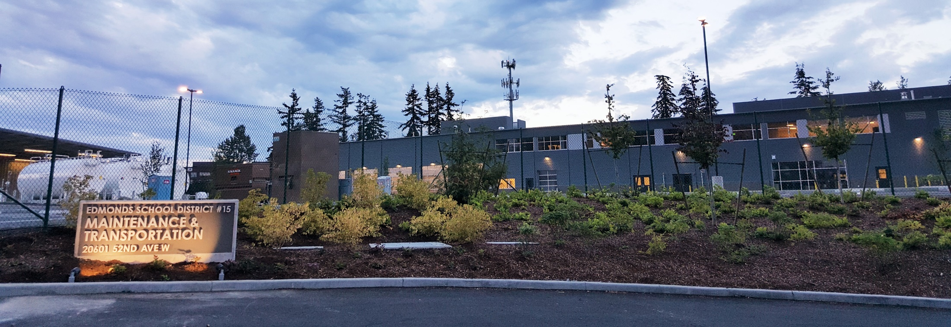
EDMONDS SCHOOL DISTRICT No. 15
Overall Lessons Learned
Invest the resources to make the process work;
Get the GC/CM involved as early as possible;
GC/CM can maximize value for all parties.

Slide 7
EDMONDS SCHOOL DISTRICT No. 15
Lynnwood and Mountlake Terrace - Lessons Learned
Utilizing Existing Buildings
Entire New Construction
Proactive Cost Estimating

Slide 8
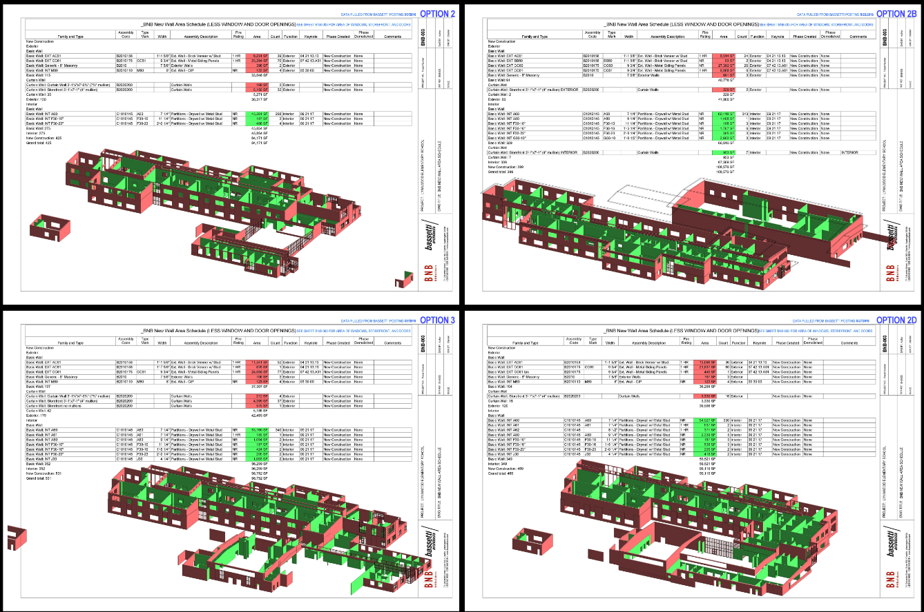
EDMONDS SCHOOL DISTRICT No. 15
Lynnwood and Mountlake Terrace - Lessons Learned
Proactive Cost Estimating

Slide 9
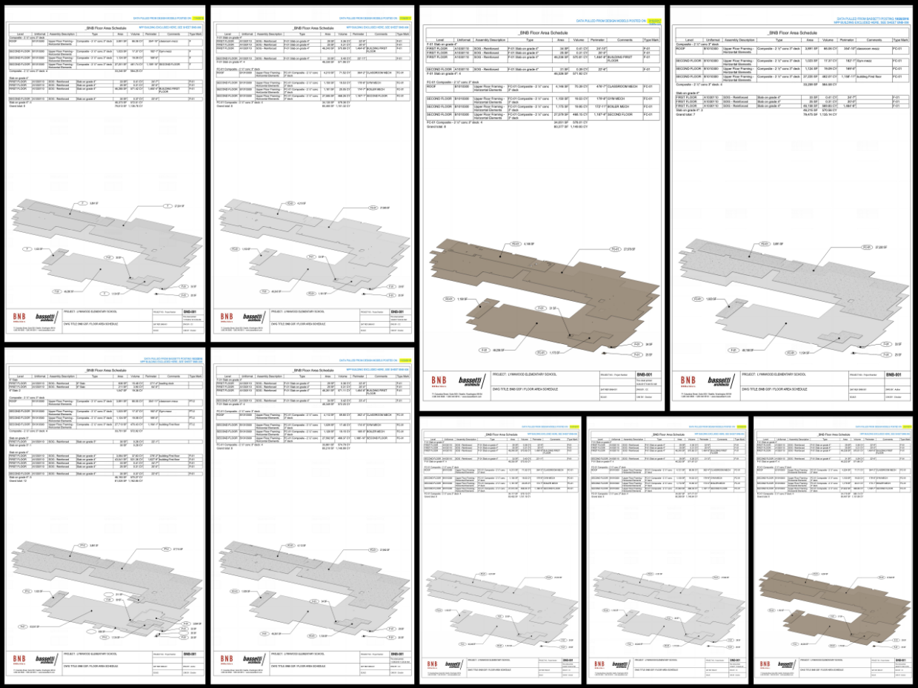
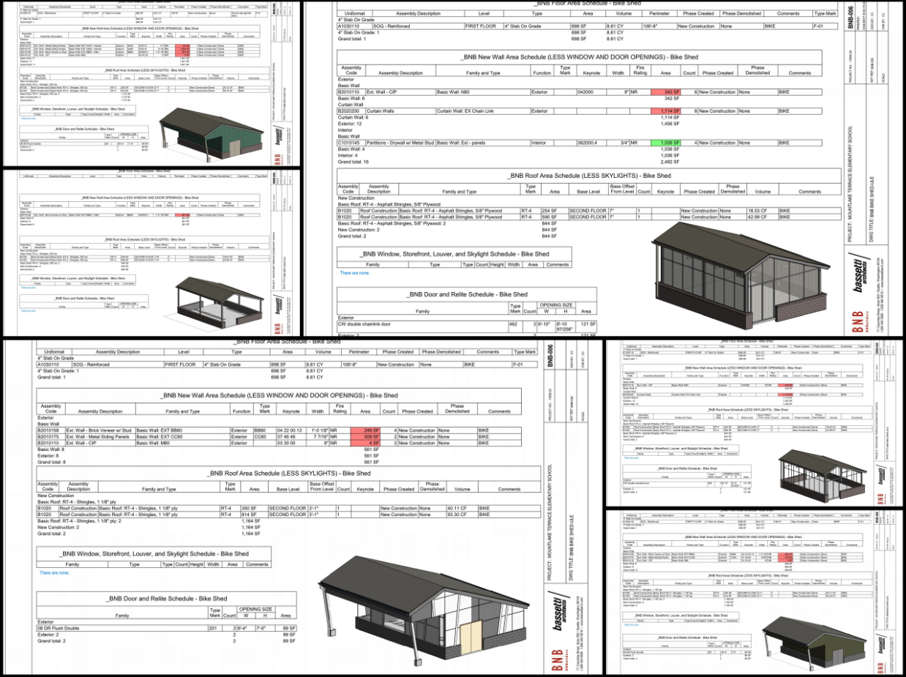
EDMONDS SCHOOL DISTRICT No. 15
Lynnwood and Mountlake Terrace - Lessons Learned
Beyond traditional BIM coordination

Slide 10
EDMONDS SCHOOL DISTRICT No. 15
Spruce - Lessons Learned
Complete Project
Phased Approach

Slide 11
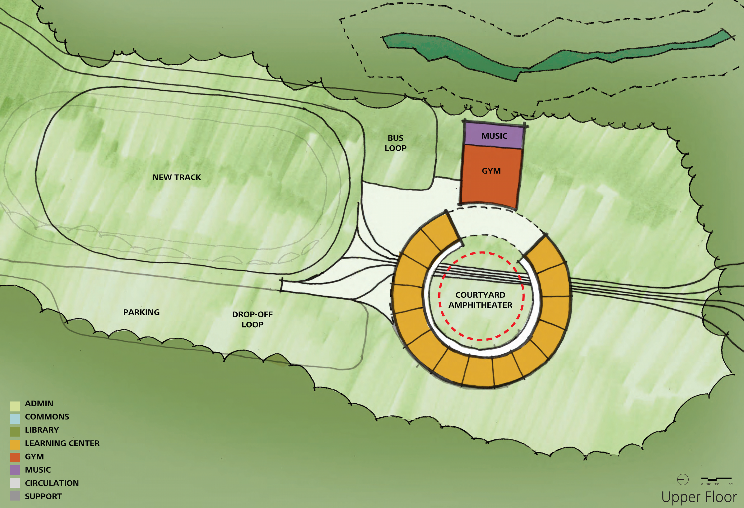
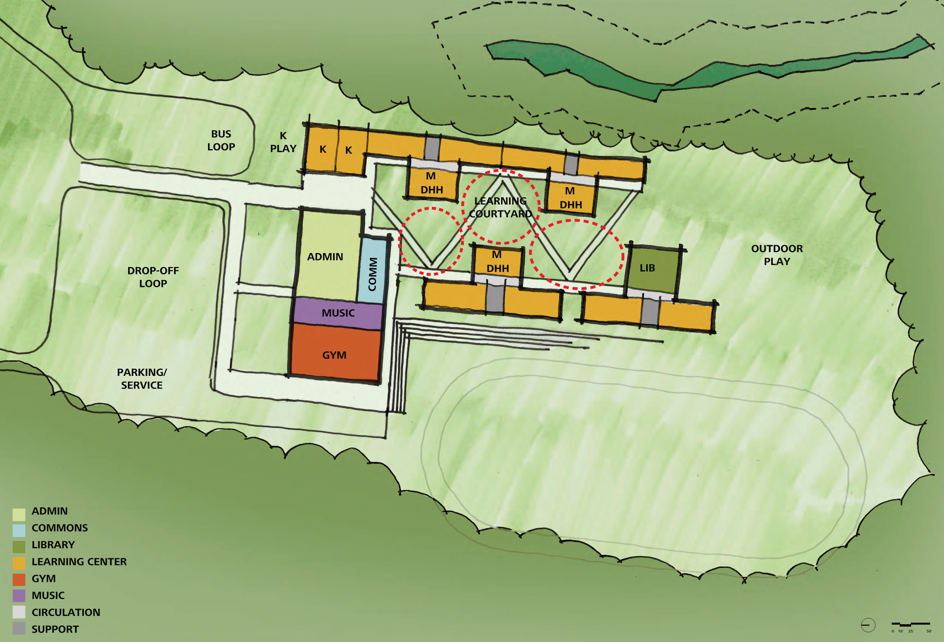
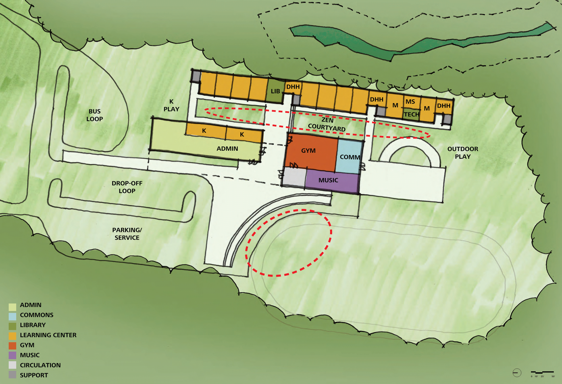
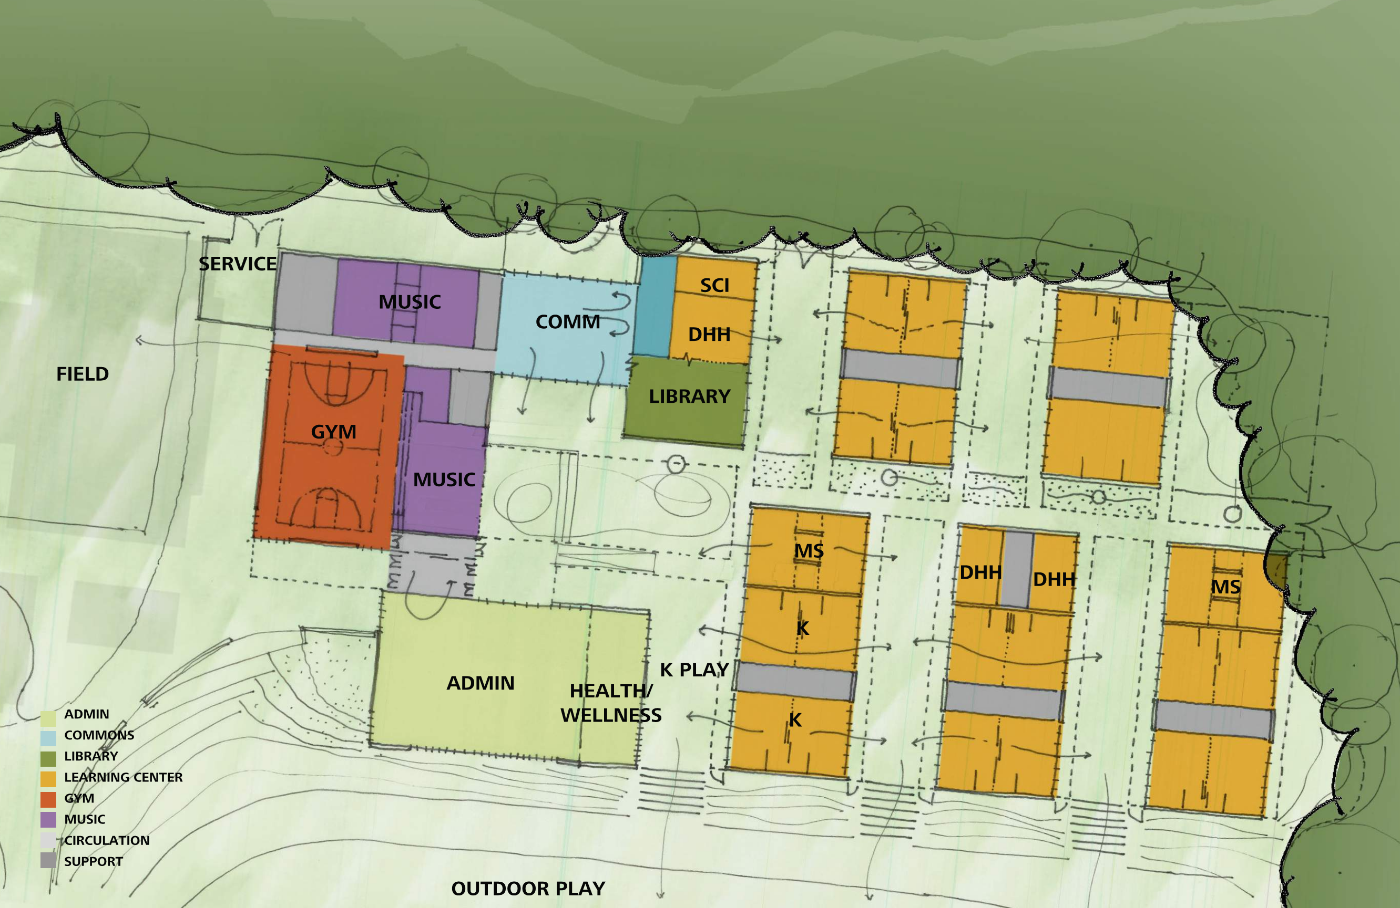
EDMONDS SCHOOL DISTRICT No. 15
Madrona Lessons Learned Schedule
Notes:
GC/CM brought on early, assisted with building location to reduce cost
Used tools budget option log, scheduling

Slide 12
EDMONDS SCHOOL DISTRICT No. 15
Complex Phasing
Madrona School Replacement Accelerated Schedule

Slide 13
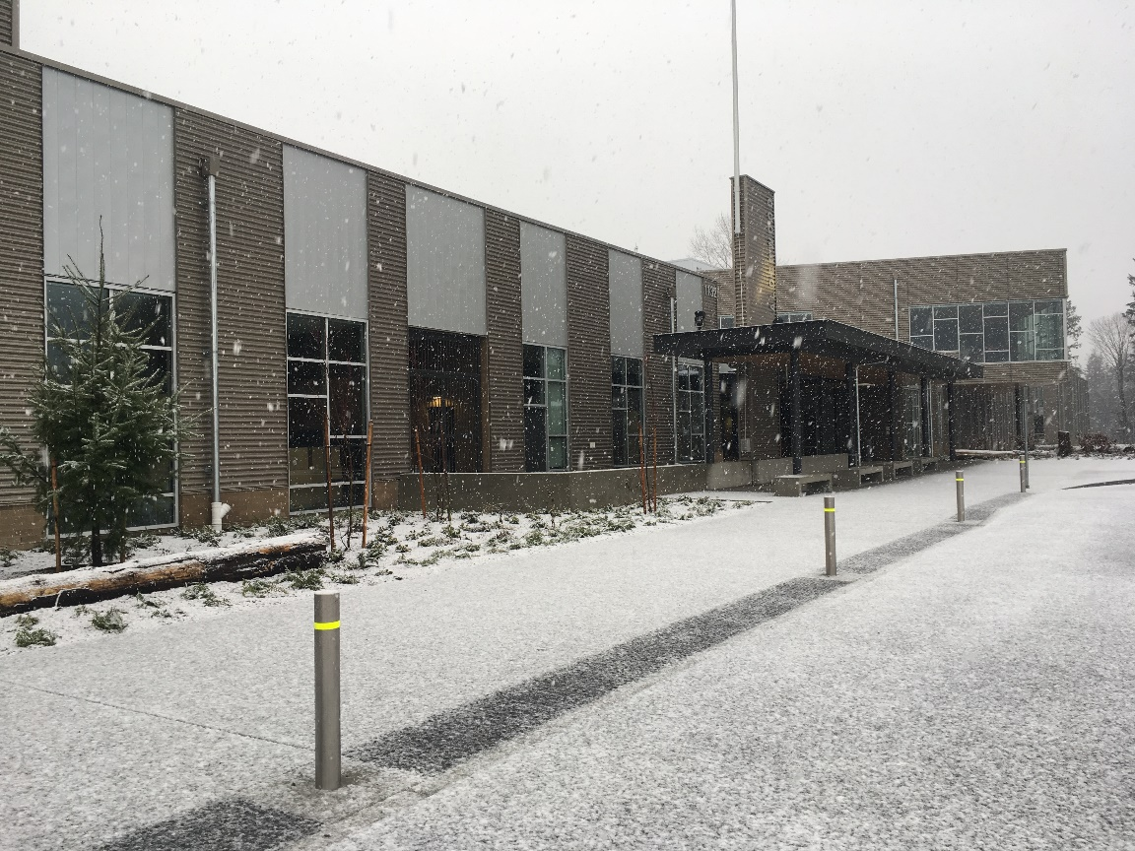
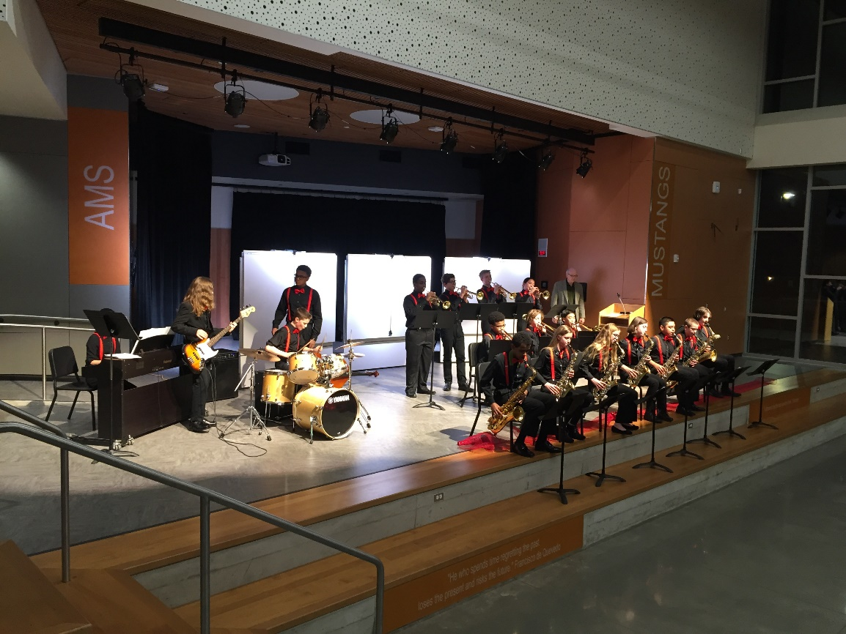
EDMONDS SCHOOL DISTRICT No. 15
Complex Phasing
Alderwood and Lynndale Lessons Learned

Slide 14
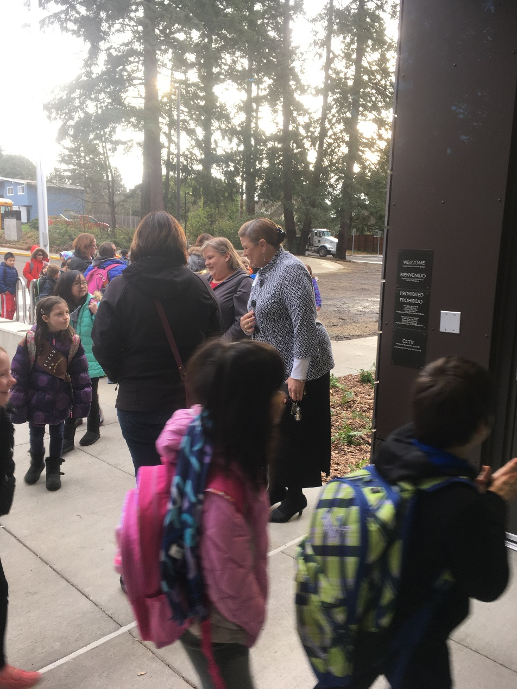
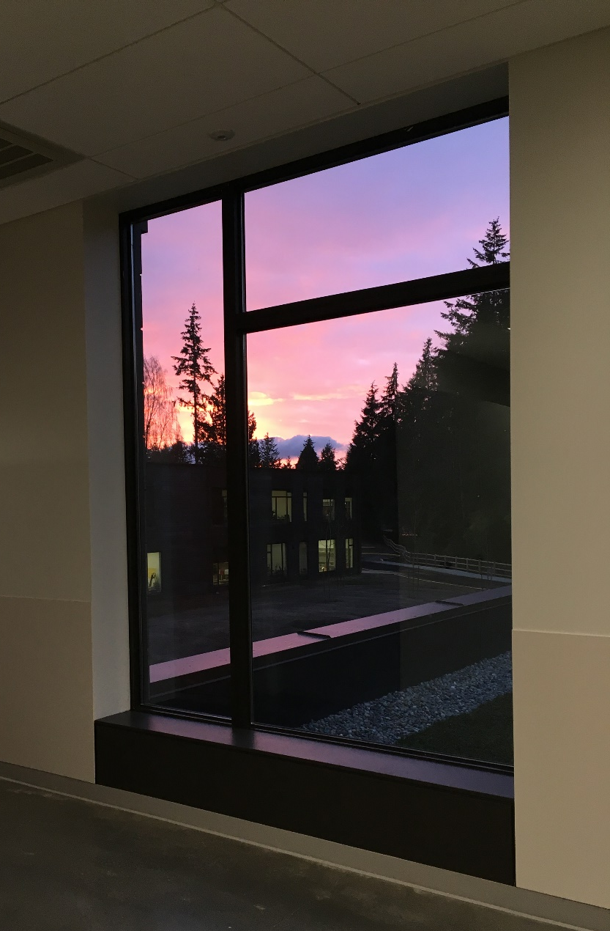
EDMONDS SCHOOL DISTRICT No. 15
Complex Phasing
Alderwood and Lynndale Lessons Learned

Slide 15
EDMONDS SCHOOL DISTRICT No. 15
GC/CM Public Body Presentation to Project Review Committee | July 24, 2014
PRC Questions & ESD Responses
Panel Question #1.
Regarding Project Delivery Knowledge and Experience: For listed projects, please describe both planned and actual (or projected) cost and schedule results, and briefly comment on reasons/lessons learned where either positive or negative variances occurred. Please indicate how lessons learned will be incorporated into forthcoming projects.

Slide 16
EDMONDS SCHOOL DISTRICT No. 15
GC/CM Public Body Presentation to Project Review Committee | July 24, 2014
PRC Questions & ESD Responses
ESD Response #1: The following projects were listed in the “Project Delivery Knowledge and Experience” section of our application (Item #3.)
New Maintenance/Transportation Facility – GC/CM
Planned Total Project Cost - $31 M
Actual Total Project Cost - $30.2 M
Lessons Learned - Cost: Continuous GC/CM collaboration with Design Team, and School District allowed the team to maximize scope and value in the face of a highly constrained budget. This experience lead to greater emphasis in subsequent projects on establishing detail cost targets at the beginning of the process.
Planned Substantial Completion - 4/4/16
Actual Substantial Completion - 8/4/16
Lessons Learned – Schedule: Despite delays arising from post-approval permit requirements and inspection procedures, project was completed on time for critical occupancy deadline. Continuous collaboration among the GC/CM, Design Team, and School District was essential to achieving this result. This experience lead to revising communications procedures with the Authority Having Jurisdiction (AHJ) for subsequent projects.

Slide 17
EDMONDS SCHOOL DISTRICT No. 15
GC/CM Public Body Presentation to Project Review Committee | July 24, 2014
PRC Questions & ESD Responses
ESD Response #1 Cont.:
Alderwood Middle School Replacement – GC/CM
Planned Total Project Cost - $68 M
Actual Total Project Cost - $ 67.5 M
Lessons Learned - Cost: The GC/CM proposed an accelerated schedule to open the school in January, which reduced the GMP significantly. It also revealed an opportunity to bid and conduct major packages off-cycle from the rest of the market. This approach was used on subsequent projects.
Planned Substantial Completion – 7/11/17
Actual Substantial Completion - 12/2/2016
Lessons Learned – Schedule: The accelerated schedule created a number of weather related risks e.g. exposing moisture sensitive soils and building interiors to winter weather. Continuous collaboration among the GC/CM, Design Team, and School District reduced the impact of these situations. Better accommodation of the impacts of accelerated schedules were built into subsequent projects. The use of EC-MC/CM procurement was beneficial to the project, but would have been more valuable if it had been possible to bring them onto the team earlier. The subsequent project which used EC-MC/CM procurement benefitted from this experience by bringing the EC-MC/CMs onto the team earlier.

Slide 18
EDMONDS SCHOOL DISTRICT No. 15
GC/CM Public Body Presentation to Project Review Committee | July 24, 2014
PRC Questions & ESD Responses
ESD Response #1 Cont.:
Lynndale Elementary School Replacement – GC/CM
Planned Total Project Cost - $ 36 M
Actual Total Project Cost - $35.9 M
Lessons Learned - Cost: The GC/CM proposed an accelerated schedule to open the school in January, which reduced the GMP significantly. It also revealed an opportunity to bid and conduct major packages off-cycle from the rest of the market. Continuous collaboration among the GC/CM, Design Team, and School District allowed the team to maximize scope and value in the face of a highly constrained budget. The quality of construction was noticeably high.
Planned Substantial Completion - 7/11/17
Actual Substantial Completion - 12/1/2016
Lessons Learned – Schedule: The accelerated schedule created a weather related risk by exposing moisture sensitive soils to winter weather. Further, a peat bog under the existing structures was exposed once demolition occurred. The GC/CM kept the impacts to a minimum and the project on schedule through continuous collaboration among the GC/CM, Design Team, and School District. The GC/CM met early and often with the AHJ to avoid impacts that affected Maintenance and Transportation.

Slide 19
EDMONDS SCHOOL DISTRICT No. 15
GC/CM Public Body Presentation to Project Review Committee | July 24, 2014
PRC Questions & ESD Responses
ESD Response #1 Cont.:
Lynnwood Elementary School Replacement – GC/CM
Planned Total Project Cost - $42.2 M
Actual Total Project Cost – TBD
Lessons Learned - Cost: The School District chose to bundle the Lynnwood Elementary project with the Mountlake Terrace Elementary project to be executed by one GC/CM as a single project. The team conducted a target value analysis charrette during Schematic Design which established a common understanding and set of goals for all parties. Continuous collaboration among the GC/CM, Design Team, and School District allowed the team to address the current bidding climate in a manner that balanced cost with program requirements, functionality and durability. The School District will continue to refine and apply the target value approach on subsequent projects.
Planned Substantial Completion – July 27, 2018
Actual Substantial Completion - TBD
Lesson Learned – Schedule: TBD

Slide 20
EDMONDS SCHOOL DISTRICT No. 15
GC/CM Public Body Presentation to Project Review Committee | July 24, 2014
PRC Questions & Responses
ESD Response #1 Cont.:
Madrona K-8 School Replacement – GC/CM
Planned Total Project Cost - $ 50.5 M Actual Total Project Cost - TBD
Lessons Learned - Cost: This project brought the GC/CM on during pre-design, which proved to be very valuable. The first whole team meeting was a cost charrette, where the various disciplines gave their expertise and experience to establish the target values. Going forward we had the Target Value Analysis to use as a baseline to keep the project within the established costs. Continuous collaboration among the GC/CM, Design Team, and School District allowed the team to address the current bidding climate in a manner that balanced cost with program requirements, functionality and durability. This project has one GMP, as a way of streamlining all documents going forward including, pay apps, schedule of values, contingency usage, audit procedures, and project closeout. We opted not to use MCCM and ECCM on this project to stay within the GC/CM’s comfort level. These lessons will be applied on subsequent projects.
Planned Substantial Completion – Phase 1 July 12, 2018, Phase 2 October 16, 2018
Actual Substantial Completion – TBD
Lesson Learned – Schedule: The original planned schedule had Substantial Completion set for July of 2019. With the help of the GC/CM and the Design Team we were able to accelerate the schedule by a full year. Our experience with accelerated schedules on the Alderwood and Lynndale projects helped us minimize the adverse impacts and maximize the value from this approach.

Slide 21
EDMONDS SCHOOL DISTRICT No. 15
GC/CM Public Body Presentation to Project Review Committee | July 24, 2014
PRC Questions & Responses
ESD Response #1 Cont.:
Mountlake Terrace Elementary School Replacement – GC/CM
Planned Total Project Cost - $ 39.2 M
Actual Total Project Cost - TBD
Lesson Learned - Cost: The School District chose to bundle the Lynnwood Elementary project with the Mountlake Terrace Elementary project to be executed by one GC/CM as a single project. The team conducted a target value analysis charrette during Schematic Design which established a common understanding and set of goals for all parties. Continuous collaboration among the GC/CM, Design Team, and School District allowed the team to address the current bidding climate in a manner that balanced cost with program requirements, functionality and durability.
Planned Substantial Completion – July 27, 2018
Actual Substantial Completion - TBD
Lesson Learned – Schedule: TBD

Slide 22
EDMONDS SCHOOL DISTRICT No. 15
GC/CM Public Body Presentation to Project Review Committee | July 24, 2014
PRC Questions & Responses
ESD Response #1 Cont.:
Spruce Elementary School Replacement – GC/CM
Estimated Total Project Cost - $ 53.3 M
Actual Total Project Cost - TBD
Lesson Learned - Cost: The replacement of this school is a “bonus” project. The full scope was not anticipated in the 2014 bond measure and requires a combination of bond funding, revenue from property sales and leases, and State Construction Assistance. Portions of these sources have not yet been fully secured. Continuous collaboration among the GC/CM, Design Team, and School District allows the team to maximize scope and value in the face of a highly constrained budget.
Planned Substantial Completion - TBD
Actual Substantial Completion - TBD
Lesson Learned – Schedule: Continuous collaboration among the GC/CM, Design Team, and School District allows the team to manage a flexible schedule that depends on future revenues.

Slide 23
EDMONDS SCHOOL DISTRICT No. 15
GC/CM Public Body Presentation to Project Review Committee | July 24, 2014
PRC Questions & Responses
Panel Question #2
For projects completed in last 3 years (New Maintenance/Transportation Facility, Alderwood Middle School Replacement, Lynndale Elementary School Replacement) please include projected GMP in addition to the final GMP, as required in the application.
ESD Response #2:
New Maintenance/Transportation Facility – GC/CM
Planned/Projected GMP – $23,450,000
Actual/Final GMP - $23,398,160
Alderwood Middle School Replacement – GC/CM
Planned/Projected GMP – $51,000,000
Actual/Final GMP - $50,740,967
Lynndale Elementary School Replacement – GC/CM
Planned/Projected GMP – $26,500,000
Actual/Final GMP - $26,422,769

Slide 24
EDMONDS SCHOOL DISTRICT No. 15
GC/CM Public Body Presentation to Project Review Committee | July 24, 2014
PRC Questions & Responses
Panel Question #3
Attachment A: Overview states, “Delivery options vary based on the characteristics of each project and based upon the budget of each project.” Explain how project budget effects your decisions on use of GC/CM.
ESD Response #3:
The characteristics and scope of each project determine the budget and also are the principal factors the School District uses in determining Delivery Method. Most District projects are either total replacements of existing facilities or upgrades of particular systems for existing facilities. The first category, total replacement, usually involves total project budgets in the range of $30 million to $70 million. These projects are often candidates for GC/CM because they are complex, often involve occupied sites and can benefit from GC/CM participation in the planning and design process. The second category, systems upgrades, which may involve replacing roofs, HVAC equipment, sports fields, traffic circulation and parking, etc. usually have total project budgets less than $5 million. These upgrade projects, which average more than $10 million a year, are usually procured through the Design/Bid/Build method. However, some larger, more complex future upgrade projects might be appropriate candidates for either GC/CM or Design/Build.

Slide 25
EDMONDS SCHOOL DISTRICT No. 15
GC/CM Public Body Presentation to Project Review Committee | July 24, 2014
PRC Questions & Responses
Panel Question #4
Please include in your presentation any “lessons learned” discussion points regarding your use of GC/CM on your projects over the last 3 years.
ESD Response #4:
General lessons learned from all projects include:
Invest the resources to make the process work;
Get the GC/CM involved as early as possible;
GC/CM approach can maximize value for all parties.
Project specific lessons learned appear in the response to question #1. Project Managers Matt Finch and Taine Wilton will discuss project specific lessons learned at the May 25th meeting and provide additional detail.

Slide 26
EDMONDS SCHOOL DISTRICT No. 15
GC/CM Public Body Presentation to Project Review Committee | July 24, 2014
Questions & Answers
Thank you!

