Slide 1
Ellensburg SD
Lincoln Elementary Project
CPARB
Project Review Committee
PDB Application for Project Approval
January 23, 2020
Notes:
Brian thanks PRC panel for opportunity
Present team introductions at the table.

Slide 2
AGENDA
Project Team and ESD Overview
Project Overview
Why PDB
Project Concept Site Plan
Project Budget
Project Schedule (PDB/ Design/Construct)
Owner Summary
Lessons Learned
Questions and Answers
Notes:
Brian slide

Slide 3
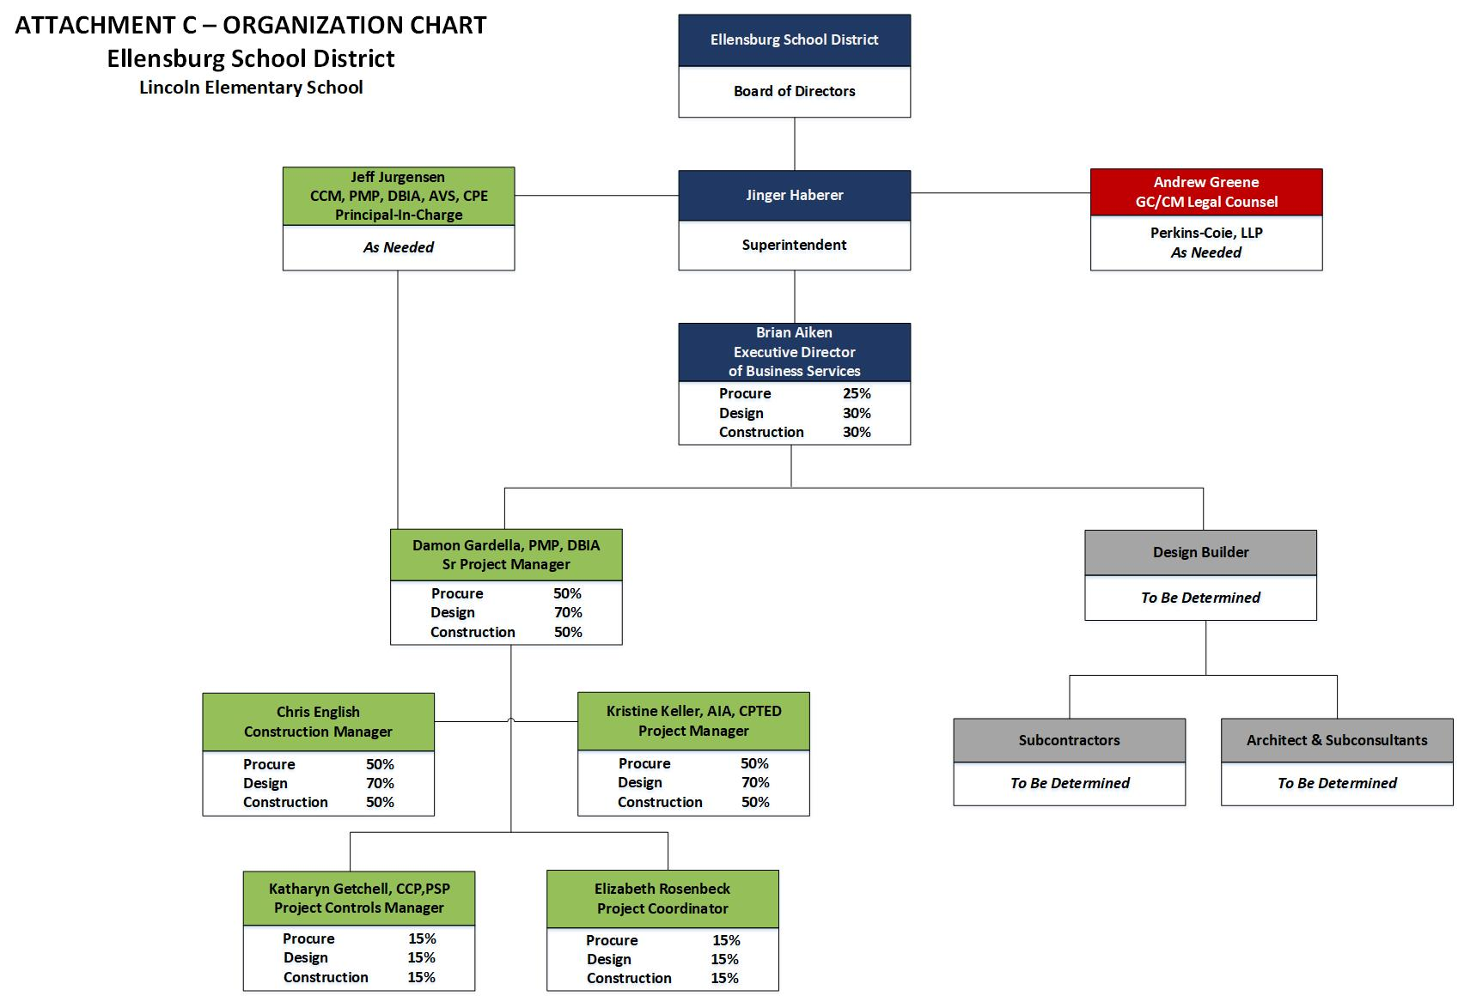
PROJECT TEAM
Notes:
Brian: Clear mgmt. plan and lines of communication
District is the decision maker; OAC and Integrus manage/facilities the process
Note Andrew Green from Perkins Coie;
Note % of effort on each phase of the projects

Slide 4
ELLENSBURG SD OVERVIEW
Located in Central WA, CWU, Ag, Natural Resources and Energy (wind farms and solar)
Enrollment 3,200 students
Strong Board and Community support for education
475 Students
Notes:
Brian; BRIEF synopsis of the Eburg Community and school district

Slide 5
PROJECT OVERVIEW
$59.5M Capital Improvement Bond Passed Nov, 2018
$16.7M in State Funding Assistance
The Program
  New Elementary School (Underway)
  New Mt Stuart Elementary School (Underway)
  Lincoln ES modernize and new addition
Notes:
Brian: Successful Bond passage and HIGHLIGHTED TWO SCHOOLS in ONE project.
Talk in detail about Lincoln, historical, site constraints, etc.
Segue to Damon next slide

Slide 6
WHY PDB– RCW 39.10.300
The construction activities are highly specialized and a DB approach is critical in developing the construction methodology.
Provide opportunity for greater innovation or efficiencies between the designer and the builder.
Significant savings in project delivery time will be realized.
Notes:
Damon SLIDE

Slide 7
PROJECT OVERVIEW
$700M +/- construction forecast in Eastern and Central WA (2020-2022)
Marketing outreach to Design Builders
ESD bond proposal based on modernization and addition to Lincoln Elementary
Program/Project Criteria for PDB
  Defined Scope of Work with Specialized construction activities
  Market conditions – GC and Subcontractor availability
  Mitigate fiscal/construction escalation risk
Notes:
Damon Slide

Slide 8
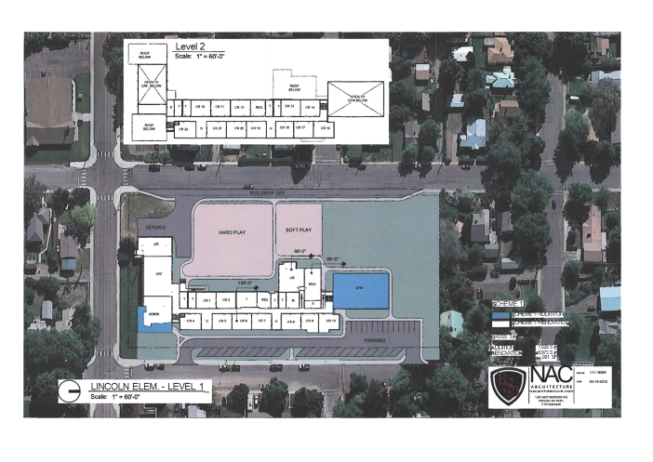
PROJECT OVERVIEW
Attachment E – Lincoln Elementary Schematic
Scope of Work
Gym addition
Relocate cafeteria, kitchen and library
Install elevator
ADA Compliant
WSEC Compliant
New MEP and Systems including fire suppression
Playground/Landscaping/Parking
More
Notes:
Damon:
Site, stakeholders, challenges, WHY PDB is critical
SEGUE TO Damon IN BUDGET

Slide 9
PROJECT BUDGET
Notes:
9
Damon MACC/GMP and contingencies

Slide 10
PDB PROCUREMENT, DESIGN, AND CONSTRUCTION SCHEDULE
Description | Duration | Start | Finish
PRC Meeting/Approval Letter | 1 day | 1/23/2020 | 1/24/2020
Draft RFQ/Ad/Outreach/Q&A | 4 weeks | 1/27/2020 | 2/21/2020
PDB RFP Process | 4 weeks | 2/24/2020 | 3/20/2020
PDB Interviews | 3 weeks | 3/23/2020 | 4/10/2020
Design Builder Selection | 1 day | 4/10/2020 | 4/10/2020
PDB Contracting | 2 months | 4/13/2020 | 6/13/2020
Early Site Package Design | 6 months | 7/01/2020 | 1/01/2021
Early Site Package Construct | 5 months | 1/01/2021 | 6/01/2021
Ongoing PDB Design/Permitting | 6 months | 1/01/2021 | 6/01/2021
Final Design | 1 day | 6/01/2021 | 6/01/2021
Negotiate GMP | 2 weeks | 6/01/2021 | 6/15/2021
PDB Construct | 11 months | 6/01/2021 | 7/01/2022
Project Completion/Punch/Move -in | 2 months | 7/01/2022 | 9/01/2022
Closeout | 2 months | 9/01/2022 | 10/31/2022
Notes:
Damon – Where we are in the process and then on board w/ PRECON SVCS
SEGUE TO STEVEN ON SCHEDULE

Slide 11
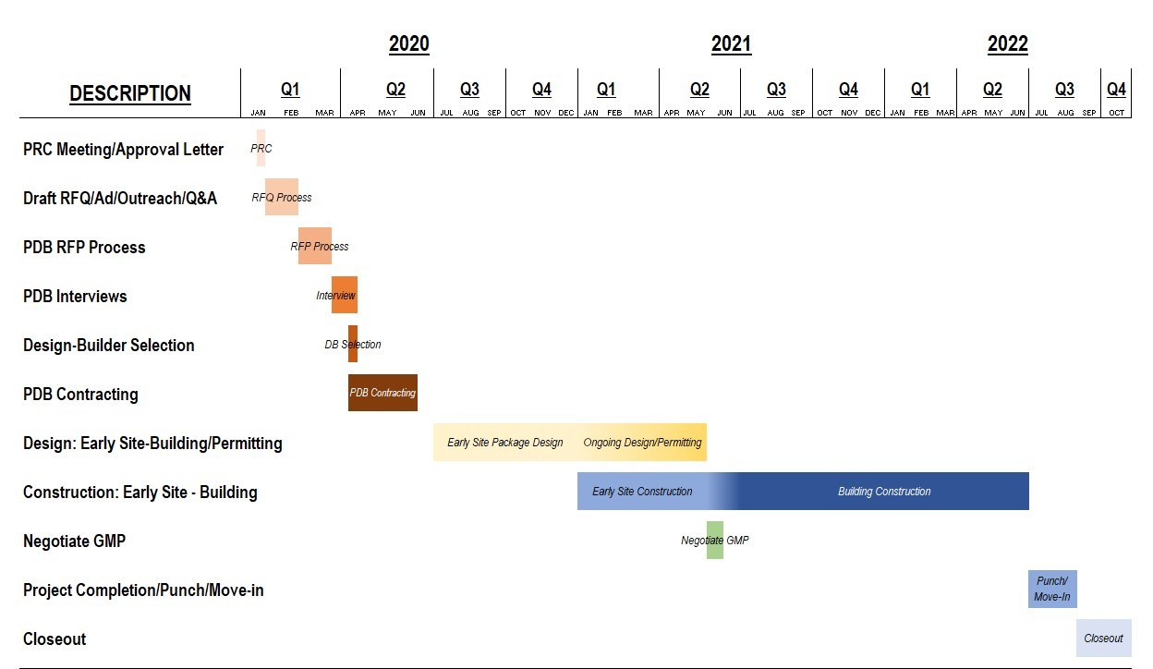
DESIGN & CONSTRUCTION SCHEDULE
Notes:
Damon
SEGUE TO BRIAN

Slide 12
OWNER SUMMARY
Substantial fiscal benefit to the public
Meets qualifying criteria under RCW 39.10.300
Public body has necessary experience or team
  Project knowledge and experience
  Sufficient contract admin staff & experience
  Clear management plan & logical lines of authority
  Necessary/appropriate funding & time
  Continuity of PM team with PDB experience
  Zero audit findings
Notes:
BRIAN ; Short and sweet; hit all points, qualified team, right budget, right experience

Slide 13
ALTERNATIVE DELIVERY LESSONS LEARNED
Increased frequency of Design and Executive Leadership meetings.
Better understanding of local jurisdictional requirements early.
Model open and transparent communications
Improve issues identification and resolution responsibilities before become larger problems

Slide 14
QUESTIONS
&
ANSWERS
Notes:
Rusty: Fields Q&A time.

