Slide 1




Wy’east
Middle School
GC/CM PROJECT APPLICATION TO THE PRC
EVERGREEN SCHOOL DISTRICT
MARCH 28, 2019

Slide 2

AGENDA
Introductions of Project Team
Project Background
Traditional Delivery Method Not Practical
Meets Qualifying Criteria – RCW 39.10
  Qualifying Project
  Management Plan
    Project Team
    Schedule
    Budget
    Funding
  Public Benefits
Summary

Slide 3
PROJECT TEAM
Sue Steinbrenner, Evergreen School District
  Executive Director of Facilities
  33 years experience
  GC/CM experience – Evergreen HS
Rick Yeo, R&C Management
  45 years experience
  GC/CM Experience - Evergreen HS, Jemtegaard K-8, Ridgefield 5-8 School, Ridgefield HS Addition
  AGC GC/CM workshop certified
Dan Bodell, R&C Management
  30 years experience
  GC/CM Experience – WSU Vancouver, Sifton Elementary School
Ali Abbaszadegan, R&C Management
  10 years experience
  $70+ million of alternative project delivery experience on 6 projects

Slide 4
PROJECT TEAM
Howard Hillinger, Parametrix
  32+ years PM-CM experience, CCM
  GC/CM experience – 10+ projects
  Member: PRC, GC/CM Heavy Civil Task Force
David Mount, Mahlum Architects
  24+ years experience
  $391 million of alternative project delivery experience on 10 projects in Washington and Oregon
LeRoy Landers, Mahlum Architects
  30+ years experience
  $300 million of alternative project delivery experience on 8 projects in Washington and Oregon
Graehm Wallace, Perkins Coie LLP
  Legal counsel
  Extensive GC/CM experience

Slide 5
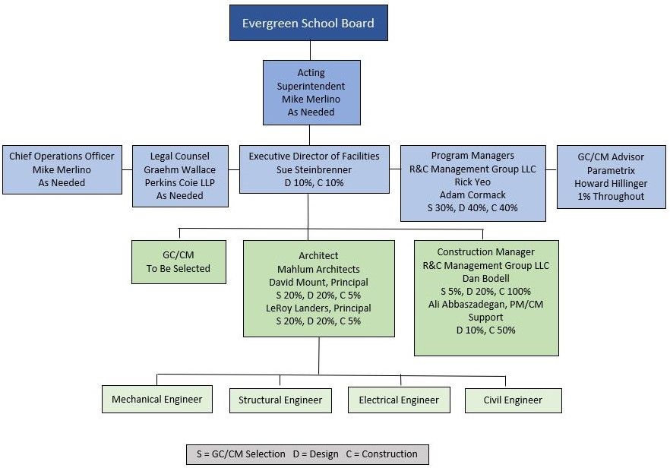
PROJECT TEAM

Slide 6
PROJECT BACKGROUND
Wy’east Middle School
118,000 square foot structure plus 22 portable classrooms.
Current Enrollment: Approx. 900 students, plus faculty and staff.
Existing site has a multi-building campus, 3 parking lots, 4 sports fields, and a track.
The replacement school will be 103,000 square feet of new construction and 37,000 square feet of renovation with a portion constructed as two or three stories.
The design will consolidate the multiple buildings into a single structure for improved safety, functionality, and reserved site area for future growth.
Construction will disrupt and cause relocation of programs.

Slide 7
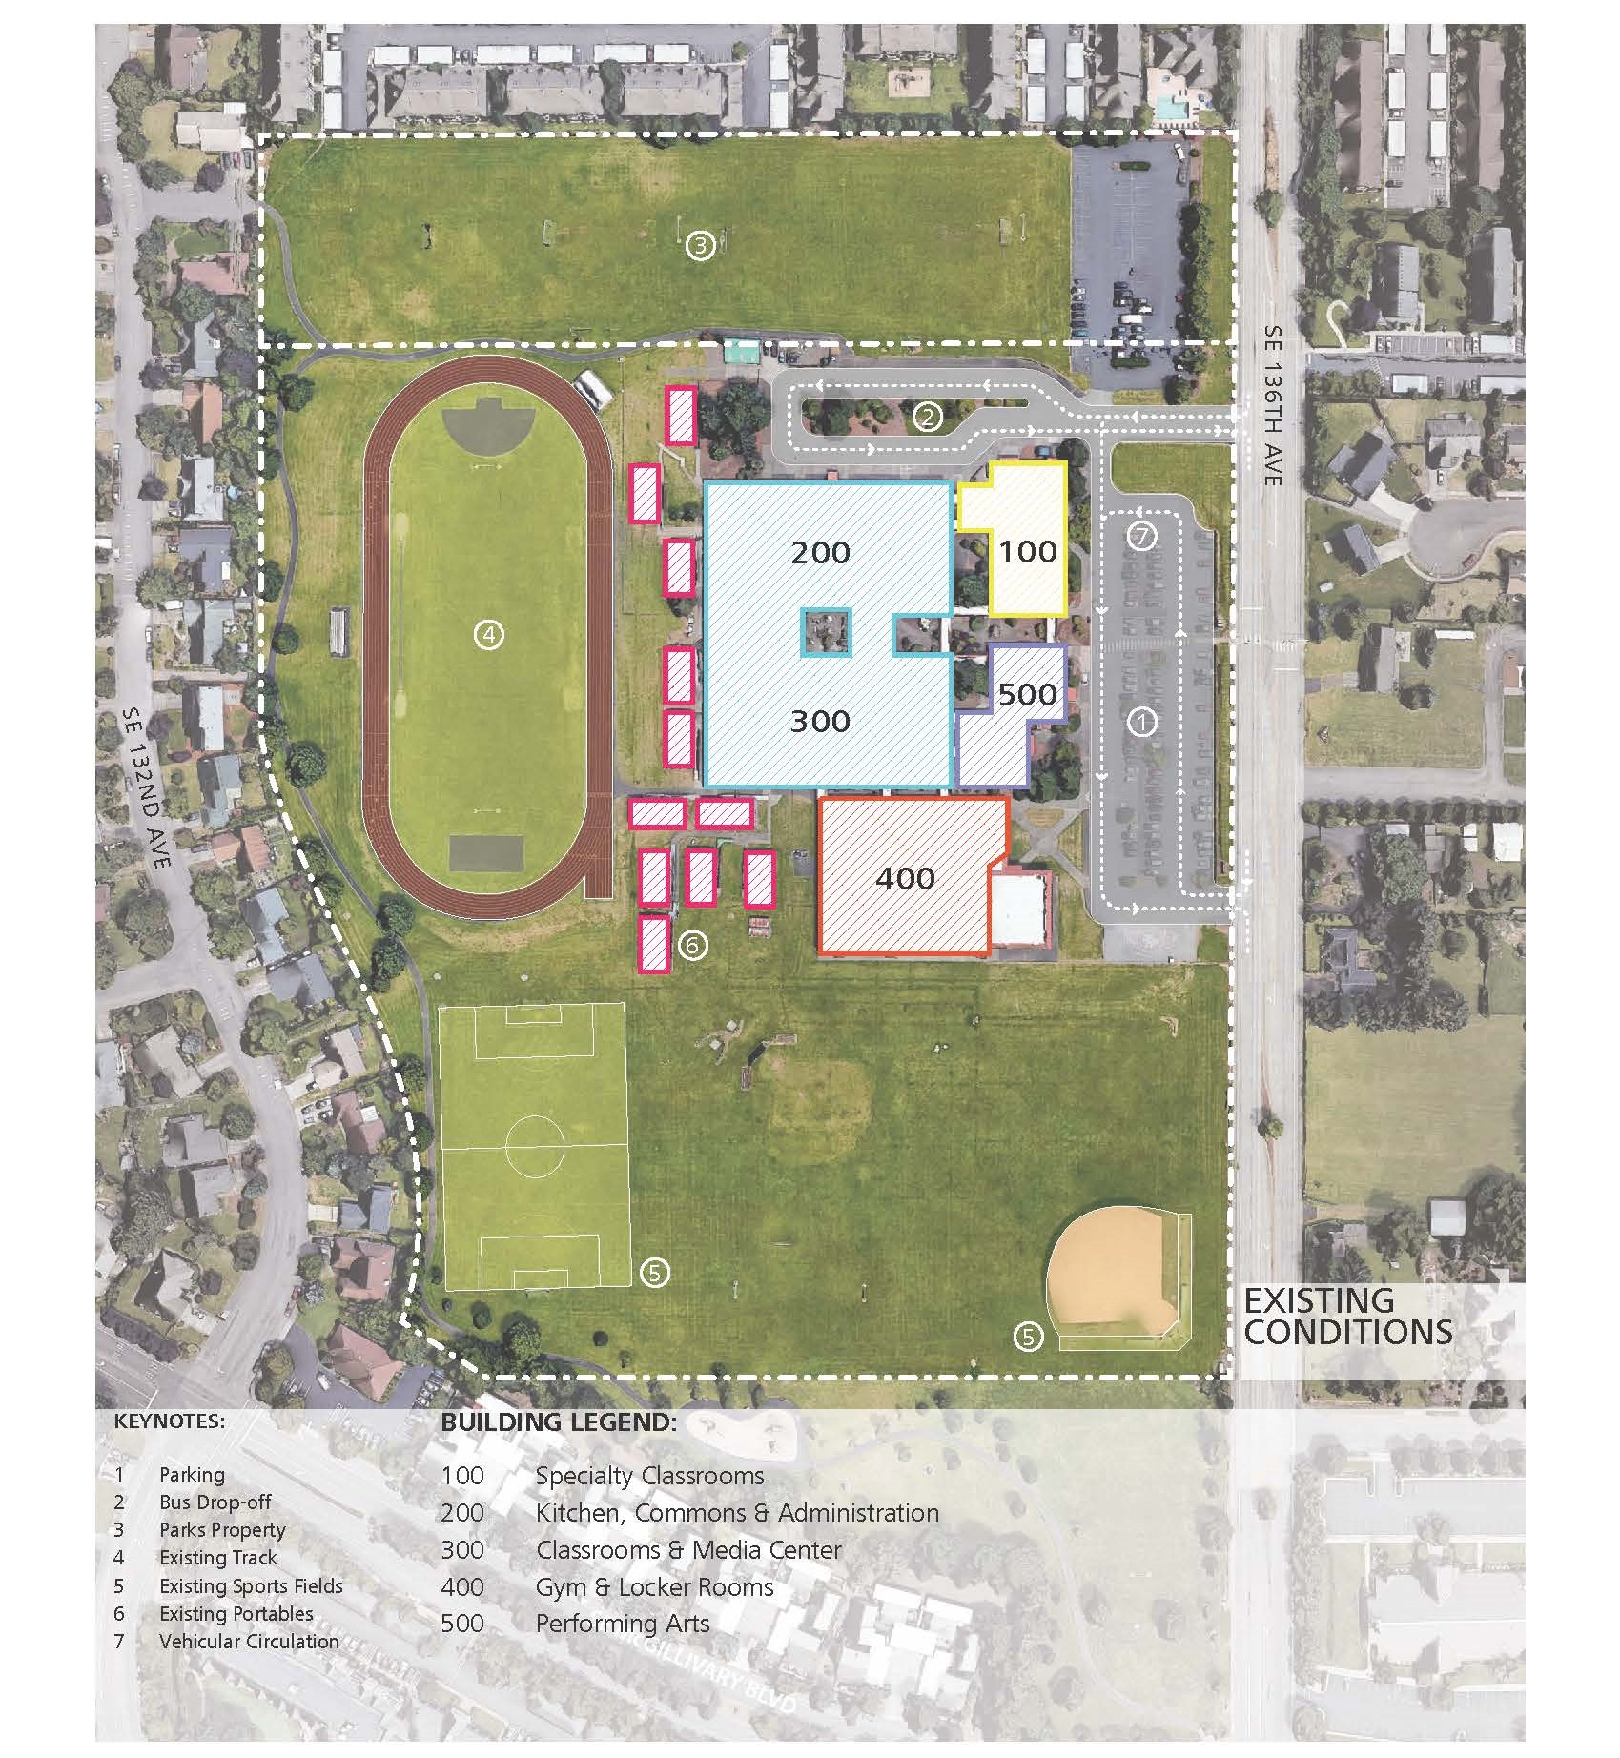
PROJECT BACKGROUND
Existing Site

Slide 8
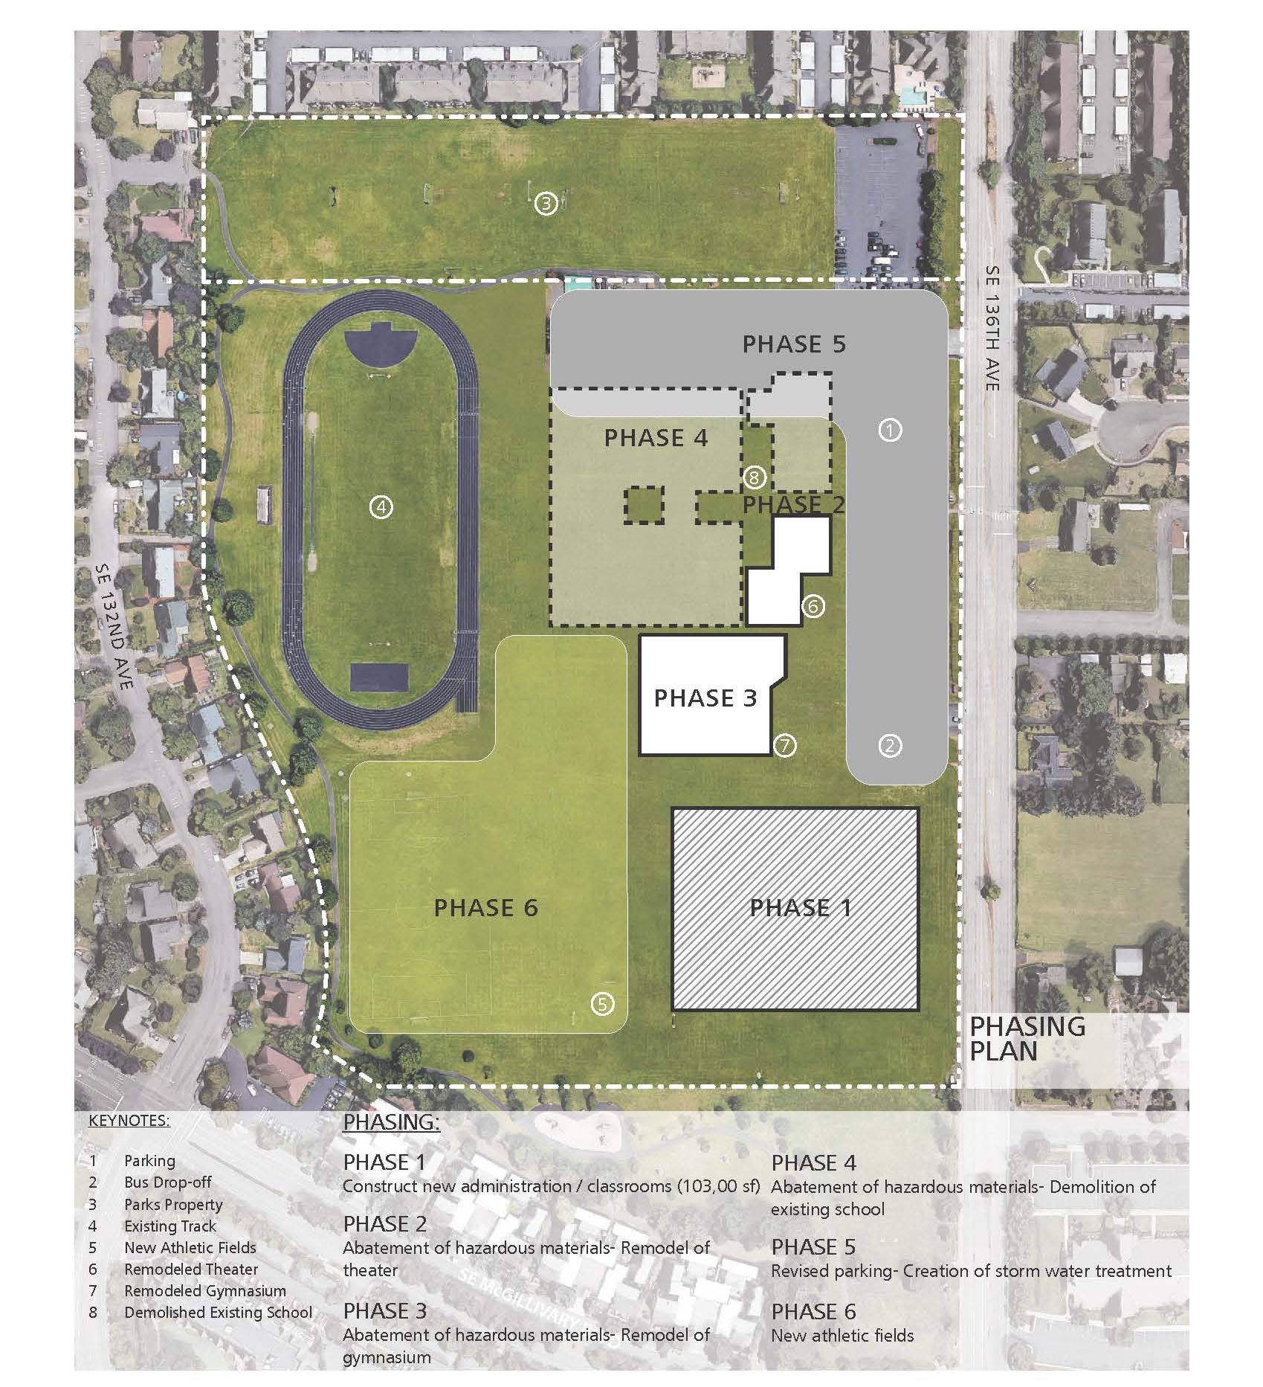
PROJECT BACKGROUND
Proposed Replacement

Slide 9
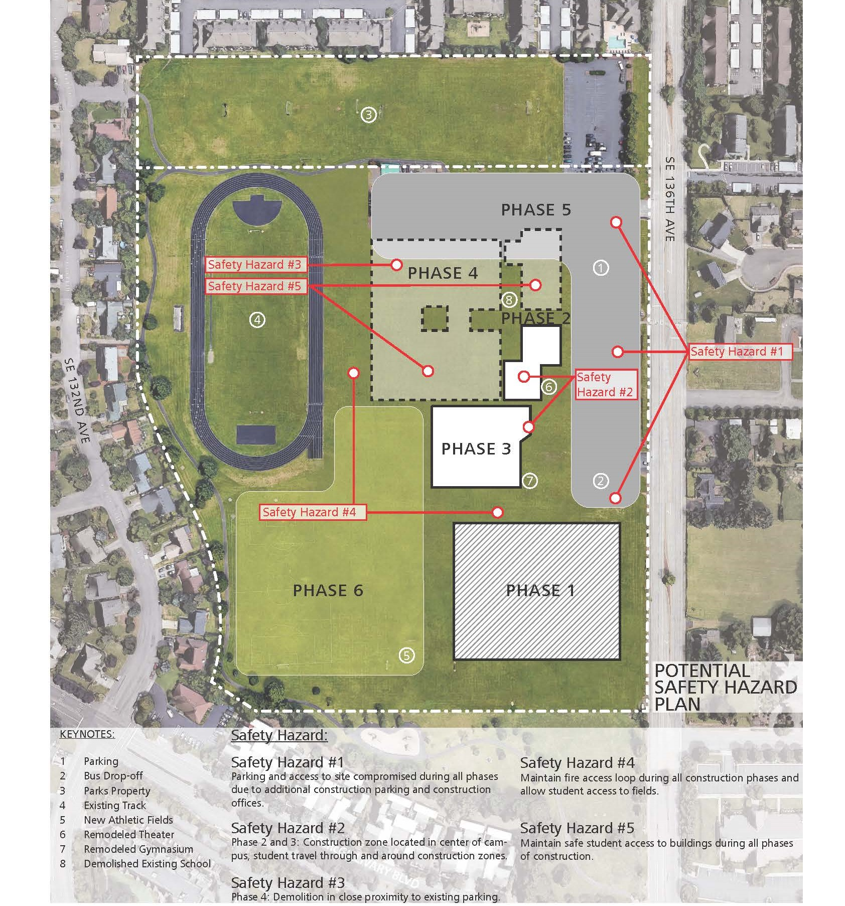
PROJECT BACKGROUND
Complexities

Slide 10
QUALIFYING GC/CM PROJECT
This Project MEETS 4 of the 5 Criteria
Implementation of the project involves complex scheduling, phasing, or coordination.
The project involves construction at an existing facility that must continue to operate during construction, with educational programs required to be relocated.
Involvement of the GC/CM is critical during the design phase.
The project encompasses a complex or technical work environment.
Not met – The project requires specialized work on a building that has historical significance.

Slide 11
QUALIFYING GC/CM PROJECT
Complex Scheduling / Phasing
Ph. 1 – New Construction
Ph. 2 – Abatement & Remodel of Theater
Ph. 3 – Abatement & Remodel of Gymnasium
Ph. 4 – Abatement & Demolition of Existing
Ph. 5 – Parking
Ph. 6 – New Athletic Fields

Slide 12
QUALIFYING GC/CM PROJECT
Occupied Site
Haz. 1 – Parking Reductions
Haz. 2 – Student Re-Route from Campus Center
Haz. 3 – Central Construction Zone
Haz. 4 – Fire Loop Access & Access to Fields
Haz. 5 – Path Proximity to Construction

Slide 13
QUALIFYING GC/CM PROJECT
Must Continue to Operate
Where Will They Go?
Displaced Programs During Construction
Phase | Displaced Program
1 | 25% of parking, baseball
2 | Theater, preforming arts
3 | Gym classes, athletics
4 | Remodeling parking
5 | Final parking completed
6 | Final athletic fields established
Student Pathways
3 Phases of Move In
Contractor Access, Staging, & Parking
Alternative Location Analysis - KEY
  Safety
  Costs
  Milestones
  Trade Offs

Slide 14
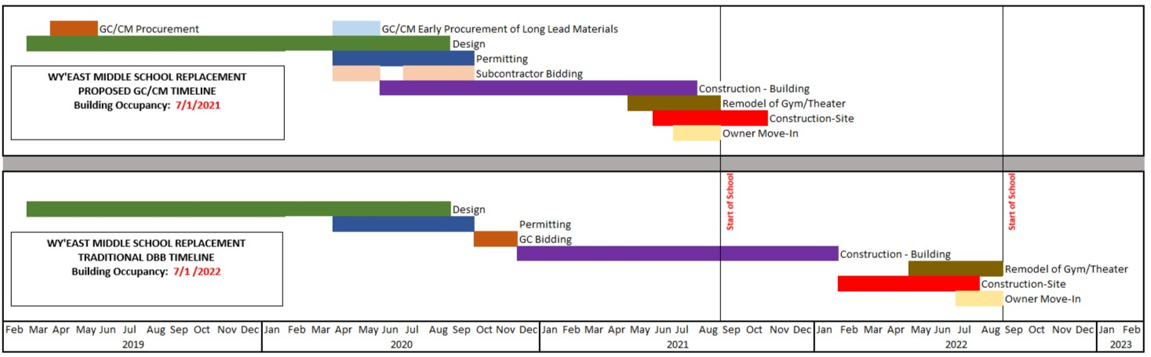
QUALIFYING GC/CM PROJECT
Early Design Involvement
Building Placement
Building Configuration
Construction Type
Estimating / VE / Alternative Strategies
Early Procurement
Phased Turn Over

Slide 15
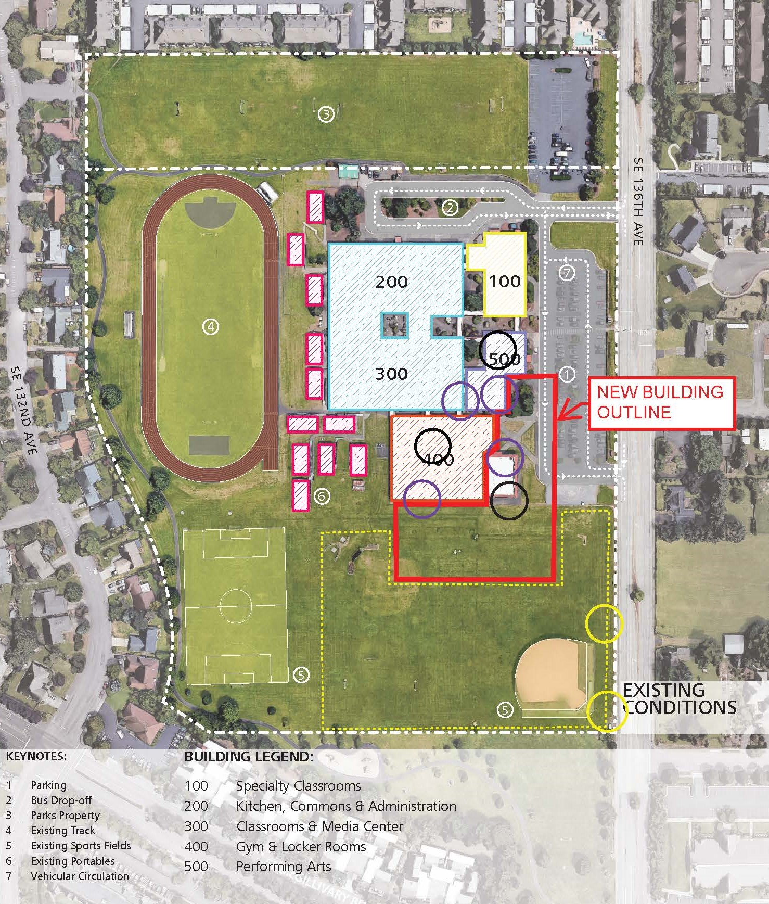
QUALIFYING GC/CM PROJECT
Complex Work Environment
Student Pathways
3 Phases of Move In
Contractor Access, Staging, & Parking
Alternative Location Analysis - KEY
  Safety
  Costs
  Milestones
  Trade Offs

Slide 16
MANAGEMENT PLAN
Project Team
Experience
  8 members with GC/CM experience
  Prior shared projects as a TEAM
  AGC GC/CM workshop certified
Controls
  Roles and responsibilities matrices
  Limits of authority
  Milestones for design and construction
Procurement
  Perkins Coie and Parametrix guidance
  Early marketing
  Formal selection with RFP, RFFP, General Conditions & Agreement

Slide 17
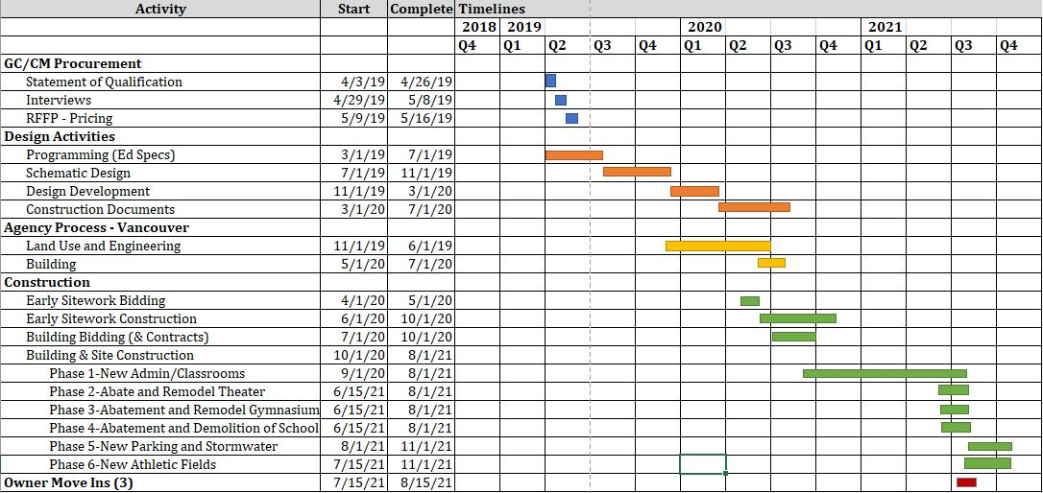
MANAGEMENT PLAN
Project Schedule

Slide 18
MANAGEMENT PLAN
Project Budget
Funding
The project budget is fully funded. Funding has been secured through the passage of the $695,000,000 capital improvement bond on February 13, 2018, estimated state School Construction Assistance Program funds of $30,000,000, and a portion of already collected local impact fees.
DESCRIPTIONS | BUDGETS
Costs for Professional Services | $7,200,855
Est. Project Construction Costs | $56,372,684
Equipment and Furnishing Costs | $3,026,988
Contract Administration Costs | $1,240,000
Contingency - GC/CM (5.5%) | $3,100,498
Contingency – Owner (5.8%) | $3,271,024
Other Related Project Costs | $550,000
Sales Tax | $5,250,014
TOTAL | $80,012,063

Slide 19
PUBLIC BENEFITS
Reduced costs
  Early start minimizes overtime and inflation exposure and maximizes efficiency
Reduced risks
  Early work release maximizes weather windows ensuring on time completion
  Higher likelihood of receiving GCCM qualification statements than traditional bids for this size project
Minimizing unforeseen conditions
  Early investigation builds a complete understanding of conflicts between existing & proposed conditions including phasing of site utilities and systems.
Public safety
  Safety protocols vetted during design ensure cost-effective implementation without shortcuts.
Reduces site complexity
  Milestones, cost, pedestrian routes, and mobilization planning analyzed in alternative schemes

Slide 20
PROJECT SUMMARY
Traditional delivery method is not practical
Meets four qualifying criteria
  Complex schedule
  Occupied site
  Involvement of the GC/CM during design is critical
  Complex work environment
GC/CM will be under contract early in Schematic Design phase
Public body is qualified
  Experienced with RCW 39.10
  Experienced personnel
  Clear and logical management plan
  Necessary funding including contingencies
  Detailed project schedule
Public benefits
  Safety
  Risk management
  Time
  Cost

Slide 21
Questions?
Wy’east
Middle School
GC/CM PROJECT APPLICATION TO THE PRC
EVERGREEN SCHOOL DISTRICT
MARCH 28, 2019

