Slide 1




Mt. View
High School
GC/CM PROJECT APPLICATION TO THE PRC
EVERGREEN SCHOOL DISTRICT
NOVEMBER 29, 2018

Slide 2
AGENDA
Introductions of Project Team
Project Background
Meets Applicable Criteria
  Qualifying Project
  Management Plan
    Project Team
    Schedule
    Budget
    Funding
  Public Benefits
Summary

Slide 3
PROJECT TEAM
Sue Steinbrenner, Evergreen School District
  Executive Director of Facilities
  33 years experience
  GC/CM experience – Evergreen HS
Rick Yeo, R&C Management
  45 years experience
  GC/CM Experience - Evergreen HS, Jemtegaard K-8, Ridgefield 5-8 School, Ridgefield HS Addition
  AGC GC/CM workshop certified
Adam Cormack, R&C Management
  14+ years experience
  GC/CM experience – Jemtegaard K-8, Ridgefield 5-8 School, Ridgefield HS Addition
  AGC GC/CM workshop certified
Scott Rose, R&C Management
  30 years experience
  GC/CM Experience – Tahoma HS, Ridgefield 5-8 School, Ridgefield High School

Slide 4
PROJECT TEAM
Howard Hillinger, Parametrix
  32+ years PM-CM experience, CCM
  GC/CM experience – 10+ projects
  Member: PRC, GC/CM Heavy Civil Task Force
Casey Wyckoff, LSW Architects, PC
  20+ years experience
  GC/CM experience – South Ridge HS, Union Ridge HS, Evergreen HS, Stoller MS
Kurtis Zenner, LSW Architects, PC
  31 years experience
  GC/CM experience – Community Duncan Dunn Residence Hall, WSU Pullman, Cleveland HS, Seattle
Graehm Wallace, Perkins Coie LLP
  Legal counsel
  Extensive GC/CM experience

Slide 5
PROJECT TEAM

Slide 6
PROJECT BACKGROUND
Mt View High School
236,947 square foot structure plus 6 portable classrooms bringing total area to 247,747 square feet.
Current Enrollment: Approx. 2,000 students.
Existing site has a multi-building campus, three parking lots, 5 sports fields, and track.
The replacement school will be 250,000 square feet with a portion constructed as two or three stories.
The design will consolidate the multiple buildings into a single structure for improved safety, functionality, and built-in site area for future growth.

Slide 7
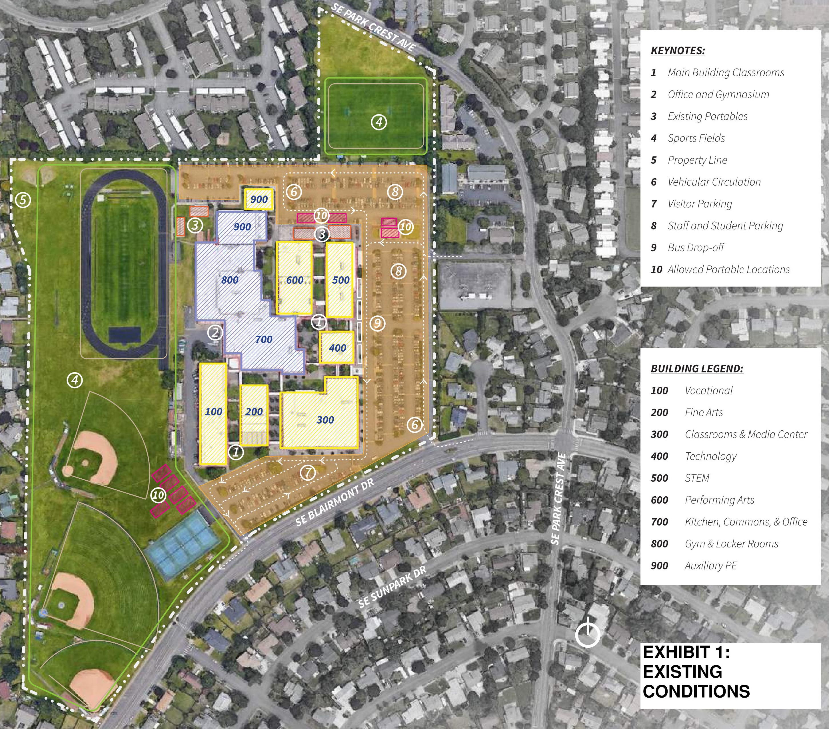
PROJECT BACKGROUND
Existing Site

Slide 8
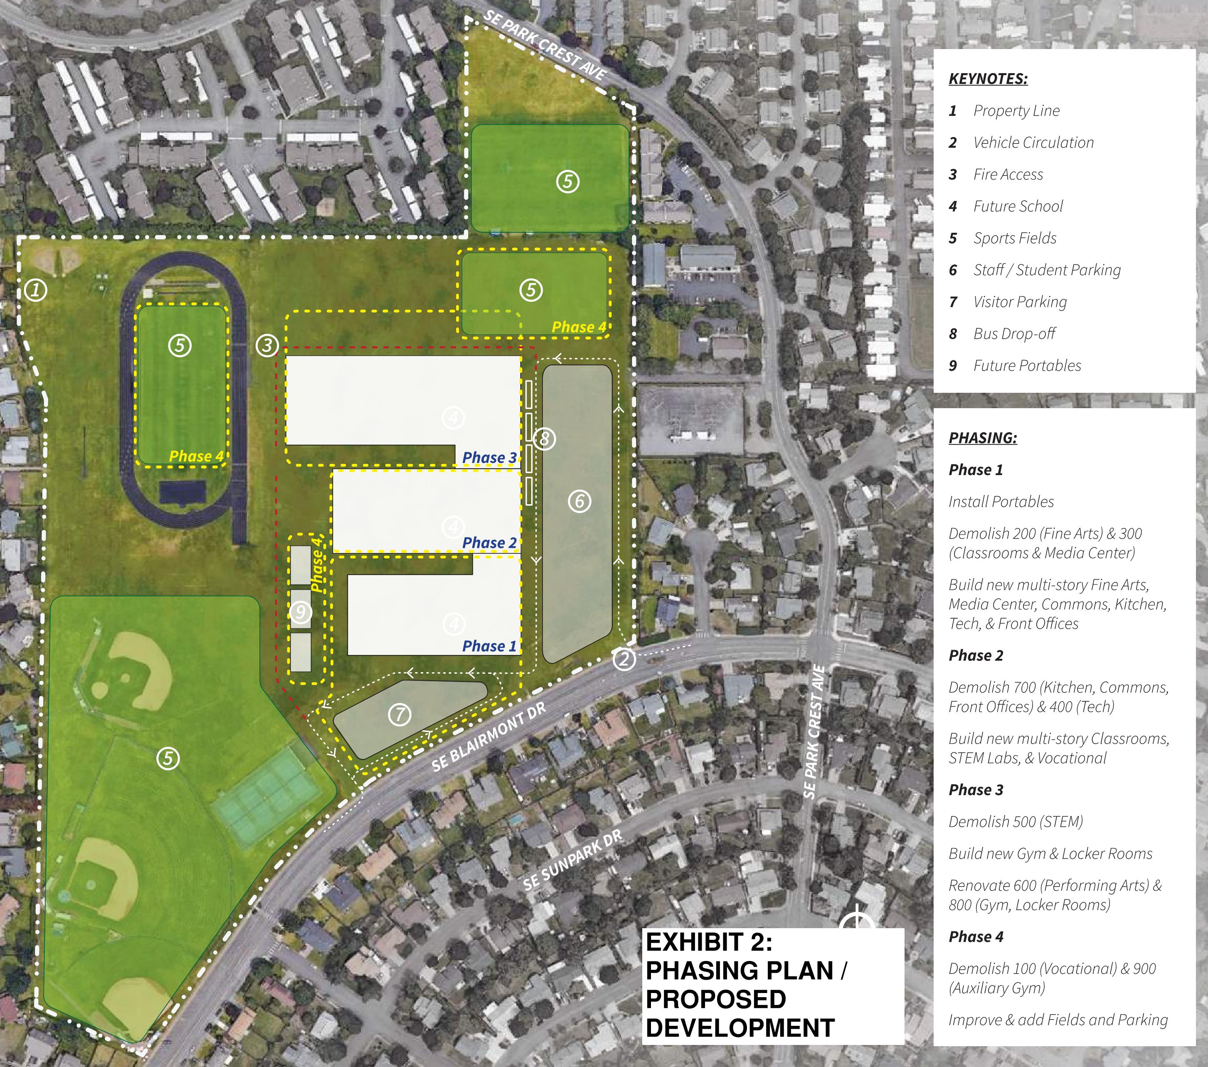
PROJECT BACKGROUND
Proposed Replacement

Slide 9
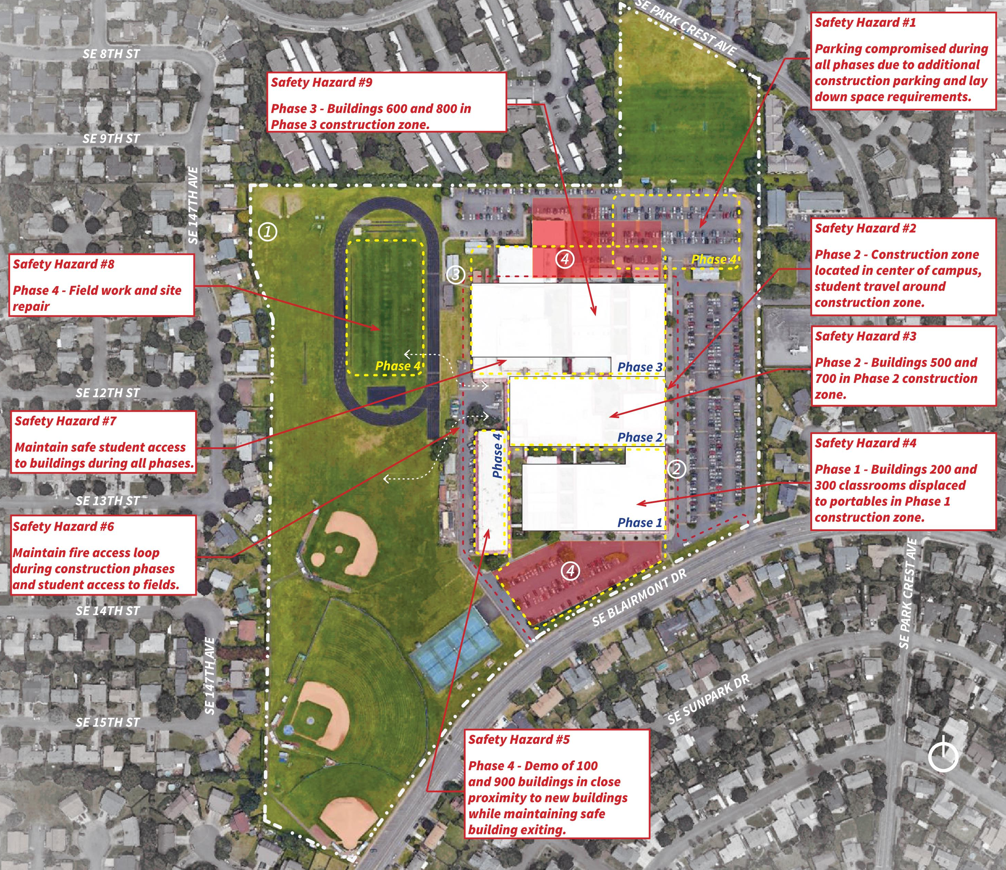
PROJECT BACKGROUND
Complexities

Slide 10
QUALIFYING GC/CM PROJECT
This Project MEETS 4 of the 5 Criteria
Implementation of the project involves complex scheduling, phasing, or coordination.
The project involves construction at an existing facility that must continue to operate during construction.
Involvement of the GC/CM is critical during the design phase.
The project encompasses a complex or technical work environment.
Not met – The project requires specialized work on a building that has historical significance.

Slide 11
QUALIFYING GC/CM PROJECT
Complex Scheduling / Phasing
Ph. 1 – Portables, Demolition & Construction
Ph. 2 – Move-In, Demolition, & Construction
Ph. 3 – Move-In, Demolition, Construction & Renovation
Ph. 4 – Move-In, Demolition, Site Restoration

Slide 12
QUALIFYING GC/CM PROJECT
Occupied Site
Haz. 1 – Parking Reductions
Haz. 2 – Student Re-Route from Campus Center
Haz. 3 – Central Construction Zone
Haz. 4 – Displacement to Portables
Haz. 5 – Path Proximity to Construction
Haz. 6 – Sustaining Life Safety Systems
Haz. 7 – Multiple Student Re-Routes at Each Phase
Haz. 8 – Field Down Time / Shuttling
Haz. 9 – Final Phase While Occupied

Slide 13
QUALIFYING GC/CM PROJECT
Early Design Involvement
Building Placement
Building Configuration
Construction Type
Estimating / VE / Alternative Strategies
Early Procurement
Phased Turn Over

Slide 14
QUALIFYING GC/CM PROJECT
Complex Work Environment
NEW BUILDING OUTLINE
Student Pathways
3 Phases of Move In
Contractor Access, Staging, & Parking
Alternative Location Analysis - KEY
  Safety
  Costs
  Milestones
  Trade Offs
ALTERNATIVE BUILDING LOCATION

Slide 15
MANAGEMENT PLAN
Project Team
Experience
  8 members with GC/CM experience
  Prior shared projects as a TEAM
  AGC GC/CM workshop certified
Controls
  Roles and responsibilities matrices
  Limits of authority
  Phasing
Procurement
  Perkins Coie and Parametrix guidance
  Early marketing
  Formal selection with RFP, RFFP, General Conditions & Agreement

Slide 16
MANAGEMENT PLAN
Project Schedule
*Work Plan to be cost analyzed by GC/CM against alternative placement on site to minimize phasing

Slide 17
MANAGEMENT PLAN
Project Budget
Funding
The project budget is fully funded. Funding has been secured through the passage of the $695,000,000 capital improvement bond on February 13, 2018, estimated state School Construction Assistance Program funds of $30,000,000, and a portion of already collected local impact fees.
DESCRIPTIONS | BUDGETS
Costs for Professional Services | $ 16,826,883
Est. Project Construction Costs – Bldg. | $ 135,803,638
Est. Project Construction Costs – Site | $ 18,626,261
Equipment and Furnishing Costs | $ 8,109,353
Contract Administration Costs | $ 3,300,000
Contingency - GC/CM (5.5%) | $ 8,493,644
Contingency – Owner (5.8%) | $ 8,960,795
Other Related Project Costs | $ 1,600,000
Sales Tax | $ 13,685,577
TOTAL | $ 215,406,151

Slide 18
PUBLIC BENEFITS
Reduced costs
  Early start minimizes overtime and inflation exposure and maximizes efficiency
Reduced risks
  Early work release maximizes weather windows ensuring on time completion
  Higher likelihood of receiving GCCM qualification statements than traditional bids for this size project
Minimizing unforeseen conditions
  Early investigation builds a complete understanding of conflicts between existing & proposed conditions including phasing of site utilities and systems.
Public safety
  Safety protocols vetted during design ensure cost-effective implementation without shortcuts.
Site complexity
  Milestones, cost, pedestrian routes, and mobilization planning analyzed in alternative schemes

Slide 19
PROJECT SUMMARY
Meets four qualifying criteria
  Complex schedule
  Occupied site
  Involvement of the GC/CM during design is critical
  Complex work environment
GC/CM will be under contract early in Schematic Design phase
Public body is qualified
  Experienced personnel
  Clear and logical management plan
  Necessary funding including contingencies
Public benefits
  Safety
  Risk management
  Time
  Cost

Slide 20
Questions?
Mt. View
High School
GC/CM PROJECT APPLICATION TO THE PRC
EVERGREEN SCHOOL DISTRICT
NOVEMBER 29, 2018

