Slide 1
FWPS Phase II CP18 Mirror Lake, Lake Grove, & Wildwood Elementary Schools GC/CM Presentation
May 24, 2018
Notes:
0

Slide 2
Agenda Mirror Lake, Lake Grove, & Wildwood Elementary Schools
Introduction
Team Qualifications
District Capital Program
Project Details
Why GC/CM?
Questions & Answers
Notes:
30 Sally
Thank you for the opportunity to present our project for consideration of approval for GCCM alternative delivery method, my name is Sally McClean, I am the Chief Financial Officer for FWPS
In our presentation today we explain why we believe our project is a good fit for this delivery method due to:
- our team qualifications
- the tight schedule and required phasing associated with existing, occupied sites
- the need for Contractor engagement in the Design Process
- the technical complexity of the projects
To that end our presentation today will inform you about
-Our Team Qualifications
-The District Capital Program
-Project details
...and then summarize with why we believe this project is a good fit for the GCCM process

Slide 3
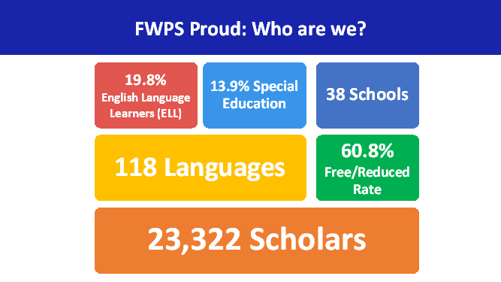
Agenda District Demographics
Notes:
15 Sally

Slide 4
Team Qualifications Project Team Structure
Owner:
Federal Way Public Schools
(FWPS)
Capital Project Team:
CBRE | Heery
A/E Firm:
Integrus Architecture
Notes:
10 Sally
So I would like to begin by introducing you to the Teams that will facilitate the project, which are grouped in to
-our Owners Team
-our Project Management Team
-and our Architectural team

Slide 5
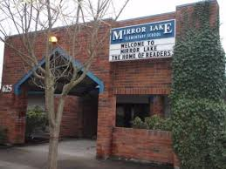
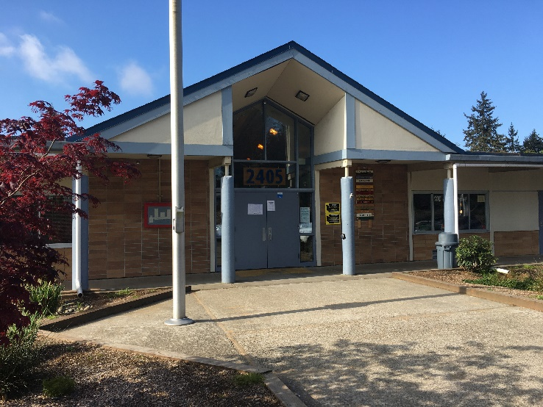
Team Qualifications (Owner)
FWPS
Sally McLean: Chief Finance and Operation Officer – 30 Years Experience, 17 Years with FWPS
Mike Benzien, Executive Director of Maintenance and Operations – 30 Years Experience
Casey Moore, Capital Projects Manager – 30 Years Experience
Notes:
30 Sally ...as I mentioned previously I am Sally McClean, CFO, ...history and experience ...intro to Mike
30 Mike ...history experience ...intro to Casey
30 Casey ...history and experience

Slide 6
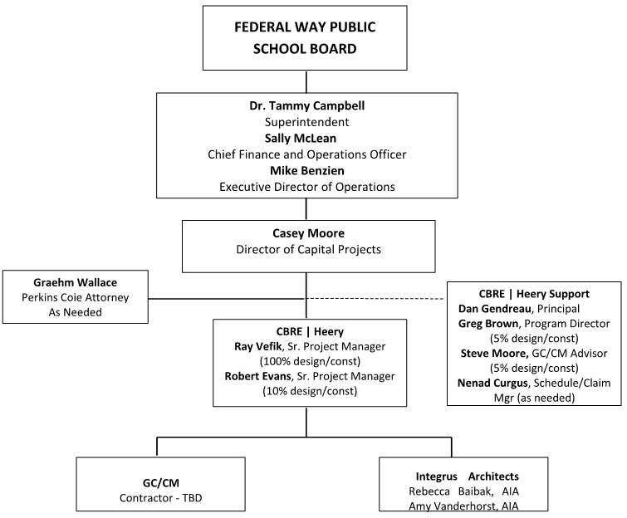
Team Qualifications Project Team Structure
Notes:
15 -Casey
Alignment to support execution of the District's strategic goals as established by Dr Campbell
My involvement 100% in deliver of Capital Program
Partners aligned to supporting execution
-Perkins Coie for Legal Guidance
-CBRE Heery for direct project management and program guidance
-Integrus as Architect
Introduction to Dan Gendreau

Slide 7
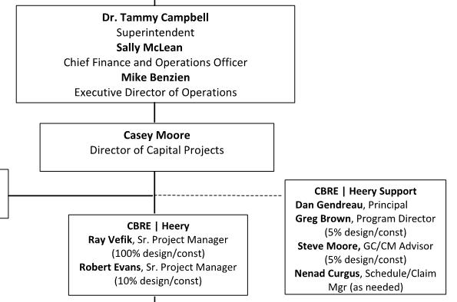
Team Qualifications Project Team Structure
Notes:
30 -Dan

Slide 8
Team Qualifications (PM Team)
Ray Vefik, RA, AIA, NCARB – Senior Project Manager, CBRE|Heery
20 years K–12 Program Management (35 years total)
Auburn SD Capital Projects Subcommittee Director, ranging over $456M total projects value
Greg Brown, AIA, LEED AP – Program Manager, CBRE|Heery
30 years K–12 Program Management -over $1B in bond projects to date
Director at Spokane Public Schools for 12 years
Director of 10 successful GC/CM projects
Led application for Spokane Public Schools to obtain Public Body Certification – First school district in State
Robert Evans, PE – Senior Project Manager, CBRE|Heery
30 years Project Management experience, including Seattle Public Schools, Lake WA SD
GC/CM, D/B, D-B-B and multi-prime management experience
Resident of Federal Way
Notes:
90-Dan
Introduce each Team member
Introduce Rebecca

Slide 9
Team Qualifications (A/E Team)
Rebecca Baibak, AIA – Principal, Integrus Architecture
25 years experience including numerous GCCM projects over the past 14 years
Recent K-12 school GC/CM projects: Einstein Middle School (Shoreline SD), Juanita High School (Lake WA SD), Park Place Middle School (Monroe SD), Rush Elementary School (Lake WA SD), and Northshore Jr High (Northshore SD).
Allocation 60% Design/20% Construction
Amy Vanderhorst – Associate Principal, Integrus Architecture
Over 15 years experience in education and civic projects as Principal and Project Manager.
Recent K-12 school GC/CM projects: Ingraham High School (Seattle Public Schools), Rainier Elementary School (Clover Park SD), Meriweather Elementary School (Clover Park SD), and Edmonds SD Support Center.
Allocation 40% Design/50% Construction
Notes:
60 -Rebecca

Slide 10
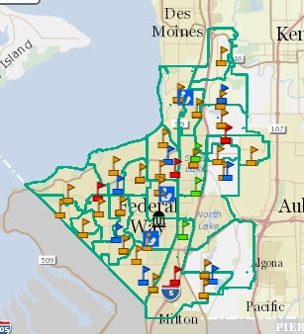
District Capital Program Phase II
Mark Twain ES
Star Lake ES
Memorial Stadium
Totem MS
Lake Grove ES
Thomas Jefferson HS
Olympic View ES
Wildwood ES
Illahee MS
Mirror Lake ES
Notes:
45 -Casey

Slide 11
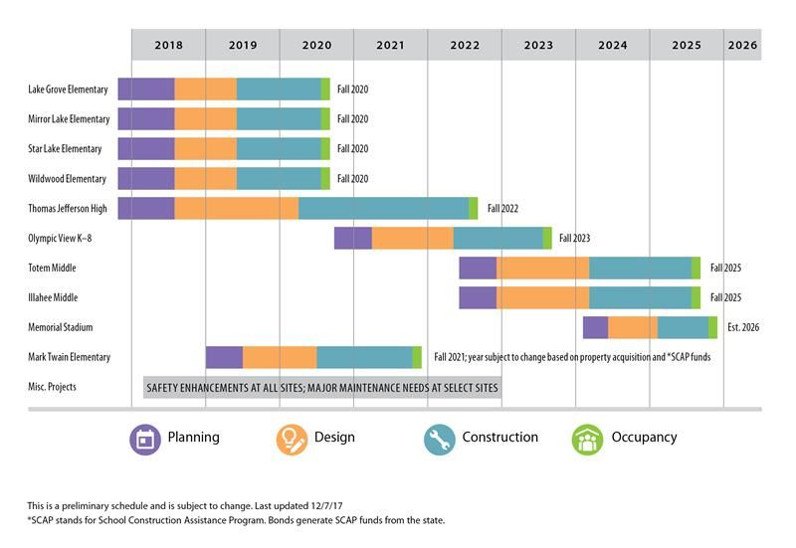
District Capital Program Phase II Schedule – Original
Notes:
30 –Casey
Number of projects
Reason for delivery over 8 years

Slide 12
District Capital Program Phase II Schedule - Revised
Notes:
45 –Casey
Impact of regional escalation particularly of long schedule for delivery of projects
Modified project schedules to deliver earlier, as a result of revised bond sales opportunities
Critically important that first three projects are delivered within scope, schedule, and budget to provide greatest opportunity to deliver subsequent projects
Deliver three elementary schools as a single project, advantages being
- designed by single architect
- designs more similar than different
- consistency in design and specification of major systems
- Ability to bid to single GCCM and engage in design process
- Anticipated savings through economy of scale
-reduced administration

Slide 13
District Capital Program Mirror Lake, Lake Grove, & Wildwood Elementary Schools Budget
Capital Program Budget $ 600.0 million
Elementary School Project Budget (each of 3)
Costs for Professional Services (A/E, Legal etc.) $ 3.0 million
Estimated project construction costs (including construction contingencies): $ 25.5 million
Equipment and furnishing costs $ 1.0 million
Off-site costs $ incl. constr.
Contract administration costs (Owner, CM etc.) $ 1.2 million
Contingencies (design & owner) $ 2.1 million
Other related project costs (permits, curriculum, environmental) $ 1.0 million
Sales Tax $ 2.1 million
Total $ 35.9 million
Projected Total Cost for the Project: $ 107.7 million
Notes:
30 -Casey
Total project value as component of entire bond is over 1/6th, accordingly very important to minimize risk in successful delivery of projects
Let's talk about the details of the project...

Slide 14
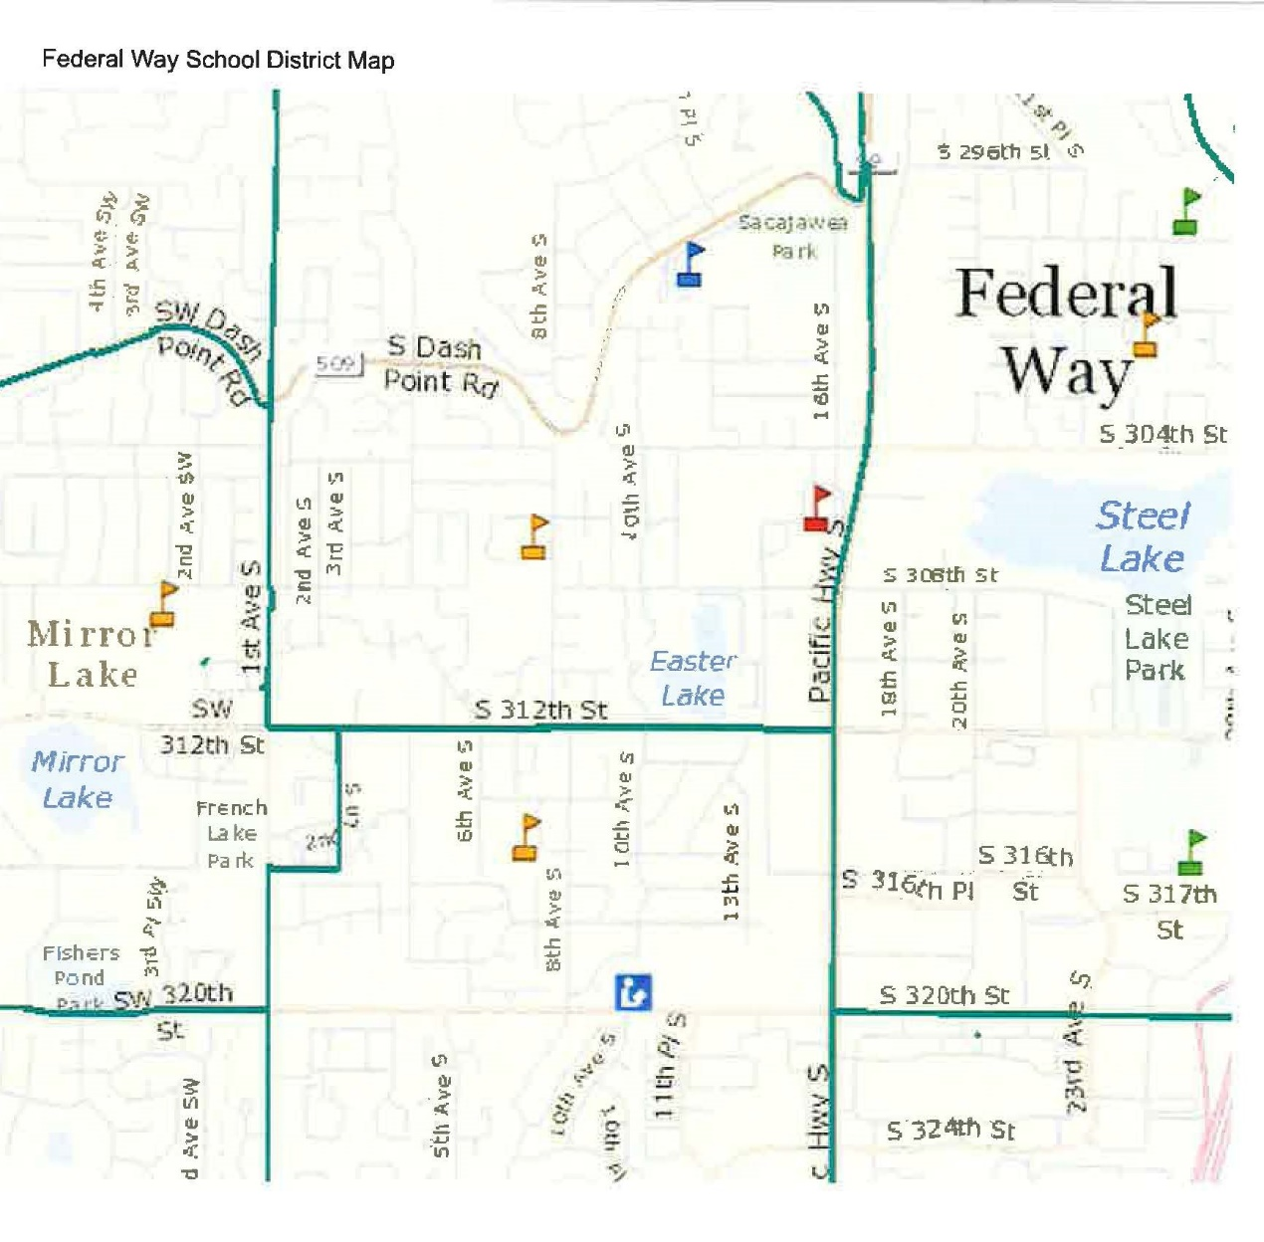
Project Details Mirror Lake, Lake Grove, & Wildwood Elementary Schools
Mirror Lake ES
Wildwood ES
Lake Grove ES
Notes:
30 –Ray
As Casey mentioned in approaching these three schools as a single project, we are looking for efficiencies in opportunity in the delivery of the projects.
A significant consideration was the relative proximity of the schools to each other, which we anticipate will provide opportunities for efficency by the Contractor

Slide 15
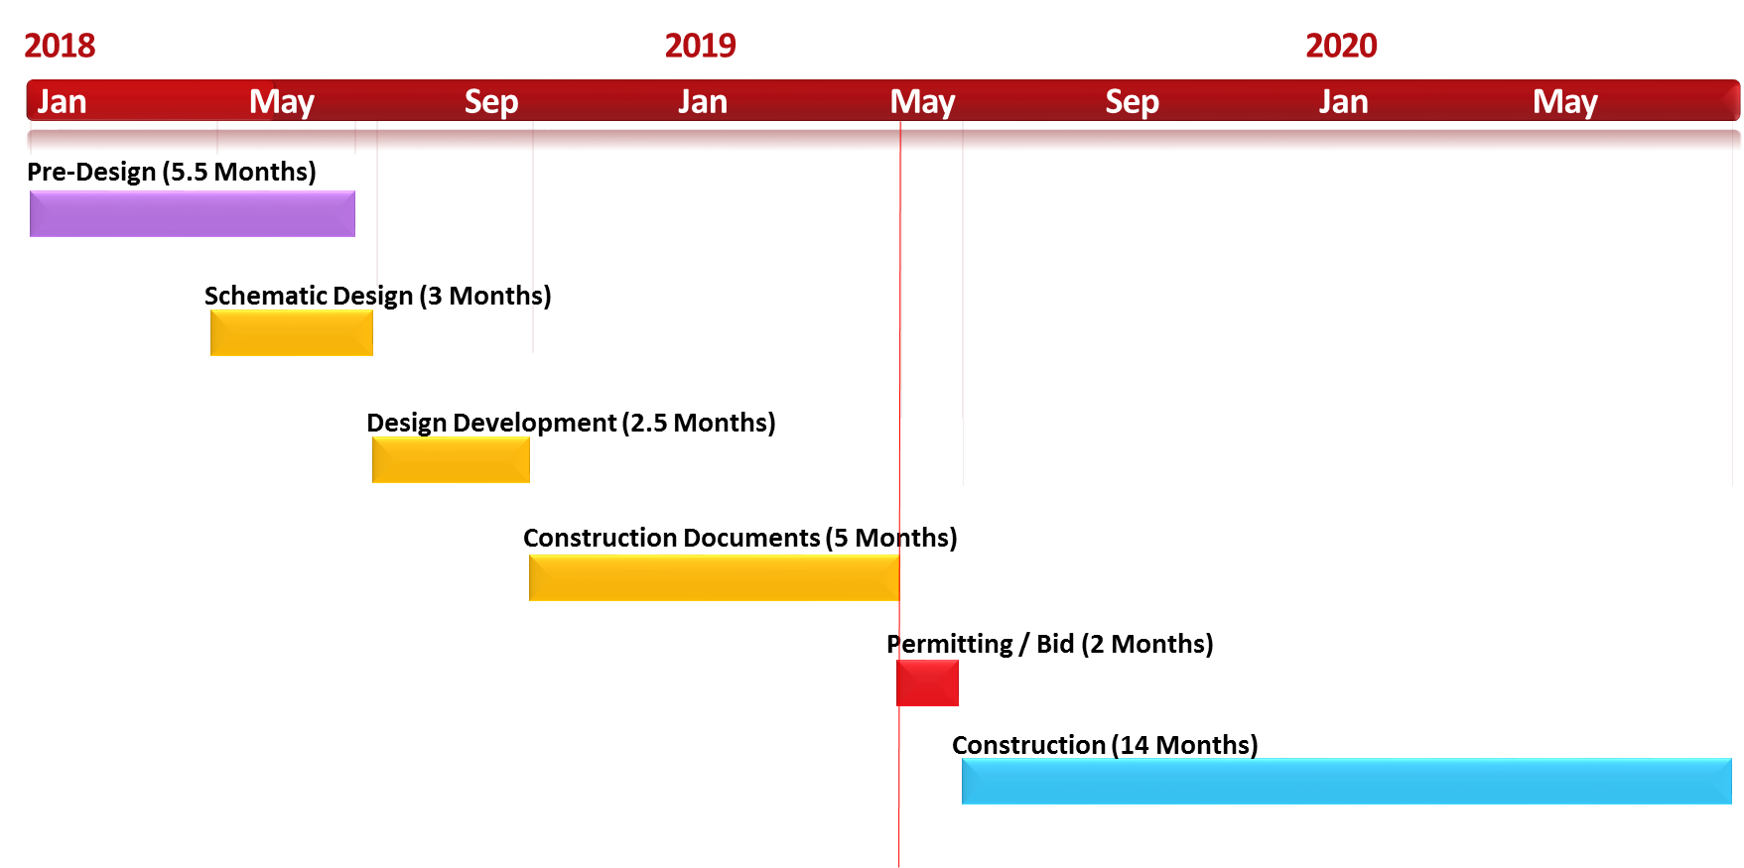
Project Details Mirror Lake, Lake Grove, & Wildwood Elementary Schools Schedule
3 Schools – 1 project
GC/CM Engagement
Notes:
30 -Ray
- Hiring the GC early is critical to assisting with design development and scheduling to be able to start construction by next summer
- Construction Schedule tight and complicated requiring Contractor pre-planning
Introduction to Rebecca

Slide 16
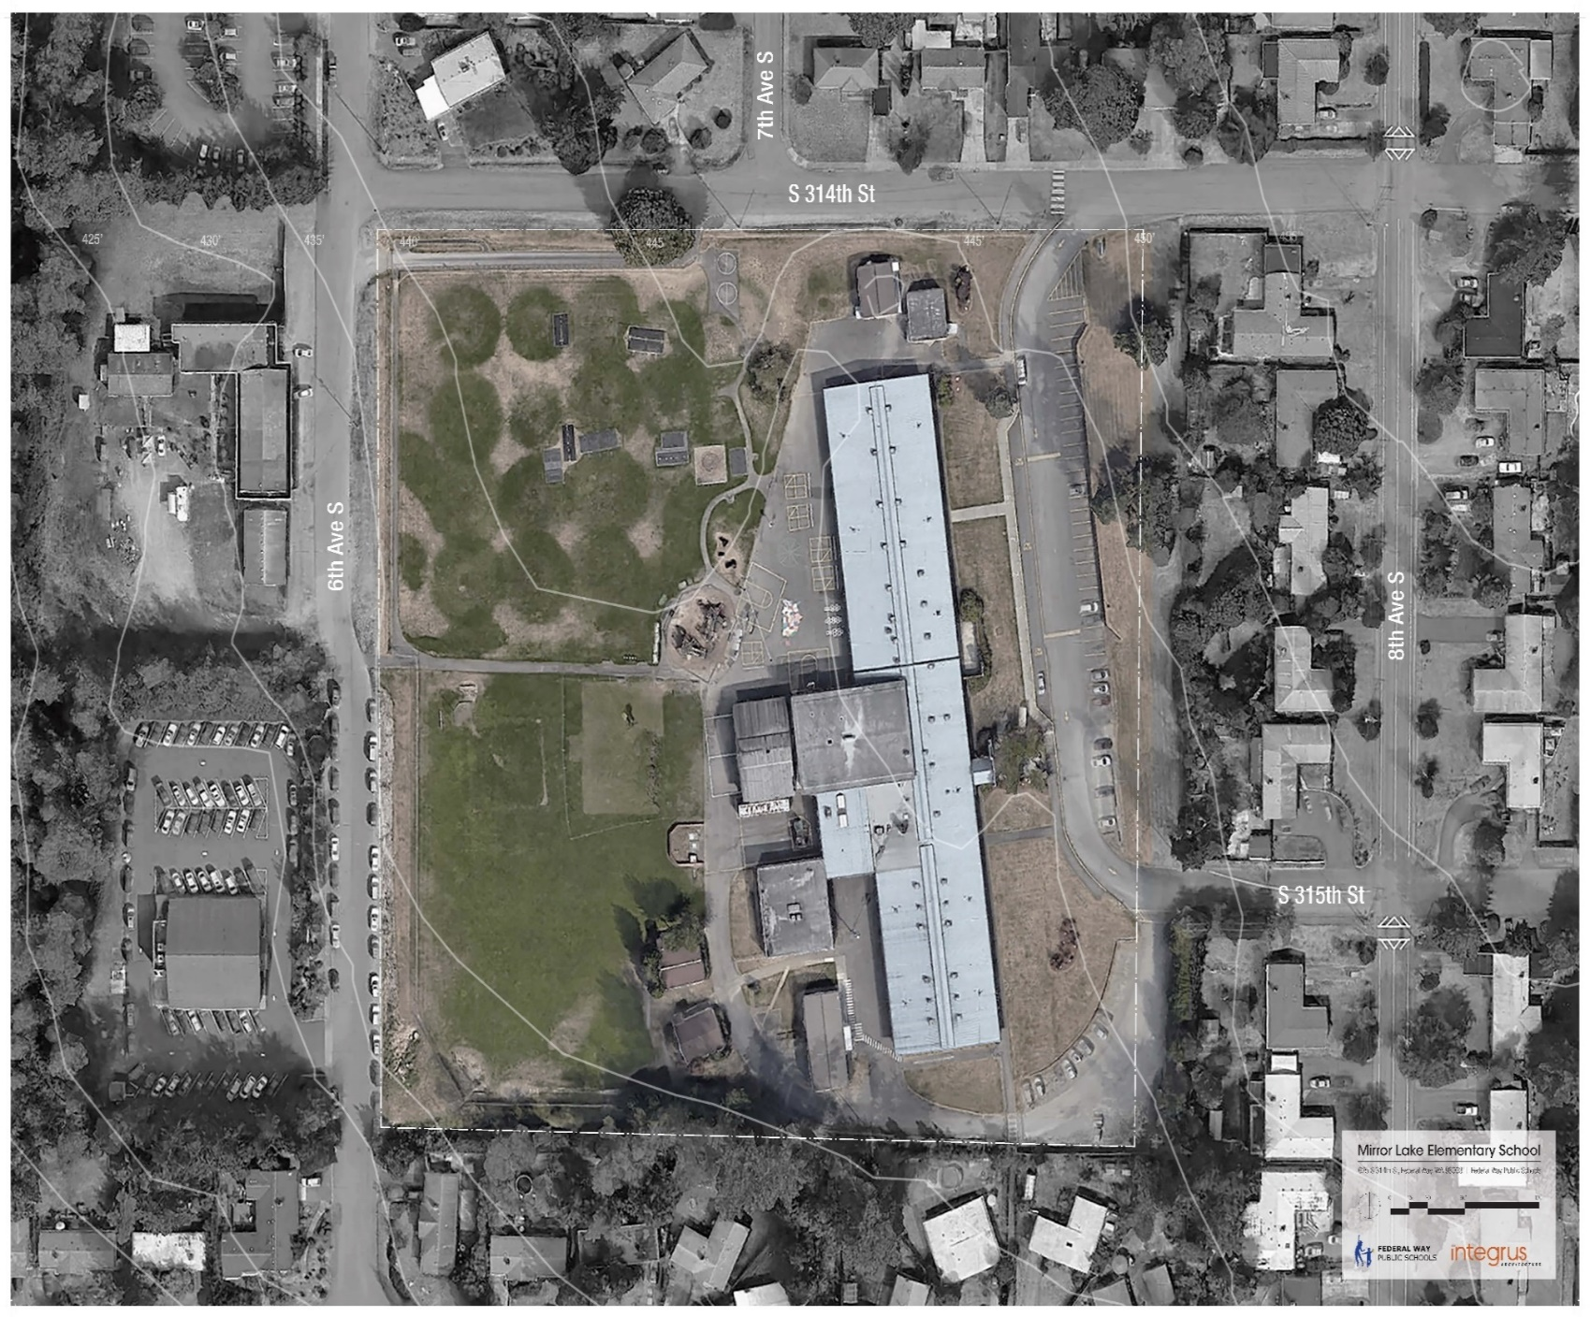
Project Details (Mirror Lake Elementary School)
Occupied Site
Perimeter/ adjacent streets and neighborhoods
Set-backs, utilities, topography/slope
Wooded Areas
8.34 Acres 43,330 sf – main bldg. 7 portables 52,230 sf – total
Notes:
90 -Rebbecca
RCW 39.10.340: The project involves construction at an existing facility that must continue to operate during construction:
The existing school will be occupied during construction. Education and operations must continue unobstructed by construction activity and remain safe throughout.

Slide 17
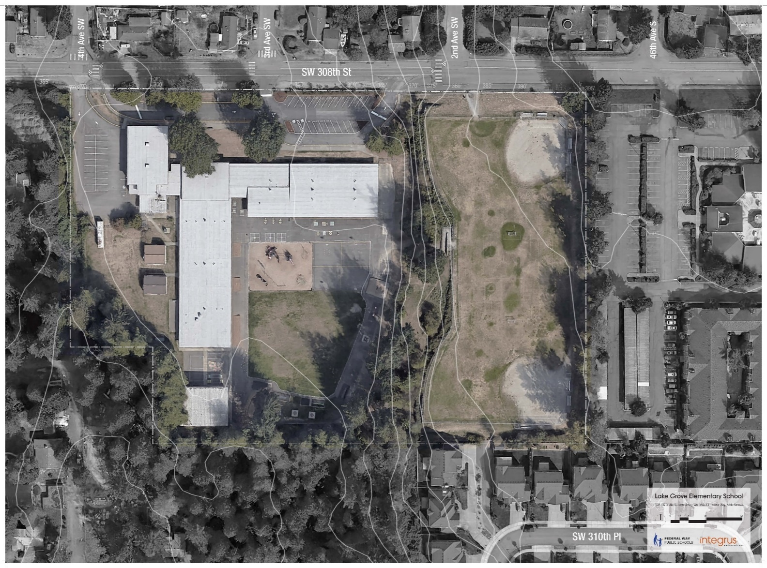
Project Details (Lake Grove Elementary School)
Occupied Site
Constrained Site
Geographical constraints lend to challenges – limited access and steep slope
Perimeter/ adjacent streets and neighborhoods
9.44 Acres 41,820 sf – main bldg. 2 portables 43,620 sf – total
Notes:
90 -Rebecca
RCW 39.10.340: The involvement of the GC/CM is critical during the design phase:
The GC/CM’s involvement during the design phase is especially critical in our regional construction market, where cost escalation is high, subcontractors and suppliers are at capacity, and bidding conditions are unpredictable.
The local Spokane market is extremely busy and stretching the limits of the local subcontractors.
GC/CM will also provide input into the products, installation methods and materials used to optimize the return on investment.
This streamlined process may allow the design phase to be compressed and reduce the need for lengthy and complicated value engineering exercises at the end of design, enabling an earlier start to construction and saving the Mead School District a significant amount of money in cost escalation.

Slide 18
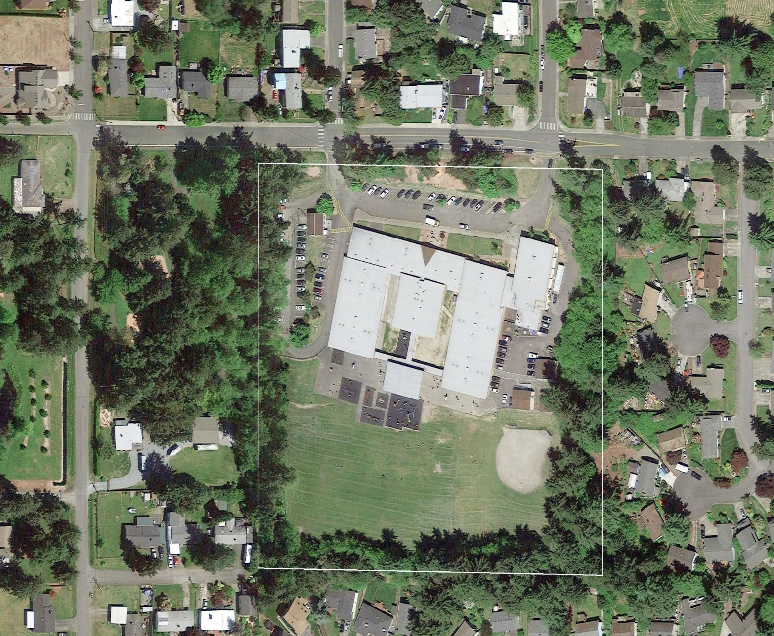
Project Details (Wildwood Elementary School)
Occupied Site
Constrained site
Geographical constraints lend to challenges – limited frontage for access
Perimeter/adjacent streets and neighborhoods
9.38 Acres 44,490 sf – main bldg. 4 portables 48,490 sf – total
Notes:
90 -Rebecca
RCW 39.10.340: The project encompasses a complex or technical work environment:
There will be complex permitting issues, utility work and potential traffic mitigation which will need to be planned and finalized before the main construction can begin
The neighborhood will be skeptical that this project can be delivered with minimal disruption to the neighborhood. Having the contractor mitigate these concerns early will ease their anxiety and help the public hearing process go more smoothly.

Slide 19
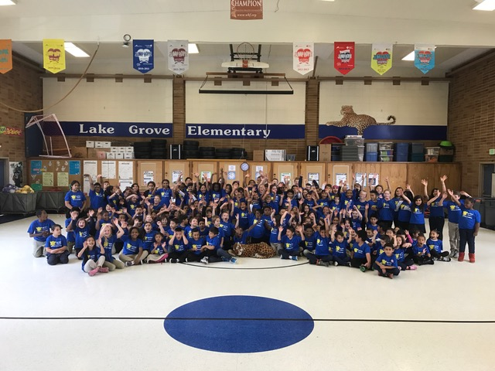
Why GC/CM?
RCW 39.10.340
Team Qualifications
Scheduling / Phasing
GC/CM critical during Design Phase
Complex & Technical Work Environment
Notes:
15 –Sally
15 –Casey
15 –Dan
15 -Rebecca
Number & Timing of Capital Projects
Engage Contractor early in Design Process to assist in management of project scope, schedule, & budget
Utilize Single Architect to develop similar designs & construction documents
Ability to Bid to a single GC/CM contractor to capitalize on economy of scale
Reduce design team and contractor Construction Administration
Proximity of sites to each other
Tight Design & Construction Schedule
Reduce Potential Project Change Impacts

Slide 20
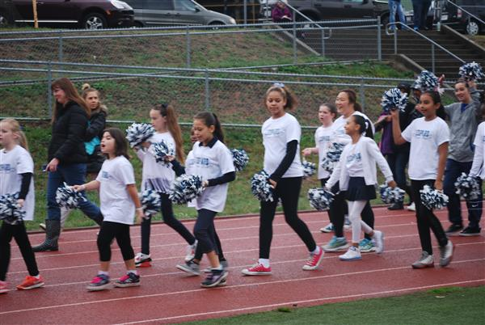
Questions & Answers Mirror Lake, Lake Grove, & Wildwood Elementary Schools
Questions & Answers
Notes:
300

Slide 21
Mirror Lake, Lake Grove, & Wildwood Elementary Schools
Thank you!
Notes:
0

