Slide 1
FWPS Phase II CP18
Thomas Jefferson High School
GC/CM Presentation
May 24, 2018

Slide 2
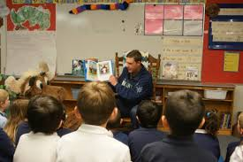
Agenda
Thomas Jefferson High School
Introduction
  District Capital Program
  Team Qualifications
  Project Details
Why GC/CM?
Questions & Answers
Notes:
30 Sally
Thank you for the opportunity to present our project for consideration of approval for GCCM alternative delivery method, my name is Sally McClean, I am the Chief Financial Officer for FWPS
In our presentation today we explain why we believe our project is a good fit for this delivery method due to:
- our team qualifications
- the tight schedule and required phasing associated with existing, occupied sites
- the need for Contractor engagement in the Design Process
- the technical complexity of the projects
To that end our presentation today will inform you about
-Our Team Qualifications
-The District Capital Program
-Project details
...and then summarize with why we believe this project is a good fit for the GCCM process

Slide 3
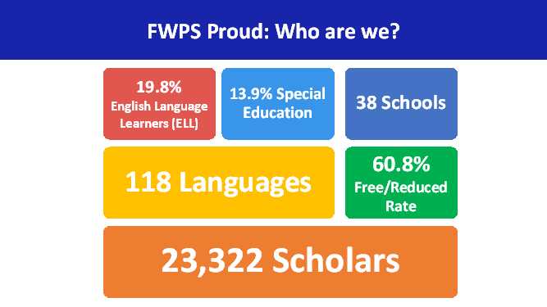
Agenda
District Demographics
Notes:
15 Sally

Slide 4
Team Qualifications
Project Team Structure
Owner:
Federal Way Public Schools
(FWPS)
Capital Project Manager:
CBRE | Heery
A/E Firm:
Bassetti Architects
Notes:
10 Sally
So I would like to begin by introducing you to the Teams that will facilitate the project, which are grouped in to
-our Owners Team
-our Project Management Team
-and our Architectural team

Slide 5
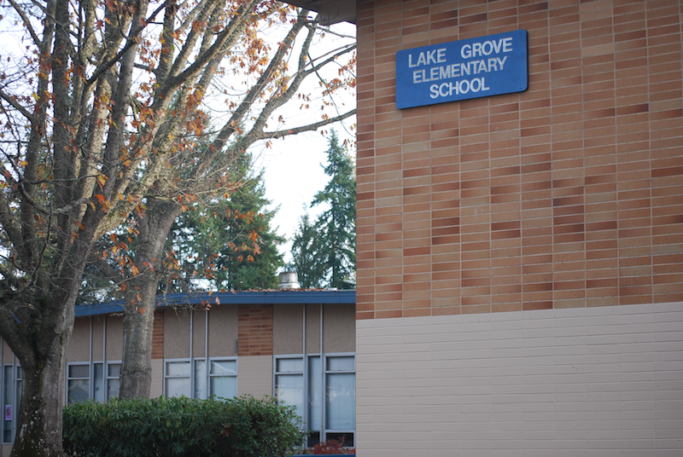
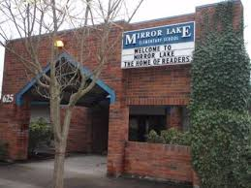
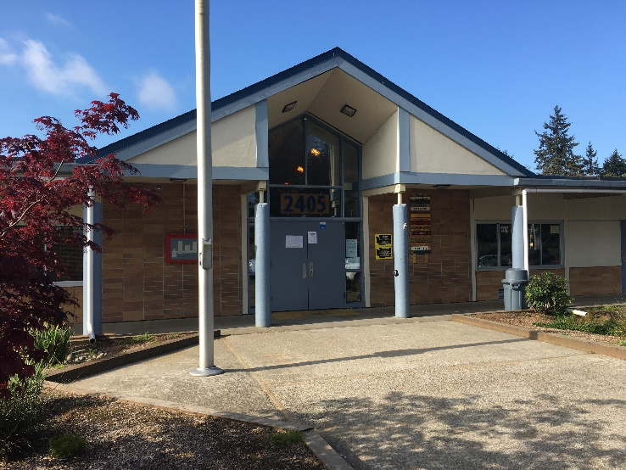
Team Qualifications
(Owner)
FWPS
  Sally McLean: Chief Finance and Operation Officer – 30 Years Experience, 17 Years with FWPS
  Mike Benzien, Executive Director of Maintenance and Operations – 30 Years Experience
  Casey Moore, Capital Projects Manager – 30 Years Experience
Notes:
30 Sally ...as I mentioned previously I am Sally McClean, CFO, ...history and experience ...intro to Mike
30 Mike ...history experience ...intro to Casey
30 Casey ...history and experience

Slide 6
Team Qualifications
Project Team Structure
Notes:
15 -Casey
Alignment to support execution of the District's strategic goals as established by Dr Campbell
My involvement 100% in deliver of Capital Program
Partners aligned to supporting execution
-Perkins Coie for Legal Guidance
-CBRE Heery for direct project management and program guidance
-Integrus as Architect
Introduction to Dan Gendreau

Slide 7
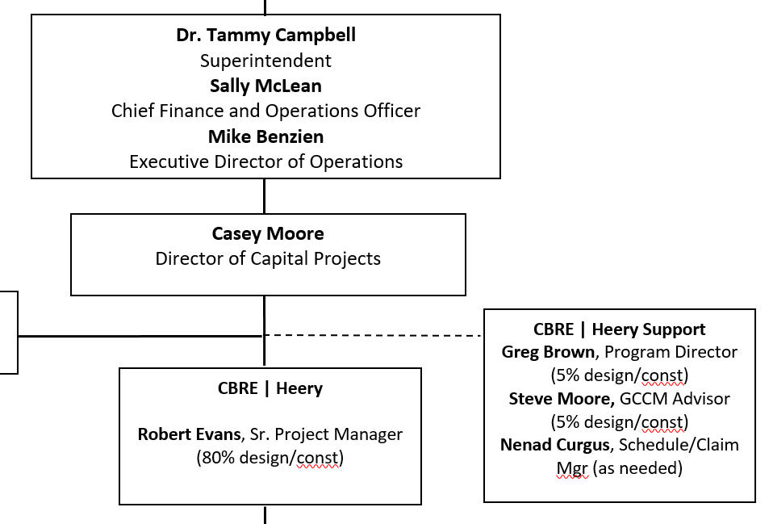
Team Qualifications
Project Team Structure
Notes:
30 -Dan

Slide 8
Team Qualifications
(PM Team)
Robert Evans, PE – Senior Project Manager, CBRE|Heery
30 years Project Management experience, including Seattle Public Schools, Lake WA SD
GC/CM, D/B, D-B-B and multi-prime management experience
Resident of Federal Way
Greg Brown, AIA, LEED AP – Program Manager, CBRE|Heery
30 years K–12 Program Management -over $1B in bond projects to date
Director at Spokane Public Schools for 12 years
Director of 10 successful GC/CM projects
Led application for Spokane Public Schools to obtain Public Body Certification – First school district in State
Steve Moore – Senior Project Manager, CBRE|Heery
18 years K–12 Program Management
Over 20 years of construction-related experience including General Contractor, program management, project management, and construction management
Notes:
90-Dan
Introduce each Team member
Introduce Bassetti

Slide 9
Team Qualifications
(A/E Team)
Lorne McConachie, FAIA – Principal-in-Charge, Bassetti Architects
40 years experience including over 12 GCCM projects over the past 14 years
Recent K-12 school GC/CM projects: Mountlake Terrace Elementary School (Edmonds SD), Lincoln High School (Seattle PS), Stewart Middle School (Tacoma PS), Lynnwood Elementary School (Edmonds SD).
Allocation 60% Design/20% Construction
Jordan Kiel, AIA, DBIA – Principal, Bassetti Architects
Over 10 years experience in education and civic projects as Principal and Project Manager.
Recent K-12 school GC/CM projects: Stewart Middle School (Tacoma PS), Denny Middle School (Seattle PS), and Chief Sealth High School (Seattle PS).
Allocation 40% Design/50% Construction
Notes:
60 -Bassetti

Slide 10
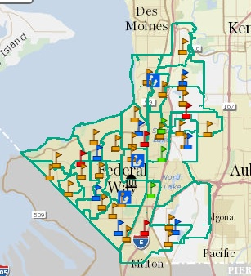
District Capital Program
Phase II
Mark Twain ES
Star Lake ES
Memorial Stadium
Totem MS
Lake Grove ES
Thomas Jefferson HS
Olympic View ES
Wildwood ES
Illahee MS
Mirror Lake ES
Notes:
30 –Casey
Number of projects
Reason for delivery over 8 years

Slide 11
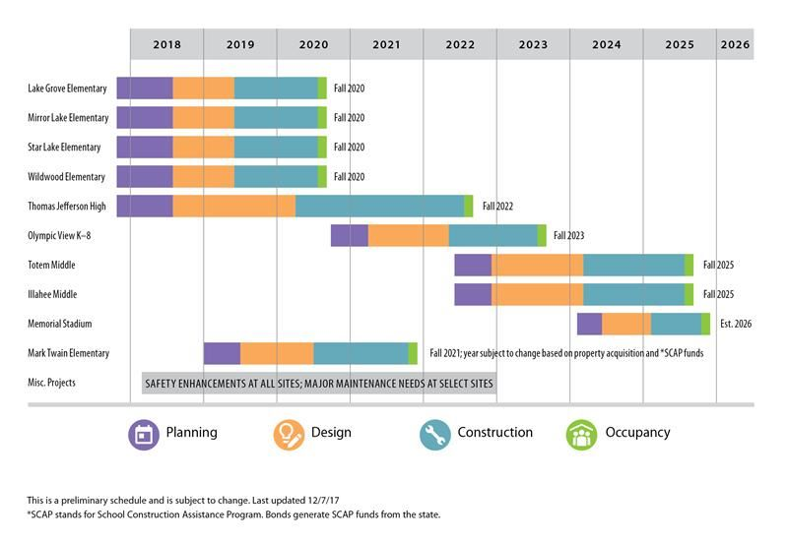
District Capital Program
Phase II Schedule - Original

Slide 12
District Capital Program
Phase II Schedule - Revised
Notes:
45 –Casey
Impact of regional escalation particularly of long schedule for delivery of projects
Modified project schedules to deliver earlier, as a result of revised bond sales opportunities
Critically important that first three projects are delivered within scope, schedule, and budget to provide greatest opportunity to deliver subsequent projects
Deliver high school on occupied site with existing facilities, phased project, tigh schedule

Slide 13
District Capital Program
Thomas Jefferson High School
Budget
Capital Program Budget $600.0 million
High School Project Budget
  Costs for Professional Services (A/E, Legal etc.) $ 9.5 million
  Estimated project construction costs (including construction contingencies): $ 82.4 million
  Equipment and furnishing costs $ 3.0 million
  Off-site costs $ incl. constr.
  Contract administration costs (Owner, CM etc.) $ 3.3 million
  Contingencies (design & owner) $ 6.0 million
  Other related project costs (permits, curriculum, environmental) $ 2.8 million
  Sales Tax $ 8.0 million
Projected Total Cost for the Project: $115.0 million
Notes:
30 -Casey
Total project value as component of entire bond is over 1/6th, accordingly very important to minimize risk in successful delivery of projects
Let's talk about the details of the project...

Slide 14
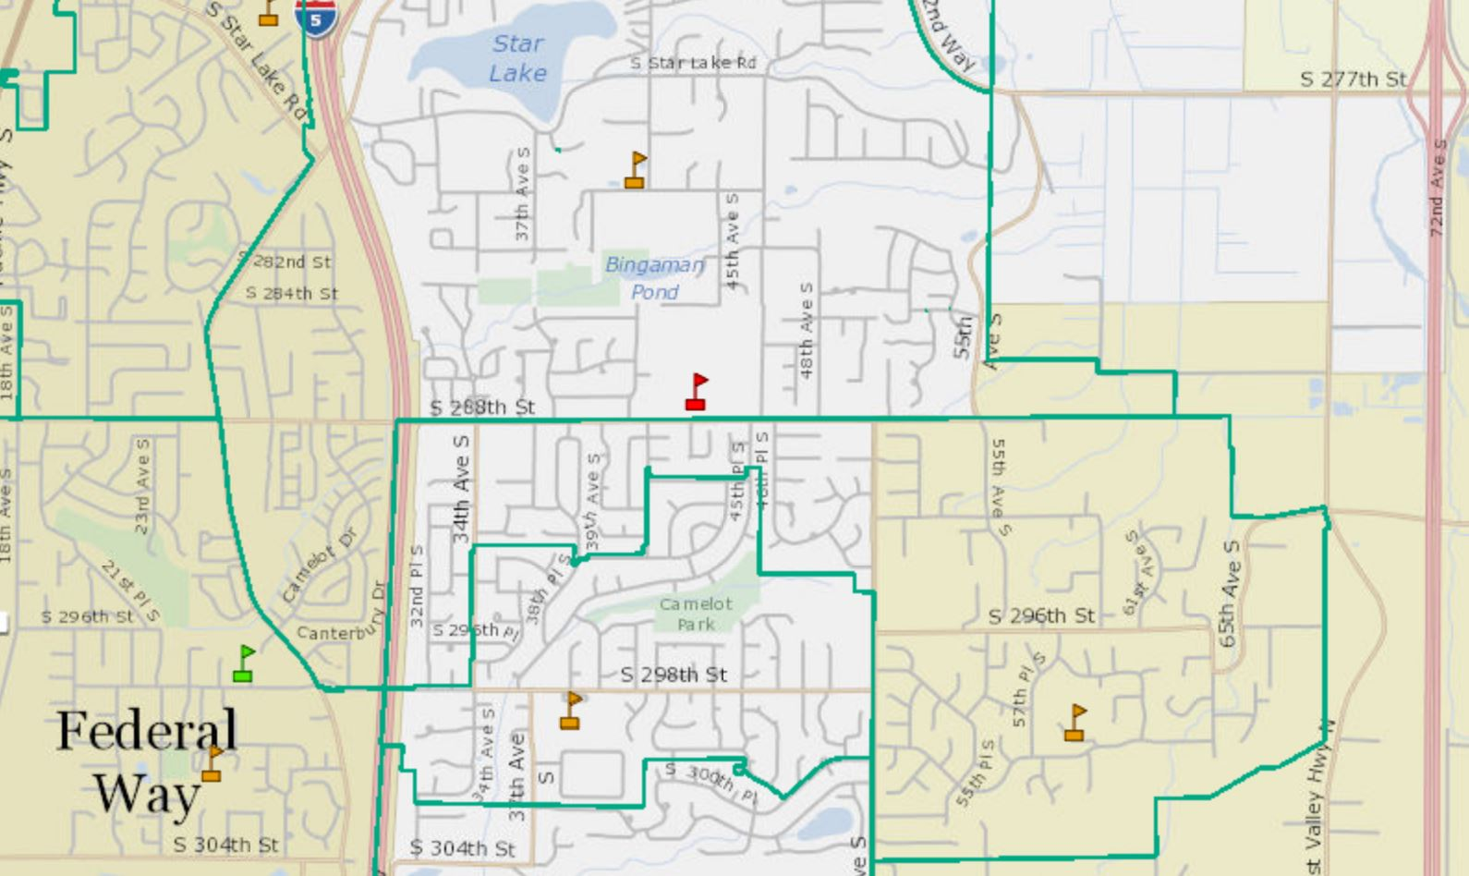
District Capital Program
Thomas Jefferson High School
Thomas Jefferson HS
Notes:
30 –Robert

Slide 15
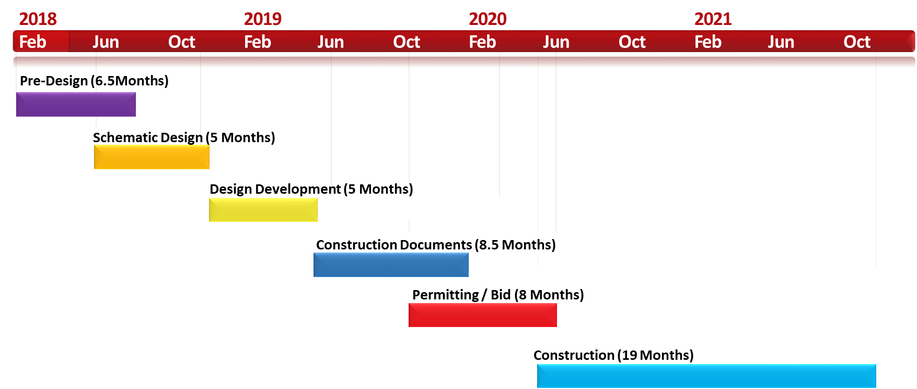
District Capital Program
Thomas Jefferson High School
Schedule
GC/CM Engagement
Notes:
30 -Robert
GCCM will brought on board at beginning of design phase
Will partner with AE and PM to manage scope, schedule and budget through design and construction
...hand off to Bassetti

Slide 16
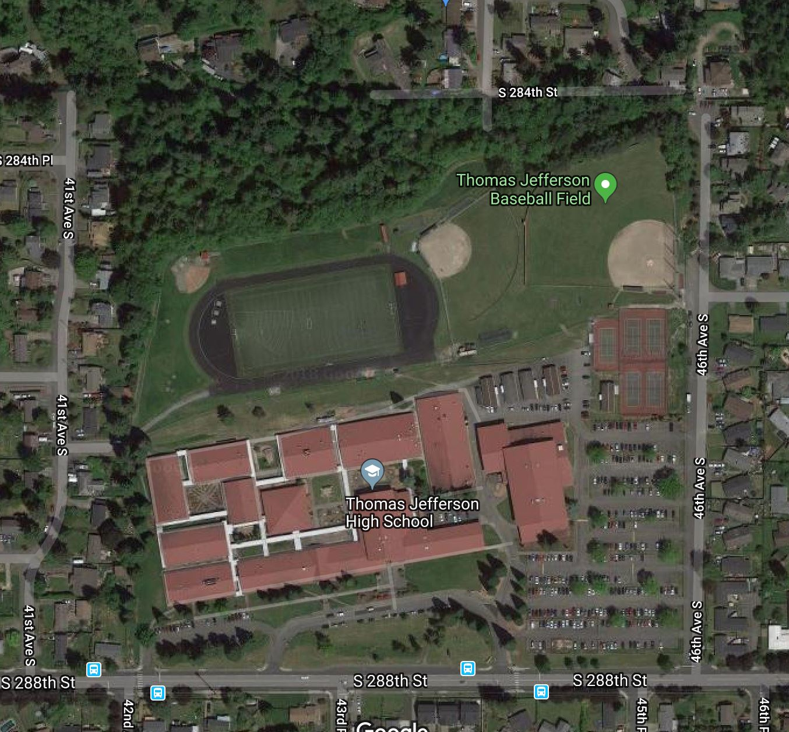
Project Details
(Thomas Jefferson High School)
Occupied Site with phased construction
Engage Contractor early in Design Process to assist in management of project scope, schedule, & budget
Environmentally sensitive area and site constraints (parking and playfields)
Tight Design & Construction Schedule to be coordinated to meet District operational, permitting and construction milestones.
38 Acres 12 buildings plus 10 portables = 179,119 sf – total
Notes:
270 Bassetti
RCW 39.10.340
(1) Implementation of the project involves complex scheduling, phasing, or coordination;
(2) The project involves construction at an occupied facility which must continue to operate during
construction;
(3) The involvement of the general contractor/construction manager during the design stage is critical
to the success of the project;
(4) The project encompasses a complex or technical work environment;
(5) The project requires specialized work on a building that has historic significance

Slide 17
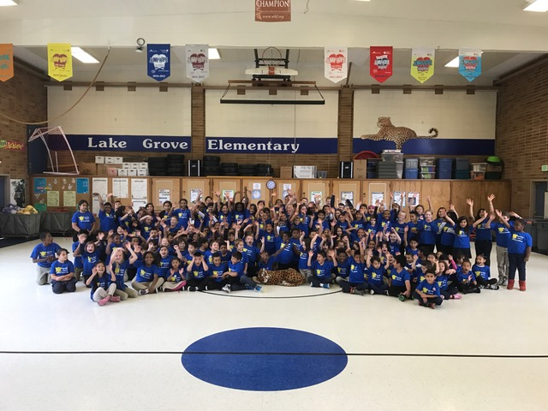
Why GC/CM?
RCW 39.10.340
Team Qualifications
Scheduling / Phasing
GC/CM critical during Design Phase
Complex & Technical Work Environment
Notes:
15 –Sally
15 –Casey
15 –Dan
15 -Bassetti
Number & Timing of Capital Projects
Phasing and extensive coordination needed to complete the design, obtain necessary permits and agency approvals and execute the work with minimum impact on school operations
Engage Contractor early in Design Process to assist in management of project scope, schedule, & budget
Proximity of wetlands, potentially wet soils and steep slopes
Tight Design & Construction Schedule
Reduce Potential Project Change Impacts

Slide 18
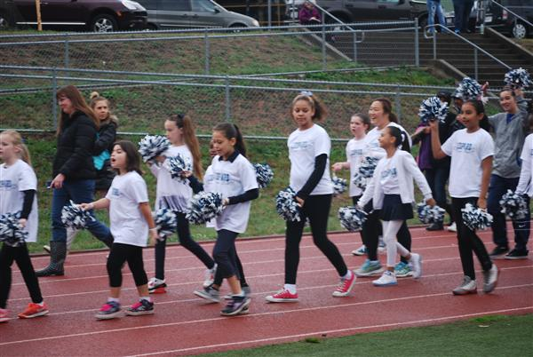
Questions & Answers
Thomas Jefferson High School
Questions and Answers

Slide 19

Thomas Jefferson High School
Thank you!

