Slide 1
FWPS Phase II CP18 Star Lake Elementary School & Totem Middle School GC/CM Presentation
July 26, 2018
Notes:
0

Slide 2
Agenda Star Lake Elementary School & Totem Middle School
Introduction
Team Qualifications
District Capital Program
Project Details
Why GC/CM?
Questions & Answers
Notes:
30 Sally
Thank you for the opportunity to present our project for consideration of approval for GCCM alternative delivery method, my name is Sally McClean, I am the Chief Financial Officer for FWPS
In our presentation today we explain why we believe our project is a good fit for this delivery method due to:
- our team qualifications
- the tight schedule and required phasing associated with existing, occupied sites
- the need for Contractor engagement in the Design Process
- the technical complexity of the projects
To that end our presentation today will inform you about
-Our Team Qualifications
-The District Capital Program
-Project details
...and then summarize with why we believe this project is a good fit for the GCCM process

Slide 3
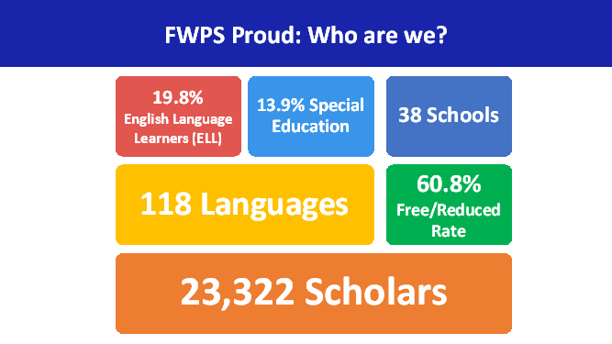
Agenda District Demographics
Notes:
15 Sally

Slide 4
Team Qualifications Project Team Structure
Owner:
Federal Way Public Schools
(FWPS)
Capital Project Team:
CBRE | Heery
A/E Firm:
McGranahan Architects
Notes:
10 Sally
So I would like to begin by introducing you to the Teams that will facilitate the project, which are grouped in to
-our Owners Team
-our Project Management Team
-and our Architectural team

Slide 5
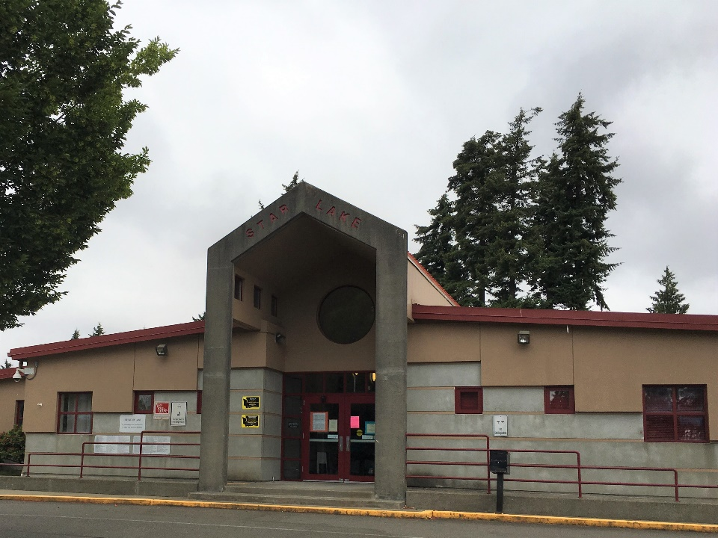
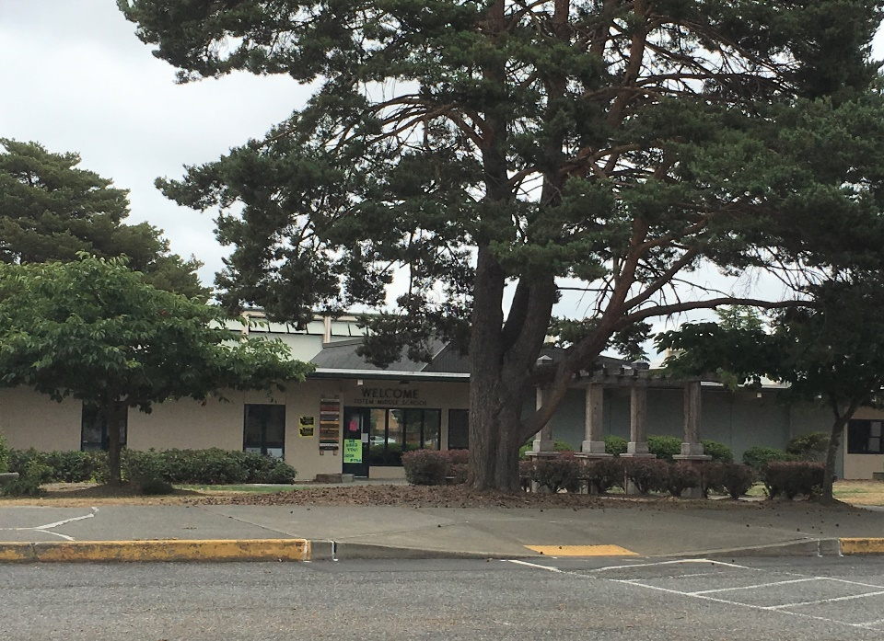
Team Qualifications (Owner)
FWPS
Sally McLean: Chief Finance and Operation Officer – 30 Years Experience, 17 Years with FWPS
Mike Benzien, Executive Director of Maintenance and Operations – 30 Years Experience
Casey Moore, Capital Projects Manager – 30 Years Experience
Notes:
30 Sally ...as I mentioned previously I am Sally McClean, CFO, ...history and experience ...intro to Mike
30 Mike ...history experience ...intro to Casey
30 Casey ...history and experience

Slide 6
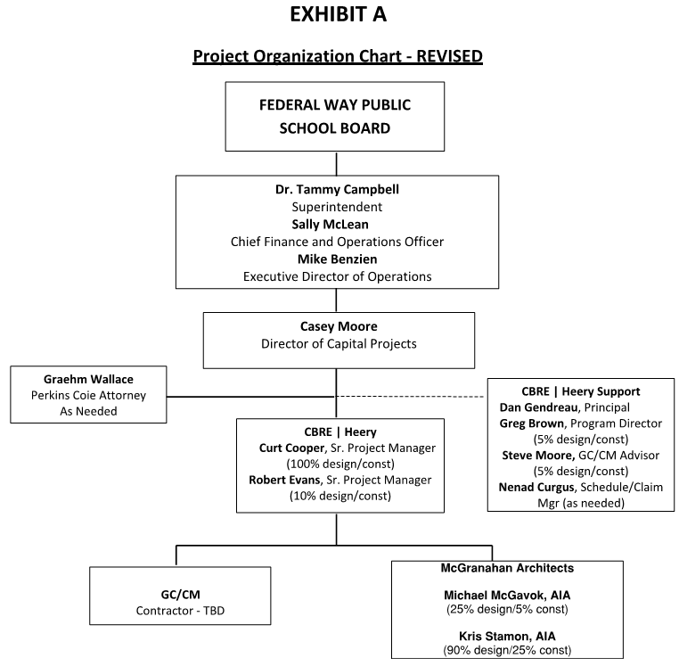
Team Qualifications Project Team Structure
Notes:
15 -Casey
Alignment to support execution of the District's strategic goals as established by Dr Campbell
My involvement 100% in deliver of Capital Program
Partners aligned to supporting execution
-Perkins Coie for Legal Guidance
-CBRE Heery for direct project management and program guidance
-Integrus as Architect
Introduction to Dan Gendreau

Slide 7
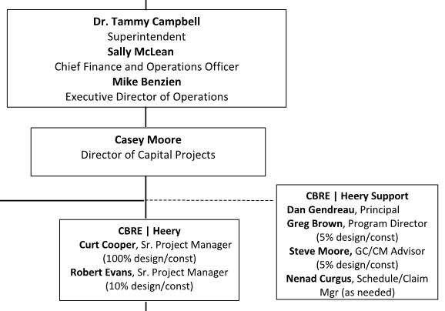
Team Qualifications Project Team Structure
Notes:
30 -Dan

Slide 8
Team Qualifications (PM Team)
Curt Cooper, RA – Senior Project Manager, CBRE|Heery
30 years public sector Program Management
Registered Architect in WA State; extensive experience in all phases of design and construction.
Proven leader and team manager/facilitator (retired Navy Captain).
Greg Brown, AIA, LEED AP – Program Manager, CBRE|Heery
30 years K–12 Program Management -over $1B in bond projects to date
Director at Spokane Public Schools for 12 years
Director of 10 successful GC/CM projects
Led application for Spokane Public Schools to obtain Public Body Certification – First school district in State
Robert Evans, PE – Senior Project Manager, CBRE|Heery
30 years Project Management experience, including Seattle Public Schools, Lake WA SD
GC/CM, D/B, D-B-B and multi-prime management experience
Resident of Federal Way
Notes:
90-Dan
Introduce each Team member
Introduce Rebecca

Slide 9
Team Qualifications (A/E Team)
Michael McGavock, AIA – Principal, McGranahan Architects
30 years experience including numerous GC/CM projects over the past 14 years
Recent K-12 school GC/CM projects: Birney Elementary School, Tacoma Public Schools, Grant Center for the Expressive Arts, Tacoma Public Schools
Allocation 25% Design / 5% Construction
Kris Stamon, AIA – McGranahan Architects
16 years experience including.
Recent K-12 school GC/CM projects: Birney Elementary School, Tacoma Public Schools; Garfield Elementary School, Olympia School District.
Allocation 90% Design / 25% Construction
Notes:
60 -Michael

Slide 10
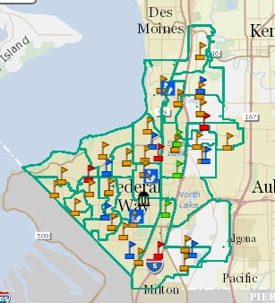
District Capital Program Phase II
Mark Twain ES
Totem MS
Memorial Stadium
Star Lake ES
Lake Grove ES
Thomas Jefferson HS
Olympic View ES
Wildwood ES
Mirror Lake ES
Illahee MS
Notes:
45 -Casey

Slide 11
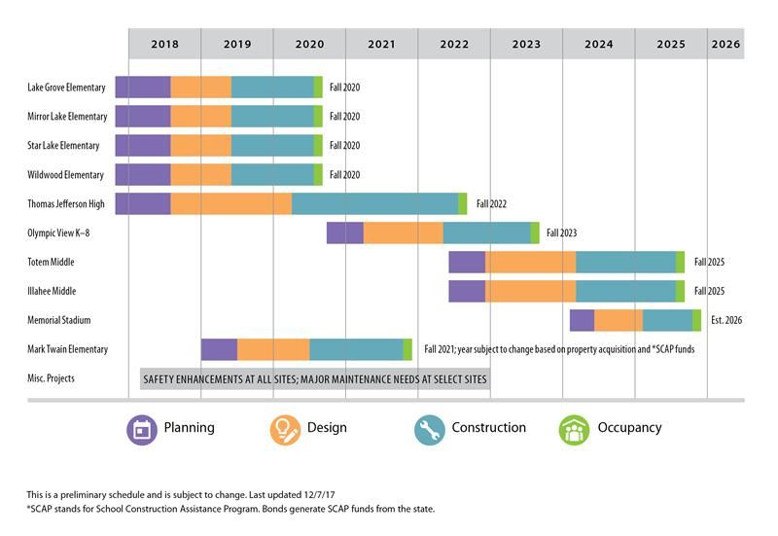
District Capital Program Phase II Schedule – Original
Notes:
30 –Casey
Number of projects
Reason for delivery over 8 years

Slide 12
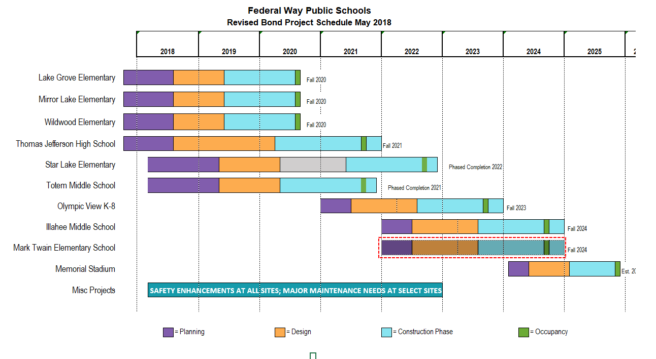
District Capital Program Phase II Schedule - Revised
Notes:
45 –Casey
Impact of regional escalation particularly of long schedule for delivery of projects
Modified project schedules to deliver earlier, as a result of revised bond sales opportunities
Critically important that first three projects are delivered within scope, schedule, and budget to provide greatest opportunity to deliver subsequent projects
Deliver three elementary schools as a single project, advantages being
- designed by single architect
- designs more similar than different
- consistency in design and specification of major systems
- Ability to bid to single GCCM and engage in design process
- Anticipated savings through economy of scale
-reduced administration

Slide 13
District Capital Program Star Lake Elementary School & Totem Middle School Budget
Capital Program Budget $ 600.0 million
Star Lake Elementary School Project Budget
Costs for Professional Services (A/E, Legal etc.) $ 3.3 million
Estimated project construction costs (including construction contingencies): $ 28.4 million
Equipment and furnishing costs $ 1.7 million
Off-site costs $ incl. constr.
Contract administration costs (Owner, CM etc.) $ 1.3 million
Contingencies (design & owner) $ 1.5 million
Other related project costs (permits, curriculum, environmental) $ 1.1 million
Sales Tax $ 2.8 million
Total Star Lake Elementary School Project Budget $ 40.1 million
Notes:
30 -Casey
Total project value as component of entire bond is over 1/6th, accordingly very important to minimize risk in successful delivery of projects
Let's talk about the details of the project...

Slide 14
District Capital Program Star Lake Elementary School & Totem Middle School Budget
Capital Program Budget $ 600.0 million
Totem Middle School Project Budget
Costs for Professional Services (A/E, Legal etc.) $ 5.7 million
Estimated project construction costs (including construction contingencies): $ 47.8 million
Equipment and furnishing costs $ 3.1 million
Off-site costs $ incl. constr.
Contract administration costs (Owner, CM etc.) $ 2.2 million
Contingencies (design & owner) $ 2.6 million
Other related project costs (permits, curriculum, environmental) $ 2.0 million
Sales Tax $ 3.5 million
Total Totem Middle School Project Budget $ 66.9 million
Projected Total Cost for the Project (2 schools): $ 107.0 million
Notes:
30 -Casey
Total project value as component of entire bond is over 1/6th, accordingly very important to minimize risk in successful delivery of projects
Let's talk about the details of the project...

Slide 15
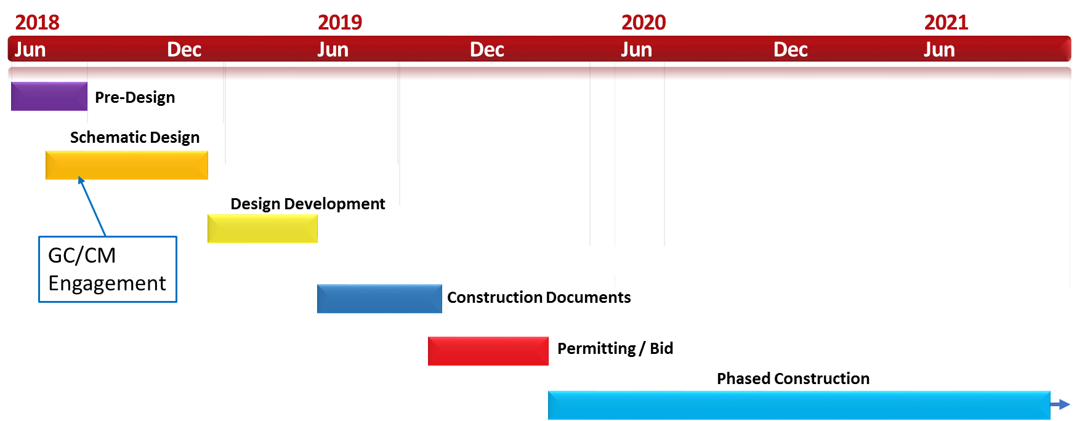
Project Details Star Lake Elementary School & Totem Middle School Schedule
2 Schools – 1 project
Notes:
30 -Curtis
- Hiring the GC early is critical to assisting with design development and scheduling to be able to start construction by next summer
- Construction Schedule tight and complicated requiring Contractor pre-planning
Introduction to Rebecca

Slide 16
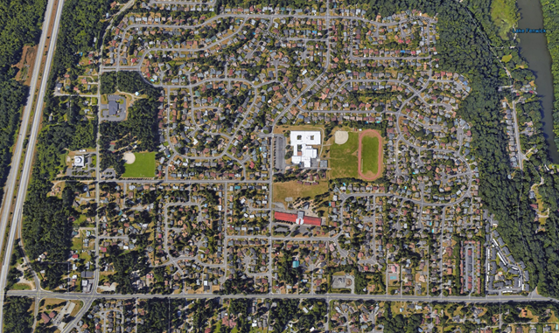
Project Details (Star Lake Elementary School & Totem Middle School)
Star Lake/Totem Site
Site surrounded by residential neighborhood
Adjacent to busy streets and highway
Wooded Areas
I5 Hwy
S 272nd
Notes:
15 -Michael
RCW 39.10.340: The project involves construction at an existing facility that must continue to operate during construction:
The existing school will be occupied during construction. Education and operations must continue unobstructed by construction activity and remain safe throughout.

Slide 17
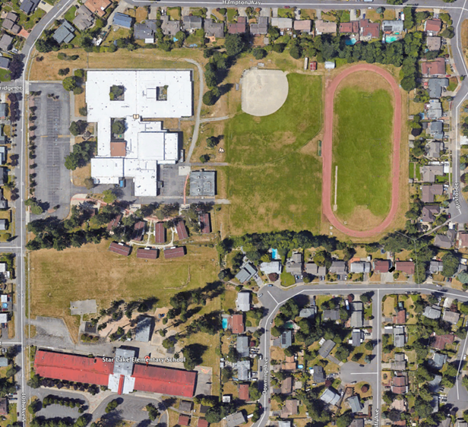
Project Details (Star Lake Elementary School & Totem Middle School)
Occupied Site
Limited Street Access
Set-backs, utilities, topography/slope
Safety & Security
Totem Middle School
Site: 28.06 Acres
Totem Middle School:
101,821 sf - Main building
5,115 sf - Outbuilding
15,454 sf - 9 portables
122,390 sf - Total
Star Lake Elementary: 44,381 sf - Main building
3,578 sf - 4 portables
47,969 sf - Total
Wooded Areas
Star Lake Elementary School
Notes:
90 –Michael
30 -Casey
RCW 39.10.340: The project involves construction at an existing facility that must continue to operate during construction:
The existing school will be occupied during construction. Education and operations must continue unobstructed by construction activity and remain safe throughout.

Slide 18
Option A – Two Schools, No Shared Spaces
Notes:
Casey

Slide 19
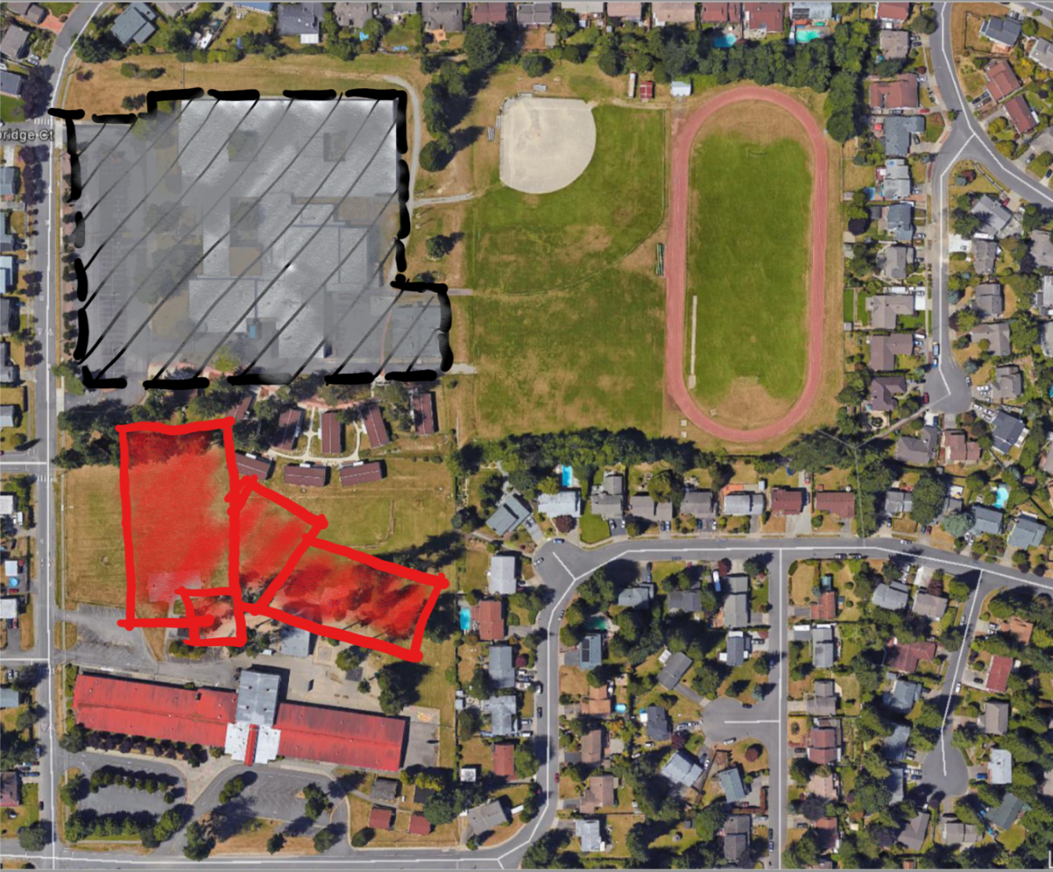
Option A – Two Schools, No Shared Spaces - Step 2
Notes:
Casey

Slide 20
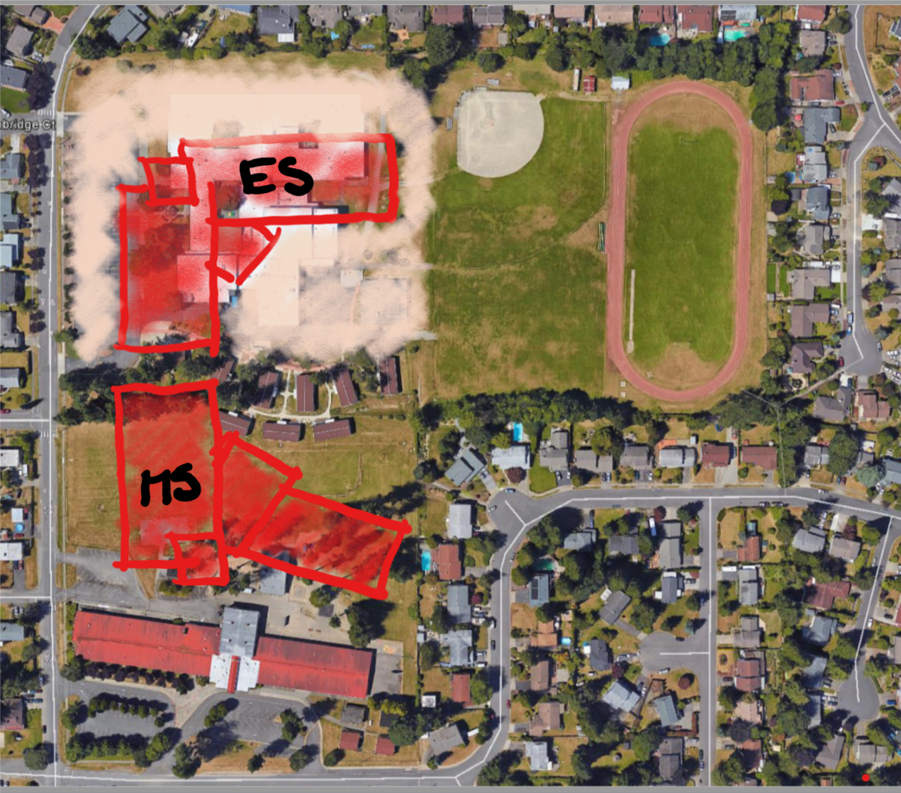
Option A – Two Schools, No Shared Spaces - Step 3
Notes:
Casey

Slide 21
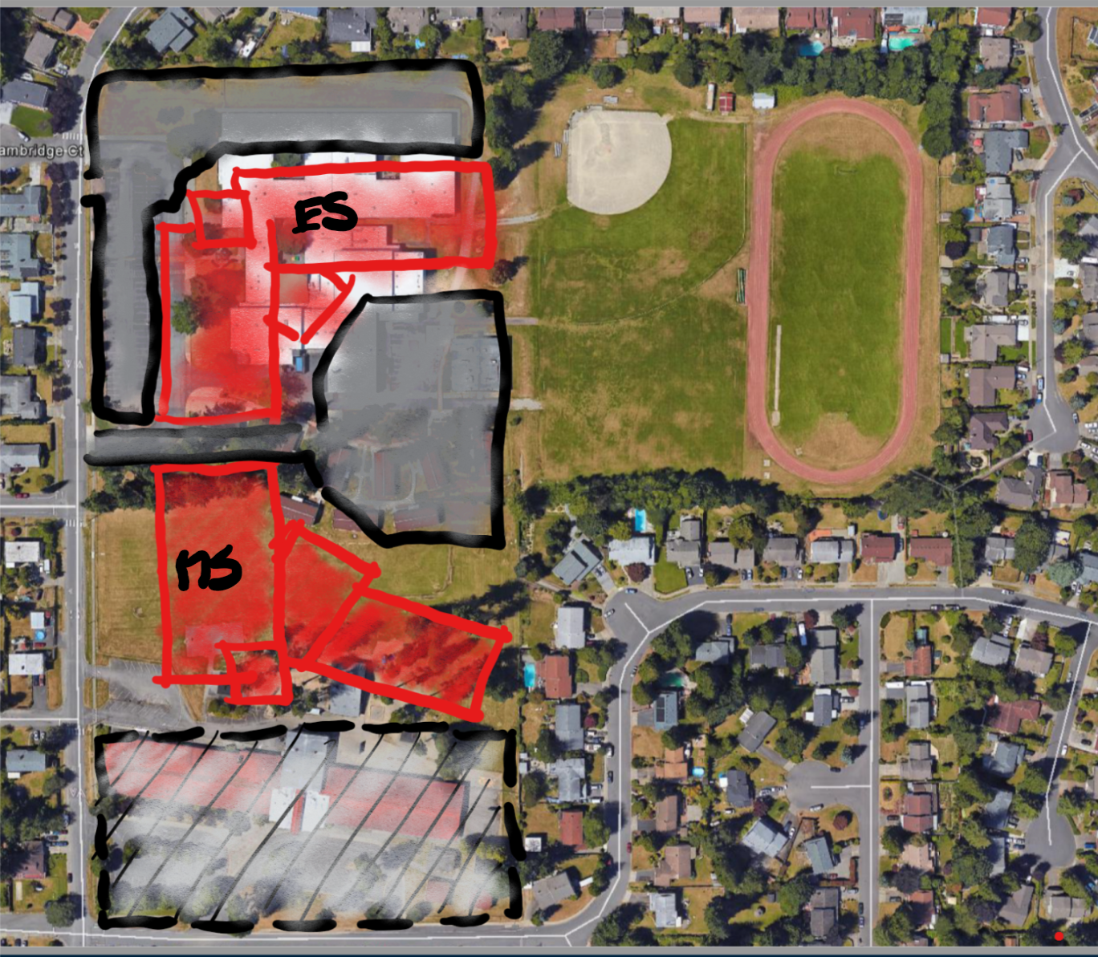
Option A – Two Schools, No Shared Spaces - Step 4
Notes:
Casey

Slide 22
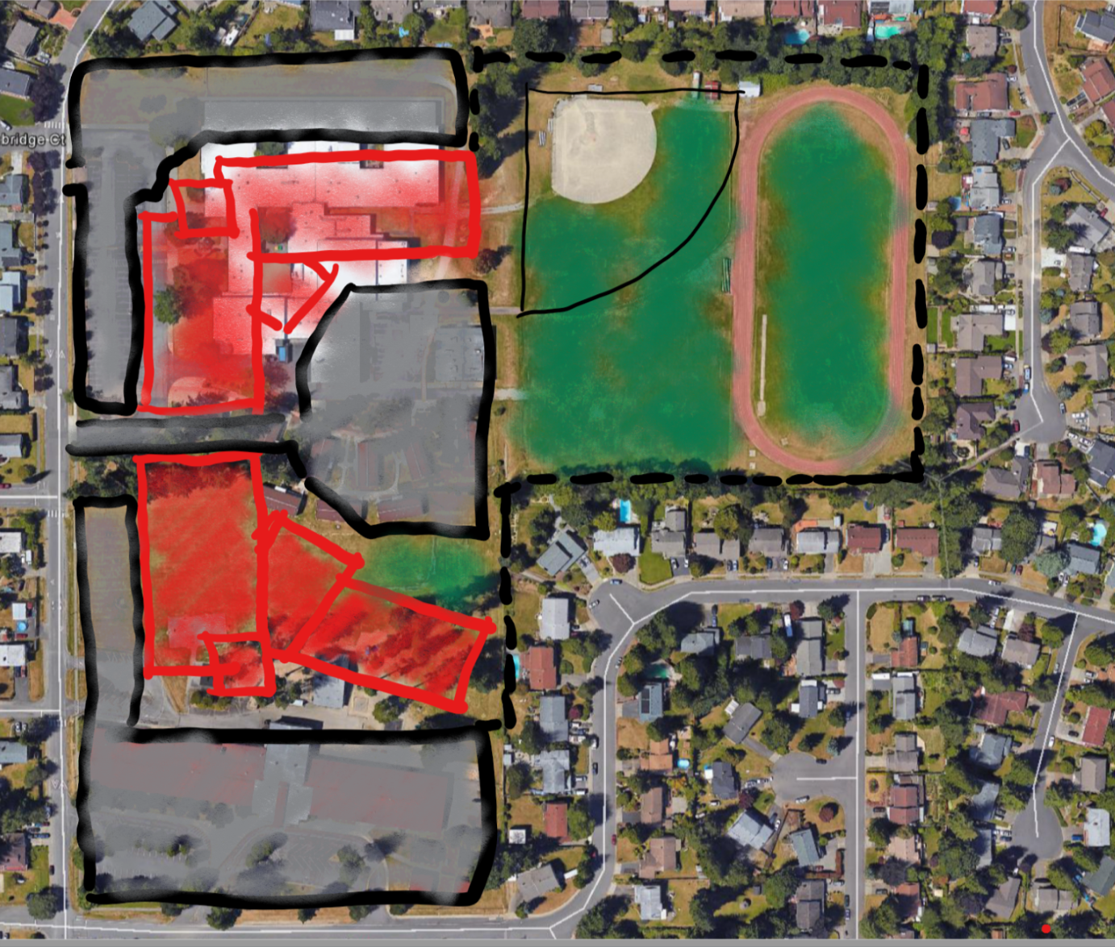
Option A – Two Schools, No Shared Spaces - Step 5
Notes:
45 - Casey

Slide 23
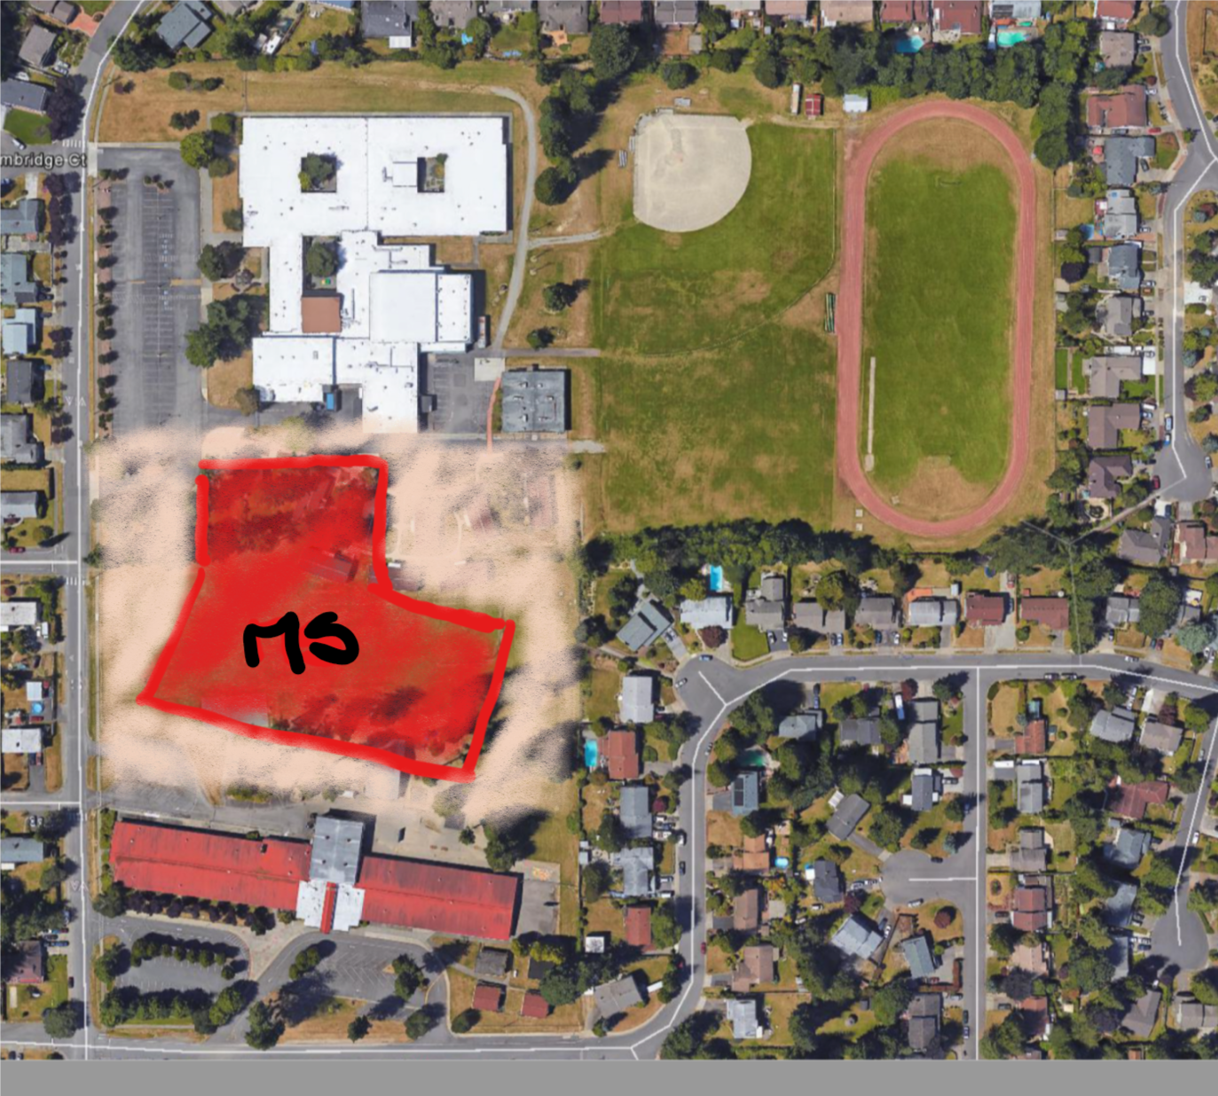
Option B – Two Schools, Shared Spaces - Step 1
Notes:
Casey

Slide 24
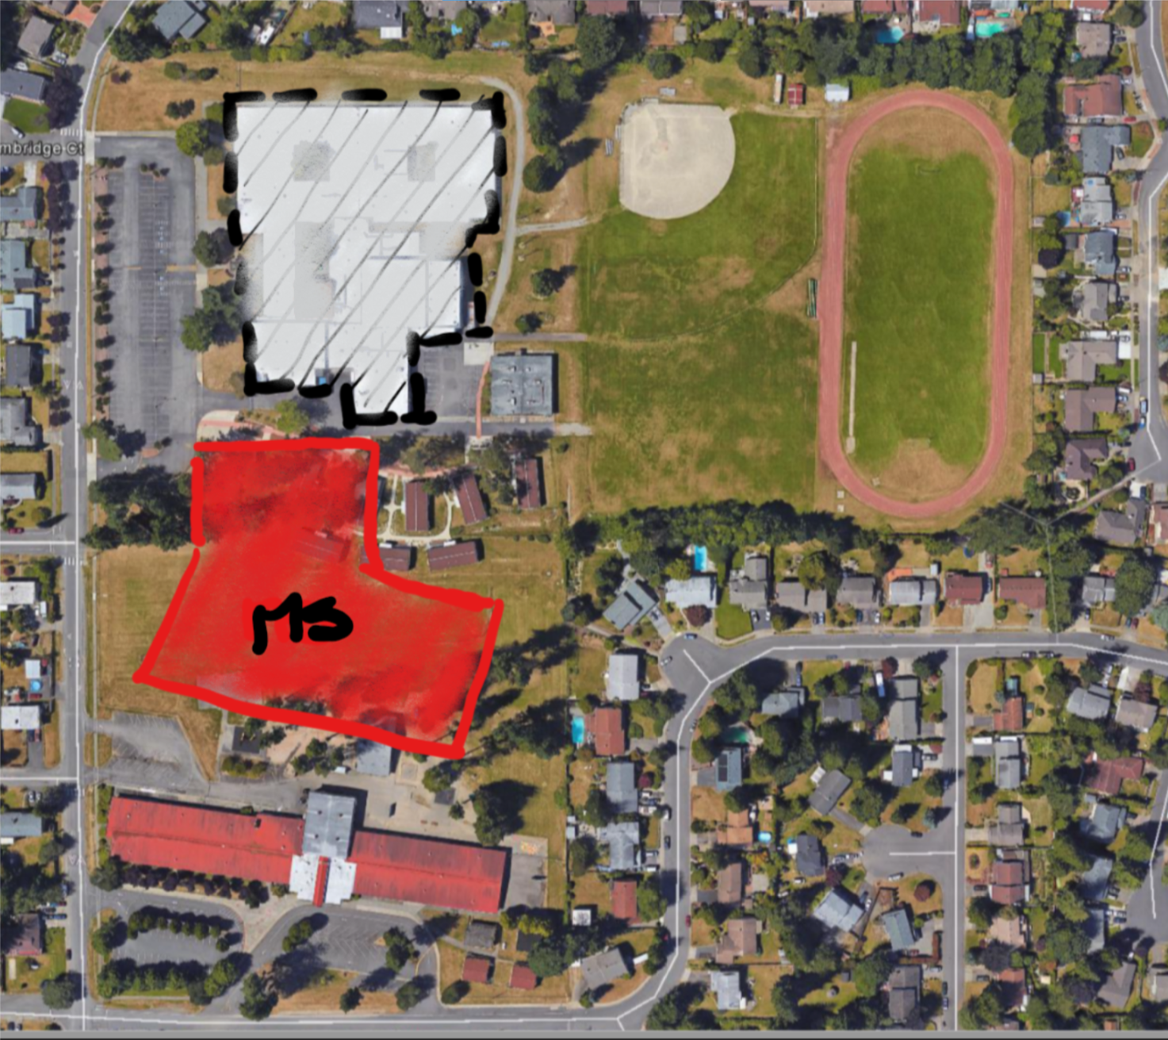
Option B – Two Schools, Shared Spaces - Step 2
Notes:
Casey

Slide 25
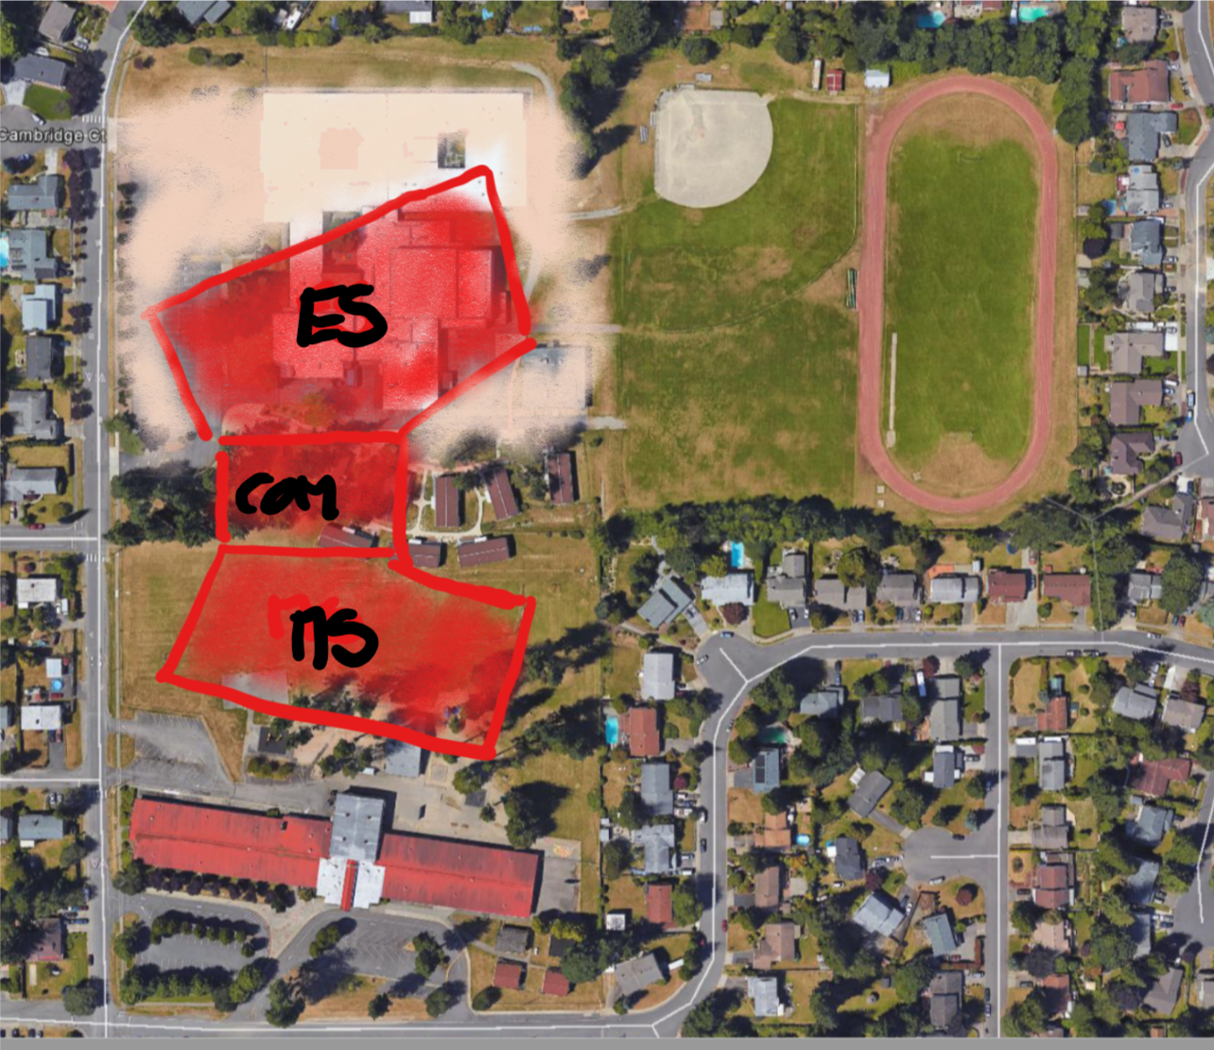
Option B – Two Schools, Shared Spaces - Step 3
Notes:
Casey

Slide 26
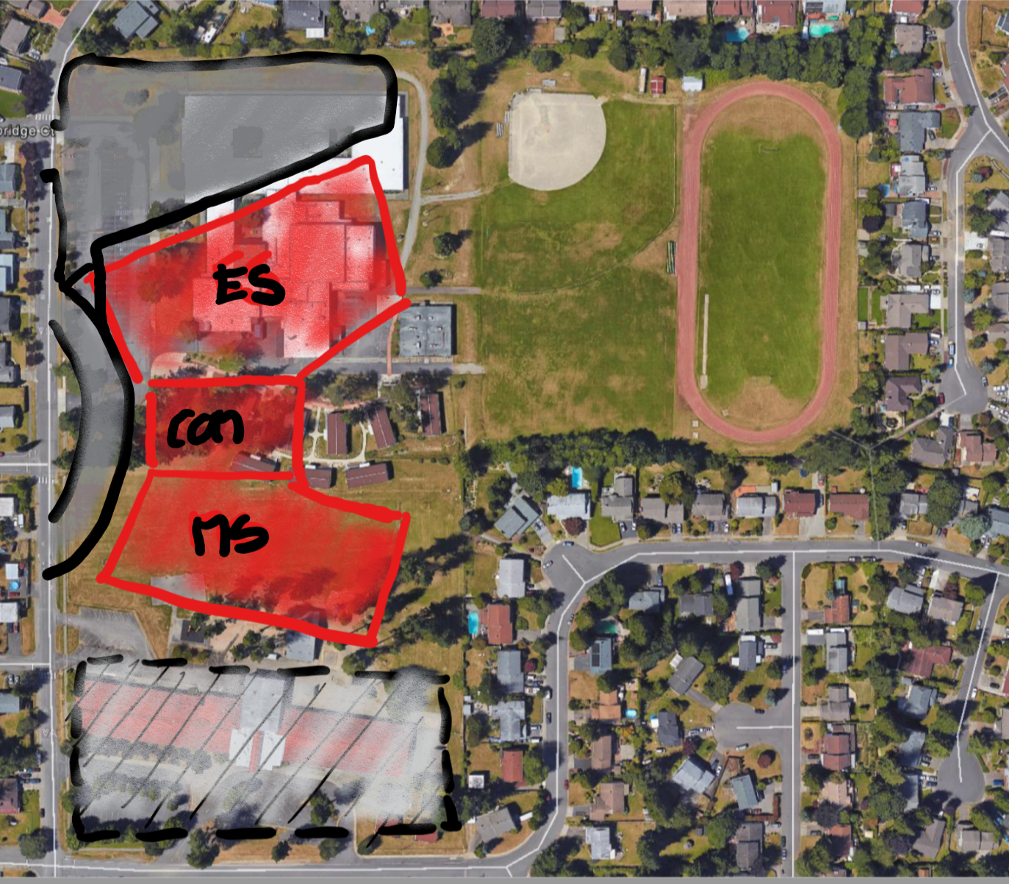
Option B – Two Schools, Shared Spaces - Step 4
Notes:
Casey

Slide 27
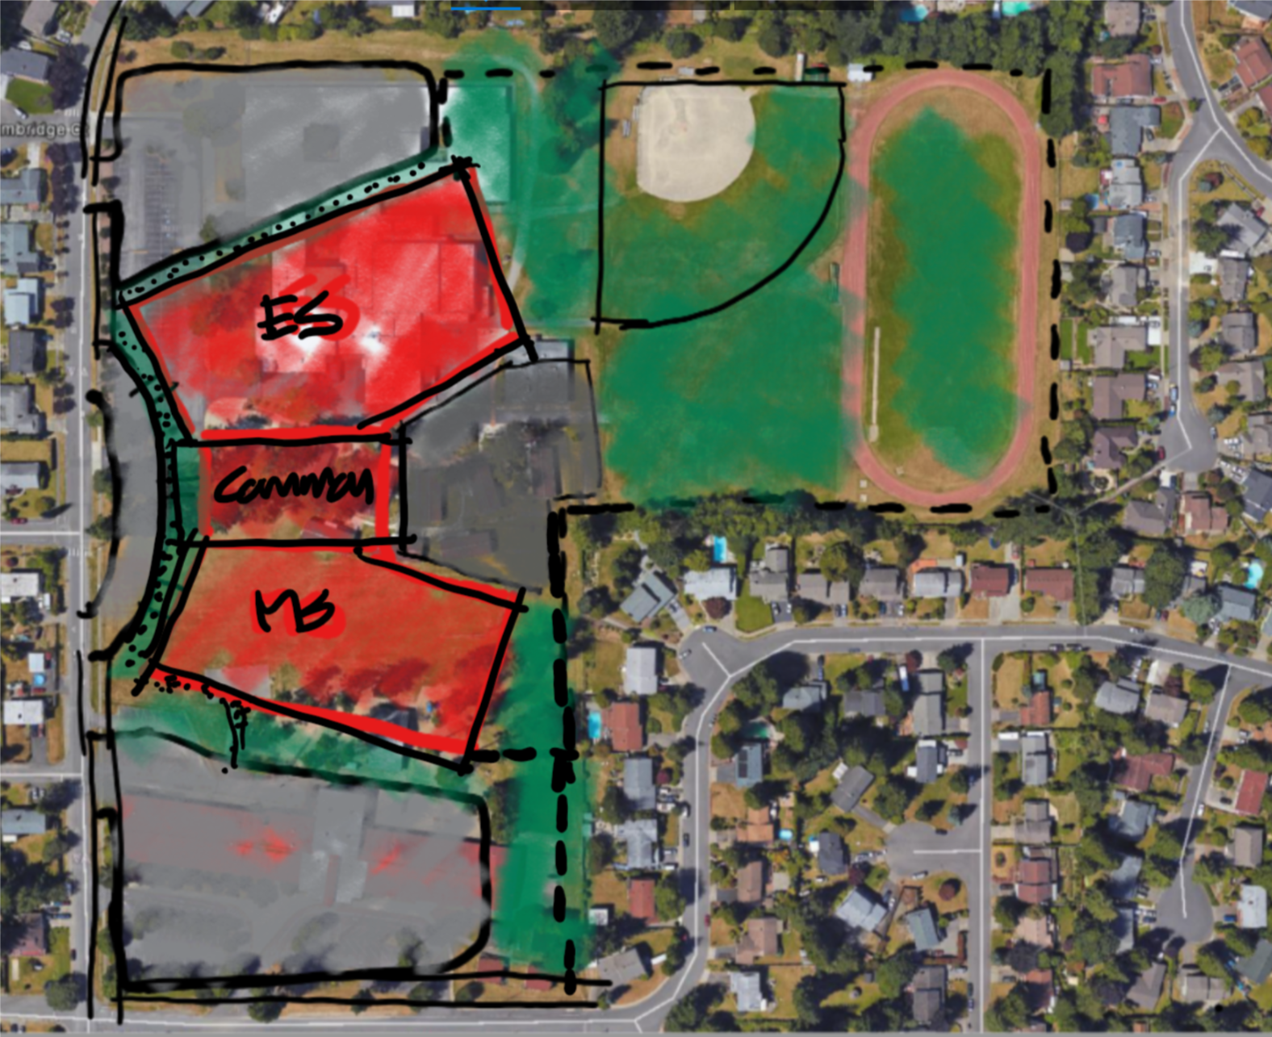
Option B – Two Schools, Shared Spaces - Step 5
Notes:
Casey

Slide 28
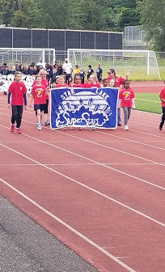
Why GC/CM?
RCW 39.10.340
Team Qualifications
Scheduling / Phasing
GC/CM critical during Design Phase
Complex & Technical Work Environment
Notes:
15 –Sally
15 –Casey
15 –Dan/Curtis
15 -Michael
Number & Timing of Capital Projects
Engage Contractor early in Design Process to assist in management of project scope, schedule, & budget
Utilize Single Architect to develop similar designs & construction documents
Ability to Bid to a single GC/CM contractor to capitalize on economy of scale
Reduce design team and contractor Construction Administration
Proximity of sites to each other
Tight Design & Construction Schedule
Reduce Potential Project Change Impacts

Slide 29
Star Lake Elementary School & Totem Middle School
Thank you!
Notes:
0

