Slide 1



FERNDALE HIGH SCHOOL REPLACEMENT PROJECT
Capital Projects Advisory Review Board, Project Review Committee
Request for GC/CM Project Delivery Method
July 25, 2019

Slide 2
AGENDA
Introductions of Project Team
Project Scope of Work
Project Challenges
Qualifying Criteria
Management Plan
Schedule & Budget
Questions?

Slide 3
PROJECT TEAM - INTRODUCTIONS
FERNDALE SCHOOL DISTRICT
Linda Quinn, Superintendent
10 years as superintendent in Ferndale; experience with multiple school construction projects
Mark Deebach, Asst. Superintendent of Business & Support Svcs.
15 years with Ferndale; experience with school construction projects
CONSTRUCTION SERVICES GROUP| ESD 112
Kirk Pawlowski, Project Executive
35+ years design, project management and executive leadership in construction
Heidi Hansen, Project Manager
20 years leading school district capital construction programs
Tex Ladish, Construction Manager
30+ years of construction management experience
Keith Bloom, GC/CM Consultant
Over 40 years & $5 billion in construction management experience
PERKINS COIE LLP
Graehm Wallace, Legal Counsel
20+ years construction law experience in WA
DYKEMAN ARCHITECTS
Tim Jewett, Principal in Charge
30+ years in architecture, 22 years leading K-12 design teams
Trish Sherman, Principal/Project Manager
27+ years in architecture, 16 years managing K-12 projects
School District Experience
GC/CM Expertise
Project Management Experts

Slide 4
PROJECT TEAM – GC/CM EXPERIENCE
Our team has experience on a number of K-12 GC/CM projects in Washington:
Lake Stevens High School* Sehome High School North Creek High School Bothell High School Marysville-Getchell High School Park Place Middle School | Surprise Lake Middle School* Kalama Secondary School* Kalama Elementary School* Lexington Elementary* Wallace Elementary*
  Supported by Perkins Coie extensive GC/CM experience
  Also 20+ higher education, health and research projects in WA & OR
* Projects in progress

Slide 5
PROJECT SCOPE OF WORK
Construct ±222,000 sf replacement high school
Replace all buildings except for Performing Arts Center (PAC)
Upgrade existing stadium, replace football/soccer field with artificial turf & re-surface track
School will be occupied during construction
Site constraints require multiple phases and select demolition
Existing buildings (except PAC) will be demolished at end of project
  Old Main building may instead be re-purposed by the City of Ferndale
Student/staff safety and operational continuity are primary concerns

Slide 6
PROJECT CHALLENGES
Existing school will be occupied during all phases of construction
Active construction areas will be adjacent to school activities
Limited site access – site surrounded by homes, businesses and railroad
District’s central transportation is located on campus – buses for entire district originate from and return to the high school
District’s central kitchen operates out of high school kitchen – daily meal deliveries to all schools, including summer meal service
Athletic fields will remain in use by community
Project meets 3 of the 6 qualifying criteria for GC/CM (RCW 39.10.340)

Slide 7
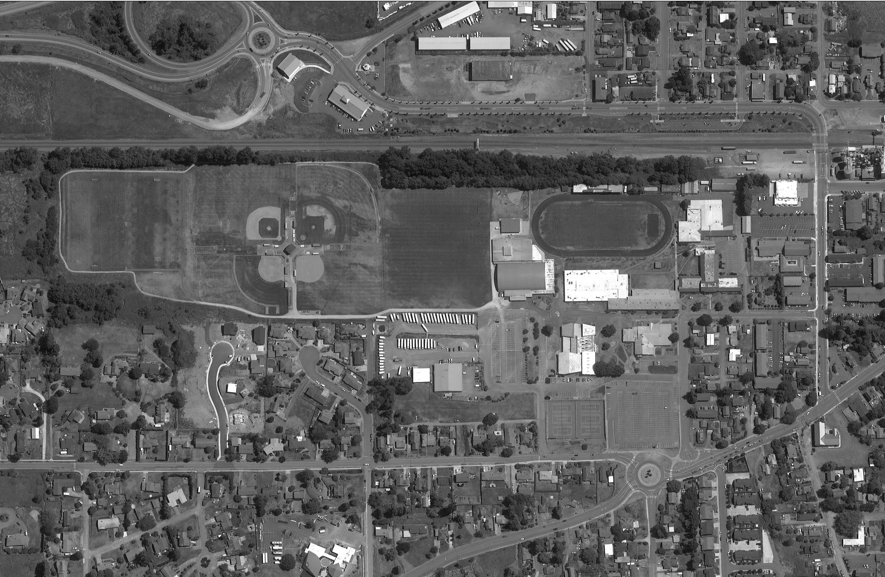
COMPLEX & CONSTRAINED SITE
FHS CAMPUS
OLD MAIN BLDG*
CONSTRUCTION AREA
×
×
DEMO
Occupied during construction
×
×
×
×
PRIMARY ACCESS
SECONDARY ACCESS
RAILROAD
CENTRAL KITCHEN
BUS YARD
*Old Main Building may be converted to City use instead of demolishing
PAC

Slide 8
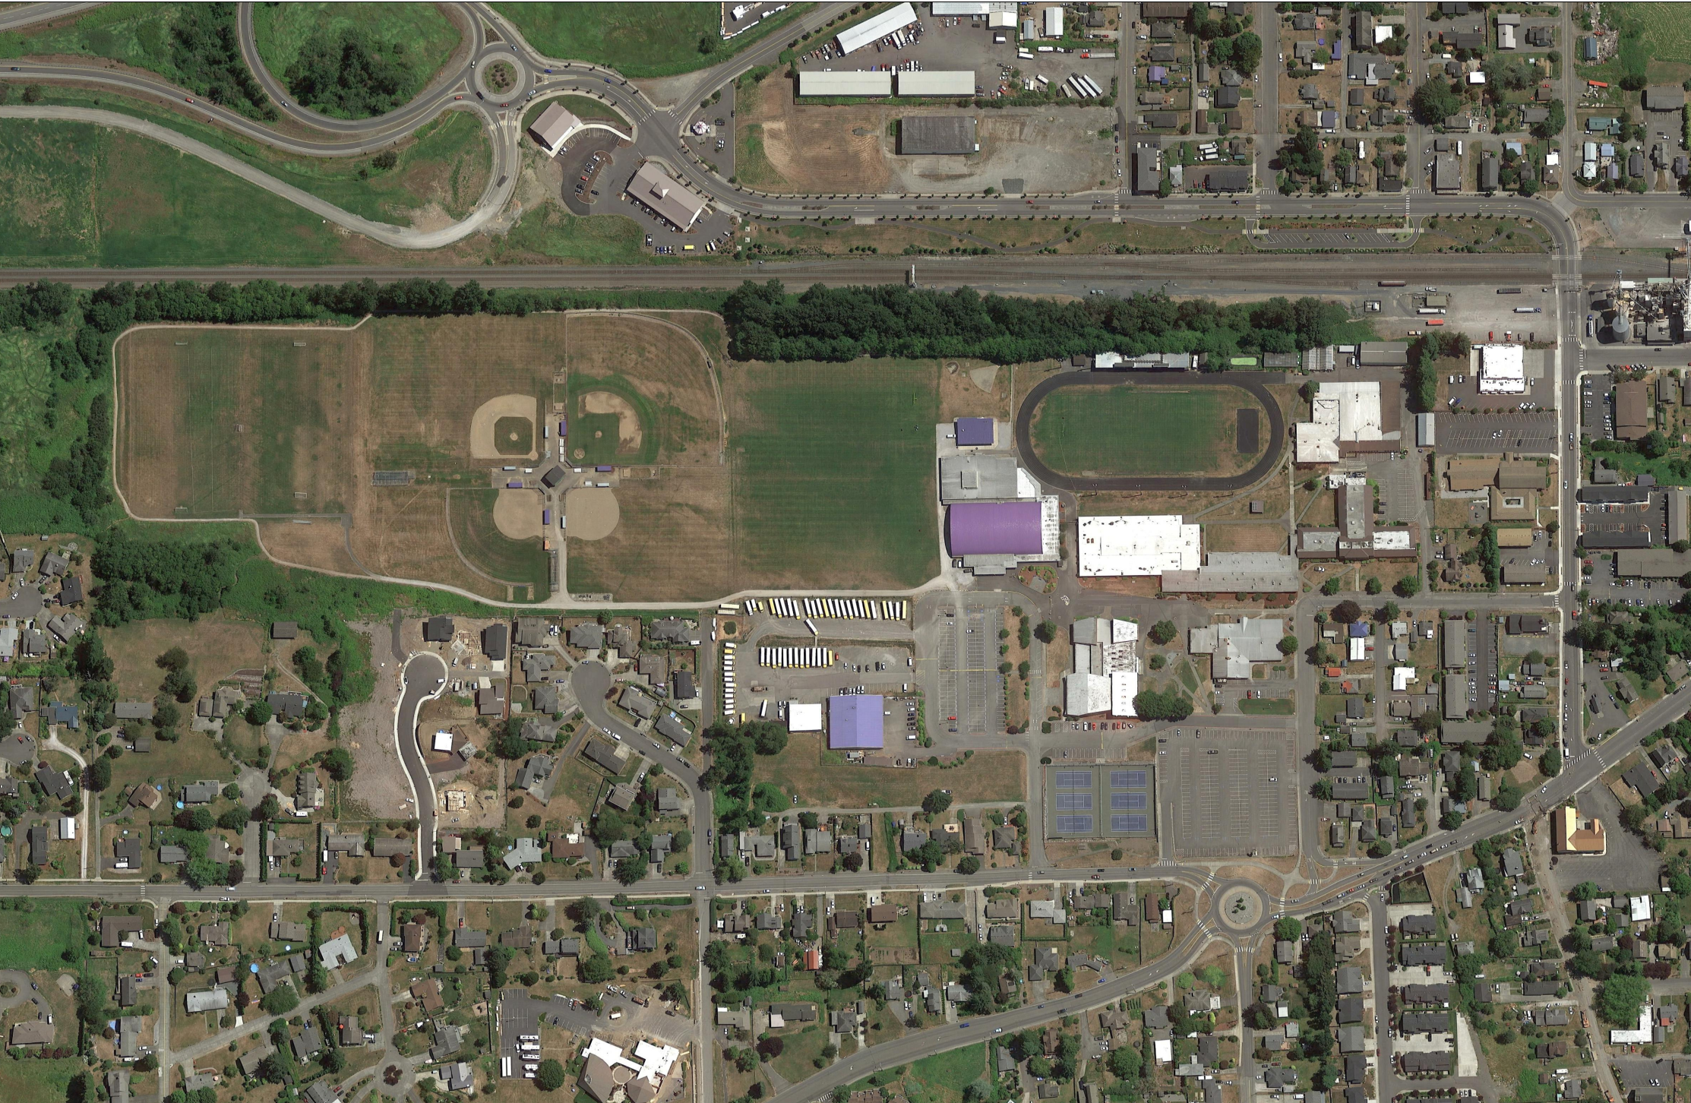
CENTRAL KITCHEN & BUS FACILITY LOCATED ON CAMPUS
BUSES
160 bus trips each AM & PM
13 mid-day trips
Average 4+ field trips daily
Buses use same access as vehicles (but stagger times)
CENTRAL KITCHEN
Daily meal deliveries to all schools
Meal service continues through summers

Slide 9
LIMITED ACCESS & PARKING
P
Student Parking & Access
Students park in 2 lots
Limited access points
Not enough spaces – many students park off campus and walk
Parent Pick-Up/Drop-Off
Uses same driveway as students and buses
Visitor Parking
Shares lot with students
During school dismissal times, exits are right-turn only
Only access to athletic fields, including community use, is through campus
Path to
Athletic
Fields
P
VISITOR
*
P
*
*

Slide 10
EARLY CONTRACTOR INPUT REQUIRED
Early and continuous site coordination by General Contractor will be critical to ensure student, staff and public safety. Cumulative impacts during construction will be significant, including:
  Relocating student pathways to/from buildings
  Changing building entrances
  Relocating student, staff and visitor parking
  Modifying access and site circulation
  Maintaining safe separation of construction traffic from buses, delivery vehicles and school traffic
Multiple site re-configurations may be required during each phase

Slide 11
QUALIFYING CRITERIA (RCW 39.10.340)
✓ | Implementation of the project involves complex scheduling, phasing, or coordination;
✓ | The project involves construction at an occupied facility which must continue to operate during construction;
✓ | The involvement of the general contractor/construction manager during the design stage is critical to the success of the project;
 | The project encompasses a complex or technical work environment;
 | The project requires specialized work on a building that has historic significance; or
 | The project is, and the public body elects to procure the project as, a heavy civil construction project.

Slide 12
MANAGEMENT PLAN
Ferndale School Board
Bond Oversight Committee
Ferndale Superintendent
Dr. Linda Quinn
Legal Counsel - Graehm Wallace Perkins Coie
Asst. Superintendent/CFO
Mark Deebach
Executive Steering Committee
Design Advisory Committee
Project Executive – CSG
Kirk Pawlowski
Design 20% / Construct 10%
Project Manager – CSG
Heidi Hansen
Design 80% / Construct 20%
GC/CM - TBD
Project Support – CSG
Keith Bloom, GC/CM Consultant +Sr. Project Manager
Design 20% / Construct 30%
Tex Ladish
Construction Project Manager
Design 40% / Construct 80%
Designer – Dykeman
Tim Jewett – PIC
SD 25% / DD 25% / CD 25%/ CA 25%
Trish Sherman – Project Manager
SD 80% / DD 80% / CD 80%/ CA 60%
Subcontractors - TBD

Slide 13
MANAGEMENT PLAN - Continuity of Experience
Experience at multiple levels of CSG, Dykeman and Perkins Coie
  Diverse range of successful GC/CM experience
  Nationally recognized legal expertise in construction
Committed leadership of District throughout the project
  Superintendent & Asst. Superintendent have experience with school construction projects
  Executive Steering Committee meets weekly
  Assistant Superintendent plans to attend next AGC GC/CM Workshop
  Ability to provide additional experienced personnel during peak work loads

Slide 14
PROJECT BUDGET
Funded by capital bonds from a tax measure passed February 2019, with additional State Construction Assistance Program (SCAP) funding

Slide 15
PROJECT MILESTONES
PROJECT MILESTONES | DATES
Begin Pre-Design & Visioning Process | June 1, 2019
School Board Approval of GC/CM Resolution | July 30, 2019
First publication of RFQ for GC/CM Services | July 31, 2019
Start Educational Specifications | August 1, 2019
Second publication of RFQ for GC/CM Services | August 7, 2019
Project Information Meeting | August 14, 2019
RFQ Submittal Deadline | August 21, 2019
Notify Short-List | August 23, 2019
Interview Short-Listed Firms | August 29, 2019
Invite Most Qualified Firms to Submit Proposals | August 30, 2019
RFP Submittal Deadline and Opening | September 10, 2019
Notify Most Qualified GC/CM | September 12, 2019
Pre-Con Work Plan Due | September 23, 2019
School Board Approval of GC/CM Selection | September 24, 2019
GC/CM Agreement w/ Pre-Con Services Executed | September 26, 2019
Begin Schematic Design | October 1, 2019
Begin Design Development | March 1, 2020
Begin Construction Documents | December 1, 2020
MACC Estimate / Negotiation (90% CDs) | March 15, 2021
School Board Approval of MACC / GMP | April 28, 2021
Begin Construction | June 20, 2021
GMP Amendment Executed | July 15, 2021
Anticipated Substantial Completion | September 1, 2023
Anticipated Final Completion | December 1, 2023
General Contractor will be on board prior to the start of Schematic Design

Slide 16
QUESTION FROM PRC – FINANCIAL CONTROLS
What other financial controls are in place or will be utilized? The ones presented are just per the board policy and do not represent how you will effectively manage and control the payments etc. associated with the project.
Invoice Review – All project invoices and pay applications are reviewed and approved for payment by the Project Manager. Invoices are back-checked against contracts and schedules to ensure that payments are within budget, scope and tracking appropriately.
Budget Tracking – A Master Budget and Financial Tracking Report are used to track budgets, encumbrances, actual and anticipated revenues and expenditures, contingency balances, and bond project fund balances.
Financial Reporting – Financial reports are shared real-time with the Executive Steering Committee, and with the Citizen’s Bond Oversight Committee and School Board on a monthly basis.

Slide 17
QUESTIONS?

