Slide 1



New Elementary School Project
July 25, 2019
Insert Picture

Slide 2
Agenda
Introductions of Project Team
Knowledge and Experience
Project Scope of Work
Funding, Timeline and Budget
Qualifying Criteria
Questions and Answers

Slide 3
a community vision for the future
New K-5 elementary school on existing campus of Fife High School

Slide 4
a community vision for the future
New K-5 elementary school on existing campus of Fife High School
Site proximity to existing occupied high school creates safety concerns, site constraints, and access impacts during construction activities

Slide 5
a community vision for the future
New K-5 elementary school on existing campus of Fife High School
Site proximity to existing occupied high school creates safety concerns, site constraints, and access impacts during construction activities
Primary concerns are the safety of the Fife School District staff, students, and visitors, and mitigating disruptive impacts during the construction period

Slide 6
a community vision for the future
New K-5 elementary school on existing campus of Fife High School
Site proximity to existing occupied high school creates safety concerns, site constraints, and access impacts during construction activities
Primary concerns are the safety of the Fife School District staff, students, and visitors, and mitigating disruptive impacts during the construction period
Confidence in project delivery model

Slide 7
a community vision for the future
New K-5 elementary school on existing campus of Fife High School
Site proximity to existing occupied high school creates safety concerns, site constraints, and access impacts during construction activities
Primary concerns are the safety of the Fife School District staff, students, and visitors, and mitigating disruptive impacts during the construction period
Confidence in project delivery model
Meets Qualifying Criteria (39.10.340)

Slide 8
a community vision for the future
New K-5 elementary school on existing campus of Fife High School
Site proximity to existing occupied high school creates safety concerns, site constraints, and access impacts during construction activities
Primary concerns are the safety of the Fife School District staff, students, and visitors, and mitigating disruptive impacts during the construction period
Confidence in project delivery model
Meets Qualifying Criteria (39.10.340)
Knowledge and Experience

Slide 9
Project Team: school district & District Legal counsel
FIFE SCHOOL DISTRICT | FIFE
Kevin Alfano, Superintendent of Fife School District
  More than 22 years in the District including 5 years as Superintendent
Jeff Nelson, Executive Director of Teaching & Learning
  35 years in Fife including 16 years as a middle school teacher
PERKINS COIE LLP | SEATTLE
Graehm C. Wallace, Partner
  22 years construction law experience in Washington

Slide 10
Project Team:
District Design & Project management
CONSTRUCTION SERVICES GROUP | ESD 112
Phil Iverson, Senior Bond Program Manager
  19 years project planning and management
Kirk Pawlowski, Project Executive
    35+ years design, project management, and executive leadership in construction
Keith Bloom, GC/CM Consulting Manager
    Over $5 billion and 40 years in construction management experience
Justin Rogers, Project Manager
    Former Director, OSPI School Facilities Organization
INTEGRUS ARCHITECTURE | SEATTLE
Brian Carter, CEO | Principal
    Statewide K12 GC/CM subject matter expert
Loretta Sachs, Project Manager
    14 years of experience including Surprise Lake Middle School

Slide 11
Knowledge and Experience
District Team’s Experience: ESD 112/CSG, Integrus Architecture, and Perkins Coie
The District’s project management and design team members have participated in GC/CM project delivery for more than 20 years
Current GCCM project at the District in progress: Surprise Lake Middle School Replacement
More than 60 alternative delivery projects and over $5 billion in construction contract management successfully completed
Nationally-respected legal expertise in construction procurement and advice during construction
Currently and successfully executing multiple GC/CM K12 projects
Ability of project management and design teams to provide additional depth of expertise with additional staff resources at any time

Slide 12
Project Scope of Work
Construct new K-5 elementary school on existing campus of Fife High School
Approximately 113,000 GSF serving 850 students
Allows District to meet growths needs of community and utilize existing 1950s-era elementary school for non-instructional purposes
Site proximity to existing high school creates safety concerns, site constraints, and access impacts during construction activities
Primary concerns are the safety of the Fife School District staff, students, and visitors, and mitigating disruptive impacts during the construction period

Slide 13
Total project cost budget
Construction: Guaranteed Maximum Price (GMP)……………………………………………$52,003,000
Off-site Costs………………………………………………………………………………included in GMP
A/E Basic & Additional Services, Consultant Fees, Legal………………………………………...$5,259,763
Permitting, Impact Fees, Utilities…………………………………………………………………..$640,000
Project Administration…………………………………………………………………………..$3,101,626
Equipment & Furnishings…………………………………………………………………………$2,700,00
Owner & Design Contingency………………………………………………………………….$7,800,450
Sales Tax …………………………………………………………………………………………$5,148,297
Total Project Cost $76,653,136

Slide 14
Funding and project Timeline
Successful Bond Election February 2018 with $75M Bonds sold in May 2018.
Second bond sale of $75M scheduled for November 2019 with remaining bonds to be sold in 2020.
Elementary School Project Schedule
  Publication for GC/CM Services late July – mid August 2019
  Short-list late August 2019
  RFP Deadline mid September 2019
  Notification mid September 2019
  Execute Pre-Con Agreement late September 2019
  Design Development Start early October 2019
  MACC Estimate / Negotiation May 2020
  GMP Execution May 2020
  Anticipated Final Completion August 2021

Slide 15
Qualifying Criteria (RCW 39.10.340)
Public bodies may utilize the general contractor/construction manager procedure for public works projects where at least one of the following is met:
Implementation of the project involves complex scheduling, phasing, or coordination;
The project involves construction at an occupied facility which must continue to operate during construction;
The involvement of the general contractor/construction manager during the design stage is critical to the success of the project;
  The project encompasses a complex or technical work environment;
  The project requires specialized work on a building that has historic significance; or
  The project is, and the public body elects to procure the project as, a heavy civil construction project. However, no provision of this chapter pertaining to a heavy civil construction project applies unless the public body expressly elects to procure the project as a heavy civil construction project.

Slide 16
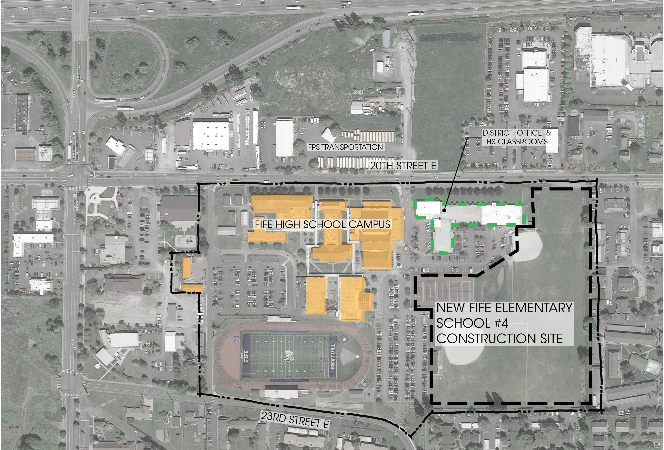
Qualifying Criteria:
Site diagram
Student/Staff Safety During Construction
Site Constraints
Access Limitations
Proximity to HS Campus
Parking Impacts
Traffic: I-5 Corridor

Slide 17
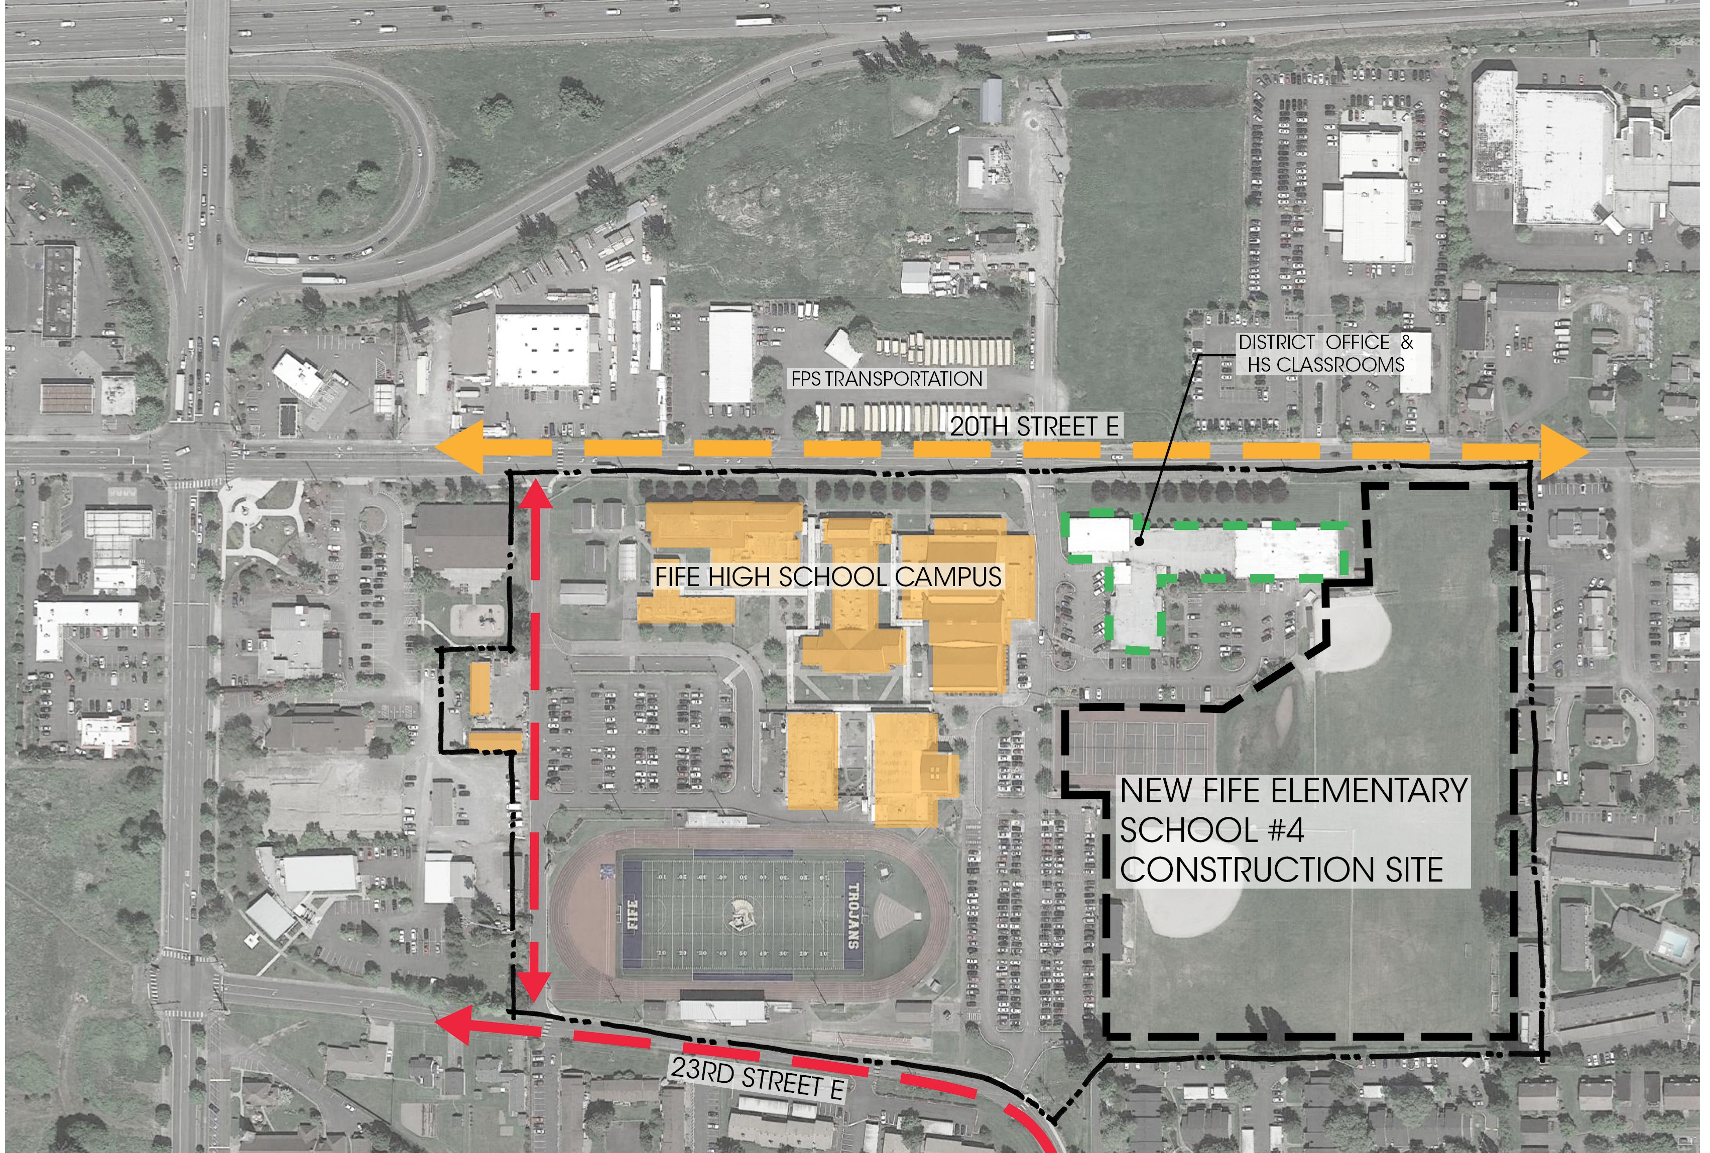
Qualifying Criteria:
Site diagram
Student/Staff Safety During Construction
Site Constraints
Access Limitations
Proximity to HS Campus
Parking Impacts
Traffic: I-5 Corridor

Slide 18
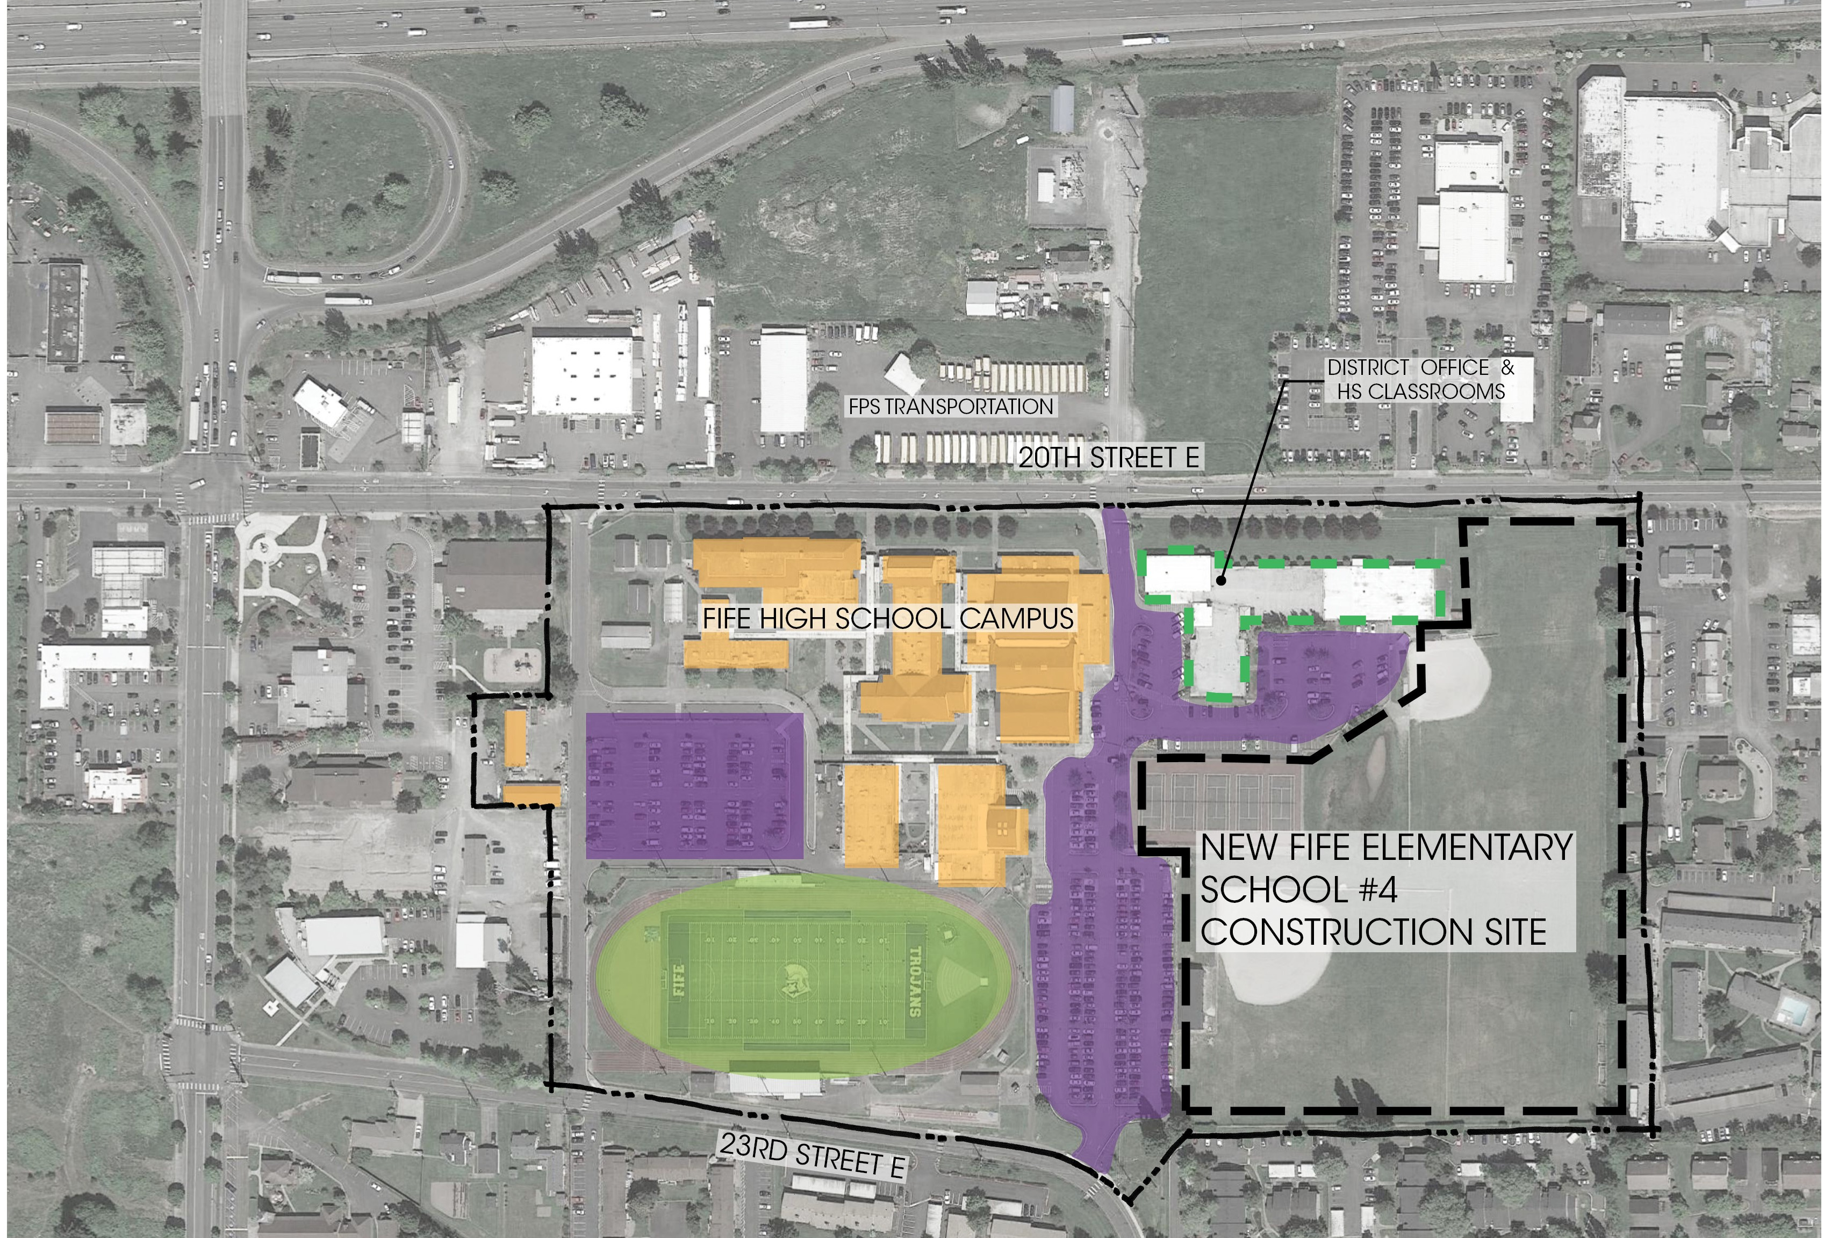
Qualifying Criteria:
Site diagram
Student/Staff Safety During Construction
Site Constraints
Access Limitations
Proximity to HS Campus
Parking Impacts
Traffic: I-5 Corridor

Slide 19
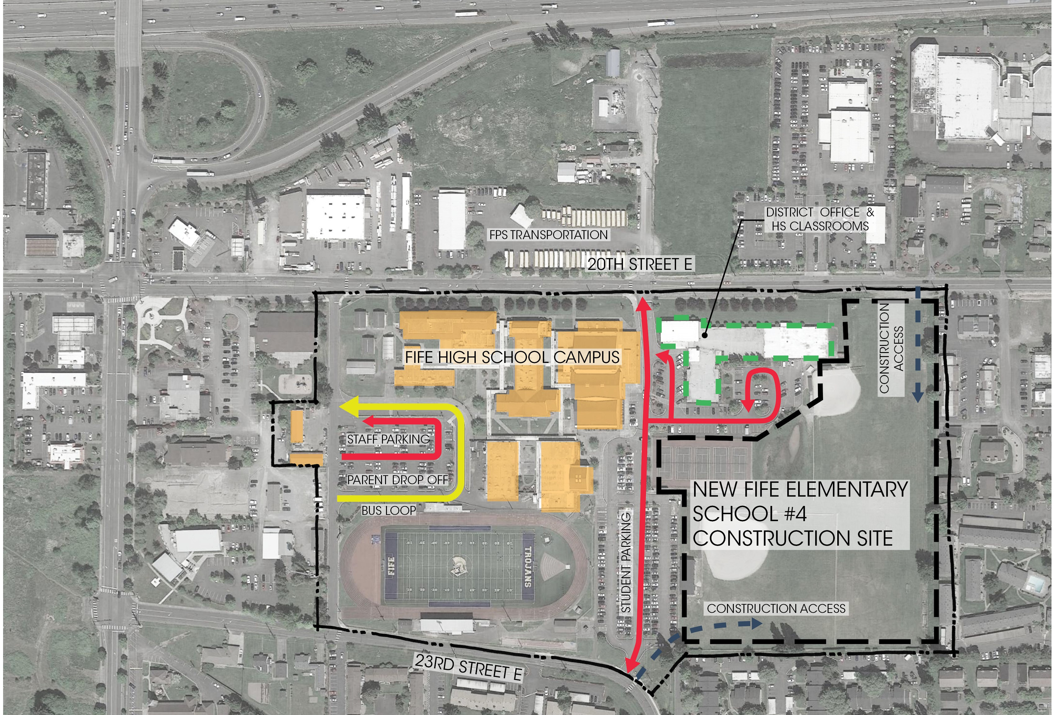
Qualifying Criteria:
Site diagram
Student/Staff Safety During Construction
Site Constraints
Access Limitations
Proximity to HS Campus
Parking Impacts
Traffic: I-5 Corridor

Slide 20
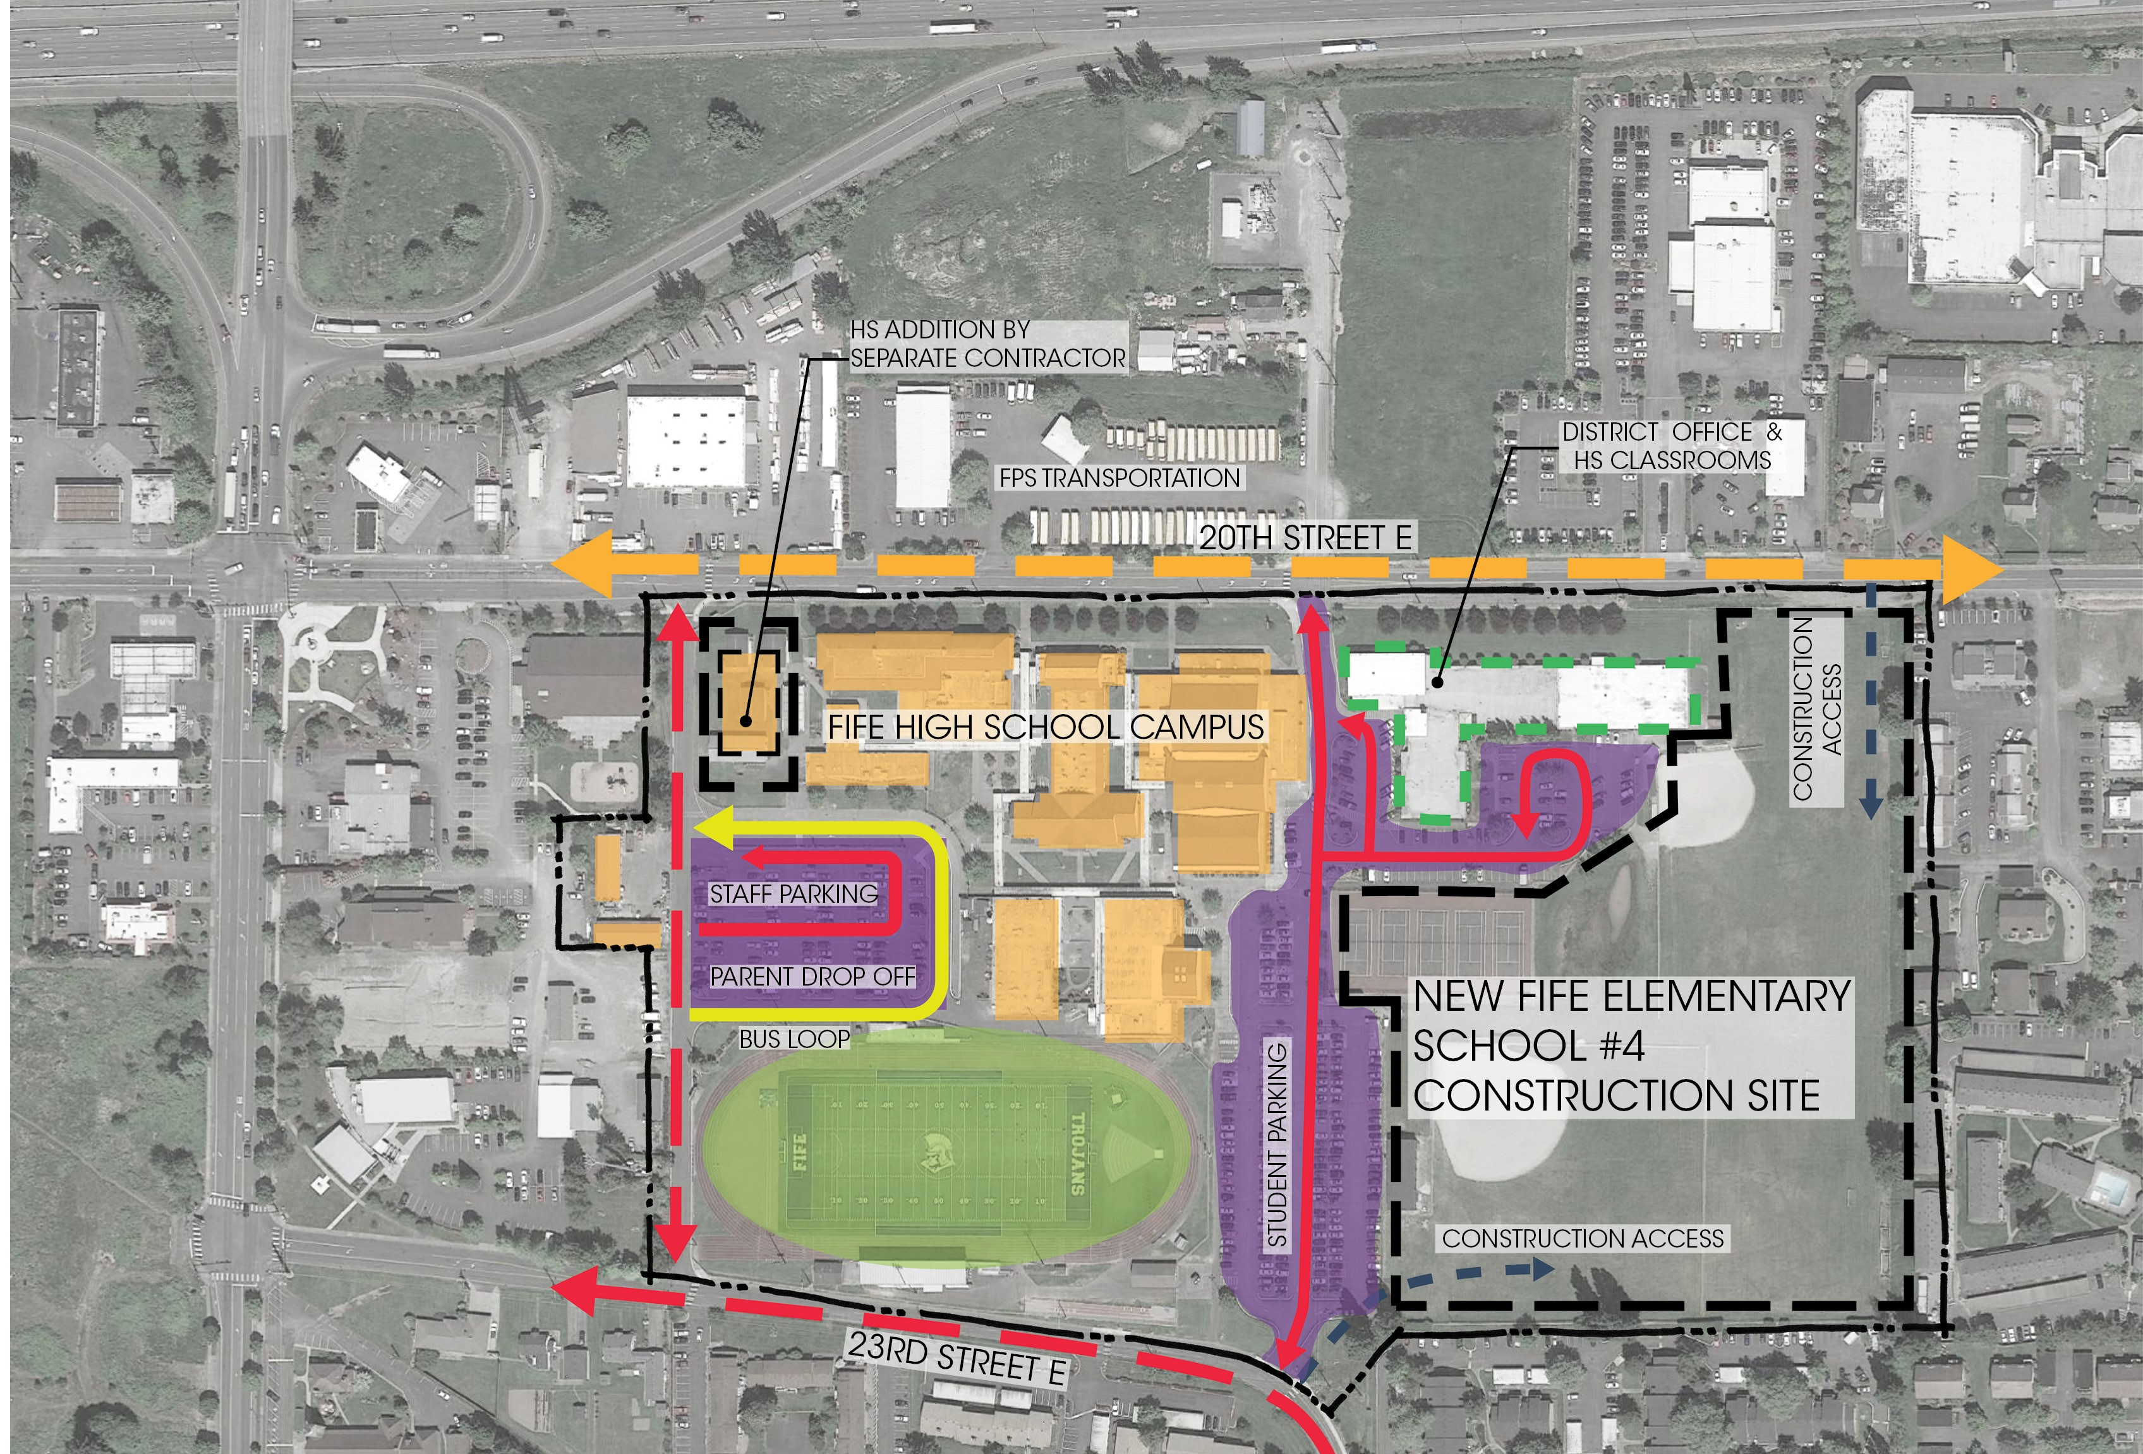
Qualifying Criteria:
Site diagram
Student/Staff Safety During Construction
Site Constraints
Access Limitations
Proximity to HS Campus
Parking Impacts
Traffic: I-5 Corridor

Slide 21
QUESTIONS FROM THE PRC
Please provide the “Off-Site Costs” as a separate line item in the Project Budget and provide a brief explanation of what the item includes.

Slide 22
QUESTIONS FROM THE PRC
Early Planning:
The District and project team determined that there would be offsite improvements beyond the typical utility relocations, street lighting, crosswalks, sidewalks, etc. required due to the proposed site.
Based on these realizations, the District and project team began working with the City of Fife, JHA (Jurisdiction Having Authority) as part of the early/conceptual planning process.

Slide 23
QUESTIONS FROM THE PRC
Current Ongoing Planning Process:
As this partnership and ongoing planning process continues with the local jurisdiction, the project team has engaged in the services of a traffic engineering firm familiar with the requirements for the local area to assist both JHA and the design team.
The project team continues to work to fully define the scope and capital cost of the potential off-site improvements.

Slide 24
QUESTIONS FROM THE PRC
Budget Planning:
Additional funds have been reserved in budget contingencies and are included in the total project budget outside of the total cost of construction (TCC) budget.
The District is still in the process of negotiating the extent of the District’s cost participation with the City of Fife.

Slide 25
QUESTIONS FROM THE PRC
Budget Planning:
The District and project team have full confidence that sufficient resources have been identified based on actual experience with similar conditions.
Partnering with a GC/CM will be vital for defining the costs and logistics of any required offsite improvements in the future.

Slide 26

Kevin Alfano, Superintendent
kalfano@fifeschools.com
PHIL IVERSON, Project Manager
PHILLIP.IVERSON@esd112.org

