Slide 1

Samaritan Healthcare | Moses Lake, WA
Presentation for PRC Approval GC/CM Project Delivery | June 27, 2019

Slide 2
Agenda
Introductions of Project Team - Dick
Why GC/CM for Samaritan Healthcare – Dick
Samaritan Healthcare – Theresa
Program and Project Overview – Joe
Project Concepts – Victoria
Schedule – Jeff
Fiduciary Management – Alex
Summary/Questions – Theresa

Slide 3
Project Team - Dick
Theresa Sullivan CEO | Samaritan Healthcare
  Overall Responsibility
Alex Town CAO | Samaritan Healthcare
  Financial Management
Joe Kunkel Owner | The Healthcare Collaborative
  Project Director Jeff Caldwell - Project Management
Victoria Nichols Partner/Project Manager | ZGF
  PAE/PCS Engineering Consultants
Dick Bratton Owner | DBPM
  GC/CM Advisory
Foster Pepper
  Counsel Experience with RCW 39.10

Slide 4
Why GC/CM for Samaritan Healthcare -Dick
SH New Hospital Project Significance
  Project Meets GC/CM Criteria
    Critical Scheduling, Phasing, Transition
    Early GC/CM Interaction Essential for Successful Project
    Undertake a 3 stage selection process
  Cost and Schedule Early Input
  Review of SD/Site Challenges/Constructability
  Establish Budget/Provide DD Baseline
  Identify and Coordinate Long Lead Items
  Rural Location-Trade Commitments and Availability
  Industry Forces $1.5B Bonds Spokane
  GC/CM Influence and Coordination of Move Transition
  Possible EC/MC/CM Approach/Advantage

Slide 5
Samaritan Healthcare - Theresa
History of Samaritan Healthcare
Grant County Public Hospital District #1 was created by community vote in December of 1947.
In 1955, the new hospital opened on Wheeler Road. Since then, the hospital has been expanded in 1980, 1992, and the largest expansion in 2002.
The community demonstrated commitment to local healthcare through the giving of their time and money both through donations and approving a levy to fund the hospital building back in 1955.
The founding fathers and mothers didn’t believe people should have to travel for healthcare.
Building On SH Past
Board of Commissioners have continued the commitment to keep healthcare local.
They have sought community input and feedback and developed a strategic plan to grow access to care locally.

Slide 6
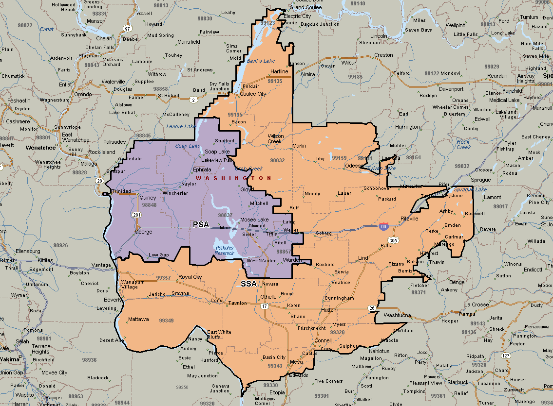
Building on the Past…
Samaritan Healthcare Service Area

Slide 7
BUILDING OUR FUTURE
Building on the Past…Community Input
Between 2016-2018 we have spoken/met with over 1,000 residents
What significant changes are needed for improving you and your family’s health care experience in Grant County?
#1
More specialty
providers available
#2
More primary care
providers available
#3
Engaged, qualified, and caring providers/staff
#4
Modern, up-to-date facilities

Slide 8
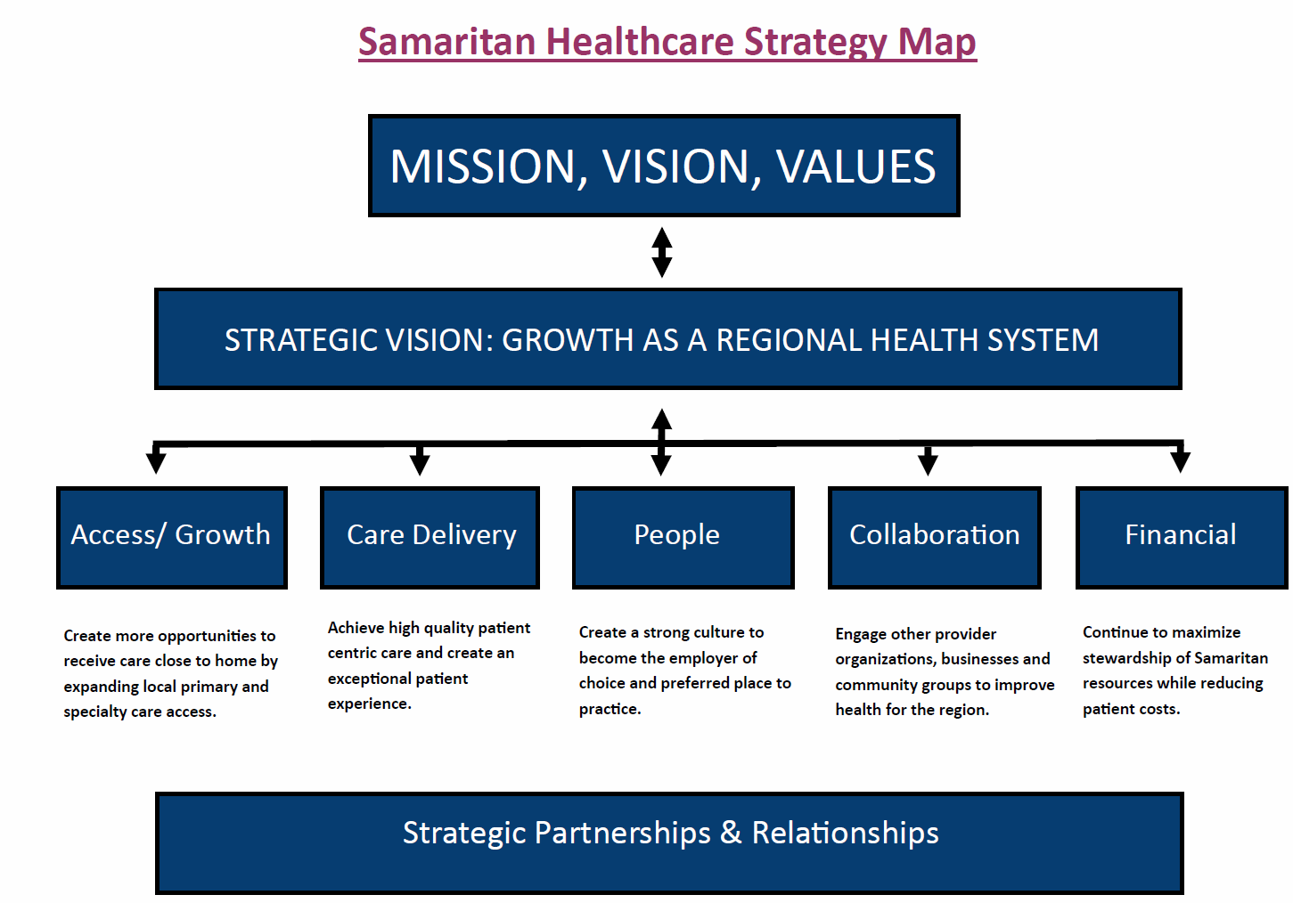
Building For The Future
5-14-19

Slide 9

Odessa Ritzville Ephrata Othello Quincy Moses Lake

Slide 10
Purpose of the New Facility
1. To enable Samaritan Healthcare to advance our strategic plan and to grow as a regional healthcare organization.
  Supporting our growing area
  Advancing services regionally through the GCHA
To eliminate our current constraints
  Land-locked
  Structural concerns with old building
To increase efficiency and patient flow
To create an exceptional patient and staff experience

Slide 11
Program and Project Overview - Joe
Tie to Strategic Plan as regional provider and Grand Columbia Health Alliance
Drove projections of volumes/market share
Evaluation of current facility – capacity, operations and ability to meet the need
Lead Samaritan to new facility development

Slide 12
Program Highlights
50 beds
6 OR’s
12 ER Bays
Full-scope imaging
Ancillary/Support
Medical office development in future
Approximately 148,000 sf (mix of hospital, ambulatory, office)

Slide 14
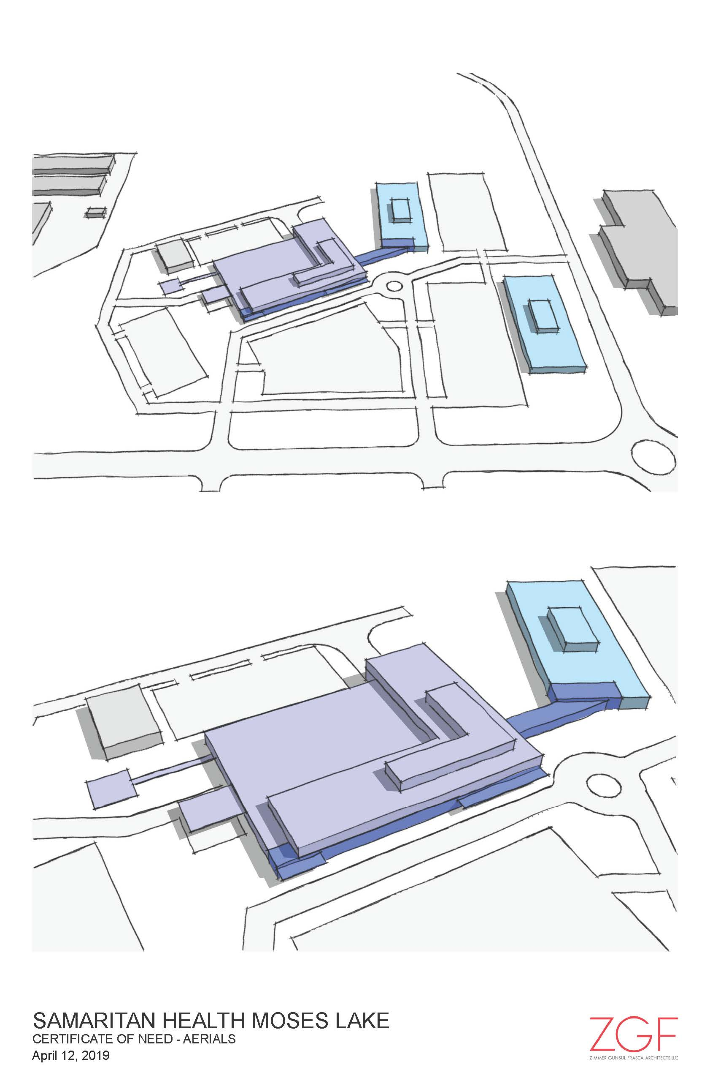
Project Concept - Victoria

Slide 15
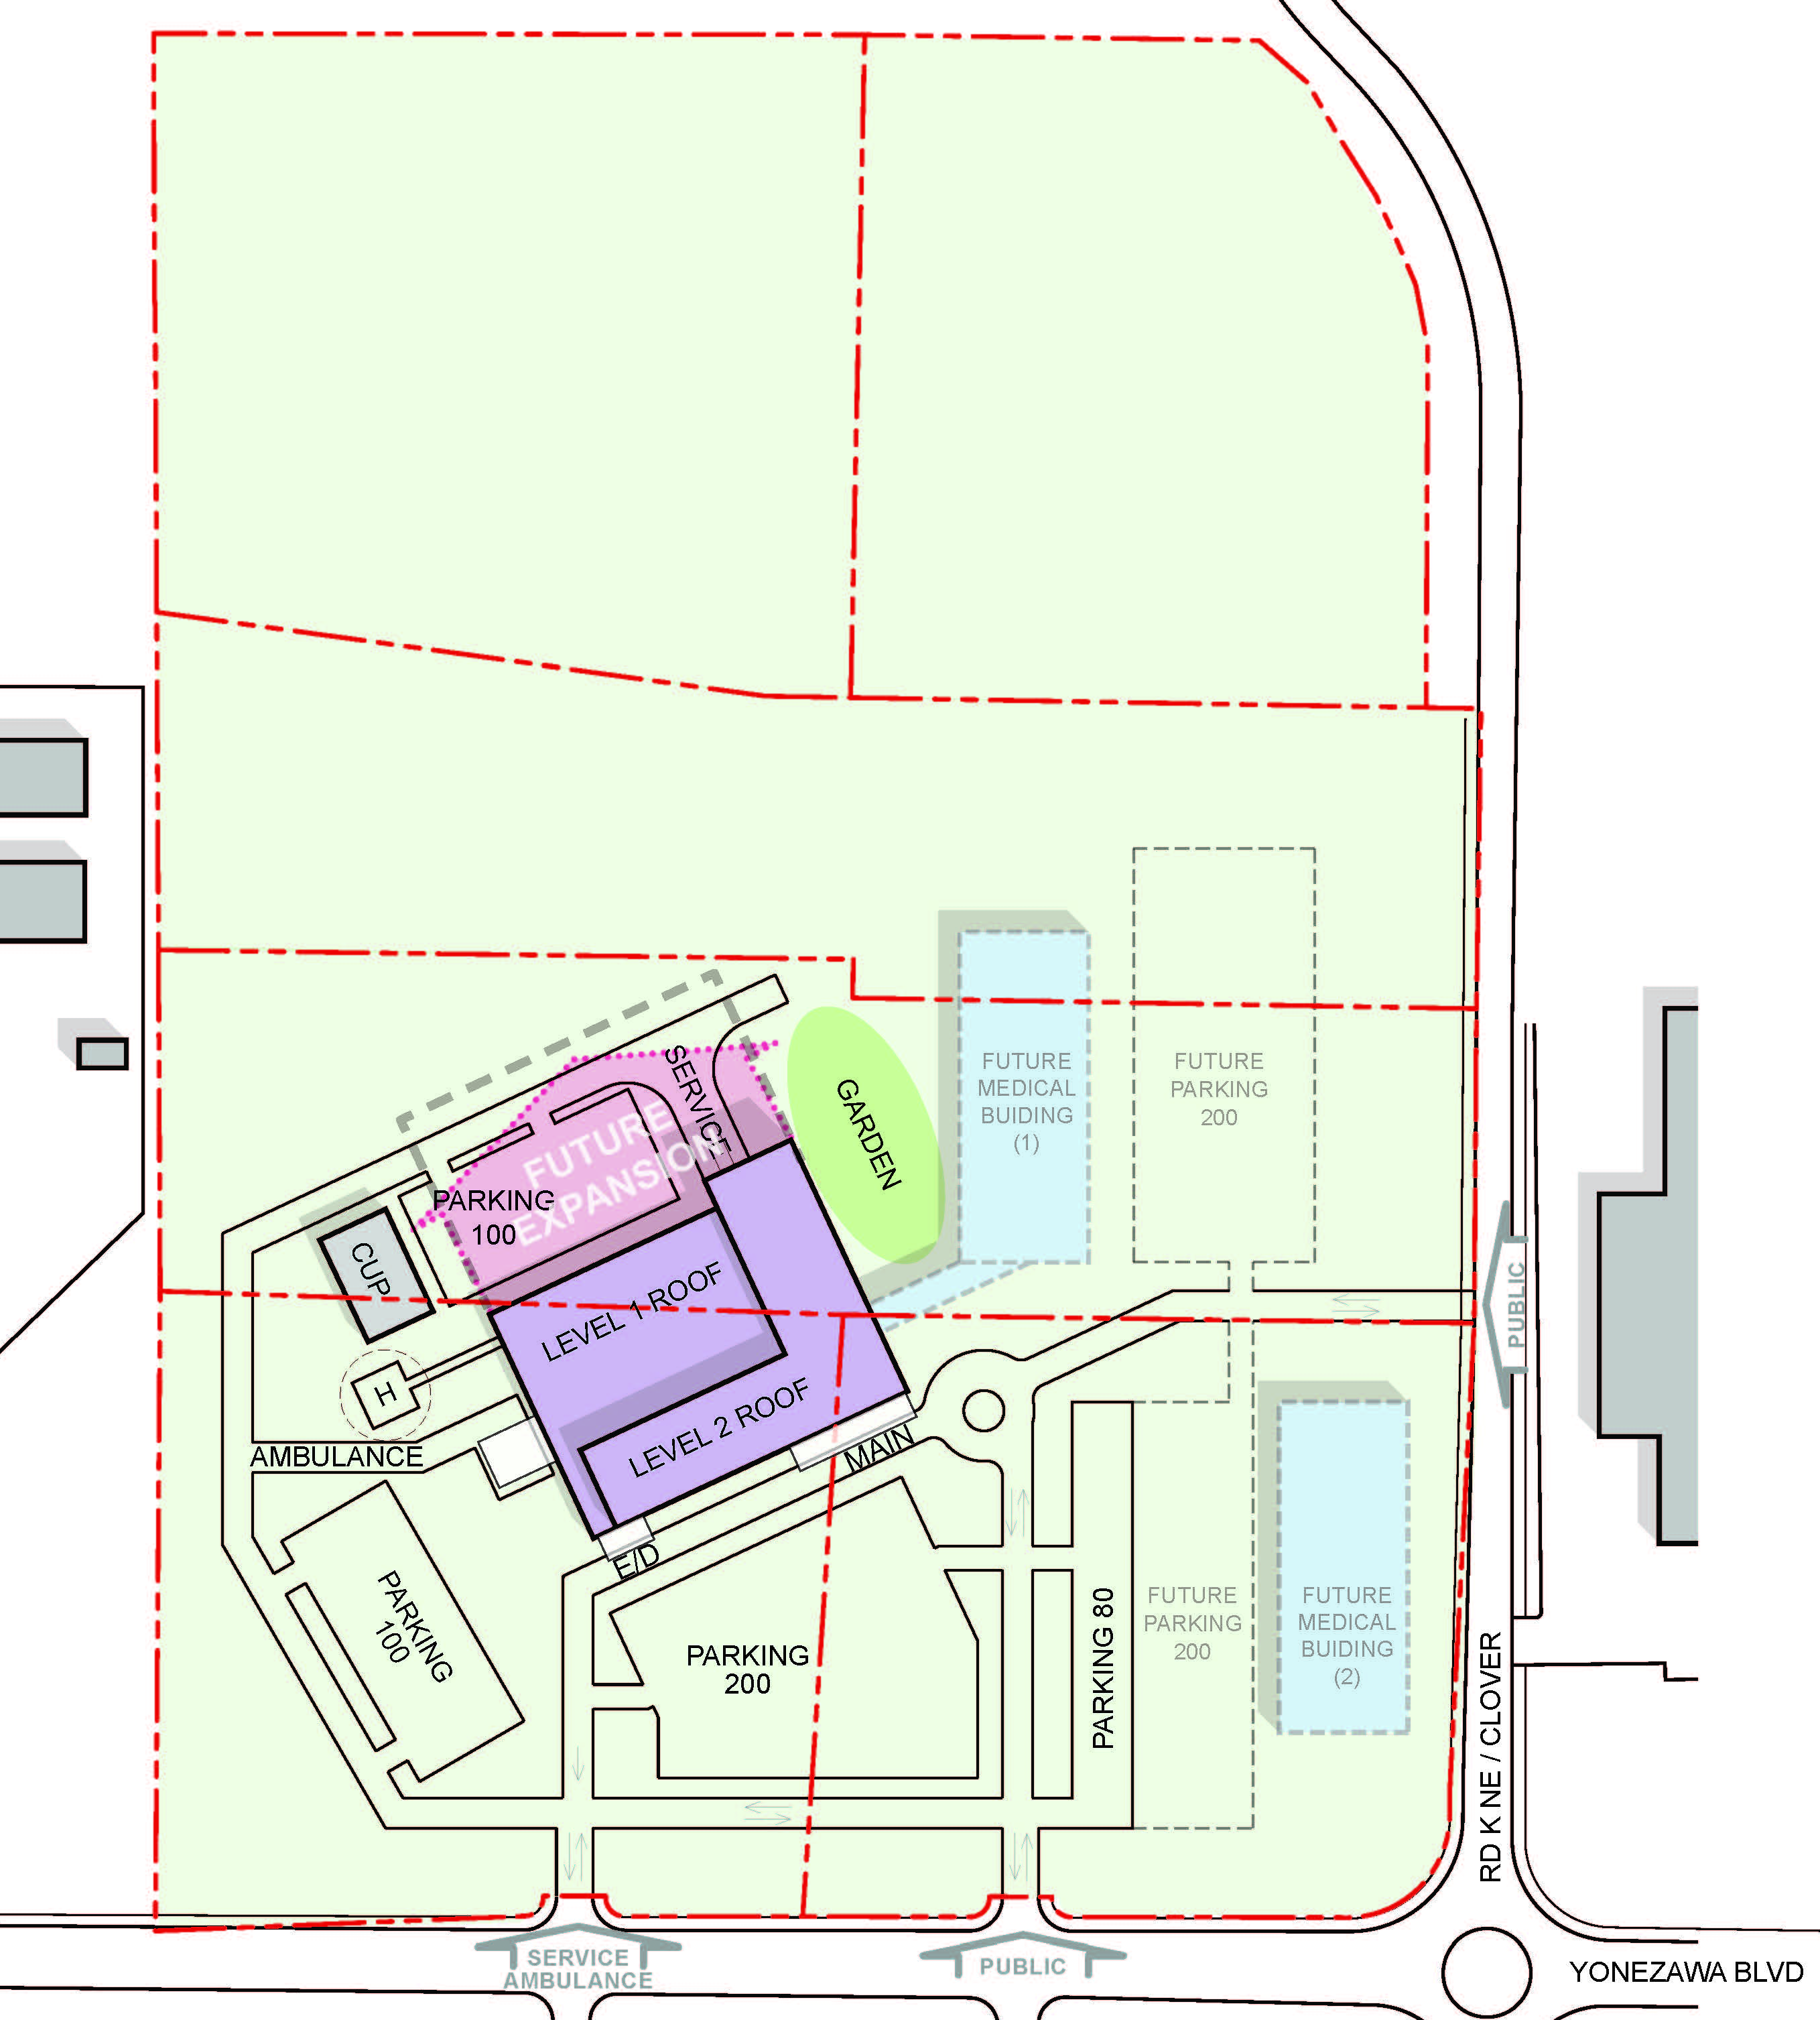
Project Concept - Victoria
Site: 25.59 ACRES, 1,114,700 SF
Building Area: 132,000 – 140,000 SF
Parking:
  Hospital: 480(@ 3.5/1000)
  Medical Building 1: 200(@ 5/1000)
  Medical Building 2: 200(@ 5/1000)

Slide 16
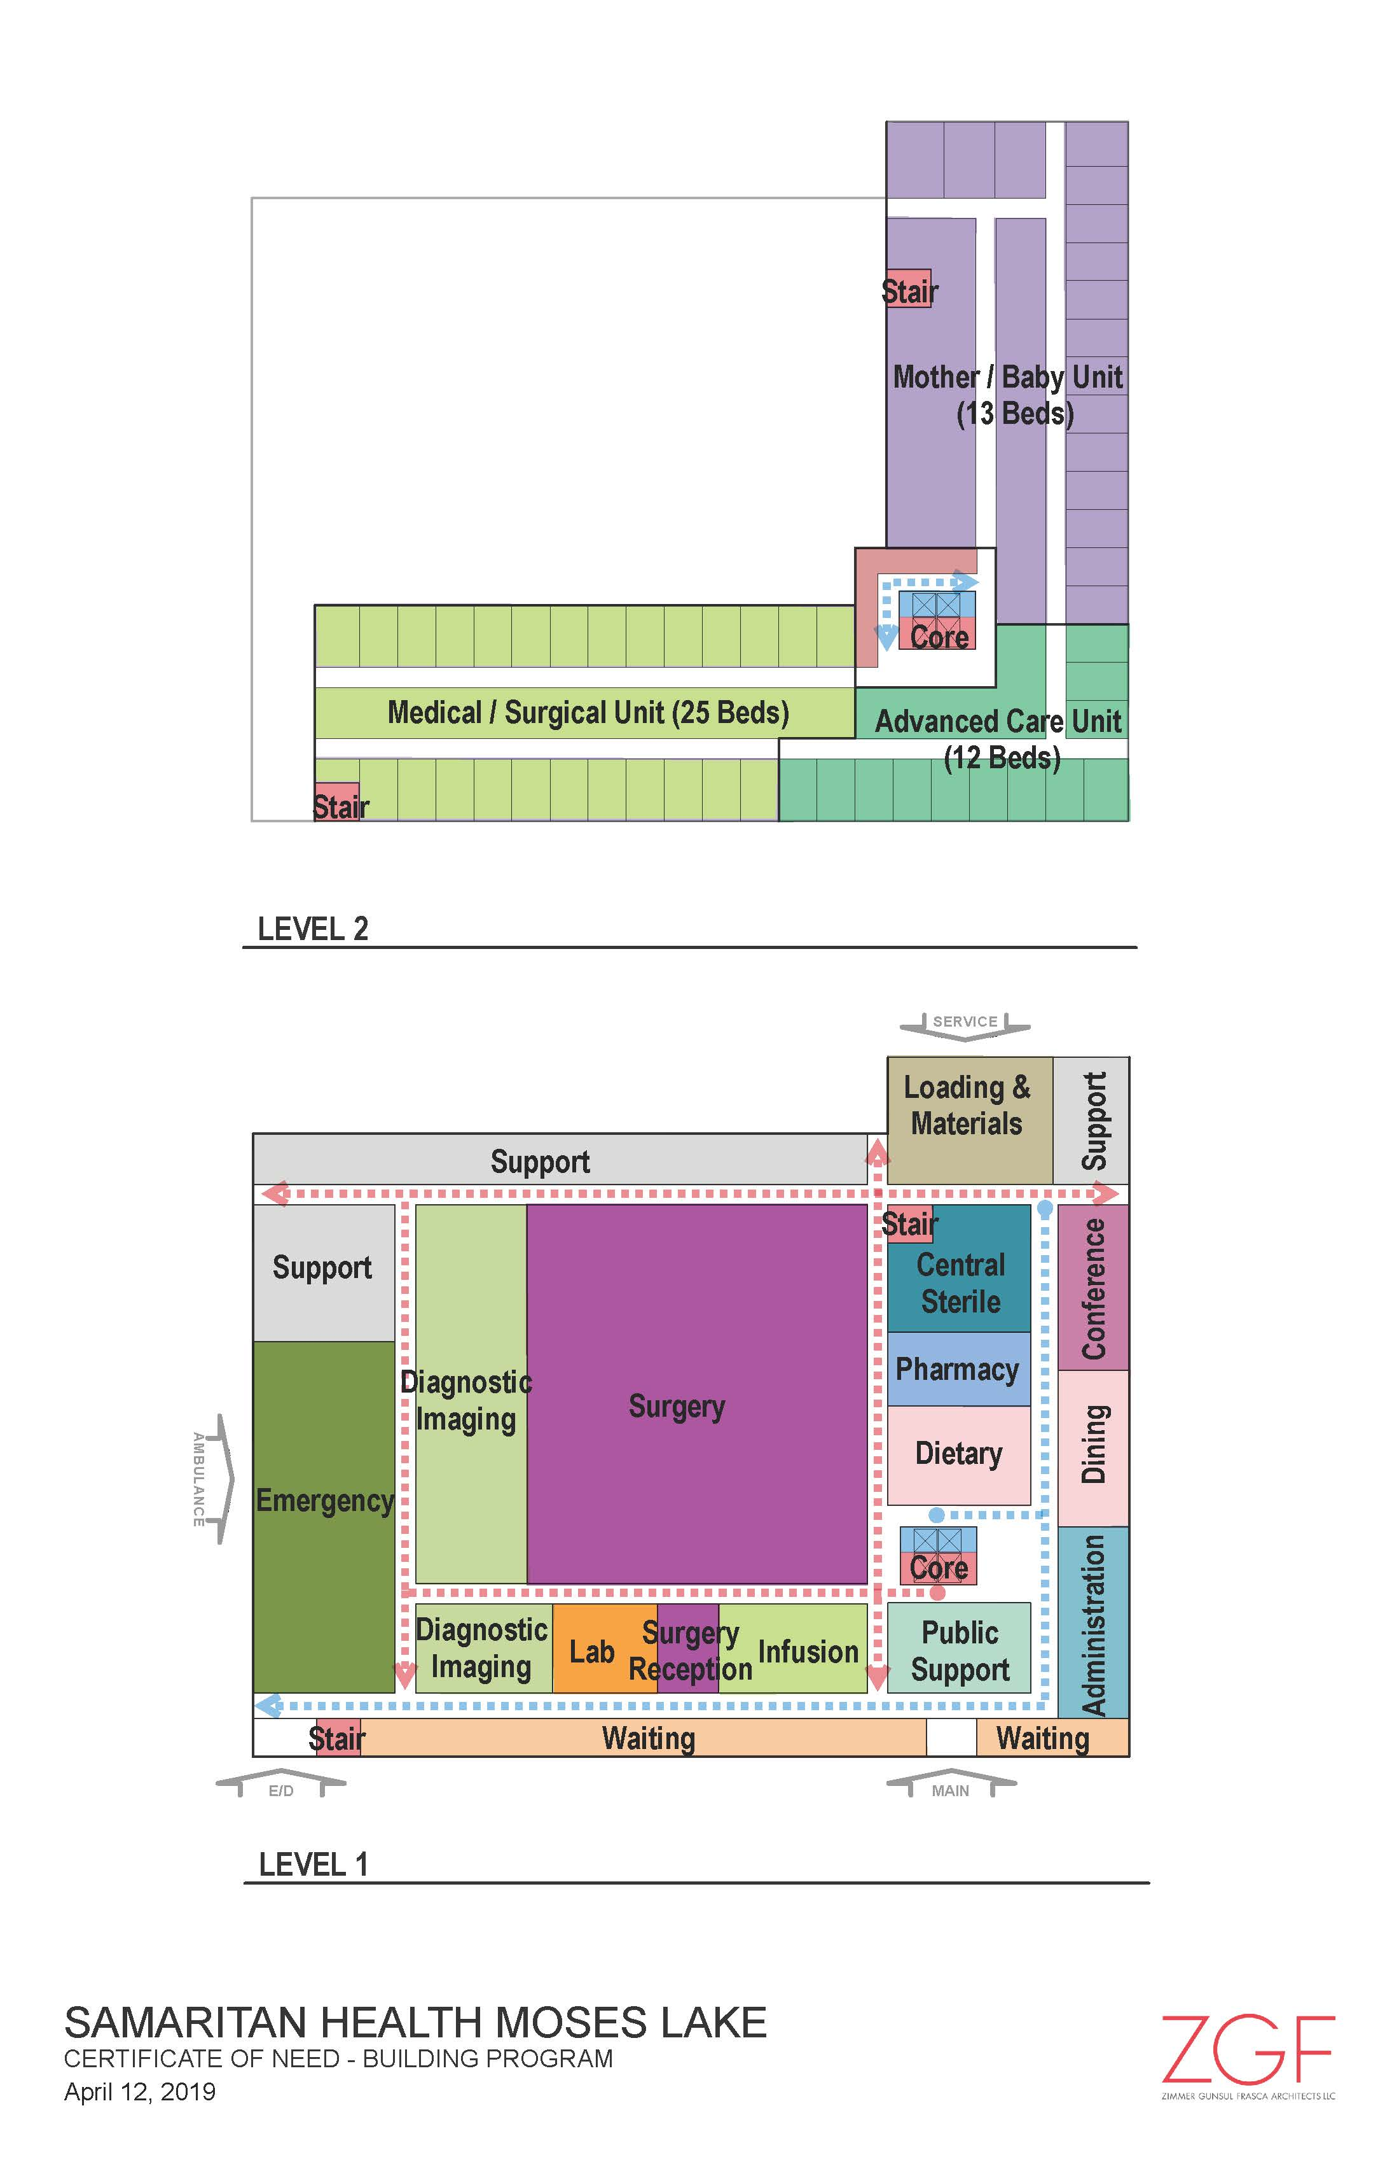
Project Concept - Victoria

Slide 17
Schedule - Jeff
Item | Task | Date
1 | GC/CM PCARB Application Submittal | May 20, 2019
2 | SH PRC Presentation | June 27, 2019
3 | GC/CM Delivery Approval | June 27, 2019
4 | Official State Authority Notice | June 28, 2019
5 | Schematic Design Complete | July 13, 2019
6 | GC/CM RFQ Due | July 24, 2019
7 | GC/CM Interviews | Aug 4, 2019
8 | GC/CM RFFP-Selection | Aug 18, 2019
9 | Baseline Estimate | Oct 1, 2019
11 | GC/CM Budget - 70% DD | Nov 1, 2019
12 | VE/Constructability | July - Sept 2019
13 | Design Development Complete | November 16, 2019
14 | Baseline MACC 90% Construct Docs | March 1, 2020
15 | Construction Docs 100% | April 24, 2020
16 | Permitting-Site/Building | April/May 2020
17 | Final MACC | April 20, 2020
18 | Site Mobilization | April 1, 2020
19 | Construction Completion | February 28, 2022

Slide 18
Fiduciary Management -Alex
Sources of Project Financing
  Financial RFP Presentation Wednesday, July 24^{th.}
  Five Financial Institutions (Cain, Raymond James, Dougherty Mortgage, Piper Jaffrey, and Bank of America).
  Will seek either USDA Funding or Public Offering Bond.
Establish Overall Proforma
  Engaged with Wipfli CPAs and Consultants on June 7th to develop a Feasibility Study to be utilized for USDA or Public Offering Bond.
Budget Control-GC/CM Input
  The use of the GC/CM during the design phase will enable estimate updates and a better opportunity for budget advice and control.

Slide 19
Fiduciary Management -Alex
Monthly Outlay Reports
  With USDA financing the project as well as other possible lending agencies Samaritan will submit a monthly Outlay Report consistent with the project budget allocations and requests for payments based on monthly invoicing from all parties providing services to the project.
Budget Reconciliation
  End of project budget truing with the GC/CM and the Financial Institutions that Samaritan partners with.

Slide 20
Summary
Response to PRC Written Questions-Dick
Applicant Final Comments- Theresa
The team – ZGF, Engineers, our Senior Leadership team including me and we would like to find the right fit in a GC.
Board Commitment - to the #Build Community project, to the vision of being a regional healthcare organization and to Samaritan providing services so our community can receive care close to home.
Financing & Feasibility - We are confident in our financing and the overall feasibility of the project
We believe the GC/CM process to provide the best value for our community and will attract the most qualified contractors for a complex project.
Questions

Slide 21
Samaritan Healthcare | Moses Lake, WA
Presentation for PRC Approval GC/CM Project Delivery | June 27, 2019

Slide 22
Garage

Slide 23
Colors (DO NOT DELETE)

