Slide 1
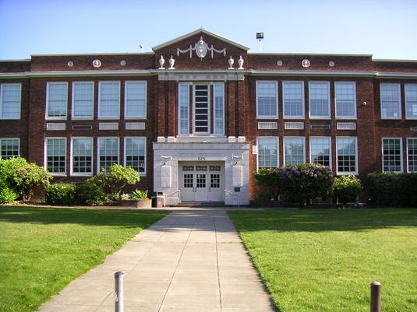
Highline
High School
Replacement
Application to use the GC/CM Project Delivery Method
March 23, 2017

Slide 2
Project Delivery Team/Agenda
Background
Project Description
Budget & Schedule
GC/CM Method
GC/CM Implementation Strategies
Contracts / RFQ and RFP
Summary/Questions
Scott Hodgins, Executive Director - primary interface with GC/CM; oversee District’s Program Deliver Team (PDT)
Dan Miles, Principal Architect - representing the design team
Sean Ryan, Project Manager – primary interface with design and construction teams
Robin Brown, Program Manager – oversee PM/CM Team; assist CM
Bernie O’Donnell, GC/CM Advisor – implementation strategy for the GC/CM selection process
Andrew Greene, Legal Counsel – Development and review of RFQ, RFP and contracts for the implementation strategy of the GC/CM process
Kirk Robinson, Cost Estimator – tracking and reconciling construction cost estimates in coordination with the GC/CM
Notes:
Scott Hodgins Slide

Slide 3
Highline High School Project Organizational Chart
Highline Public Schools
School Board
Highline Public Schools
Dr. Susan Enfield
Superintendent
Highline Public Schools
G. Scott Hodgins
Executive Director of Capital Construction & Planning
Legal Counsel
Andrew Greene
Perkins Coie
GC/CM Contract/Project Counsel Advice
Vanir Construction Management
Bernie O’Donnell
GC/CM Advisor
Project and Construction Management Team
Vanir Construction Management
Robin Brown – Program Director
Sean Ryan– Senior Project Manager
Kirk Robinson – Cost Estimator
Designer
Bassetti Architects
Dan Miles - PIC
Mark Smedley – Sr. Project Manager
Lindsay Crawford – Sr. Project Architect/Designer
GC/CM
TBD
Subcontractors
TBD
Notes:
Scott Hodgins Slide

Slide 4
Background
Highline High School – District’s flagship; both historical and emotional significance to the Highline community
Capital bond is citizen driven initiative; Phase 1 of a 20 year capital improvement plan of approximately $1.4 billion
$299.85 million bond passed in November 2016; approximately $71 million in state and local matching funds; total program = ~ $371 million
Reliance on state and local match from SCAP, FAA and Port of Seattle
Notes:
Scott Hodgins Slide

Slide 5
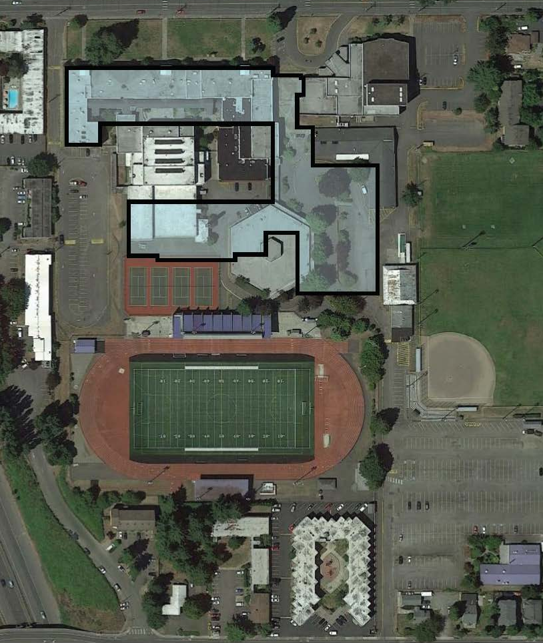
Existing Highline High School
Buildings from 1923, 1924, 1925, 1928, 1931, 1938, 1946, 1953, 1966
Major renovations 1989
Site Area: 11.8 Acres (w/o Stadium)
Notes:
Dan Miles Slide

Slide 6
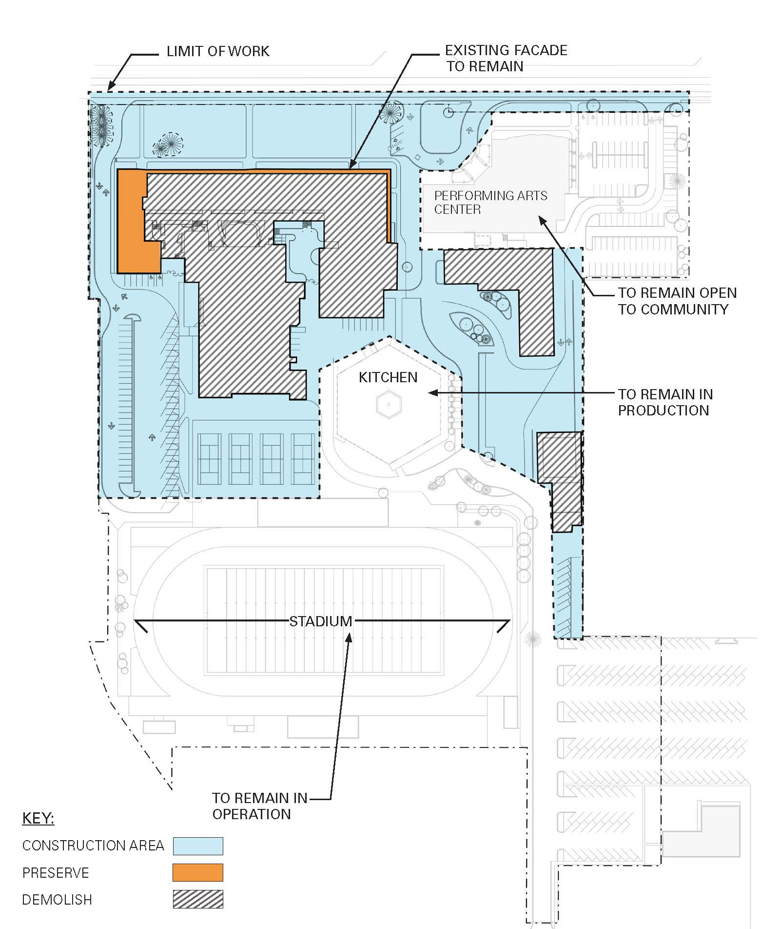
Highline High School – Phase 1.A
Demolition of 193,000 SF
Reconstruction of 31,900 SF
Existing Performing Arts Center: 32,900 SF
Total New School Area: 230,000 SF
Student Population: 1500
Production Kitchen Remains in Full or Partial Operation
North Facade Remains Potentially
Notes:
Dan Miles Slide

Slide 7
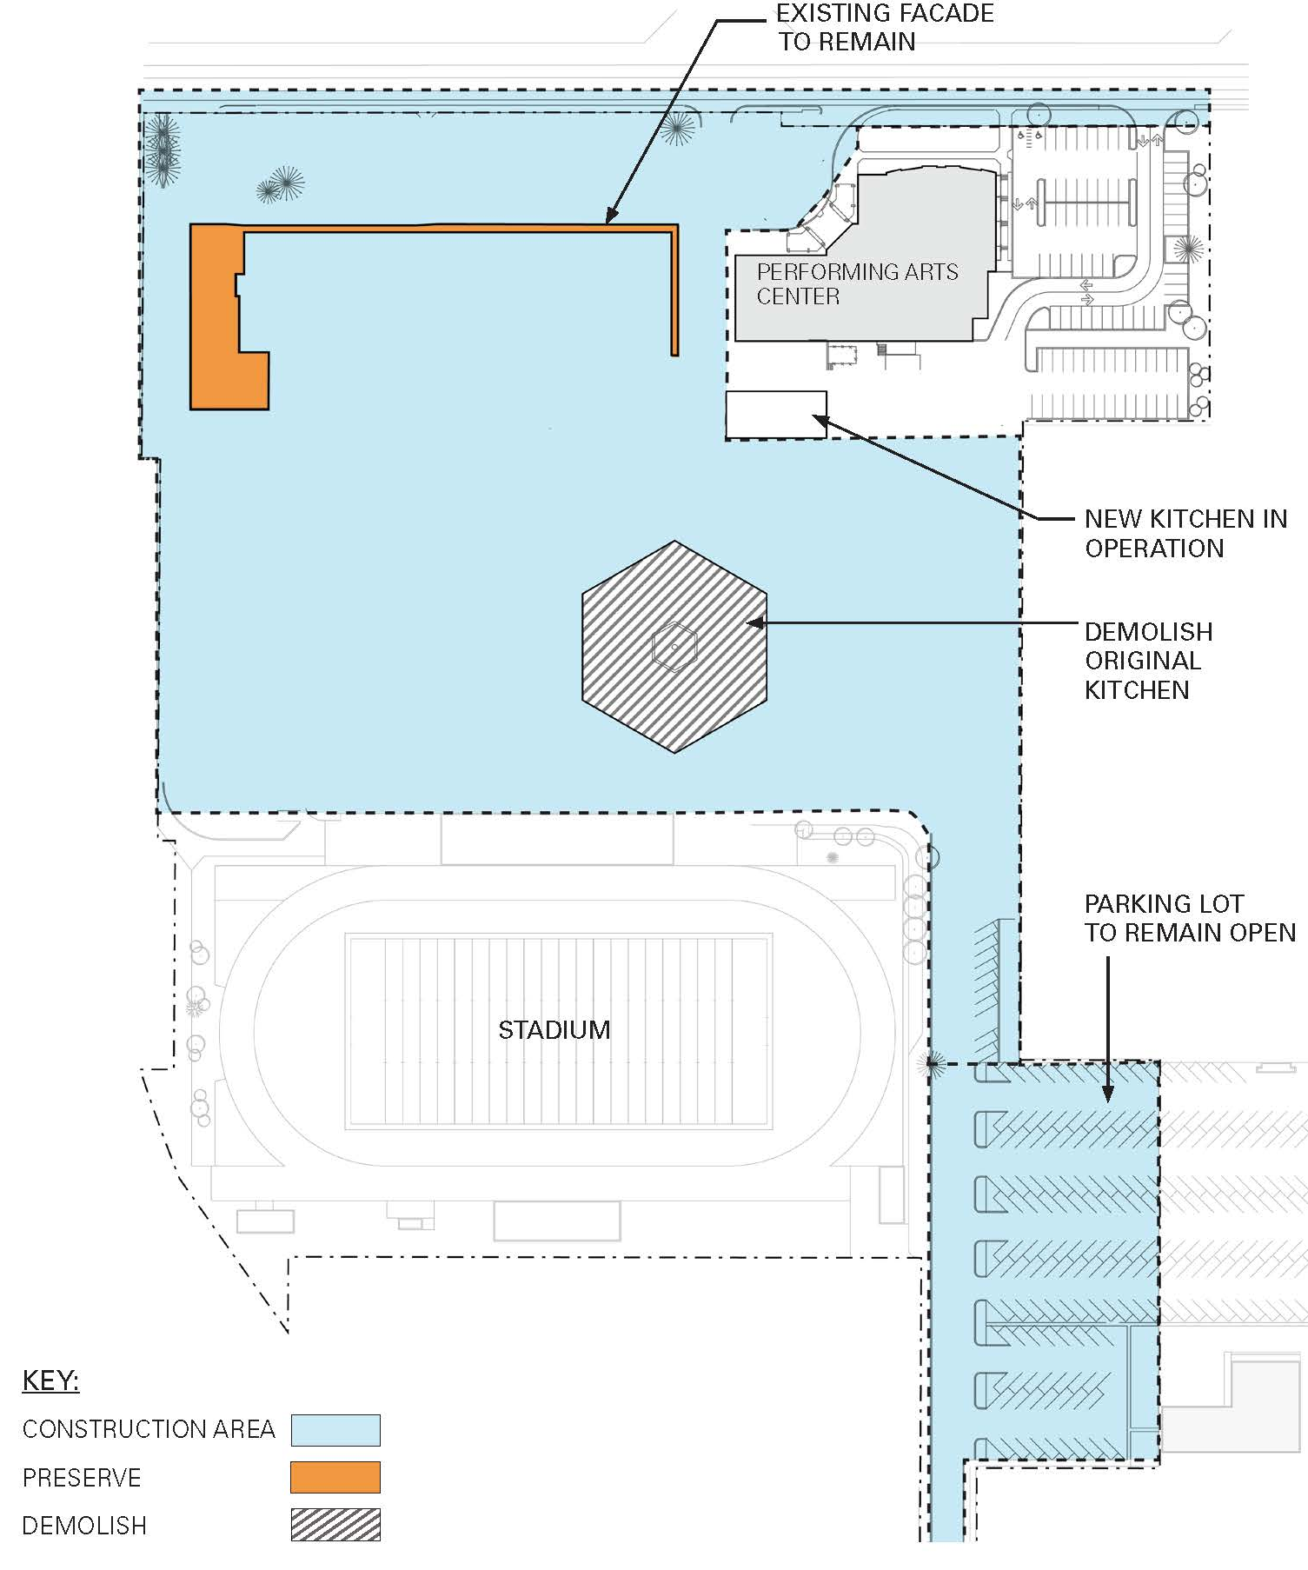
Highline High School – Phase 1.B
Reconstruction/Renovation of 31,900 SSF
New Construction of Additional SF (Production Kitchen)
Demolition of 22,000 SF
Notes:
Dan Miles Slide

Slide 8
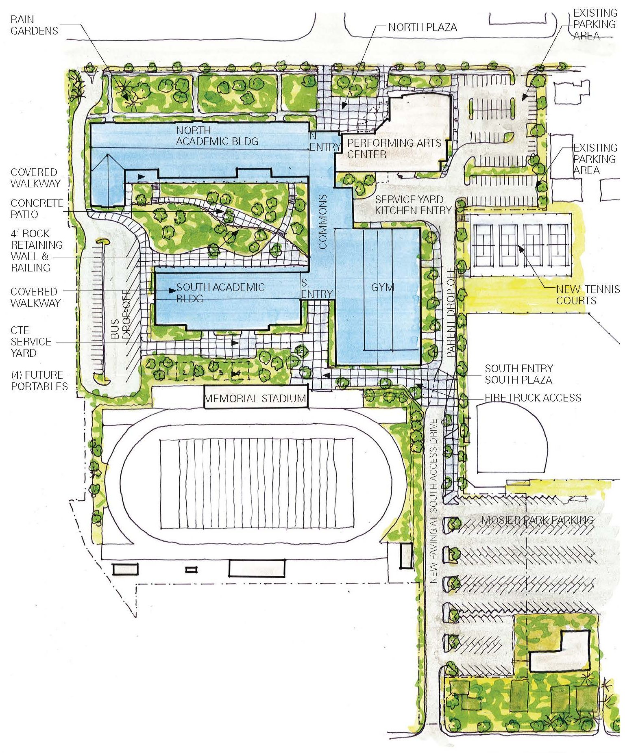
Highline High School – Site Plan
Total New School Area: 230,000 SF
Student Capacity: 1500
Connection to Existing Performing Arts Center
Site Area for Future Portables if Required
Notes:
Dan Miles Slide

Slide 9
Highline HS Project Budget
Costs for Professional Services (A/E, Legal etc.) | $12,277,040
Estimated project construction costs (including construction contingencies): | $106,884,809
Equipment and furnishing costs | $8,598,800
Off-site costs | $1,279,131
Contract administration costs (owner, cm etc.) | $8,238,758
Contingencies (design & owner) | $9,061,923
Other related project costs (briefly describe) | $1,639,399
Sales Tax | $10,311,356
Total | $158,291,216
Notes:
Sean Ryan’s Slide

Slide 10
Project Schedule
Notes:
Sean Ryan’s Slide

Slide 11
GC/CM Method
Aggressive design and construction schedule
Multi-phased construction is required
Small compact site
Site will be shared with multiple on-going school functions:
Performing Arts Center
Memorial Stadium
Playfields (owned by the City of Burien)
Shared parking
Food production kitchen serving other schools
Assist design team in masonry facade strategies
Pre-construction services
Notes:
Robin Brown’s Slide

Slide 12
Pre-Construction Services
Cost estimating
Evaluations and investigations of existing conditions
Phasing strategy – demolition/site & building
Scope and packaging of subcontract bid documents
Value engineering of design concepts
Constructability review of contract documents
Review and take ownership of project’s general and division 1’s
Assist in marketing project to the contracting community during this busy construction cycle

Slide 13
GC/CM Implementation Strategies
The District will market this project to contractors with significant school construction and other public works experience to maximize potential GC/CM proposers.
The District and GC/CM will agree on a Subcontracting Plan that sets priority of the buyout and scope of work for individual bid packages.
The District will develop their own independent estimate aligned in bid package format to reconcile with the GC/CM at 90% Construction Document phase.
Bid protection contingencies will be negotiated for bid packages.
The buyout of bid packages will be compared to the budget as the buyout progresses.
Notes:
Bernie O’Donnell’s Slide

Slide 14
GC/CM Contracts
RFQ and RFP development.
Contract will be based on AIA form of agreement and include responsibilities of the GC/CM during the pre-construction and construction phases.
The contract will comply with all requirements of RCW 39.10.
Notes:
Bernie O’Donnell’s Slide

Slide 15
PRC’s Pre-Interview Questions
Please explain the respective roles and responsibilities of the management team members.
Who will be the primary interface for the GC/CM? Please explain how decisions will be made as needed to execute the GC/CM contract and keep the project moving.
How would delays in funding from outside sources affect the project?
Notes:
Scott Hodgins Slide

Slide 16
Questions?
Thank you for your consideration.
Notes:
Scott Hodgin’s Slide

