Slide 1

Application for
Design-Build
Project Approval
Issaquah School District 411
New High School
Thursday, January 25, 2018

Slide 2
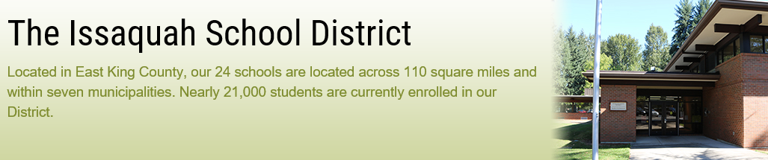
Agenda
    Introductions
    Scope
    Schedule
    Budget and Funding
    Qualified Project Team
    Why Project is Suited for Design-Build
    Questions

Slide 3
Scope
New High School
Reduce student populations at Issaquah High School and Skyline High School and accommodate growth
1,800 students in grades 9-12
260,000 gross square feet
High-performance building
Science suite, athletic facilities, library, gym, commons, dining, and performing arts center
Accommodate a new elementary school at a future date.
All-weather turf athletic field, parking for staff, students, and bus parking below the football field / track
Located at 4200 228th Ave SE, Issaquah, WA, 98029.

Slide 4
Schedule
EVENT | DAYS | START | FINISH
Draft RFQ / Ad / Meetings / Q&A | 37 | 12/20/2018 | 1/26/2018
PRC Meeting / Approval | 0 | 1/25/2018 | 1/25/2018
DB Procurement & Contracting | 60 | 1/26/2018 | 3/27/2018
Preliminary Design, Estimating, Validation | 210 | 3/28/2018 | 10/24/2018
Permitting | 240 | 9/1/2018 | 4/30/2019
Final Design, Estimating, Validation | 190 | 10/26/2018 | 5/4/2019
Negotiate GMP | 45 | 4/1/2019 | 5/16/2019
Construction - Early Site Package | 120 | 4/1/2019 | 7/30/2019
Construction - Building | 665 | 7/1/2019 | 4/26/2021
Cx / Systems Training / Shake-down | 180 | 4/27/2021 | 10/24/2021
Move-in, Furnish, Set-up | 120 | 5/1/2021 | 8/29/2021

Slide 5
Budget & Funding
Project funding has been secured through a $533.5MM capital bond approved by voters in April of 2016. Conceptual Project Budget
PM/CM and professional services (consulting, legal, etc.) | $2,000,000
Estimated project DB costs (incl. construction contingencies) | $93,000,000
Equipment and furnishing costs | $5,400,000
Off-site costs | $1,200,000
Contingencies | $8,500,000
Sales Tax | $9,900,000
Total Budget | $120,000,000

Slide 6
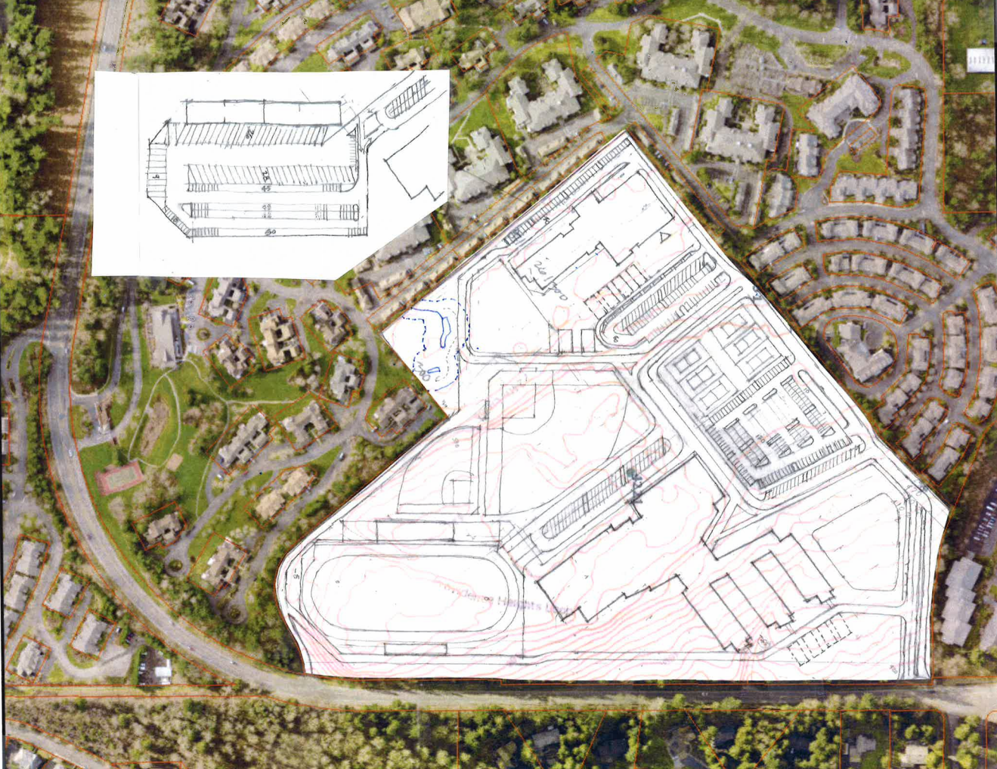
Conceptual Site Plan
New High School

Slide 7
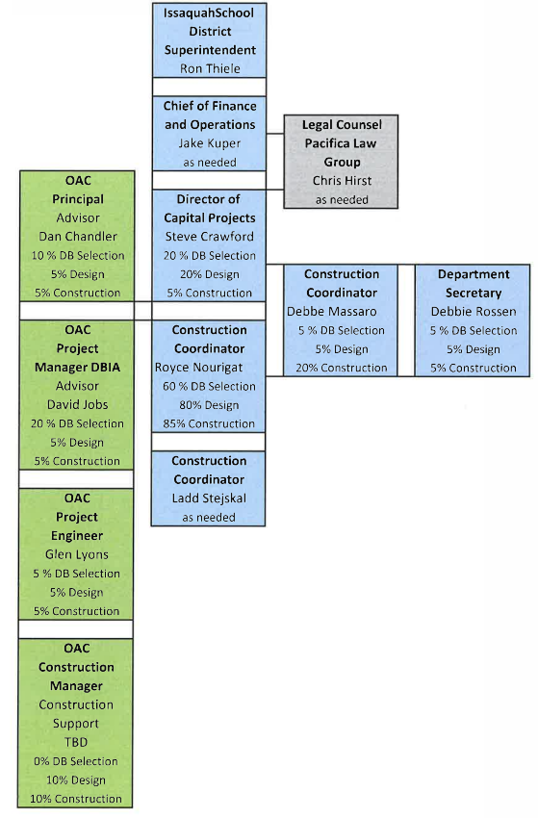
Project Team

Slide 8
Why Project is Suited for DB
Meets All Three RCW 39.10.300 Criteria
Construction activities are highly specialized
  Parking under athletic field
Opportunity for greater innovation and efficiencies
  Improved planning to accommodate future Elementary School onsite and complex HS programming
Significant savings in project delivery time can be realized
  Fast tracking design and construction
  Subcontractor procurement

Slide 9

Centralia High School Modernization
Questions?

