Slide 1

Application for
Design-Build
Project Approval
Issaquah School District 411
New Middle School
Thursday, January 25, 2018

Slide 2
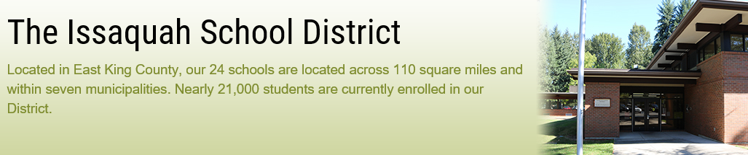
Agenda
    Introductions
    Scope
    Schedule
    Budget and Funding
    Qualified Project Team
    Why Project is Suited for Design-Build
    Questions

Slide 3
Scope
New Middle School
Reduce student populations at five existing middle schools and accommodate growth
900 students in grades 6-8
130,000 gross square feet
High-performance building
Science suite, music, athletic facilities, library, gym, commons with stage and dining
Minimize impacts to existing elementary school.
All-weather turf athletic field, parking for staff, students, and bus parking below the football field / track
Located at 565 NW Holly Street, Issaquah, WA.

Slide 4
Schedule
EVENT | DAYS | START | FINISH
Draft RFQ / Ad / Meetings / Q&A | 37 | 12/20/2018 | 1/26/2018
PRC Meeting / Approval | 0 | 1/25/2018 | 1/25/2018
DB Procurement & Contracting | 60 | 1/26/2018 | 3/27/2018
Preliminary Design, Estimating, Validation | 150 | 3/28/2018 | 8/26/2018
Permitting | 240 | 7/1/2018 | 2/26/2019
Final Design, Estimating, Validation | 190 | 8/27/2018 | 3/5/2019
Negotiate GMP | 30 | 2/19/2019 | 3/21/2019
Construction - Early Site Package | 120 | 2/19/2019 | 6/19/2019
Construction - Building | 450 | 3/22/2019 | 6/14/2020
Cx / Systems Training / Shake-down | 90 | 5/15/2020 | 8/13/2020
Move-in, Furnish, Set-up | 90 | 5/15/2020 | 8/13/2020

Slide 5
Budget & Funding
Project funding has been secured through a $533.5MM capital bond approved by voters in April of 2016. Conceptual Project Budget
PM/CM and professional services (consulting, legal, etc.) | $1,200,000
Estimated project DB costs (incl. construction contingencies) | $57,500,000
Equipment and furnishing costs | $3,300,000
Off-site costs | $750,000
Contingencies | $5,300,000
Sales Tax | $5,950,000
Total Budget | $74,000,000

Slide 6
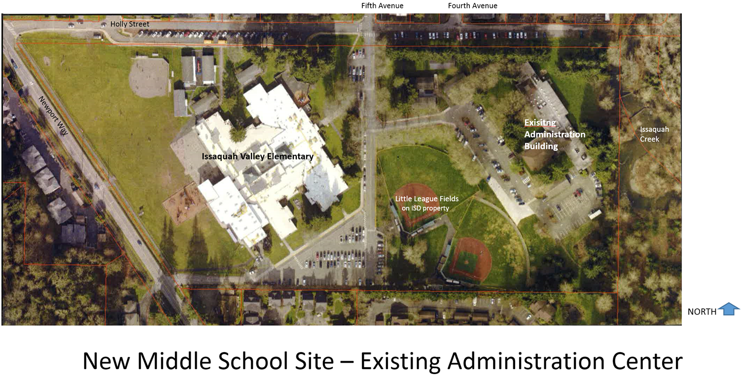
Conceptual Site Plan
New Middle School

Slide 7
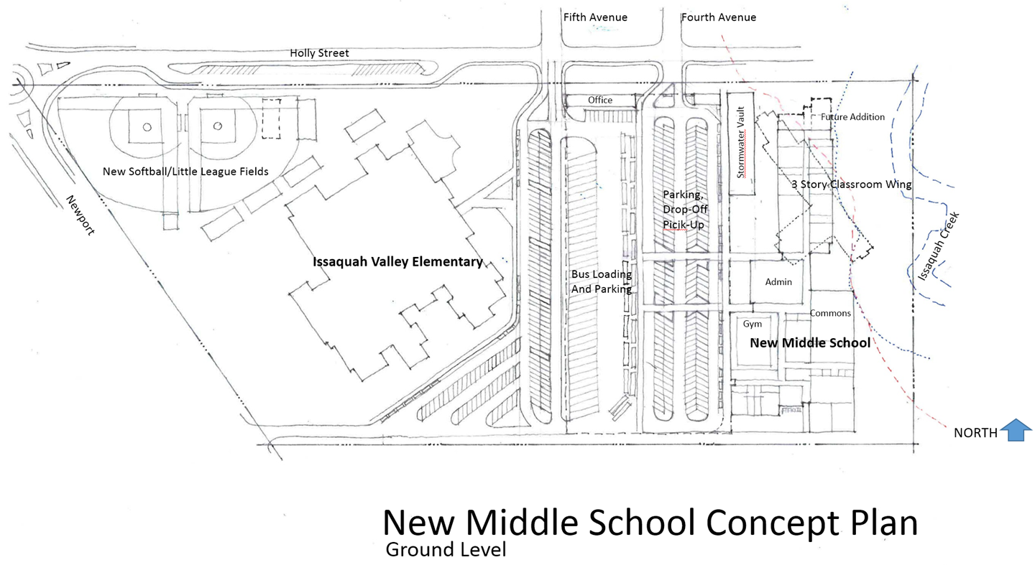
Conceptual Site Plan
New Middle School

Slide 8
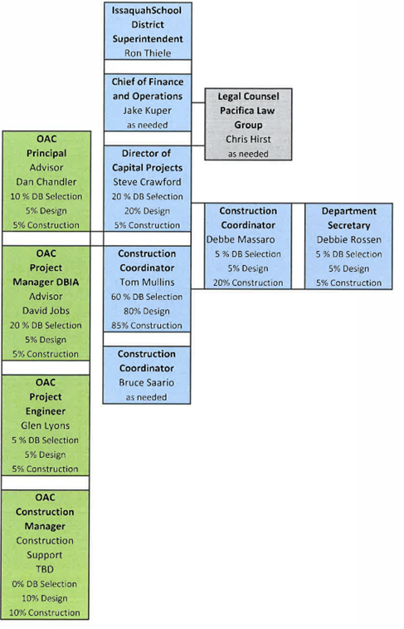
Project Team

Slide 9
Why Project is Suited for DB
Meets All Three RCW 39.10.300 Criteria
Construction activities are highly specialized
  Parking under athletic field
Opportunity for greater innovation and efficiencies
  Improved planning to minimize impact to existing elementary school and demo of existing admin buildings
Significant savings in project delivery time can be realized
  Fast tracking design and construction
  Subcontractor procurement

Slide 10

Centralia High School Modernization
Questions?

