Slide 1


GC/CM PROJECT DELIVERY REQUEST/PRESENTATION
KALAMA SCHOOL DISTRICT 402
NEW SECONDARY SCHOOL
AND ELEMENTARY SCHOOL REPLACEMENT
CPARB-PRC - September 27, 2018

Slide 2
Agenda
Project Team
Experience
Project Organization
Project Scope
Budget
Schedule
Questions?

Slide 3
Introductions of The Team
Kalama School District
  Eric Nerison – Superintendent
  Wes Eader – Vice Chair KSD School Board
Perkins and Coie
  Legal Counsel - Graehm Wallace/Andrew Greene
BLRB Architects
  Greg McCracken - Principal
  Jonah Jensen – Design Project Manager
  Lee Fenton – Principal Architect GC/CM Design Liaison
Construction Services Group | ESD 112
  Keith Bloom, Sr. Project Manager.
  Laura Petersen, Project Manager

Slide 4
Team Experience
CSG, BLRB and Perkins Coei team members have participated in GC/CM project delivery individually for more than 20 years in Washington.
Project team members have completed more than 60 alternative delivery projects in Washington.
Project team members have completed a combined total of over $2 billion in GC/CM delivery

Slide 5

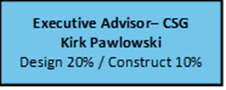
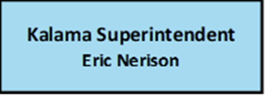
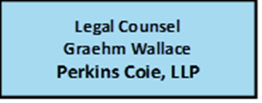
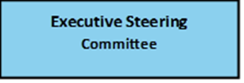
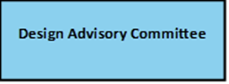
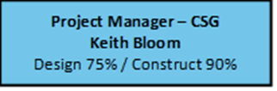

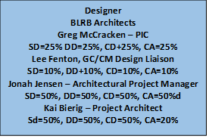
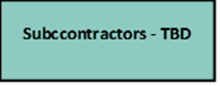
Project Organization
Project Manager CSG
Laura Pedersen
Design 50%/ Construct 100%

Slide 6
New Kalama Schools Project Scope
Replace existing Elementary School with new construction
Build new Secondary School in central core of campus
Schools will be occupied during construction
Site constraints require phasing and select demolition.
Primary concern is the safety of the students.
Access for secondary school construction equipment is extremely limited

Slide 8
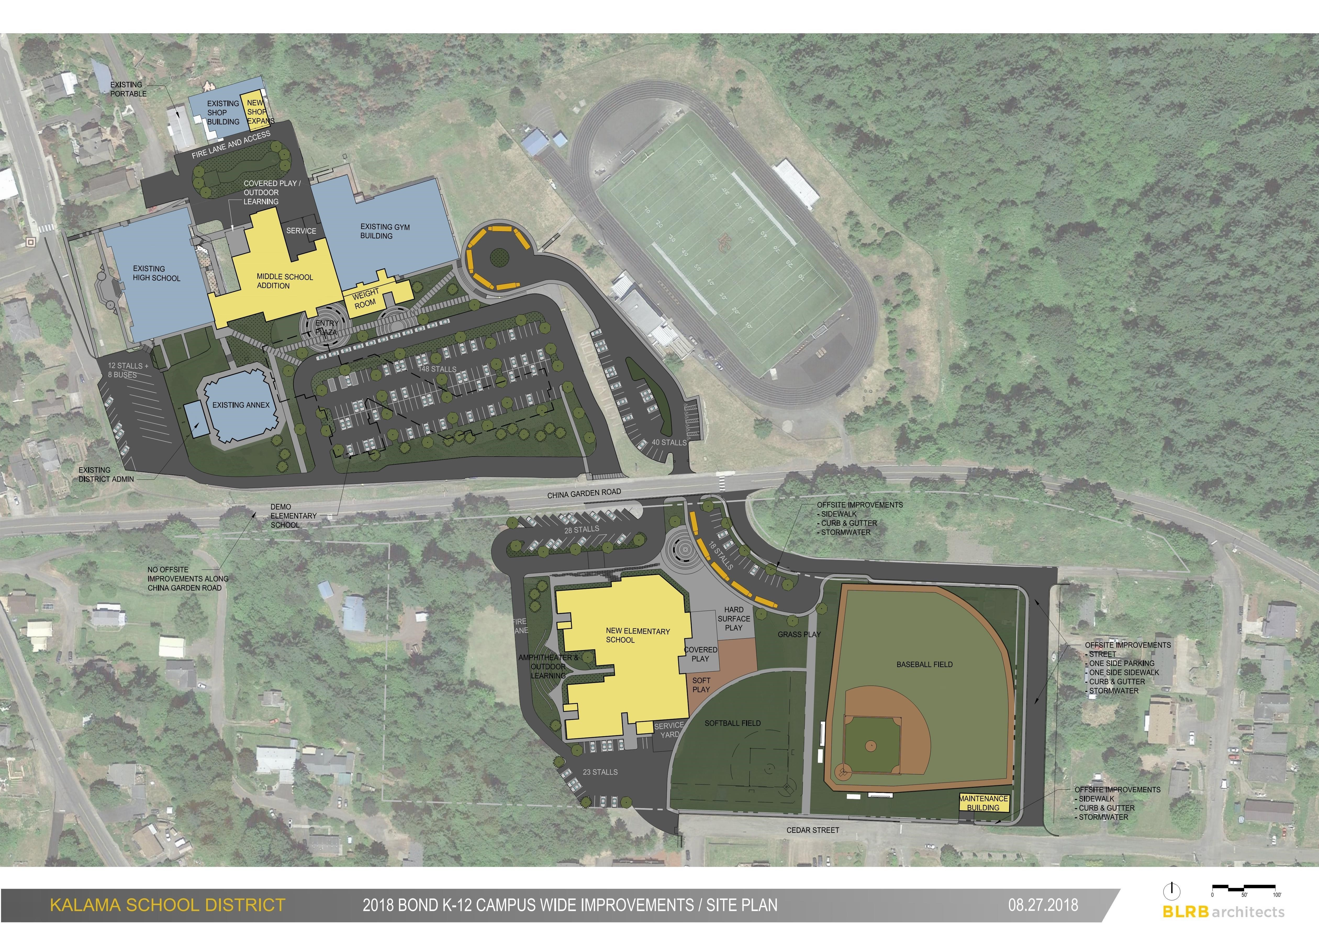

Slide 9
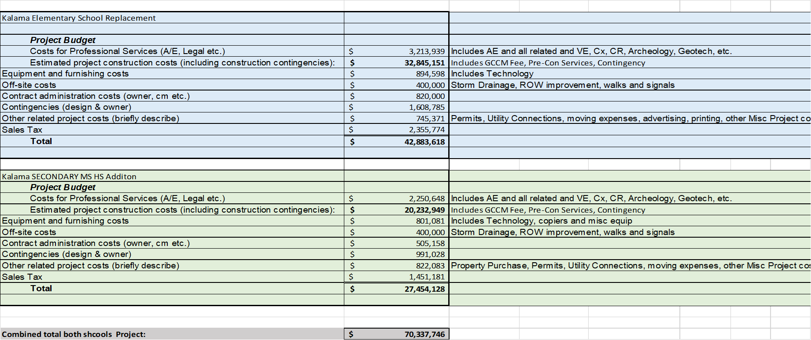

Slide 10
GC/CM Onboard Schedule– Revised September 27, 2018
Schedule
  Advertise for GC/CM Services – September 28 - Oct 18th, 2018
  RFP Deadline – October 18 , 2018
  Short-list – October 22, 2018
  Interview – October 26, 2018
  Notification – October 29, 2018
  Schematic Design Complete – Extended November 30, 2018
  MACC Estimate / Negotiation – June 19, 2019
  GMP Executed June 26, 2019
  Anticipated Final Completion – December of 2020

Slide 11

QUESTIONS?
Eric Nerison, Superintendent
Eric.nerison@kalama.k12.wa.us
Keith Bloom, Sr. Project Manager
Keith.bloom@esd112.org
Greg McCracken
GMccracken@BLRB.com

