Slide 1

GC/CM PROJECT DELIVERY REQUEST/PRESENTATION
KALAMA SCHOOL DISTRICT 402
NEW SECONDARY SCHOOL
AND ELEMENTARY SCHOOL REPLACEMENT
CPARB-PRC July 26, 2018

Slide 2
Agenda
Project Team
Project Scope
Schedule
Budget
Qualifying Criteria
Experience
Questions?

Slide 3
Introductions of The Team
Kalama School District
Eric Nerison - Superintendent
Perkins and Coie
Legal Counsel - Greahm Wallace
Construction Services Group | ESD 112
  Keith Bloom, Regional Manager /Construction Phase project manager.
  Kelley Wilson, Design Phase project manager
  Kirk Pawlowski, Executive Director CSG
BLRB Architecture
  Greg McCracken - Principle
  Jonah Jensen – Design Project Manager
  Kai Bierig – Project Architect

Slide 4
Team Experience
CSG, BLRB and Perkins Coei team members have participated in GC/CM project delivery individually for more than 20 years in Washington.
Project team members have completed more than 60 alternative delivery projects in Washington.
Project team members have completed a combined total of over $2 billion in GC/CM delivery

Slide 5
Project Organization
Kalama School District
CSG
Eric Nerison,
Superintendent
Perkins and Coie
GCCM
BLRB
District’s Professional Specialty Consultants
Sub-Contractors
Sub-Consultants

Slide 6



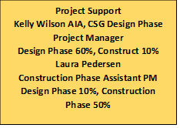
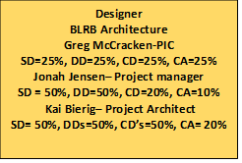
Project Organization
KALAMA ELEMENTARY AND SECONDARY PROJECT ORGANIZATION
Kirk Pawlowski
Program Manager
Design 10% /Construct 10%
Legal Counsel
Graehm Wallace
Perkins Coie
Project Manager - CSG
Keith Bloom
Design 40%/Construct 50%
Subcontractors - TBD

Slide 7
New Kalama Schools Project Scope
Replace existing Elementary School with new construction
Build new Secondary School in central core of campus
Schools will be occupied during construction
Site constraints require phasing and select demolition.
Primary concern is the safety of the students.
Access for secondary school construction equipment is extremely limited

Slide 11
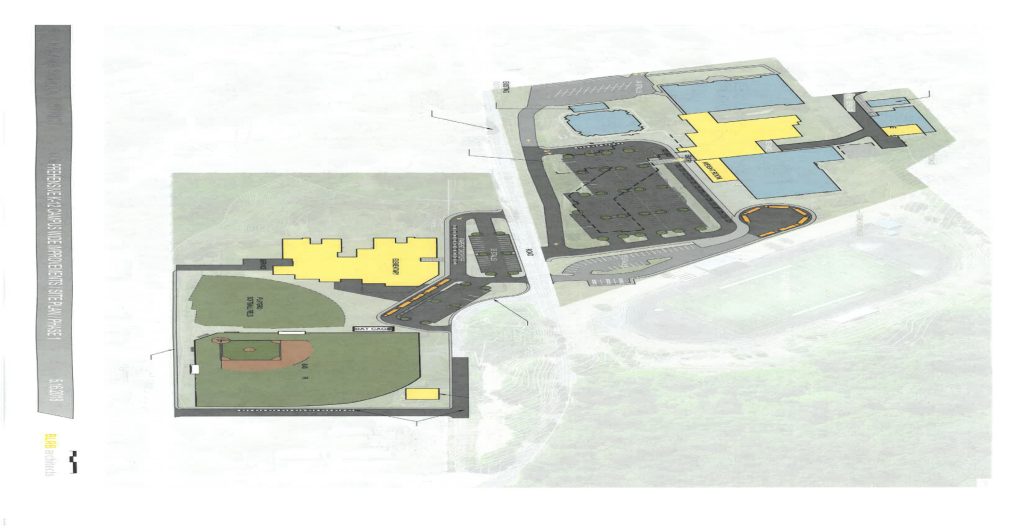
Site Constraints

Slide 12
GC/CM Onboard Schedule– Revised July 26, 2018
Schedule
  Publication for GC/CM Services – August 10– August 17, 2018
  Short-list – September 10, 2018
  Schematic Design Complete – Extended to October 15, 2018
  RFP Deadline – September 14, 2018
  Notification – September 22, 2018
  Negotiate/execute agreement for Pre-con services September 28, 2018
  MACC Estimate / Negotiation – April 25, 2019
  GMP Executed May 30, 2019
  Anticipated Final Completion – August to November of 2020

Slide 13
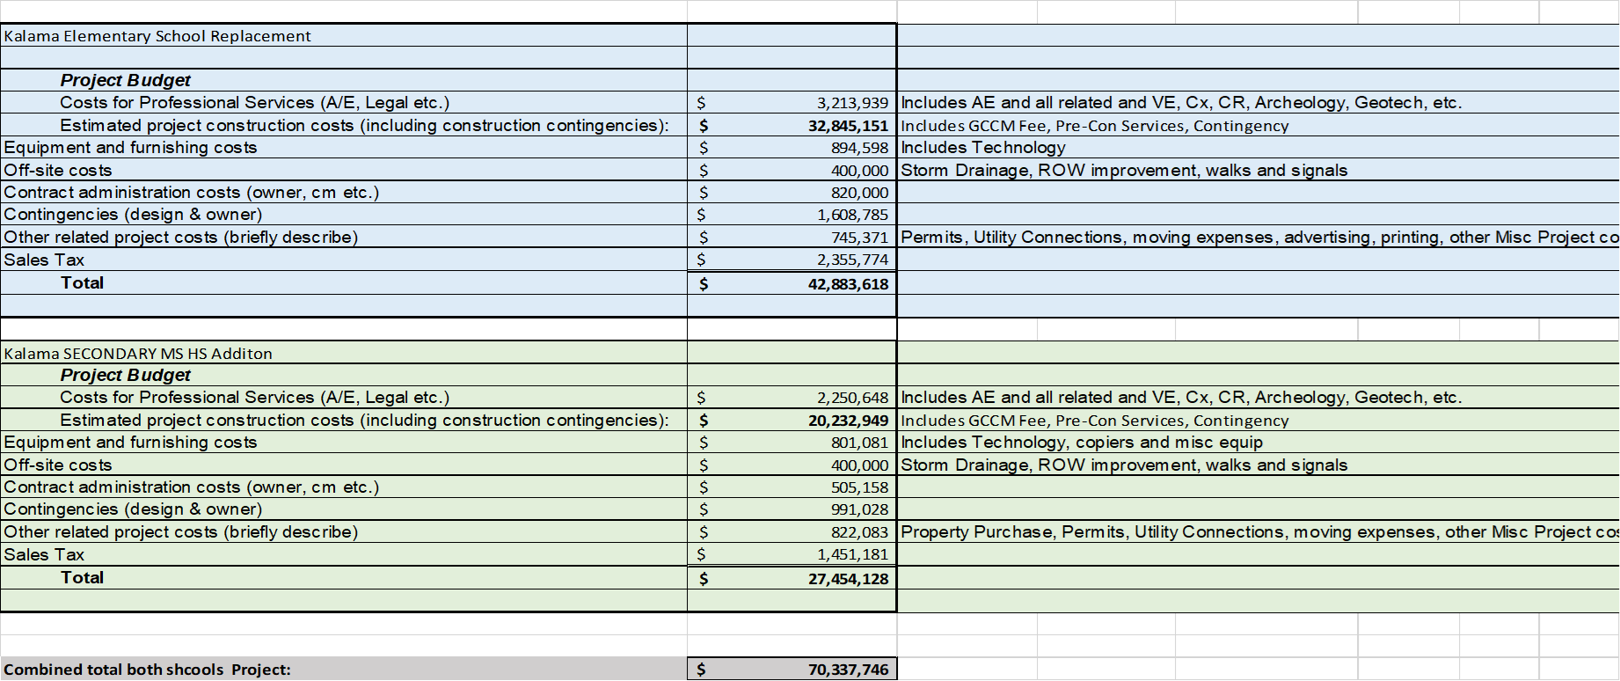

Slide 14

QUESTIONS?
Eric Nerison, Superintendent
enerison@kalamaSD.edu
Keith Bloom, Project Manager
Keith.bloom@esd112.org

