Slide 1
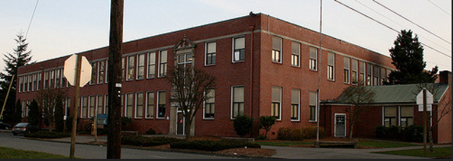
Wallace and Lexington Elementary SCHOOLs
July 26, 2018

Slide 2
Agenda
Introductions of Project Team
Project Scope of Work
Qualifying Criteria
Necessary Experience
Questions?

Slide 3
Kelso Project Organizational chart

Slide 4
Project Team
Attendees:
Kelso School District
Scott Westlund, Executive Director of Business and Operations, Kelso School District
14 years school administrative experience, 6 years as Chief Fiscal and Operations Officer for Kelso School District #458
Construction Services Group | ESD 112
Phil Iverson, Project Manager / VE Team Lead
15 years project planning and management
Richard Skreen, Project Manager
20+ Years K-12 project design and planning
Integrus Architecture
Patrick Donnelly, Architect, Senior Associate
25 years of experience, 10 specifically dedicated to K-12
4

Slide 5
Project Team
Also on the Team:
Keith Bloom, GC/CM Consulting Manager
Over $5 billion in construction management experience
Kirk Pawlowski, Project Executive
35+ years design, project management, and executive leadership in construction
Amy Vanderhost, AIA, Associate Principal, Integrus Architecture
Extensive GC/CM experience including Meriwether, Rainer Elementary Schools, and Ingraham High School
David Van Galen, AIA, Design Principal, Integrus Architecture
Colm Nelson, LLP, Foster Pepper
5

Slide 6
Scope of Work
Wallace Elementary School
Replacement of the 49,017 sf existing 1942 building
New ~54,000 SF building
450 students
K-5
The new schools will include:
adequate and updated space for special education programs
general instruction classrooms
spaces for art/music science, library/multimedia, gymnasium, cafeteria, and covered play areas.
6

Slide 7
Scope of Work
Lexington Elementary School
Provide additional housing and to replace an existing elementary school
New ~72,000 SF building
650 students
K-5
The new schools will include:
adequate and updated space for special education programs
general instruction classrooms
spaces for art/music science, library/multimedia, gymnasium, cafeteria, and covered play areas.
7

Slide 8
Qualifying criteria Location & current market conditions

Slide 9
Qualifying criteria Critical project strategy
Bundling and coordination of key project components
Single design consultant with resources from Portland to Seattle for Lexington and Wallace
Bundling Lexington and Wallace with a single GC/CM is critical for coordination and drawing in resources to the Kelso projects in the increasingly volatile market

Slide 10
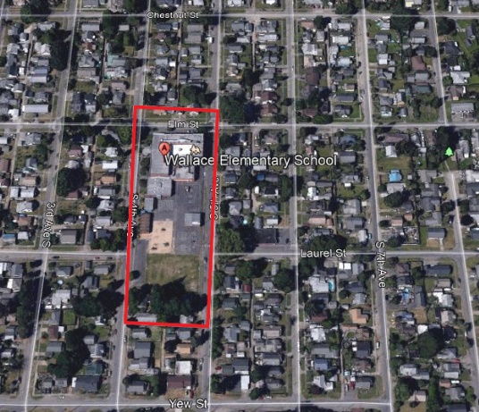
Qualifying Criteria Site Constraints – Existing Conditions
Congested site less than 2.5 acres
Residential neighborhood, narrow streets
Occupied site
Lexington: wet low-lying with county dike adjacency creating complex Storm water disbursement issues
10

Slide 11
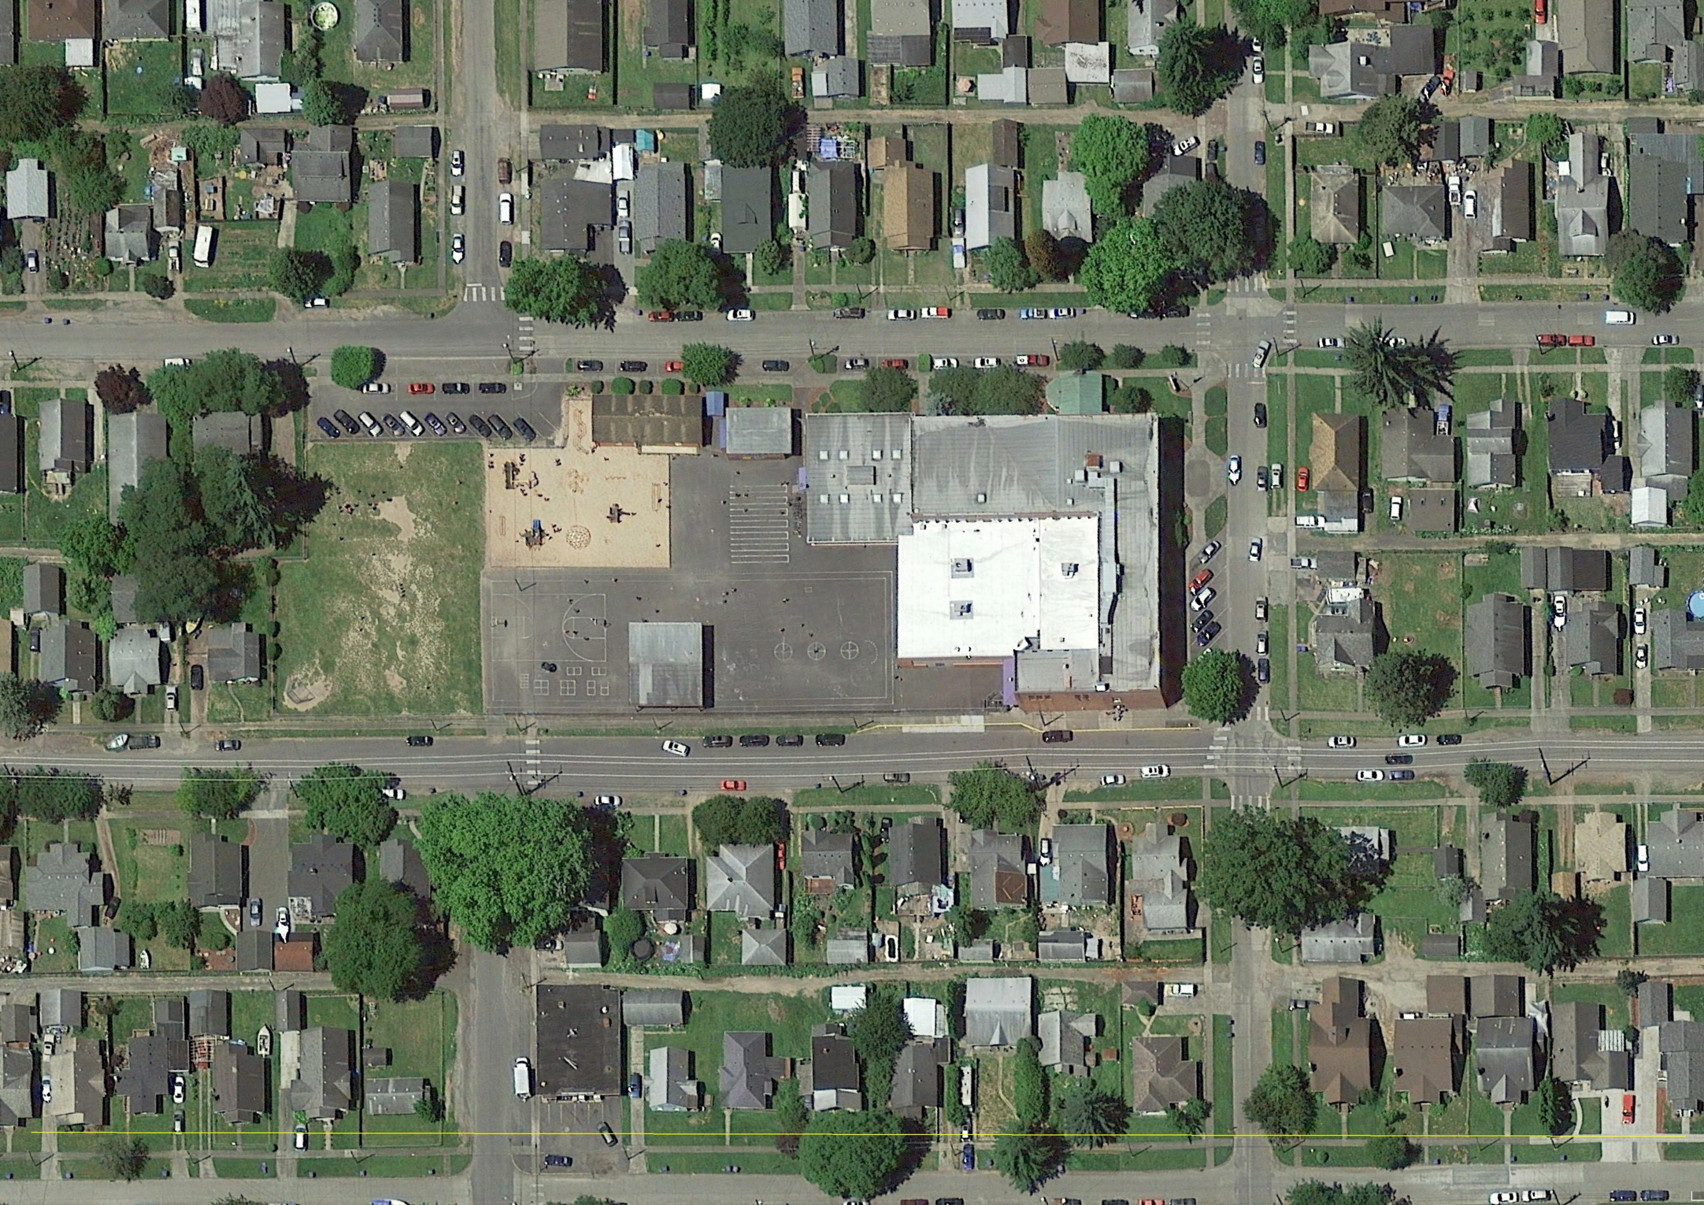
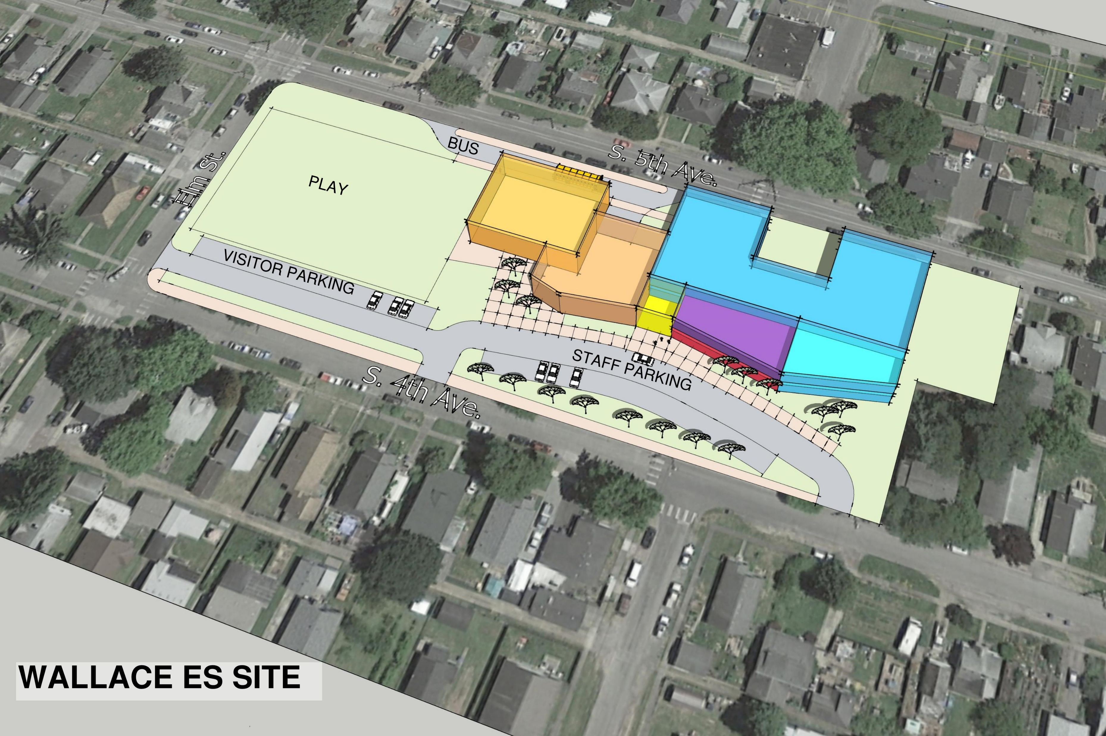
Wallace Site
11

Slide 12
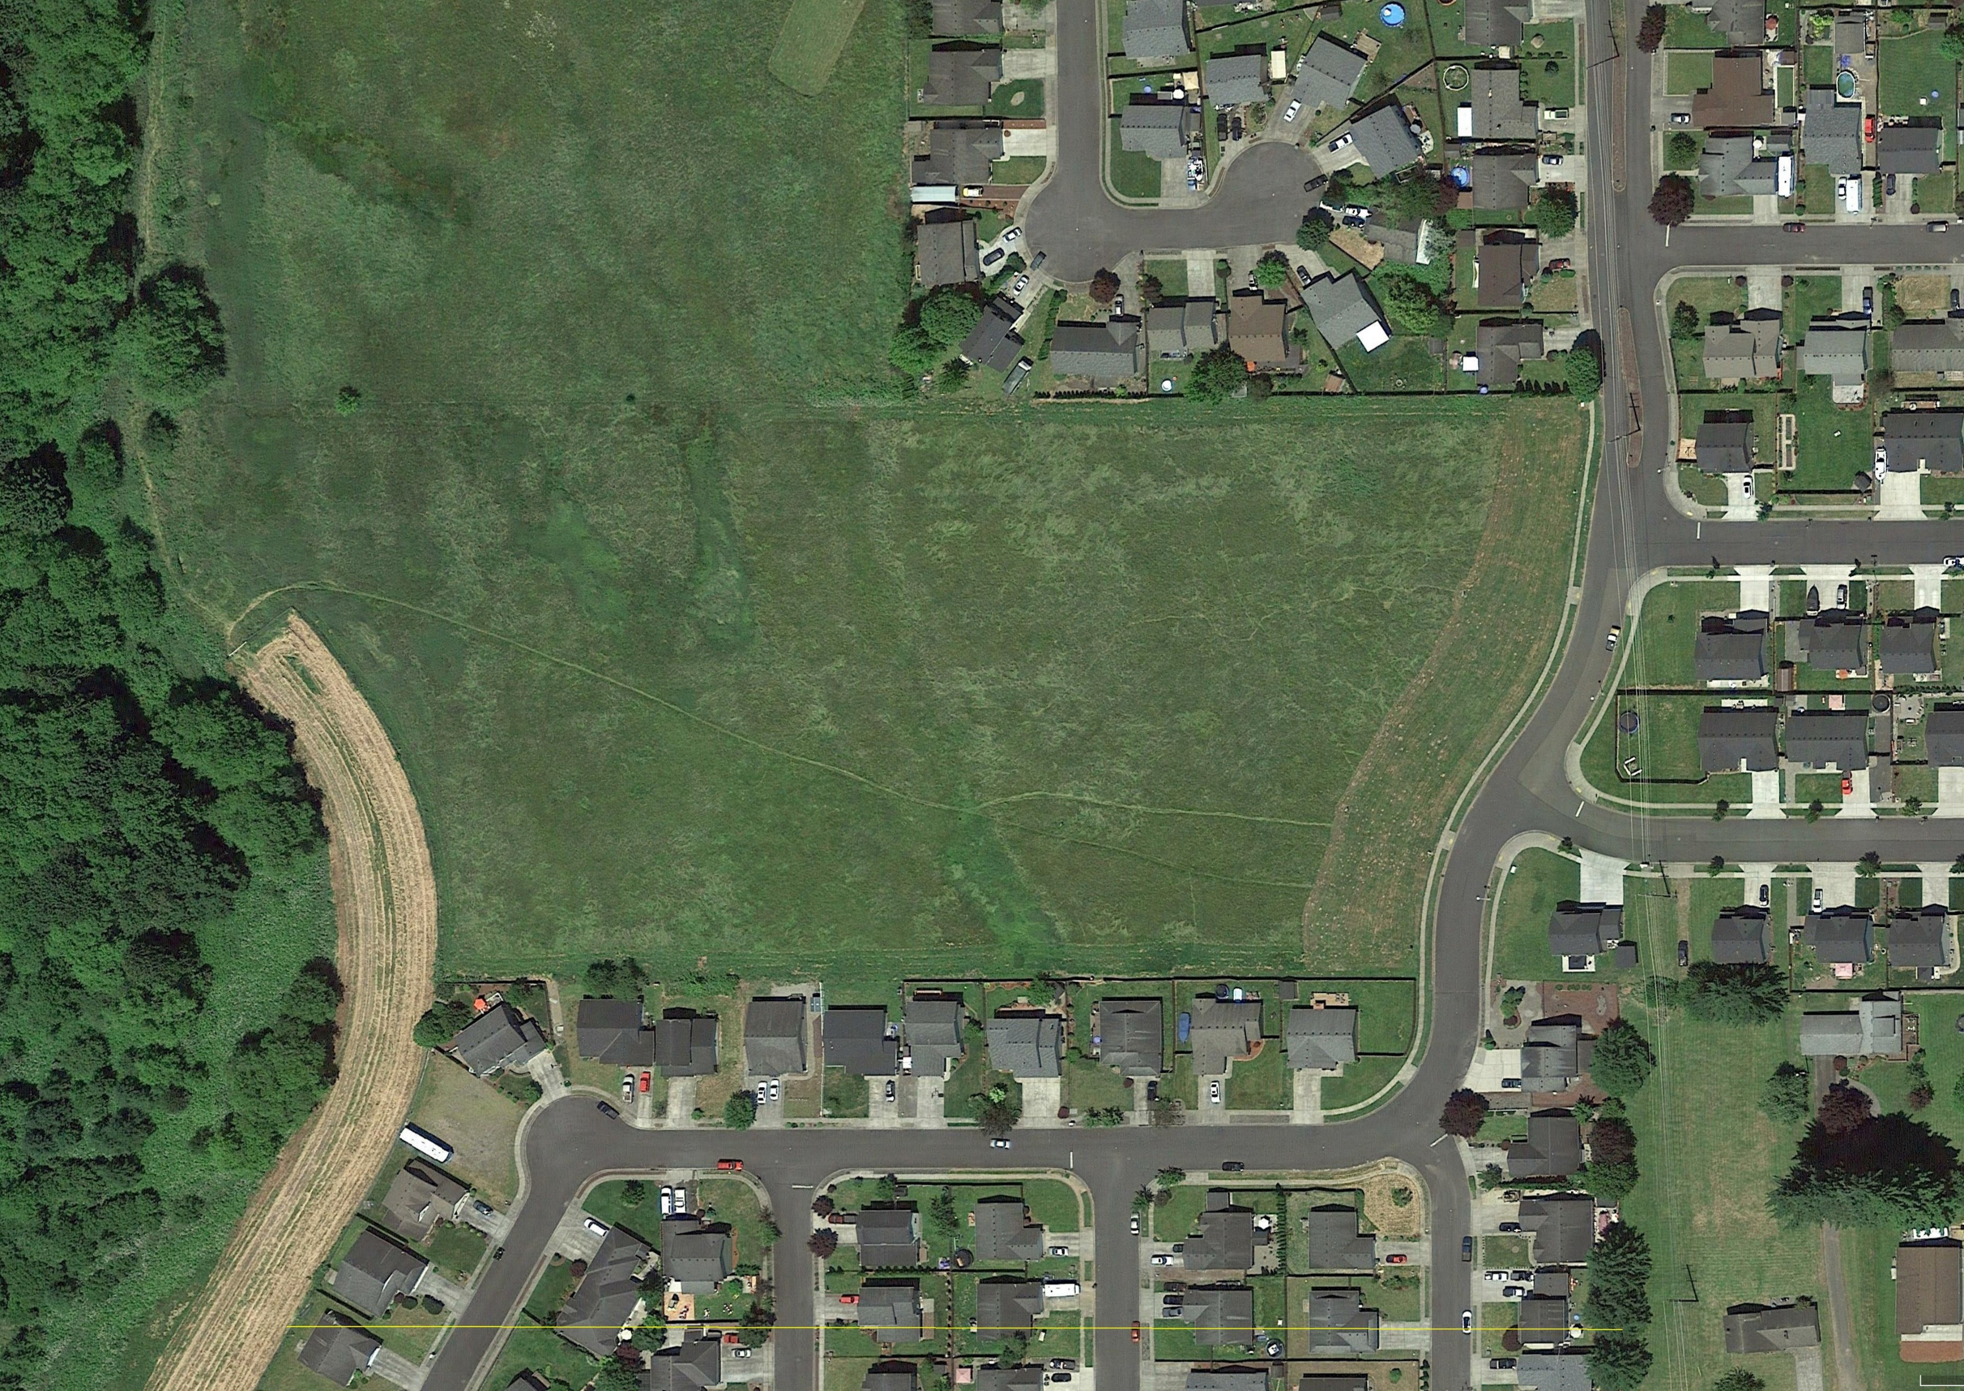
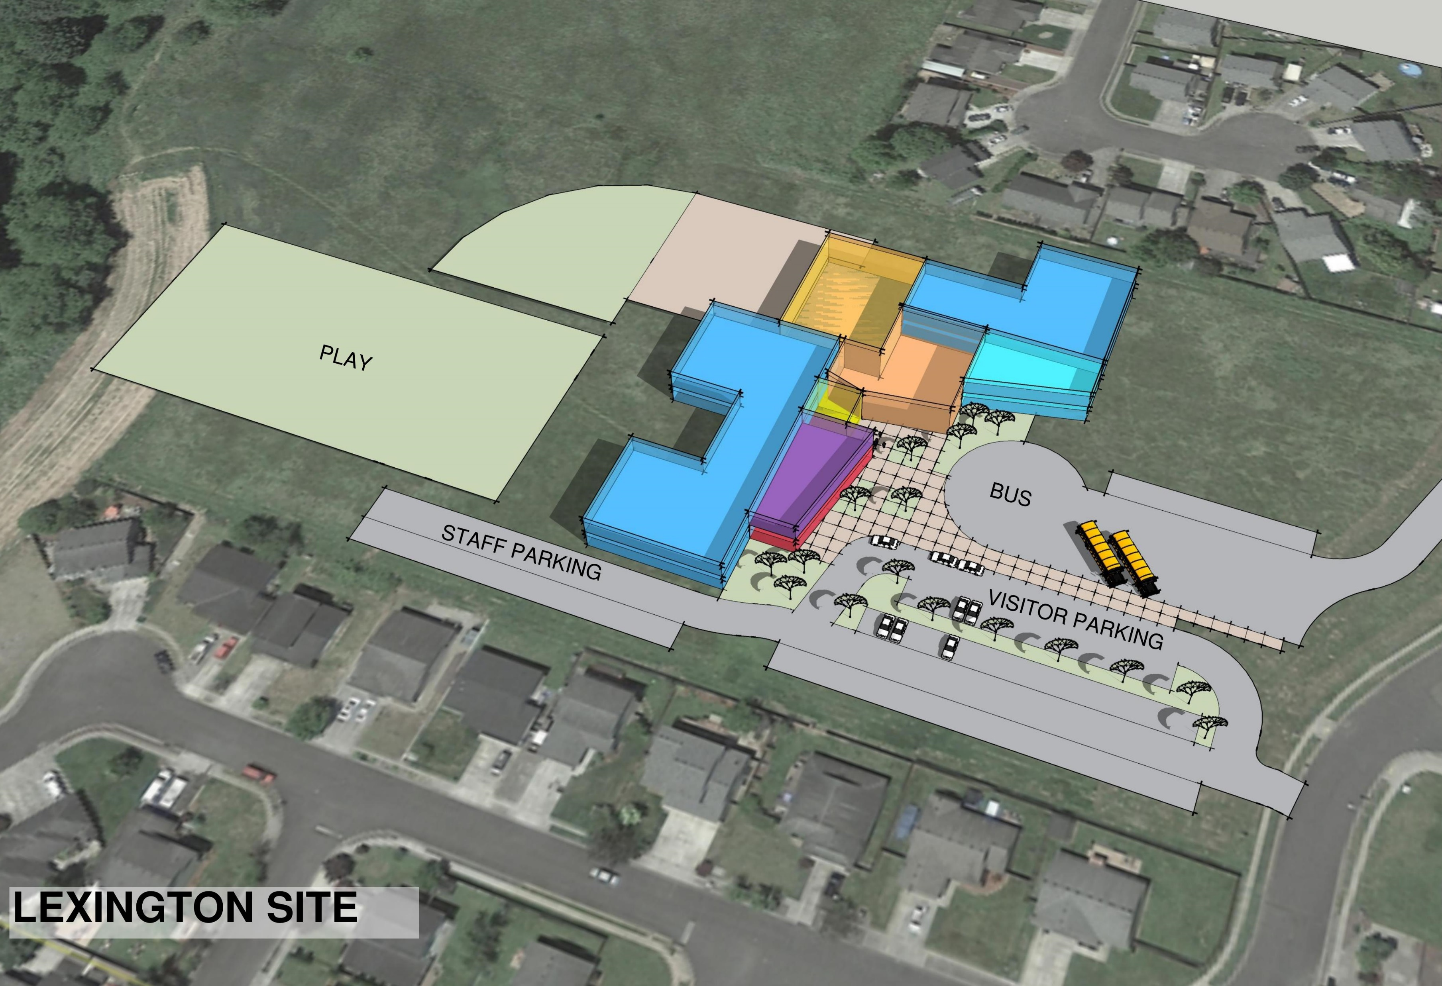
Lexington Site
12

Slide 13
Project Schedule updated July 26, 2018
Schedule
Publication for GC/CM Services – July 30 – August 10th, 2018
GC/CM Presubmittal Meeting – August 14th, 2018
GC/CM Statement of Qualifications due August 23rd 2018
GC/CM short list August 28th 2018
GC/CM interview September 11th 2018
GC/CM Fee Proposal opening September 13th 2018
Programming/Ed Specs June - August 2018
Schematic Design August - October 2018
Design Development November through February 2019
Construction Documents February through June 2019
Permitting process April through June 2019
Anticipated start of construction May 2019
Anticipated completion of Construction August 2020
13

Slide 14
Project budget
14

Slide 15
Mary Beth Tack, Superintendent
Marybeth.tack@kelsosd.org
Phil Iverson, Project Manager
Philip.iverson@esd112.org
15

