Slide 1


Team Introductions
Project Overview
PRC Questions Answered
Q&A

Slide 2
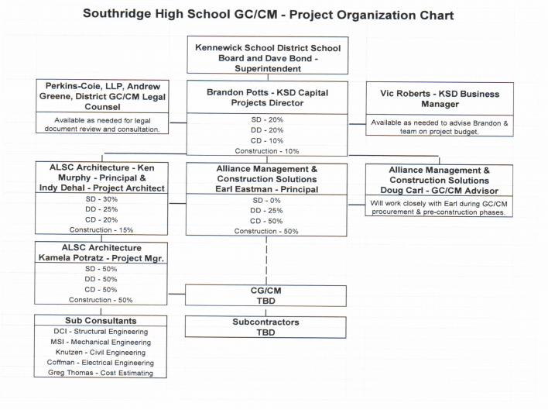

Slide 3
Dave Bond, Superintendent - Kennewick School District
Role on this Project: District Superintendent
Superintendent at Kennewick School District for 11+ years.
Provided oversight on 17+ major school construction projects at Kennewick School District during those 11+ years.
Principal at Kamiakin High School for five years, with part of that time during a 2-year + remodel process.
Understands the complexity of running a large high school while having a remodel project happening on-site.
  Safety
  Student Management
  Schedule coordination

Slide 4
Dave Bond, Superintendent - Kennewick School District
Role on this Project: District Superintendent
2009 Bond included funding for seven projects.
New – Cottonwood Elementary
Remodels- Canyon View Elementary, Southgate Elementary, Sunset View Elementary, Cascade Elementary, and Lincoln Elementary (GC/CM projects).
New in Lieu – Eastgate Elementary

Slide 5
Dave Bond, Superintendent - Kennewick School District
Role on this Project: District Superintendent
2015 Bond included funding for five projects.
New – Chinook Middle School, Sage Crest Elementary, Amon Creek Elementary
New in Lieu – Desert Hills Middle School, Westgate Elementary
K-3 Class-Size Reduction Grant Funding provided funding for three projects.
Expansion – Expanded Amon Creek Elementary to 38 classrooms.
New – Fuerza Elementary.
New in Lieu / Expansion – Amistad Elementary

Slide 6
Dave Bond, Superintendent - Kennewick School District
Role on this Project: District Superintendent
Other Locally Funded Projects – Legacy High, Mid-Columbia Partnership
2019 Bond included funding for six projects.
New in Lieu / Expansion – Amistad Elementary
New in Lieu – Kennewick High
Expansion – Southridge High*, Kamiakin High
New – Elementary #18
Remodel – Ridge View Elementary
* Proposed GCCM Project

Slide 7
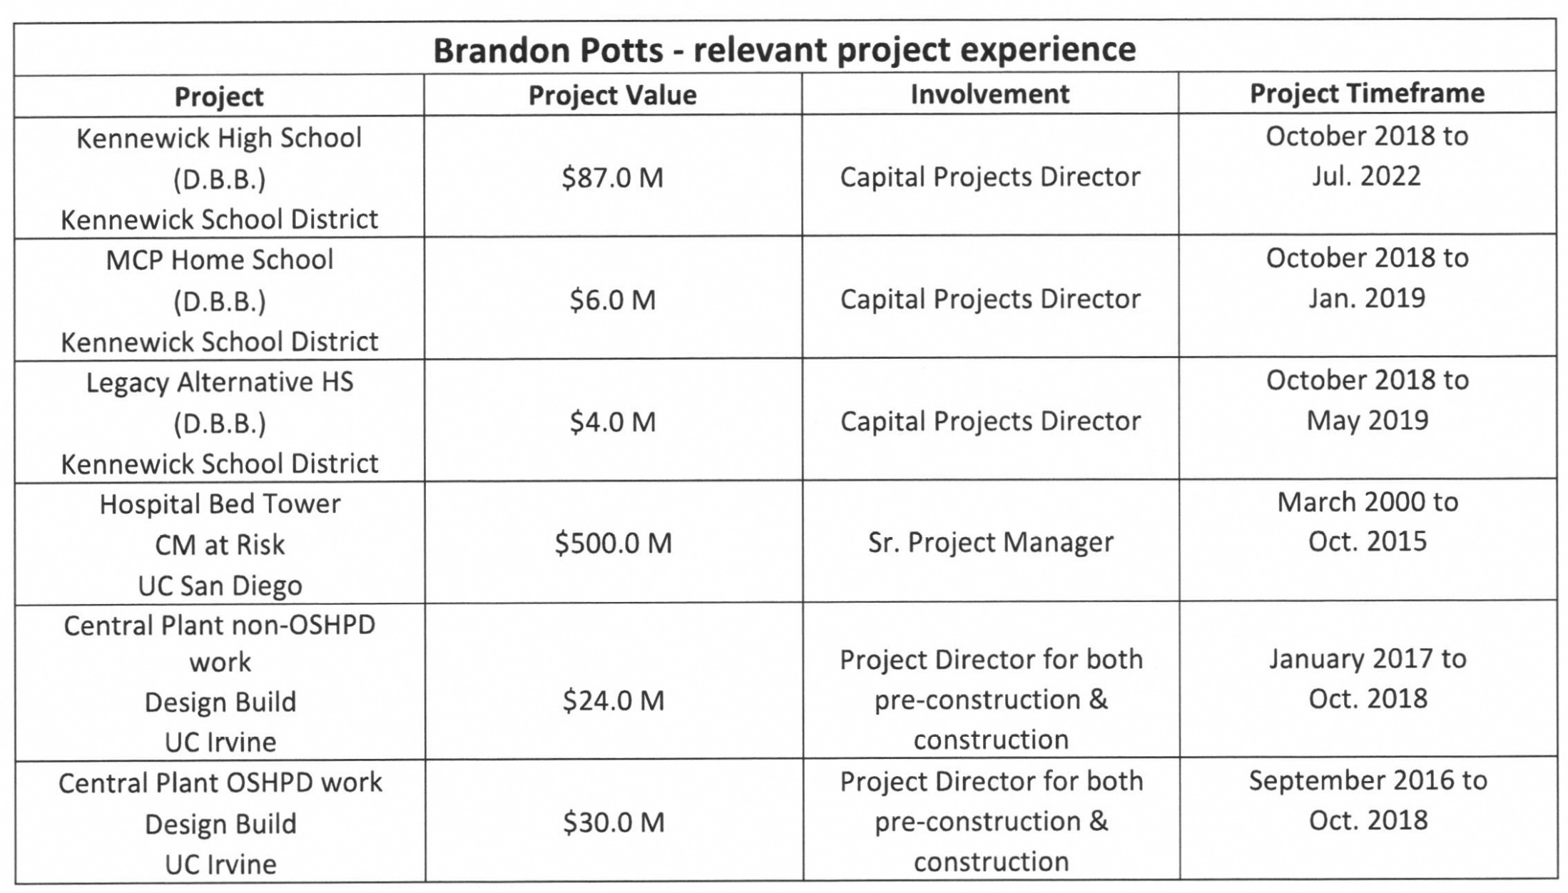
Brandon Potts, Director of Capital Projects - Kennewick School District
Role on this Project: KSD Construction Director
15 years as a general contractor working though design, preconstruction, construction and closeout of multiple alternative delivery public procurement (D-B & CM at Risk) projects.
Completed many large construction projects as a Construction Director utilizing alternative delivery methods with public institutions.

Slide 8
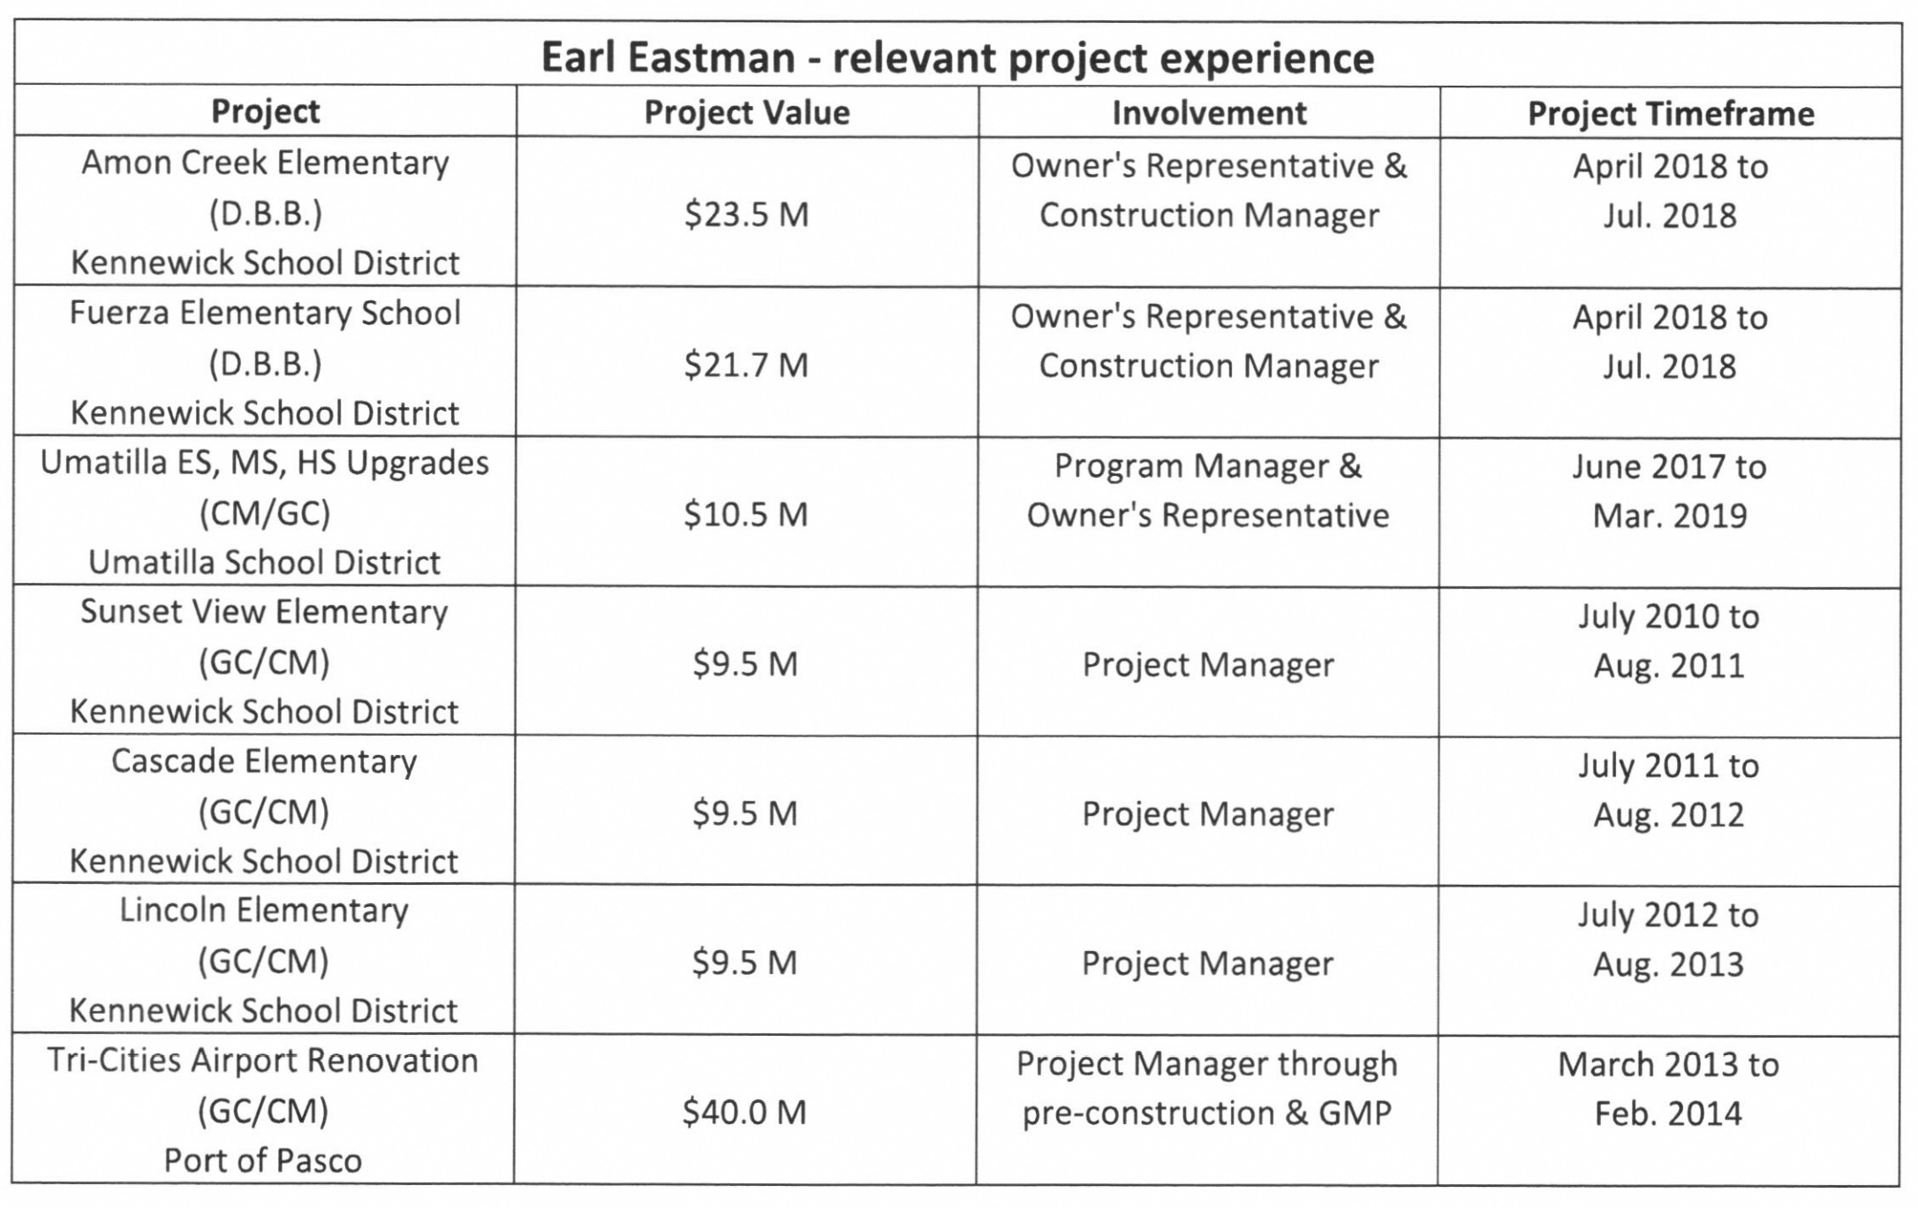
Earl Eastman, Principal – Alliance Management & Construction Solutions
Role on this Project: Construction Manager & Owner’s Representative
Extensive K-12 experience in General Contractor's Project Manager role and more recent role of Construction Manager and Owner's Representative roles.
Completed 3 GC/CM elementary school projects for Kennewick School District.
Led pre-construction phase through negotiation of MACC/GMP for $40 million GC/CM expansion to Tri Cities Airport (Port of Pasco).

Slide 9
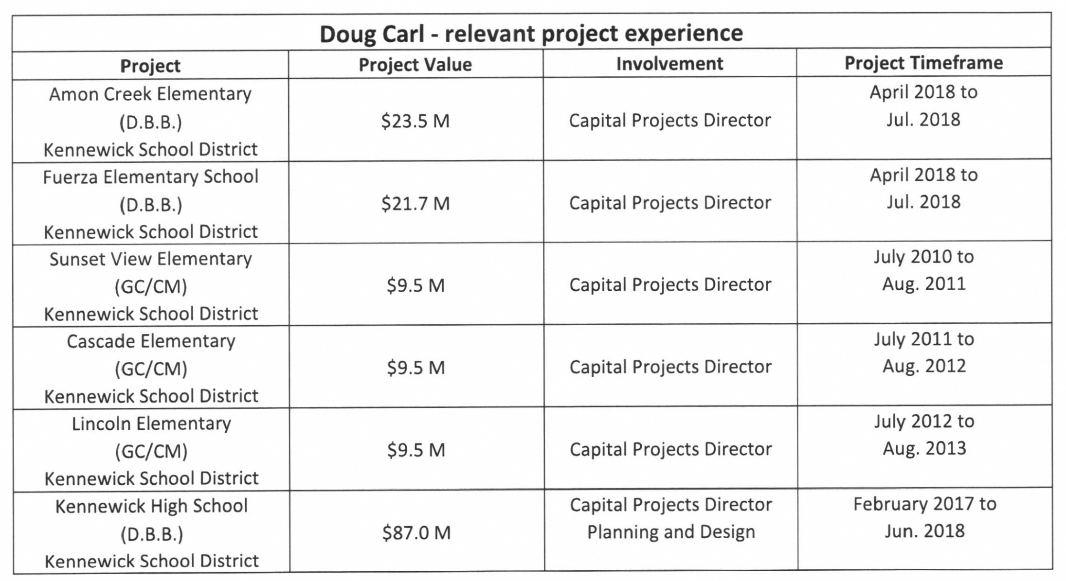
Doug Carl – Alliance Management & Construction Solutions
Role on this Project: GC/CM Procurement Advisor
Capital Projects Director for the Kennewick School District for 13 years.
Responsible for Long Range Planning, Bond Program Management, design construction and closeout.
Led the District’s effort to gain approval for use of GC/CM delivery method for the District’s only other GC/CM project.

Slide 10
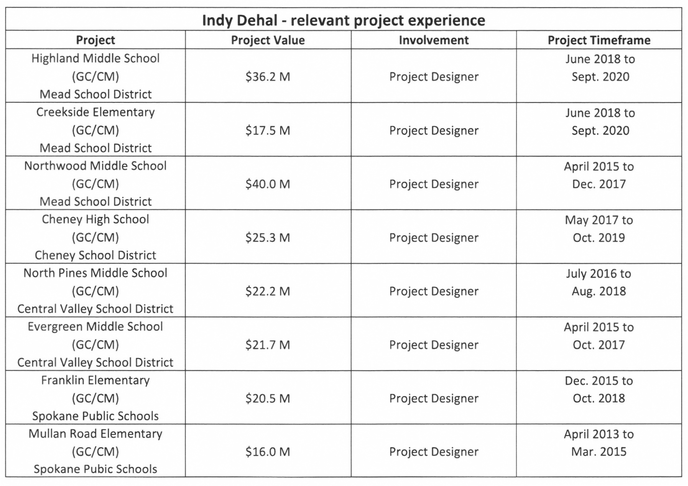
Indy Dehal, Principal – ALSC Architects
Role on this Project: Project Designer
Numerous K-12 school GC/CM projects and other alternative delivery method projects.
GC/CM projects include Highland Middle School, Creekside Elementary, Northwood Middle School (Mead SD); North Pines Middle School, Evergreen Middle School (Central Valley SD); Cheney High School (Cheney SD); Franklin Elementaryand Mullan Road Elementary (Spokane SD).

Slide 11
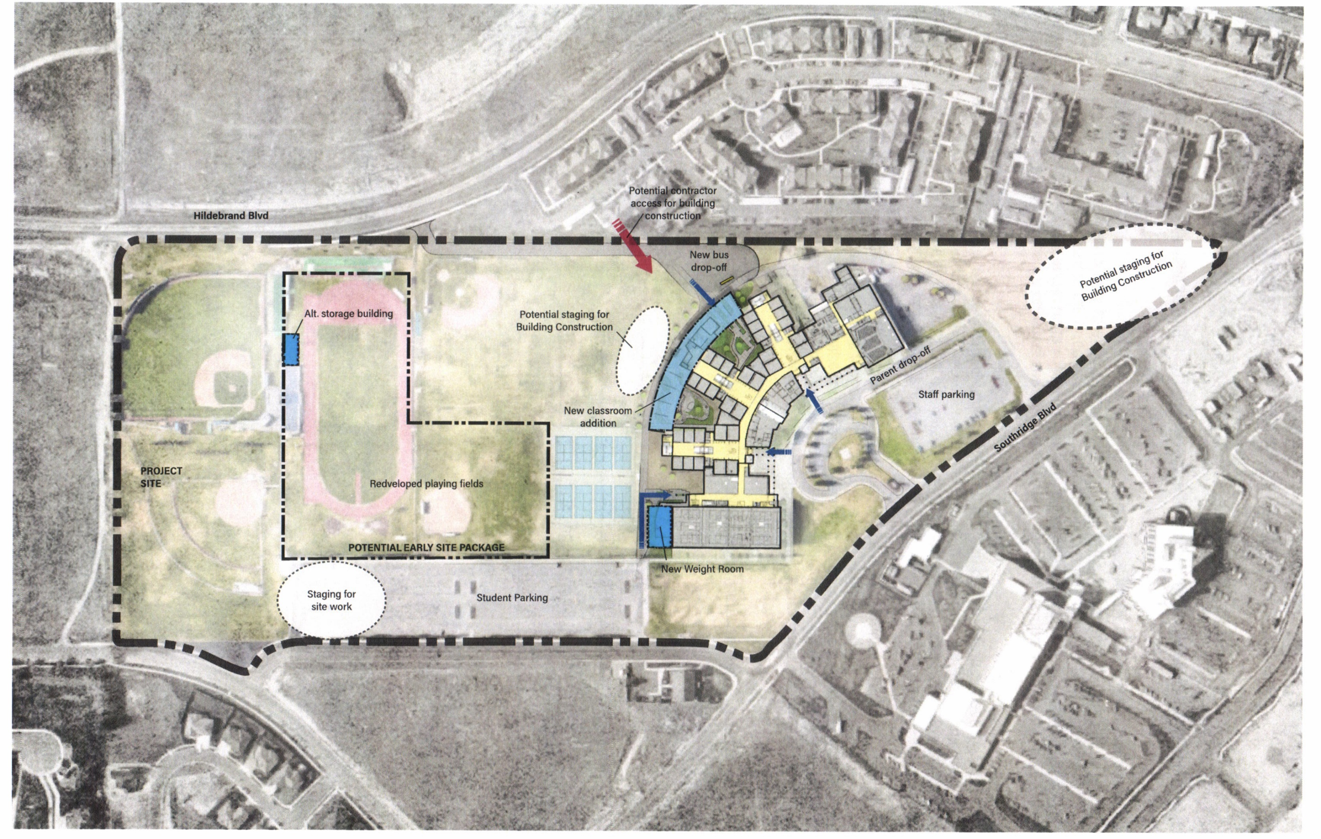
PROJECT OVERVIEW: Site Plan

Slide 12
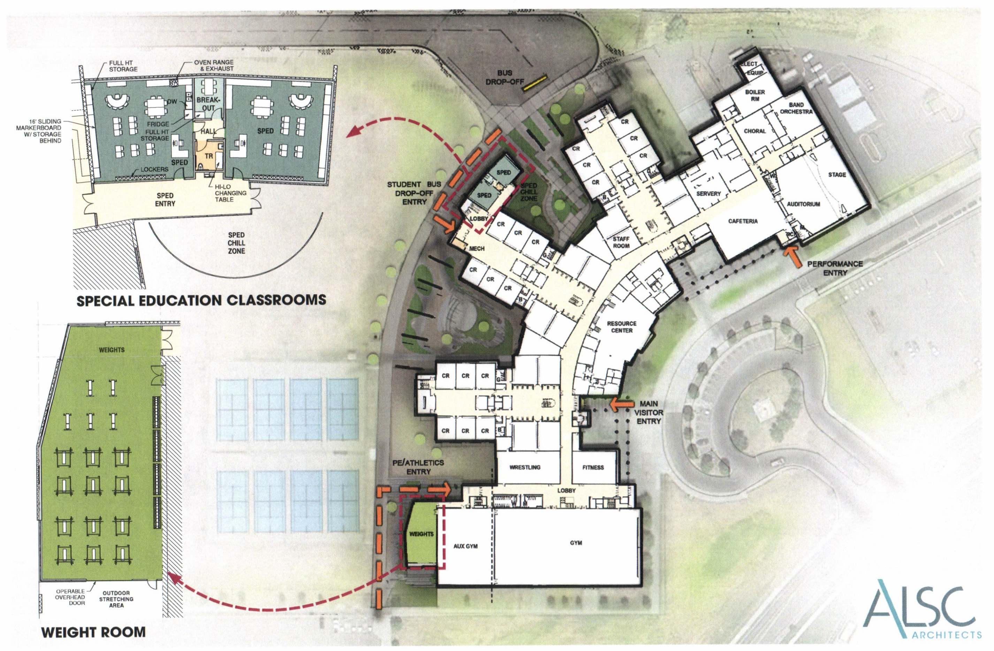
PROJECT OVERVIEW: First Floor Plan

Slide 13
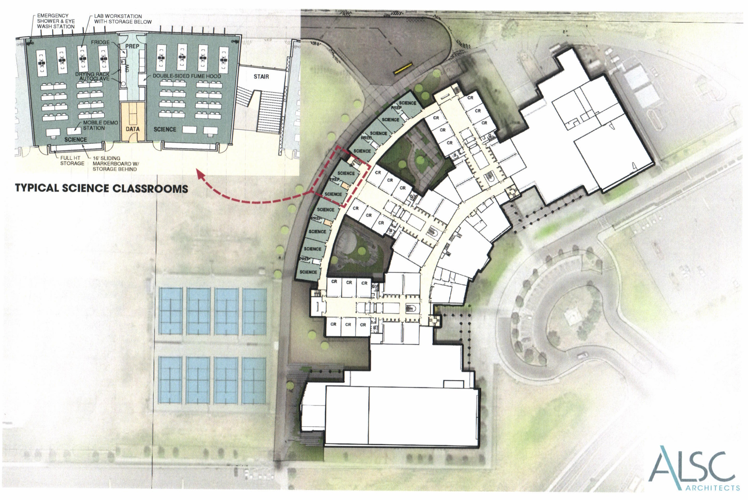
PROJECT OVERVIEW: Second Floor Plan

Slide 14
PRC QUESTIONS ANSWERED: Divide up questions
It appears the GC/CM contractor will not be under contract until the final portion of design development. How will the GC/CM provide enough valuable input with only 1 month of input prior to the DD being completed? The GC/CM will be on board for approx. 6 months prior to finalizing 100% Construction Documents. The project team feels that this will be enough time to obtain critical input on constructability, bid strategy, site logistics, temporary construction measures and schedule sequencing to ensure minimal impacts to students and staff during construction to justify the GC/CM process.
In reviewing the site drawings what again makes this so worthy of a GC/CM, it just does not seem to be complicated at all?
  Construction Zone – The construction area is surrounded on all (4) sides by the existing school, athletic fields, and student parking lots. It is anticipated that the contractor will need to work around multiple entry and exit points without affecting students, staff, parents, and the community. Students and Staff will need to pass through parts of the construction zone on a daily basis to access the school’s classrooms, offices, and athletic facilities. The contractor will need to work with the school to plan changes to student management as the building goes through the phases of construction. Students will be involved in athletic practices on fields adjacent to the construction project. Student parking may be disrupted throughout the project.
  Noise Mitigation – We will need to tie-in to the existing school at multiple locations on both the 1st and 2nd floors while classes are being held. Temporary construction barriers will be required to minimize noise and dust within the school. Obtaining contractor feedback during the completion of design will help to ensure impacts to classes are minimized.
  Bid Environment – There will likely be many contractors that can bond a project of this value ($13M) but have had limited or no experience with expansions that connect to an active school campus. The ability to select a contractor based on their plan to maintain student safety and minimize staff impact would increase the probability of a successful expansion.

Slide 15
QUESTIONS & ANSWERS

