Slide 1
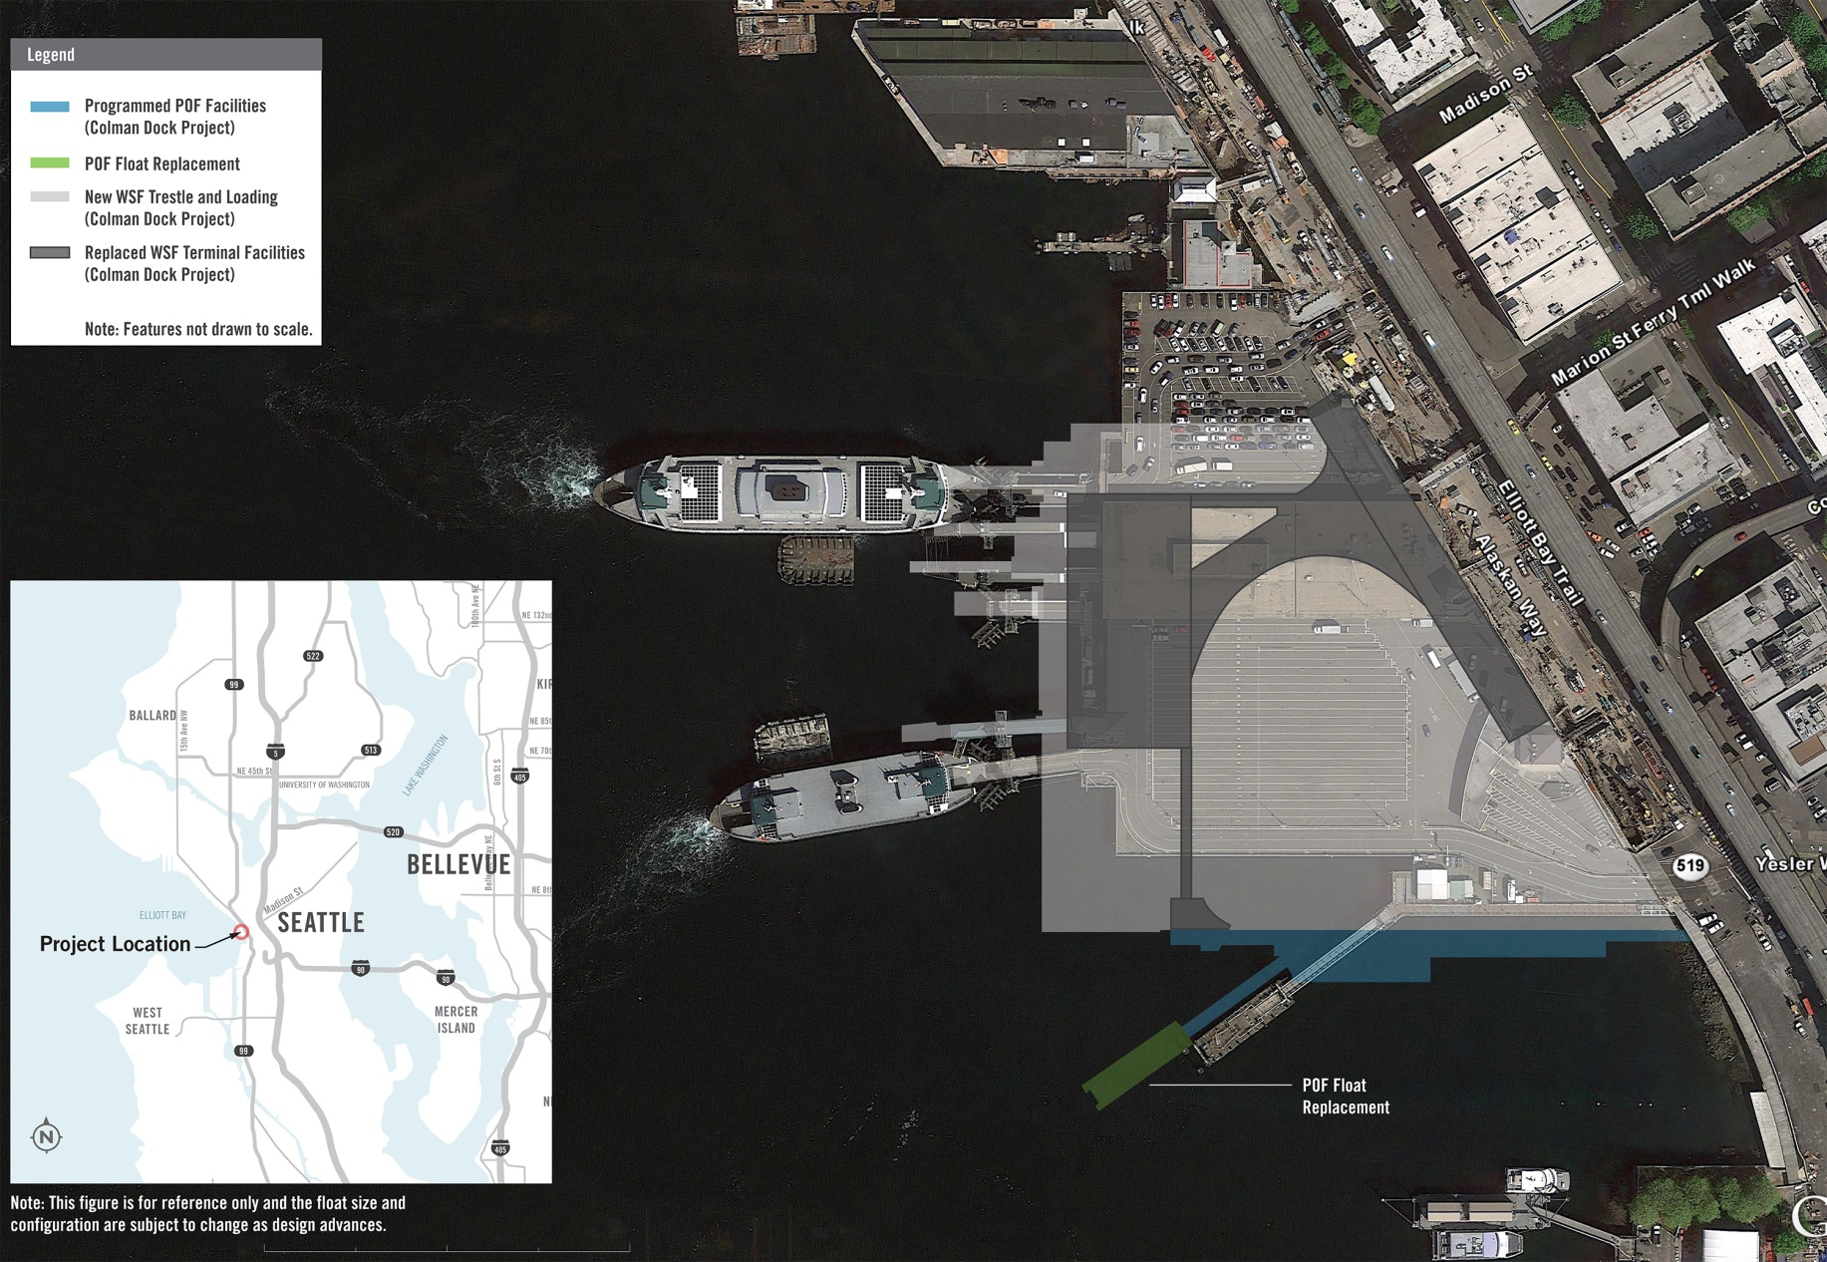
Pier 50 Float Replacement
Project Overview

Slide 2
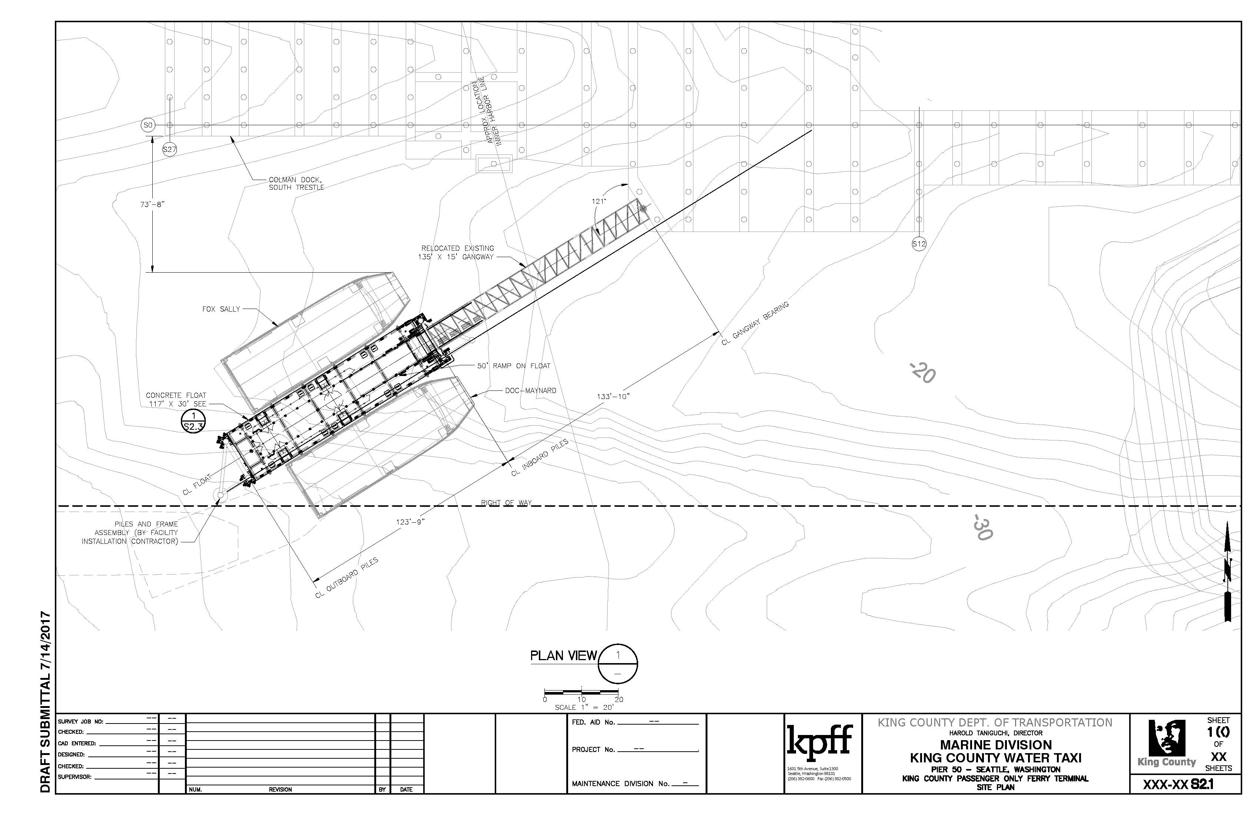
Pier 50 Float Replacement
Project Overview

Slide 3
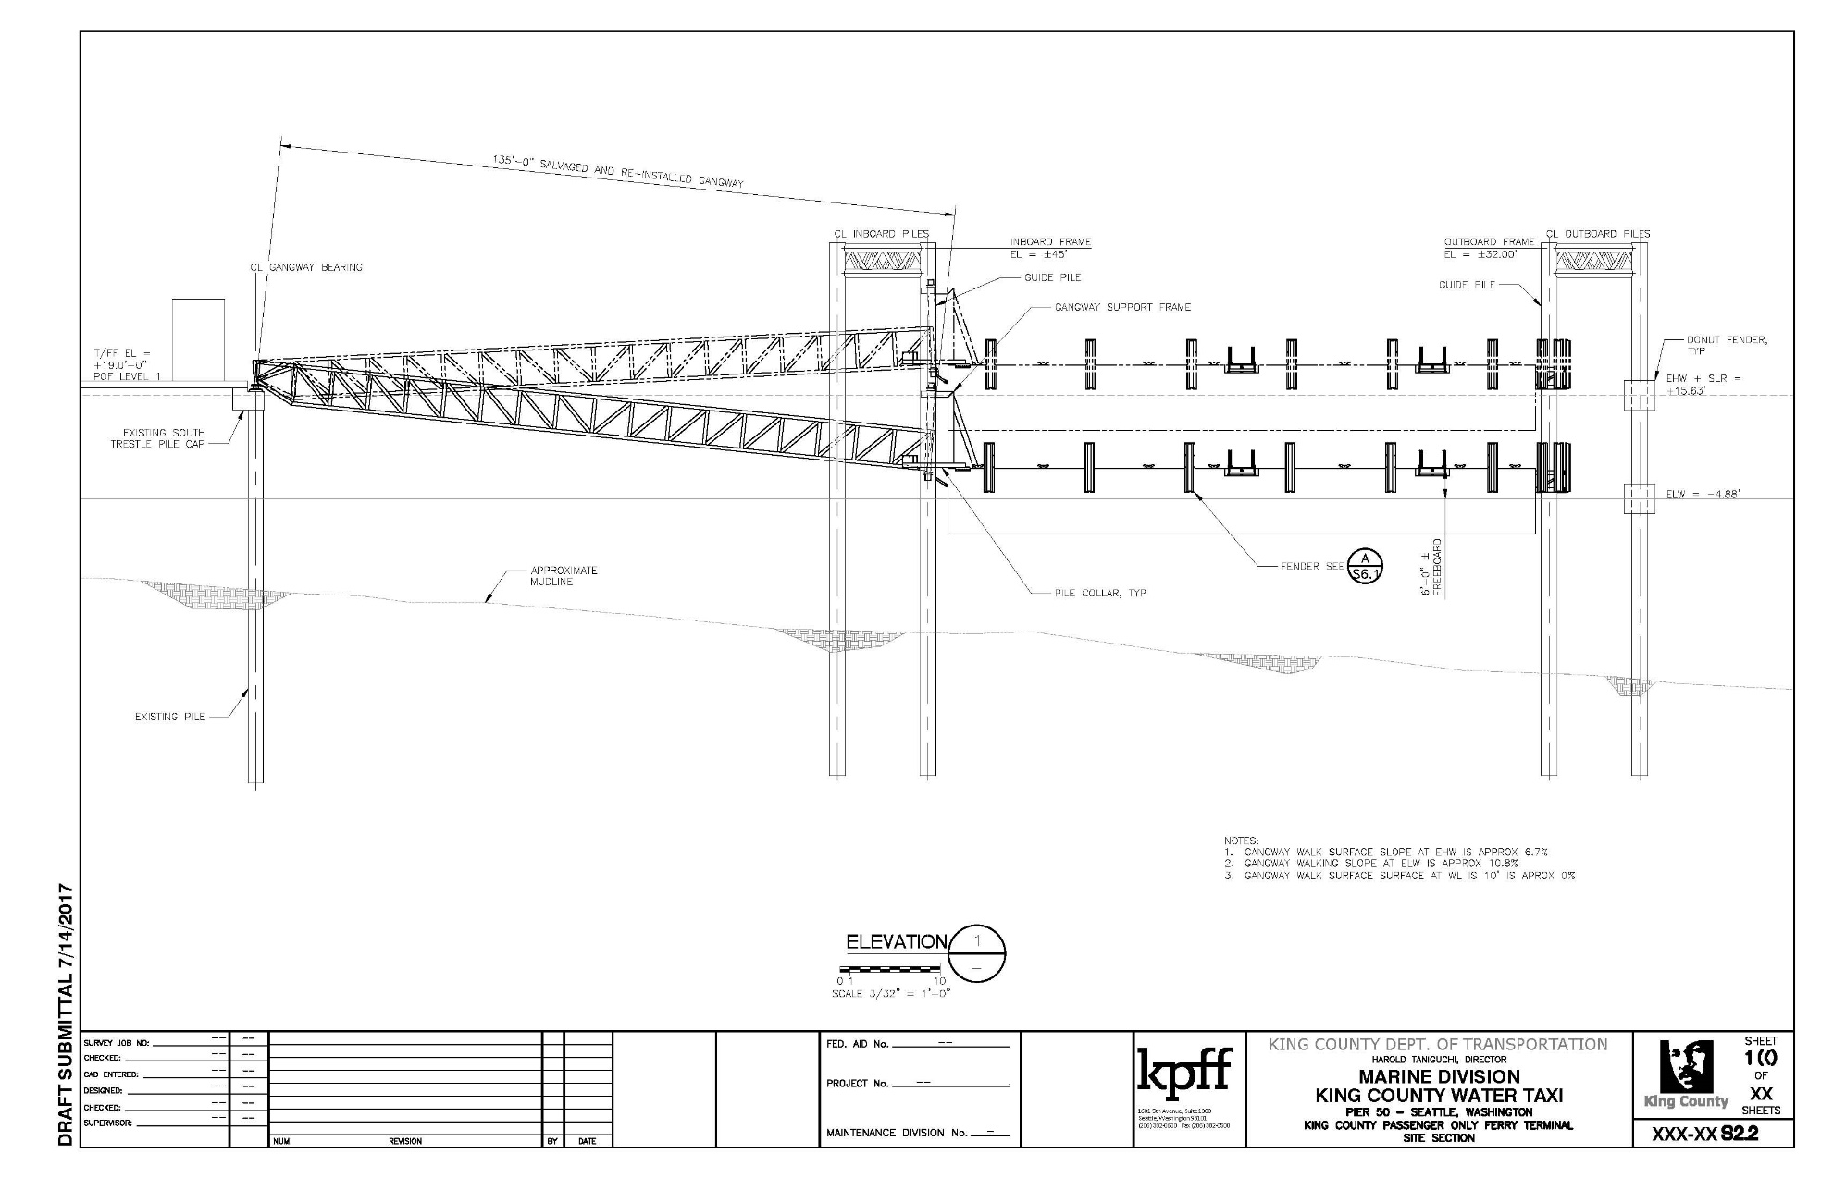
Pier 50 Float Replacement
Project Overview

Slide 4
Pier 50 Float Replacement
Key Staff
King County Staff
  Ron Panzero, Marine Division Project Manager
    17 years delivering marine capital projects
    DB and DBB
  Greg Suko, Transit Construction Managing Engineer
    30 years construction management experience
    DB and DBB projects
  Trisha Roth, Procurement
    Contract specialist for capital projects
Consulting
  Ed Debroeck, KPFF Consulting Engineers
    Lead designer, extensive DB experience

Slide 5
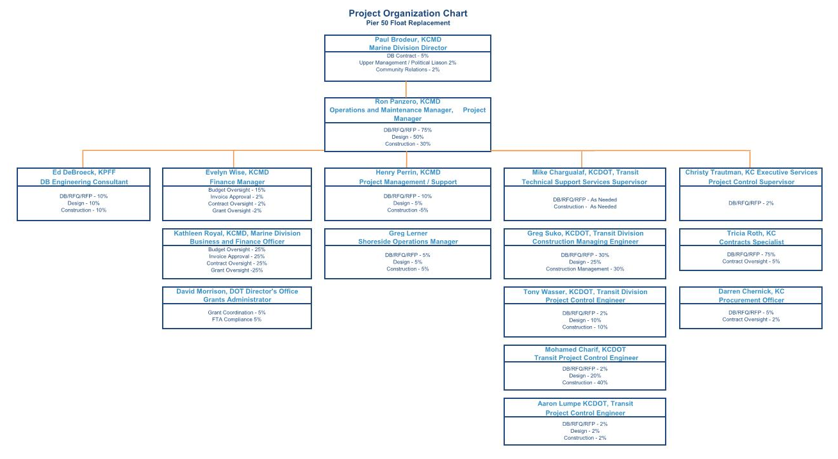
Pier 50 Float Replacement
Other Staff
Notes:
- Supported by large King County organization with financial, construction management, contracting knowledge

Slide 6
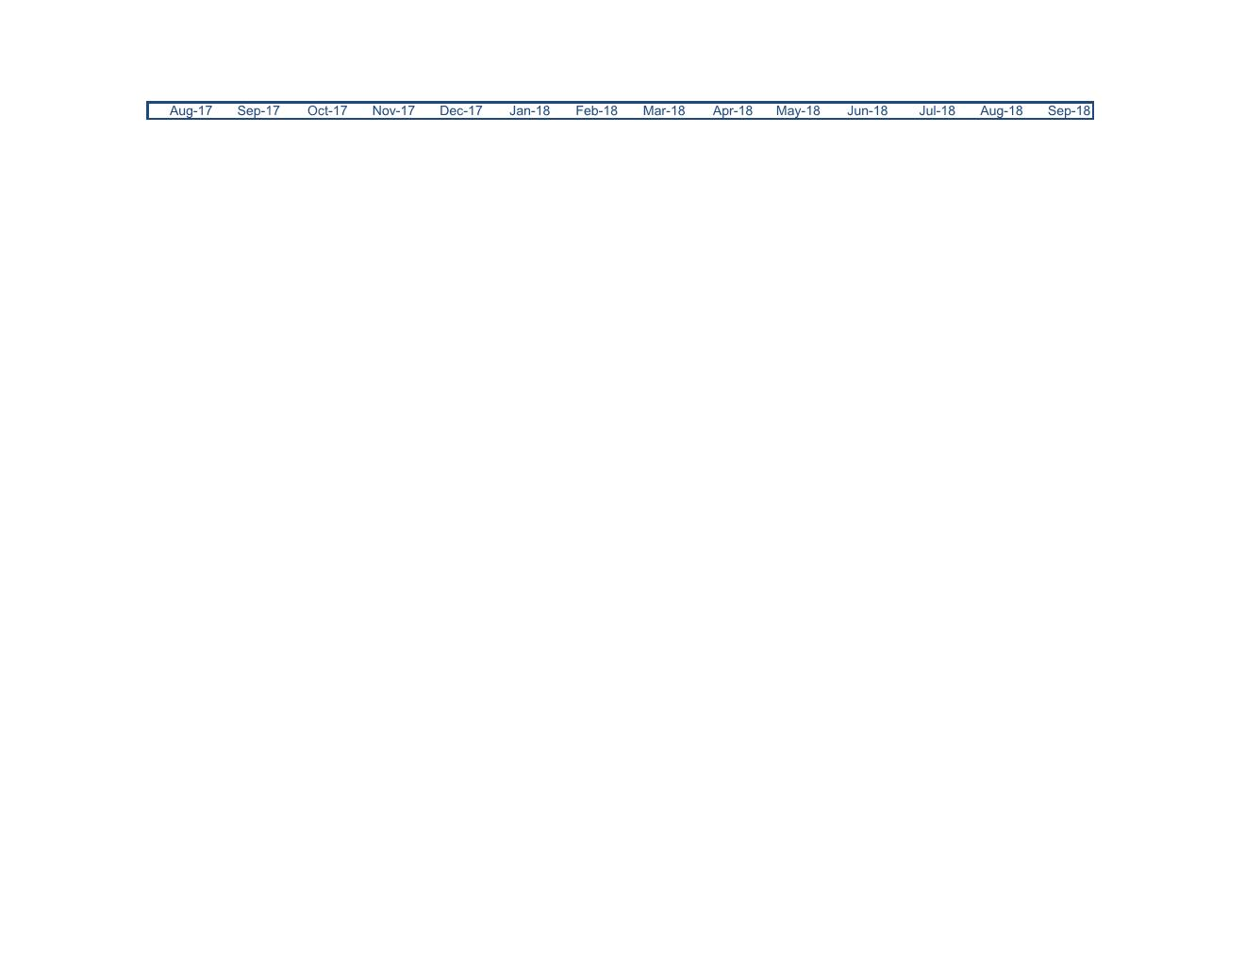
Pier 50 Float Replacement
Project Schedule
Statements of Qualifications Due
Finalists Scored and Team Selected
PRC Approval
Issue RFP
Commence Design and Construction
Float Delivered
Fish Window (Feb 15 – Aug 1)
Shortlist Finalists
Finalize Contract and NTP
Colman Dock Preservation
Project Completion
RFQ Advertisement
RFPs Due and
Interviews Conducted

Slide 7
Pier 50 Float Replacement
Project Budget
Professional Services | $ 650 000
Construction Costs (est.) | $2,400,000
Equipment and Furnishings | $ 240,000
Contract Administration | $ 289,000
Contingencies | $ 890,000
Other Related Costs | $ 356,000
Sales Tax | $ 260,000
Total | $5,085,000
Notes:
- 80% grant funds, 20% local funds

Slide 8
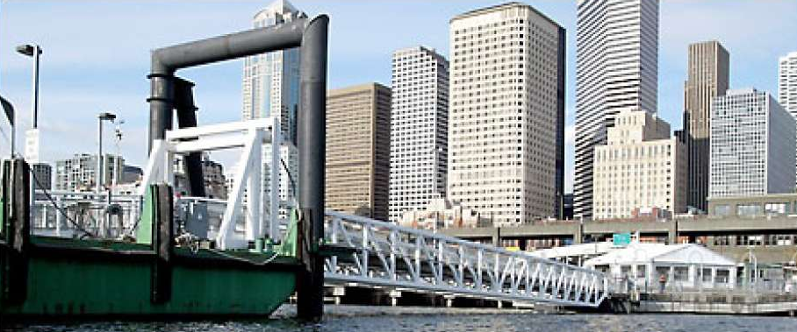
Pier 50 Float Replacement
RCW 39.10.300(1)(a):
Highly Specialized Construction
Unique Marine Environment
Limited Contractors Qualified to Build Floats
Photo of Pier 50 from the water courtesy of the Seattle Pi
Notes:
- Wind and wave action impacts the stability of the float and must be designed accordingly.
- Operational considerations between the owner/design-build team

Slide 9
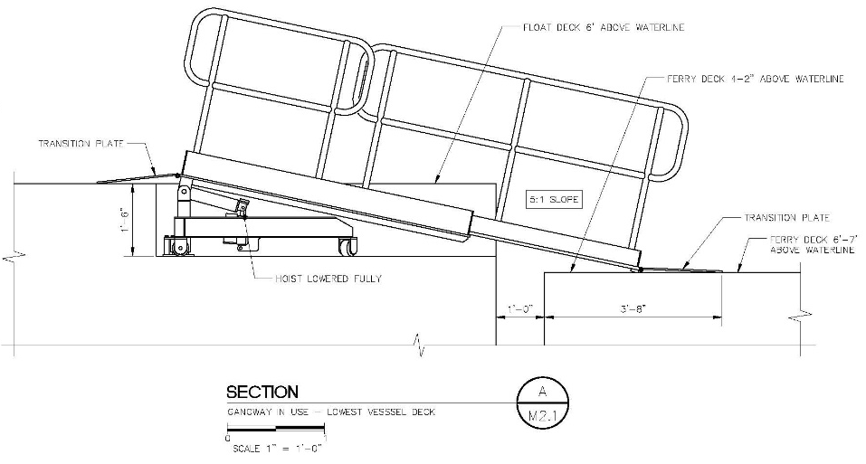

Pier 50 Float Replacement
RCW 39.10.300(1)(b):
Innovation and Efficiencies
Operational Considerations
Reduce Long-term Maintenance Costs
Notes:
- Designer and Contractor working together to design more efficient system that can be constructed.
- Incorporate unique innovations into the design that are able to be constructed.
- Unique marine environment

Slide 10
Pier 50 Float Replacement
RCW 39.10.300(1)(c):
Delivery Time Savings
Relationship of the Team
King County Marine Division
Designer - Builder
Notes:
- Direct communication between King County and the DB team
- Reduced change orders since the builder has been involved in the design

Slide 11
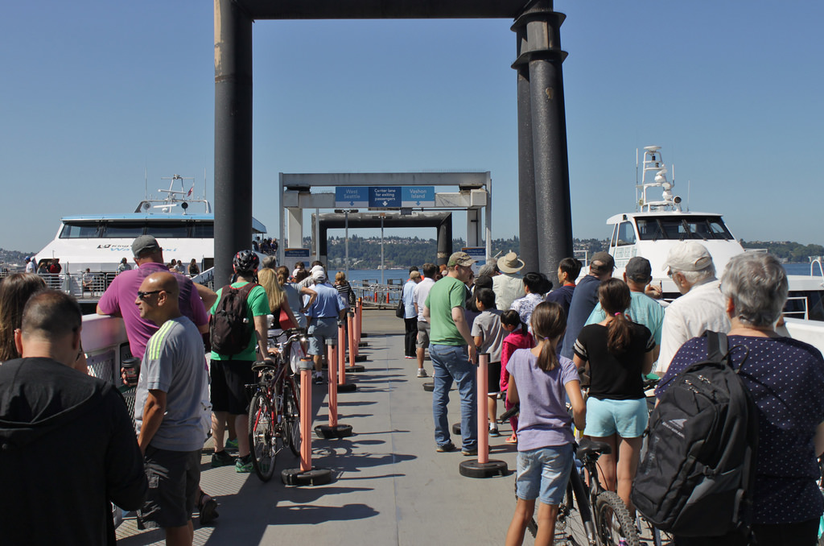
Pier 50 Float Replacement
Public Benefit
Cost Savings
Schedule Efficiencies
Public Safety
Courtesy of the Seattle Transit Blog
Notes:
- Efficiencies in cost with public dollars

Slide 12
Pier 50 Float Replacement
Questions?

