Slide 1



Aging Infrastructure & Seismic Improvements
Application for Project Approval
GC/CM Contracting Procedure
Nov 30, 2017
11:00 am

Slide 2
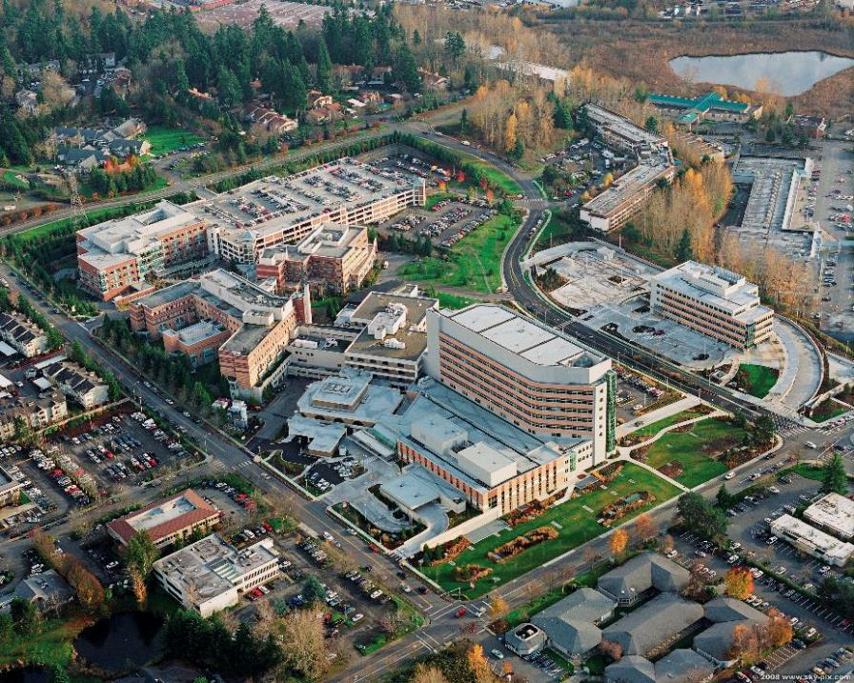
King County Public Hospital District No. 2
Aging Infrastructure & Seismic Improvements
Notes:
Ty:
Brief history of EH and CM Dept.

Slide 3

AGENDA
  Project Overview
  Team
  Why GC/CM?
Notes:
Ty to Kick Off Meeting.

Slide 4
Project Overview
  Description
  Funding
  Schedule
Notes:
Dan:
Description

Slide 5
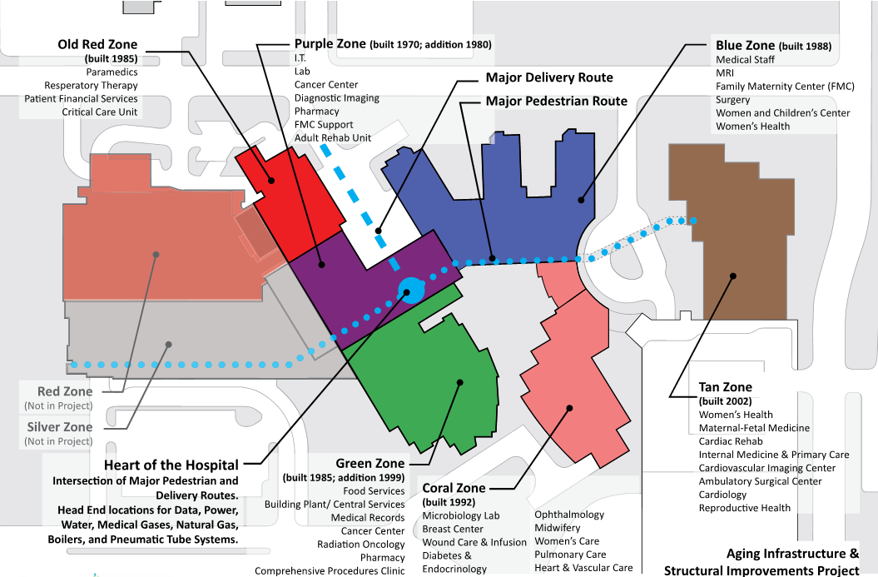
Project Description
Notes:
Dan:
Description of buildings and how they are tied in – and age.

Slide 6
Project Funding
  Initially fund Pre-Construction & Design through Cash Reserves (+/- $15m)
  Bond Referendum April 2019 ($ TBD) GC/CM Needed
Notes:
Ty

Slide 7
Project Schedule
  Complex, Multi-Phase Project
  Acute Care Environment
    Fully Operational
  Need GC/CM: Key Player to Assist Team in Figuring this out!
Notes:
Melissa:
This project is unique, complex, and will require a high degree of department coordination.
Hospital will remain fully operational, 24/7/365.
GC is needed for early investigations as well as schedule/cost analysis/greater degree of certainty.
Pin down dollars that we can take to the community and capture bond approval.

Slide 8
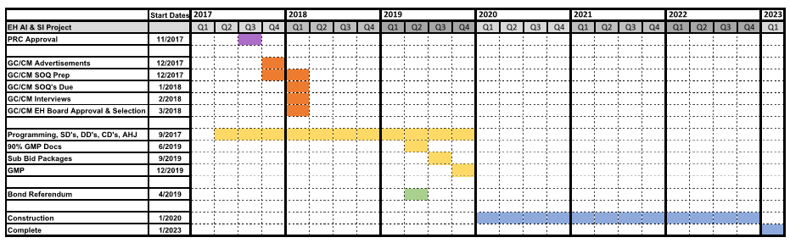
Project Schedule
Notes:
Melissa:
Anticipate advertising GC/CM SOQ next week.. Based on your approval.
Our selection process will follow RCW 39.10.
Anticipate GC/CM selection 1st or 2nd Quarter of 2018.
Would then onboard into design/precon. 2 years of design followed by 3 years of construction.
Total of 5 years, wrapping up 2022 or 1st quarter of 2023.

Slide 9
Project Team
  Management Team
  Design Team
Notes:
Ty

Slide 10
Management Team
  EvergreenHealth CM Department
    40 years D/B/B experience, $1B+ Campus
  OAC Services
    35+ GC/CM Projects, $1.5B
  John Palewicz
    24 GC/CM & DB Projects, $1.2B
  David Alskog, Esq.
  GC/CM, EC/CM, MC/CM - TBD
Notes:
Ty: A dozen full-time staff members eager to learn about GC/CM.

Slide 11
Design Team
  EvergreenHealth Medical Planners – Owner
  SRG Partnership – Architect
  CPL – Structural Engineer
  Notkin – Mechanical Engineer
  Stantec – Electrical Engineer
  GC/CM, EC/CM, MC/CM (TBD)
Notes:
Duncan/SRG:
Leads the design, with help of consultants with deep experience in GC/CM, EC/CM, MC/CM

Slide 12
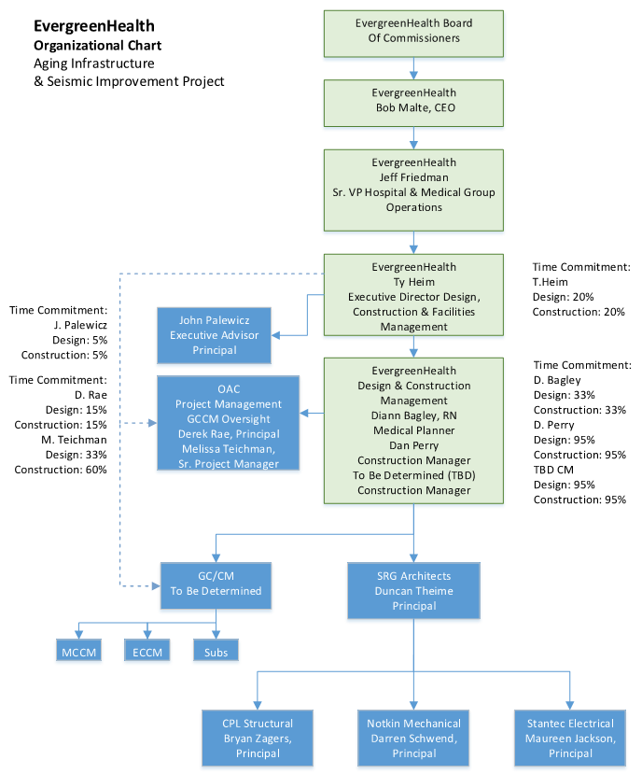
Team
Notes:
Dan:
Dan is the HUB, the Heart. Dan is the point person, 95% committed to this project. Day-to-day contact with the design team and the contractor.

Slide 13
Why GC/CM?
The EvergreenHealth Aging Infrastructure and Seismic Improvement project meets 4 of the 6 statutory criteria (One is required).
EvergreenHealth feels strongly that GCCM is the most appropriate contracting procedure for this project when each criteria is viewed through the lens of construction work being done in an active Acute Care Hospital where patient, staff and public safety is paramount.
  Complex scheduling, phasing, and coordination
  Facility must continue to operate during construction
  Involvement of the GC/CM is critical during design
  Complex and technical work environment
Hand-selected team.
Notes:
Ty. We meet 4 of 6 statutory criteria. This makes sense for this type of project (24/7/365)
Closing.

Slide 14
Thank You!
Notes:
Ty.

Slide 15
Questions & Answers

